Slide 1

A STORY OF VISION AND EXCELLENCE IN SMALL & MID-SIZE Ys
Meagan Hamblett

Slide 2
SIX LEVERS
OF CONNECTION
CREATING CONNECTED COMMUNITIES​

Slide 3

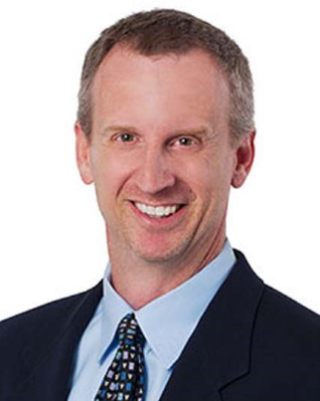
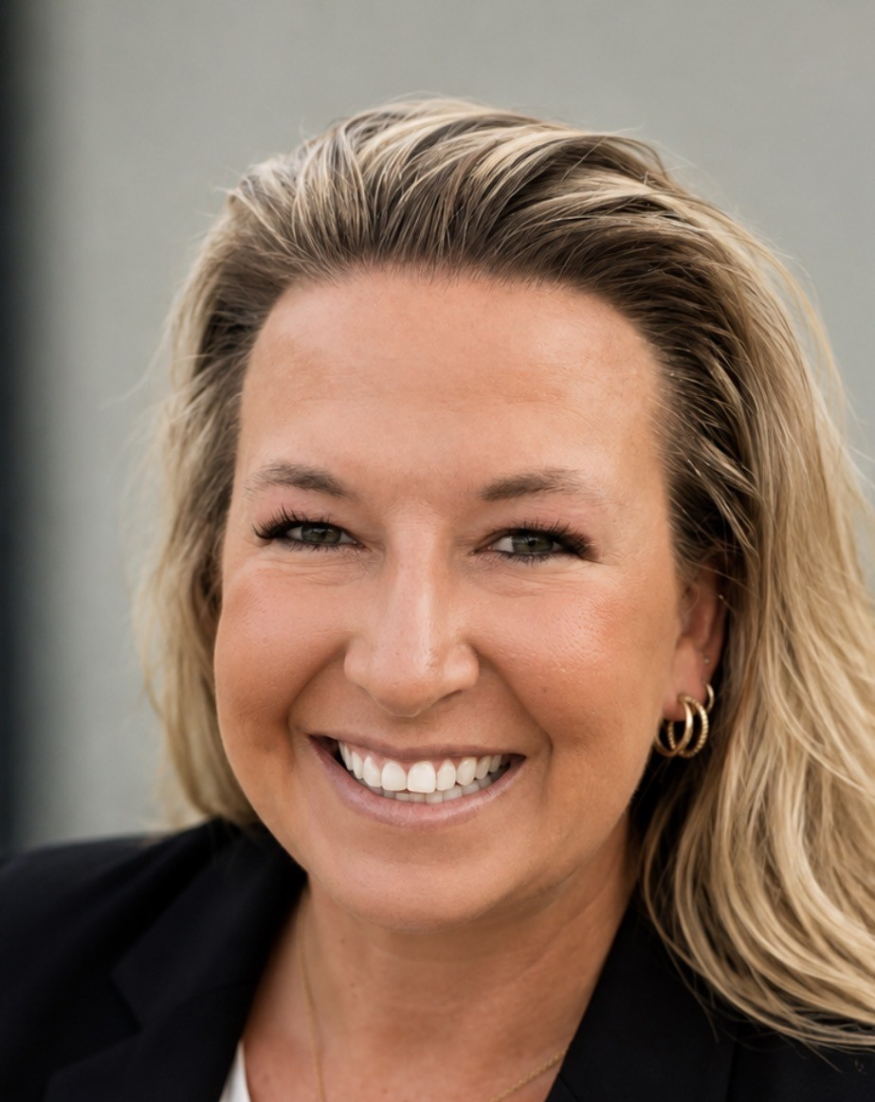
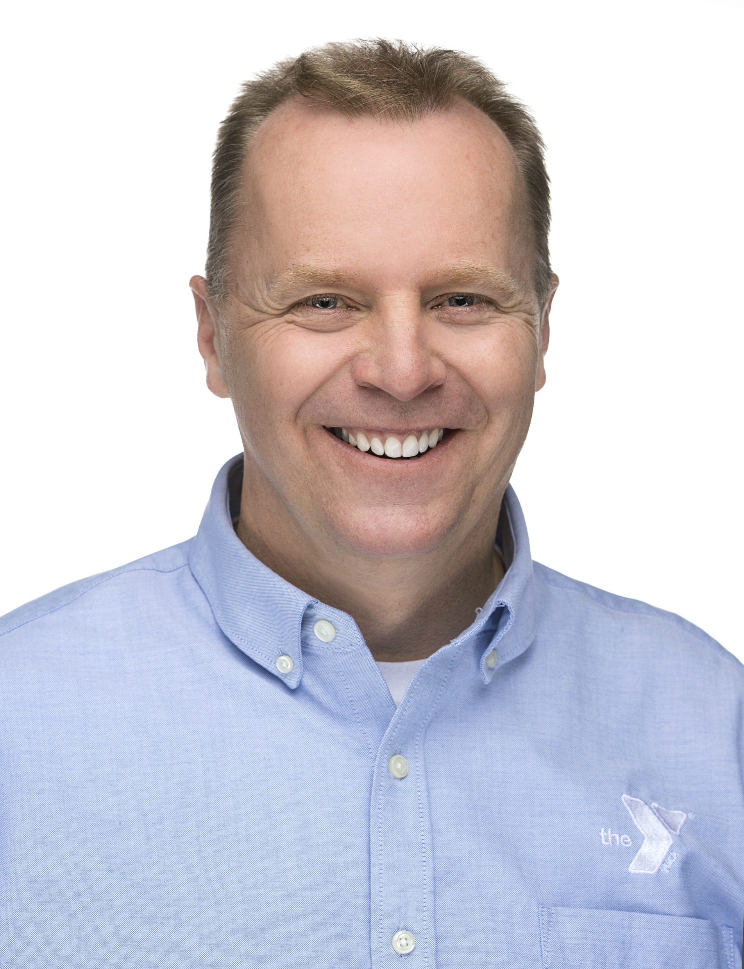
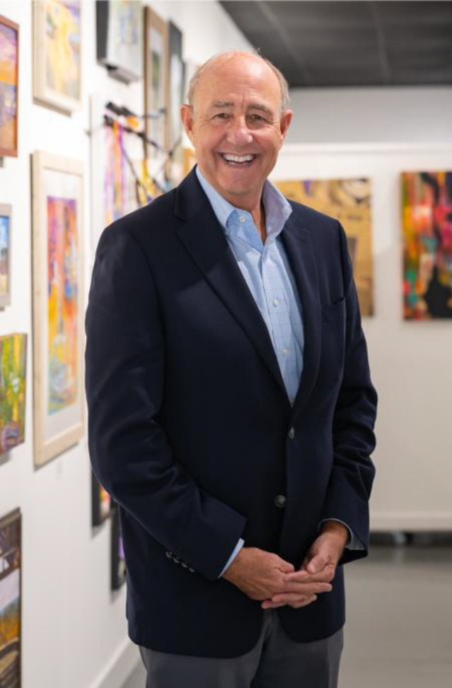
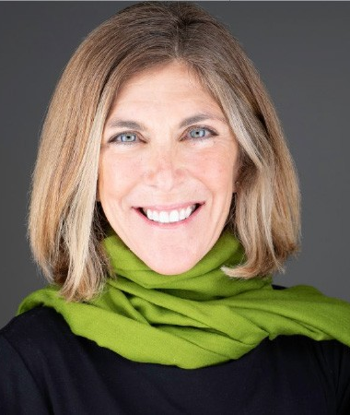
PANELISTS
Jeff Knox
Marie Carlson
Bryan Bailey
David Byrd
Tory Mackey
CEO
YMCA of Tuscaloosa
Executive Director of Social Impact
Skagit Valley YMCA
President & CEO
Woodson YMCA
CEO
YMCA of Coastal Carolina
Executive Director
Chapin Foundation

Slide 4

EFFECTIVE LOCAL PARTNERSHIPS
Jeff Knox

Slide 5

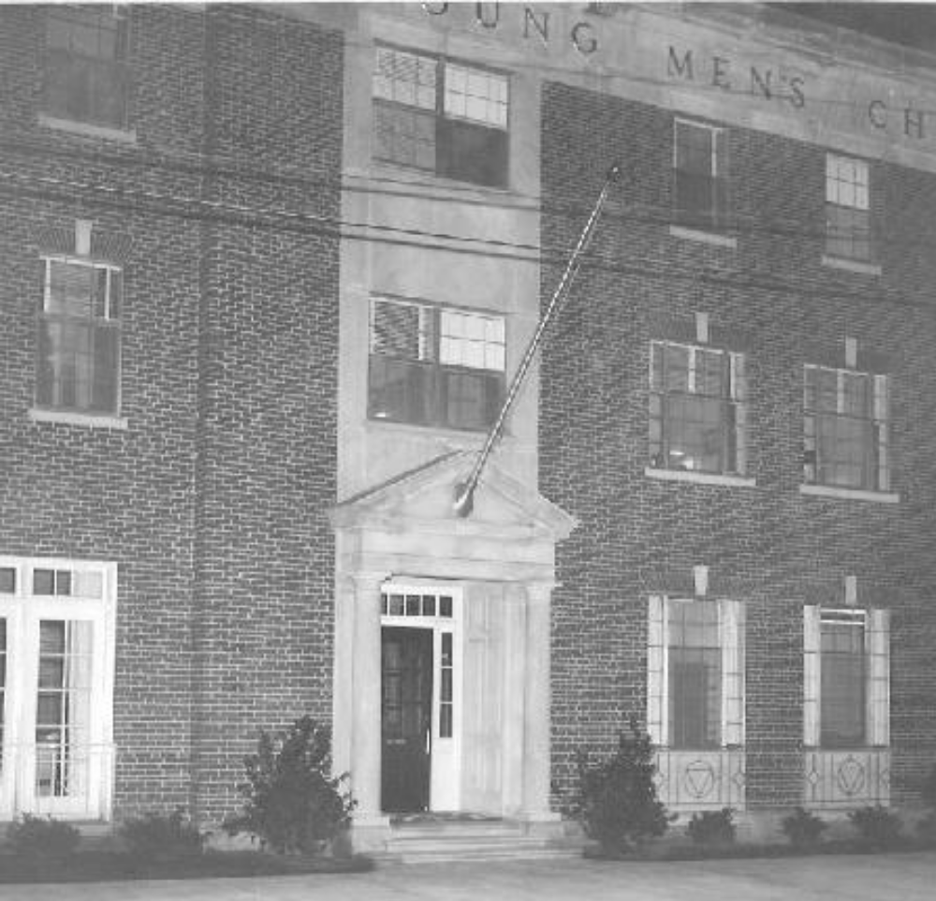
HISTORY
1908: YMCA Tuscaloosa Founded
Privately owned/funded
Disbanded between 1917 & 1922
1953: YMCA Expanded
Planning for downtown building and new branch began
1959: First YMCA Building Opened
1961: Benjamin Barnes Opened
Organized by and for the Black community during segregation

Slide 6
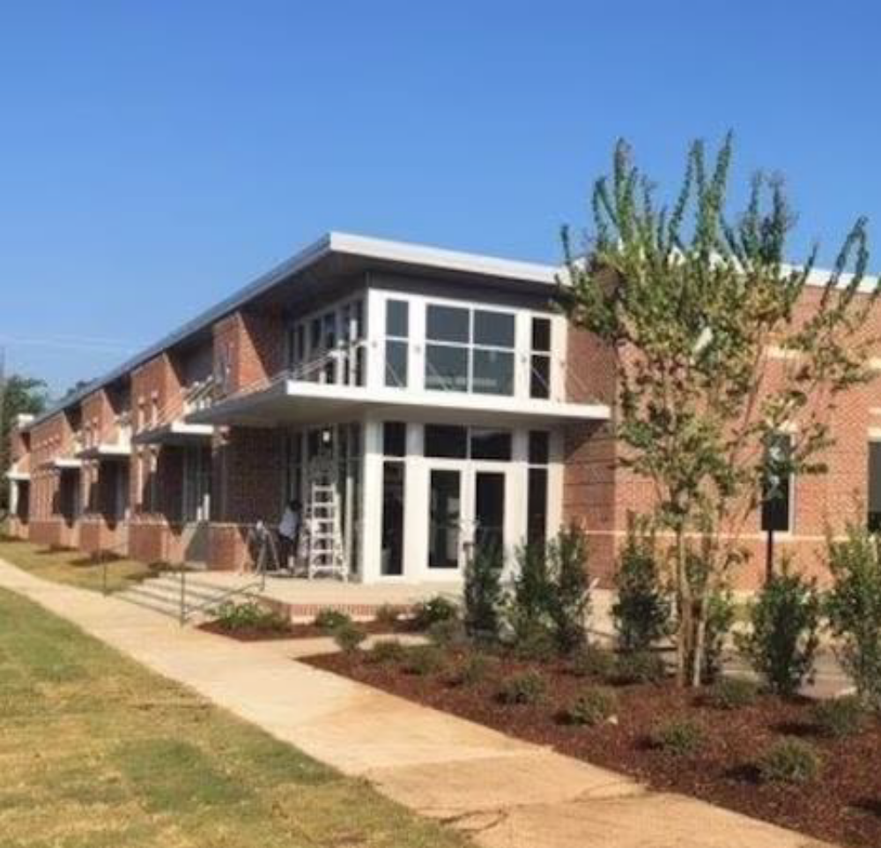
DOWNTOWN YMCA
Jan. 2015: Executed Lease
City executed lease on new downtown building after years of planning
Aug. 2016: Grand Opening
New YMCA facility opened in Downtown Tuscaloosa

Slide 7
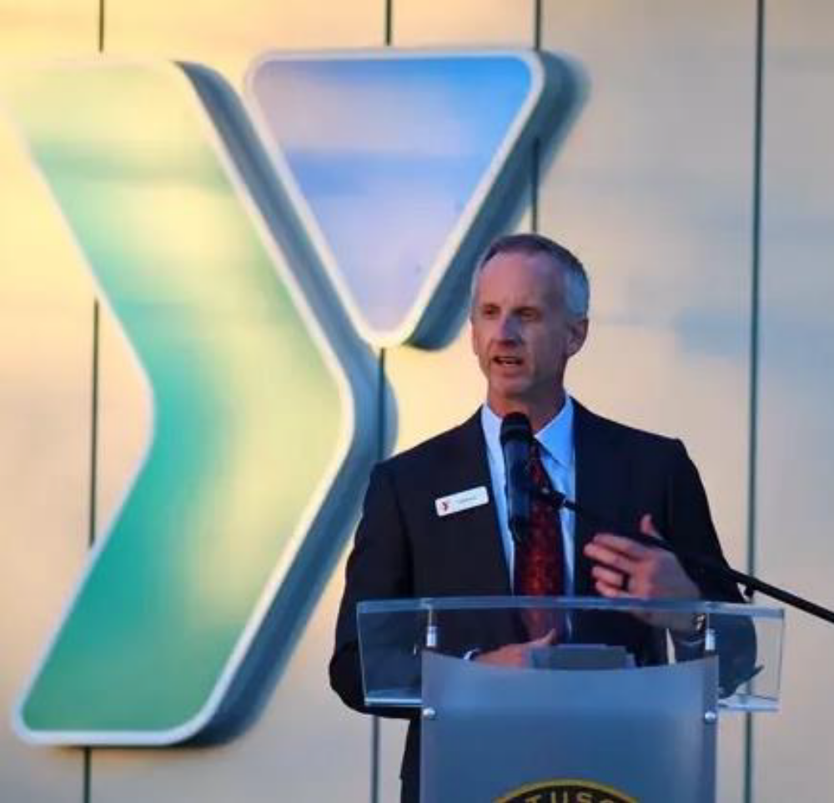
NEW CEO & COVID
Oct. 2020: New CEO
Jeff Knox
Inherited financially strained YMCA
City negotiations continued
COVID-19 Pandemic
YMCA hit by pandemic
Restrictions on indoor exercise Social distancing requirements
Debt increased
City purchase negotiations began

Slide 8
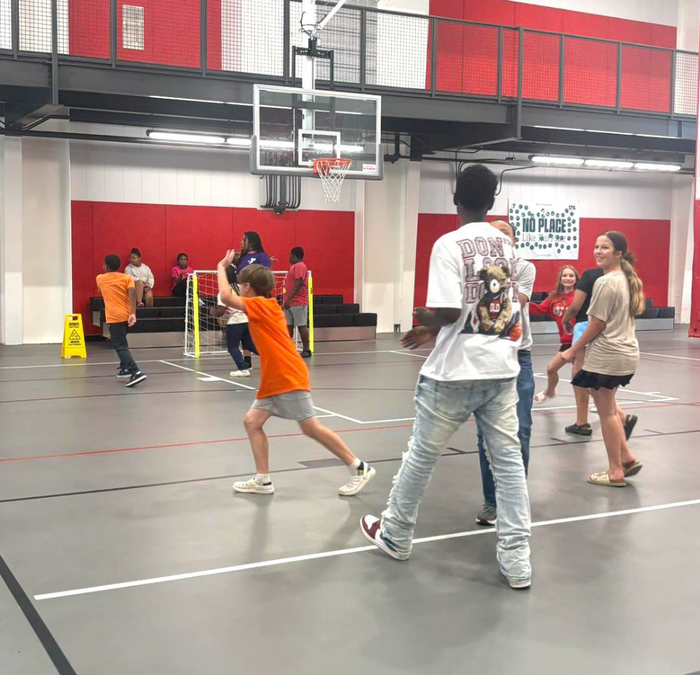
LOOKING LOCAL
Local level goals aligned
Easier communication
Same issues facing the community
Efficiency
Mutual benefits

Slide 9
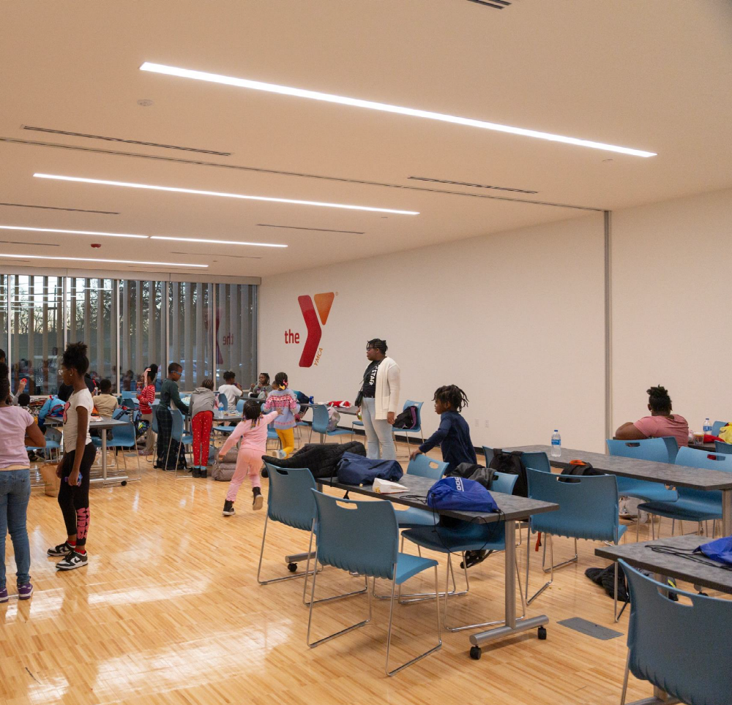
PROPERTY PURCHASES
Jan. 2021: City Purchases Both Properties
City Council votes unanimously to purchase both properties
Relieved the YMCA of its debt
Allowed more funding for programs and operations

Slide 10
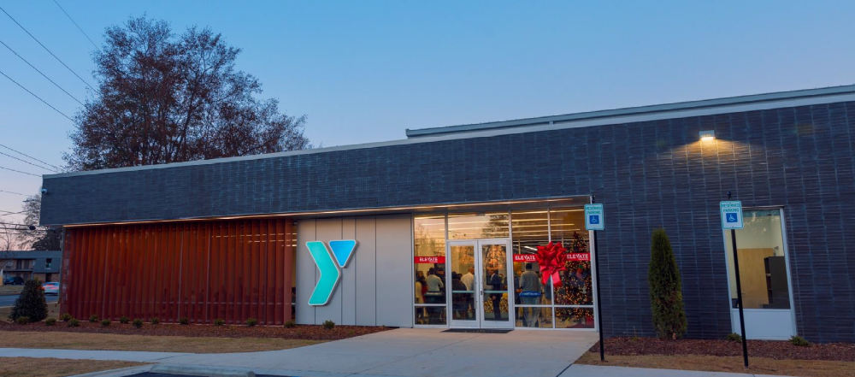
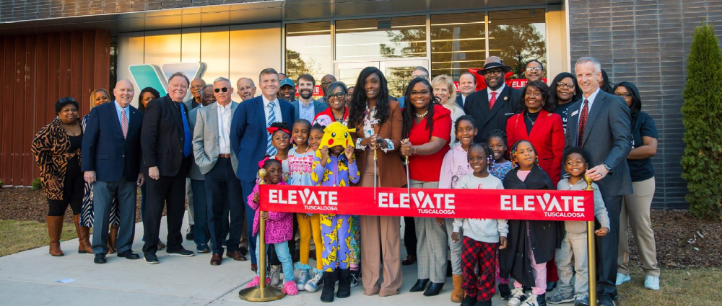
BARNES YMCA
Mar. 2021: New Baseball League
May 2021: Renovations Began
Oct. 2023: Groundbreaking
Leaders broke ground on new Benjamin Barnes facility
Dec. 2024: Grand Opening
Grand opening for new Benjamin Barnes YMCA

Slide 11
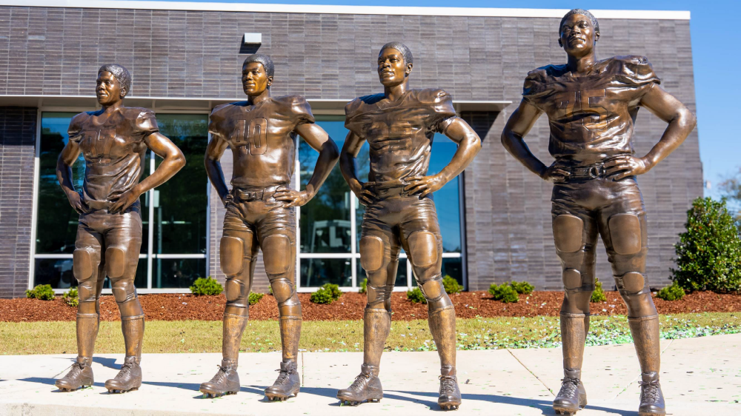
November 2025: Marshall Four Statues Unveiled

Slide 12
June 2025: Downtown YMCA Accessible Pickleball Courts

Slide 13
SKAGIT VALLEY FAMILY YMCA: HOUSING WAS NEVER THE POINT – BELONGING WAS
Marie Carlson

Slide 14
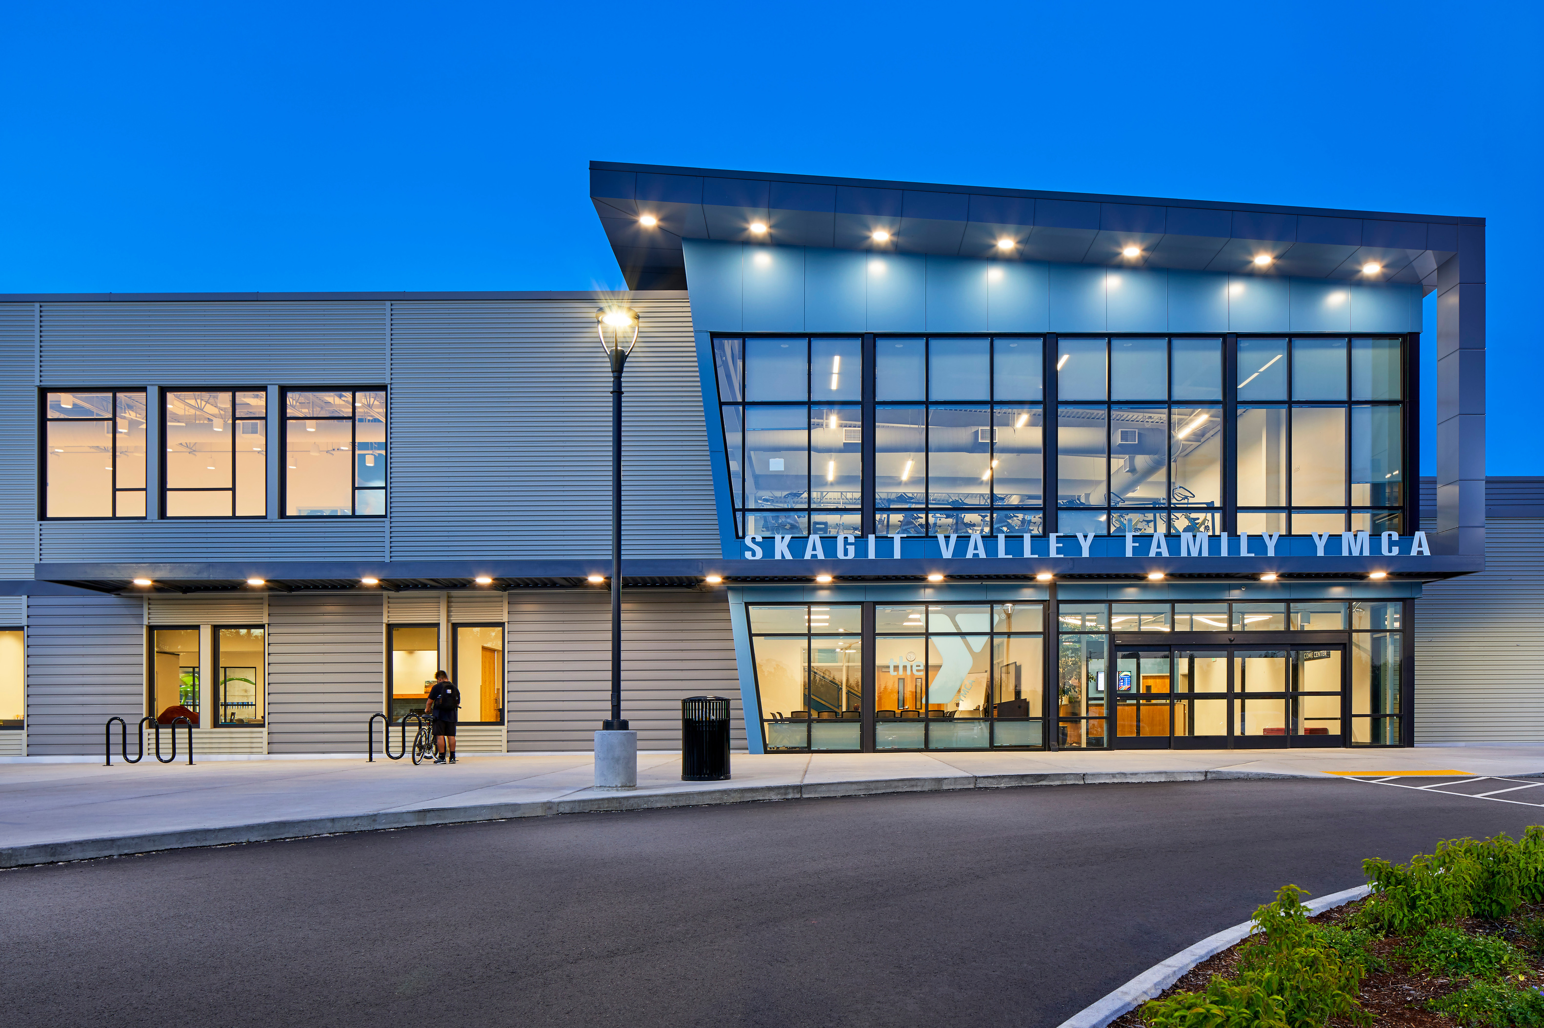
HOUSING HAS ALWAYS BEEN PART OF THE YMCA STORY
19th-century cities drew young men away from family and familiar communities.
The YMCA created places for stability, connection, and belonging.
Stability creates conditions for participation.
participation is what makes communities stronger

Slide 15
THE DEEPER LESSON:
HOUSING WAS A PLATFORM FOR BELONGING
Residents were connected
to programs, clubs,
relationships, and community
People were not just recipients—
they could contribute,
volunteer, and lead.
STABILITY
CONNECTION
PARTICIPATION
A safe place to live creates
room to focus, recover, and plan.

Slide 16
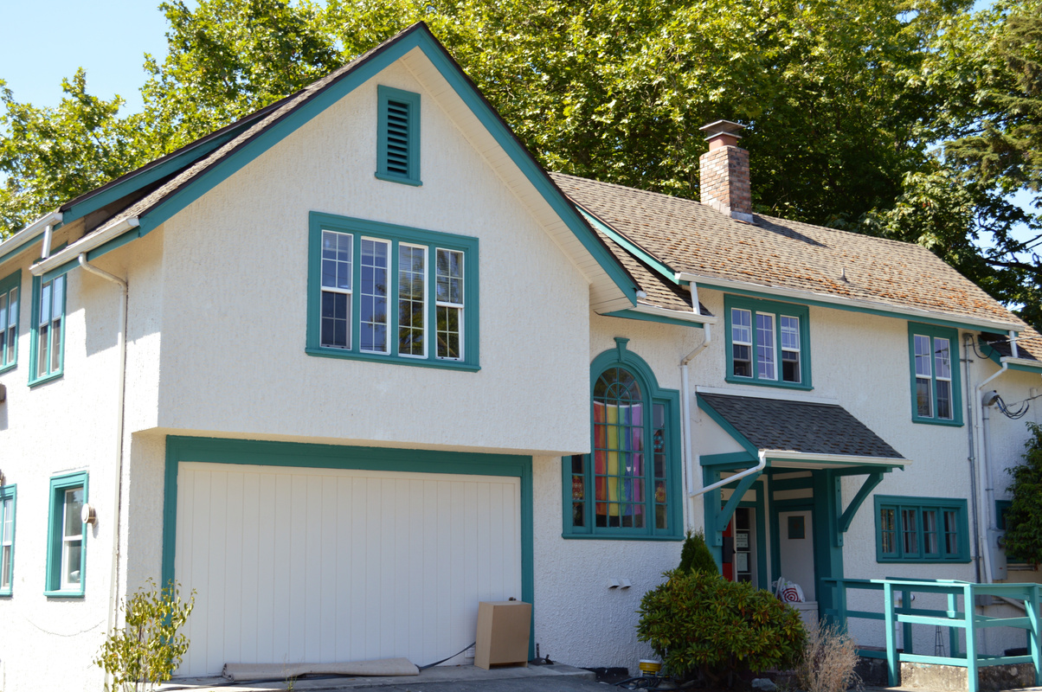
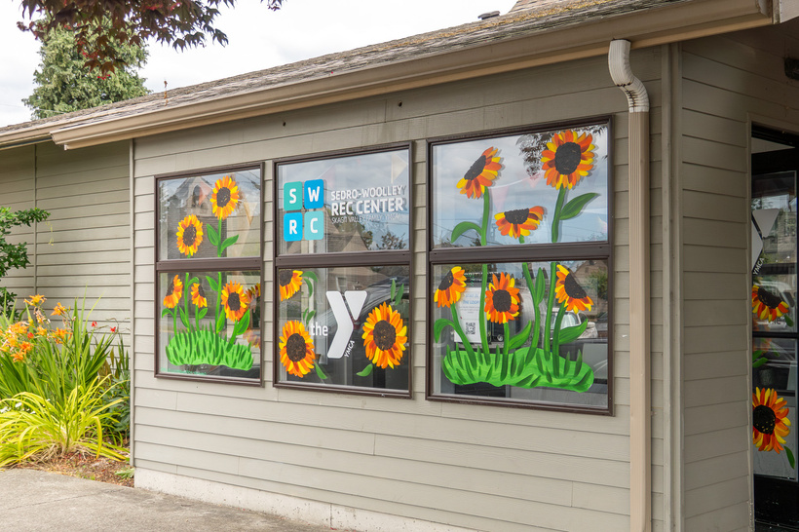
Evolution of Social Impact
2001
2005
2018
2022
  Skagit YMCA takes over operations of the Oasis Youth Shelter
  Skagit YMCA assumes full financial responsibility of Oasis Youth Shelter
  Dean Snider hired as CEO
  Oasis Youth Shelter = emergency overnight shelter and Daylight Shelter (daytime drop-in center)
  City of Sedro-Woolley leases old library facility to Skagit YMCA to run into free afterschool drop-in center

Slide 17
EVOLUTION OF SOCIAL IMPACT
2024-25
2025
2026
  Social Impact Division takes shape
    Oasis, Sedro-Woolley Rec Center, MV HOPE Coalition, Street Outreach programs working together
  Skagit YMCA launches and completes successful capital campaign to rebuild Oasis Youth Shelter, growing from 6 beds to 14 beds
  Communities for Functional Zero (C4F0) coalition takes shape; Skagit YMCA takes on lead agency role for Skagit County
  Host Homes Pilot Program launches as part of Social Impact work
  Remodel of Sedro-Woolley Rec Center begins
3
| PRESENTATION TITLE | SKAGIT VALLEY FAMILY YMCA

Slide 18
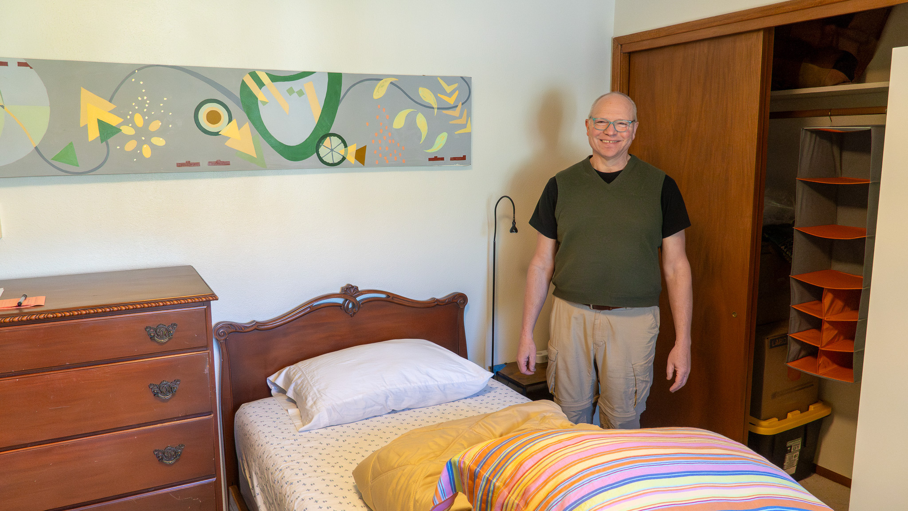
HOST HOMES – Part of Shelter Services
Creating a community-based housing option through trained individuals and families opening their homes to youth experiencing housing instability.

Slide 19
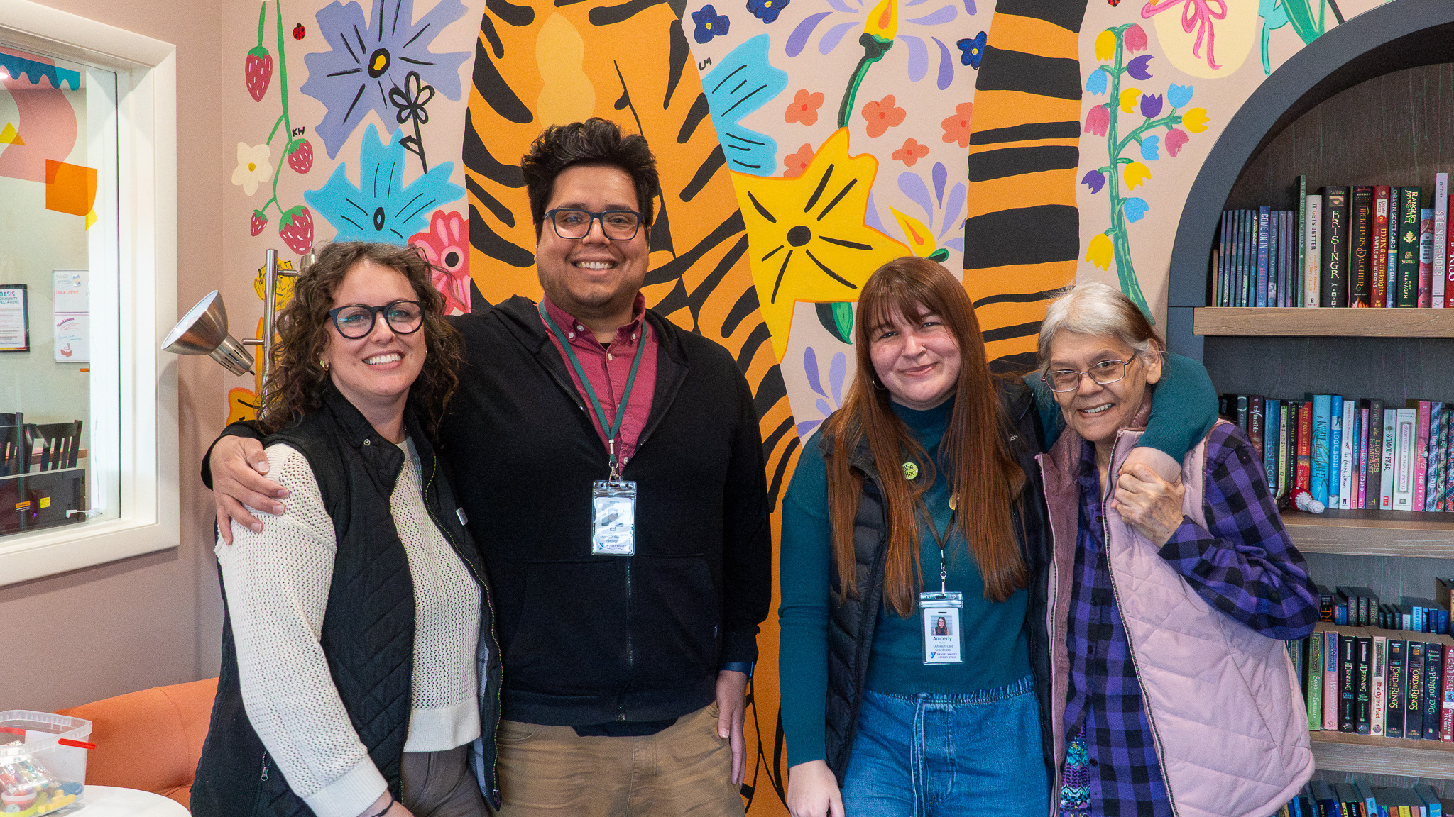
STREET OUTREACH SERVICES
Outreach connects young people to a safe place,
relationships, and resources.

Slide 20
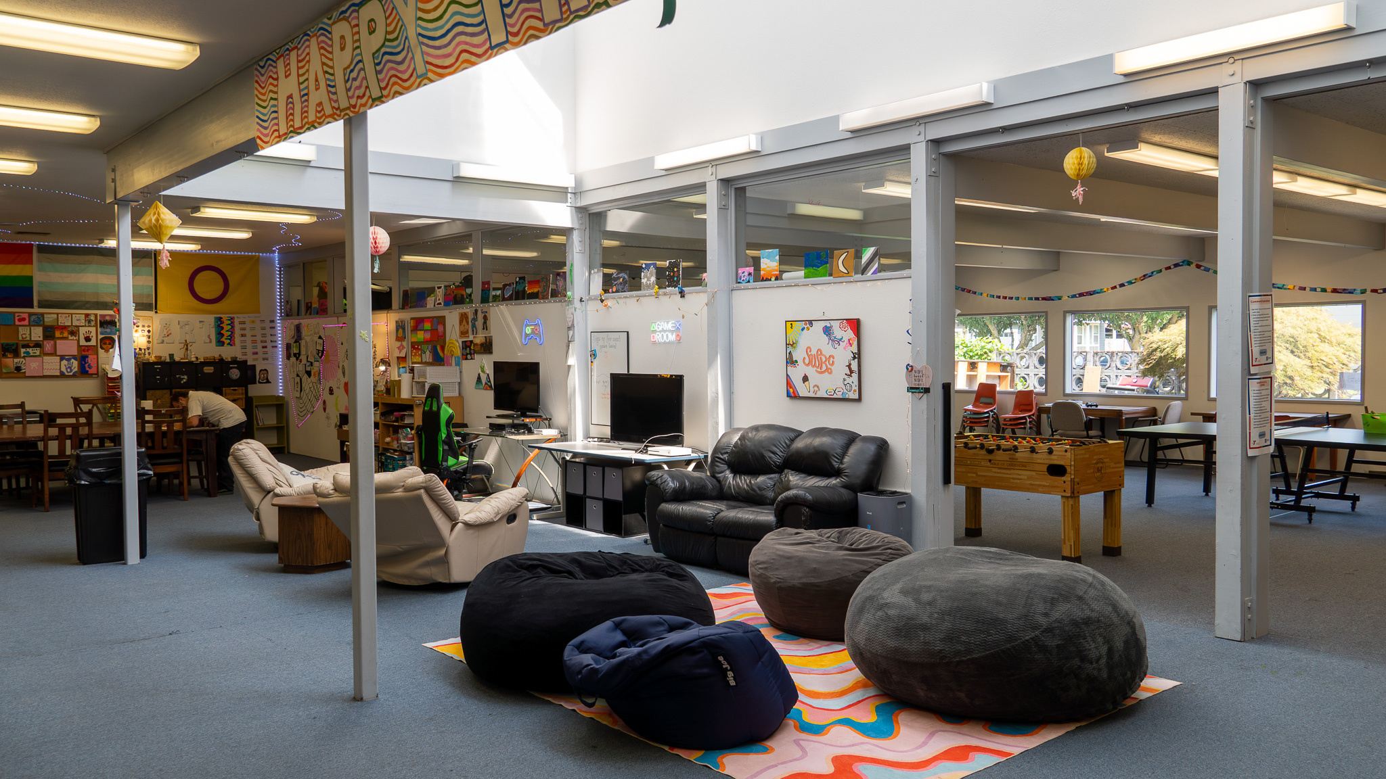
SEDRO-WOOLLEY REC CENTER

Slide 21
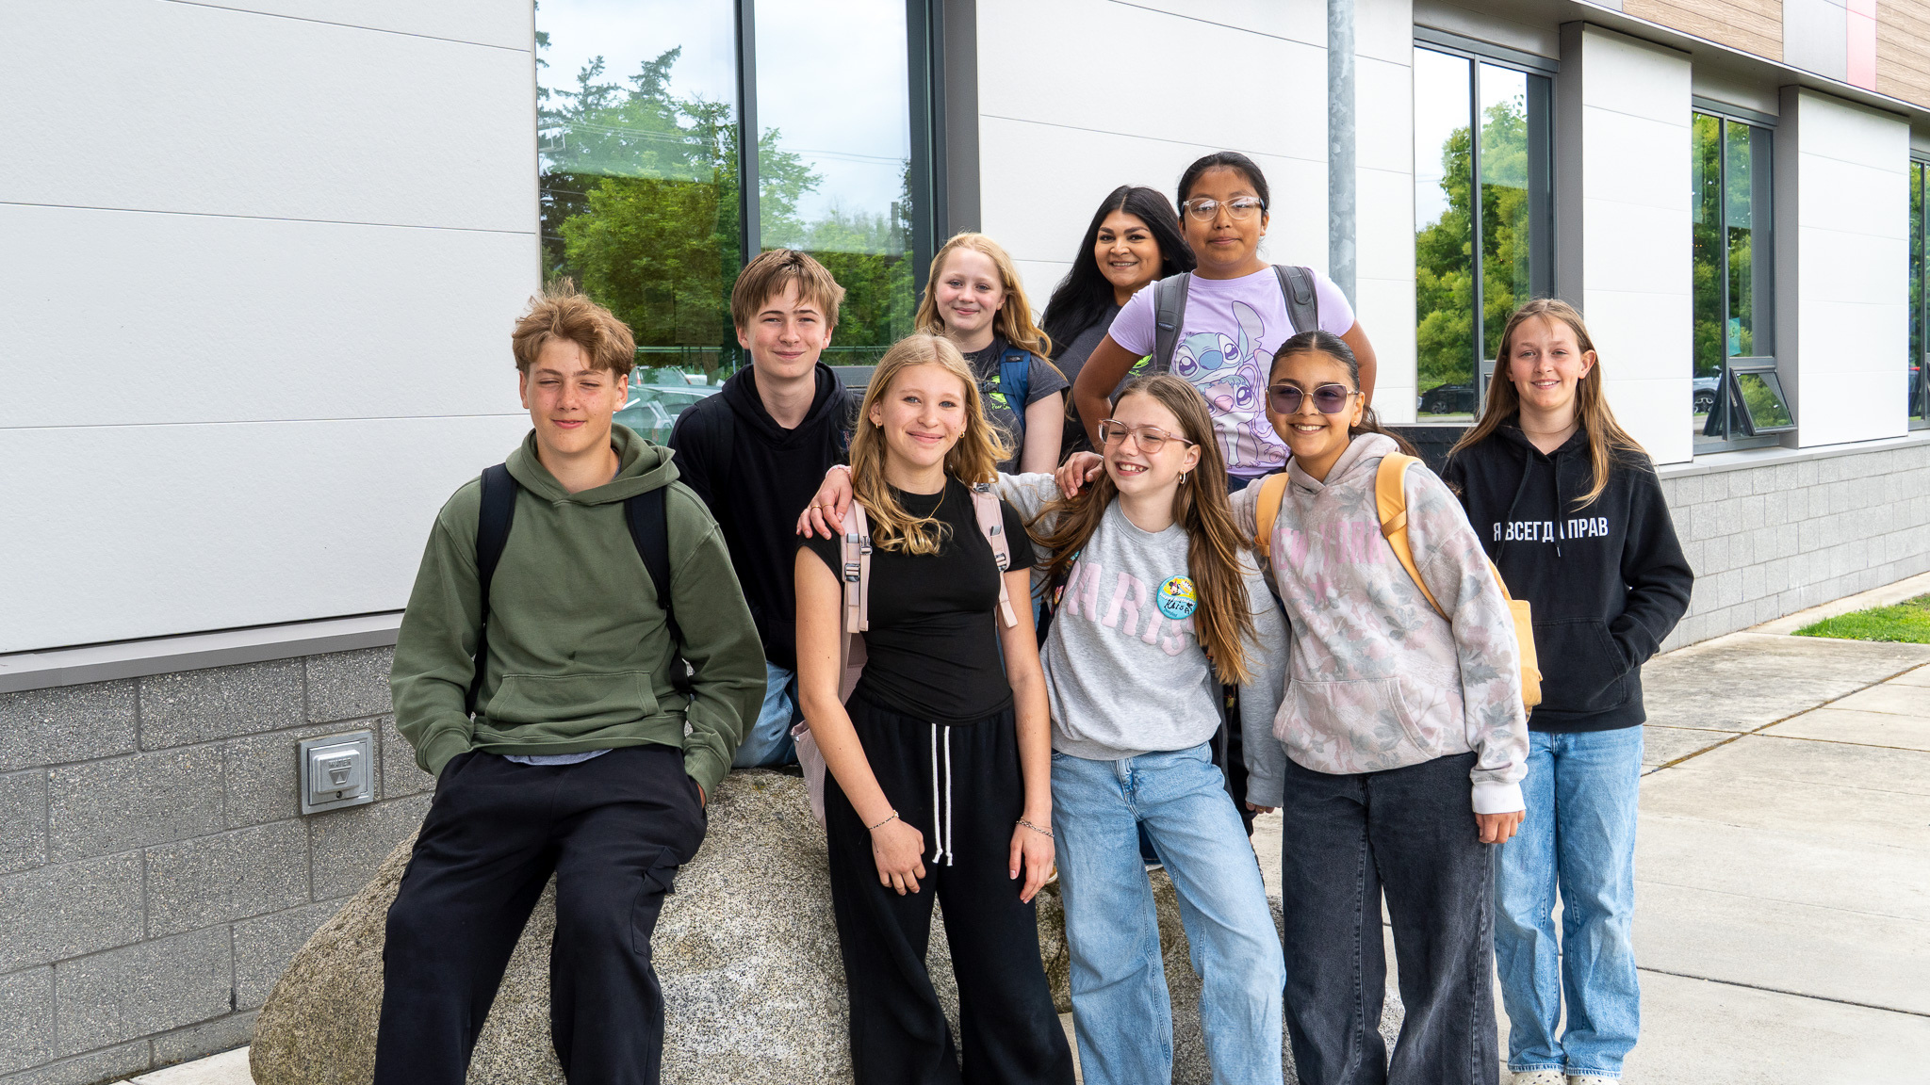
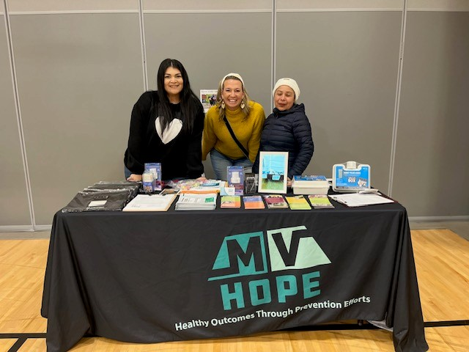
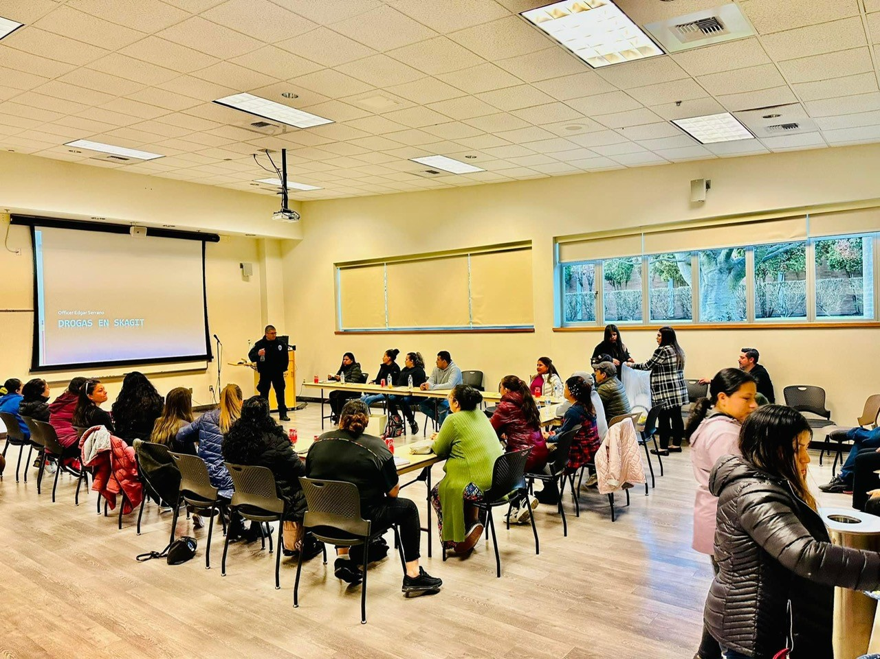
MV Hope Substance Abuse
Prevention
Community coalition working to prevent youth substance abuse, promote mental health and build a healthier, more connected community
MV HOPE COALITION

Slide 22
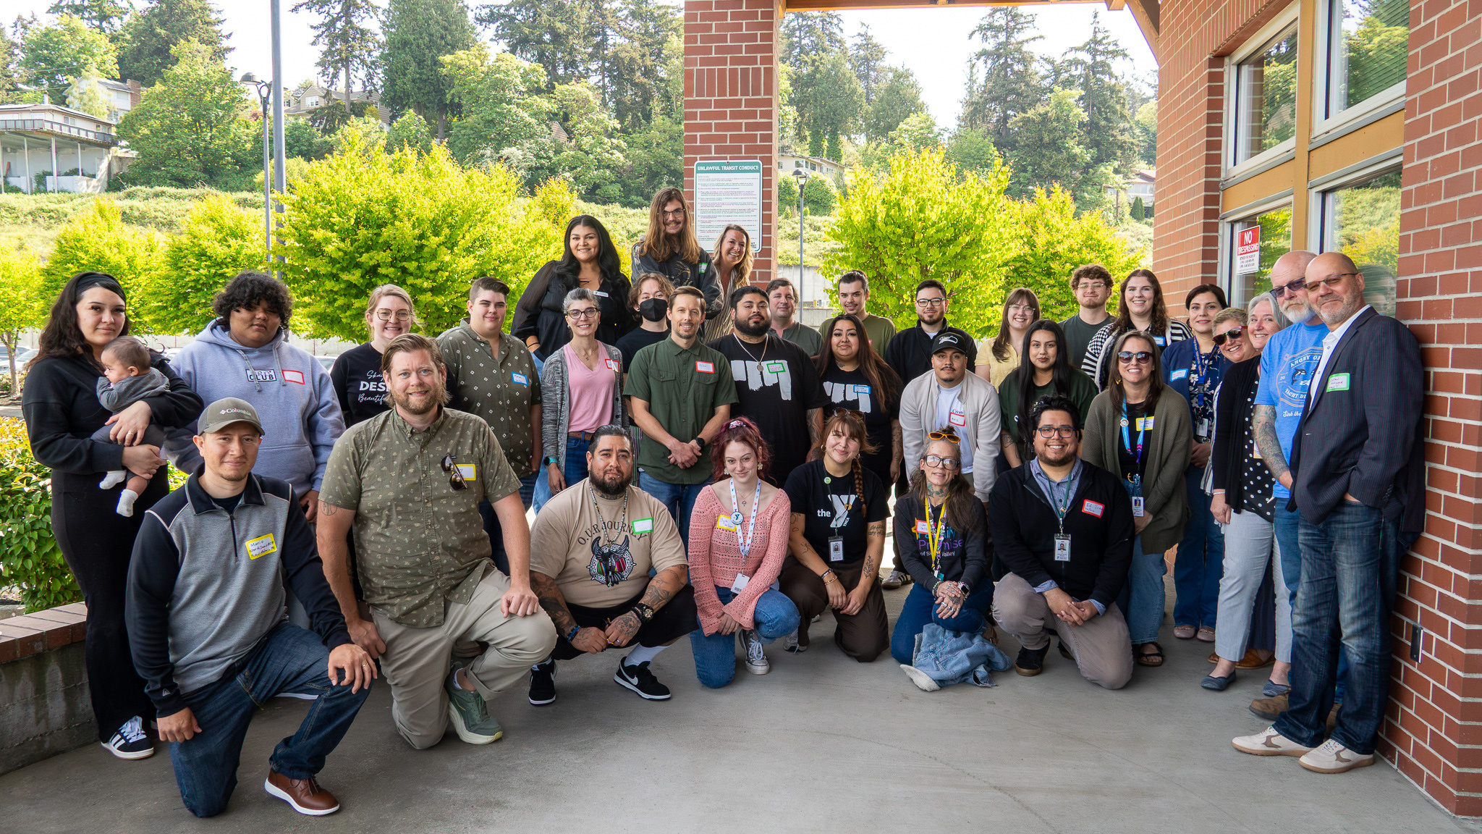
COMMUNITIES FOR FUNCTIONAL ZERO
address the conditions that contribute to youth and young adult homelessness and instability.

Slide 23
Strong communities are built when people have the
stability to participate—and the relationships that invite them to belong.
When housing, programming, membership, and leadership work together,
the result is more than housing. It is community.

Slide 24

THE LANDING AT WOODSON YMCA
Bryan Bailey

Slide 25

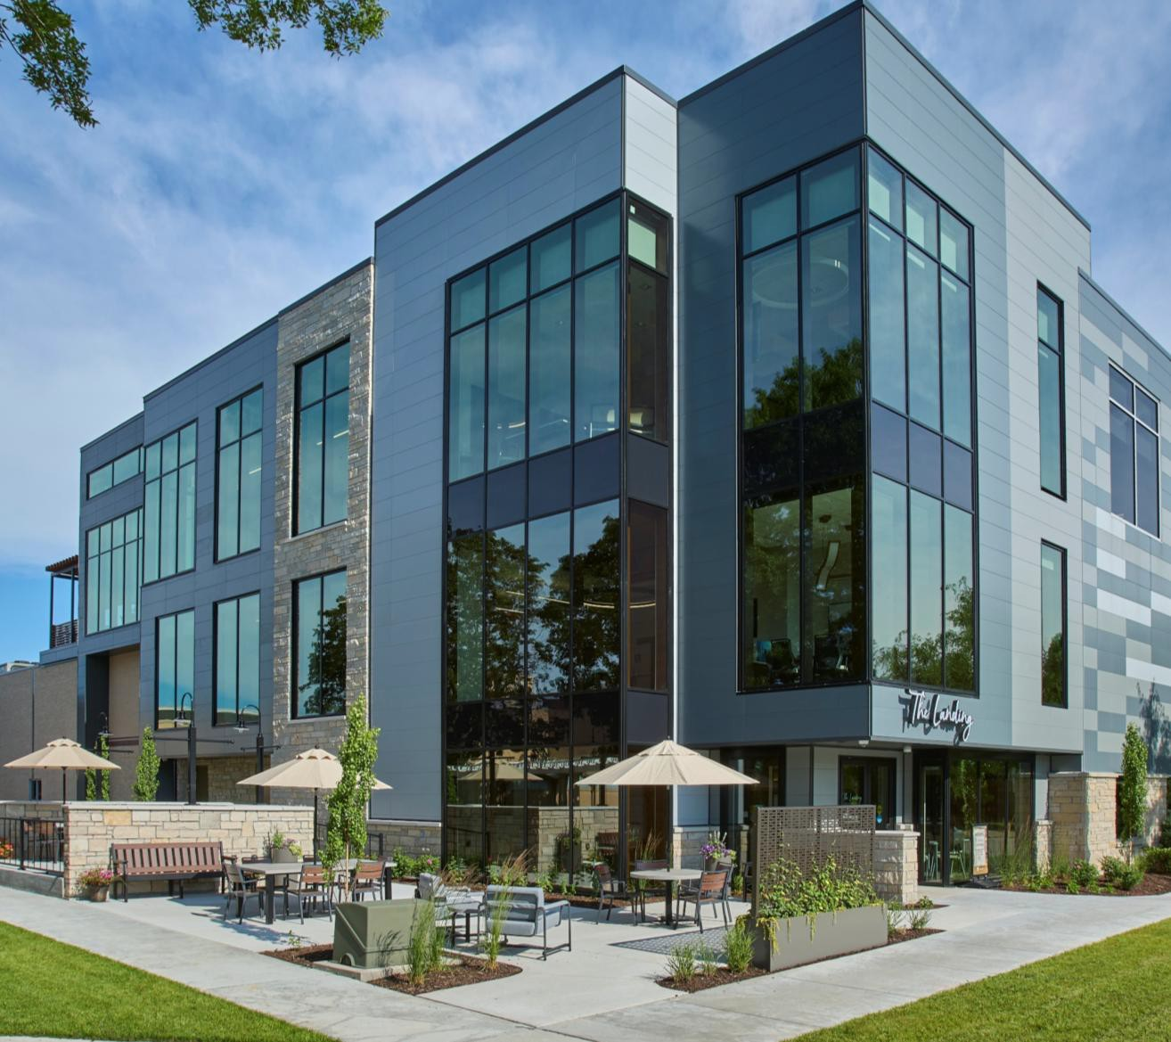
The Landing at the Woodson YMCA
Senior Activity Center located within the YMCA for members 55+.
Opened in Fall 2019 – 1600 Members
Summer 2026 – over 6,000 Members
Mission & Vision – Promote positive aging, connection, wellness and purpose.
Areas of Focus:
  Member Experience
  Programming Excellence
  Community Engagement
  Strategic Growth & Impact
  Mission Aligned Team Culture

Slide 26
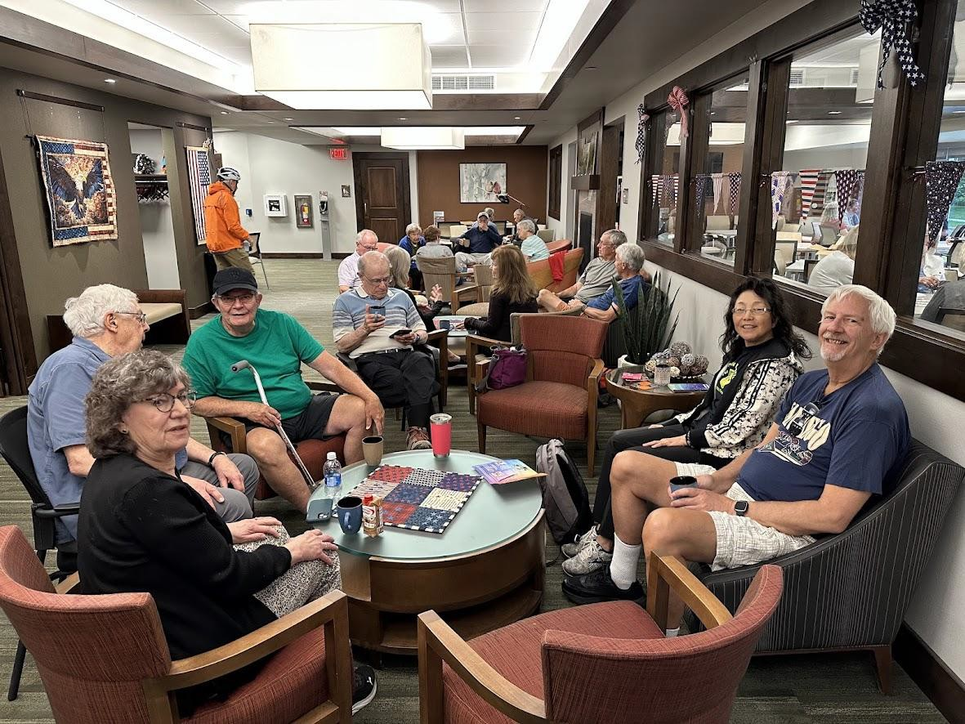
PROMOTING SOCIAL CONNECTION AND Reducing Social Isolation
Connection happens every day — over a game, billiards, a conversation on the patio, or simply spending time together.
Social connection supports overall health and well-being.
Loneliness is linked to a 64% increased risk of dementia.
Social isolation is associated with a 26% higher risk of premature death.
At The Landing, connection isn’t just something we talk about—it’s
something we create every day.

Slide 27
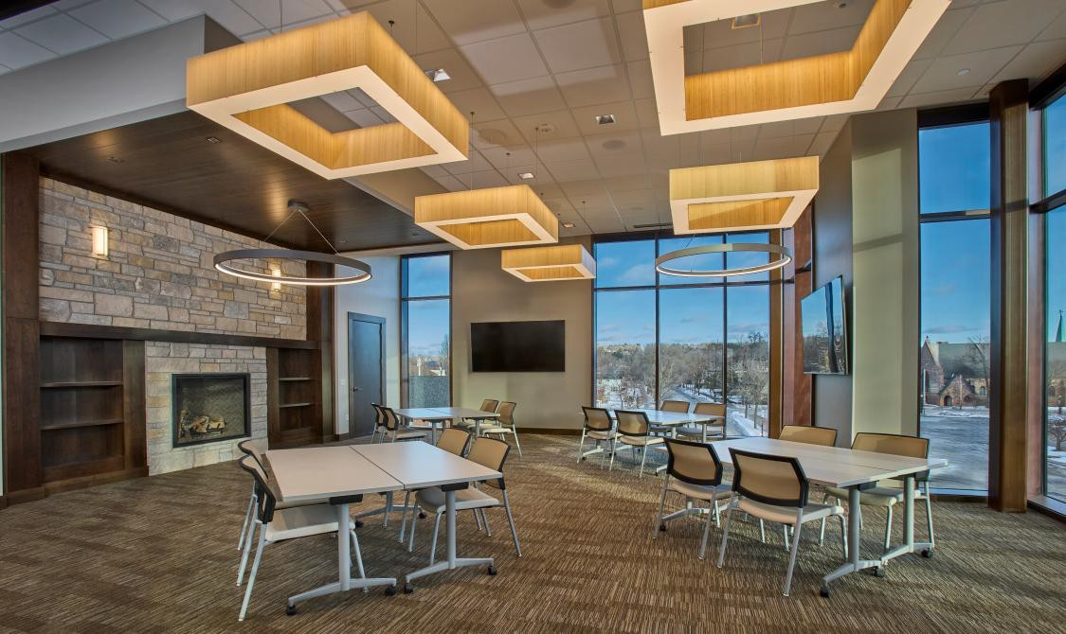
80+ Unique Programs Each Month
PLAY • LEARN • WELLNESS • SOCIALIZE
Who Leads Our Programs?
  Community Professionals
  Retired Topic Experts
  Local Business & Community Partners
  YMCA Staff & Volunteers
Program Variety
  Educational & Lifelong Learning
  Hobbies & Special Interests
  Health & Wellness
  Arts, Culture & Creativity
  Social & Recreational Activities
  Technology & Current Topics
+Evidence Based Programs

Slide 28
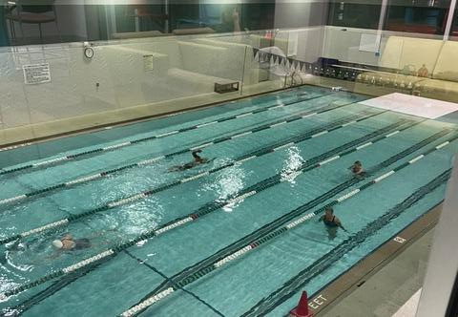
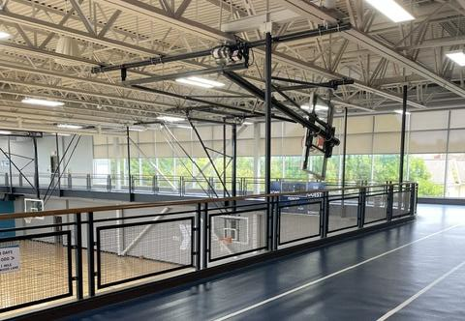
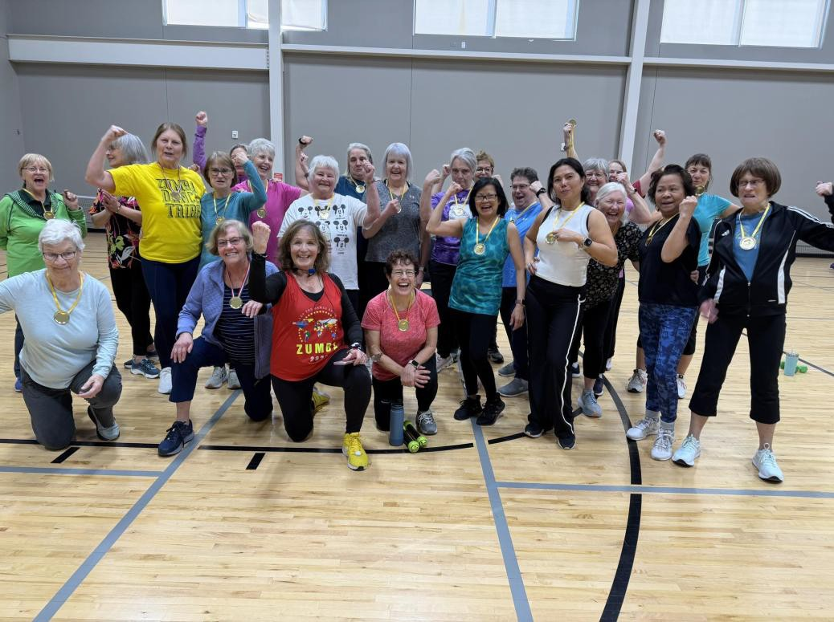
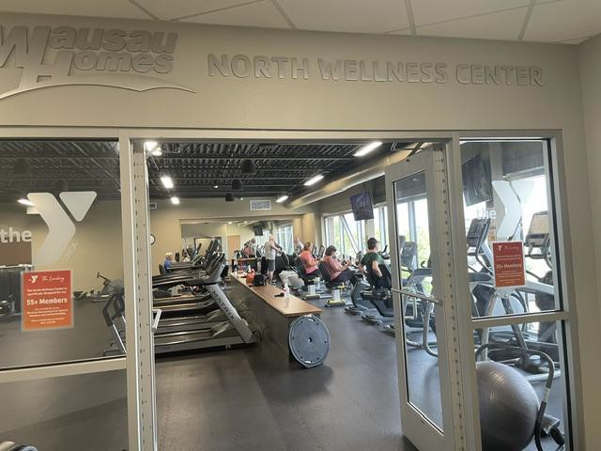
Senior focused YMCA Amenities
The YMCA + The Landing: A Holistic Approach to Aging
Together, We Support the Whole Person.
The YMCA provides the foundation for PHYSICAL WELLNESS
The Landing builds the SOCIAL & INTELLECTUAL CONNECTION
A community where older adults can continue to thrive.

Slide 29

175 YEARS OF LEADERS
INVESTING IN THEIR COMMUNITY
David Byrd & Tory Mackey

Slide 30

1943
2008
2026
1851
1984
2023
2030
Notes:
The Y turns 175 this year
What's evolved: buildings, programs, technology
What hasn't: community leaders seeing the Y as theirs to build
Three moments tell that story here — 1943, 1984, and today

Slide 31
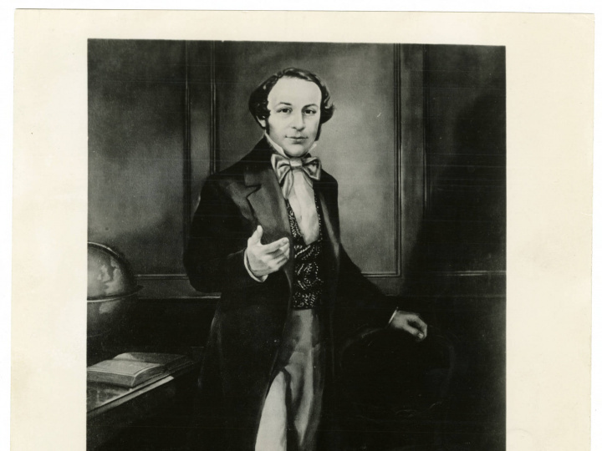
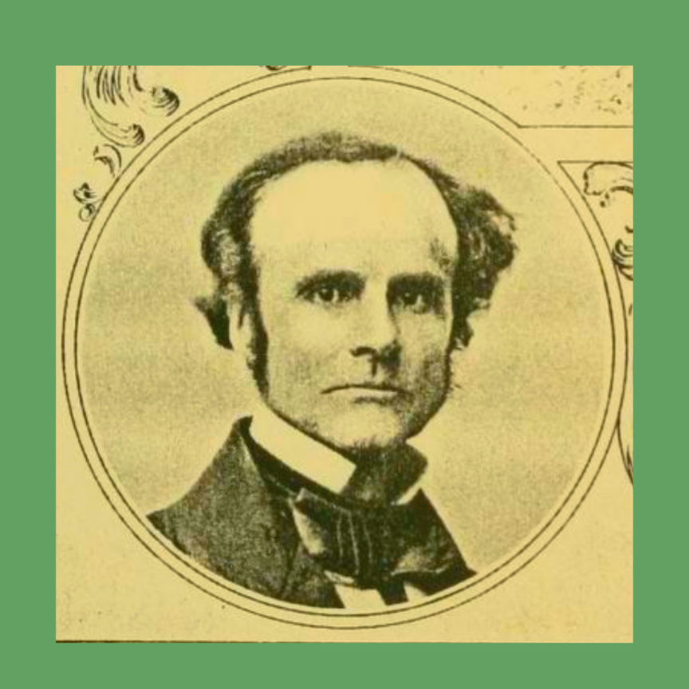
1851
George Williams, Founder the YMCA
Thomas Valentine Sullivan, Founder of the Boston YMCA i]1
Notes:
The Thread (David, :20)
The Y turns 175 this year
What's evolved: buildings, programs, technology
What hasn't: community leaders seeing the Y as theirs to build
Three moments tell that story here — 1943, 1984, and today

Slide 32
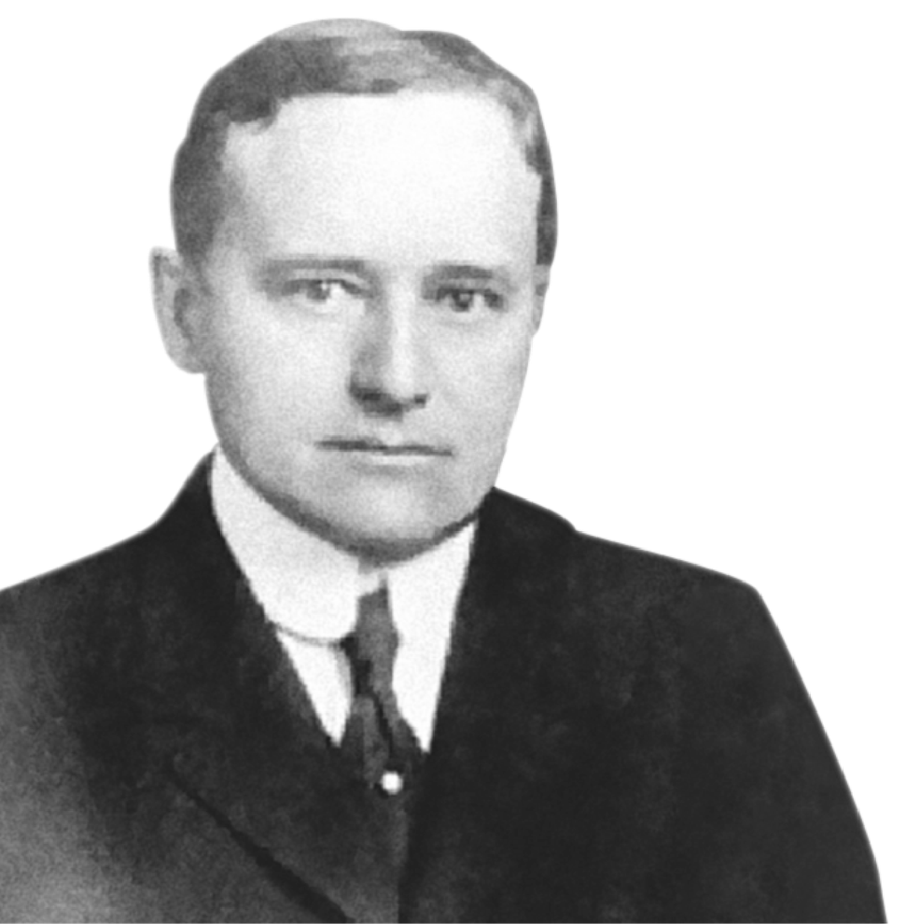
1943
Simeon B. Chapin has an Inspiring Vision
Simeon B. Chapin has an Inspiring Vision
His vision laid the foundation for community strength.
His vision laid the foundation for community strength.
Notes:
1943: Simeon B. Chapin's Vision (Tory, 1:00)
Tory tells the story of Mr. Chapin
He established the Chapin Foundation and named the Y as one of its four founding pillars
His belief: a strong YMCA is a core element of a strong community
That belief became a standing legacy commitment — not a one-time gift

Slide 33
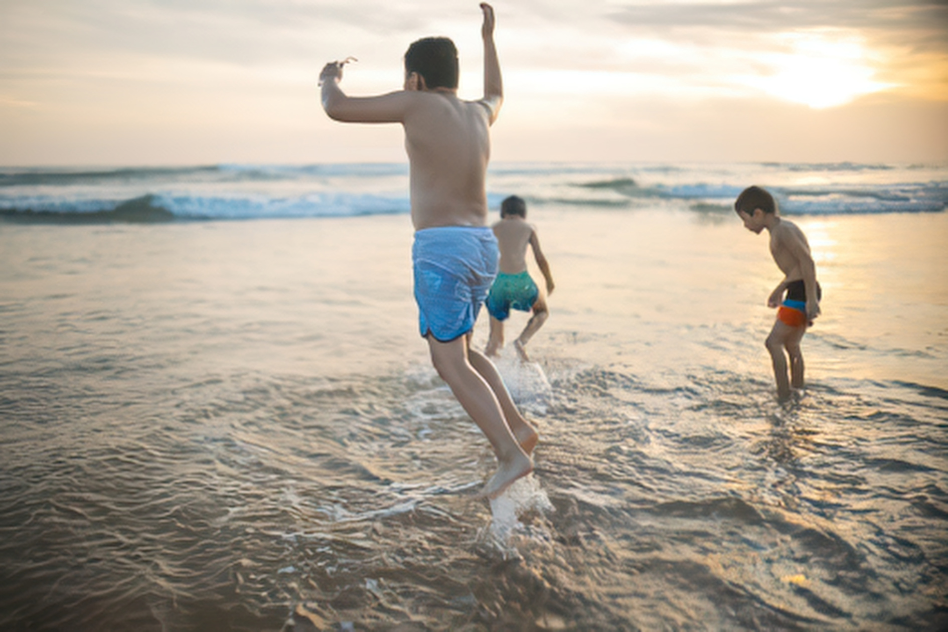
1984
Our Community Identifies Its Need
Our Community Identifies Its Need
Leaders recognized the YMCA as a solution
Notes:
1984: A Community Identifies Its Own Need (David, :30)
Local Y established as an association — the original purpose: teach kids to swim, in hotel pools
Community leaders again saw a gap and decided the Y was the answer
Same pattern as 1943: leaders naming the Y as the solution, not being asked to

Slide 34
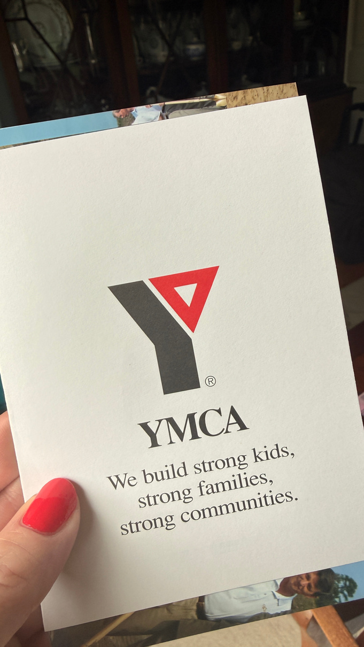
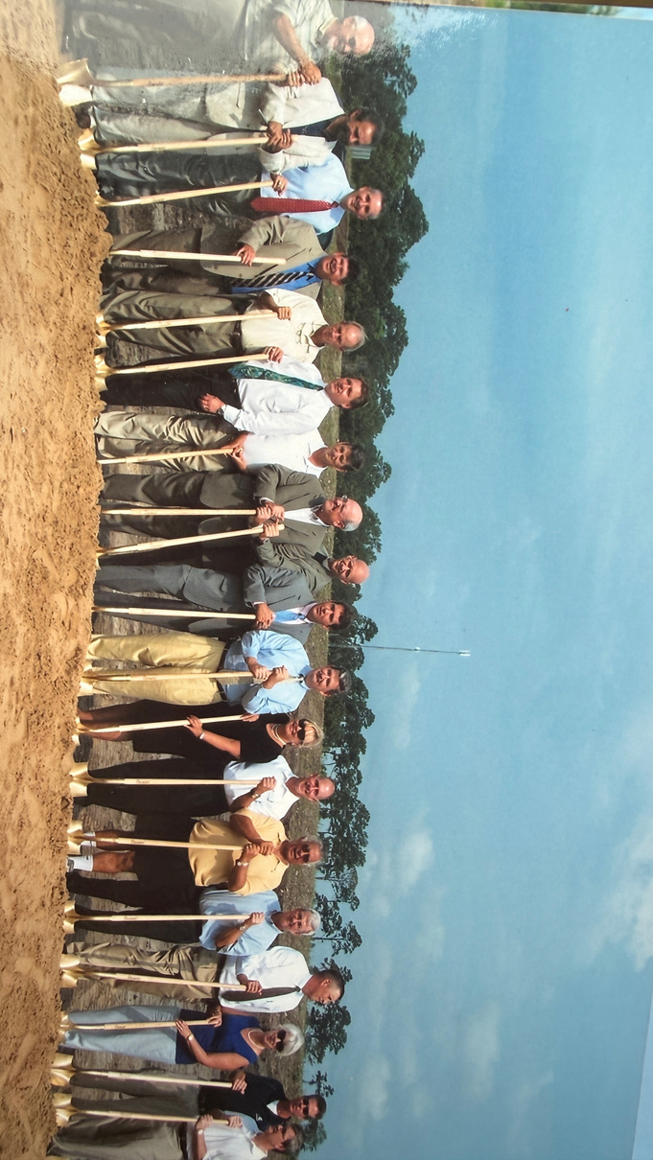
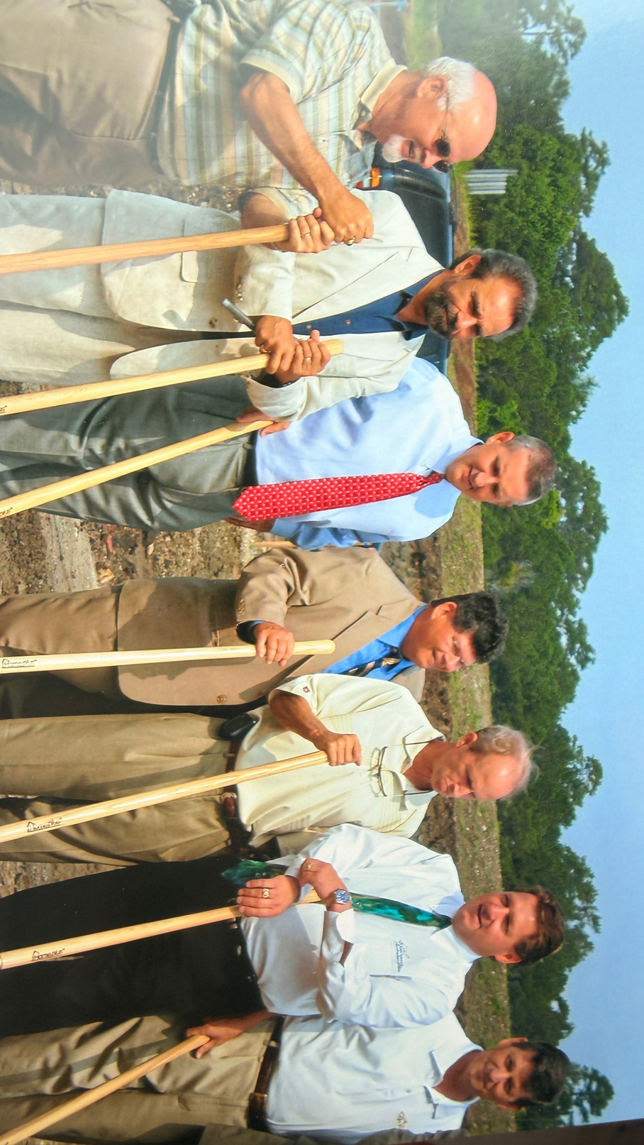
2008
Notes:
The Y turns 175 this year
What's evolved: buildings, programs, technology
What hasn't: community leaders seeing the Y as theirs to build
Three moments tell that story here — 1943, 1984, and today

Slide 35

2023
Our five priorities guide our mission:
COMMUNITY HEALTH
Our community will lead the way as one of the healthiest in the country.
MENTAL WELLNESS
Our community will feel connected and supported, experiencing an improved quality of life and mental health.
ACCESSIBLE CHILDCARE
Child Care will be affordable and accessible to every working parent.
WATER SAFETY
Everyone in our community will gain water safety skills and confidence.
TEEN CAREER & COLLEGE READINESS
Our community’s children will graduate from high school prepared for a career ​or higher education.
Notes:
2023: David's 50 Years, Same Playbook (David, :45)
Fast forward: David's five decades in the movement
Same approach Chapin's generation used — get every leader in the room, invested
This is where your Vision Priorities / leadership forum material plugs in as "here's what that looked like this time"
Key Leadership Strategies
Collaborative decision-making
Inclusive planning sessions
Engaging expert facilitators
Community feedback mechanisms
Essential Community Engagement
Building strong partnerships
Fostering trust and transparency
Prioritizing community needs
Creating shared goals

Slide 36
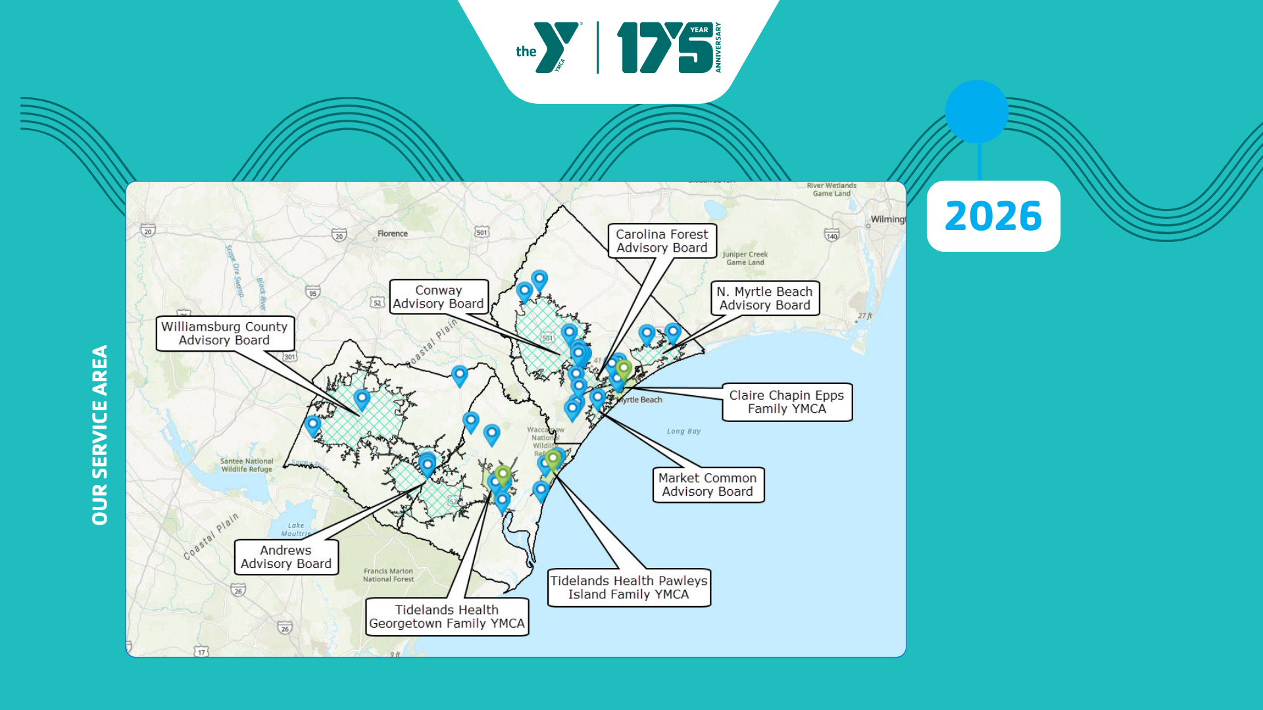
Notes:
The Real Engine: Follow Up, Follow Up, Follow Up (David, :50)
it's 2026 - you can start today.
A meeting without a follow-up is a meeting that didn't happen
Follow up within 24 hours
Follow up within the month — an update, or another ask: another meeting, join a committee
Keep following up with real progress, not just check-ins
Get their cell phone. Text. Call. Schedule the next call before you leave the room.
— Give Them a Reason to Say Yes (David, :30)
This is what the Long Range Planning Committee and the Leadership Forum did — gave 200 leaders a real seat and a real task, not a spectator role
People invest in what they helped build
--It's Never "Do This for the Y" (David, :35)
Every ask is community-centered, never Y-centered
The Y as the solution to community issues — not the beneficiary of charity
Collaborate, don't compete — bring partners in, don't guard turf
Don't be afraid to say no — protect the trust, it's the whole asset

Slide 37

2030
YMCA OF COASTAL CAROLINA
One Community,
One Vision
"That all of them may be one, Father, just as you are in me and I am in you." - John 17:21
Notes:
Anyone Can Do This (David, :20)
The five Vision Priorities, the forums, the Chapin model — none of it is proprietary
What makes it work isn't the tactics. It's the follow-up and the momentum behind them.
That's the differentiator, and it's replicable in any Y, any size
Slide 10 — Closing (David, :15)
1943, 1984, 2023 — different leaders, same instinct: see the need, name the Y as the answer, invest
That's still how it works
Thank you

Slide 38

THANK YOU

