Slide 1

Advancing Early Cancer Detection Education Through Community Connection

Slide 2

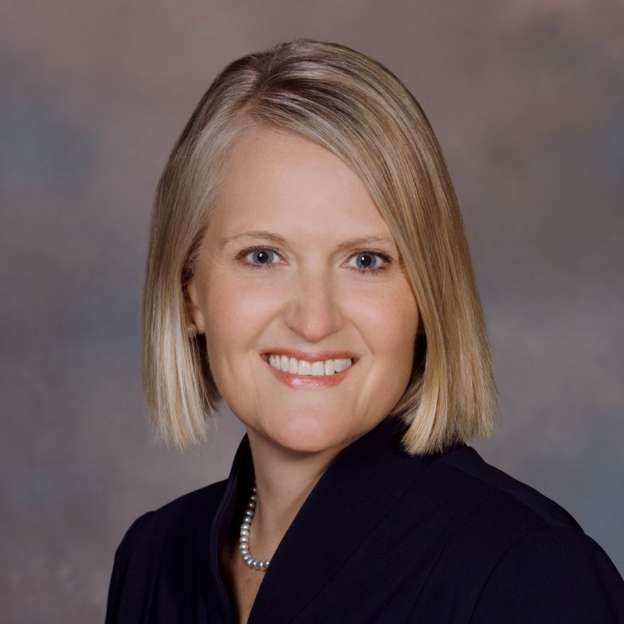
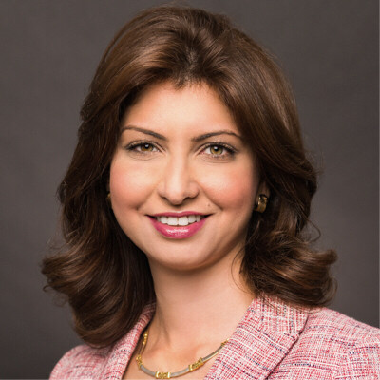
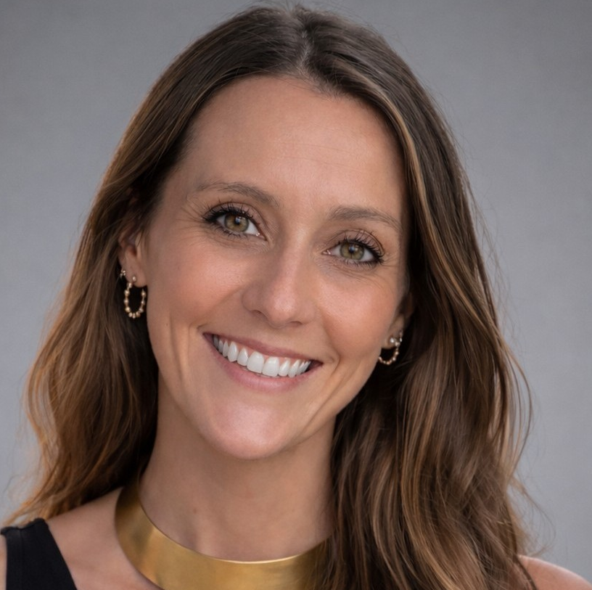
Advancing Early Cancer Detection Education Through Community Connection
Abby Rogers
Executive Vice President
Growth & External Engagement
YMCA of the USA
Nancy Ghattas
Vice President, US Oncology Commercial Franchise Head, Immuno Oncology
AstraZeneca
Moderator: Sarah Petty
Senior Director, Partnerships & Philanthropy
YMCA of the USA

Slide 3

THANK YOU
For additional information about this grant opportunity:
Rya Hooks
Manager, Project Portfolio Implementation
rya.hooks@ymca.net

