Slide 1

BOARD ENGAGEMENT WITH FUNDRAISING
Bill Stanczykiewicz, Ed.D.

Slide 2


Board Engagement with Fundraising
Bill Stanczykiewicz, Ed.D.
Senior Assistant Dean for
External Relations
Clinical Associate Professor
Director & Rosso Fellow,
The Fund Raising School

Slide 3

Fundraising
“The gentle art of teaching the joy of giving!”

Slide 4


Slide 5

Scope | Board Responsibilities
Internal | Determine mission and purpose
 | Strategic planning
 | Evaluate the CEO
 | Oversee programs and services
 | Fiscal control
External | Reduce risk
 | Rolodex / Contact list
 | Donate and fundraise
Legal | Ensure legal compliance
(Miller-Millesen, 2003)

Slide 6
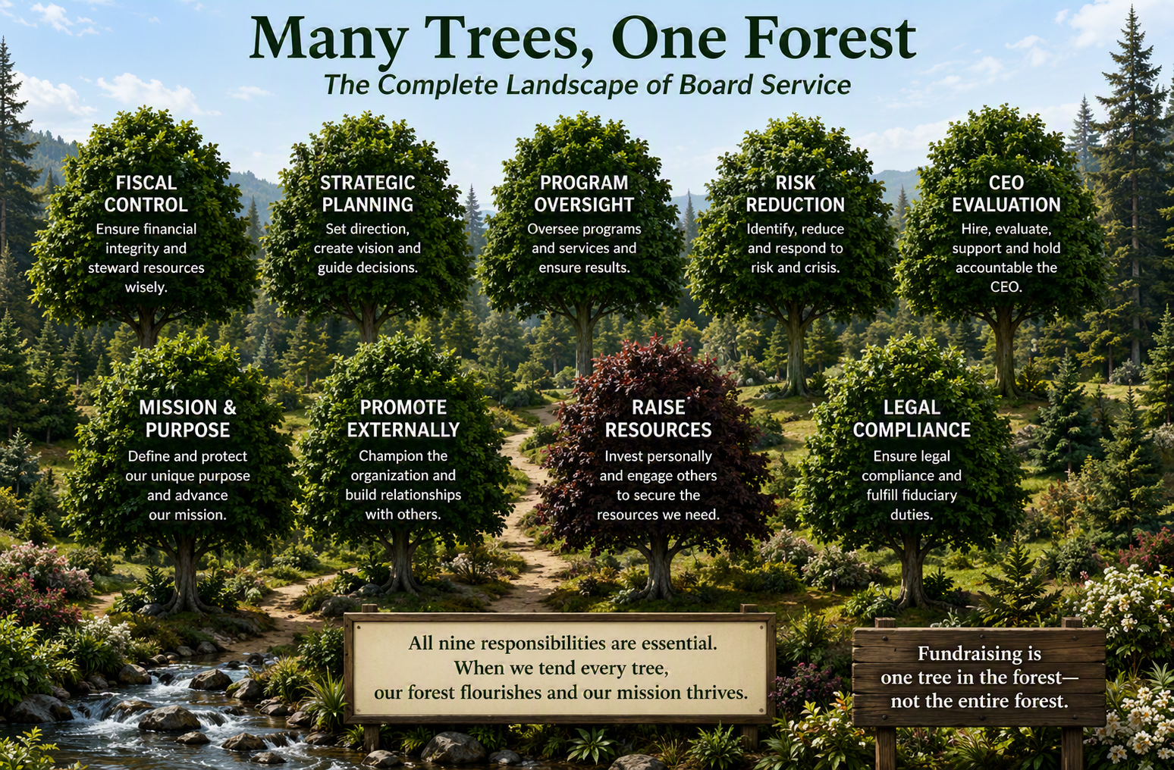

Slide 7
PASSION FOR THE CAUSE
Selective Recruitment&
Retention
Clear Expectations
Fundraising Committee
Research Says…
Peer-to-Peer Influence
Ongoing Engagement
Outreach from
Key Staff
BOARD ENGAGEMENT WITH FUNDRAISING!

Slide 8
1. Selective Recruitment & Retention:
Passion for the Cause
Questions to Ask
What evidence do we have that this prospective board candidate is passionate about our nonprofit’s cause, mission, programs, and impact?
How does the prospective board candidate explain how our nonprofit’s cause matters to them personally?
Does the prospective board member have stories to tell of life-change or community improvement associated with our nonprofit’s cause?
Has the prospective board member volunteered with our nonprofit or a similar nonprofit elsewhere?
What are we observing and learning as the prospective board candidate meets with board leadership and the CEO?
What are we observing and learning as the prospective board candidate visits or otherwise learns about our programs and services?
Is there anyone else we know who can provide additional information about the prospective board member?
(Balduck et al., 2010; Hoye, 2007; Kugel & Mercado, 2024;
Preston & Brown, 2004; Rentschler et al., 2023)

Slide 9
1. Selective Recruitment & Retention
Identify open board seats;
Determine board needs (demographics, skills, other personal attributes);
Maintain an active list of potential board members;
Patiently vet prospective new board members, starting with passion for the cause;
Meet with the prospective board candidate to learn more about their potential strengths associated with serving on the board;
Assess other intangibles associated with team chemistry;
Consider inviting the prospective board candidate to first serve on a board committee;
The board’s governance committee then assesses the gathered information and decides whether or not to recommend the candidate to the full board;
If the board approves: Invite, Welcome, Orient, Celebrate!

Slide 10
1. Selective Recruitment & Retention:
Removing Unengaged Board Members
“If you’re unwilling, then I need to know that. I don’t want to waste your time. We’ll move on to somebody else. Don’t become involved.
“If you feel strongly about not (making a charitable donation), then don’t take a (board) seat from someone who could. Resources are limited, (but) people are plentiful.”
(Stanczykiewicz, 2020)

Slide 11
2. Communicate Expectations
Communication | Result
Expectations for donating and fundraising during new board member orientation | Active board participation in donating and fundraising is 11 times greater
Fundraising Expectations | 94% of nonprofits with full board participation in fund development communicated these expectations
NO Fundraising Expectations | 87% of nonprofits without full board participation in fund development did not communicate expectations
“We try to paint the clearest picture possible of what they’re getting themselves into so that there are no surprises. We go through ten different things that we expect from a board member, and one of them is (charitable) giving.”
(Stanczykiewicz, 2020)

Slide 12
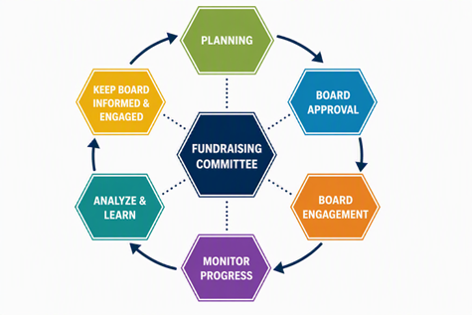
3. Fundraising Committee
Active board participating in donating and fundraising nearly doubles!
“The fundraising committee transforms our nonprofit's fundraising to ‘we’ instead of, ‘the staff is here; the staff does all of the fundraising.’”
(Stanczykiewicz, 2020)

Slide 13
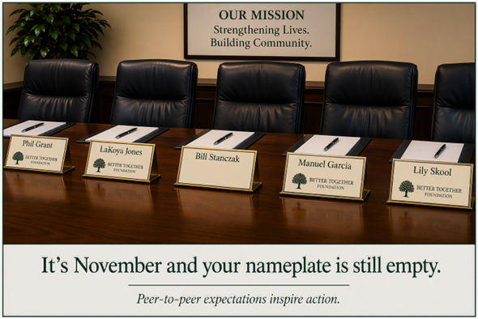
4. Peer-to-Peer Influence
“Board members can (encourage fundraising) and say that once, and it’ll resonate. I (the CEO) could say that 10,000 times, and it won’t. There’s a lot of peer-to-peer communication.”

Slide 14
5. Ongoing Engagement
SELF-FOCUSED
OTHERS-FOCUSED
Enhance my self-worth
To feel important
Gain recognition in the community
To experience self-healing
I eventually want to be hired by this nonprofit
I am retired, unemployed, or otherwise need something to do
My employer expects me to serve on the board
I have friends on the board
Out of loyalty to the nonprofit
Learning more about the cause
Commitment to the mission
Sharing their expertise and professional skills
In ways that are helpful to others
Especially people served by the nonprofit
Advancing the nonprofit's success
While contributing to society
(Miller-Stevens & Ward, 2019)

Slide 15
5. Ongoing Engagement
Mission Moment
“Big Rock” at board meetings
Invites to programs & events
Quarterly luncheons
Donor meetings
Donor stewardship
Apparel
Board retreats
“In this last board meeting, after the mission moment, we had one board member say, ‘I change my pledge.’ In the meeting she (increased) her pledge because she realized just how important her investment is.”
(Stanczykiewicz, 2020)

Slide 16
6. Outreach from Key Staff
BOARD-REGARDING BEHAVIORS | IN PRACTICE | RESULT
Show Respect | Attend meetings and events that are important to the board member | Board member knows you see them as a whoe person, not as someone obligated to help your nonprofit
Consistent Interactions | Meet with board members in-person between board meetings | Board members stay engaged, and their prospective donor list stays active
Promote Innovation | Provide board members with advanced notice of the “big rock” for the next board meeting | Board members can prepare and then thoughtfully participate in the next board meeting
Celebrate Board Member Accomplishments | Contact board members with their donor provides a gift | No board members ever complained about being thanked or celebrated too often!
Time Information | Communicate with board members based on their preferences | Board members appreciate seamless and accessible info
“That's the first time somebody has said, ‘Hey, here's some tickets for you. Why don't you come and join us?’ It's nice to be recognized without somebody just always expecting something from you.”
(Herman & Heimovics, 1990; Stanczykiewicz, 2020)

Slide 17
Board Member Resistance & Possible Solutions

Slide 18
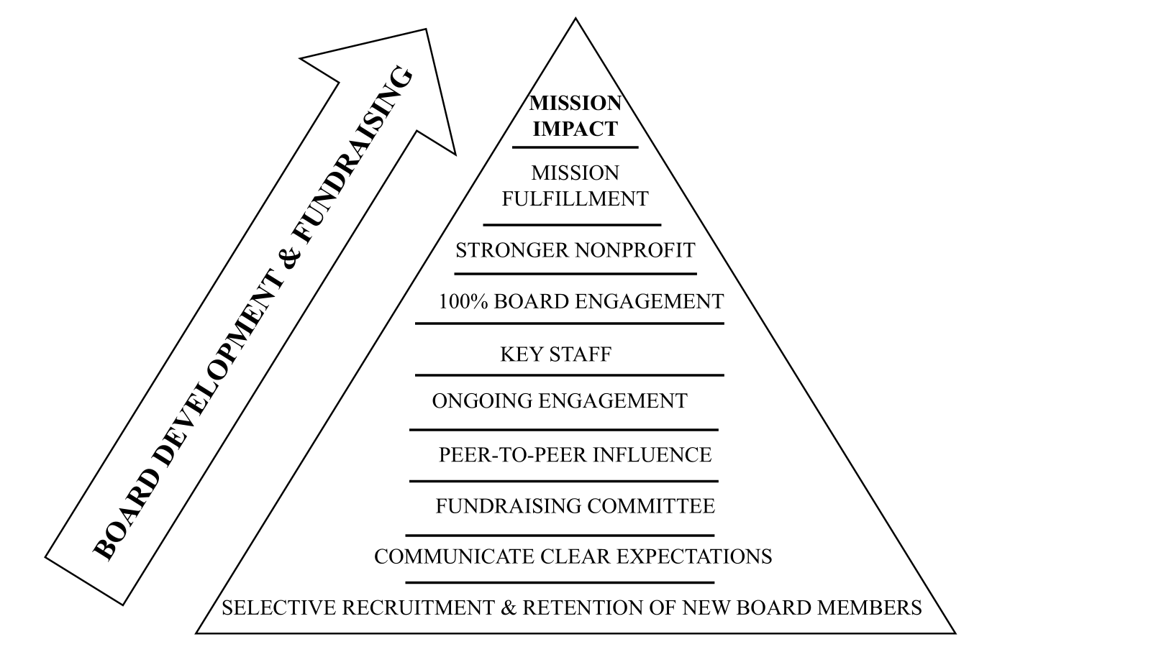

Slide 19
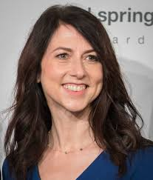
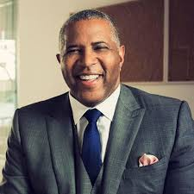
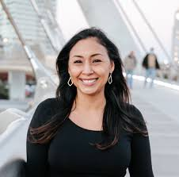
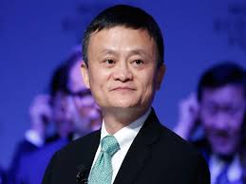
Board Structure, Composition, & Practices
Board size
Board composition (Representation)
How many board meetings
Fundraising training
Staff engagement with the board and board committees
Board assessment

Slide 20
Board Engagement with Fundraising
FUNDRAISING | BOARD ROLE
Organizational Readiness | Ensure program fidelity to the strategic plan; approve budget & fundraising plan
Annual Fund | Donate; Prospect list; Introductions to prospects
Donor Stewardship | Thank you notes, emails, phone calls; in-person meetings
Major Gifts | Help qualify prospects; attend donor meetings; tell “Miracle Moment” stories
Fundraising Campaigns | Approve campaign plan; campaign donation; attend meetings with lead donors
Planned Giving | Approve additional training as needed; pledge or make a planned gift

Slide 21


Slide 22

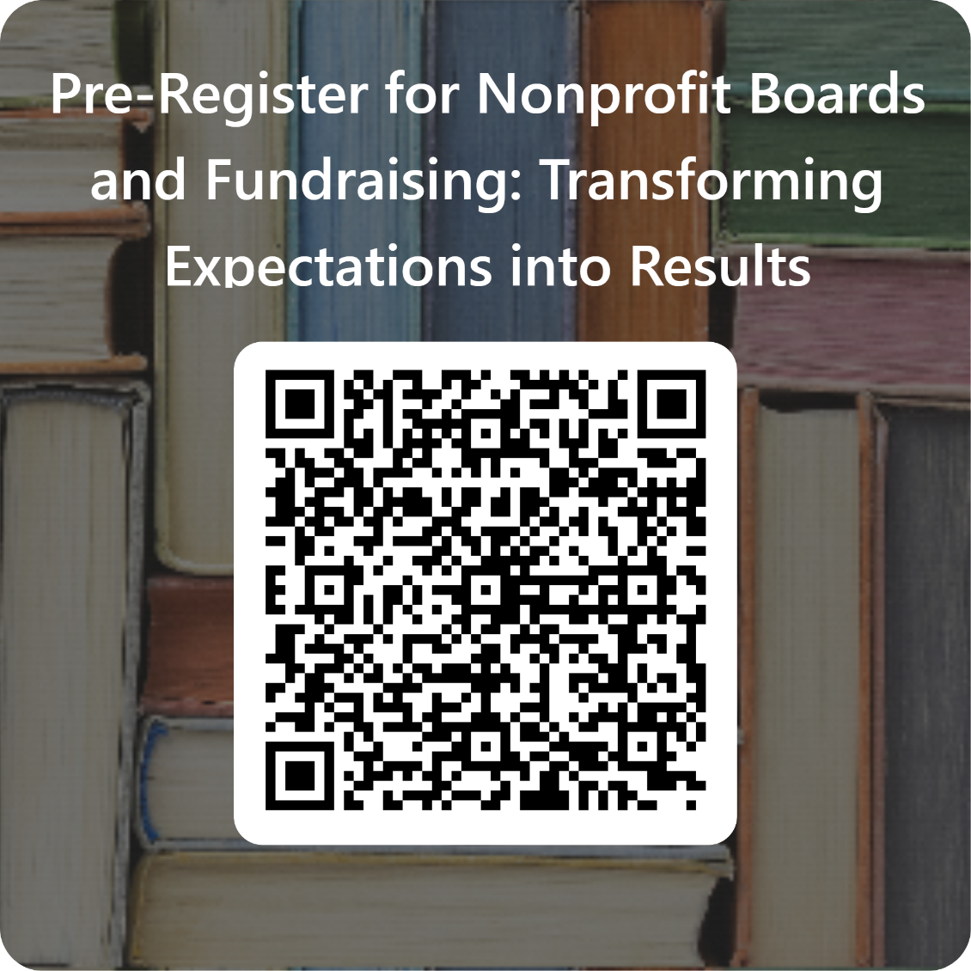
For more information,
please contact
The Fund Raising School
TFRS@iu.edu
Thank You.
philanthropy.indianapolis.iu.edu

