Slide 1

Amplifying Impact Through
Purpose-Driven Board Leadership
Tara Huffman, JD

Slide 2
Amplifying Impact Through
Purpose-Driven Board Leadership
Tara Huffman, JD
Chief Program & Strategy Officer

Slide 3
About BoardSource
Our mission is to inspire and support nonprofit boards and executives to lead justly and with purpose.
We engage over 1 million leaders annually through our resources and programs. BoardSource is also a respected thought leader in the social sector, a position we leverage to amplify critical issues that we think need more attention from nonprofit boards.

Slide 4
Session Objectives
Delve into the Four Principles of Purpose-Driven BoardLeadership (PDBL) framework and examples of its implementation
Explore ways to apply the framework to amplify the impact Ys are having in their local jurisdictions and across the nation
Share perspectives, ideas, and questions—your feedback will support your peers and inform our resources and approach.

Slide 5
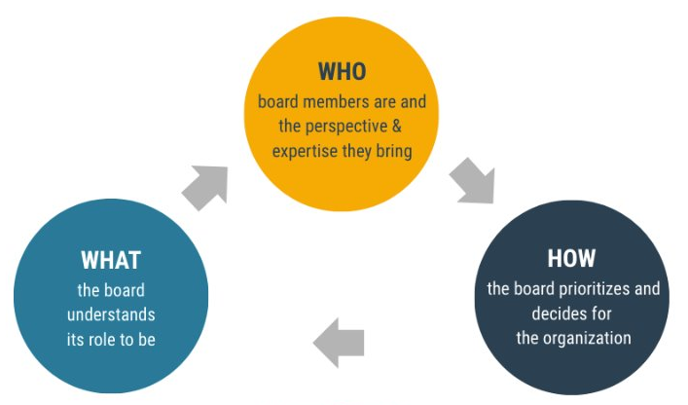
Role Understanding is Fundamental

Slide 6
The Board's Essential Roles
Setting Direction
& Strategy
Ensuring
Resources
Providing
Oversight
  Commitment to mission and purpose
  Understanding of priority areas of work and communities served
  Cultivated ability to do sensemaking and strategic thinking as a collective
  Understanding of purpose and context to confidently select and support a capable CEO
  Understanding of financial strategy and business model
  Ability to bring resources and connections to the organization through networks
  Understanding of purpose and context to confidently select and support a capable CEO
  Understanding of financial strategy and business model
  Ability to bring resources and connections to the organization through networks

Slide 7
The Board's Essential Roles
Setting Direction
& Strategy
Ensuring
Resources
Providing
Oversight
Safeguarding and Sustaining the Organization

Slide 8
The Board's Essential Roles
Setting Direction
& Strategy
Ensuring
Resources
Providing
Oversight
Leveraging the Organization for Impact

Slide 9
10 Basic Responsibilities of Nonprofit Boards
1. Determine mission and purposes, and advocate for them.
2. Select the chief executive.
3. Support and evaluate the chief executive.
4. Ensure effective planning.
5. Monitor and strengthen programs and services.
6. Ensure adequate financial resources.
7. Protect assets and provide financial oversight.
8. Build and sustain a competent board.
9. Ensure legal and ethical integrity.
10. Enhance the organization’s public standing.

Slide 10
The State of Boards 2024
Disconnected from communities/people they serve
43.5% of chief executives say they don’t have the right board members to establish trust in the communities they serve
33% of boards place a high priority on “knowledge of community served”
29% prioritize “membership within the community we serve”
Ill-informed about the ecosystems in which they operate
28% of boards prioritize “knowledge of the organization’s work/field” in board recruitment
Not demographically representative
2/3 of board members are from the same demographics
No longer prioritizing fundraising above everything else
2024 LWI data shows that setting strategy is now a higher priority than fundraising, for the first time.

Slide 11
An Opportunity for Reinvention

Slide 12
Three Modes of Governance
The Governance as Leadership Framework
Strategic
Fiduciary
Generative
The Board’s Oversight Role
Are we doing what we said we would do?
Do we have appropriate systems and controls?
The Board’s Planning Role
What impact do we want to have in the next 5 years?
How should we prepare for a significant change that we are facing as an organization?
The Board’s Sensemaking Role
Who are we?
What’s most important to us?
What are the most important questions facing us as an organization?
The Board’s Sensemaking Role
Who are we?
What’s most important to us?
What are the most important questions facing us as an organization?

Slide 13
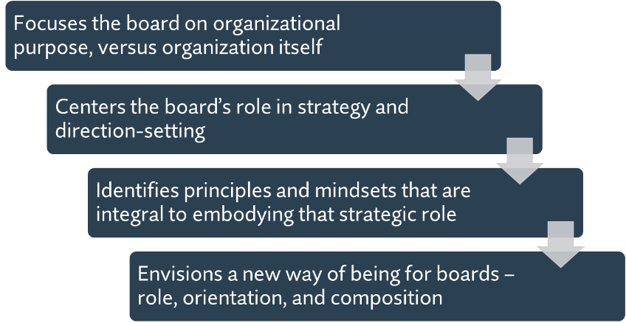
A New Framework for the Board’s Role:
Purpose-Driven Board Leadership
The Board’s Sensemaking Role
Who are we?
What’s most important to us?
What are the most important questions facing us as an organization?

Slide 14
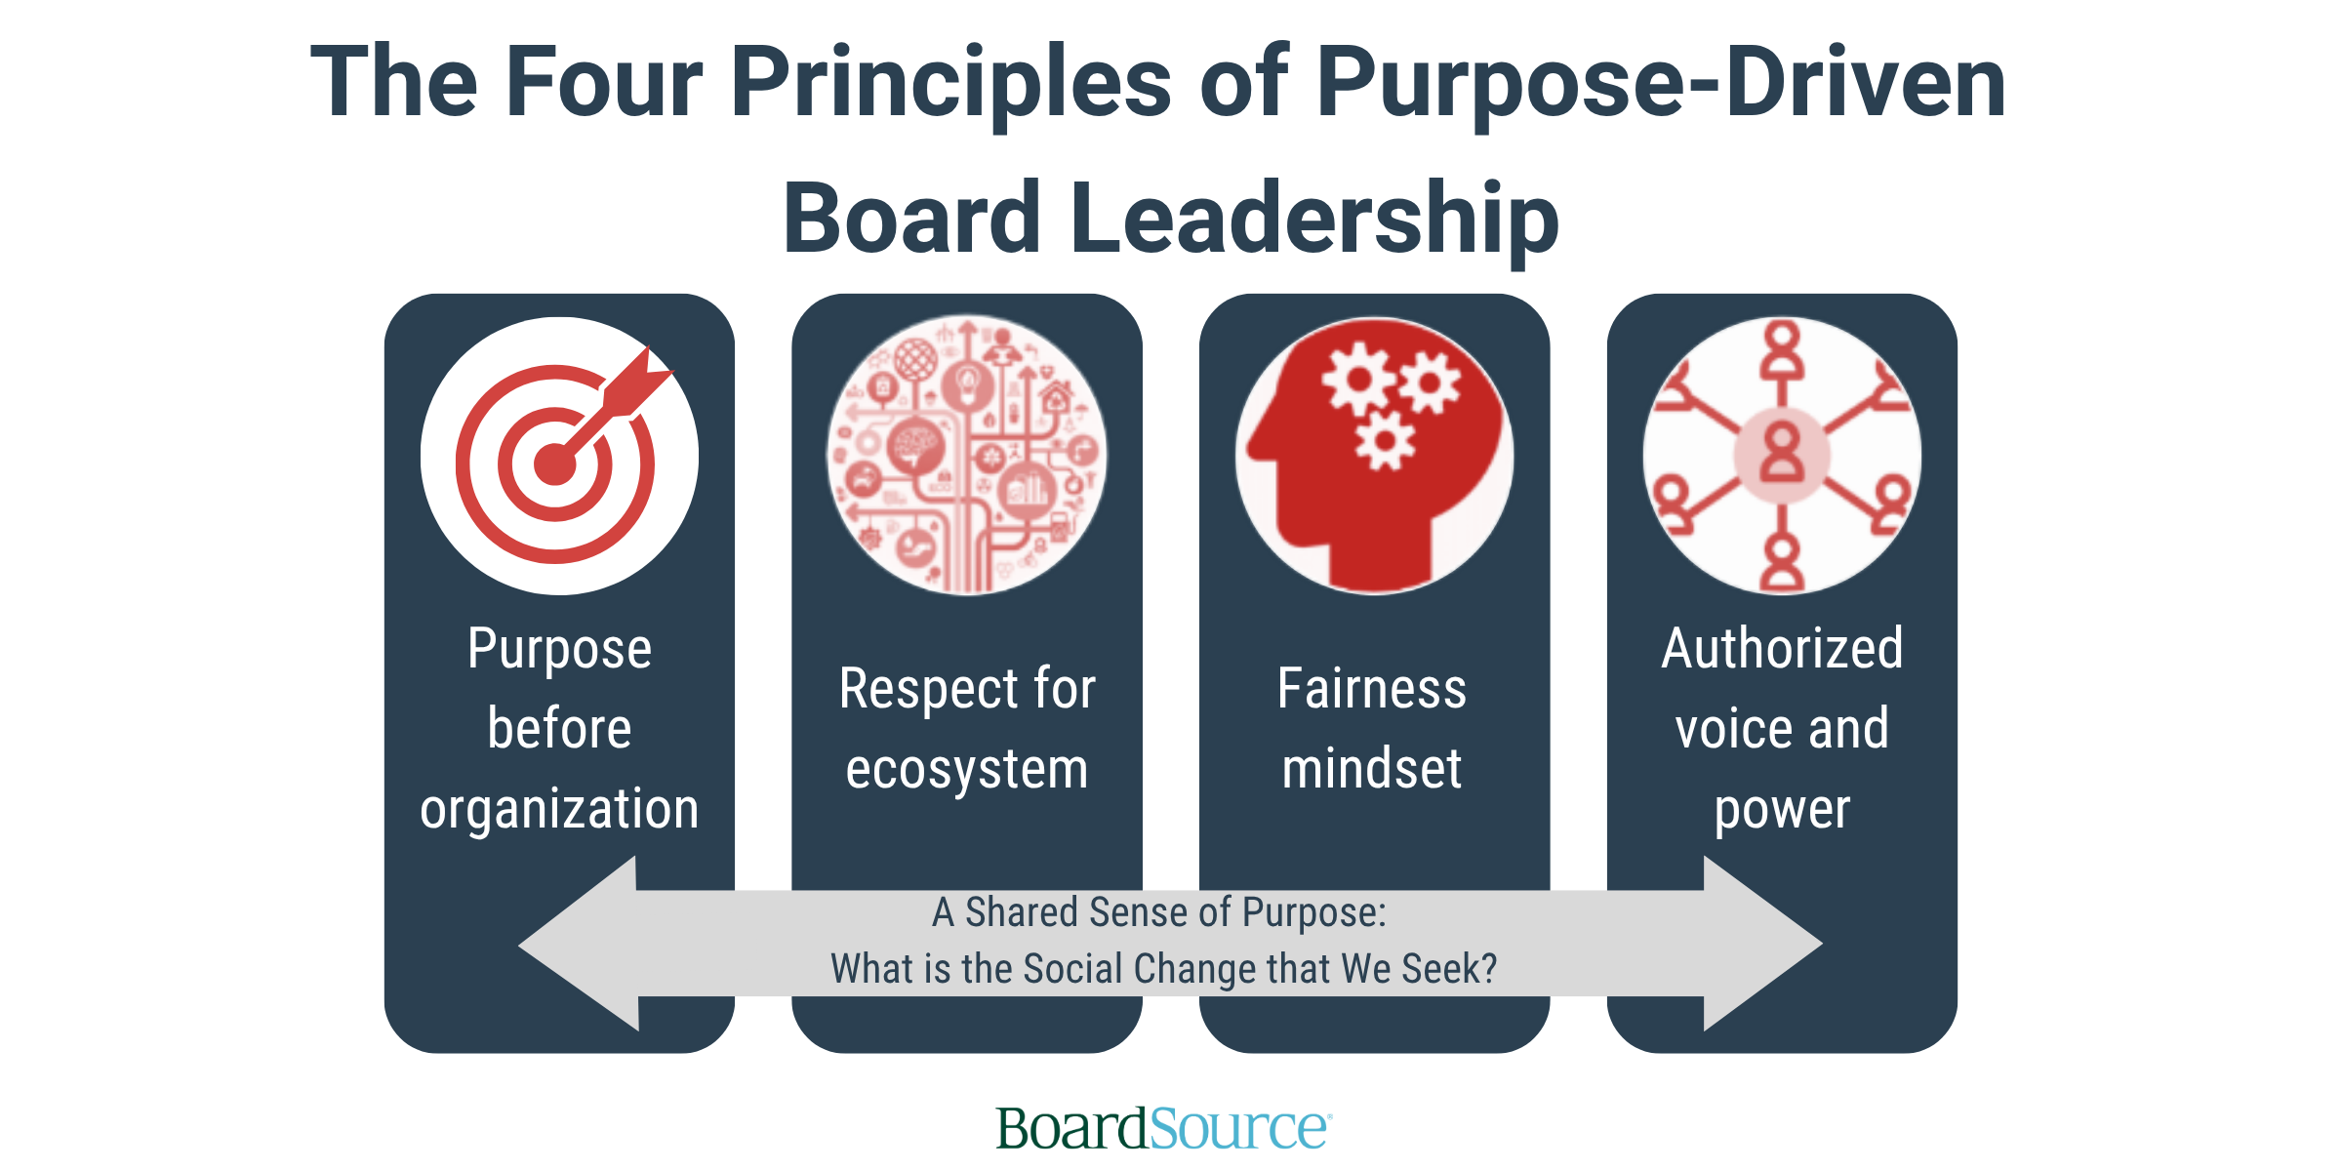

Slide 15
What is Your Organization’s Purpose?
What problem are we trying to solve or what new reality are we trying to create?​
Why were we founded and why do we exist today?​
What is “the why” for your organization’s work?​

Slide 16
Principle #1: Purpose before Organization
Definition: Prioritizing the organization’s purpose, versus the organization itself.
Moves the organization away from viewing itself as the “center of its own gravity;” focuses the organization on its collective purpose and how it can best steward its resources in service to that purpose
“Purpose before Organization” scenario: When faced with a freeze on federal funding and threats of massive cuts, a victim services organization teamed up with other organizations that serve the same population to create a single message and meet with foundation officers, local and state elected leaders, and the media to ensure all were aware of the impact of the loss of funding on the broader community.

Slide 17
Principle #1: Purpose before Organization
What’s best for our organization?
What’s best for the desired social outcome we seek?

Slide 18
The Four Principles of
Purpose-Driven Board Leadership
Purpose before organization
Respect for ecosystem
A Shared Sense of Purpose:
What is the Social Change that We Seek?

Slide 19
Principle #2: Respect for Ecosystem
Definition: Acknowledgement that the organization’s actions can positively or negatively impact its surrounding ecosystem, and a commitment to being a respectful and responsible ecosystem player.
Requires boards to:
Have knowledge and perspective of the organization’s role as part of a collection of organizations working to address societal challenges and impacts.
Consider the impact of their actions on the ecosystem as part of decision-making processes.
“Respect for Ecosystem” scenario: a housing development organization is selling property that provides affordable housing. It could sell to the highest bidder, knowing that the developer wants to offer high-end condos. For a lower bid, it could sell it to another housing development organization that will provide housing and services to current tenants or others who meet the same criteria. A traditional framing of the board’s role might lead the board to accept the highest bid as aligned with their financial policies. A purpose-driven frame would lead to board to consider selling to the other housing organizations as aligned with the collective purpose of their eco-system.

Slide 20
Principle #2: Respect for Ecosystem
How would this impact our organization?
How would this impact all of the players and dynamics within our ecosystem? Will it help us – as an ecosystem – do the most good?

Slide 21
Reflection Questions
  What resonated with you?
  Where do you have questions, concerns, or pushback?
  What aspects of Purpose-Driven Board Leadership do you think would feel more or less natural to your board?
Purpose before organization
Respect for ecosystem

Slide 22
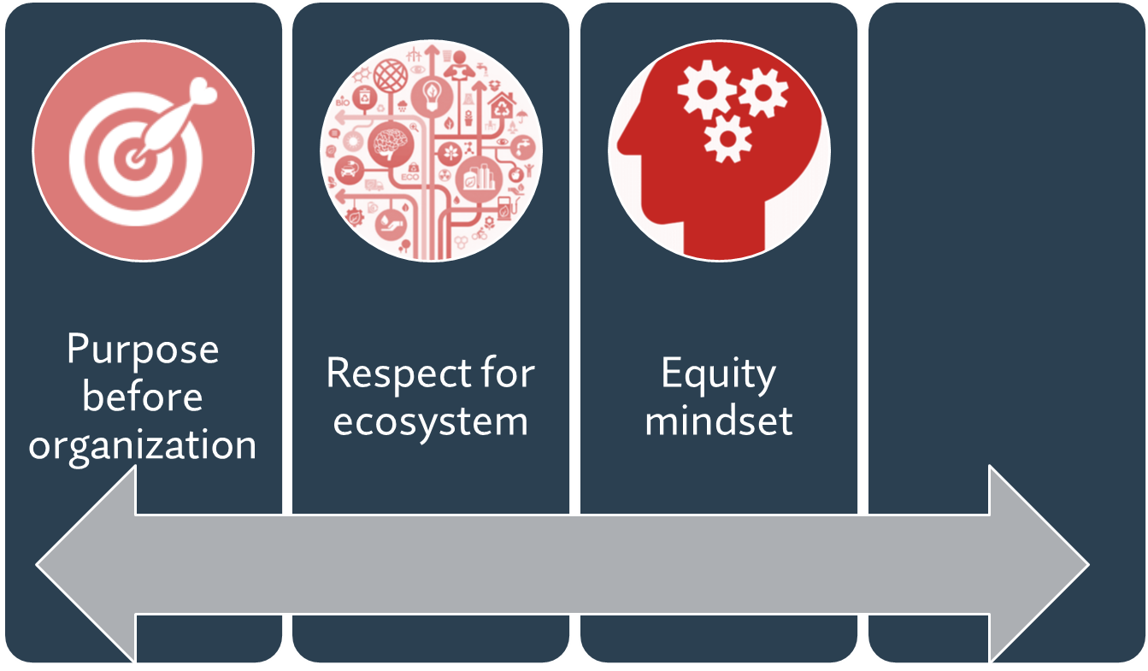
The Four Principles of
Purpose-Driven Board Leadership
Fairness
mindset
A Shared Sense of Purpose:
What is the Social Change that We Seek?

Slide 23
Principle #3: Fairness Mindset
Definition: A commitment to advancing outcomes that result in opportunities for all, and interrogating and avoiding the ways in which the organization’s strategies and work may reinforce systemic unfairness.
Capture disparate impacts across various domains, including:
The fair allocation of organizational resources
Programmatic oversight that can capture disparate impacts on certain populations
Strategic and effective board composition
“Fairness Mindset” scenario: While reviewing its long‑term strategy, a board realized that many of its priorities consistently benefited the same groups—those easiest to reach and fund. Over time, this shaped who benefited from the organization’s work. A fairness mindset led the board to pause and ask who the strategy was really working for, and whether its choices were reinforcing uneven outcomes or helping to reduce them.

Slide 24
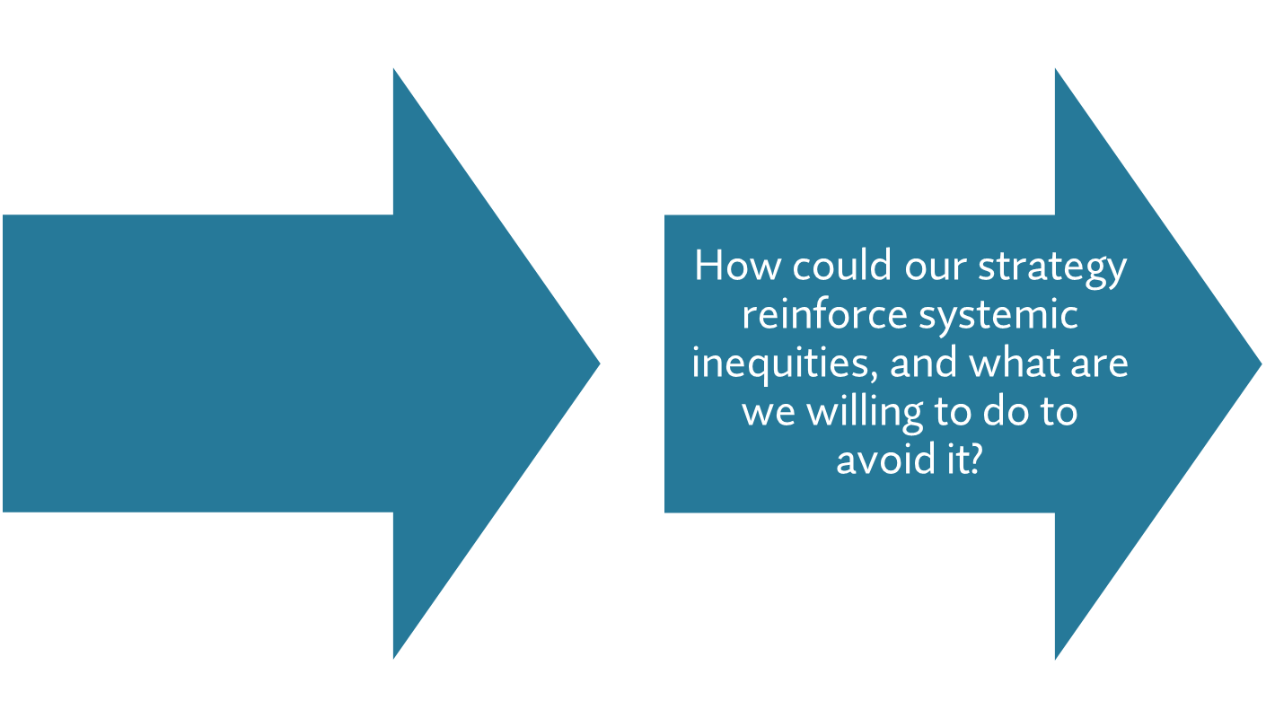
Principle #3: Fairness Mindset
How could our strategy lead to unfair outcomes and what are we willing to do to correct that?
How will our strategy advance our mission?

Slide 25
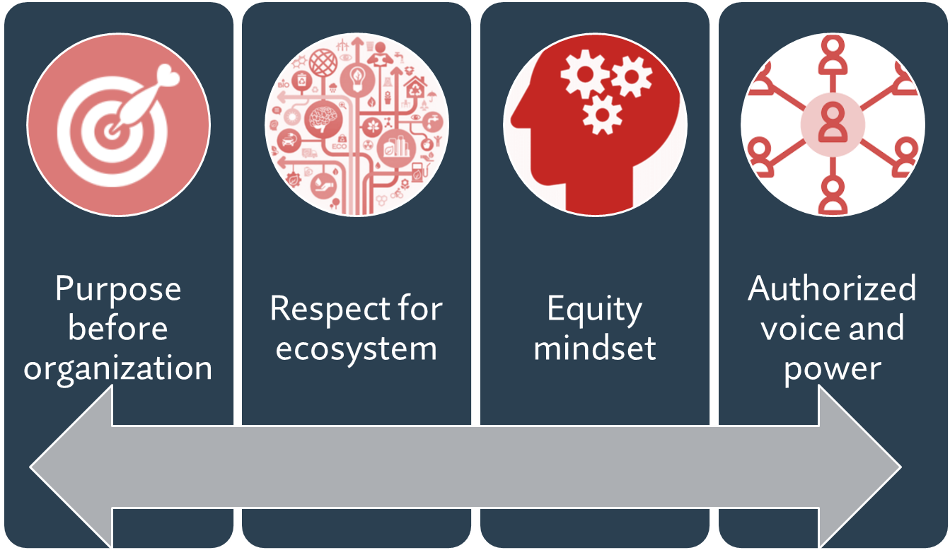
The Four Principles of
Purpose-Driven Board Leadership
Fairness mindset
A Shared Sense of Purpose:
What is the Social Change that We Seek?

Slide 26
Principle #4: Authorized Voice & Power
Definition: A recognition that organizational power and voice must be authorized by those most impacted by the organization’s work.
Organizational decisions should be made within the context of real understanding of community assets, needs, preferences, and aspirations.
Requirement to listen to community needs and experiences – and to share power by inviting those individuals with relevant lived experiences onto the board
“Authorized Voice and Power” scenario: : A Federally Qualified Health Center had been meeting the legal requirement of the patients on the board by having a percentage of current board members become patients rather than as intended. They hired a new chief executive who insisted they recruit board members from current patients, resulting in the board being more reflective of the population they serve, the larger community and ensuring the board deliberation included input from those with lived experience.

Slide 27
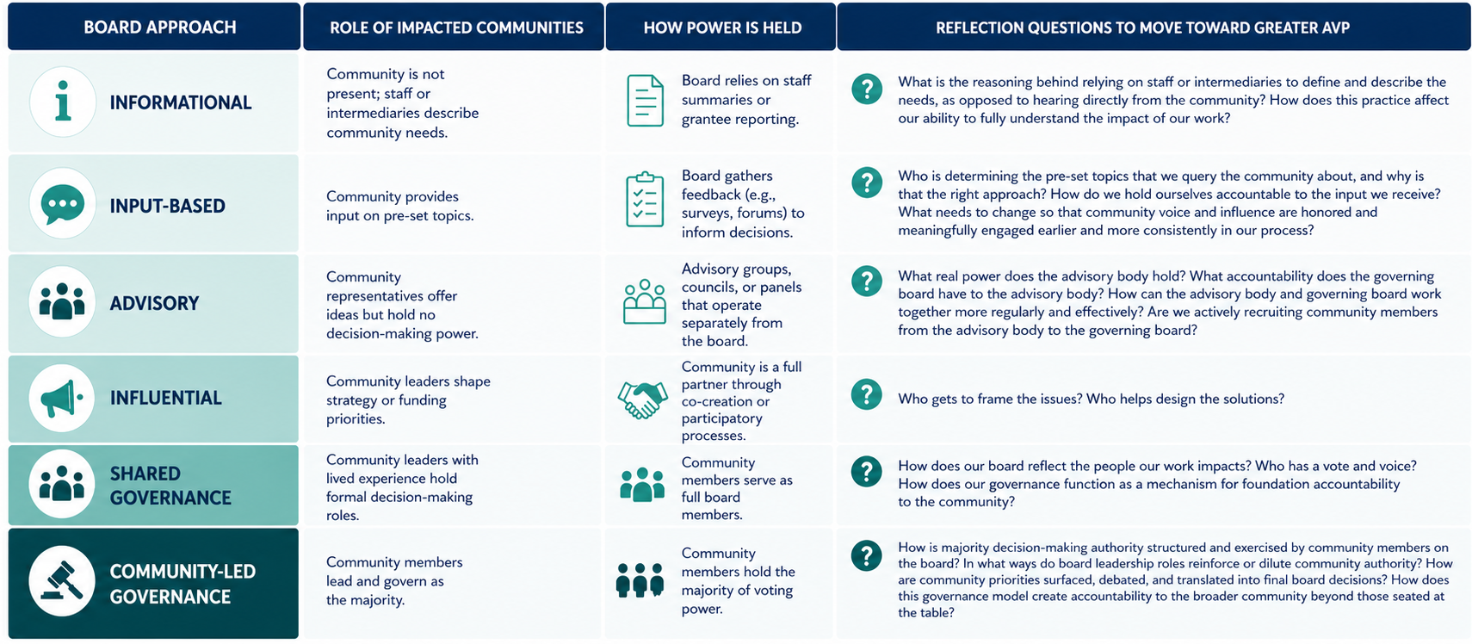

Slide 28
Principle #4: Authorized Voice & Power
Are we as a board populated in a way that ensures our power is held by the community impacted by the org’s work? Are we doing all we can to understand what our programmatic stakeholders tell us is most important?
What do we* think is best?
*without intentional reflection on how who “we” are informs our perspective

Slide 29
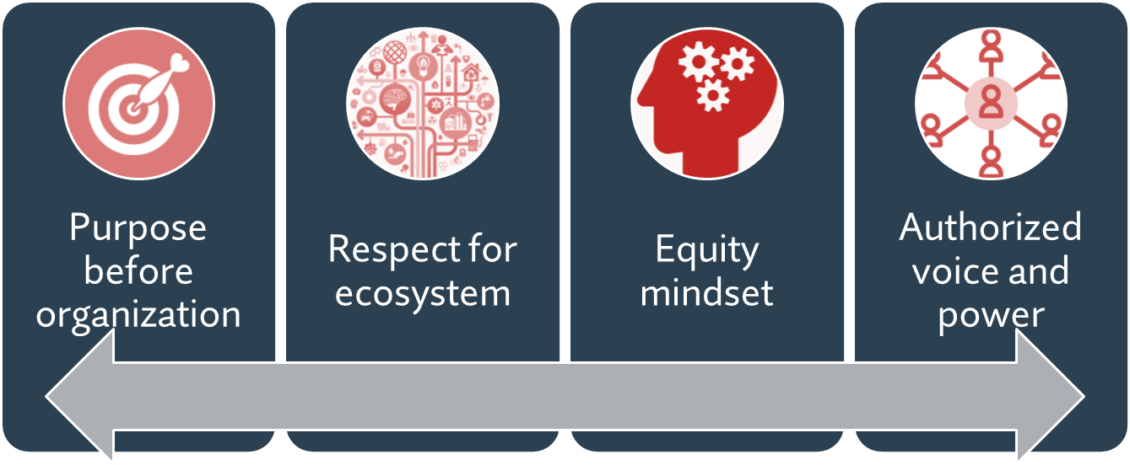
Reflection Questions
  What resonated with you?
  Where do you have questions, concerns, or pushback?
  What aspects of Purpose-Driven Board Leadership do you think would feel more or less natural to your board?
Fairness mindset

Slide 30
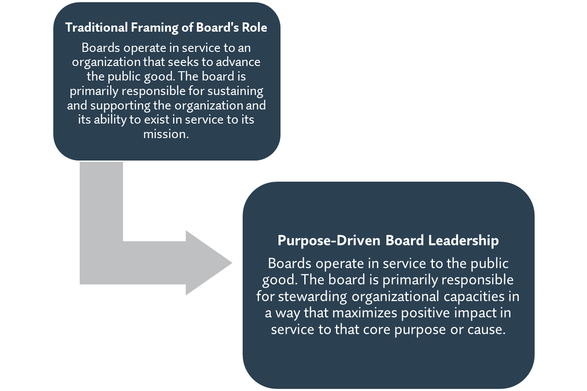
A New Orientation to Board Service

Slide 31
Purpose-Driven Board Leadership
Determine and advocate mission and purpose
Select the CEO
Support/ Evaluate CEO
Ensure effective planning
Monitor/strengthen programs and services
Ensure adequate resources
Protect assets/
provide financial oversight
Build/sustain a competent board
Ensure legal/ethical integrity
Enhance organization’s public standing

Slide 32
10 Basic
Responsibilities
3 Modes of
Governance
Applying a Purpose-Drive Board Leadership Lens

Slide 33


Rethinking Board Recruitment

Slide 34
Reframing Board Recruitment
Needed from All
Commitment to mission, purpose, and the people and communities served by the organization
Reputational capital that cultivates trust amongst community stakeholders
Willingness to dedicate time and energy to fulfill responsibilities and commitments
Relational skills to operate effectively in the collective

Slide 35
Reframing Board Recruitment
Needed from All
Commitment to mission, purpose, and the people and communities served by the organization
Needed from Most
Grounded insights and perspectives about the work the organization does and the people and communities it serves
Ability to connect the organization with individuals, organizations, and communities of influence (policymakers, programmatic partners, community-based leaders, and donors)
Reputational capital that cultivates trust amongst community stakeholders
Deep understanding of the organization’s programmatic and business model
Understanding of the ecosystems in which the organization is operating
Relational skills to operate effectively in the collective
Willingness to dedicate time and energy to fulfill responsibilities and commitments

Slide 36
Reframing Board Recruitment
Needed from All
Commitment to mission, purpose, and the people and communities served by the organization
Needed from Most
Grounded insights and perspectives about the work the organization does and the people and communities it serves
Ability to connect the organization with individuals, organizations, and communities of influence (policymakers, programmatic partners, community-based leaders, and donors)
Needed from Some
Ability to connect the organization with big donors/funders
Ability to provide specialized expertise in areas of relevance to legal, financial, and employment oversight
Reputational capital that cultivates trust amongst community stakeholders
Deep understanding of the organization’s programmatic and business model
Understanding of the ecosystems in which the organization is operating
Relational skills to operate effectively in the collective
Willingness to dedicate time and energy to fulfill responsibilities and commitments

Slide 37

Thank you for your time and leadership!
  Scan to learn more about BoardSource Membership

