Slide 1

BOUNDARY SPANNING LEADERSHIP
Preston Yarborough

Slide 2

Boundary Spanning Leadership
YMCA General Assembly
September, 2026
New Orleans, LA

Slide 3


What we will explore today…
What is boundary spanning leadership?
What kinds of boundaries impact us?
What strategies can help us span boundaries more effectively?
© Center for Creative Leadership. All rights reserved.
3
Creative #: 1392016982
Notes:
0:02
Session Overview
Quickly share the primary learning questions listed on the slide.

Slide 4

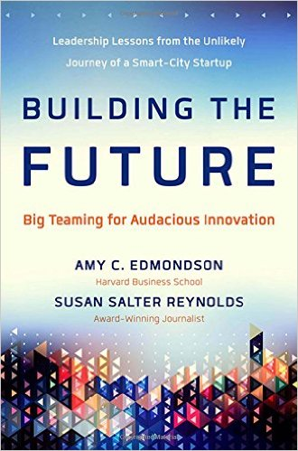
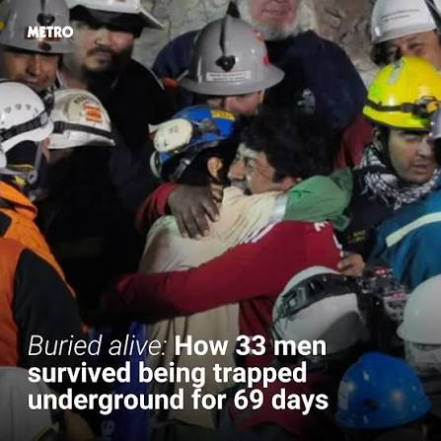
Notes:
0:05

Slide 5

Boundary Spanning Leadership
We span boundaries when we solve problems by reaching out to other groups who have fresh insights. Some boundaries may be as simple as working with people in a different department or as complex as working across cultures, time zones and languages.
*Yip, J., Ernst, C., & Campbell, M. (2009). Boundary Spanning Leadership: Mission critical perspectives
from the executive suite. A Center for Creative Leadership Organizational Leadership White Paper.
Notes:
0:06

Slide 6
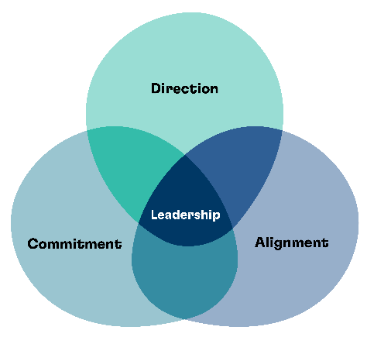
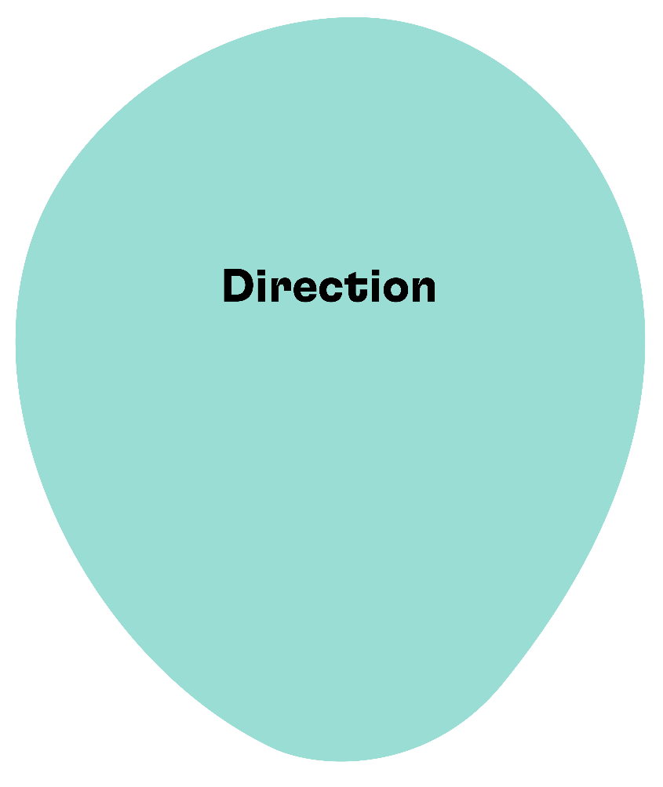
Leadership Outcomes
Direction: Agreement in
the group on overall goals
Notes:
0:09
Leadership Outcome – Direction
The first outcome is Direction which is the agreement in the group on the overall goals.
We agree on what we intend to accomplish together.
We have a clear vision of what the group needs to achieve.
When groups have a strong Direction, all members have a shared understanding of what success looks like and agree on what to accomplish together.
Shared understanding and agreement of goals does not mean that all members of the group have participated in setting the direction.
If there is no shared understanding of the direction and people don’t agree on what it is the group is trying to accomplish, it will be difficult to work together as a cohesive group.
It is not enough for one person or a subset of people to set the direction – a process of communicating and discussing that direction with ALL members is needed so that it is widely agreed upon and understood.
Invite participants to answer the following questions:
How can you achieve widespread agreement on direction, even when you as the leader, or a small group, had determined the direction?
Solicit response from the class.
Invite participants to respond to the following questions: (includes an EDI lens)
Who is involved in setting direction? Who is not?
How do we involve/engage others in the process?
How do we get to the core motivation for each person?
6

Slide 7
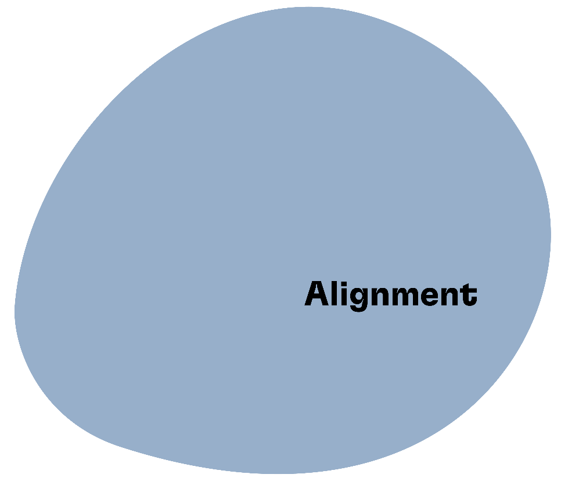
Leadership Outcomes
Alignment:
Coordinated work within the group
Notes:
0:09
Leadership Outcome – Alignment
The second outcome is Alignment which is effective coordination and integration of work so that it fits together.
Although individuals take on different tasks in the group, their combined work fits together.
The work of each individual is well coordinated with the work of others.
When there is alignment, team members with different tasks, roles, and/or expertise coordinate their work so that they operate smoothly together. There is no duplication of effort or working at cross purposes. Alignment is often the “messiest, most difficult” part of the process. Alignment is affected by the size of the group and/or complexity of the direction or goal.
Invite participants to respond to the following questions: (includes EDI lens)
How do we coordinate so that there is interdependence, not division?
What different groups do we need to connect with?
How do we deal with conflict when differences clash?
7

Slide 8
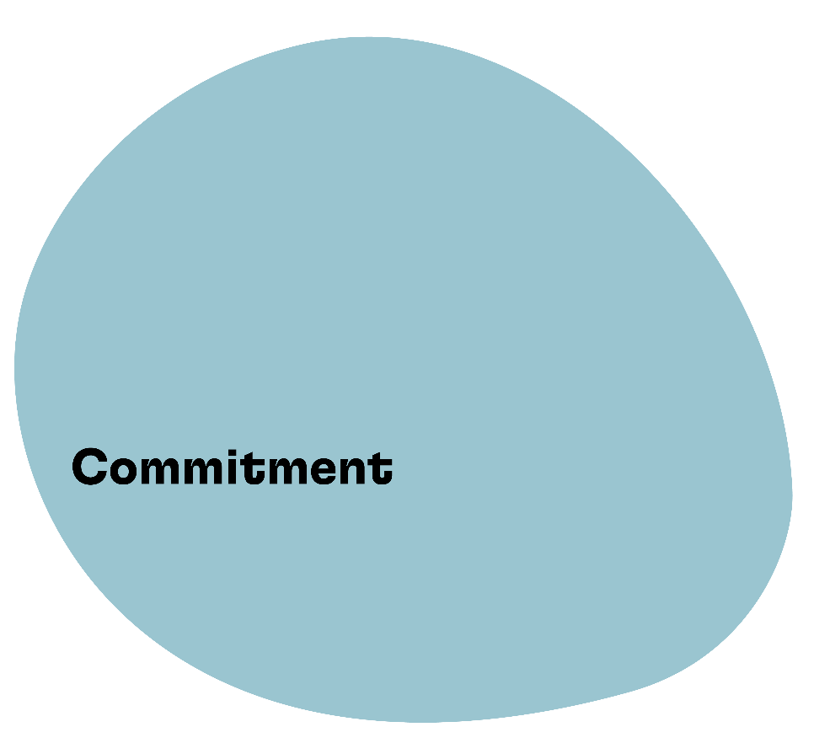
Leadership Outcomes
Commitment:
Mutual responsibility
for the group
Notes:
0:09
Leadership Outcome – Commitment
The third outcome is Commitment. Commitment is the mutual responsibility for the success and wellbeing of the group.
People in the group are committed to the group.
They take responsibility for the welfare of the group members.
When you have commitment, group members feel responsible for the group as a whole and not just their individual interests.
Commitment requires trust and will allow the group to stick together in difficult times. When there is high commitment in the group, members are willing to give “discretionary effort” to make the success and wellbeing of the collective a priority.
It is important to note that we are not talking about commitment to the Direction. If you have engaged people in the process of creating a shared Direction, then commitment to the Direction is “baked into the process”. With Commitment, we are talking about commitment to the group (organization, department, project team) over personal interests.
Invite participants to respond to the following questions: (includes EDI lens)
How do we develop connection and interdependence?
How are all included? What are the barriers to inclusion?
How do we get buy-in and participation in the process?
8

Slide 9

Leadership
Notes:
0:09
Leadership
When a group has all 3 of these DAC outcomes present then they have effective leadership.
Direction, Alignment, and Commitment is what enables people to work together as a cohesive group to produce collective results.
Think back to the group experience you shared with a partner earlier. As you think back on that experience, raise your hand in response to the following questions:
Does your group have strong agreement on direction?
Strong coordination of work?
High levels of mutual commitment to the group?
Transition Statement
Let’s take a closer look at what happens when one of the DAC elements is missing. As we review each element, think about group experience that you have had where one of these outcomes was not met.
9

Slide 10

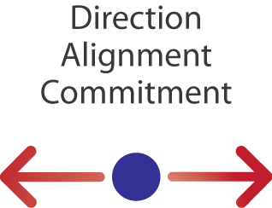
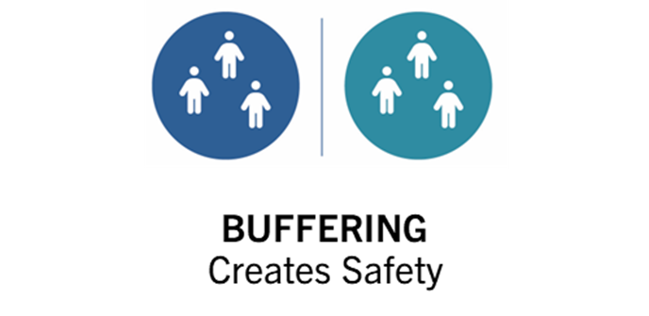
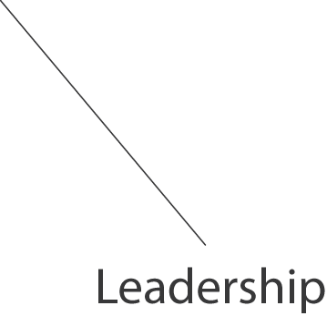

Boundary Spanning Leadership
is the capability to create direction, alignment, and commitment across boundaries in service of a higher vision or goal.
Yip, J., Ernst, C., & Campbell, M. (2009). Boundary Spanning Leadership: Mission critical perspectives from the executive suite. A Center for Creative Leadership Organizational Leadership White Paper.
Notes:
0:12
Boundary Spanning Leadership
Boundary spanning leadership is the capability to create direction, alignment, and commitment across boundaries in service of a higher vision or goal.
Facilitator note: Don’t discuss DAC in any depth unless this is the first time they have heard of it.

Slide 11
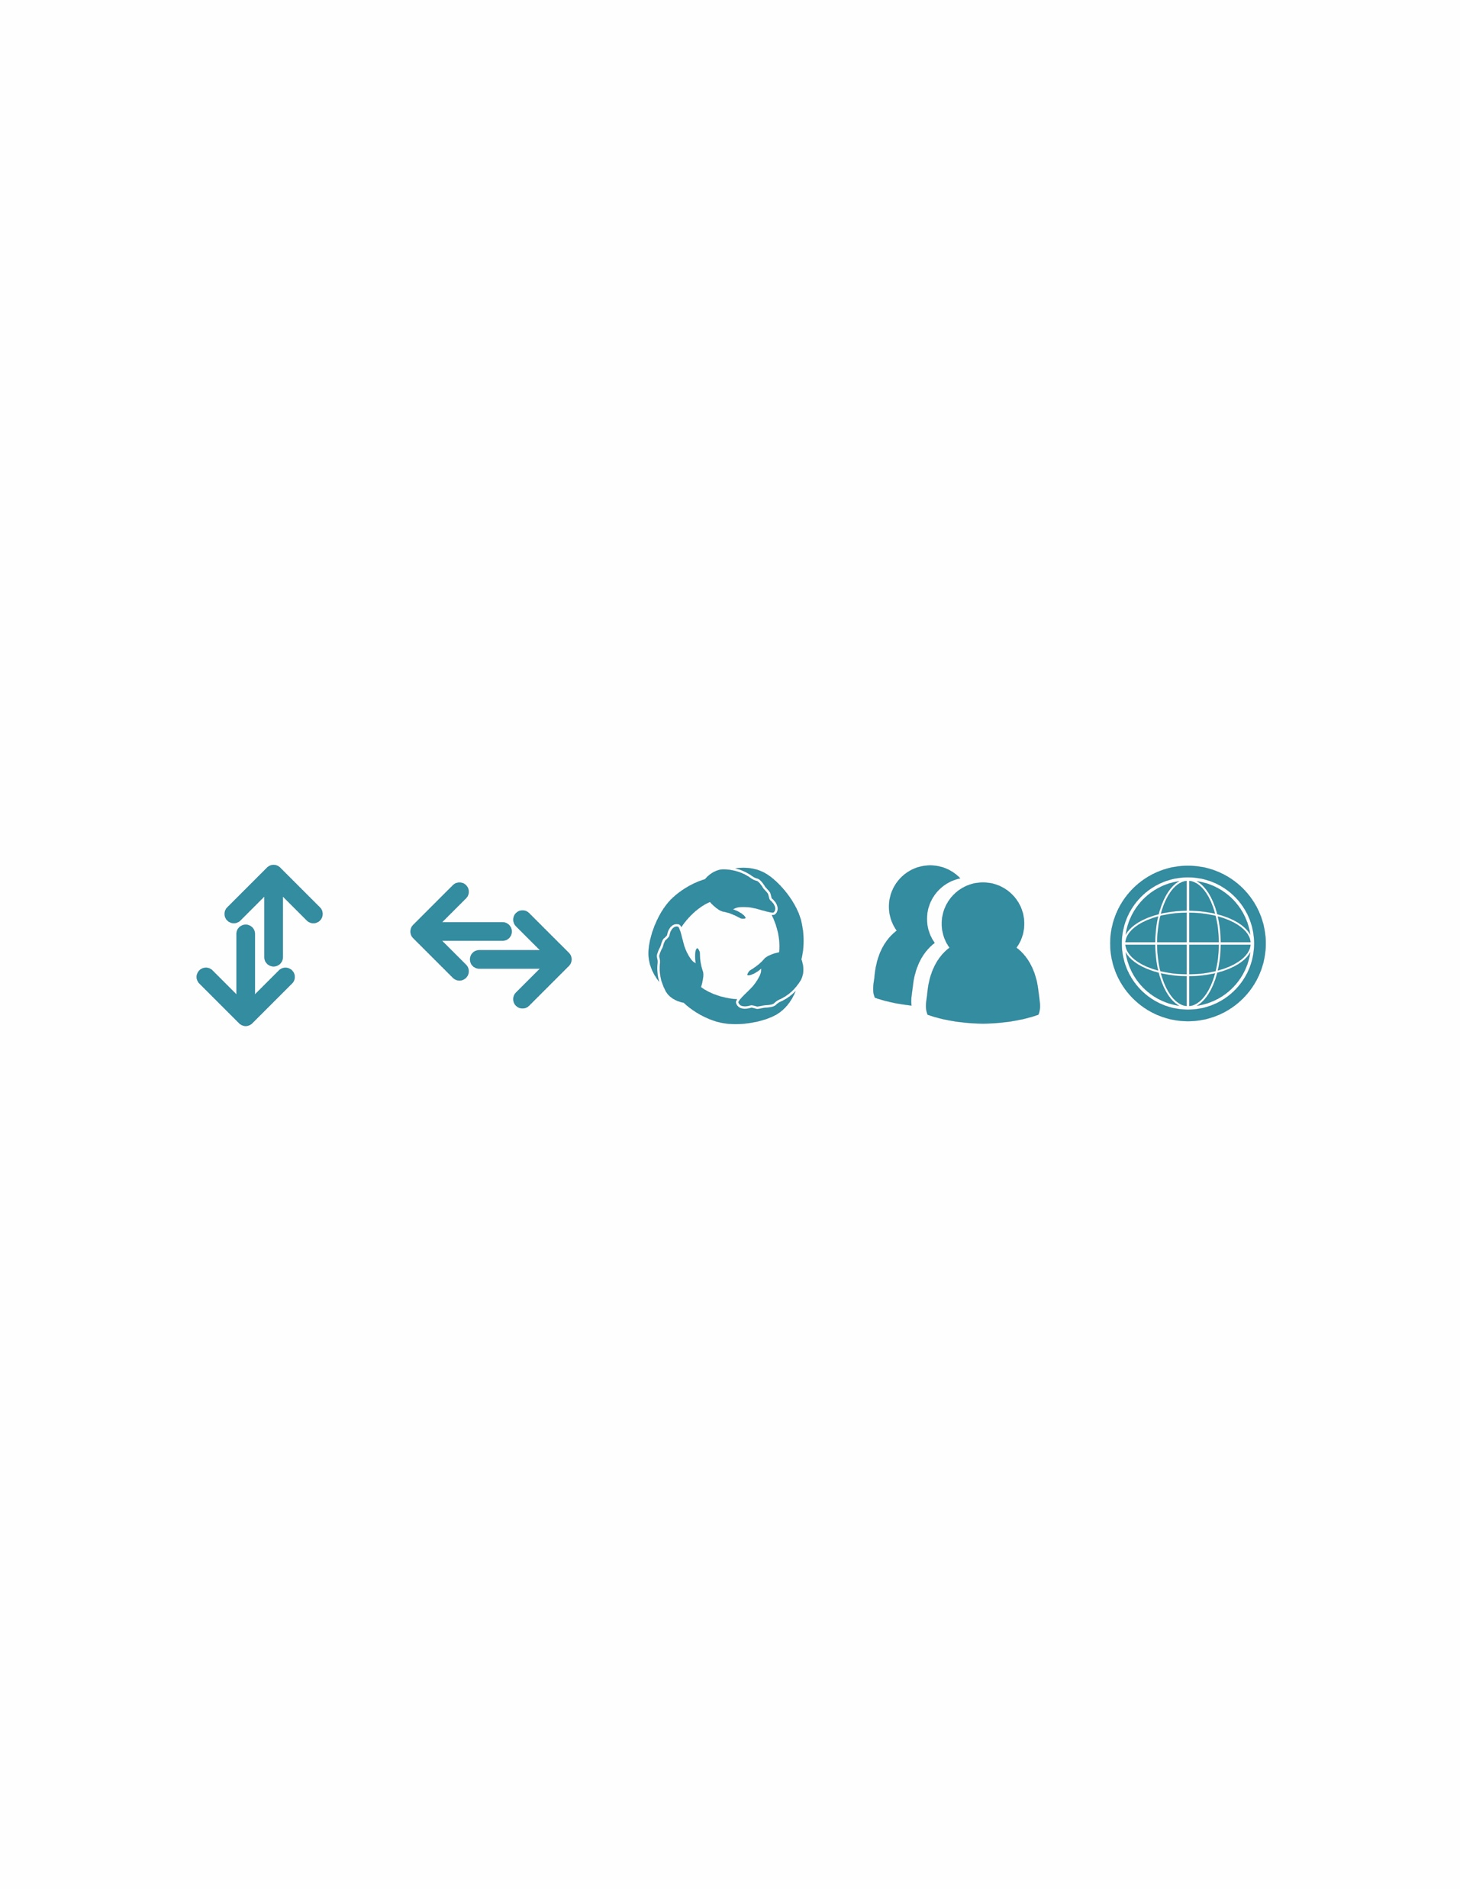
The Five Organizational Boundaries
Vertical
Horizontal
Stakeholder
Group
Geographic
across levels &
authority
across functions
& expertise
across external
groups & interests
across diverse
groups & differences
across markets
& distance
Notes:
0:17
The Five Organizational Boundaries (2R/Image, 2L/Inform)
Research reveals that the following five boundaries exist in an organization: Vertical, Horizontal, Stakeholder, Demographic and Geographic.
Ask the group to share examples of each boundary in chat.
Optional: Introduce the 5 boundaries using the video narrated by lead author Chris Ernst (2:27): https://vimeo.com/98963194/b50aae62d2
Tech note: When you share your screen, be sure to check the boxes to optimize for sound and video
Optional: you may share a metaphor that Chris Ernst used to describe the boundaries. Imagine we are building a house for our extended family which comes with naturally occurring boundaries:
Vertical Boundaries: the floors and ceilings which separate people by story
Horizontal Boundaries: the walls which divide people into different rooms on the same story
Stakeholder Boundaries: the people we have to deal with outside the house (e.g., utility companies, neighbors, Homeowners association, etc.) in order to run the house
Demographic Boundaries: the different ways in which people inside the house differentiate themselves (gender, age group, race, sexual orientation, political affiliation, to name a few)
Geographic Boundaries: perhaps you have members of your family who live in another city or state with whom you are trying to coordinate a family vacation

Slide 12
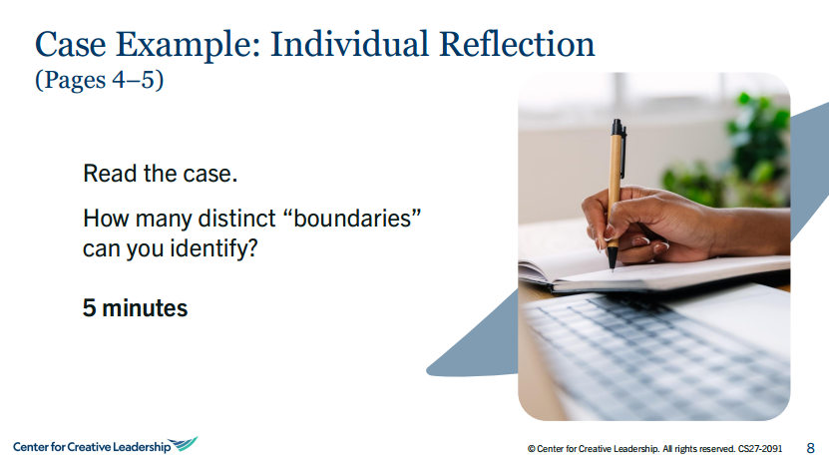
Notes:
0:23

Slide 13
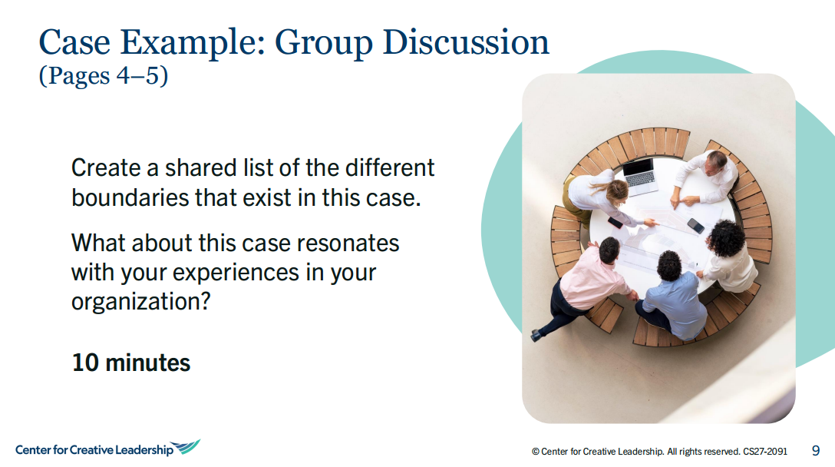
Case Example: Partner Discussion
Create a shared list of the boundaries and issues you noticed in this case.
From your point of view, which issues are highest priority? Where would you start?
8 minutes
Notes:
0:32

Slide 14
How do we prioritize what should be most important?
Notes:
0:40

Slide 15
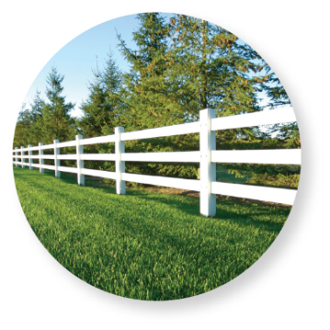


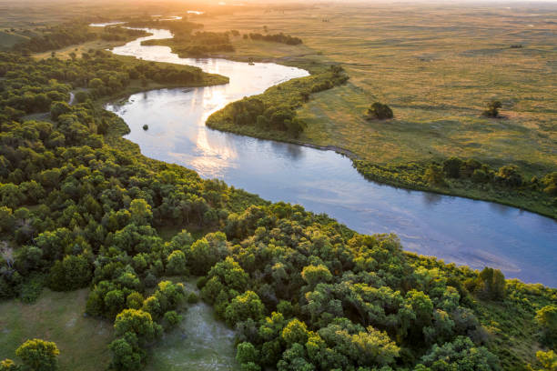
Three Universal Boundary Spanning Strategies
Forging
Common Ground
Discovering
New Frontiers
Managing
Boundaries
Leverage the power of differentiation: Understand the unique values, skills, and expectations members bring to the collaborative work
Summary: Facilitate Understanding
Leverage the power of integration: Develop trust-worthy connections to find common ground and mobilize toward a common goal
Summary: Build a community committed to a common goal
Combine the capabilities of differentiation and integration: Operate as a highly informed, opportunistic, and agile network that functions as a team of teams
Summary: Unlock new potential
Notes:
0:50
Explain the three BSL strategies:
To span boundaries, leaders and organizations need to learn how to use three universal strategies.
Managing Boundaries is about understanding what makes each person or group unique.
Forging Common Ground is discovering what we have in common and mobilizing toward a common goal.
Discovering New Frontiers is about creating a ‘team of teams’ that achieves synergies by harnessing the best of aspects of each.
The following metaphors can be used to describe each of the three strategies:
Managing boundaries taps into the power of differentiation. It is represented by the image of a fence. In the picture you see an attractive white fence. You could climb over it, or crawl thru it, but the fence clearly plays a role in differentiating the trees on one side and the grass on the other side.
Forging common ground taps into the power of integration. It is represented by a bridge. A bridge is a universal sign of connection, of unification, or bringing things together.
Discovering new frontiers taps into the power of innovation. It is represented by the open highway – speed, adventure, agility, new possibility.

Slide 16
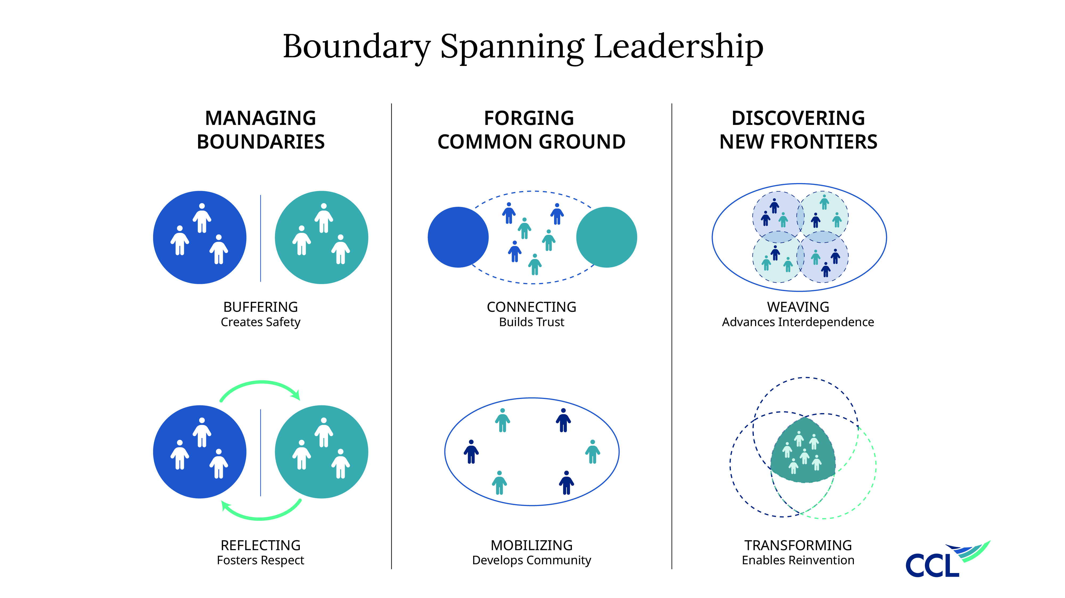
Interdependence of Strategies
DISCOVERING
NEW FRONTIERS
FORGING
COMMON GROUND
MANAGING
BOUNDARIES
Objective:
Advance Interdependence
Objective:
Build Trust
Objective:
Create Safety
Objective:
Enable Reinvention
Objective:
Unlock New Potential
Develop Community
Objective:
Build Collective Commitment to a Shared Outcome
Foster Respect
Facilitate Understanding
Notes:
0:52
To span boundaries, leaders and organizations need to learn how to use three universal strategies.
Suggest that the presenter talks about these strategies by drawing upon the three metaphors as follows:
Managing boundaries taps into the power of differentiation. It is represented by the image of a fence. In the picture you see an attractive white fence. You could climb over it, or crawl thru it, but the fence clearly plays a role in differentiating the trees on one side and the grass on the other side.
Forging common ground taps into the power of integration. It is represented by a bridge. A bridge is a universal sign of connection, of unification, or bringing things together.
Discovering new frontiers taps into the power of innovation. It is represented by the open highway – speed, adventure, agility, new possibility.
Strategies are interdependent and can have a cumulative effect. In other words, Managing Boundaries will enhance your ability to Forge Common Ground. Managing Boundaries and Forging Common Ground effectively will enhance your ability to Discover New Frontiers. That’s not to say these can’t function independently, but the effort will be stronger when all strategies are effectively utilized and sustained over time.

Slide 17
Diagnostic Check
Research from Andy; tendencies and impacts—importance of MB strategy
DISCOVERING
NEW FRONTIERS
FORGING
COMMON GROUND
Have we transformed into an agile network of collaborative partners?
MANAGING
BOUNDARIES
Have we become a community built on trust and a shared goal?
Are we having the conversations necessary to do difficult work together?
Notes:
0:54
To span boundaries, leaders and organizations need to learn how to use three universal strategies.
Suggest that the presenter talks about these strategies by drawing upon the three metaphors as follows:
Managing boundaries taps into the power of differentiation. It is represented by the image of a fence. In the picture you see an attractive white fence. You could climb over it, or crawl thru it, but the fence clearly plays a role in differentiating the trees on one side and the grass on the other side.
Forging common ground taps into the power of integration. It is represented by a bridge. A bridge is a universal sign of connection, of unification, or bringing things together.
Discovering new frontiers taps into the power of innovation. It is represented by the open highway – speed, adventure, agility, new possibility.
Strategies are interdependent and can have a cumulative effect. In other words, Managing Boundaries will enhance your ability to Forge Common Ground. Managing Boundaries and Forging Common Ground effectively will enhance your ability to Discover New Frontiers. That’s not to say these can’t function independently, but the effort will be stronger when all strategies are effectively utilized and sustained over time.

Slide 18
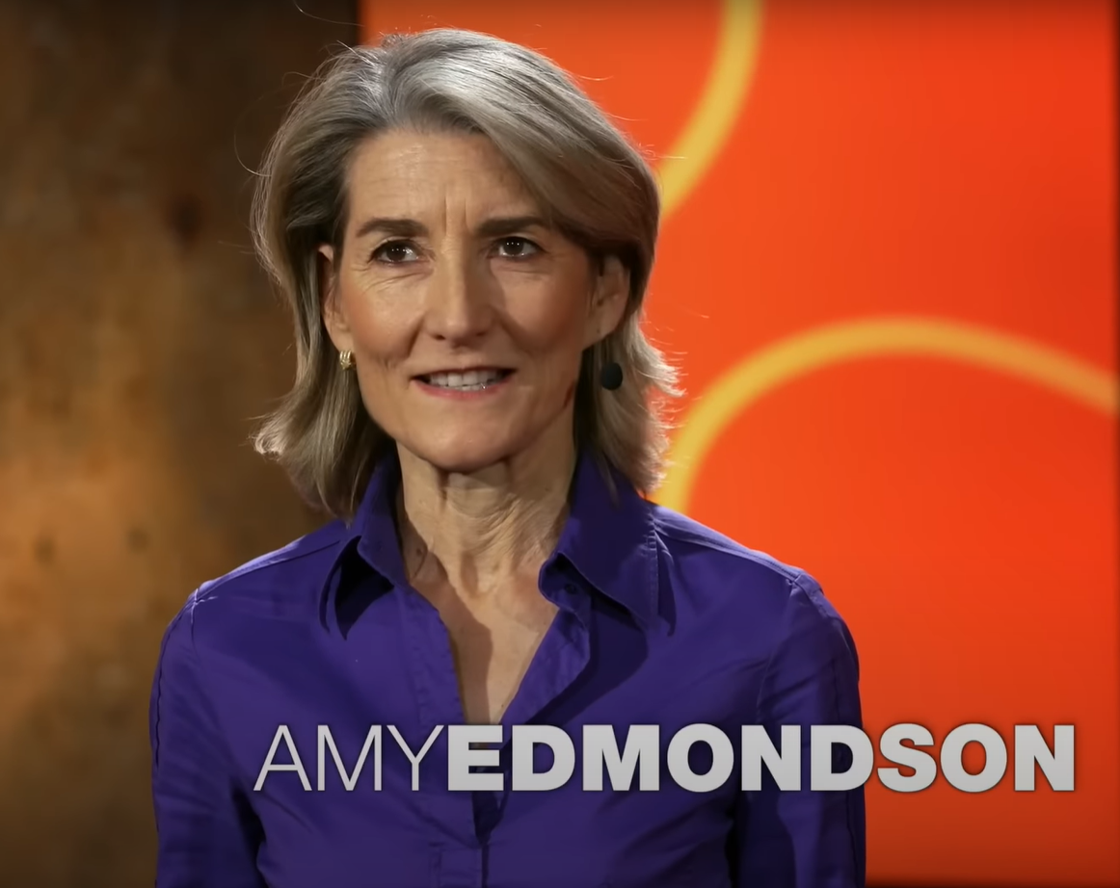
City of the Future
Boundary Spanning challenges…
Underlying issues that can contribute to conflict?
Timeframe differences,
Differences in values,
Different ways of thinking and problem solving…
Notes:
0:60
Quick BSL Story
When you come back We’ll be eager to hear what themes and patterns came out in your conversations.
*This could be done in the large group. If you have more than 2 hours for this session participants can share their stories verbally (this could take an additional 20 min)

Slide 19
Managing Boundaries
If we understood one another more clearly, what might that free us up to do?
Why Do We Manage Boundaries?
  To Facilitate Understanding.
  We appreciate differences and similarities between “us” and “them”
  We increase respect between “us” and “them”
  We flush assumptions from the system
    (D) Clarify shared purpose
    (A) Clarify roles and responsibilities
    (C) Clarify behavioral expectations
    (C) Clarify collaboration guidelines and non-negotiables
Diagnostic: Are we having the conversations necessary to do difficult work together?

Slide 20
Powerful Questions for Managing Boundaries
MANAGING
BOUNDARIES
Why we Manage Boundaries: To understand the unique values, skills and expectations members bring to the collaborative work.
Powerful Questions to Manage Boundaries
Are we having the conversations (and understanding) necessary to do difficult work together?
What assumptions do we need to examine?
What conversations are we not having?
What conversations are we continually having but aren’t making progress? Why?
If we understood one another more clearly, what might that free us up to do?
What is our shared purpose? Why is it important to you?
Are we able to be vulnerable with one another?
Objective:
Create Safety
Objective:
Foster Respect
Facilitate Understanding
Notes:
Powerful questions: Can we be vulnerable together?

Slide 21

Forging Common Ground
Why Should We Forge Common Ground?
  To build collective commitment to a shared outcome.
  We connect authentically with others and build trust—which enables candid communication about key values, perspectives, and challenges
  We strive to link people and build bridges across groups
  We assess how diverse and well-rounded our network of connections might be
  We build a community who is collectively committed to the shared work and its outcomes.
Diagnostic: Have we become a community built on trust and a shared goal?

Slide 22
Powerful Questions for Forging Common Ground
FORGING
COMMON GROUND
Why we Forge Common Ground: To develop trustworthy connections to find common ground and mobilize toward a common goal.
Powerful Questions to Forge Common Ground
To what degree do we feel mutual trust?
To what extent have we developed a community who feels invested and responsible for shared outcomes?
What capabilities or perspectives may be missing from our community?
Is our community sufficiently diverse? Does it represent a range of constituents and span multiple boundaries?
What can we learn from others that can help us accomplish our goal more effectively?
Objective:
Build Trust
Objective:
Create Community
Collective Commitment to a Shared Outcome
Notes:
Powerful questions: Can we be vulnerable together?

Slide 23

Discovering New Frontiers
Why Should We Discover New Frontiers?
  To unlock new potential.
  Each group recognizes its unique roles or contributions that weave with others in service of a larger, collective objective.
  Stakeholder groups co-create and manage DAC together; they align and re-align resources as requirements change; stakeholders refine their ability to learn with and from one another.
  Sustained weaving of capabilities, and the learning generated therein, helps the organization to understand itself, its people, and its environment in new ways.
  Insights help catalyze transformation, enabling the organization to lean into future challenges and opportunities.
Diagnostic: Have we transformed into an agile network of collaborative partners?

Slide 24
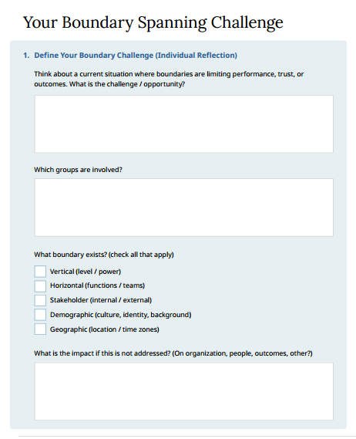




Reflect on Your Boundary Spanning Challenge
(Page 7 of handout)
Reflect on what you’ve learned about boundary spanning and a current challenge you face.
What specific actions might you take to span boundaries more effectively?
Pair up with a partner to share your reflections and provide each other with suggestions.
Creative #: 567697695
Notes:
Reflect & Share
Now you’ll have an opportunity to pair up with someone and share perspectives on each of your networks.
Encourage participants to pair up with someone who is NOT currently part of their network to ensure fresh perspectives. (If there are any pairings that should be avoided, it may be necessary to inform the Producer prior to the breakout session.)
Debrief: What was that experience like? Were there any particular insights or suggestions that emerged from that conversation that you will make an effort to apply?

Slide 25
Takeaways
Accomplishing shared goals is challenging. Successful teaming requires spanning multiple organizational boundaries.
Leaders can use three universal strategies to effectively span boundaries: Managing Boundaries, Forging Common Ground, and Discovering New Frontiers.
The strategies have distinct objectives, but work interdependently. Boundary spanning is a dynamic process – diagnose where you are to know which strategy to emphasize.
Notes:
Takeaways
Here you will see several key takeaways from our session.
There are many more resources in your workbook, including information if you want to explore this framework and processes further, and resources to address situations in each of the domains.

Slide 26
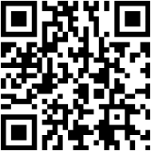



The Y & CCL Partnership: Learning Content Library
Available Now – 25+ Digital Lessons in the YMCA Learning Hub
Agency
Active Listening
Asking Powerful Questions
Boundary Spanning
Creating Accountability
Delegating Effectively
Emotional Intelligence
Feedback That Works
Influence
Learning Agility
Leadership Networks
Managing Conflict
Mindset Matters
Psychological Safety
Talent Conversations
Trust
Vision
….and more
https://learn.ymca.org/learn/catalog/view/83
Coming Next
Digital Courses
Deeper, multi-lesson courses launching November 2026
Workshop Kits
Facilitator-ready materials for in-person team sessions
Role-Based Pathways
Curated CCL content mapped to key roles across the Y

