Slide 1

Building Skills through the YMCA Bridgebuilding Blueprint™
George Zavala & Nicky Rosenbluth

Slide 2

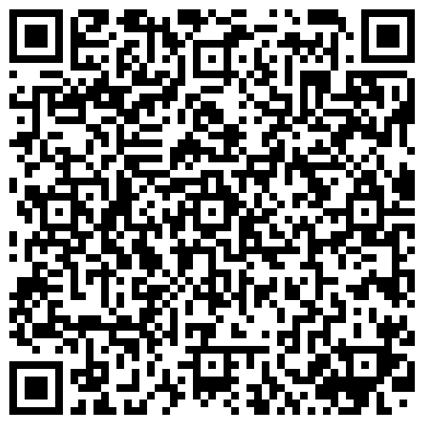
PARTICIPANT GUIDE
Scan the QR Code
Use this QR code to access the Participant Guide for this session
You can also find it in the Cvent App in our session.
Notes:
GEORGE
Scan this QR code to access the Participant Guide for this session.
You can also access it in Cvent – it’s located in the session materials on the app

Slide 3

welcome
Notes:
Welcome (GEORGE)
Hello everyone! Welcome to our session Building Skills through the YMCA’s Bridgebuilding Blueprint here at GA!

Slide 4
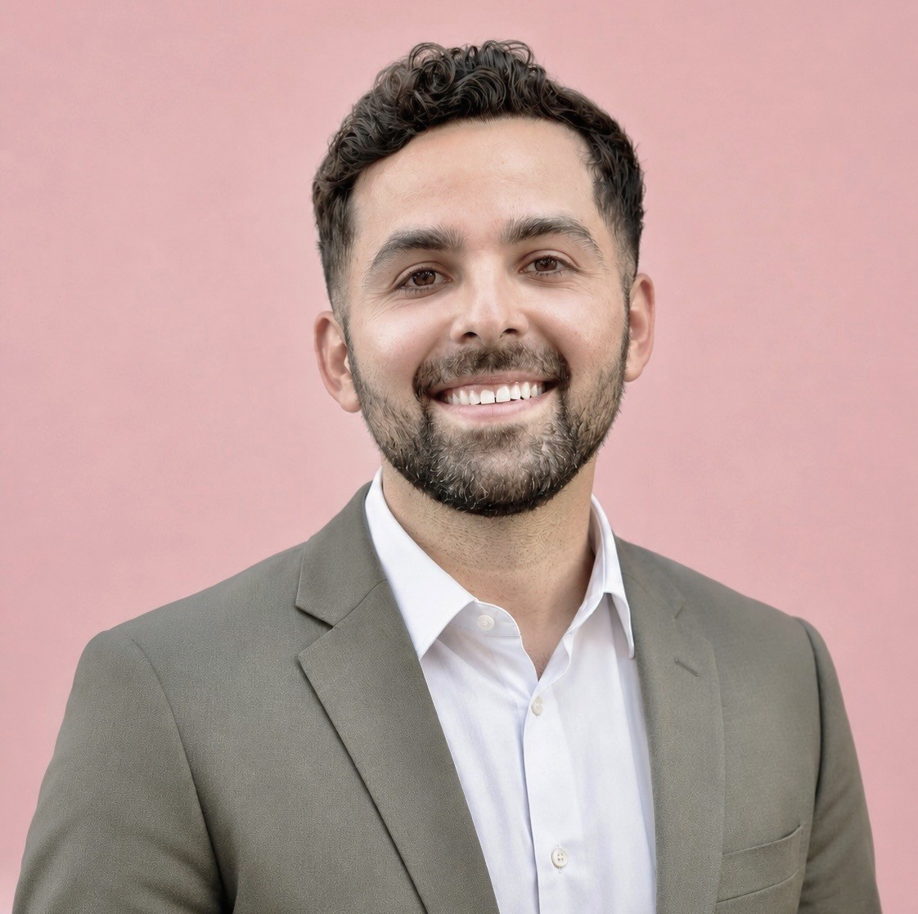
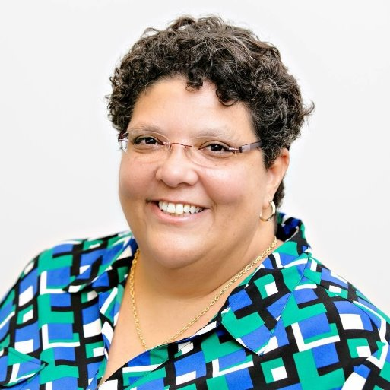
Speakers
George Zavala
Manager, Community Bridging & Belonging
Y-USA
Nicky Rosenbluth
Vice President, Leadership Development
Valley of the Sun YMCA
Notes:
GEORGE & NICKY
“Hello, my name is Nicky Rosenbluth”
Intro of Nicky
I’ll turn it over to George to introduce himself.
“Hi everyone, I’m George Zavala”
Hi, everyone. I’m George Zavala, Manager of Community Bridging & Belonging at YMCA of the USA.
My work focuses on helping Ys strengthen relationships, build belonging, and develop the skills and practices needed to work across differences.

Slide 5
Why This Matters
Notes:
NICKY

Slide 6
175 Years of connection
For 175 years, the YMCA has helped people:
Learn
Grow
Belong
Contribute
Build relationships
Notes:
175 Years Later (NICKY)
Opening
This year marks 175 years of the YMCA in the United States.
Across that history, the YMCA has helped people learn, grow, belong, contribute, and build relationships.
People have formed lifelong friendships, met mentors, discovered new opportunities, found a sense of purpose, and experienced what it feels like to matter.
This week, thousands of us have traveled from across the country to celebrate that legacy.

Slide 7
Who Is in the Room?
Raise your hand if:
You’re new to the YMCA.
This is your first General Assembly.
You have met someone new this week.
You have reconnected with someone you had not seen in a while.
There is still someone you hope to meet or learn from before GA ends.
Notes:
Who’s in the Room (NICKY)
Let’s look around and get a sense of who is in the room.
Raise your hand if:
You’re new to the YMCA.
This is your first General Assembly.
Met someone new this week.
Reconnected with someone you had not seen in a while.
There is still someone you hope to meet or learn from before GA ends.
Take a look around the room. We may be having different experiences at General Assembly, but we are all participating in some way

Slide 8
What Should We do at GENERAL Assembly
Introducing ourselves
Exchanging ideas
Strengthening relationships
Building new connections
Looking for renewed clarity and purpose
Notes:
What Should We Do at General Assembly (NICKY)
But regardless of how long we've been at the Y (or even at GA), every one of us is spending this week doing something remarkably similar. We’re:
Introducing ourselves.
Looking for new ideas.
Growing existing relationships.
Building new relationships.
Maybe even searching for inspiration, purpose, or clarity.
In other words, we're actively participating in the very thing we're talking about this week. Connection.

Slide 9
GENEral Assembly is our immediate practice space
What helps you engage?
What causes you to step back?
What do you contribute to the people around you?
The real value is what we carry back to our teams, branches, boards, and communities.
Notes:
General Assembly Is Our Immediate Practice Space (NICKY)
General Assembly gives us an immediate place to notice how that connection happens. We can pay attention to what helps us engage, what causes us to step back, and what we contribute to the people around us.
But GA is only our immediate practice space. The real value of today’s session is what it helps us do when we return to our teams, branches, boards, and communities.

Slide 10
Partner exchange
Think about the last 24 hours at General Assembly…
When did you feel most connected?
What behaviors influenced the experience?
Briefly share:
The moment you thought about
The behavior(s) that shaped the experience
Something you could carry into the rest of GA
Notes:
Partner Exchange (NICKY)
Think about the last 24 hours at General Assembly.
Identify one moment when you felt connected to another person, a group, or the larger YMCA community.
What happened in that moment? What did someone do that contributed to the experience?
Take a few seconds to identify one specific behavior.
GIVE 30 SECONDS
Instructions
Turn to someone on your right. Introduce yourself if you have not already met.
We’ll give y’all about two minutes to briefly describe the moment you thought about and name the behavior(s) that helped create connection.
GIVE 2 MINUTES

Slide 11
Behaviors Become Experiences
These are not abstract qualities. They are practices.
Listening
Noticing
Inviting
Following through
Making introductions
Asking questions
Creating space
Notes:
Behaviors Become Experiences (NICKY)
As you may have gathered from your brief conversations, these are not abstract ideas. They are observable behaviors and practices.
Did anyone observe or hear any in your partner’s story?
Those behaviors influence whether people experience trust, belonging, growth, and the ability to contribute.
They can also be practiced and strengthened. That idea sits at the center of the YMCA Bridgebuilding Blueprint.

Slide 12
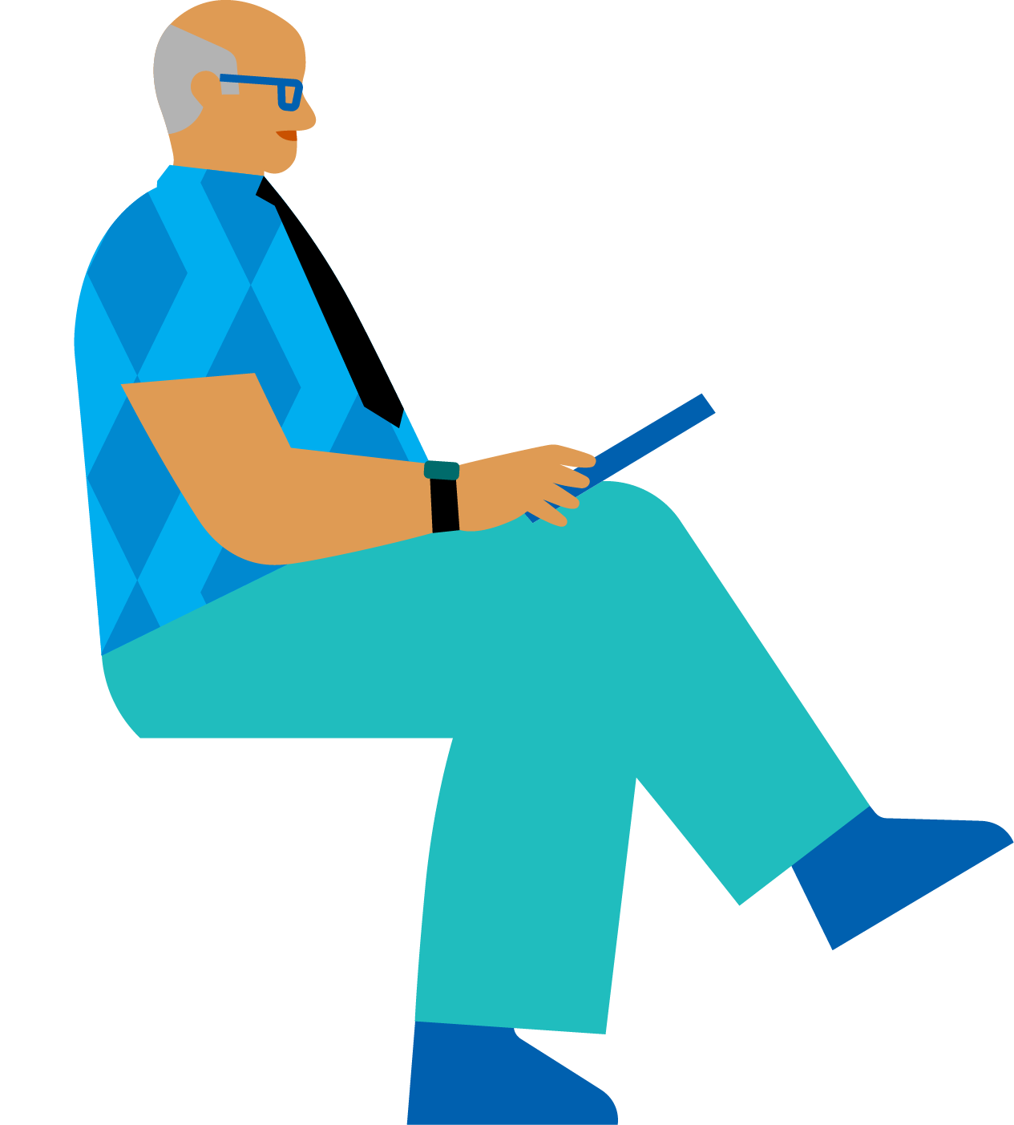
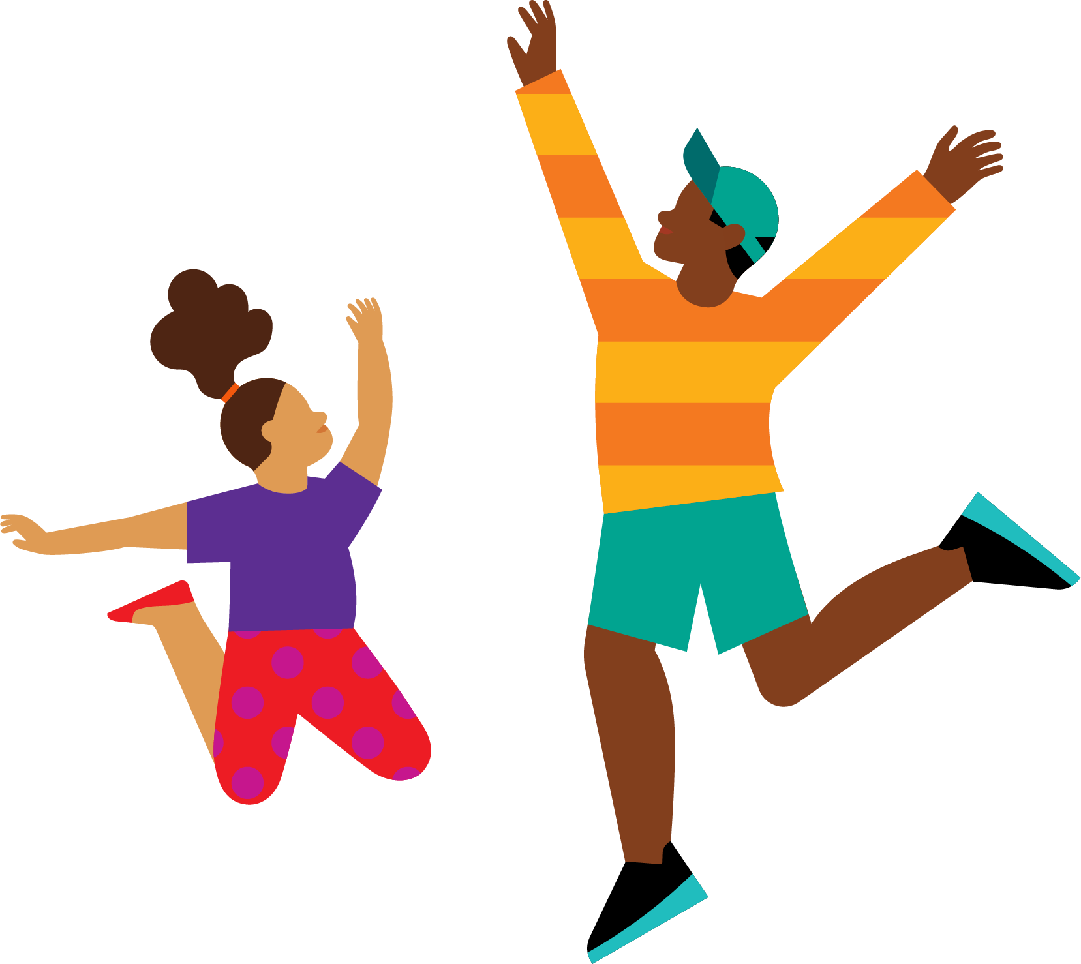
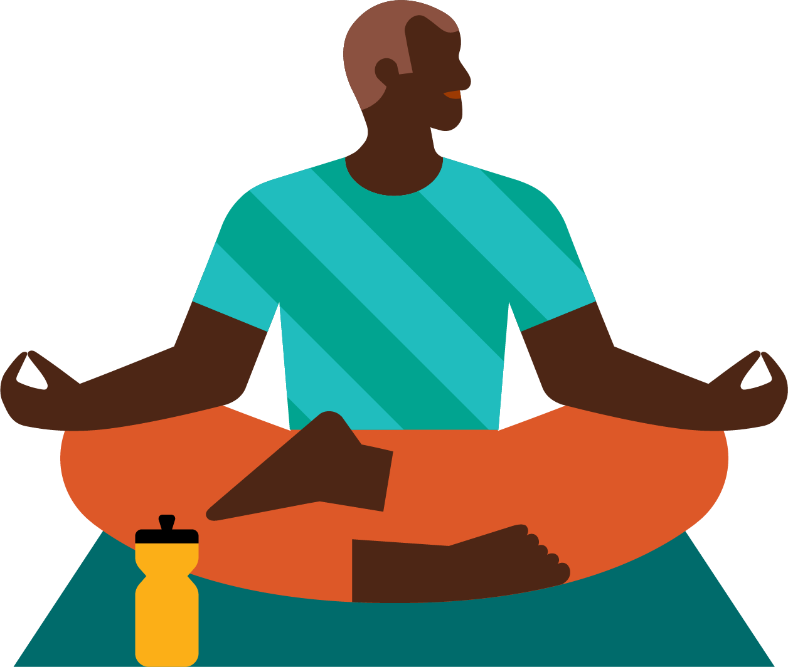
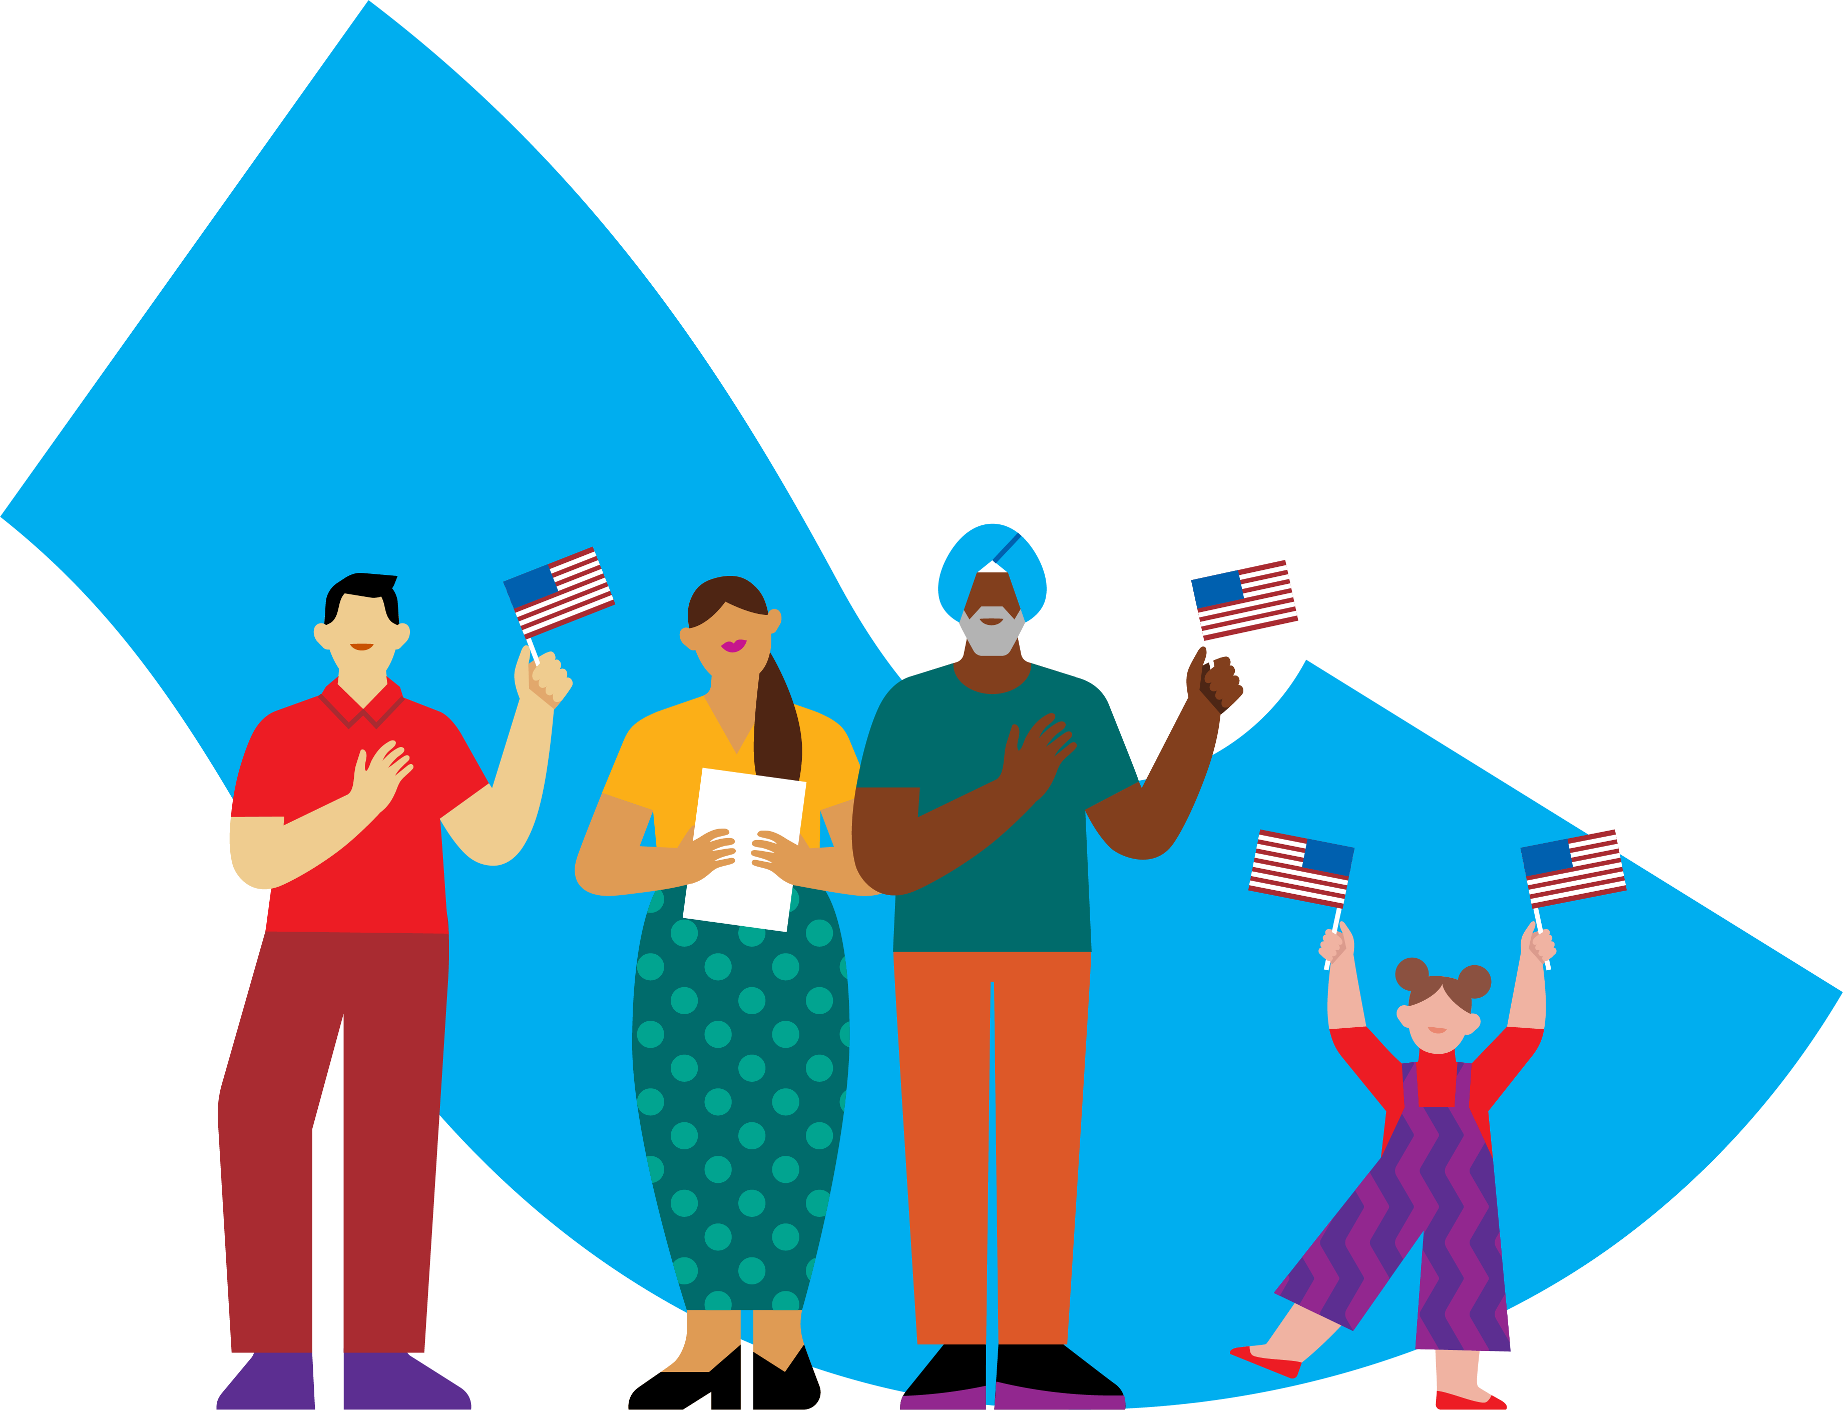
Social connection and our health
Youth Health
4 in 10
U.S. high school students experienced persistent sadness or hopelessness.
Older Adult Health
50%
Higher risk of developing dementia associated with chronic loneliness and social isolation.
Everyday Health
29% and 32%
Higher risk of heart disease and stroke associated with poor social relationships.
Economic Health
$154 billion
Estimated annual cost to U.S. employers from stress-related absenteeism attributed to loneliness.
Notes:
Social Connection and our Health (NICKY)
The behaviors we just identified may appear small, but the experiences they help create have implications for health.
For YMCA staff, this is not abstract. We see it in our youth programs, fitness centers, older-adult programs, workplaces, and communities.
Let’s look at it through four dimensions of health.
First, youth health.
In 2023, four in ten U.S. high school students reported persistent sadness or hopelessness. One in five seriously considered attempting suicide.
Next is older-adult health.
Chronic loneliness and social isolation are associated with an approximately 50 percent higher risk of developing dementia among older adults, even after accounting for demographics and health status.
There is also everyday physical health.
Poor social relationships are associated with a 29 percent higher risk of heart disease and a 32 percent higher risk of stroke.
Finally, there is economic health.
The U.S. Surgeon General’s Advisory estimates that stress-related absenteeism attributed to loneliness costs U.S. employers approximately $154 billion each year.
These figures touch the people who enter our facilities every day: a teenager in an afterschool program, an older adult attending a group exercise class, a member working toward a health goal, or an employee trying to remain engaged at work.
We are not suggesting that one program or one conversation can solve these challenges.
That is why connection is not an extra benefit of YMCA work. It is part of how we support health.

Slide 13
The YMCA’s Next Chapter
Creating Connected Communities
The YMCA’s bold, shared vision for strengthening community by fostering meaningful human connection.
“How do we become more intentional about helping people build relationships, experience belonging, achieve their goals, and contribute to something larger than themselves?”
Notes:
The YMCA’s Next Chapter (NICKY)
In celebration of our 175 years in the United States, we are looking toward what the next 175 can look like.
At the center of that vision is a practical question:
How do we become more intentional about helping people build relationships, experience belonging, achieve their goals, and contribute to something larger than themselves?
Creating Connected Communities is the YMCA’s bold, shared vision for strengthening community by fostering meaningful human connection.
The YMCA Bridgebuilding Blueprint was created to help us understand those differences and use them with greater intention.
George, let’s look at how the Blueprint was developed and what it is designed to help people do.

Slide 14

Introducing the YMCA Bridgebuilding Blueprint™
Notes:
Moving Bridgebuilding into Practice (GEORGE)
Thanks Nicky.
The Blueprint was not developed outside the YMCA and then handed to the Movement.

Slide 15

Moving Bridgebuilding Into Practice
The Bridgebuilding Blueprint began with a practical question:
“How do we help people move bridgebuilding from concept into practice?”
Notes:
Moving Bridgebuilding into Practice (GEORGE)
It began with YMCA leaders, staff, volunteers, and partners asking a practical question:
How do we help people move bridgebuilding from concept to into practice?
More specifically, how do we equip people with actionable skills and behaviors that strengthen trust, belonging, and connection in their everyday work and interactions?

Slide 16
Created by the Y, for the Y
Co-created
With YMCA staff, volunteers, community partners, and field leaders
Grounded
In research on belonging, motivation, bridgebuilding, and social connection
Informed
By national partners, field experts, and the realities of local Ys
Tested and Refined
Through a YMCA innovation process shaped by feedback and continuous learning
Notes:
Created by the Y, for the Y (GEORGE)
The original work was led by the 2025 Bridging Community Connections Innovation Team, a group of YMCA leaders from across the country.
The team tested language, challenged assumptions, and explored what bridgebuilding looks like in the everyday work at the Y.
The process was grounded in national research, informed by external partners and field experts doing this work, and refined through feedback from YMCA staff, volunteers, and leaders.
Through that work, the Innovation Team recognized several distinct patterns in how people contribute.
People may strengthen relationships, create structure and follow-through, develop others, ask questions before moving into action, design pathways for participation, or keep a group connected to shared purpose.
The goal was to create shared language that helps people understand what they naturally contribute, recognize the strengths of others, and work together more intentionally.

Slide 17
The Blueprint’s Growing Reach
1,000+
people have taken the YMCA Bridgebuilding Blueprint™
2025 Fall Activation Learning Cohort
750 participants
241 unique YMCA associations represented
2026 Activation Learning Cohorts
27 Ys officially trained to facilitate the Blueprint
700 people trained through local Blueprint experiences
Notes:
A Tool Shaped by Learning (GEORGE)
The Blueprint has continued to evolve through testing, feedback, and use across the YMCA Movement since we launched last Fall.
Across our various learning opportunities, more than 1,000 people have taken the Blueprint.
The 2025 Fall Activation Learning Cohort reached 750 participants representing 241 unique YMCA associations.
In 2026, 27 Ys were officially trained to facilitate the Blueprint and have delivered local experiences reaching 700 people.
What matters for our conversation today is that every use of the Blueprint has given us another opportunity to learn what resonates, what requires clarification, and what people need in order to apply their skills.

Slide 18
More Than Another Assessment
Your report helps you understand:
Profile | How you naturally contribute
Mindset | What motivates your contribution
Primary Strengths | The capacities you already use
Growth Opportunities | What you can continue strengthening
Where You Create Impact | Where your strengths can make a difference
Practice | How to put those strengths into action
Notes:
More Than Another Assessment (GEORGE)
The Blueprint was not designed to be another assessment you complete, read once, and never return to.
By a show of hands, how many of you have completed an assessment, read the results, and rarely or never returned to them?
PAUSE FOR PARTICIPANTS TO RESPOND.
That is exactly what we are trying to avoid.
Your Profile is an entry point, not the end of the experience.
The full report helps you understand:
How you naturally contribute
What motivates that contribution
The skills you already use
The skills you can continue strengthening
Where your strengths can create impact
How you can put those strengths into practice
Pay attention to what resonates, what surprises you, and what gives you language for something you may already do without thinking about it.

Slide 19
Not another initiative
The Bridgebuilding Blueprint is:
Optional: It is not a required or mandated assessment.
Flexible: Use the parts that add value for your people and work.
Practical: Apply it within existing programs, teams, partnerships, and priorities.
Reusable: Return to the report as situations and relationships change.
Notes:
Not Another Initiative (GEORGE)
Before you experience the Blueprint, we want to make one thing clear.
The Bridgebuilding Blueprint is available at no cost to YMCA staff, volunteers, leaders, boards, and associations.
It is not a mandated assessment, and it is not another Y-USA initiative that every association is expected to adopt or implement.
It was designed as a flexible resource that Ys can use where it adds value.

Slide 20

Take the YMCA’s Bridgebuilding Blueprint™
Notes:
NICKY
So rather than spending more time talking about the Blueprint, let's experience it for ourselves.

Slide 21

How This Activity Will Work
Step 1: Take the Blueprint
Complete the questions and scenarios.
Step 2: Review Your Report
Notice what resonates, surprises you, or raises a question.
Step 3: Discuss Your Results
Share what you noticed with people seated near you.
Notes:
How This Activity Will Work (NICKY)
Some of us in the room may have taken the Bridgebuilding Blueprint over the last year. But, in a moment, you will complete our latest version of the Bridgebuilding Blueprint. Here is how we will spend the next 20 minutes.
First, you will use one of the QR codes to access and complete the YMCA Bridgebuilding Blueprint. We will allow approximately 15 minutes for this portion.
When you finish, remain in your report and begin reviewing your results.
Then, we will use those results in conversations with people seated near you. You will not be asked to report out to the full room or explain every part of your result.
There are no perfect answers or reactions. The goal is to respond honestly, notice what stands out, and learn through the conversation that follows.

Slide 22
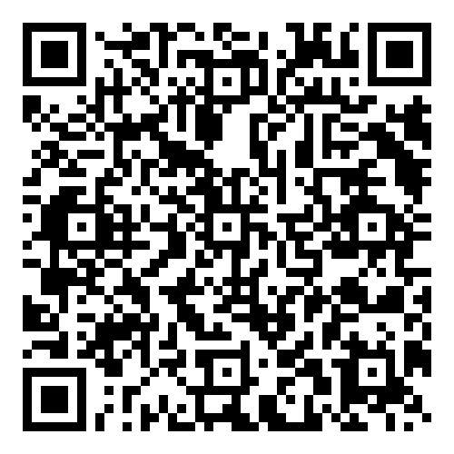
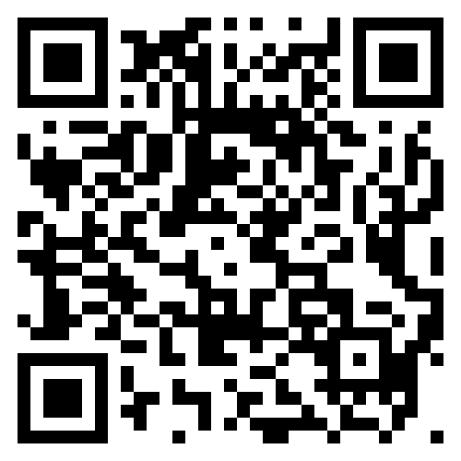
ACCESS THE BLUEPRINT
Choose the option that gets you into the experience most quickly.
You will have approximately 15 minutes.
Need assistance? Raise your hand.
The Learning Hub
QR Code
Team Up Project
QR Code
www.teamupproject.org/#teamup
Notes:
Accessing the Bridgebuilding Blueprint™ (NICKY)
You will see two access options on the screen.
If you have access to the Learning Hub, you may use that route.
If you do not have access or experience difficulty signing in, use the Team Up version.
The website is: www.teamupproject.org/#teamup
Choose whichever option gets you into the experience most quickly.
If you need help loading or navigating the Blueprint on your phone, raise your hand. Our room hosts are available to assist.
Go ahead and begin.
Facilitator note:
Prepare the room host and speaker host to assist with:
Scanning the QR codes
Accessing the Learning Hub
Navigating the Blueprint on a phone
Locating and downloading completed reports
Print this slide as a participant handout. Keep the QR codes large enough to scan from both the projected slide and the printed version. Include the short URLs in case a participant cannot use a QR code.
LET 5 MINUTES PASS

Slide 23
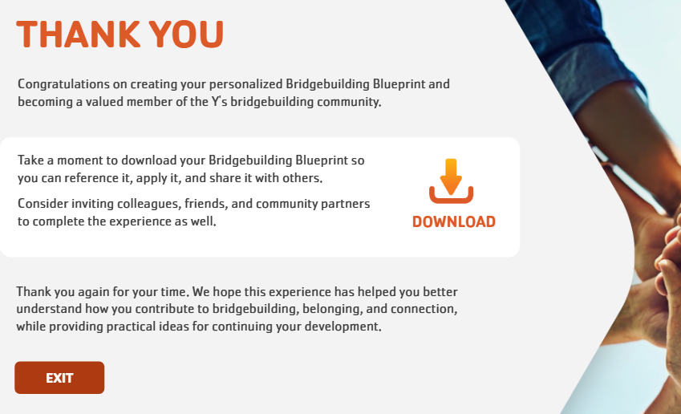
10 Minutes remaining
You have approximately 10 minutes.
When You Finish
On page 5 of your report:
Select Download
Save your report
Begin reviewing your results
Notes:
10 Minutes Remaining (NICKY)
You now have approximately 10 minutes remaining.
If you have finished, remain in your report.
Go to page five, select Download, and save a copy so you can return to it later.
Then begin reviewing your results. You do not need to understand everything yet. Focus on what catches your attention.

Slide 24
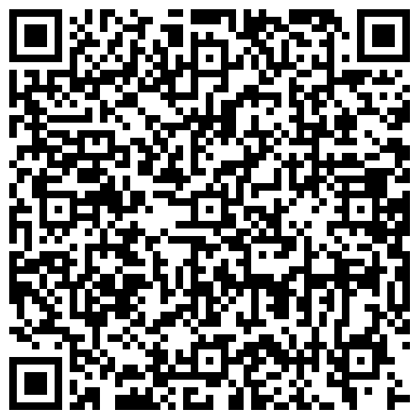
Report Access Backup
Having difficulty opening your report?
Use this QR code after completing the Bridgebuilding Blueprint if you cannot open your downloaded report.
Scan the QR code to access the Blueprint report PDFs.
Find the report with your Mindset_Profile
Notes:
Report Access Back Up - 2 Minute Reminder (NICKY)
We have approximately two minutes remaining.
If you have completed the Blueprint, make sure you have downloaded your report and begin identifying the sections listed on the screen.
Having difficulty opening your report? Use this QR code after completing the Bridgebuilding Blueprint if you cannot open your downloaded report.
Scan the QR code to access the Blueprint report PDFs.
Find the report with your Mindset_Profile

Slide 25
Review Your Results
If you have completed the Blueprint, identify:
Your Profile
Your Mindset
One strength that feels familiar
One insight that surprises you
One growth opportunity or practice prompt you want to explore
You do not need to read the entire report yet.
Notes:
Reflection While Reviewing Your Report (NICKY)
As you finish, begin exploring your report.
You do not need to read every section or decide whether every statement fits perfectly. Focus on the parts that catch your attention.
Notice what feels familiar, what surprises you, and what helps you put language around something you may already recognize in yourself.
Also identify one growth opportunity or practice prompt that feels relevant to your work. We will use these parts of the report in the next activity.
I’ll give you 3 minutes to review.
LET AUDIENCE REVIEW FOR 3 MINUTES

Slide 26

Understanding your mindset:
what motivates you
Notes:
Understanding Your Mindset: What Motivates You (GEORGE)
Your report offers two connected perspectives.
Let’s begin with Mindset and what it can help us understand about why we stay engaged in building relationships.

Slide 27

How and Why Are Different Questions
Your Profile
How you naturally contribute to bridgebuilding
Your Mindset
What motivates that contribution
Your Bridgebuilding Contribution
How your Mindset shapes the way your Profile is expressed.
Notes:
How and Why Are Different Questions (GEORGE)
Your report offers three connected pieces of information:
Your Profile describes how you naturally contribute to bridgebuilding.
Your Mindset explains what motivates that contribution.
Your Bridgebuilding Contribution statement brings the two together. It describes how your Mindset shapes the way your Profile is expressed.
This distinction matters because people may take similar actions—or even share the same Profile—for different reasons.

Slide 28
Three blueprint mindsets
Commitment-Driven
Responsibility | Service | Dependability | Follow-through
Community-Driven
Relationships | Belonging | Connection | Shared experience
Purpose-Driven
Lasting change | Shared vision | Systems improvement | Impact
Notes:
The Three Blueprint Mindsets (GEORGE)
The Blueprint describes three primary Mindsets.
Commitment-Driven reflects motivation rooted in responsibility, service, dependability, and follow-through.
Community-Driven reflects motivation rooted in relationships, belonging, connection, and shared experience.
Purpose-Driven reflects motivation rooted in lasting change, shared vision, systems improvement, and impact.
These are not fixed or exhaustive categories. Most of us can draw on all three.
Your result identifies the motivation you may rely on most naturally.
Room Pulse (GEORGE)
Let’s get a quick picture of the Mindsets represented in the room. When I name your Mindset, raise your hand.
Call each Mindset individually:
Commitment-Driven
Community-Driven
Purpose-Driven
You can already see that people in this room may care about the same goals while drawing their motivation from different places.

Slide 29
EXPLORE YOUR MINDSET
Return to the Mindset section of your report on page 1.
Review your:
What it Means
What Motivates You
What Helps you Thrive
Watch For
Choose one item from each section.
Notes:
Explore Your Mindset (GEORGE)
Return to the Mindset section of your report on Page 1.
Take a moment to review three areas:
What It Means
What Motivates You
What Helps You Thrive
Watch For
Choose one item from each section that feels especially relevant to you.
GIVE PARTICIPANTS 45 SECTIONS TO REVIEW REPORT

Slide 30
Partner exchange
Share — 60 seconds per person
Which motivation most consistently keeps you engaged? Share an example.
Which condition helps you contribute at your best? What happens when it is missing?
Which “watch for” could affect how you connect or work with people who are different from you?
Notes:
Partner Exchange (GEORGE)
You will each have approximately 60 seconds to share.
First, identify the motivation that most consistently keeps you engaged.
Give your partner a brief example of where that shows up in your everyday life or YMCA work.
Next, identify one condition that helps you contribute at your best.
Consider what happens when that condition is not present.
Finally, choose one item from Watch For.
How could that tendency affect the way you connect or work with someone whose experience, identity, motivation, or perspective differs from your own?
As you listen, notice where your motivations and needs are similar and where they differ.
GIVE PARTICIPANTS 2 MINUTES FOR EXCHANGE

Slide 31

Understanding Your profile:
How you naturally build bridges
Notes:
Understanding Your Profile: How You Naturally Build Bridges (NICKY)
Now that we have explored why we contribute, let’s look more closely at the contribution itself through your Profile.

Slide 32

What Is a Bridgebuilding Profile?
Your Profile describes how you naturally contribute.
Your Profile reflects the strengths, approaches, and behaviors you are most likely to use when:
Building relationships
Fostering belonging
Solving challenges
Navigating differences
Helping people work together
Notes:
Understanding your Profile (NICKY)
Your Mindset helps explain why you contribute. Your Profile describes how you naturally contribute to bridgebuilding efforts.
It reflects the strengths, approaches, and behaviors you are most likely to use when:
Building relationships
Fostering belonging
Solving challenges
Navigating differences
Helping people work together
Your Profile does not describe everything you can do. It gives you language for the contribution you may make first or most naturally.

Slide 33



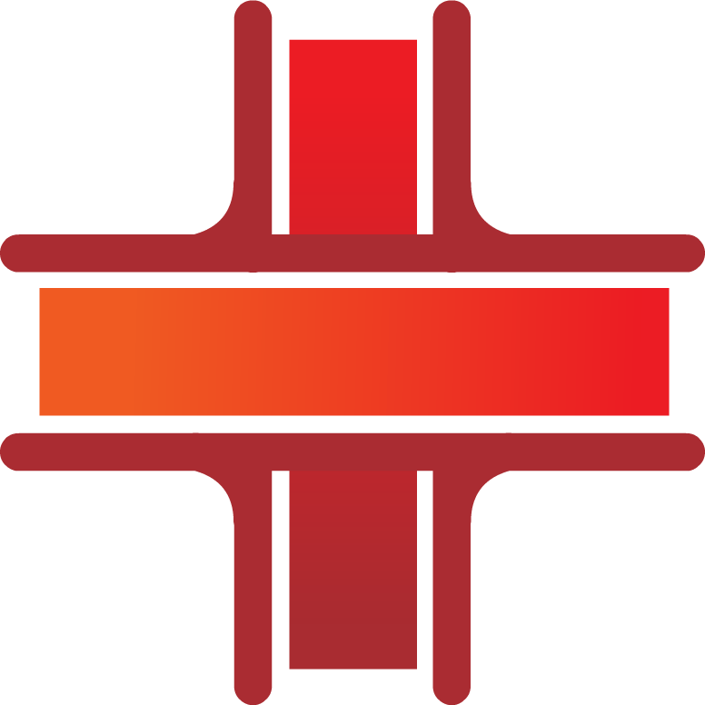
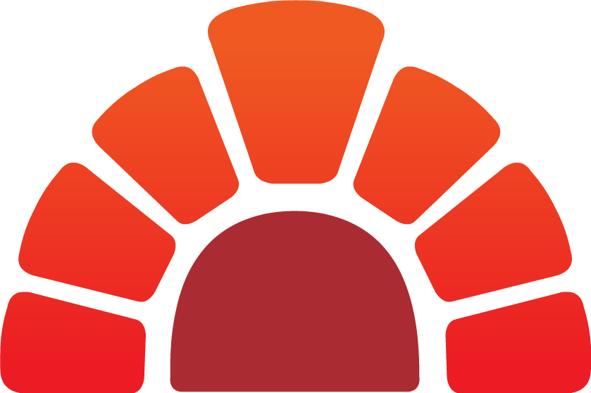
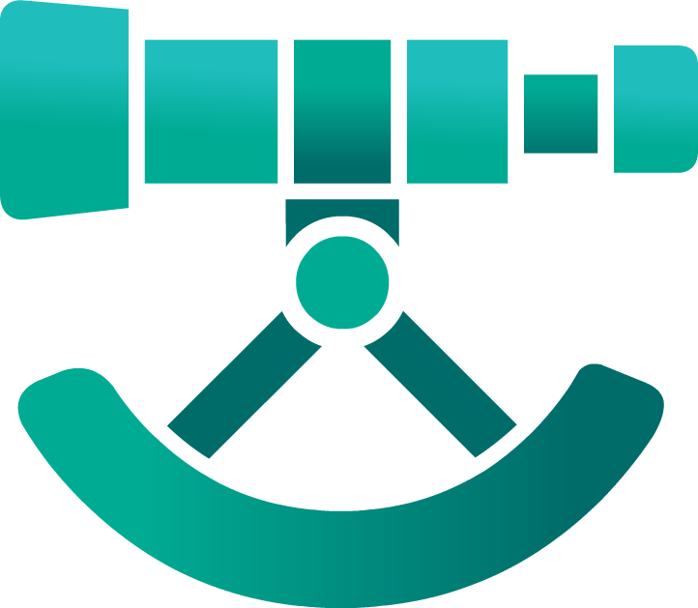
The six bridgebuilding profiles
ANCHOR
ARCHITECT
ENGINEER
WELDER
MASON
SURVEYOR
Notes:
Six Profiles, Different Contributions (NICKY)
The Blueprint describes six ways people may naturally contribute.

Slide 34
ANCHOR
Keeps People Connected to Purpose
Grounds people in shared values, direction, and what matters most
Notes:
NICKY
Anchors keep people connected to purpose.
They help individuals and groups remain grounded in shared values, direction, and what matters most.

Slide 35
ARCHITECT
Designs Pathways for Belonging
Transforms ideas into structures, systems, programs, and plans that help belonging last
Notes:
NICKY
Architects design pathways for belonging.
They transform ideas into structures, systems, programs, and plans that help connection last.

Slide 36
ENGINEER
Turns Intention Into Action
Creates practical systems, reliability, and consistency that move bridgebuilding from vision to reality
Notes:
NICKY
Engineers turn intention into action.
They create practical systems, reliability, and consistency that move bridgebuilding from vision to reality.

Slide 37
MASON
Develops People Through Relationships
Builds trust through intentional relationships and helps others grow, heal, and succeed
Notes:
NICKY
Masons develop people through relationships.
They build trust one relationship at a time and help others grow, heal, and succeed through intentional support.

Slide 38
SURVEYOR
Creates Understanding Before Action
Helps people see more clearly by listening, learning, asking questions, and exploring different perspectives
Notes:
NICKY
Surveyors create understanding before action.
They help people see more clearly by listening, learning, asking questions, and exploring different perspectives.

Slide 39
WELDER
Strengthens the Bonds That Hold People Together
Creates connection, cohesion, and trust across differences
Notes:
NICKY
Welders strengthen the bonds that hold people together.
They create connection, cohesion, and trust across differences.

Slide 40
The six bridgebuilding profiles
ANCHOR
ARCHITECT
ENGINEER
WELDER
MASON
SURVEYOR
Notes:
NICKY
Each Profile represents a useful contribution. No single Profile represents everything a relationship, team, organization, or community needs.

Slide 41
Your profile In your own words
Return to your Profile Description on page 1.
Consider: How would you summarize your Profile Description for someone unfamiliar with the Blueprint?
Focus on the central contribution
Use your own words
Do not read the report word for word
Take 30 seconds to reflect.
Notes:
Your Profile In Your Own Words (NICKY)
Return to your Profile Description on page 1.
Take a moment to consider:
How would you summarize your Profile Description in your own words?
Avoid reading the report word for word. Think about how you would explain your Profile to someone unfamiliar with the Blueprint.
ALLOW APPROXIMATELY 30 SECONDS.

Slide 42
Partner exchange
Turn to someone seated near you. Each person will share:
Your Profile summary in your own words
How your Profile has shown up here or at work
As you listen, focus on understanding what your partner naturally brings.
Notes:
Partner Exchange (NICKY)
Turn to someone seated near you. Each person will have approximately one minute.
Share:
Your Profile summary in your own words.
Share how it’s shown up here or at work
As you listen, focus on understanding what your partner naturally brings.
ALLOW APPROXIMATELY 2 MINUTES.
Your Profile gives you language for how you naturally contribute.
It is not a fixed set of abilities, and it does not mean that only certain skills are available to you.

Slide 43
Understanding Your Bridgebuilding Skills:
Strengths and Growth Opportunities
Notes:
Understanding Your Bridgebuilding Skills: Strengths and Growth Opportunities (GEORGE)
Your Profile describes how you naturally contribute to bridgebuilding.
The next part of your report identifies the skills that support that contribution.

Slide 44
From profile to skills
Your Core Skills help make your contribution possible.
18 Core Skills shared across:
Six Profiles
Three Mindsets
The meaning of each skill remains consistent. How you apply it is personalized through your Profile.
Notes:
From Profile to Skills You Create Impact (GEORGE)
The Blueprint includes 18 Core Skills shared across all six Profiles and all three Mindsets.
That consistency is important. A skill has the same core meaning regardless of your Profile or Mindset. What changes is how you may apply it through your particular Profile.

Slide 45
skills you use and strengthen
Your report offers two ways to explore your skills.
Primary Strengths
Skills you may already use naturally and consistently.
Growth Opportunities
Skills that could expand your effectiveness or help you respond differently.
A Growth Opportunity is not a flaw. It is a capacity you can continue developing.
Notes:
Skills You Use and Skills You Can Strengthen (GEORGE)
Your report identifies two ways to consider the skills:
Primary Strengths: Skills you may already use naturally and consistently.
Growth Opportunities: Skills that could expand your effectiveness or help you respond differently when a situation requires it.
A Growth Opportunity is not a weakness or personal flaw. It is a skill that may help you move beyond your natural first response.
The 18 Core Skills extend across three areas:
Individual and relational practice
Organizational and leadership practice
Systems-level and community engagement

Slide 46
Name your skills
Return to the Primary Strengths and Growth Opportunities in your report on Page 2.
Name one skill that represents:
A strength you recognize
A skill you want to use more intentionally
A growth opportunity you want to explore
Enter only the skill’s name.
Share it out loud with the group.
Notes:
Name Your Skills (GEORGE)
Return to the Primary Strengths and Growth Opportunities in your report on Page 2.
Name one skill that stands out to you. It may be:
A strength you recognize in yourself
A skill you want to use more intentionally
A growth opportunity you want to explore
Use the skill’s name rather than describing the entire example.
ASK PEOPLE TO YELL STRENGTHS
These skills are available across every Profile and Mindset. No Profile owns a particular skill, and no result limits the skills you can develop.

Slide 47
Understanding Your Impact:
Where Your Strengths Build Connection
Notes:
Understanding Your Impact: Where Your Strengths Build Connection (NICKY)
We have now explored three connected parts of the Blueprint:
The next question is where those strengths and skills can create impact.

Slide 48
Where You Create Impact
Your Profile, Mindset, and skills can influence three interconnected areas.
Individual
How another person experiences support, understanding, purpose, belonging, and opportunities to contribute.
Organization
How meetings, programs, practices, systems, leadership, and culture support connection.
Community
How partnerships, trust, coordinated action, and progress toward shared goals develop.
Notes:
Where You Create Impact (NICKY)
Your Blueprint report identifies three interconnected areas where your bridgebuilding contribution can create impact: Individual, Organization, and Community.
At the Individual level, your strengths influence how another person experiences support, understanding, purpose, belonging, and opportunities to contribute.
At the Organization level, those strengths can shape meetings, programs, practices, systems, leadership, and culture.
At the Community level, they can influence partnerships, trust, coordinated action, and progress toward shared goals.
These are not three separate applications of bridgebuilding, and one level is not more important than another. They help you consider where your contribution may begin and how its influence can extend.

Slide 49
Impact builds across levels
Organizational culture
influences how a Y shows up in community
Repeated practices
shape organizational culture
Individual interactions
become repeated practices
Notes:
Impact Builds Across Levels (NICKY)
Although the report organizes impact into three levels, bridgebuilding does not stay neatly within one of them.
An individual interaction can introduce a different way of listening, making decisions, or inviting participation.
When that behavior is practiced consistently, it can influence how a team works together.
Over time, repeated practices can shape organizational culture, and that culture affects how a Y builds trust, forms partnerships, and shows up in its community.
The movement across these levels is not always linear.
The point is not to decide that your profile belongs at only one level. It is to recognize where you have an opportunity to begin and consider how your actions might create influence beyond that starting point.

Slide 50
Build Your Blueprint Commitment
Notes:
Build Your Blueprint Commitment (NICKY)
You do not need to create a new initiative. The goal is to use your Blueprint insight to become more intentional within something that already exists.

Slide 51
Build your blueprint commitment
Return to your report and identify:
  Mindset: What motivates you?
  Profile: How do you naturally contribute?
  Core Skill: What will you use or strengthen?
  Impact: Who or what do you want to influence?
  Practice: What specific action will you take?
Take 60 seconds to bring these pieces together.
Notes:
Build Your Blueprint Commitment (NICKY)
You have now explored several connected parts of your Blueprint report.
Take a moment to bring those pieces together.
Return to your report and identify:
Your Mindset
Your Profile
One Core Skill you want to use or strengthen
One place where you want to create impact
One practice you can take
You do not need to use the exact language from your report. Focus on creating a commitment that is specific and useful to you.
ALLOW APPROXIMATELY 60 SECONDS

Slide 52
DRAFT YOUR COMMITMENT
Complete this statement:
Motivated by my ____1____ Mindset, I will use my strengths as a ____2____ and use or strengthen the skill of ____3_____ to ___4____ within the next 30 days. This will help ___5___ experience more ___6____.
Key:
First blank: Your Mindset
Second blank: Your Profile
Third blank: One Core Skill
Fourth blank: A specific action
Fifth blank: The person or group you hope to influence
Sixth blank: The experience you want to help create
Notes:
Draft Your Commitment (NICKY)
Use the framework on the screen to draft your commitment.
Begin with your Mindset and Profile.
Then name the Core Skill you intend to use or strengthen.
Use your selected practice prompt to identify a specific action.
Finish by naming who you hope to practice with and what you want them to experience.
You do not need to copy the exact wording from your report. Put the commitment into language that is clear and useful to you.

Slide 53
Sample blueprint commitment
Example:
Motivated by my Community-Driven Mindset, I will use my strengths as a Welder and strengthen active listening by inviting two newer staff members into our next team discussion. This will help newer staff experience more belonging and participation.
Notes:
NICKY
Example:
Motivated by my Community-Driven Mindset, I will use my strengths as a Welder and strengthen active listening by inviting two newer staff members into our next team discussion. This will help newer staff experience more belonging and participation.
ALLOW APPROXIMATELY 90 SECONDS.

Slide 54
Partner exchange
Share your Blueprint Commitment statement with two people seated near you.
Listen for:
Who will be involved?
Where could it happen?
What would the person actually do?
Notes:
Partner Exchange (NICKY)
Turn to someone seated behind you and share your commitments with each other. Then, share it with another person.
Each person will have one minute to share
ALLOW APPROXIMATELY TWO MINUTES.

Slide 55
closing
Notes:
Closing (GEORGE)
If today’s experience has raised questions you want to explore further…

Slide 56

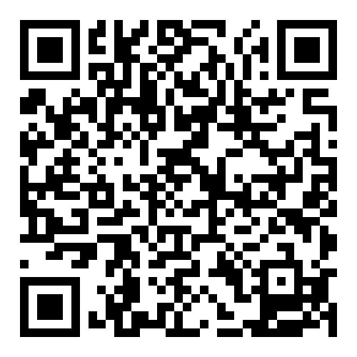
SCAN QR CODE
What is it?
Bridgebuilding and Belonging at the Y is a 3-session virtual learning series designed to equip YMCA staff and volunteers with the skills and strategies to strengthen connection and belonging.
What are the dates?
October 22nd, 2p-3p CST: Discover your Bridgebuilding Blueprint
October 29th, 2p-3p CST: Strengthen Relationships Across Difference
November 5th, 2p-3p CST: Create the Conditions for Connection and Belonging
What does it cost?
The Activation Learning Cohort is free for all YMCA staff & volunteers
Notes:
Staying Connected to the Work (GEORGE)
If today’s experience has raised questions you want to explore further, the Fall 2026 Activation Learning Cohort provides an opportunity to continue that work.
The cohort is open to YMCA staff and volunteers across the Movement. It includes three virtual sessions on October 22, October 29, and November 5 from 2:00 to 3:00 p.m. Central Time.
Participants will explore the Blueprint more deeply, strengthen practical bridgebuilding skills, and consider how those practices can be applied across their roles, teams, organizations, and communities.
Whether you work directly with members, lead a team, build partnerships, or support community initiatives, the experience is designed to connect the Blueprint to work you are already doing.
Registration closes October 9. You can scan the QR code to learn more and register.

Slide 57
closing
The Bridgebuilding Blueprint™ is a free resource for YMCA staff, volunteers, and associations.
Use it to:
Lead teams
Design programs
Support members
Build partnerships
Navigate differences
Strengthen community
Notes:
Final Comments (GEORGE)
Thank you all so much for joining us today and spending time learning about the Bridgebuilding Blueprint.
The Blueprint is free and available to YMCA staff, volunteers, and associations across the Movement.
It is not a mandated assessment or a separate initiative competing with your existing work. It is a resource designed to support the work already happening across the Y.
Return to it as you lead teams, design programs, support members, develop partnerships, navigate differences, and strengthen your community.

Slide 58

Our profile photo
Find Your Profile
Move toward the area marked for your Profile:
Anchor
Architect
Engineer
Mason
Surveyor
Welder
Introduce yourself to at least one person in your Profile group. We will take a group photo once everyone is in place.
If you prefer to remain seated, you can participate from where you are.
Notes:
Find Your Group (NICKY)
Thank you for spending this time with us.
Before we leave, we want to capture our Profile Photos.
Our room hosts will hold signs for each of the six Profiles.
Begin moving toward the area marked for your Profile.
If you prefer to remain seated or need to stay where you are, please do. You can still participate in the photo.
As you gather, introduce yourself to at least one person in your Profile group.
Once everyone is in place, we will take the photo and you can leave
ALLOW APPROXIMATELY THREE MINUTES FOR PARTICIPANTS TO MOVE AND ASSEMBLE.

Slide 59
THANK YOU
George Zavala
YMCA OF THE USA
George.Zavala@ymca.net
Nicky Rosenbluth
VALLEY OF THE SUN YMCA
Nicky.Rosenbluth@vosymca.org

