Slide 1
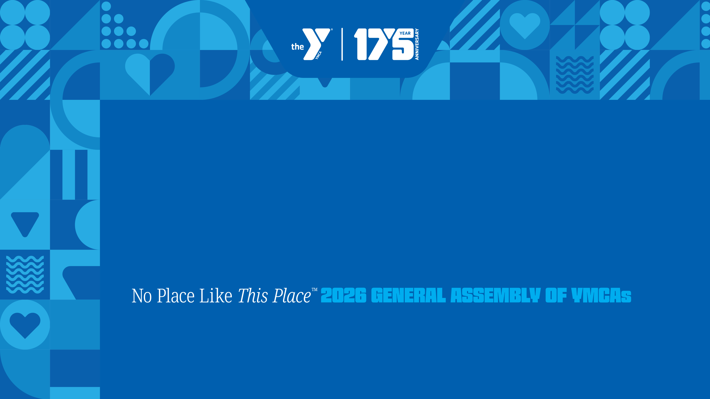
BUILDING A FUTURE WORKFORCE
Moderator: Halina Martinez, Y-USA
Panelists:
Kentrella Jones, YMCA of Greater Montgomery
Ann-Margaret Gutierrez, YMCA of Montclair
Yo Sabha, YMCA of the Triangle
September 18, 2026

Slide 2

Building a future workforce: a strategic workforce development initiative by Y-USA
What we are doing: Hear from YMCA leaders who have been exploring trends shaping tomorrow’s workforce.
What to expect: gain insights into skills, partnerships, and programs that prepare youth for future careers.

Slide 3
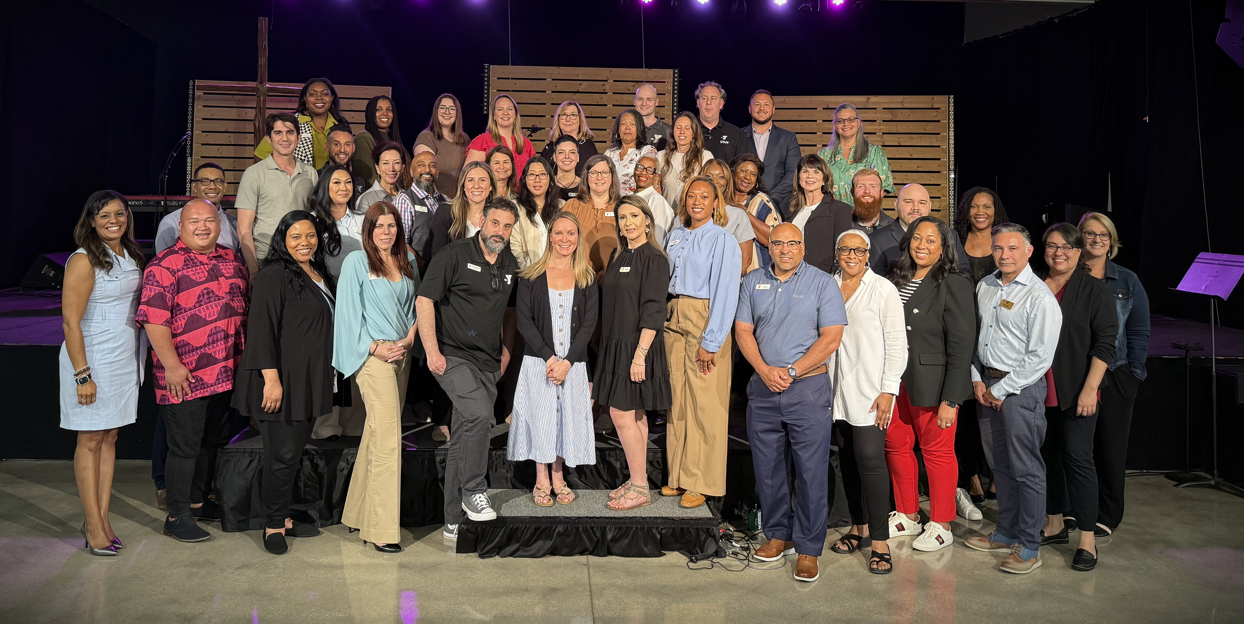
Project team

Slide 4

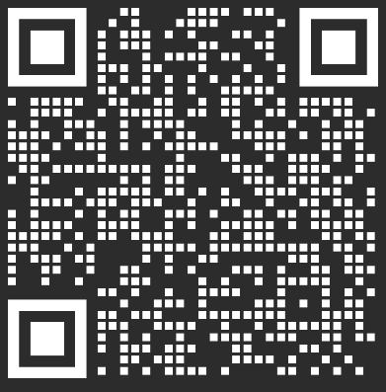
To learn more, visit LINK:

Slide 5
THANK YOU
YMCA OF THE USA
800 872 9622

Slide 6
SIX LEVERS OF CONNECTION​
ELEVATE CONNECTION​
Use shared language and stories to strengthen
purpose and connection.​
PRACTICE CONNECTION SKILLS​
Develop the skills and reinforce the culture that make meaningful connection possible.​
EMBED CONNECTION EVERYWHERE​
Design and deliver experiences that create connection.​
CREATE CONNECTED SPACES​
Build physical and digital environments that spark interaction and create access and belonging for all. ​
INVITE CONTRIBUTION ​
Provide opportunities for people to share their time, talents, and voices to create change.​
SUPPORT WELL-BEING​
Foster experiences that elevate health and well-being and help all people thrive. ​

