Slide 1

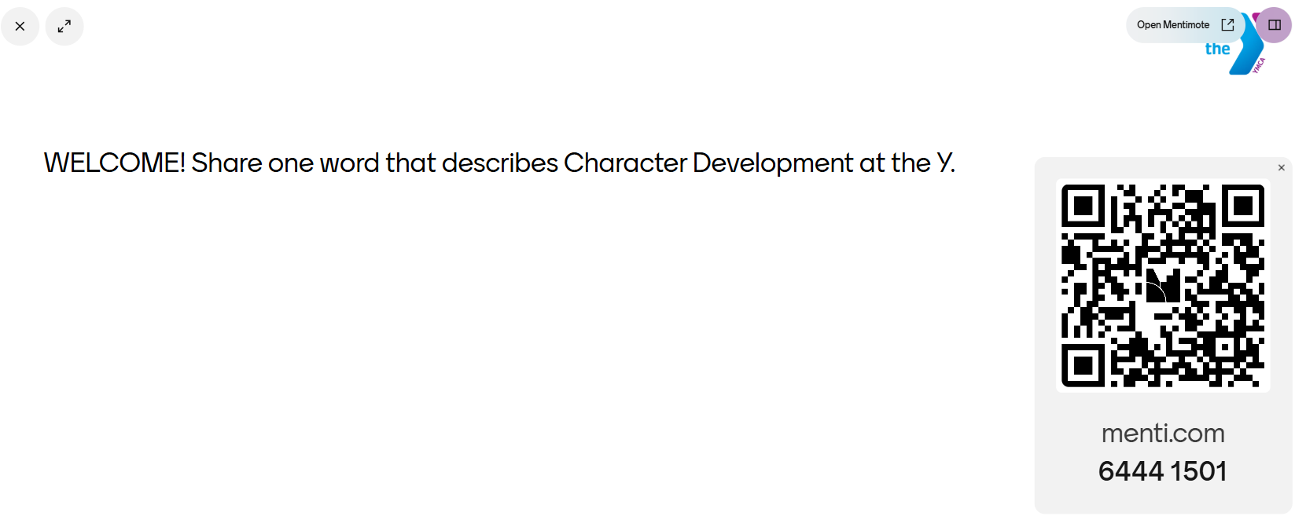
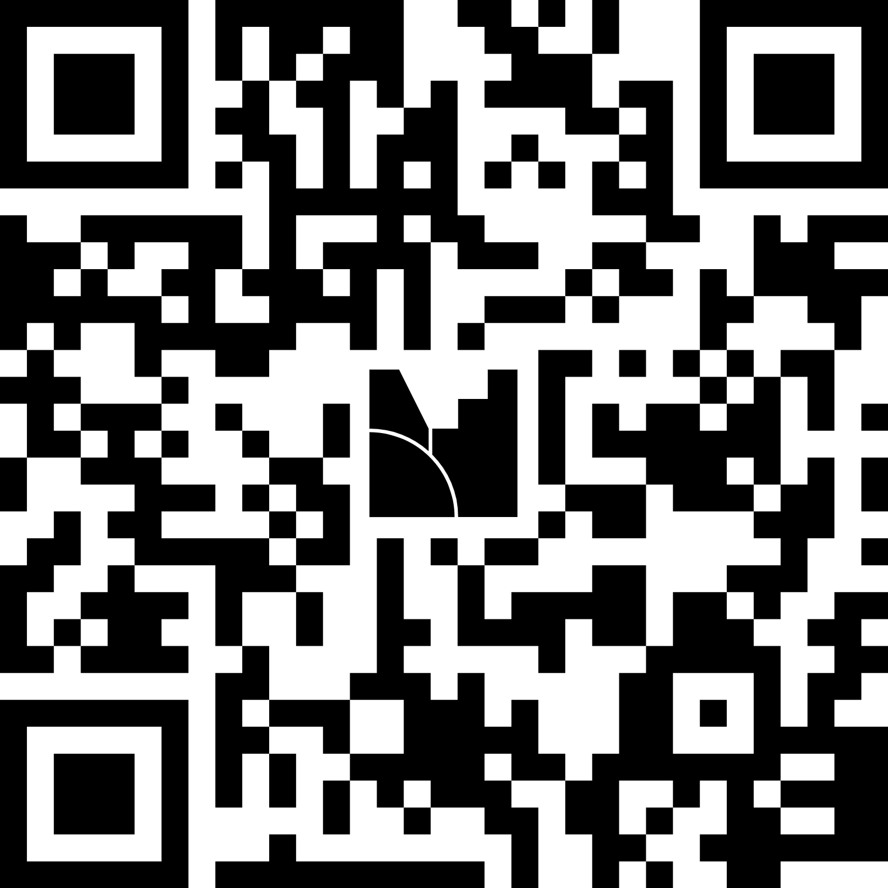
Welcome!
SCAN QR or go to site to add to our word cloud!
OR visit: www.mentimeter.com
Code: 6444 1501
Notes:
Warm Welcome – 5-7 min
Menti: https://www.menti.com/alsb9ffdeoid
Menti Code: 6444 1501
<div style='position: relative; padding-bottom: 56.25%; padding-top: 35px; height: 0; overflow: hidden;'><iframe sandbox='allow-popups allow-scripts allow-same-origin allow-presentation' allowfullscreen='true' allowtransparency='true' frameborder='0' height='315' src='https://www.mentimeter.com/app/presentation/altmv5uhzrj1p8o7g9furf33qcco674j/embed' style='position: absolute; top: 0; left: 0; width: 100%; height: 100%;' width='420'></iframe></div>
Invite participants to scan the Menti responses. Call out two or three patterns using participants’ own words.
SAY: These responses remind us that character development shows up in different ways across the Y. Our opportunity is to make the practices more visible, consistent and intentional.

Slide 2

CHARACTER DEVELOPMENT AT THE Y LEARNING ZONE
Louis Ogle, YMCA of Greater New Orleans
Candace Crane, Northern Middlesex County YMCA
Kim Keith, YMCA of the Triangle
Notes:
Opening – 7 min
WELCOME!! Thank you for joining us today. This session highlights tools and practices that strengthen values-based leadership.
We will hear from 3 Ys who will share their advanced approaches for fostering character development in youth and adults.
Today we used quick survey tool to hear directly from you to get a pulse check around shared language and association that you each have with Character Development at the Y. At the end of this learning zone session, we will give you another opportunity to share even more to join us in supporting Character Development at the Y.
Thank you again for your responses from our welcome pulse check and for participating in our “warm welcome” and in the opportunity to make these tools and practices more visible, consistent and intentional.

Slide 3
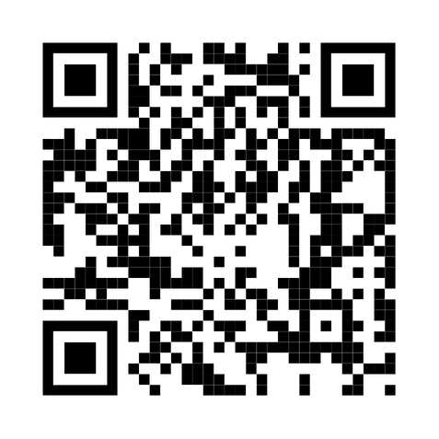
Character Development At the Y
Overview & Definition
Character development is the process through which youth develop and integrate a set of values, skills, attitudes, and behaviors that allow them to operate successfully and responsibly in learning, work, and life.

Slide 4
Character Development At the Y
YMCA approach
Everyday interactions | Adult Influence | Supportive Environments
Character development happens in greetings, transitions, conflicts, choices, reflection, leadership, and repair. | Adults shape the culture by how they listen, guide, respond, model, and support youth practice. | Programs and organizations create conditions that make strong adult practices easier to use consistently.
Notes:
Character development is not accomplished solely through a single program. It is how we as adults in their lives show up in everyday interactions. It is the way we create experiences within supportive environments where young people can belong, grow, contribute, and thrive.
Since important work that has been happening since 2017 through the Character Development Learning Institute, character development happens through relationships, supportive environments, and intentional adult actions that are improved over time, not through standalone experiences. A warm welcome consistently practiced that becomes a welcome routine, can help create the conditions where young people feel safe, known, valued, and ready to participate.

Slide 5
Character Development At the Y everyday practices, lasting impact
WARM Welcome
Empathy → Shows care and belonging.
Emotion Management → Creates emotional safety.
Responsibility → Encourages engagement.
Personal Development → Invites learning.
Relationship Building → Builds trust and connection.
Notes:
Character development is not one more thing to do. It is what happens when we use everyday moments intentionally to help young people grow. This also includes how we show up for each other. We decided to choose one practice that is easy for Y folks to practice everyday in their programs, team meetings, and more! It can be a powerful example of how adult practices become visible in everyday interactions.
A warm welcome is often the first character-building moment of the day. It communicates belonging, models empathy, strengthens relationships, supports emotional readiness, creates opportunities for responsibility, and opens the door for personal growth.
Empathy
Greeting youth by name, noticing who may be withdrawn, and showing interest in their experiences communicates, "I see you and you matter." This reflects understanding and valuing others' perspectives and experiences.
Relationship Building
Consistent welcomes create trust, belonging, and connection. Simple actions such as learning names, checking in, and creating a welcoming tone help youth feel connected to adults and peers.
Emotion Management
A calm, predictable welcome routine can help youth regulate emotions as they transition into a program space. Check-ins provide opportunities to acknowledge feelings and help youth reset if needed.
Responsibility
Youth can be given meaningful roles in welcoming others, leading greetings, or helping newcomers feel included. This builds reliability, contribution, and ownership.
Personal Development
Welcoming interactions can encourage reflection, goal setting, and growth. Questions such as "What are you hoping to accomplish today?" help youth connect participation to their own development.

Slide 6
Character Development At the Y
Intentional practices, lasting impact
Quick survey
Empathy → Listens to youth voice.
Emotion Management → Might surface emotional needs.
Responsibility → Promotes accountability.
Personal Development → Guides reflection and growth.
Relationship Building → Strengthens connections.
Notes:
Another tool and practice is applying measurement to what we do. The quick survey today also showed how we use different language and words to describe character development.
Data is most valuable when it helps us learn, adapt, and improve, rather than simply measure results.
Quick data checks help adults notice what's working, identify opportunities for growth, and make small adjustments that strengthen character-building experiences over time.
Quick data checks turn everyday observations and feedback into learning, helping adults strengthen relationships, improve practice, and better support youth character development
We invite you to think how you have done or witnessed something like this or in the past with your staff, in your programs, or in other spaces with people.
Empathy: Helps adults understand youth perspectives.
Emotion Management: Identifies emotional needs and concerns.
Responsibility: Encourages accountability for youth experiences.
Personal Development: Supports reflection and growth.
Relationship Building: Reveals opportunities to strengthen connections.

Slide 7
Character Development At the Y consistent practices, lasting impact
Honesty
Respect
Responsibility
Caring
Empathy
Emotion Management
Responsibility
Personal Development
Relationship Building
Character-centered practices are important to values-based leadership
Notes:
These practices, identified from the work that begun with the Character Development Learning Institute in 2017, have been re-verified through an environmental scan by an external Y-USA partner in 2025 and continue to be key character-centered practices that when practiced with consistency, intentionality, and continuous improvement help strengthen character development efforts at our Ys and in our communities across the country. These practices of empathy, emotion management, responsibility, personal development, and relationship building are also how we embody the core values and show how our Y core values of honesty, respect, responsibility, and caring come to life.
As you listen to this next section, if anything comes up for you, we’d love to hear from you as well. We will have a survey at the end for you to share your stories of character development at your Y!

Slide 8
INVITE
CONTRIBUTION
Provide opportunities for
people to share their time,
talents, and voices to
create change.​
Notes:
Now, we are going to hear from members of a Character Development project advisory group who is working alongside Y-USA, Y-USA partners, and YMCA network to help embed character development in communities across the country.

Slide 9

fostering character development in youth and adults
Notes:
12 min (3-4 min each presenter)

Slide 10
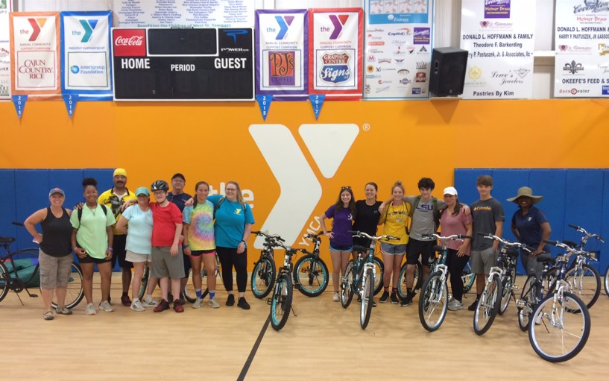
YMCA of greater New Orleans our story begins
Participation in Character development learning institute
Leaders Club at West St. Tammany Branch
  Offered activities in the five adult practice areas
  Added to activities:
    Parent participation
    Physical activity
    Outdoor element
Notes:
Participated in Character development learning institute
Leaders Club at our West St. Tammany Branch (Other Ys implemented through after school, summer camp, youth sports, etc.)
Had no idea what we were doing. We chose to offer activities in the five adult practice areas to teens enrolled in the program
We added parent participation to our activities
Included physical activity and outdoor element to activities

Slide 11
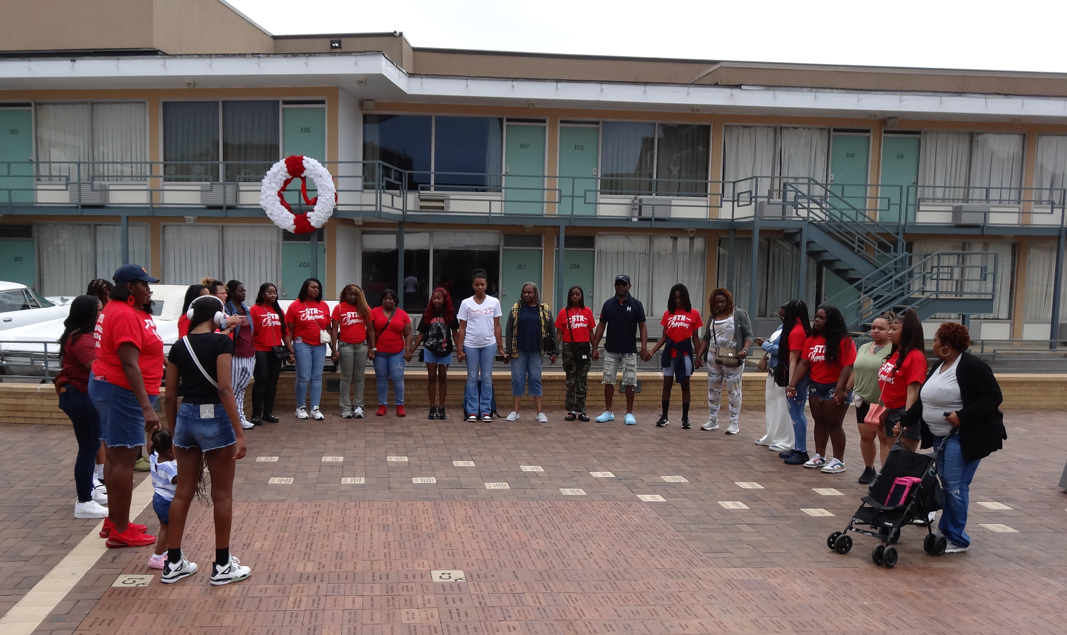
YMCA of greater New Orleans putting it all together
Warm Welcomes
Communication Skills: Public Speaking/Writing
Authentic Choices
Mindfulness
Tie Current Activity to Prior Learning
Parent Involvement

Slide 12
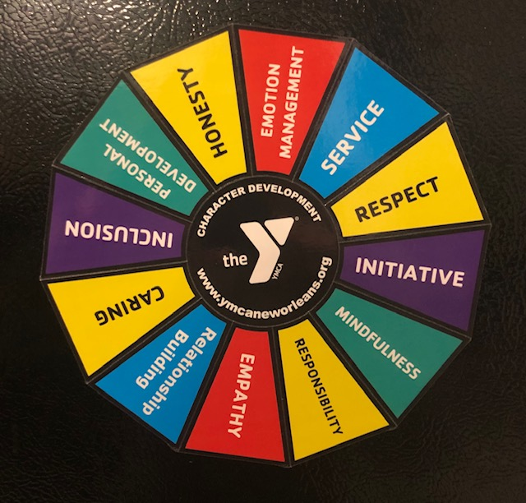
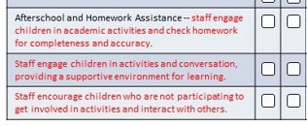
YMCA of greater New Orleans expanding impact & cultural change
Character Wheel
Added Character Development Essentials to Standard Practices and Expectations for Branches
Staff Training & Evaluation

Slide 13
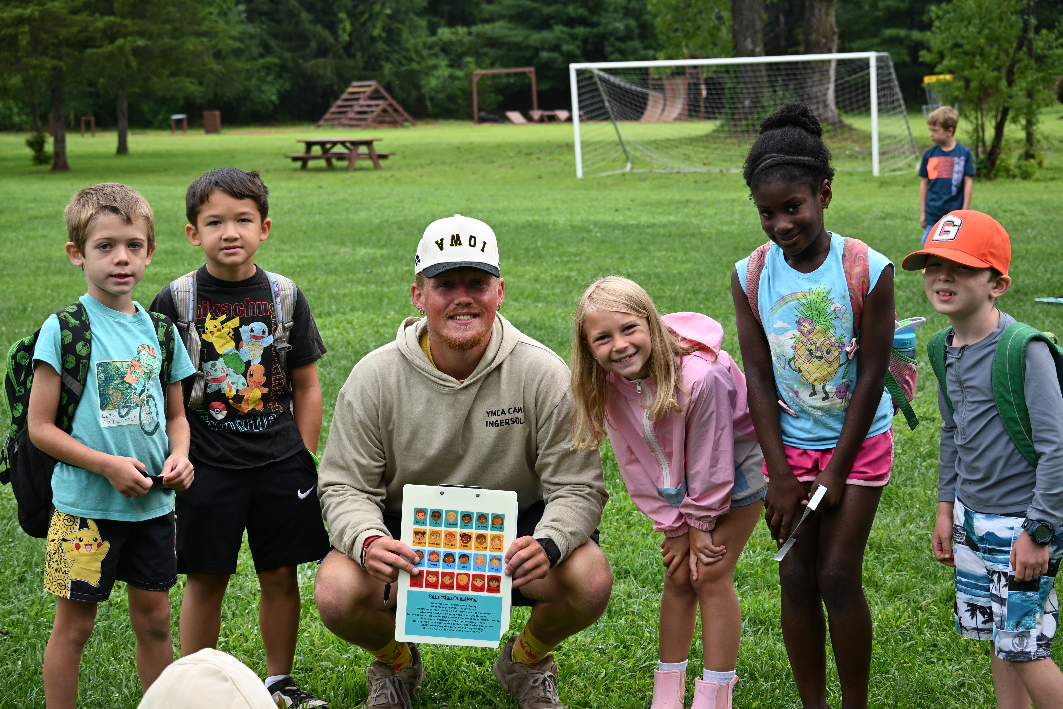
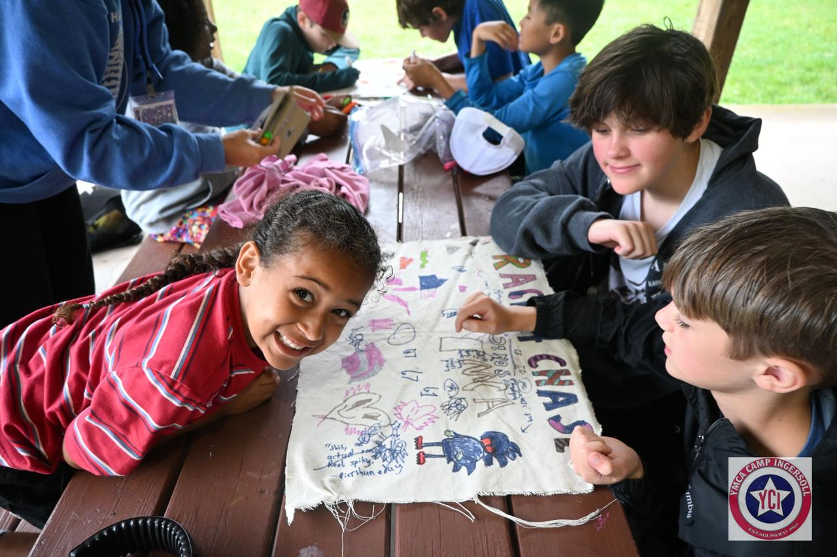
Northern Middlesex County YMCA creative consistent Communication
Check-in Clipboards
Group Flags
Responsibility Roles
Character Classes
Notes:
Northern Middlesex County YMCA
Check-In Clipboards – Each morning, counselors use a clipboard with different emotions to check in with their campers and give them an opportunity to share how they are feeling before the day begins.
Group Flags – Each group creates a flag that represents their group, including how they want to be treated by others and what their group expectations are for the session.
Responsibility Roles (Ownership Opportunities) – Campers are assigned different roles each morning to help them build responsibility and ownership. These roles encourage campers to take care of their belongings, contribute to their group, and help others.
Character Classes – Throughout the summer, campers participate in character-building classes focused on our core values of Honesty, Respect, Responsibility, and Caring. Activities include designing and building group shields, learning what each value means, and completing different challenges.

Slide 14
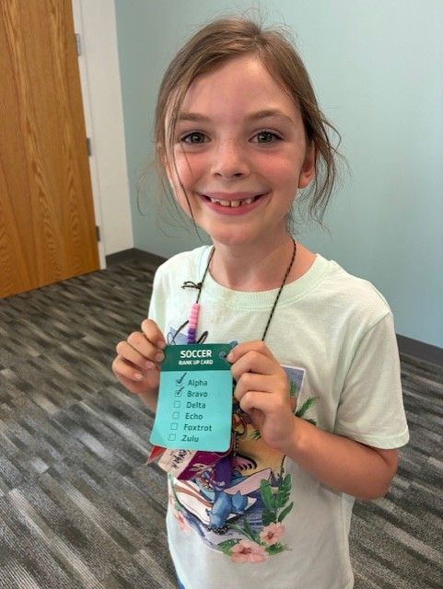
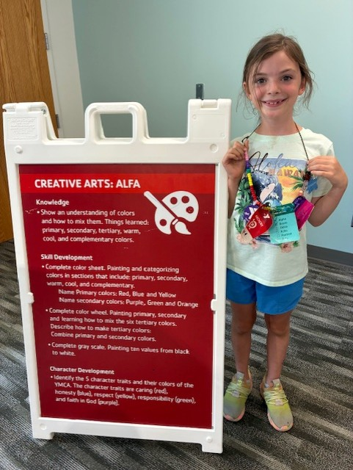
YMCA of the Triangle every bead tells a story
Character development at summer day camp
Personal Development
Relationship
Building
Counselors know interests, strengths and motivations
Goal setting through Creative Arts rank progression and Soccer skill growth
Responsibility
Emotion Management
Practice, effort, accountability and ownership of goals
Persevering through setbacks, frustration and slow progress
Notes:
CDLI Insight: Character development happens when caring adults intentionally show up through consistent practices that help young people grow.

Slide 15
Character Development At the Y it happens in everyday moments
Key elements
Adults intentionally show up for young people and each other
Experiences created with and for young people to help them grow
How the Y reinforces and supports efforts consistently over time
Notes:
Closing – 5 min
Thank to our presenters. I learned from them that you do not need to have every answer before you begin. Start with intentional practices, learn what works, and build conditions that that help staff deliver a consistent experience. Character development becomes real when caring adults use intentional practices often enough that young people experience them consistently.
Character Development helps make the "how" of positive youth development more visible, intentional, measurable, and scalable across the Y Network.
Character Development lives in everyday moment.
We have heard from three Ys and as part of our current project, we want to hear from you and the larger Y network. How does character development happen at your Y?

Slide 16
Character Development At the Y it happens in everyday moments
Key elements
Adults intentionally show up for young people and each other
Experiences created with and for young people to help them grow
How the Y reinforces and supports efforts consistently over time

Slide 17
What can you do to foster character development at your Y?
HOW Ys
CAN TAKE
ACTION ​

Slide 18
PRACTICE
CONNECTION
SKILLS​
Develop the skills and
reinforce the culture that
make meaningful
connection possible.​

Slide 19
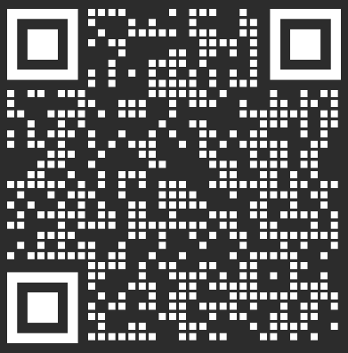
Character Development At YOUR Y!
Y Network Survey &
Scan QR code to take the survey
Share the survey with staff and volunteers at your Y
THANK YOU!
Notes:
We invite you to share your Y story! Share what your Y is doing now, what is working and where support is needed.
The survey will help us understand current approaches, learn from what is working and identify where Ys may need resources or support.
The survey will help us move from individual stories to a clearer picture of how character development is being implemented across Ys
CD Network Survey: https://engagement.ymca.org/jfe/form/SV_22YEiYn7OP5p7CK
Stay tuned for more.
We plan to post Character Development Updates on LINK in October!
E-Learnings coming soon to the Learning Hub!
Additional resources and opportunities to support Character Development at the Y will be available on LINK soon!​

Slide 20
THANK YOU
Halina Martinez
YMCA OF THE USA
800 872 9622
halina.martinez@ymca.net

