Slide 1

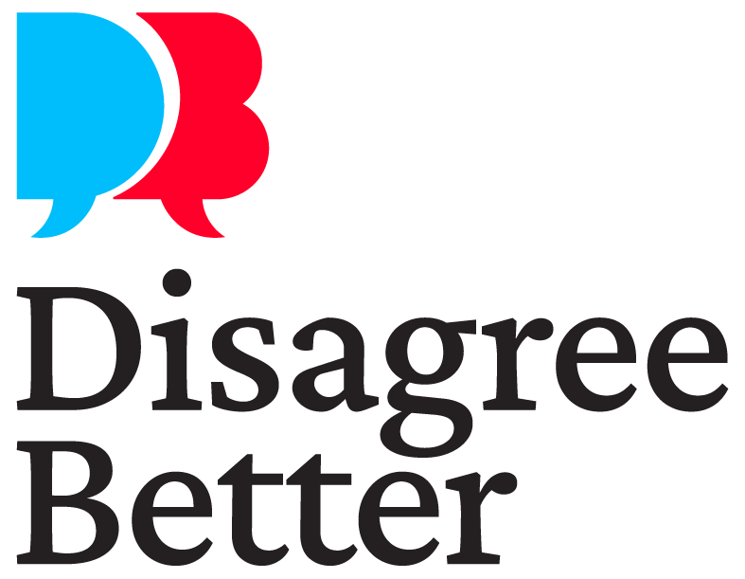
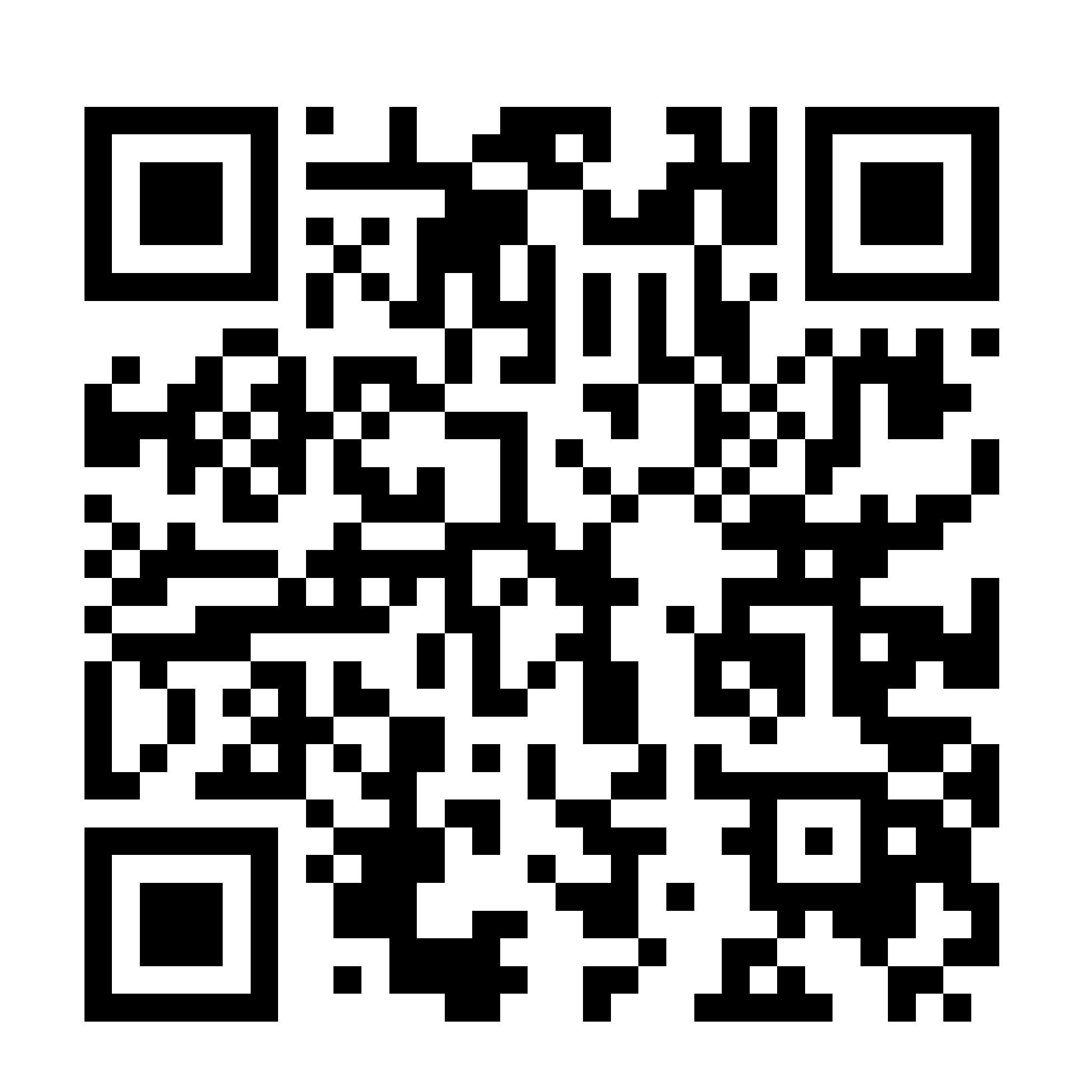
Disagree Better to Build Community
Dr. Chad Ford
International Conflict Mediator and Peace Educator
Marianne Viray
Executive Director, Disagree Better
🌐 disagreebetter.us
✉️ hello@disagreebetter.us
📷 @DisagreeBetter

Slide 2
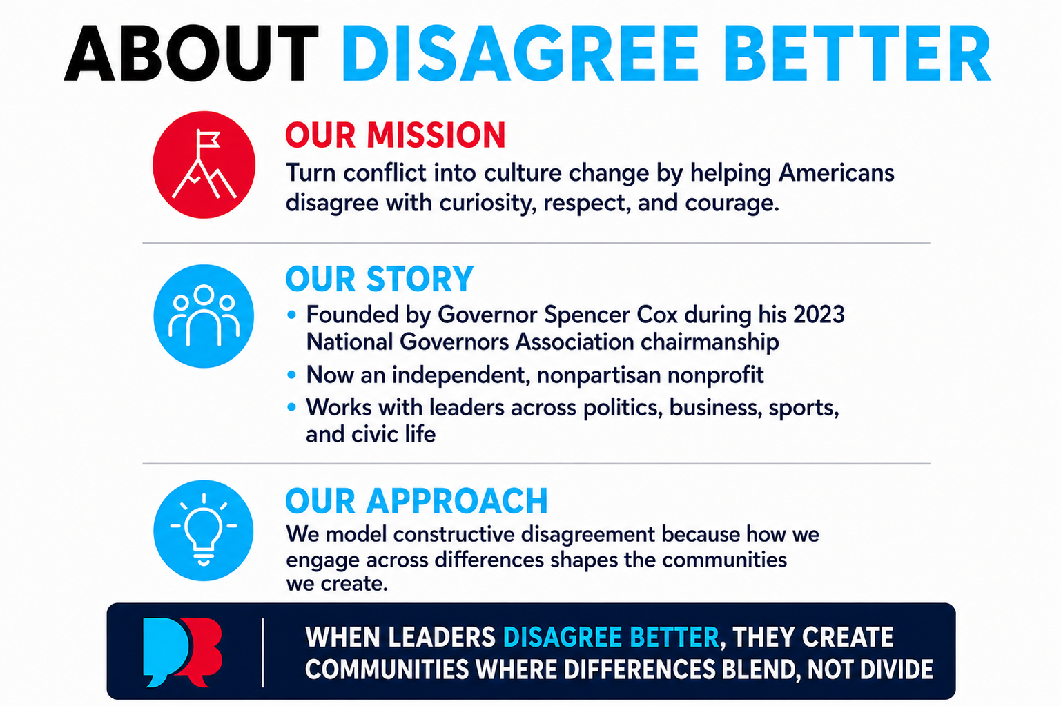
Notes:
How do you feel about slightly changing the Our approach to: We model constructive disagreement because how we engage across differences shapes the communities we create

Slide 3
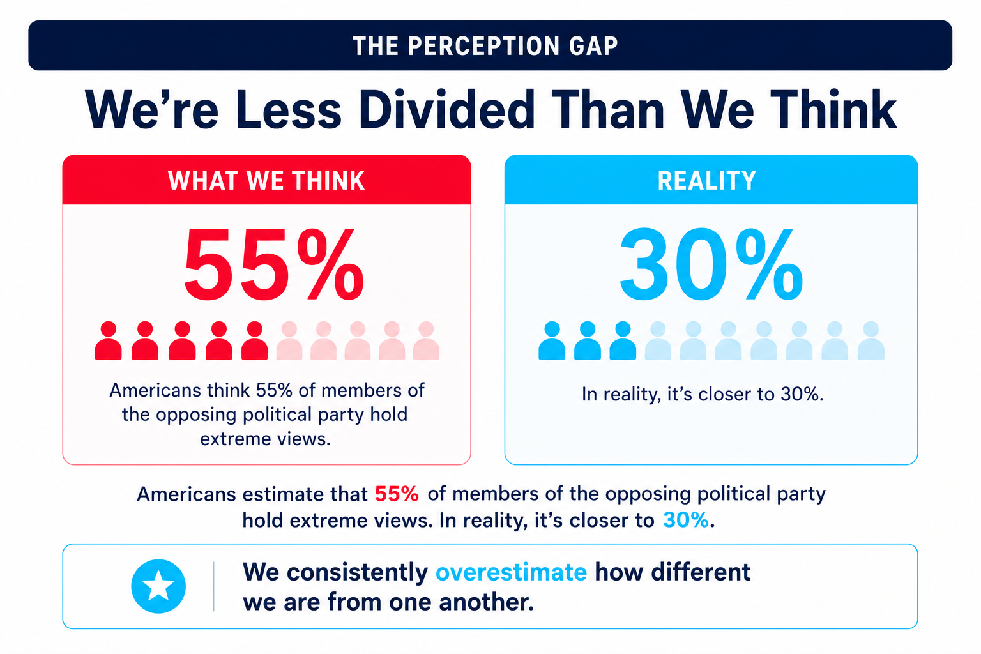
Notes:
References: 71% stat - More in Common, 8 in 10 is from Gallup, 9 in 10 is from AP-NORC

Slide 4
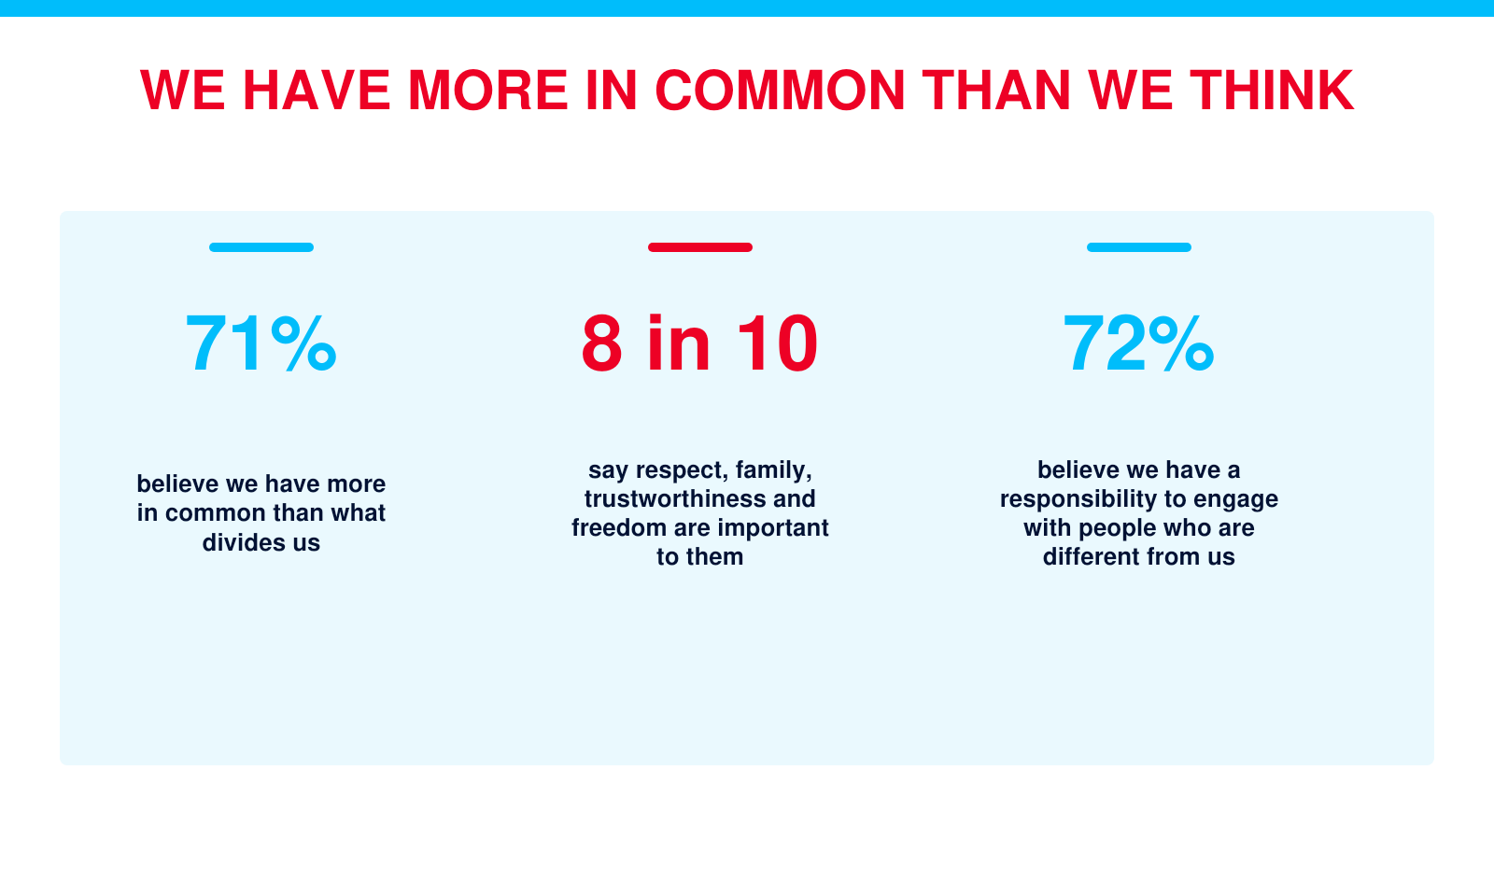

Slide 5
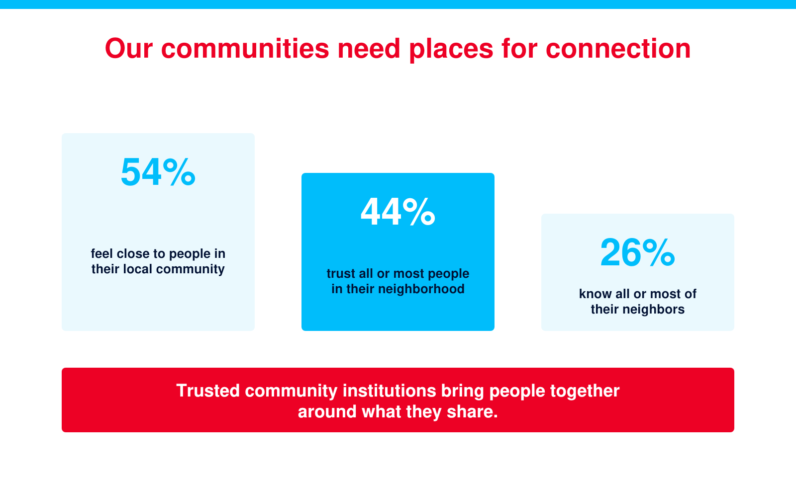

Slide 6
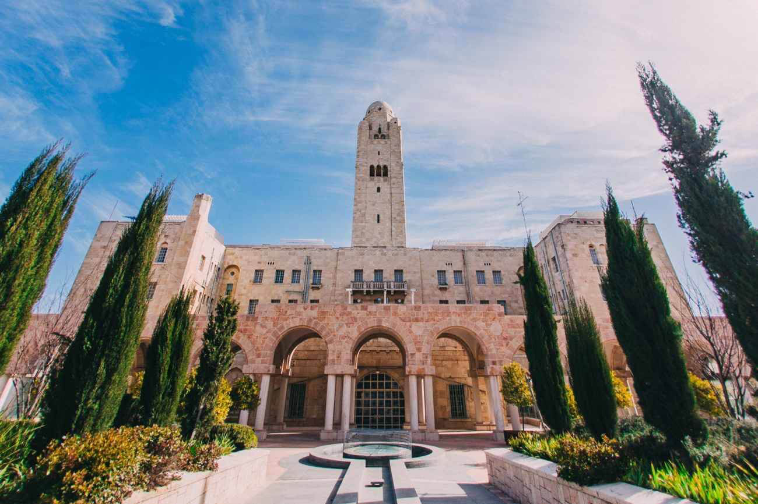
Photo: Jerusalem International YMCA

Slide 7
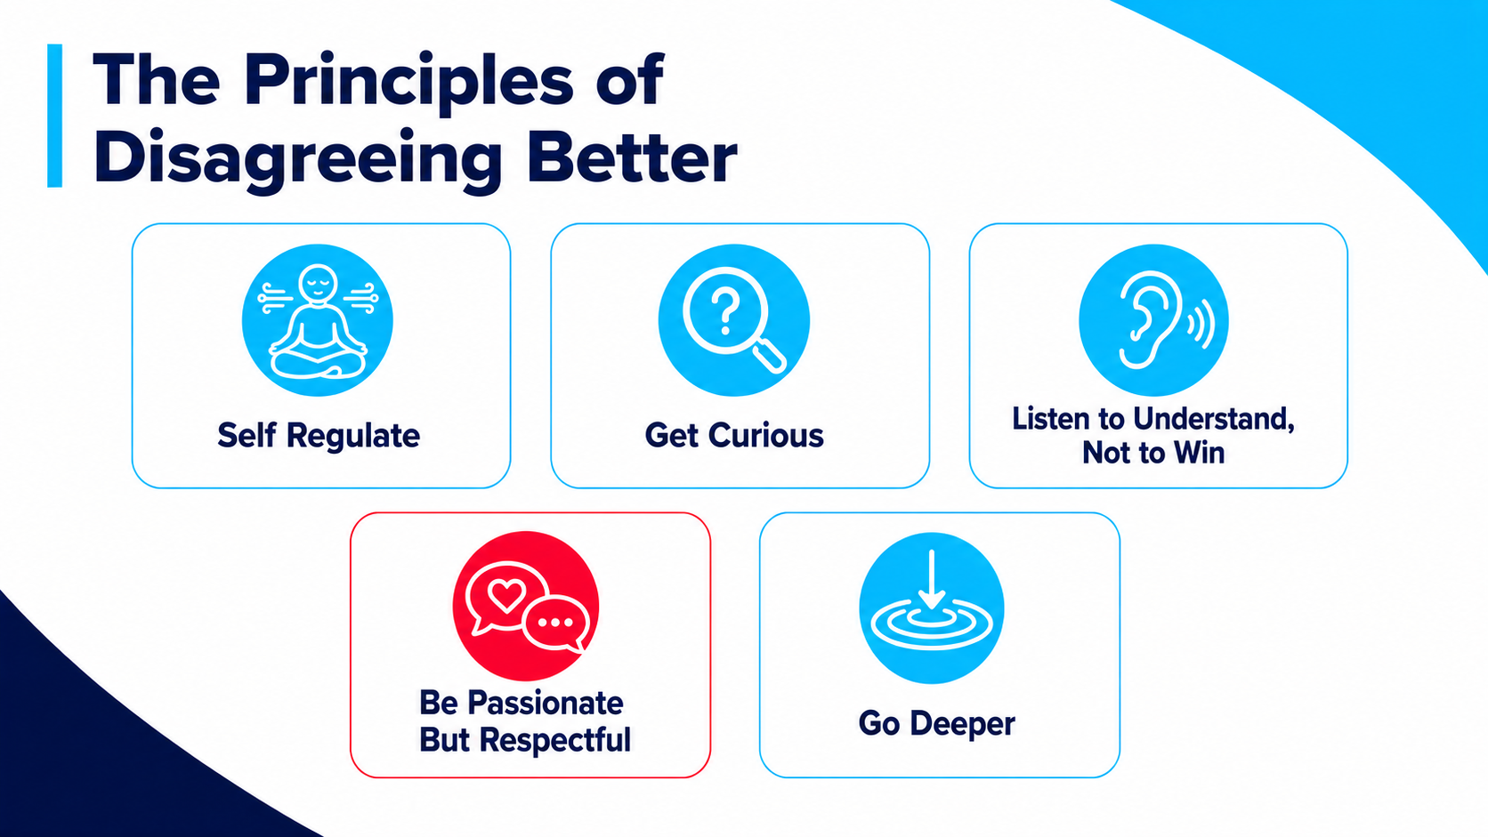

Slide 8
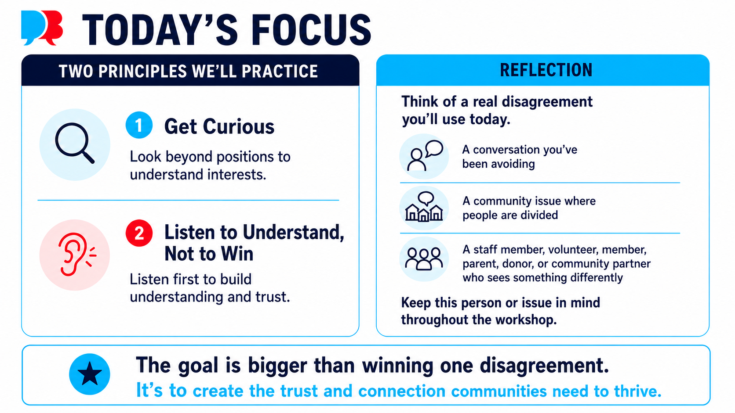

Slide 9
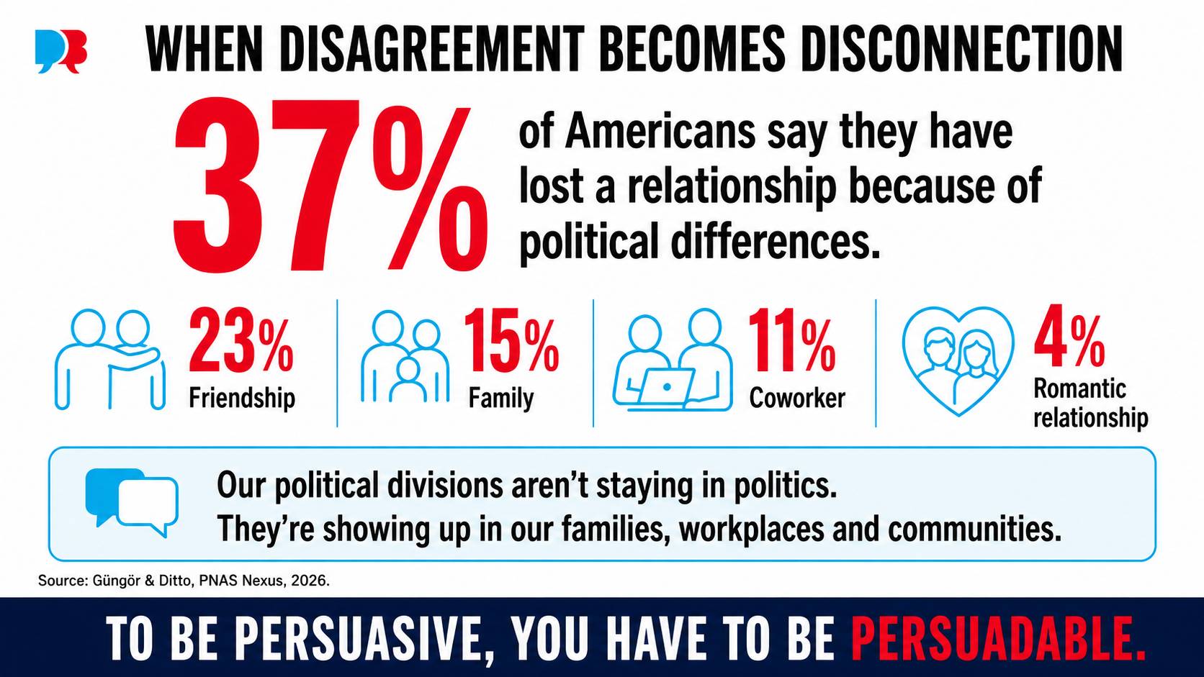
Notes:
likIe we shouldnt use the covey quote its so overused i like the bottom line much better because its unique To be persuasive, be persuadable everyone has h

Slide 10
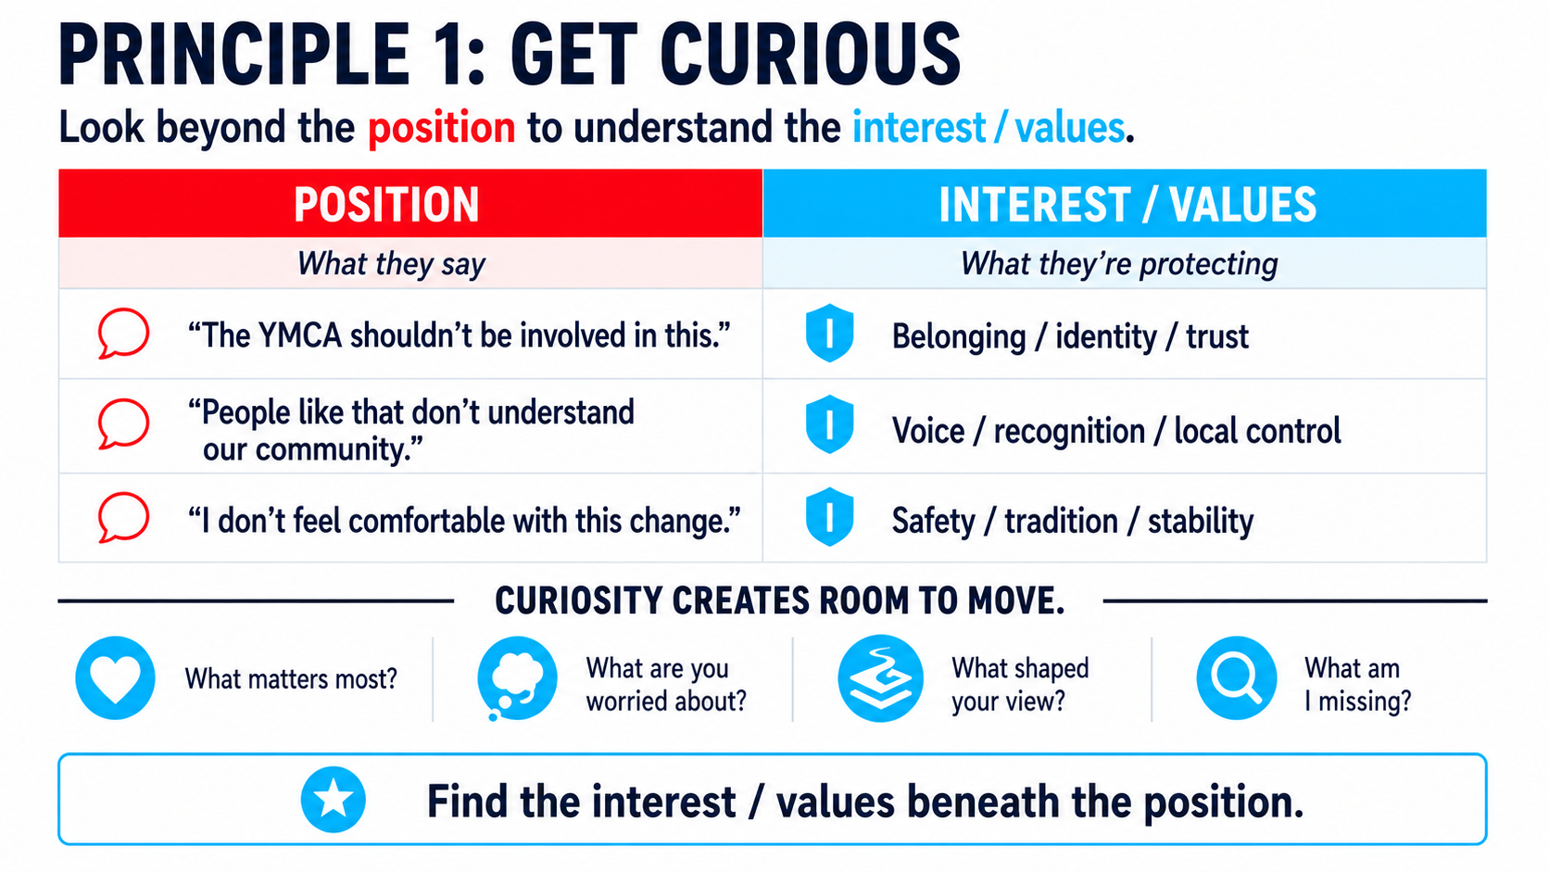

Slide 11
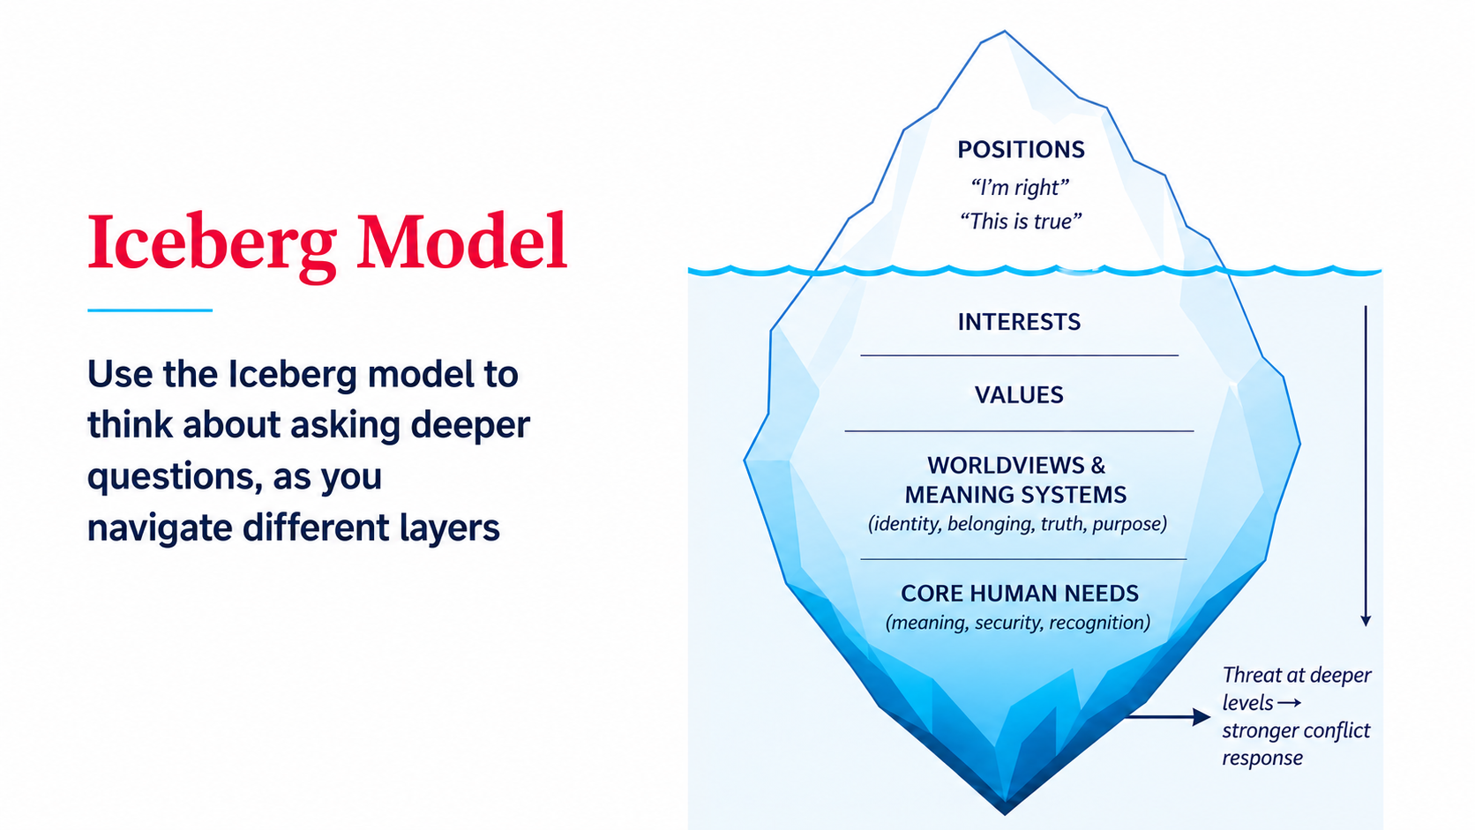

Slide 12
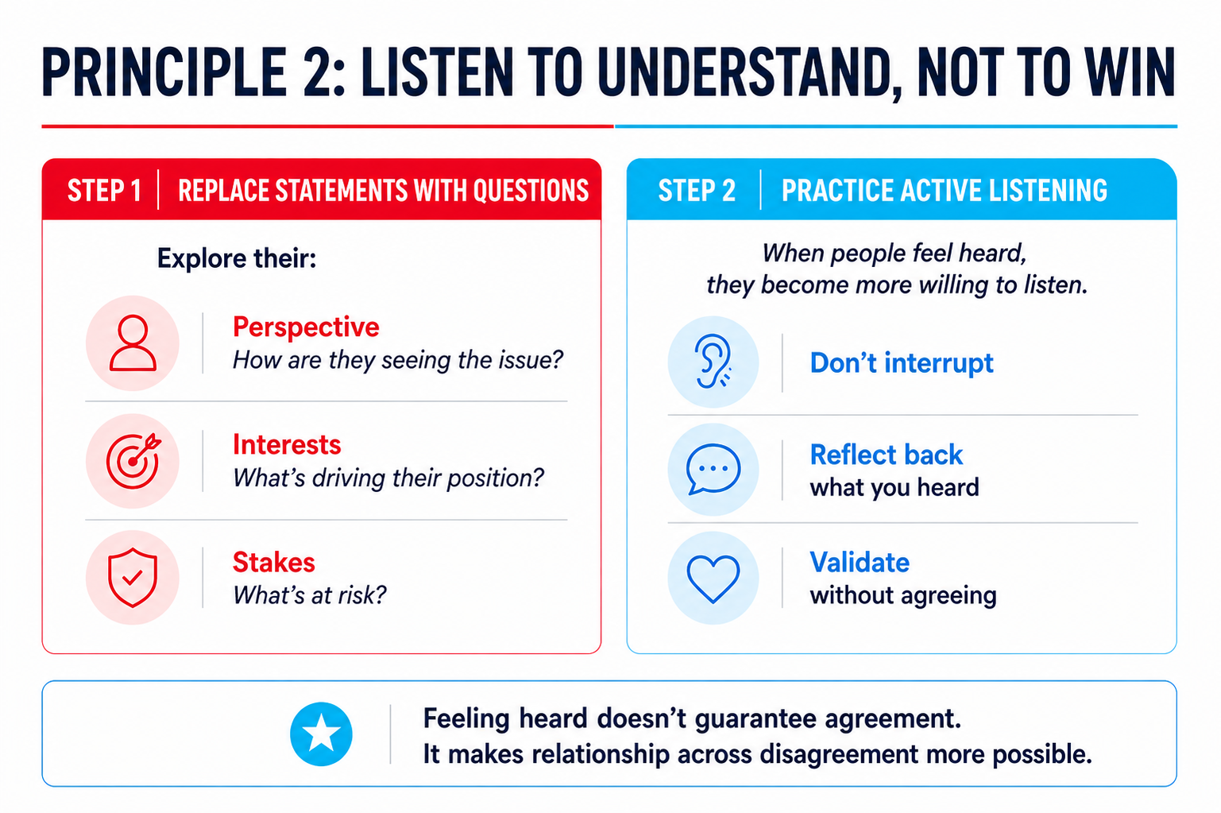

Slide 13
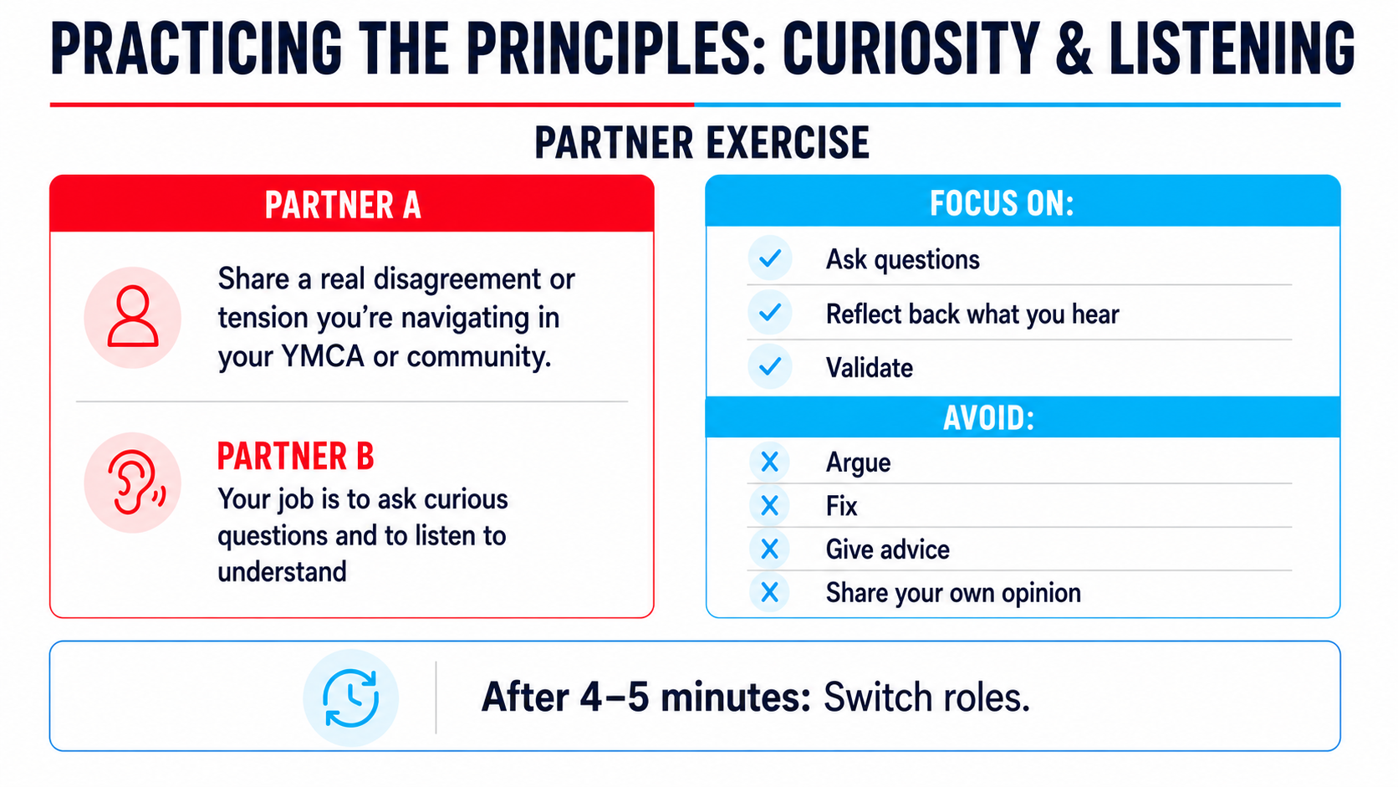

Slide 14
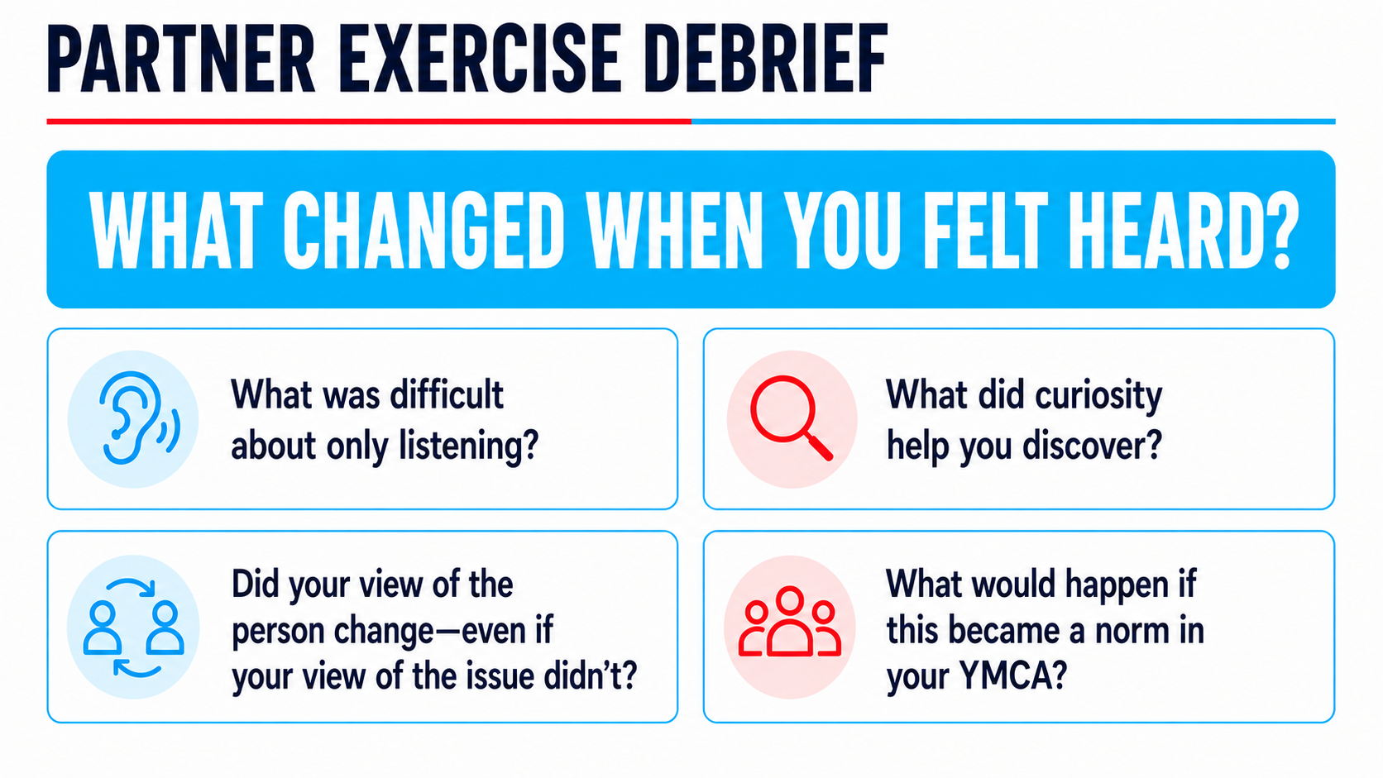

Slide 15
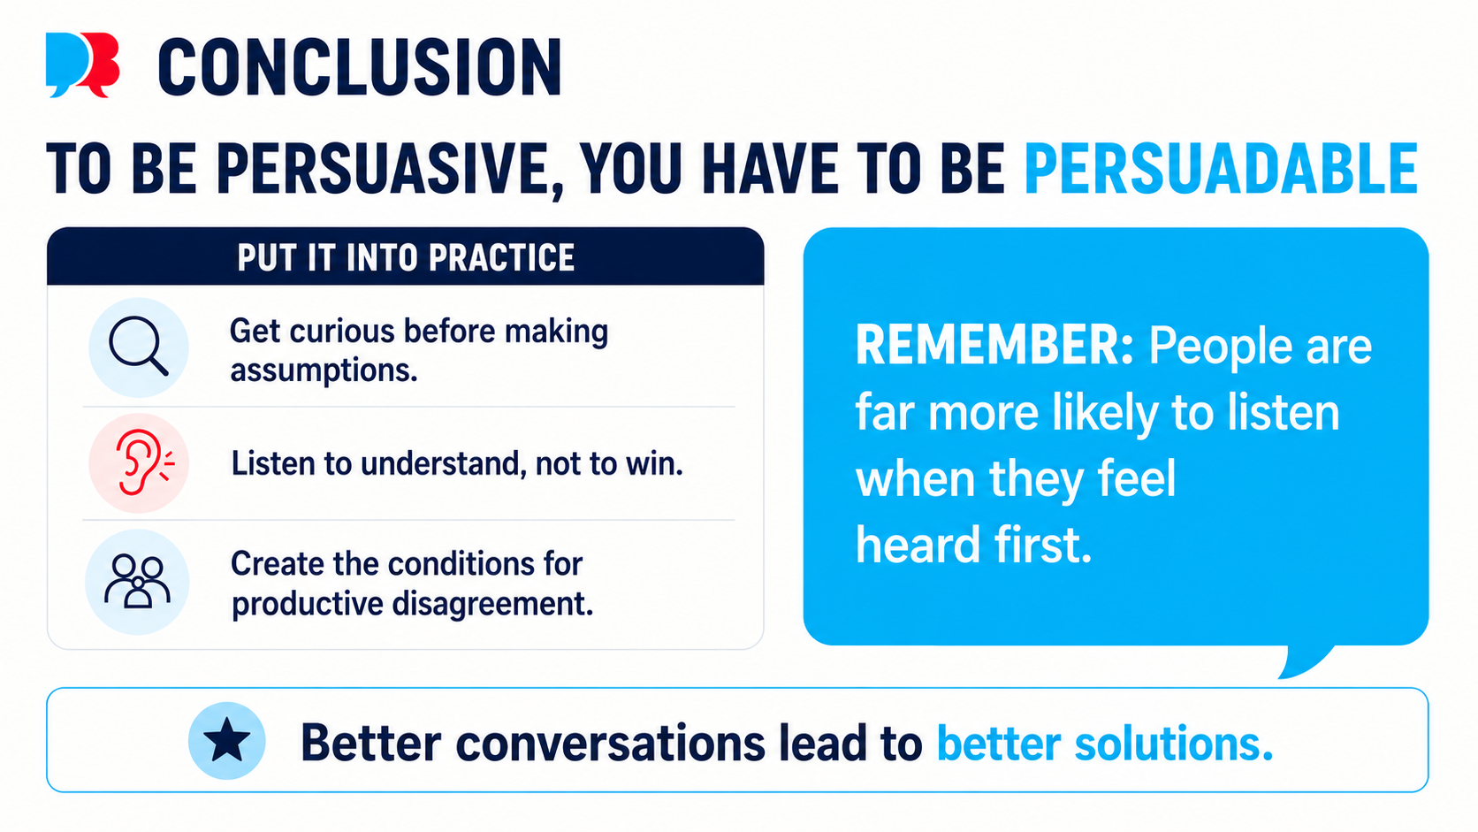

Slide 16
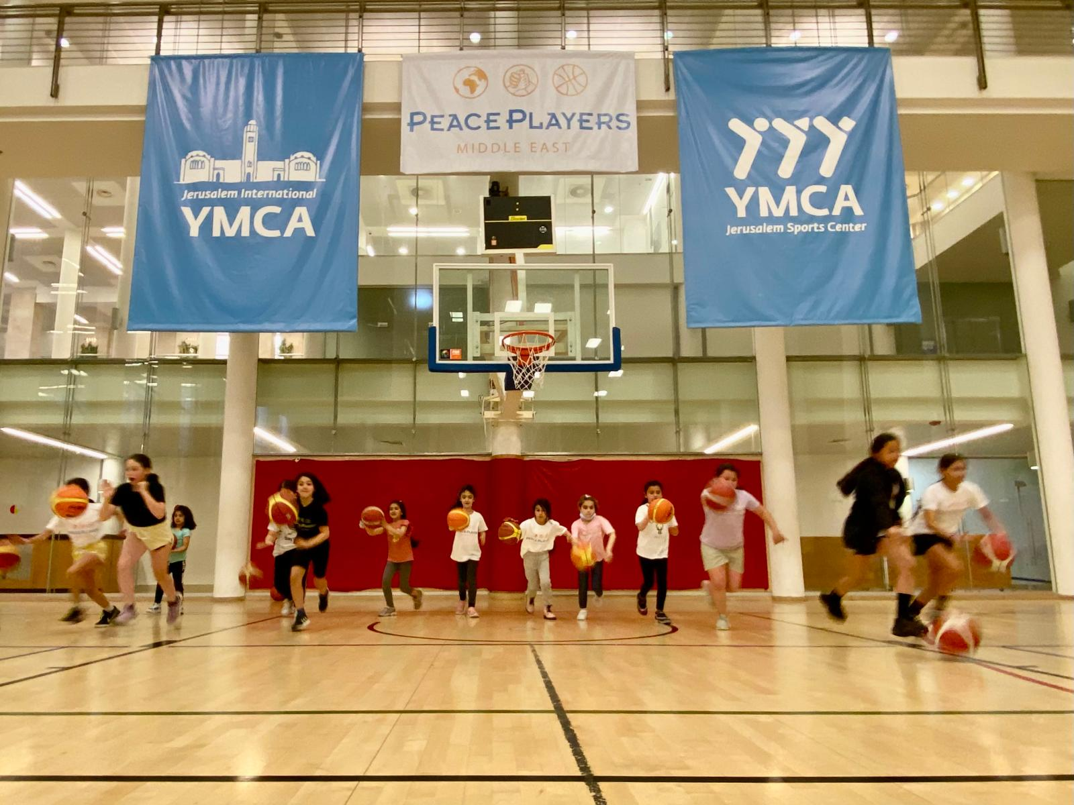
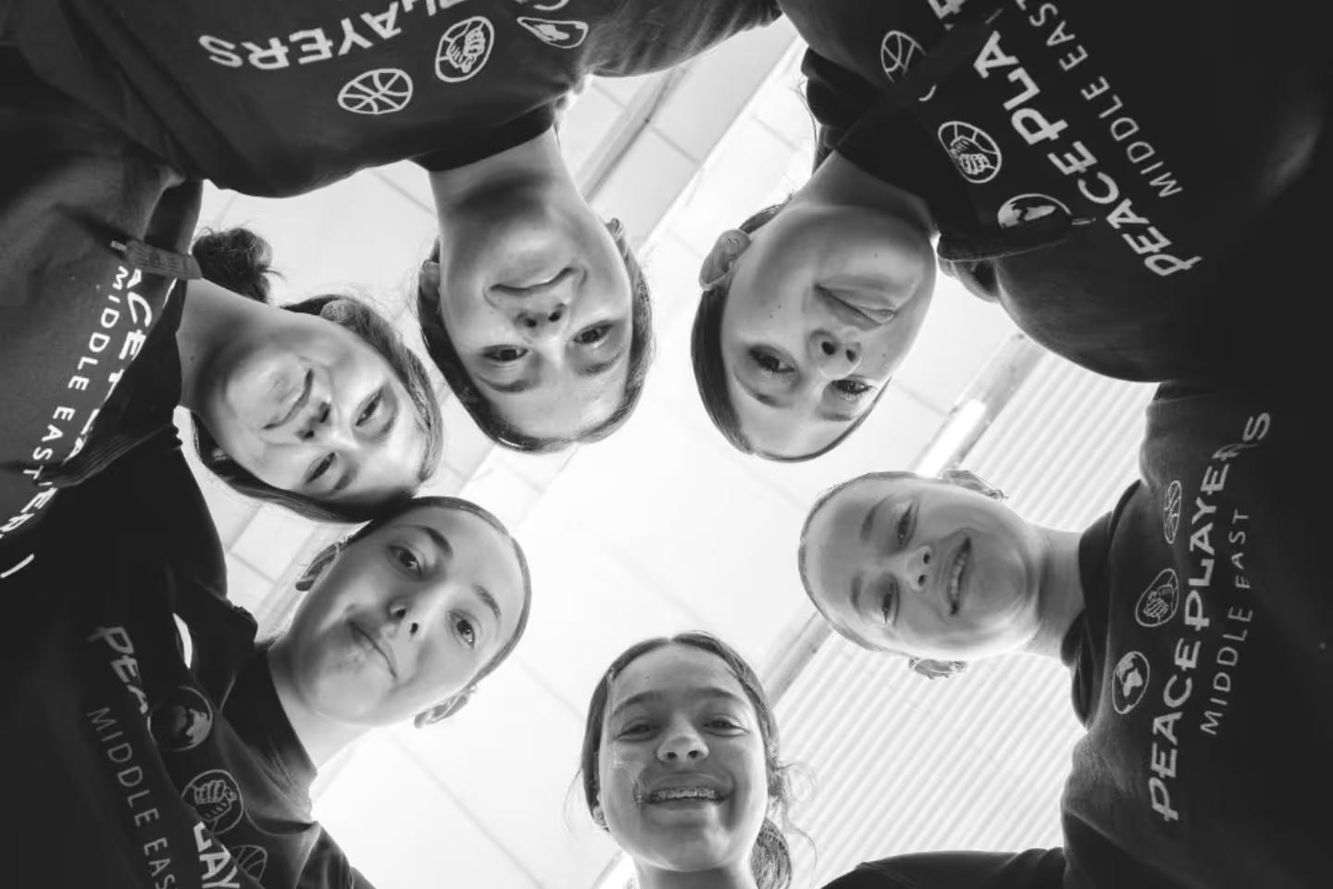

Slide 17
