Slide 1

EXPANDING FOOD ACCESS IN CRISIS & BEYOND
Lauren Anderson – Instacart
Stacey McDaniel – YMCA of the USA

Slide 2
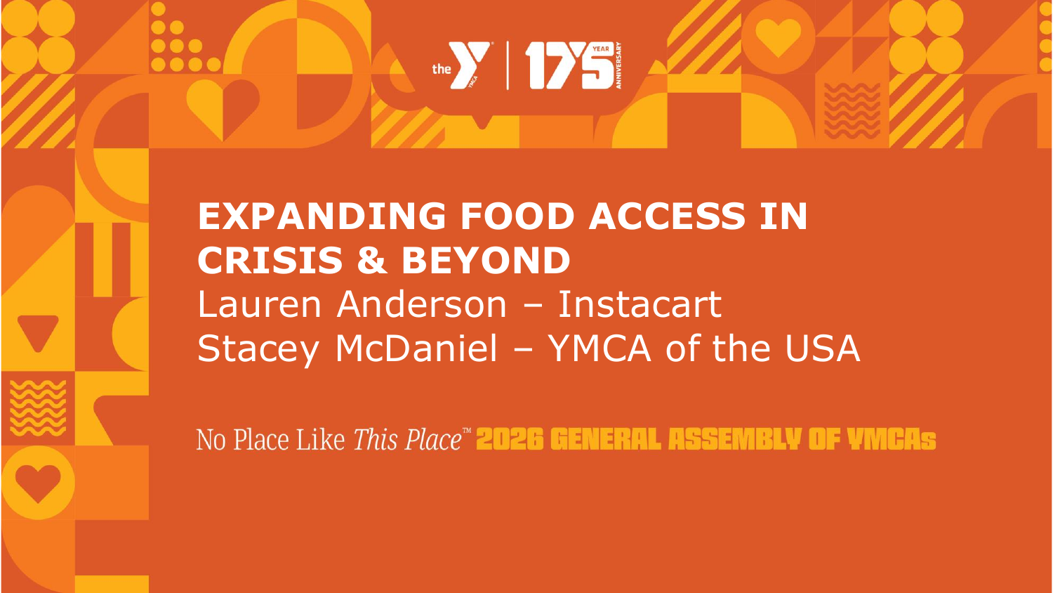

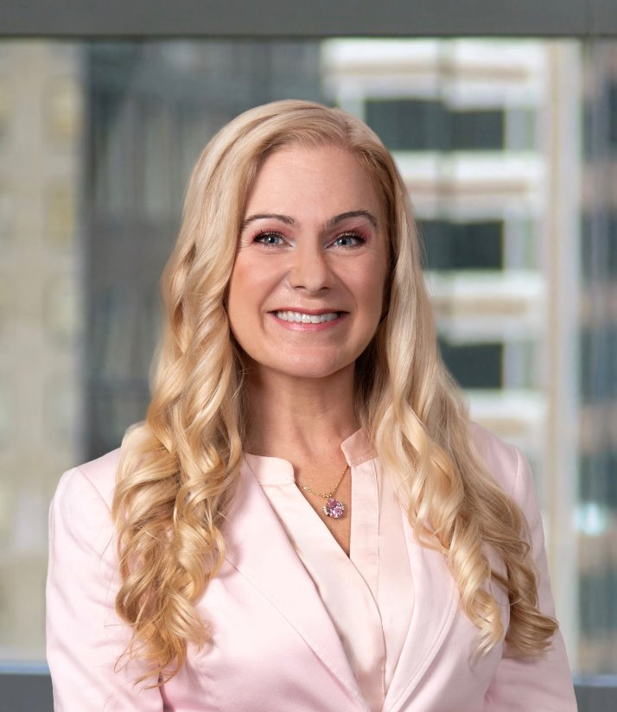
EXPANDING FOOD ACCESS IN CRISIS AND BEYOND
General Assembly · September 2026
Photo
Photo
ABOUT THIS SESSION
● How a crisis partnership grew into a multi-year food access strategy
● Community Carts, Fresh Funds, and employee engagement
Laura Anderson
Stacey McDaniel
● Expanding grants and volunteer programs in 2026–2027
Director, Social Impact
Instacart
Director, Anti-Hunger
YMCA of the USA

Slide 3
WHO WE ARE
Instacart
YMCA of the USA
● Creating a world where everyone has access to the food they love and more time to enjoy it together.
● Anti-hunger programming centered in creating connected communities through all three causes: youth development, healthy living, and social responsibility
● Reaches 98% of U.S. households — including nearly every SNAP-enrolled home and 95% of low-income, low-access areas.
● Deep roots in neighborhoods where food insecurity is highest
● Social impact programs span food access, nutrition, and disaster response.
● Trusted partner in emergency and long-term response

Slide 4

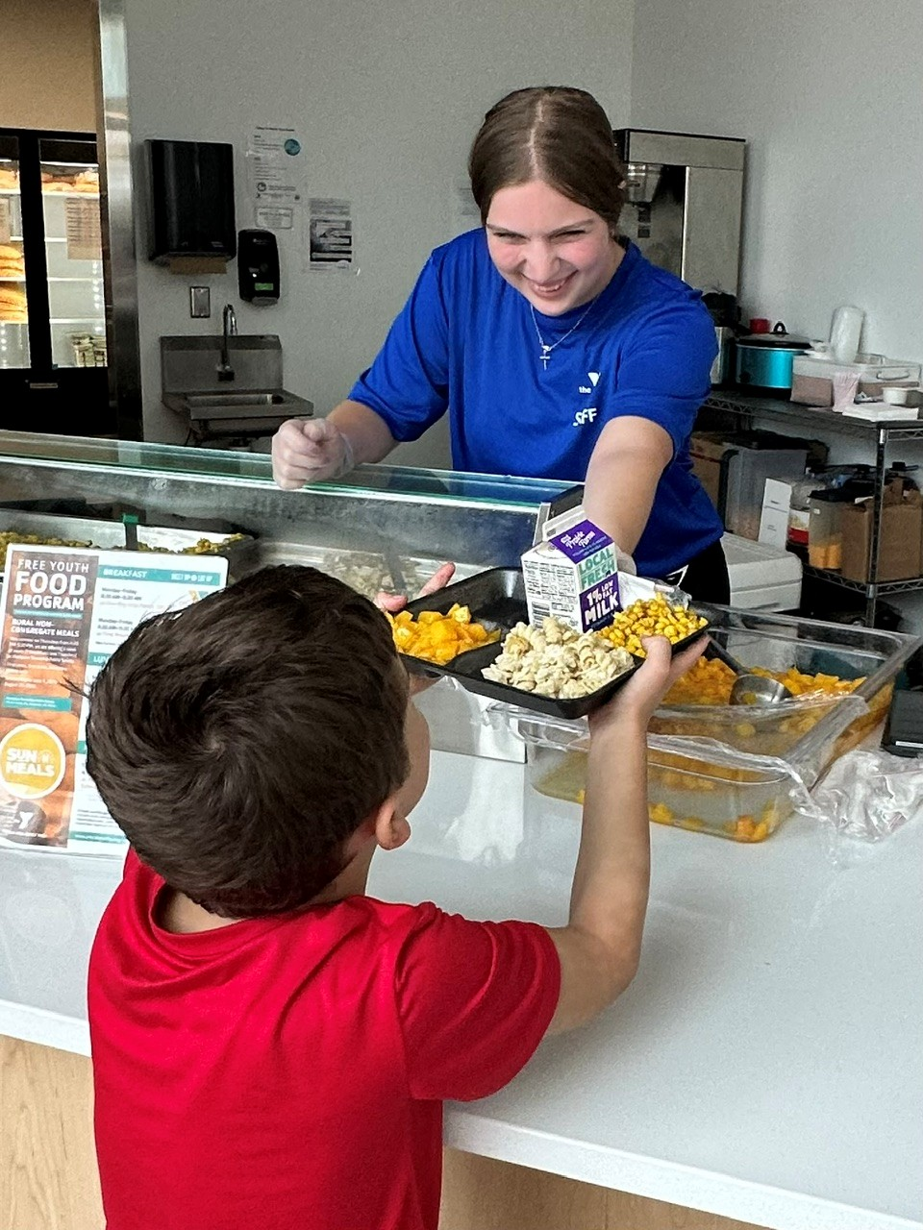
Building capacity
Year-Round food programs
Build capacity & infrastructure for meals through CACFP/SFSP out-of-school time meal programs. The infrastructure can be leveraged for emergency responses and Federal Disaster Nutrition Assistance provisions are often made for non-congregate CACFP/SFSP meal provision during disasters.
* Check out: Food Programs 101
DYK – Ys served 58M meals last year!
Dow Bay Area YMCA - MI
Notes:
Portage IN recent example: SHANNON BURHANS, CEO severe storm August 11th (the day before school started back). Because of their SFSP/CACFP sponsor relationship with the state agency they were approved for immediate waivers to serve non-congregate grab and go meals for youth. While they didn’t have power – they were able to put shelf stable meals together. They also partnered with another organization who was cooking hot meals and the Y staff delivered meals to adults and kids who were stuck in their homes.

Slide 5

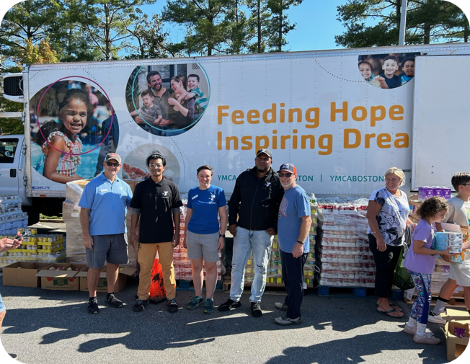
Broadening food access
Offer consistent, convenient, stigma-free access to food through pantry, market, & distribution through partnerships. These existing partnerships allow for quick scaling up and immediate response during disasters.
*Learn more with Y-USA’s Food Pantry, Market & Distribution Resource
YMCA of Greater Boston delivers food to YMCA of Western North Carolina after Hurricane Helene.
Notes:
Additional resource: Video from YUSA on the Y response in Hurricane Helene: https://vimeo.com/1030206084/f8875374c6?ts=0&share=copy

Slide 6
01
HOW IT STARTED

Slide 7
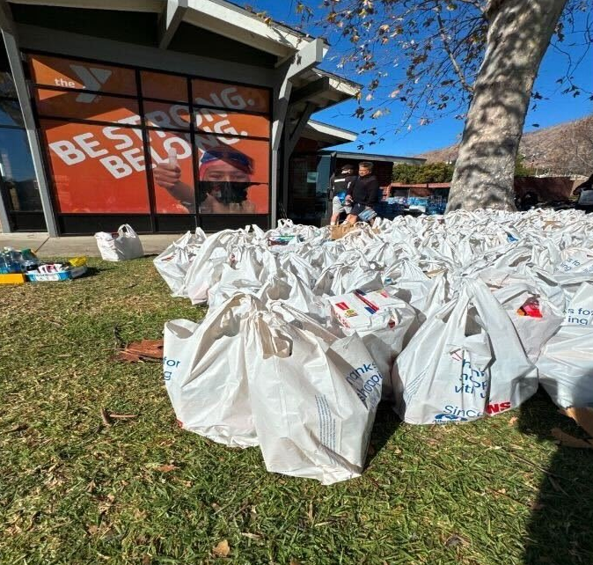
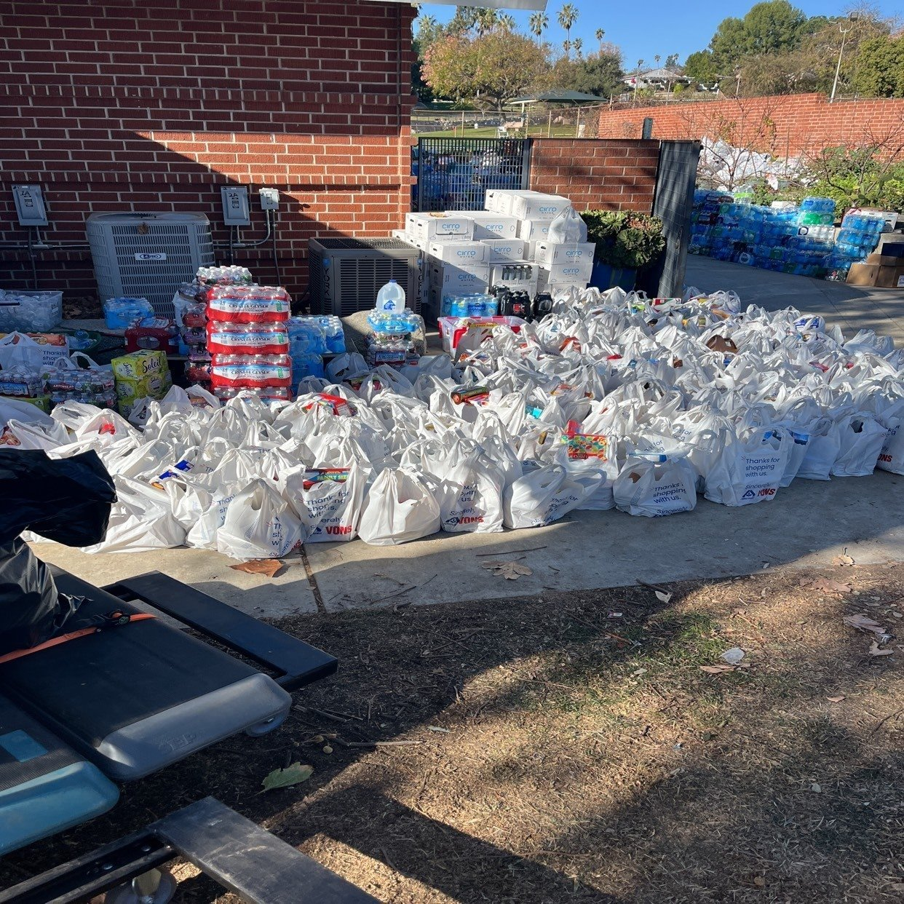
COMMUNITY CARTS
[Photo 1]
Grocery Delivery When Communities Needed It Most
When wildfires swept through LA in early 2025, Instacart deployed Community Carts to support 18 LA-based YMCAs — getting grocery delivery directly to displaced families when traditional supply chains broke down.
[Photo 2]

Slide 8
120,000
items donated by customers from all 50 states.

Slide 9
A BROADER SHARED MISSION
“Access to nutritious food shouldn't depend on where you live, what you earn, or whether a disaster just hit your community.”

Slide 10
A MULTI-YEAR, MULTI-PROGRAM PARTNERSHIP
01
02
03
Disaster
Response
Food
Security
Employee
Engagement
Year-round programming supporting food security programming at ten local YMCAs through a combination of cash grants and Instacart in-kind support.
Connecting Instacart employees to the mission through volunteer events at YMCA sites, starting in New York City and San Francisco in 2026.
Community Carts reimagines the traditional food drive, making it easy for anyone to donate groceries and supplies directly through the Instacart app, delivered by Instacart shoppers. Instacart waives delivery and service fees on all Community Carts orders.

Slide 11
YEAR 1 PARTNERSHIP LOCATIONS
FOOD ACCESS GRANTS · 2026
VOLUNTEER EVENTS
01
California
New York City
New York
November 2026
02
03
Colorado
San Francisco
04
Florida
December 2026
05
Delaware
5 additional grant markets to be selected for 2027

Slide 12
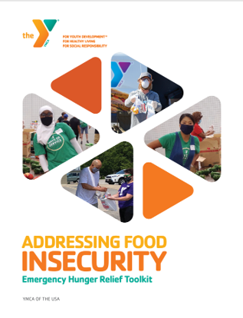
Be ready!
Tips for emergency hunger relief
Build strong community partnerships before a crisis.
Map community needs and available resources.
Maintain flexible food sourcing options.
Stock shelf-stable foods and backup supplies.
Plan multiple distribution methods.
Ensure adequate storage, equipment, and transportation.
Cross-train staff and build a volunteer pipeline.
Stay prepared for USDA waivers and compliance requirements.
Communicate consistently with families, partners, and funders.
Track impact, tell stories, and continuously adapt.
*Take a deeper dive with Y-USA’s Emergency Hunger Relief Toolkit

Slide 13

Apply your learnings
How have you responded with hunger relief in times of disaster?
What tips/strategies are you taking away from this conversation to support your response in the future?

Slide 14
SIX LEVERS OF CONNECTION​
ELEVATE CONNECTION​
Use shared language and stories to strengthen
purpose and connection.​
PRACTICE CONNECTION SKILLS​
Develop the skills and reinforce the culture that make meaningful connection possible.​
EMBED CONNECTION EVERYWHERE​
Design and deliver experiences that create connection.​
CREATE CONNECTED SPACES​
Build physical and digital environments that spark interaction and create access and belonging for all. ​
INVITE CONTRIBUTION ​
Provide opportunities for people to share their time, talents, and voices to create change.​
SUPPORT WELL-BEING​
Foster experiences that elevate health and well-being and help all people thrive. ​

Slide 15
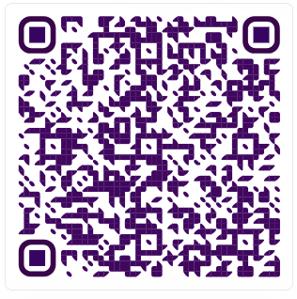
THANK YOU
Stacey McDaniel
Director Strategy & Quality Practices, Anti-Hunger
YMCA of the USA
312-419-2865
Stacey.McDaniel@YMCA.net
Access resources by joining the Anti-Hunger Community on Link!

