Slide 1

THE FUTURE OF GROUP FITNESS
Jenn Gilburg, Y-USA
Cathy Spencer-Browning, MOSSA
Gael Gebow, YMCA of Snohomish County
Notes:
Welcome, everyone. We are excited to spend this time exploring the future of group fitness and the opportunity it creates for Ys.
Today’s conversation is not only about what is next in fitness. It is about how group fitness can help people achieve their goals, feel connected, and experience a stronger sense of belonging.
You will hear perspectives from Y-USA, MOSSA, and the YMCA of Snohomish County, bringing together national strategy, industry expertise, and local Y experience.
As we move through the session, we invite you to consider what these ideas could mean for your own Y, your staff, and the communities you serve.
Transition:
Let’s start by introducing ourselves and creating a little connection in the room.

Slide 2

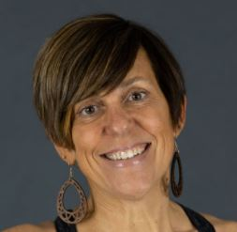
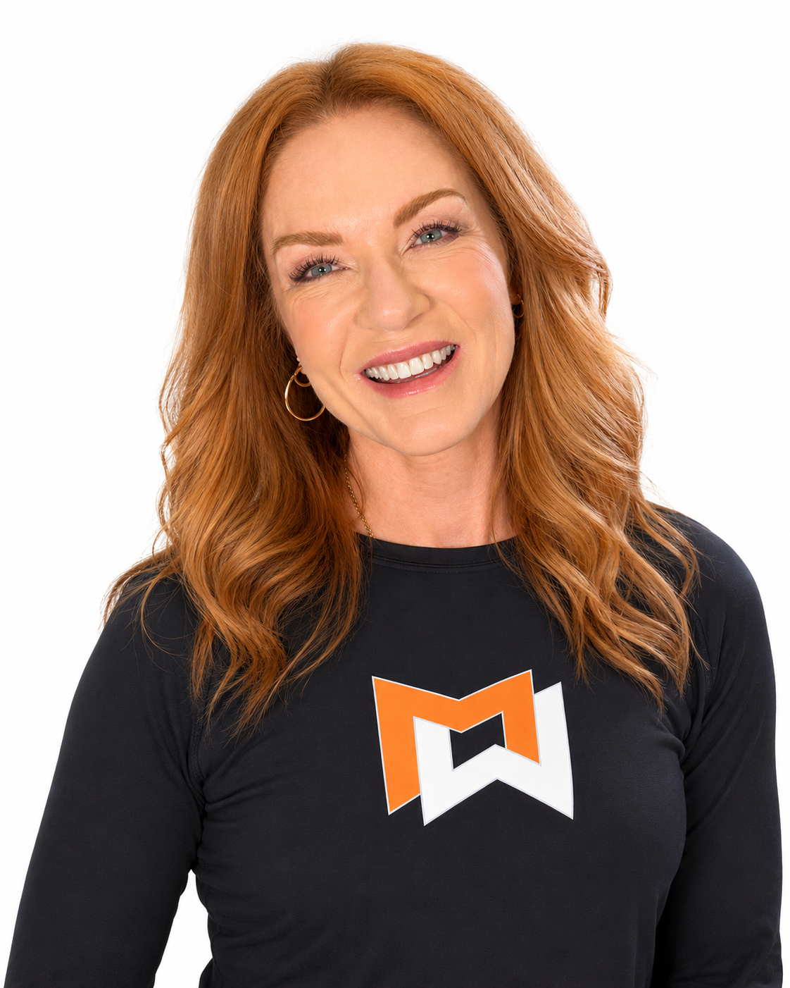
welcome
Jenn Gilburg
Director, Project Implementation
Y-USA
Cathy Spencer-Browning
VP of Training and Programming
MOSSA
Notes:
I’m Jenn Gilburg from YMCA of the USA, and I’m joined by Cathy Spencer-Browning, Vice President of Training and Programming at MOSSA.
Later, we will also hear from Gael Gebow from the YMCA of Snohomish County.
Each of us brings a different perspective to this conversation, but we share a belief that group fitness can play a powerful role in creating opportunities for members to achieve their goals, build meaningful relationships, and feel a sense of belonging.
We want today’s session to be interactive, so we encourage you to reflect, connect with others, and think about how these ideas could translate to your Y.
Transition:
Before we explore connection as a strategy, we want to begin by experiencing it.

Slide 3
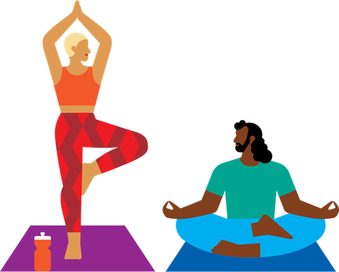
Let’s connect
Turn to your neighbor and share:
  Name
  YMCA
  One or two words that describe a place where you feel connected?
Notes:
Please turn to someone near you and introduce yourself.
Share your name, your YMCA, and one or two words that describe a place where you feel connected.
As you listen to one another, notice what makes that place feel welcoming, meaningful, or comfortable.
We will give you a few moments to connect, and then we will come back together.
After the activity:
Thank you. Hold onto the words you selected.
Those words remind us that connection is not accidental. It is shaped by the environments, relationships, and experiences we intentionally create.
Transition:
That idea of intentionality is at the heart of what we want to explore today.

Slide 4
The future of group fitness
Drive engagement
Support achievement
Deepen Relationships
Create connection
Build community
Notes:
Today, we’ll explore how high-quality group fitness experiences can drive engagement, support achievement, deepen relationships, create connection opportunities, and build community.
These outcomes help us see group fitness as both a health and wellness experience and a community-building opportunity.
Transition:
Let’s frame this opportunity through the YMCA’s Six Levers of Connection.

Slide 5
SIX LEVERS OF CONNECTION​
ELEVATE CONNECTION​
Use shared language and stories to strengthen
purpose and connection.​
PRACTICE CONNECTION SKILLS​
Develop the skills and reinforce the culture that make meaningful connection possible.​
EMBED CONNECTION EVERYWHERE​
Design and deliver experiences that create connection.​
CREATE CONNECTED SPACES​
Build physical and digital environments that spark interaction and create access and belonging for all. ​
INVITE CONTRIBUTION ​
Provide opportunities for people to share their time, talents, and voices to create change.​
SUPPORT WELL-BEING​
Foster experiences that elevate health and well-being and help all people thrive. ​
Notes:
The Six Levers of Connection help us think intentionally about how YMCA experiences strengthen connection and belonging.
All six can come to life through group fitness. Today, we’ll focus on two: Support Well-Being and Create Connected Spaces.
Together, they position group fitness as both a health and wellness experience and a powerful connection experience.
Transition:
Let’s begin with the opportunity to support well-being.

Slide 6
SUPPORT
WELL-BEING​
Foster experiences that
elevate health and
well-being and help
all people thrive. ​
Notes:
Support Well-Being reminds us that group fitness can help people move more, build strength and confidence, and establish healthy routines.
It also reminds us to intentionally create experiences where everyone feels welcomed, encouraged, capable, and supported. By supporting the whole person, group fitness can help people thrive.
Transition:
Well-being becomes even more powerful when people also feel connected and that they belong.

Slide 7
CREATE
CONNECTED
SPACES​
Build physical and
digital environments
that spark interaction
and create access and
belonging for all. ​
Notes:
Create Connected Spaces reminds us that a group fitness room is more than a place to exercise. It is an intentionally designed experience where people feel welcomed, participate together, and belong.
Small choices, from how participants are greeted to how opportunities for connection are created, can help relationships and community grow.
Together, Support Well-Being and Create Connected Spaces position group fitness as a place where people become stronger and more connected.
Transition:
This intersection of movement, strength, and connection is one of our greatest opportunities for the future of group fitness.

Slide 8

MOSSA
Notes:
Cathy will now help us look more closely at that opportunity.
She will invite us to look beyond the next trend or device and consider what people actually need from group fitness.
Her section will explore how movement and strength can be delivered through shared experiences that support engagement, relationships, and community.
Cathy, I’ll turn it over to you.

Slide 9

The
Future of
Group fitness
Notes:
· Asked to speak about “the future of Group Fitness”
· Audience probably expects trends and technology
· But that’s not where I’m going
KEY PHRASE
The future may be much simpler than we think

Slide 10
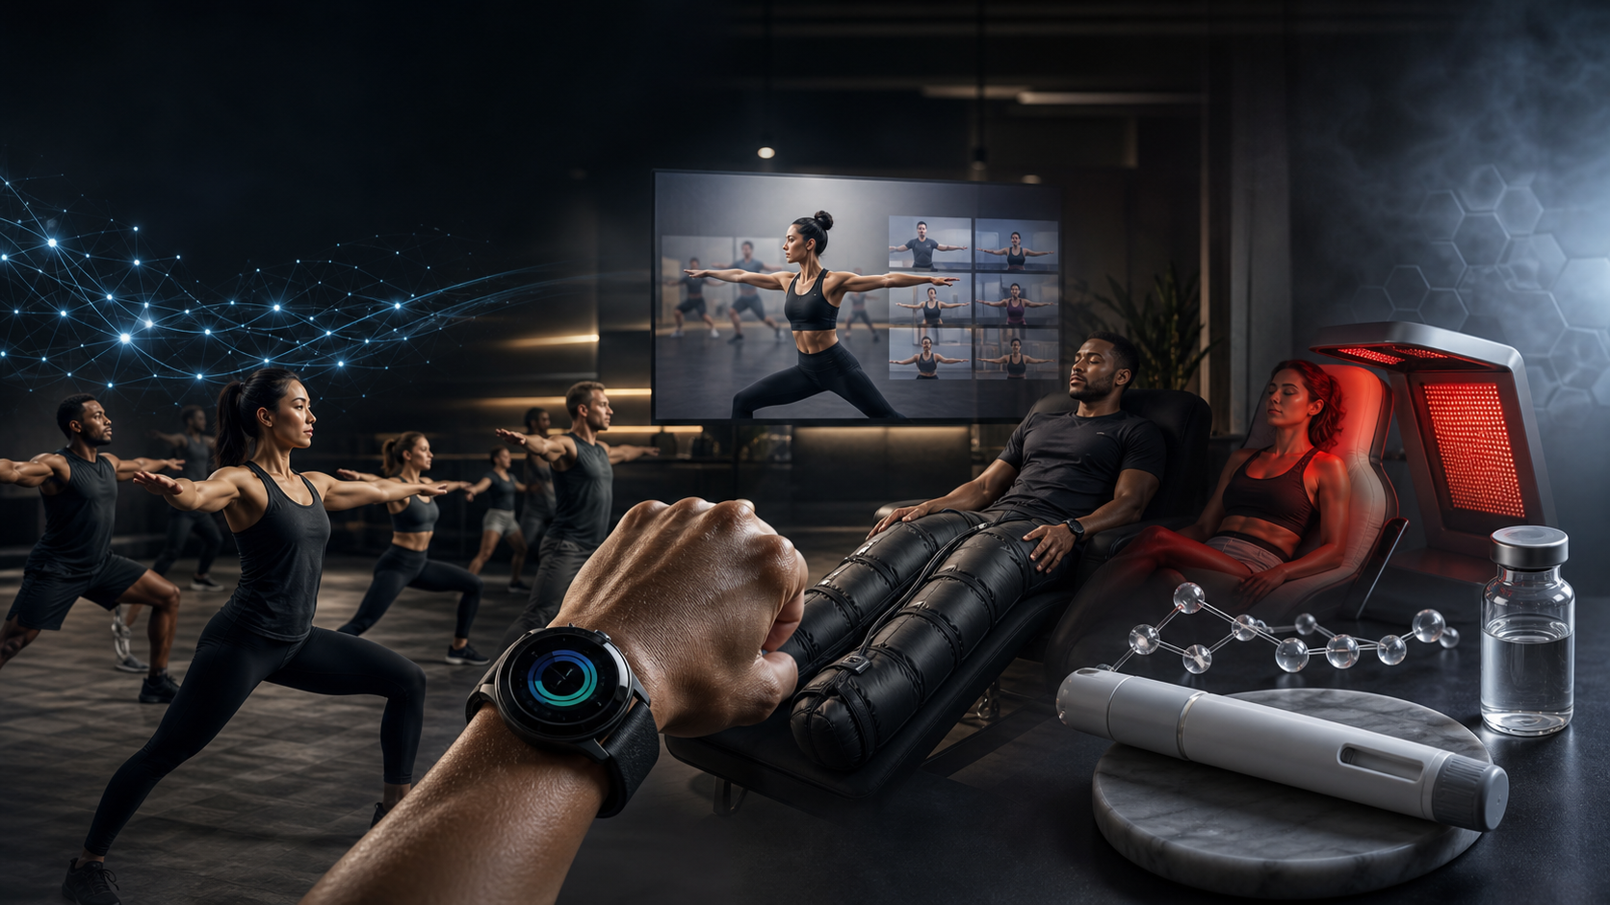
THE FUTURE OF GROUP FITNESS
When we picture the future…
AI
SMART WATCHES
VIRTUAL FITNESS
RECOVERY TECHNOLOGY
GLP-1s
Notes:
· AI. Smart watches. Virtual fitness. Recovery. GLP-1s.
· Industry instinct = look for what’s next
· Next trend. Next technology. Next big thing.
· Important? Yes.
· Most important conversation? Maybe not.
LAND ON
I keep coming back to a much simpler question…

Slide 11
THE BETTER QUESTION
?
WHAT DO PEOPLE
ACTUALLY NEED
FROM US
BEYOND THE NEXT TREND. BEYOND THE NEXT DEVICE.
Notes:
· This is the better question.
· Beyond the next device or trend.
· Answer this well → see Group Fitness differently.
· Biggest opportunity may already exist.
KEY PHRASE
Maybe it’s been hiding in plain sight.

Slide 12
THE CHALLENGES KEEP COMING.
AND THE LIST ISN'T GETTING SHORTER.
PHYSICAL ACTIVITY
STRENGTH
HEALTHY AGING
LONELINESS
CONFIDENCE
CHRONIC DISEASE
BELONGING
SOCIAL CONNECTION
INSTRUCTOR DEVELOPMENT
MENTAL WELL-BEING
MEMBER RETENTION
MOTIVATION
INCLUSION
AGING WELL
ACCESSIBILITY
MORE TO SOLVE
PREVENTION
COMMUNITY HEALTH
Notes:
· Physical activity
· Strength demand
· Healthy aging
· Instructor recruitment and development
· Retention
· Belonging
· Looks like many different problems.
· What if they’re more connected than we think?
LAND ON
What if something already inside the YMCA could impact all of them?

Slide 13
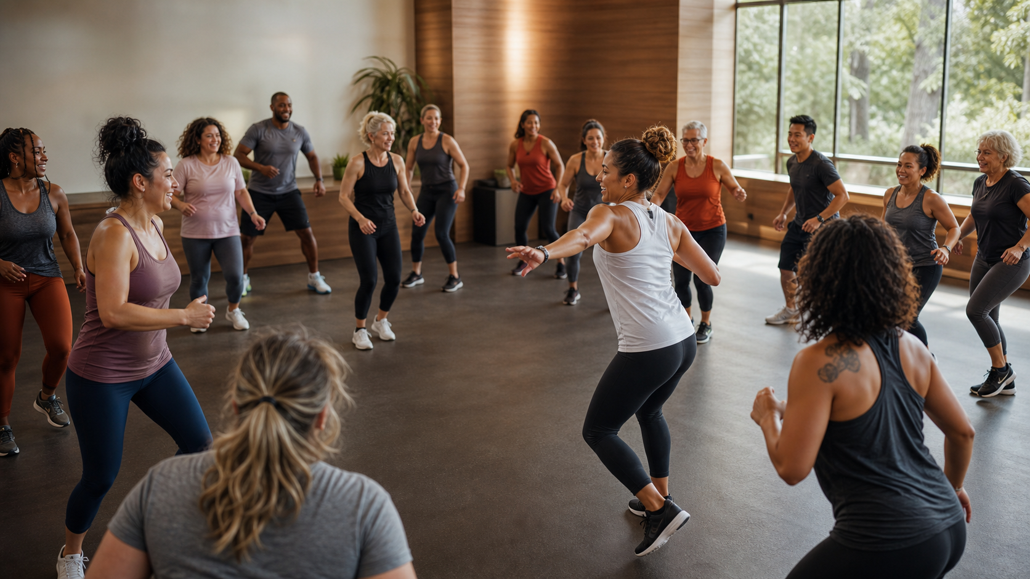

WHAT IF ONE OPPORTUNITY COULD ADDRESS MANY OF THEM?
WHEN I SAY
STRENGTH
HEALTHY AGING
PHYSICAL ACTIVITY
GROUP FITNESS
GROUP
MOTIVATION
WHAT DO YOU THINK?
SOCIAL CONNECTION
INSTRUCTOR DEVELOPMENT
WHAT DO YOU SEE?
BELONGING
MEMBER RETENTION
Notes:
· What do YOU see?
· Instructor → music, choreography, coaching
· Director → schedules, subs, staffing
· Leadership → participation, retention, budgets
· We see it through the lens of our job.
KEY PHRASE
I think we’ve made Group Fitness too small.

Slide 14
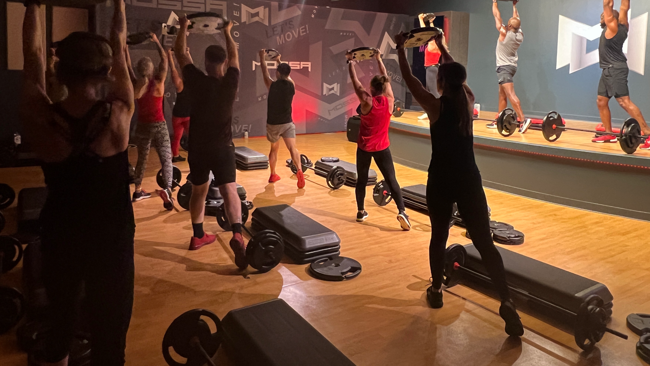
A SHARED
MOVEMENT
EXPERIENCE
Notes:
· Don’t just think “class.”
· Think: what happens when people move together
· Stranger → familiar face
· Familiar face → relationship
· Confidence grows
· Belonging grows
KEY PHRASE
That’s a shared movement experience.

Slide 15
SOCIAL
MOTION
MOVEMENT DOESN'T JUST CHANGE OUR BODIES.
IT CHANGES OUR RELATIONSHIPS.
Notes:
· Science catching up with what great instructors already know.
· Something happens when people move together.
· Social motion
· Movement creates social connection.
BEST LINE
Movement doesn’t just change our bodies. It changes our relationships.

Slide 16
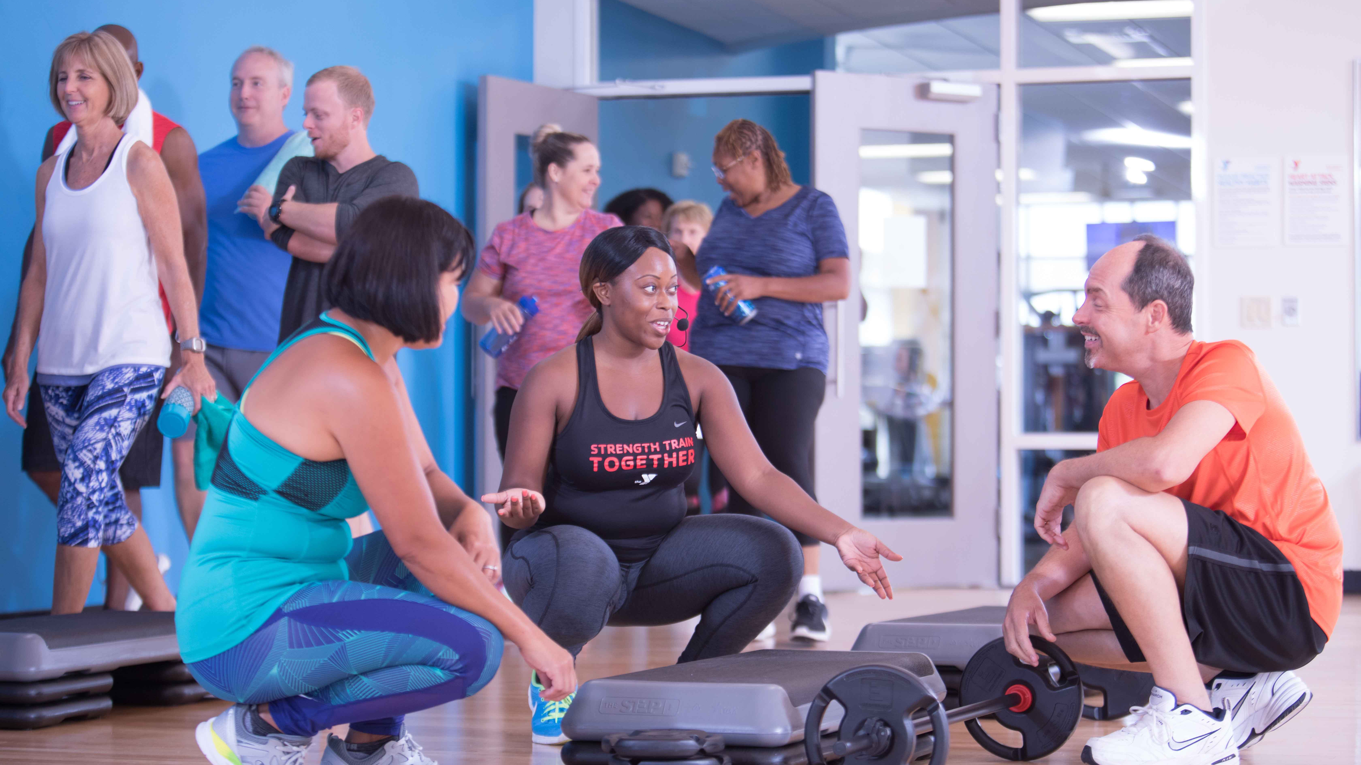
Notes:
· Great classes create connection before, during, and after.
· People notice each other.
· Someone knows your name.
· Someone notices when you’re missing.
· Getting people to exercise = one challenge.
· Getting them to keep exercising = another.
KEY NUGGET
Relationships give people a reason to come back.

Slide 17
ELEVATE CONNECTION
EMBED CONNECTION EVERYWHERE
PRACTICE CONNECTION SKILLS
CONNECTED
COMMUNITIES
CREATE CONNECTED SPACES
INVITE CONTRIBUTION
SUPPORT WELL-BEING
Notes:
· YMCA Connected Communities work.
· Two levers jumped out: Create Connected Spaces and Support Well-being
· Group Fitness can do both.
· Room = not just exercise space.
· It can be intentionally designed for belonging.
· And it can make people stronger, healthier, more capable.
BEST LINE
A place where people become stronger and a place where people become connected.

Slide 18
MOVEMENT
IS THE ACTIVITY
COMMUNITY
IS THE OUTCOME
Notes:
· Bottom line:
· Movement is the activity.
· Community is the outcome.
· Now layer in the biggest fitness opportunity right now…
SEGUE
What happens when we combine strength training with community?

Slide 19
STRENGTH
CULTURAL MOMENTUM
IS HAVING A
MOMENT
Notes:
· Strength demand is real — and deserved.
· Muscle supports independence, metabolic health, bones, and doing what we love longer.
· This is bigger than aesthetics.
KEY PHRASE
Strength is having a moment — and I don’t see it going away.

Slide 20
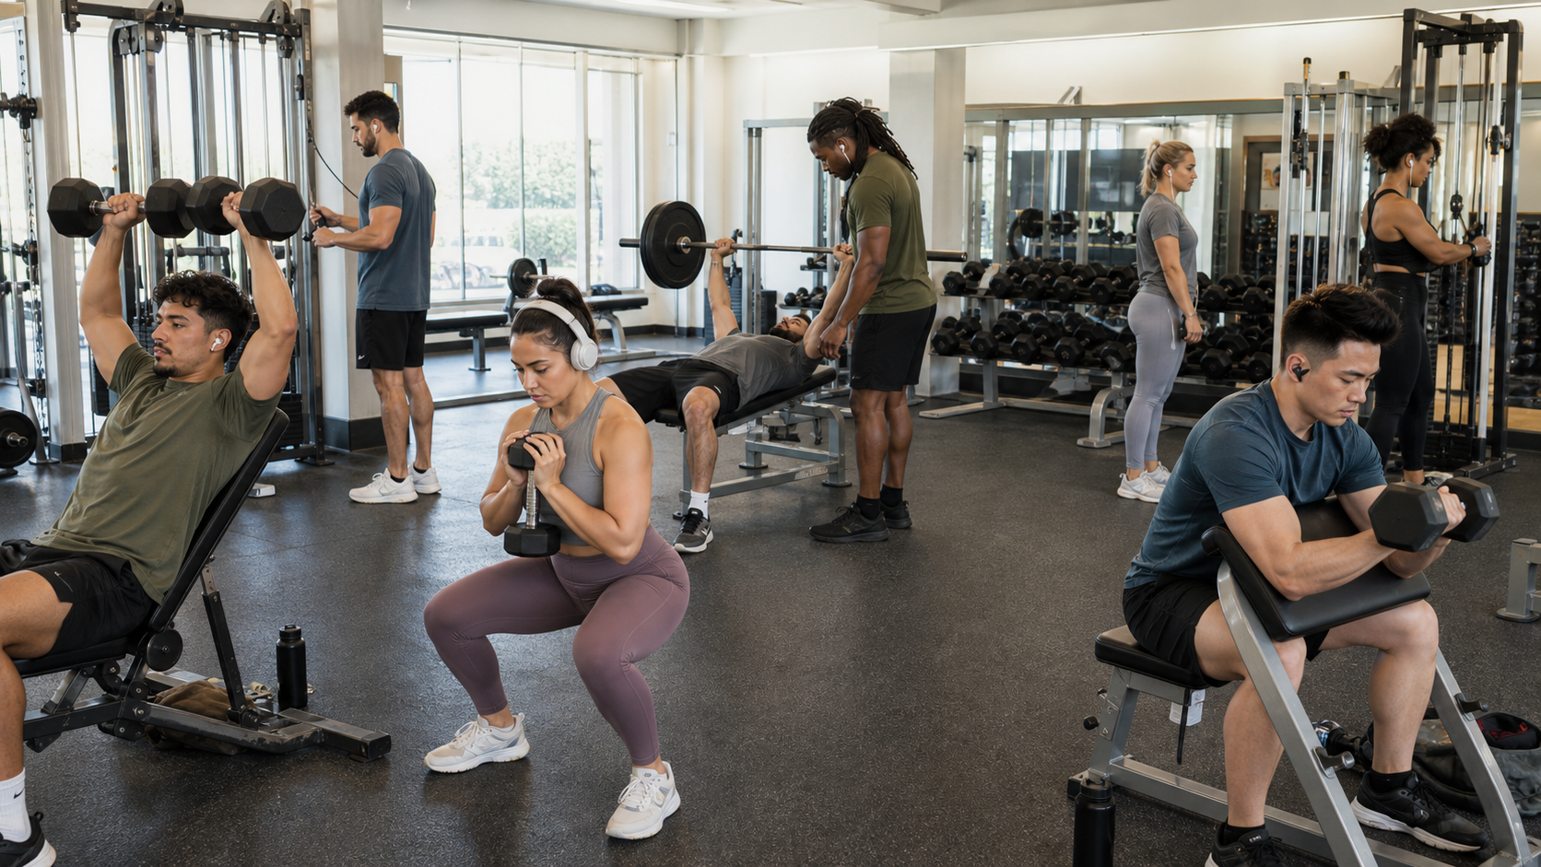
Notes:
· Familiar sight.
· People working hard.
· Getting stronger.
· Headphones on.
· Doing exactly what they came to do.
· Not criticizing this. There’s absolutely a place for it.
DIRECTION
Pause here.

Slide 21
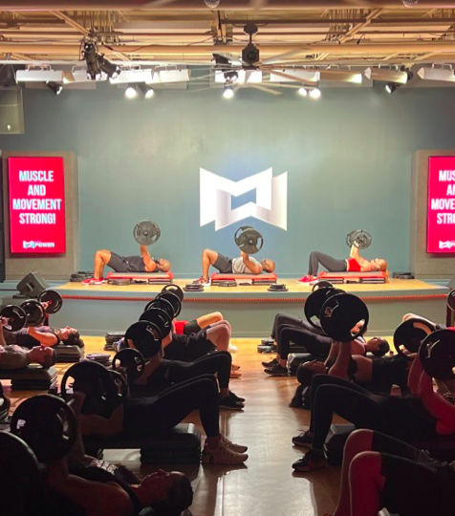
NEXT TO EACH OTHER
WITH EACH OTHER
Notes:
· Notice the difference.
· Next to each other versus with each other
· Both can build strength.
· One adds shared experience.
BEST QUESTION
What if we could help people get stronger with each other?

Slide 22
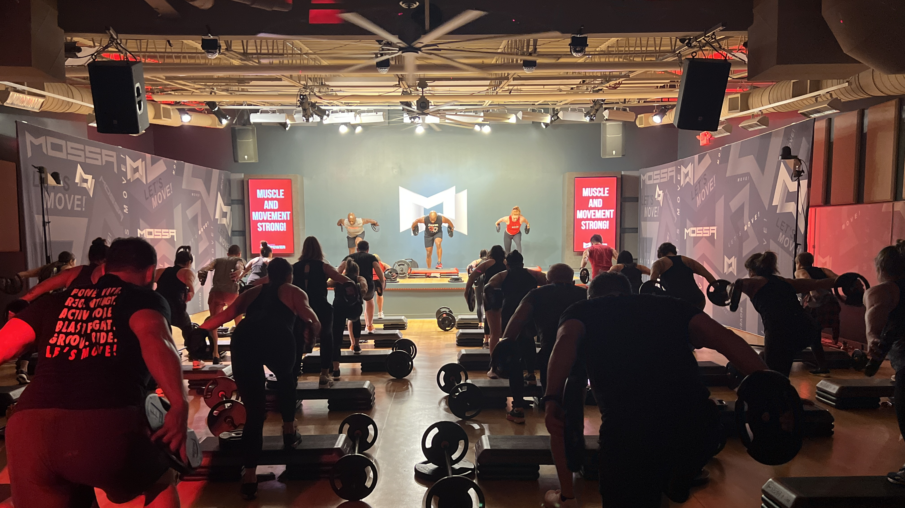
WHAT IF WE COULD
MEET THE DEMAND FOR
STRENGTH TRAINING
AND also build
COMMUNITY?
Notes:
· Strength boom ≠ just buy more equipment.
· Bigger question: How can we deliver strength in a way that also delivers on who we are?
· In a group: first-timer realizes “I can do this”; encouragement; familiar faces; people notice absence; people get stronger together.
BEST LINE
Stronger bodies and stronger communities at the same time.

Slide 23
STRENGTH IS
TRENDING
COMMUNITY IS
TIMELESS
IMAGINE BUILDING BOTH IN THE SAME ROOM
Notes:
· Strength = current demand.
· Community = enduring human need.
· YMCA can combine them.
SAY ALMOST EXACTLY
Strength is trending. Community is timeless. Imagine building both in the same room.

Slide 24

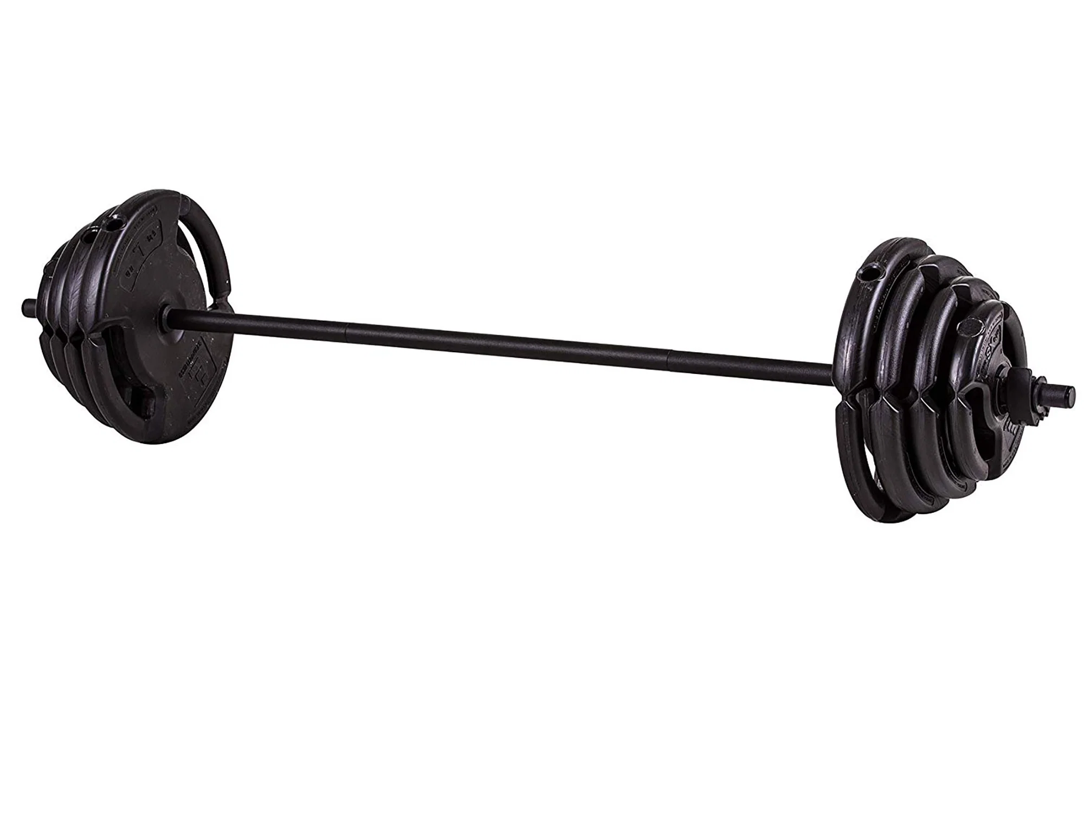
NOT JUST ANY
STRENGTH CLASS
WE OFFER STRENGTH TRAINING
BUT DO WE?
Notes:
· Now raise the standard.
· Putting “strength” on the schedule isn’t enough.
· If we promise stronger → must actually deliver.
· Quality matters.
· Strength class ≠ merely exercising with weights.
BEST LINE
If we say strength training, we have to deliver strength training.

Slide 25
STRENGTH DOESN’T HAPPEN
BY ACCIDENT
03
PROGRESSION
02
PLAN
01
PURPOSE
Notes:
· Great strength training is intentional.
· Purpose
· Plan
· Progression
· Exercise selection
· Load
· Structure
· What happens over time
KEY PHRASE
Strength doesn’t happen by accident. Are we actually delivering a great strength-training experience?

Slide 26
EFFECTIVE ENOUGH
ENGAGING ENOUGH
TO CREATE
TO CREATE
RESULTS.
ADHERENCE.
THE STANDARD IS BOTH.
Notes:
· Quality has two sides.
· Safe, effective, and progresses people.
· AND people must want to come back.
· Great program + no adherence = limited impact.
BEST WORDING
Does it work? And do people want to keep coming back? The standard is both.

Slide 27
Based in science.
PROFESSIONALLY
Periodized.
PROGRAMMED
TESTed.
Engineered music.
A DISCIPLINED SYSTEM…
COACHING.
REpeatable.
Notes:
· Professional programming = disciplined system.
· Science
· Periodization
· Testing
· Engineered music
· Coaching
· Repeatability
· Not just a workout. An intentionally designed experience.
KEY PHRASE
Something that works — and something that sticks.

Slide 28
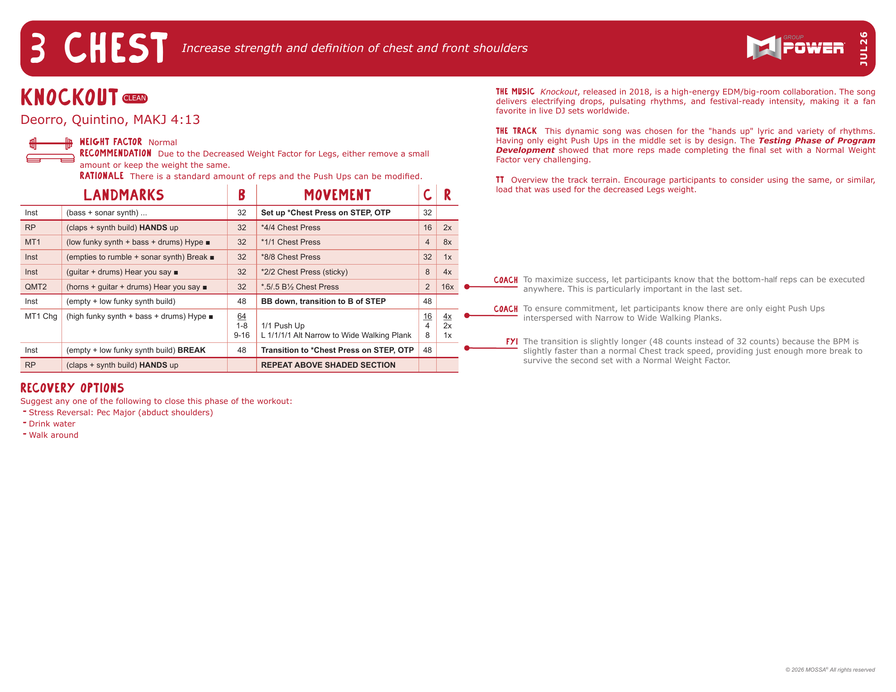
WHAT
PROFESSIONAL
PROGRAMMING
MAKES
POSSIBLE
Notes:
· If quality matters…
· What does professional programming make possible?
· Much more than a good workout.
· Everybody benefits.
TRANSITION
Let’s look at who wins.

Slide 29
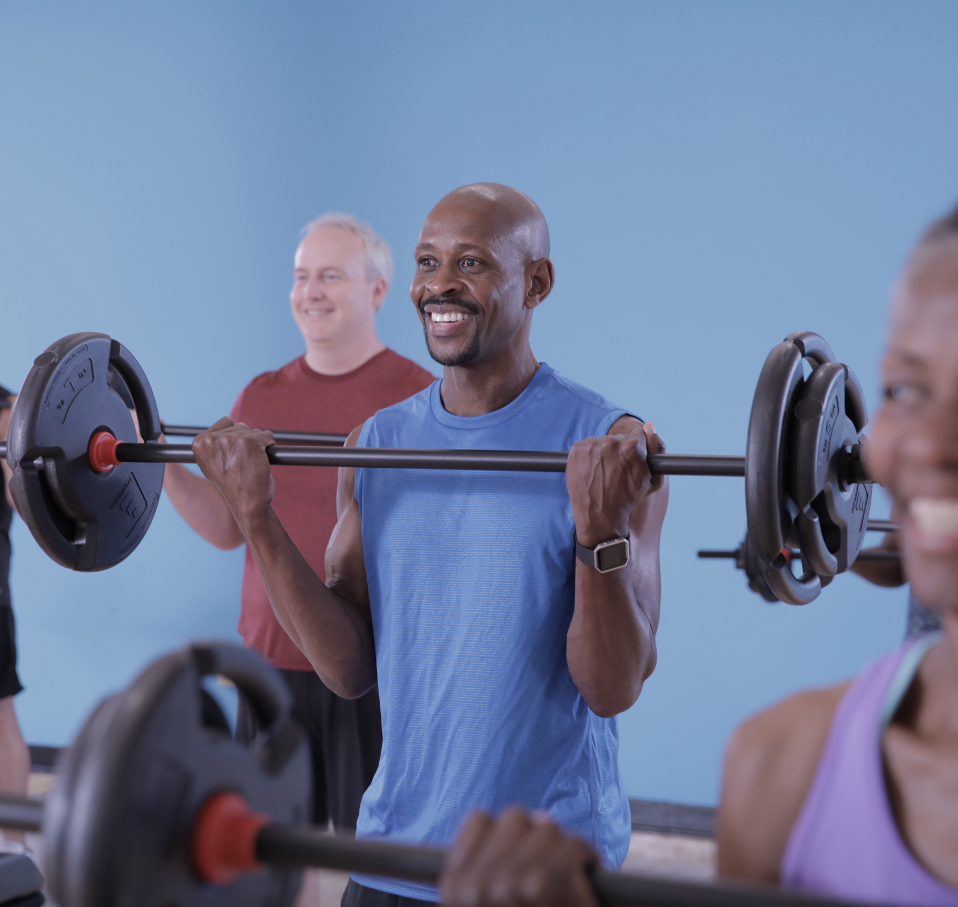
THE BENEFIT TO
THE
PARTICIPANT
Notes:
· Intentional workout
· Exercises make sense
· Progression makes sense
· Coaching is consistent
· Familiarity builds confidence
· Plan behind the experience
· Over time → trust
KEY NUGGET
They know what they’re walking into. They know they can succeed.

Slide 30

THE BENEFIT TO
THE
INSTRUCTOR
CAR-EOGRAPHY
300
HOURS
Notes:
· Personal story: freestyle → CAR-eography
· Professional programming ≠ prepare less. It changes where the effort goes.
· Workout already developed, tested, and refined.
· Teach again and again → confidence and polish.
· That creates BANDWIDTH.
· Less mental energy on “what comes next?”
· More attention on who’s in front of me: Who’s new? Who needs coaching? Who needs encouragement?
BEST LINE
The workout deserves their preparation. The people deserve their attention.

Slide 31
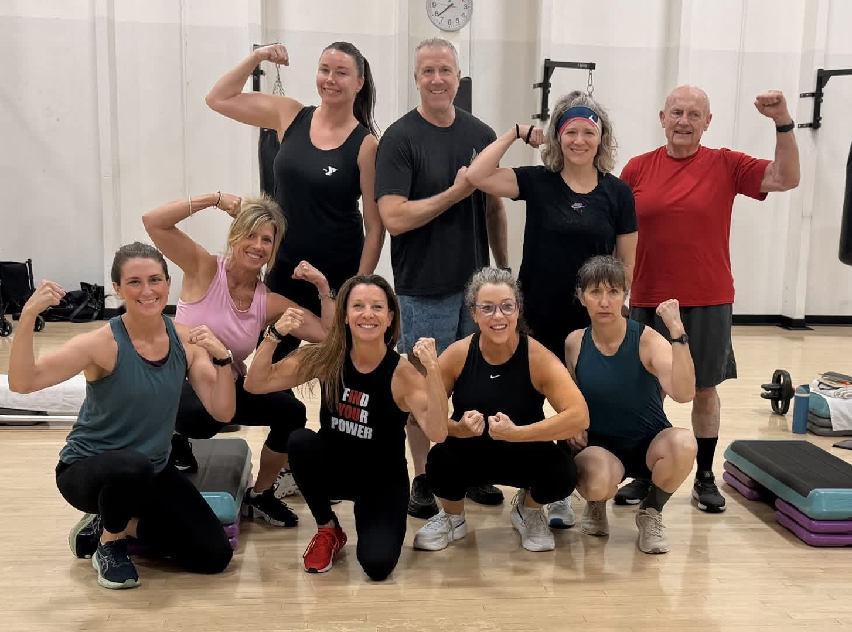
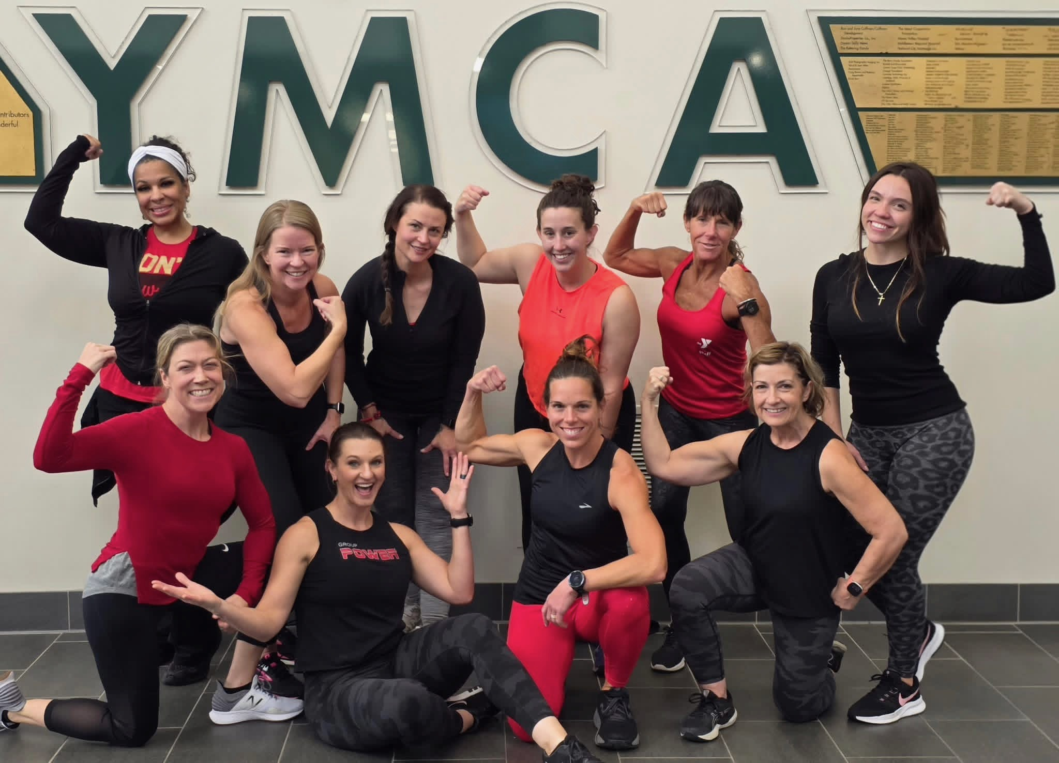
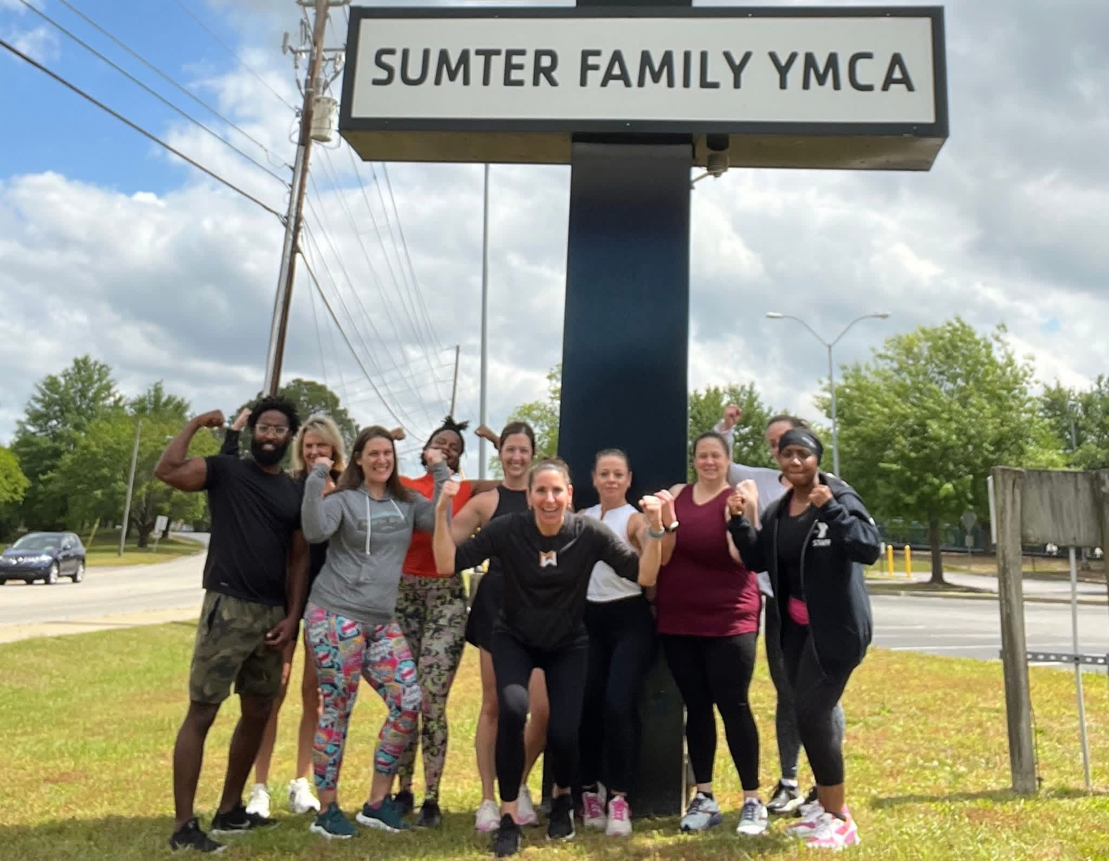
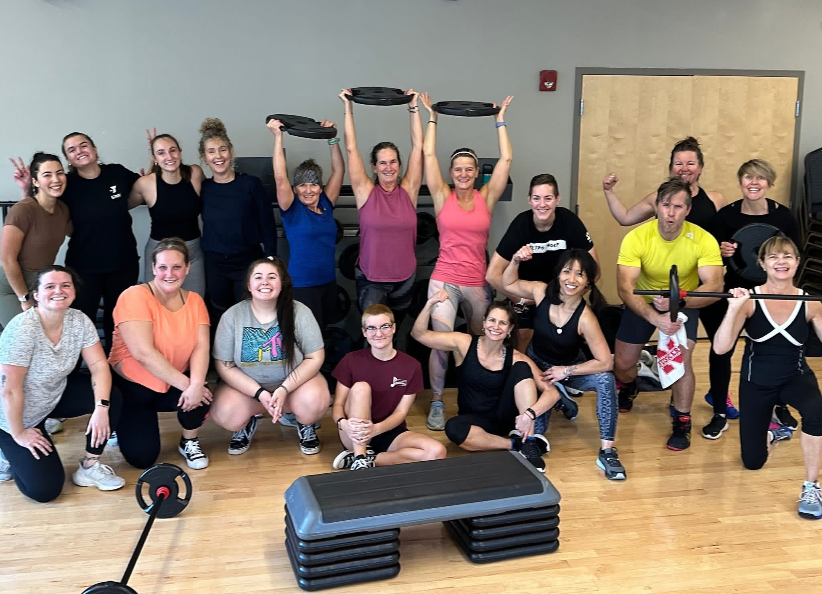
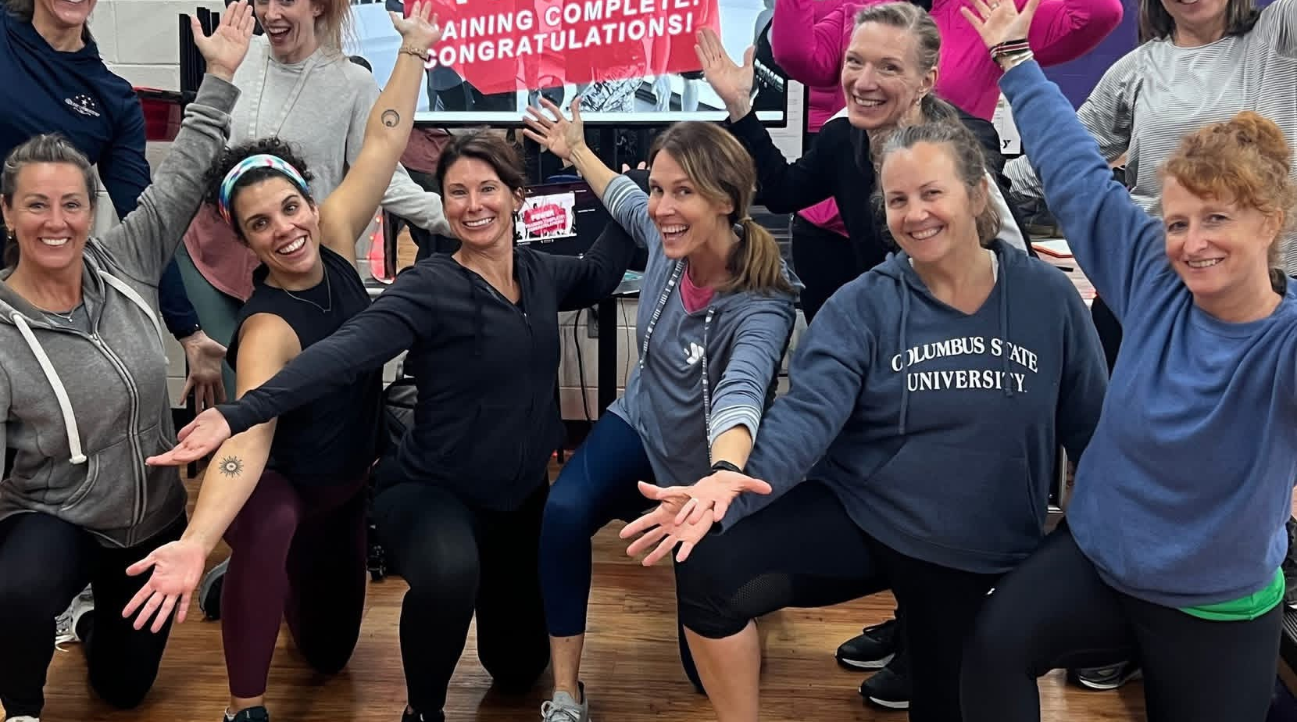
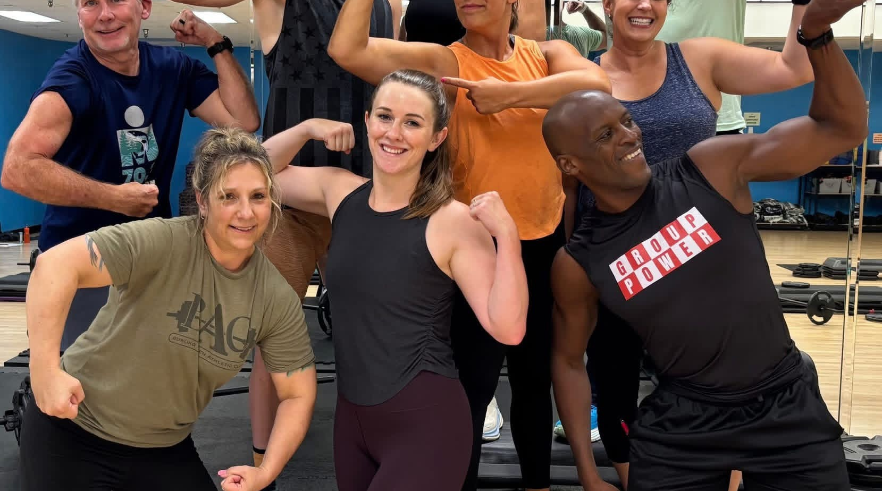
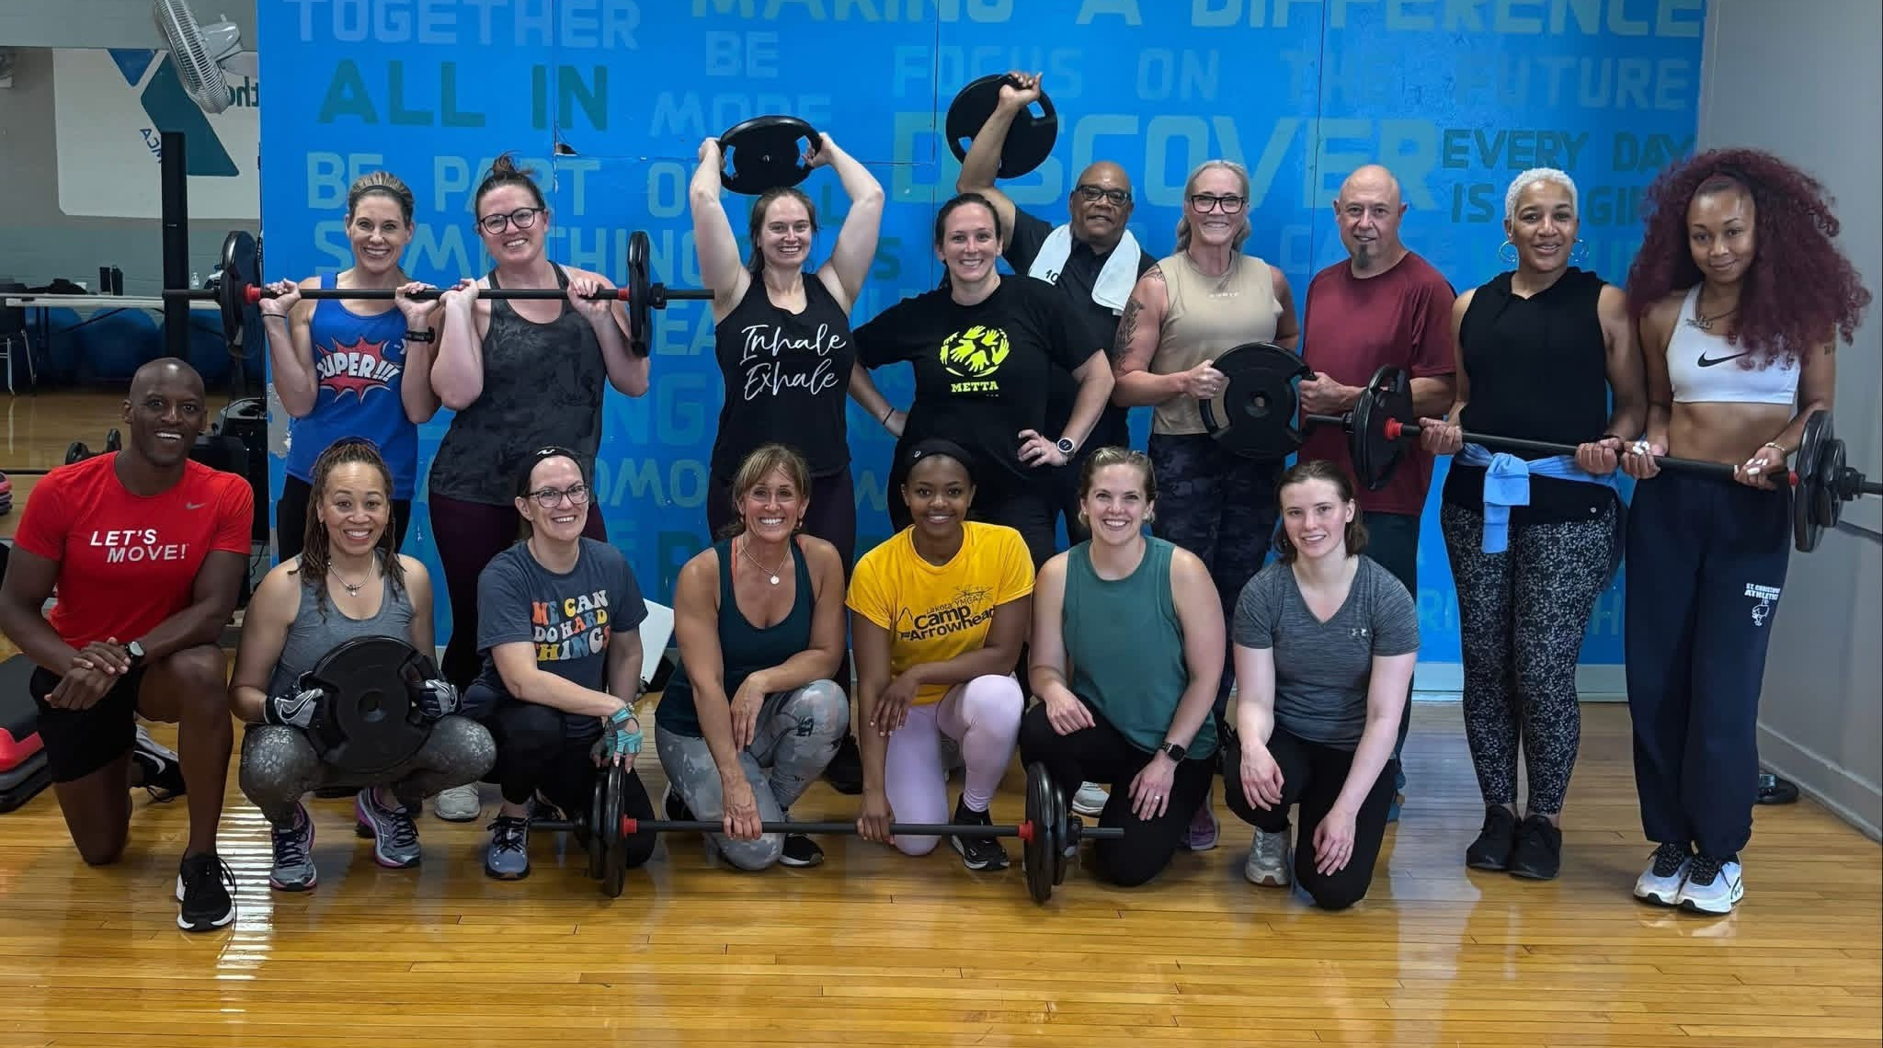
THE BENEFIT TO THE
GROUP FITNESS DIRECTOR
TEAMS BECOME A SYSTEM
ONE PROGRAM
ONE STANDARD
ONE TEAM
Notes:
· Not managing random classes. Managing a program.
· Common standard.
· Common language.
· Subs feel familiar.
· New instructors have framework.
· Instructors coach and support each other.
LAND ON
You build a team instead of a collection of individuals. One program. One standard. One team.

Slide 32
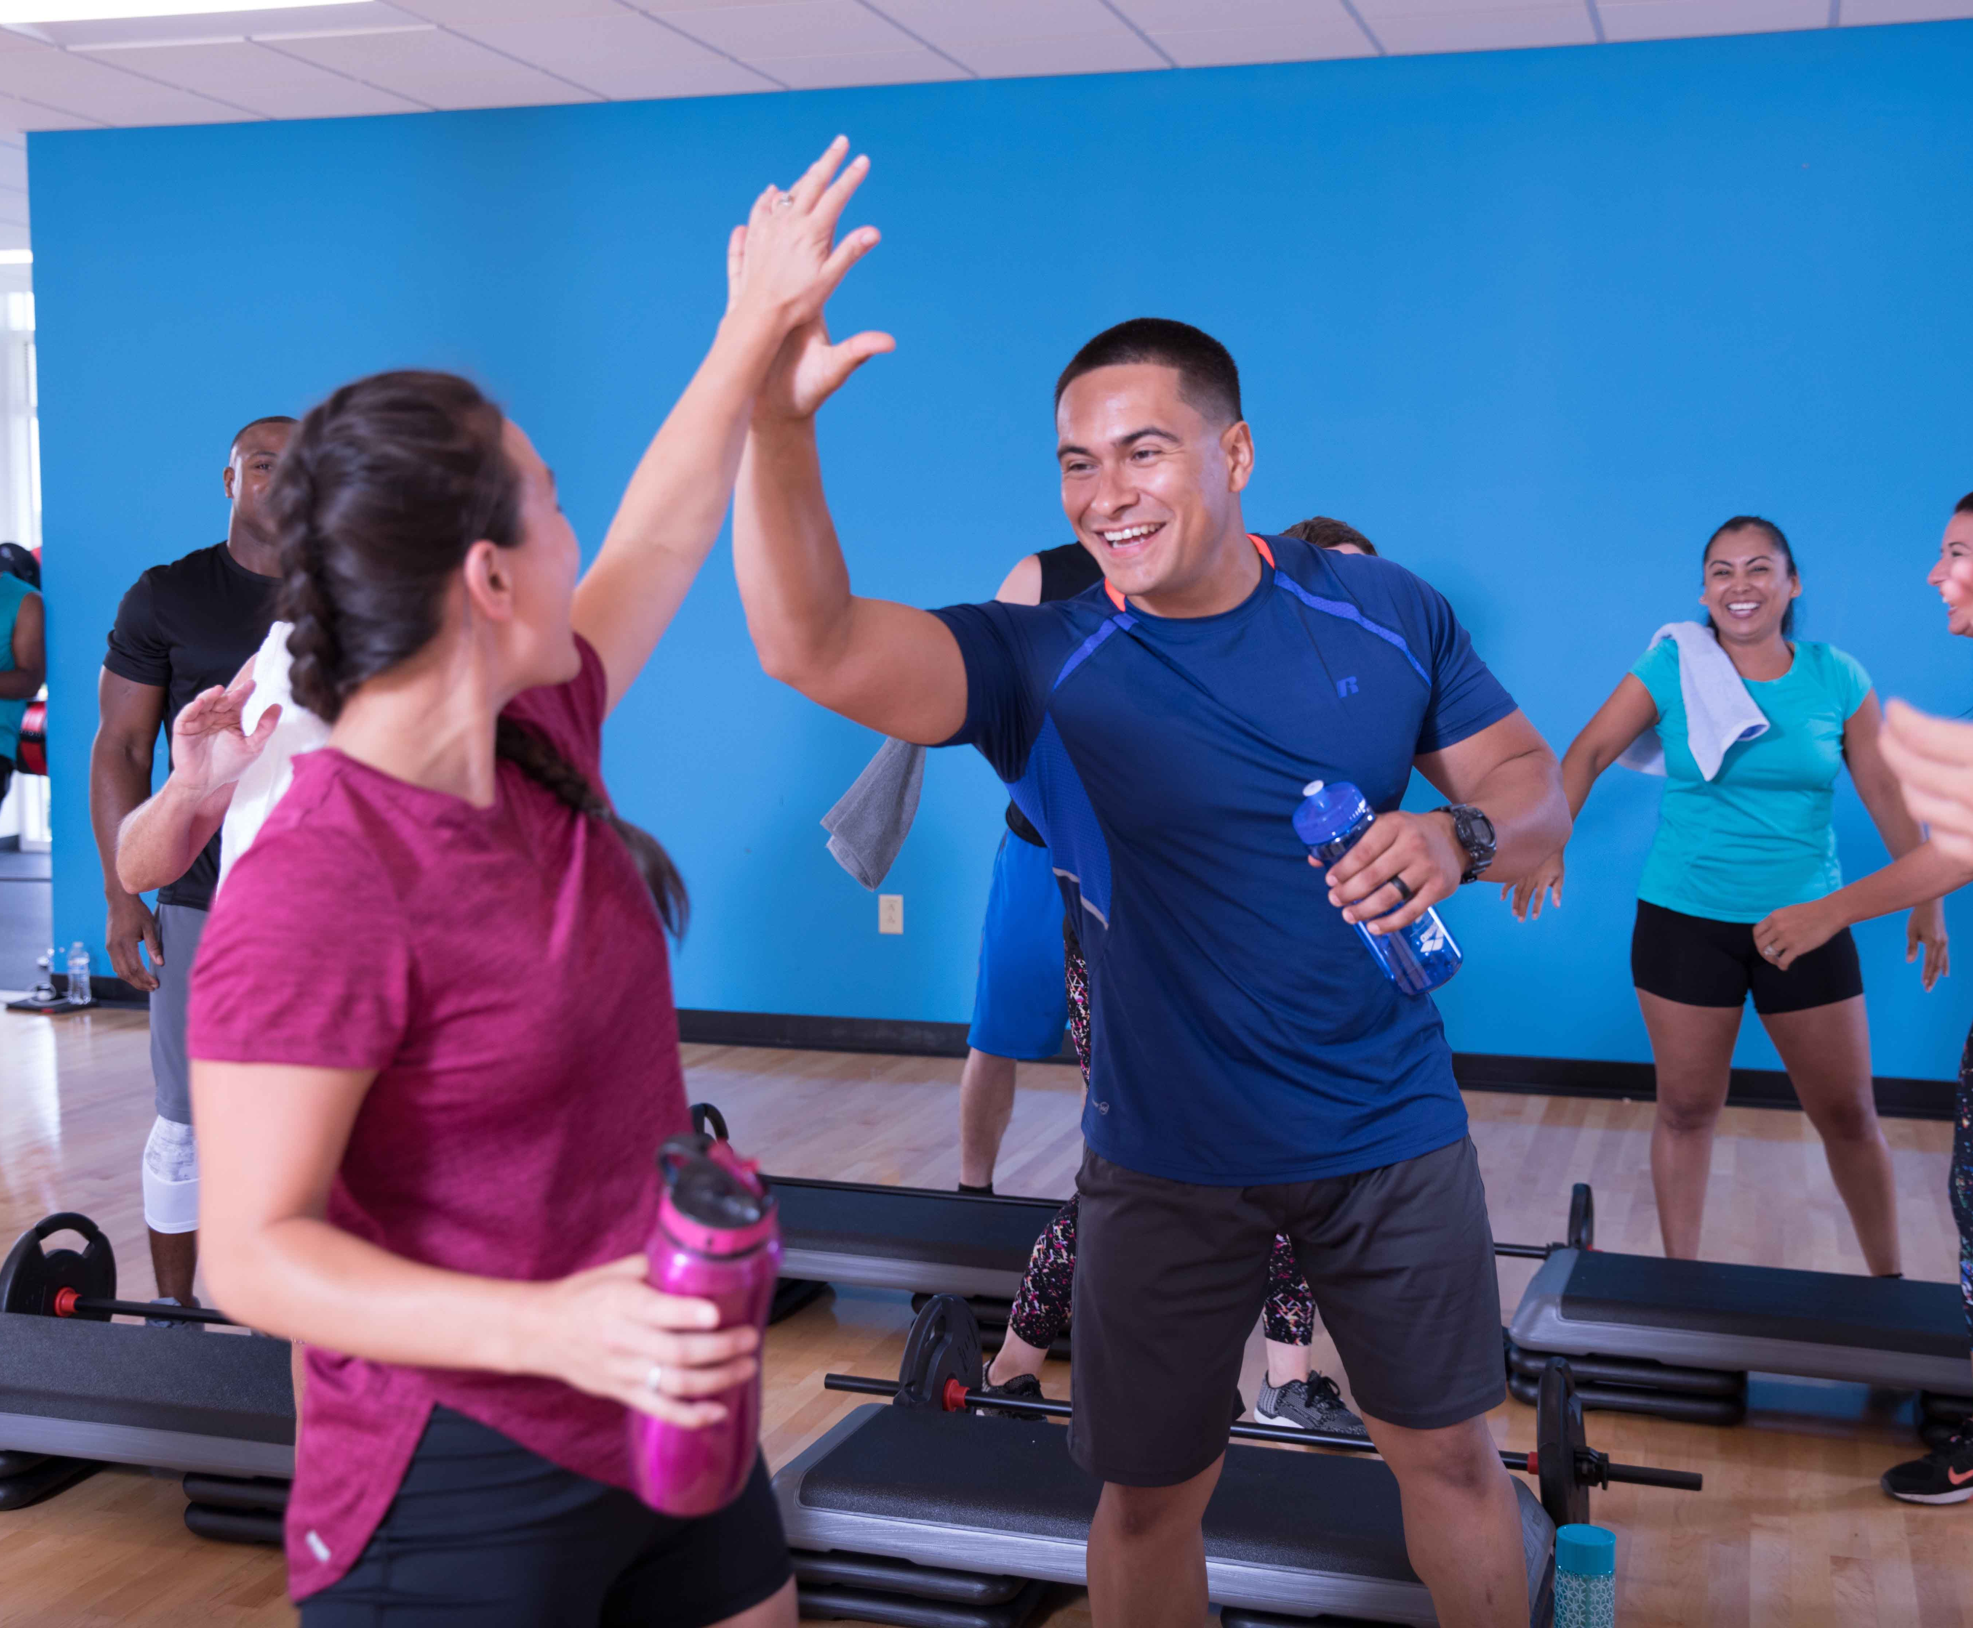
THE BENEFIT TO
THE YMCA
BIGGER
THEN ONE
INSTRUCTOR
Notes:
· Biggest organizational benefit.
· Experience becomes bigger than one instructor.
· Personal freestyle story: substitute came in → attendance dropped; once saw that as a compliment; eventually realized the vulnerability.
· If class depends on one personality, one resignation, vacation, or retirement can destabilize it.
· Professional programming gives continuity.
· Instructor still matters enormously. But the community survives.
BEST LINE
The class stops belonging to one instructor and starts belonging to the community.

Slide 33
STICKY WEB
EVERY CONNECTION REINFORCES THE OTHERS
WORKOUT
WORKOUT FRIENDS
MEMBER
INSTRUCTOR
INSTRUCTOR TEAM
YMCA
Notes:
· Member connected to workout, instructor, workout friends, instructor team, and YMCA.
· Each connection reinforces the others.
· More points of connection = harder for relationship to unravel.
KEY PHRASE
That’s what makes it sticky.

Slide 34
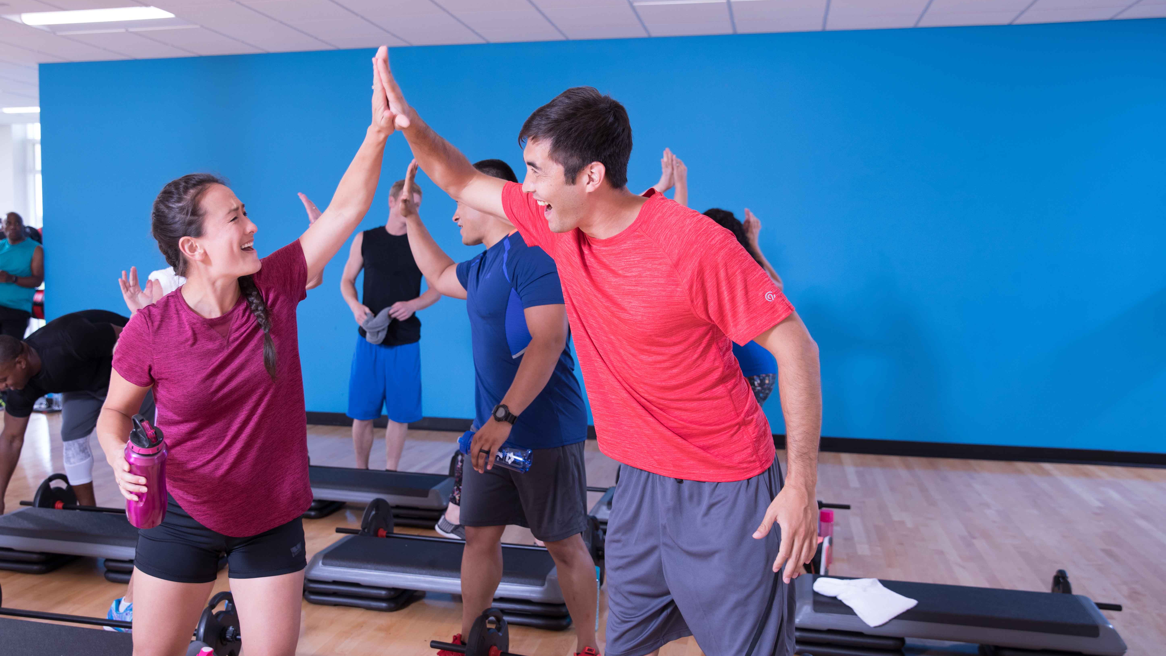
EVERYBODY
WINS
PARTICIPANT
INSTRUCTOR
GROUP FITNESS DIRECTOR
YMCA
Notes:
· Participant → better experience
· Instructor → better environment and more bandwidth
· Director → stronger team
· YMCA → more consistent, resilient, sticky program
LAND ON
That’s the real value of professional programming.

Slide 35
Connection in action
Gael Gebow
Association VP, Membership, Healthy Living, & Family Advancement
YMCA of Snohomish County

Slide 36
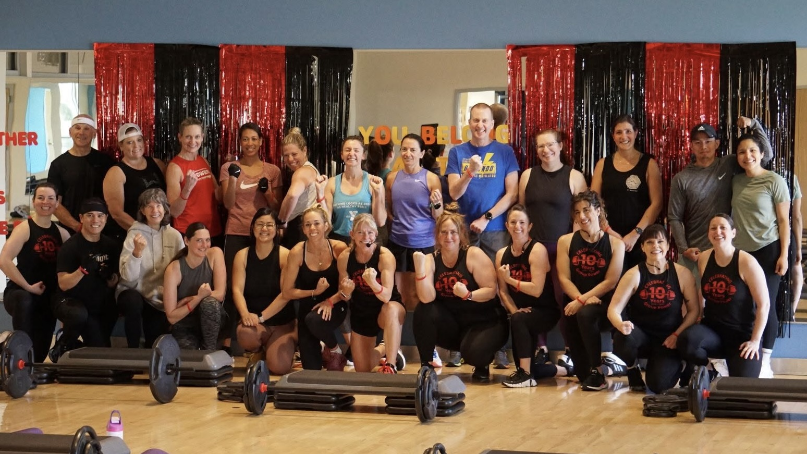
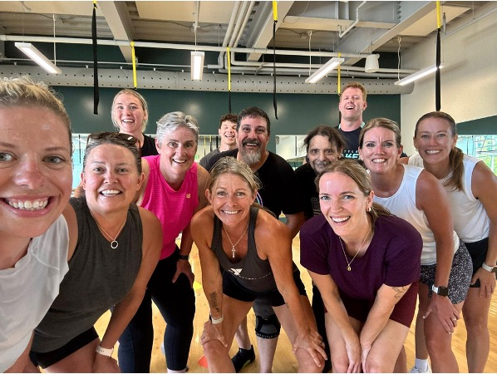
Creating connection

Slide 37
HIDING IN
PLAIN SIGHT
One of the YMCA’s greatest opportunities
has been hiding in plain sight all along.
GROUP
Notes:
· Bring story back to opening.
· Future isn’t only about what’s next.
· One of YMCA’s greatest opportunities may already be here.
· Group Fitness can improve health, build strength, create connection, build belonging, and strengthen community.
BEST PHRASE
Maybe one of the greatest opportunities for the future of the YMCA has been hiding in plain sight all along.

Slide 38
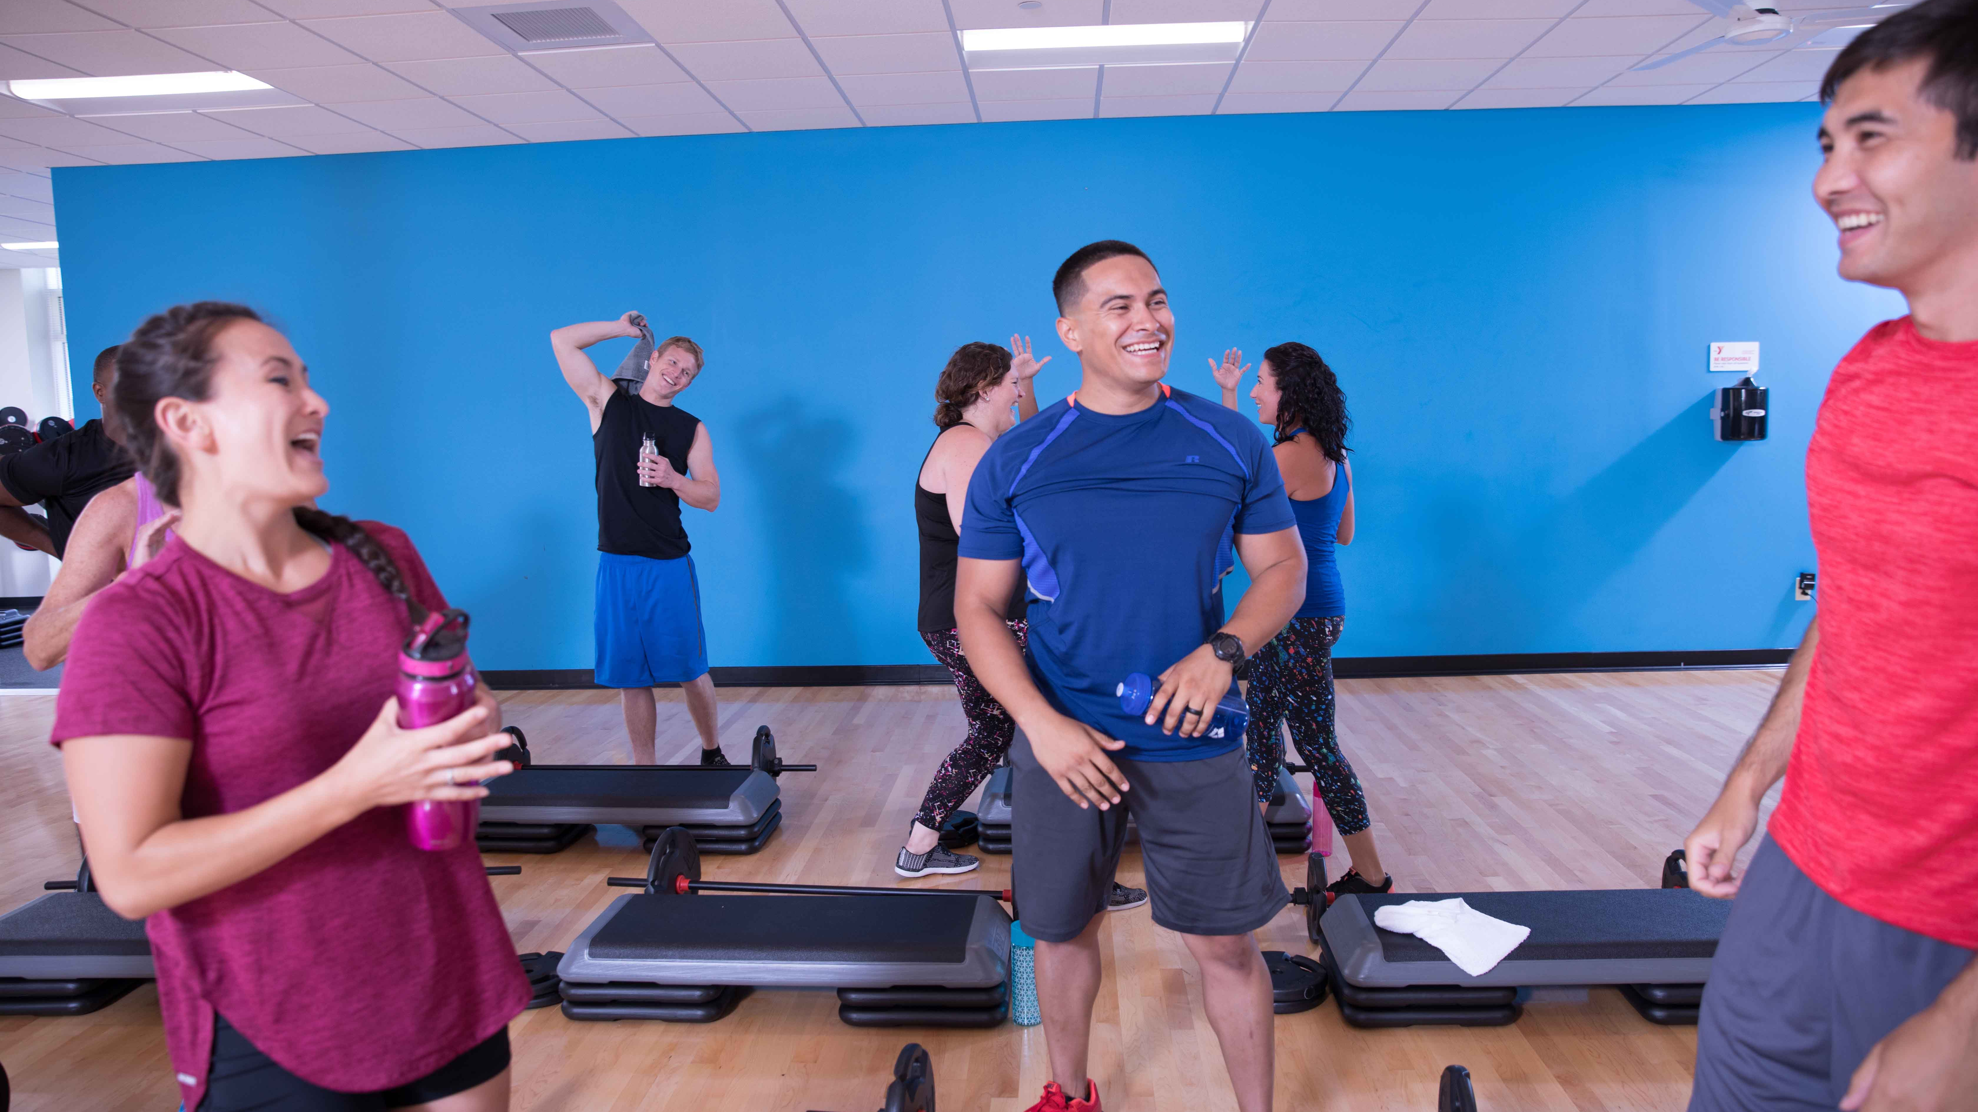
GROUP
PEOPLE COME FOR THE WORKOUT.
THEY STAY FOR THE COMMUNITY.
Notes:
· Slow down.
· Pause.
· Look up.
THEN
People come for the workout. They stay for the community.
STOP. No explanation afterward. That line is the ending.

Slide 39
THANK YOU
Jenn Gilburg
YMCA OF THE USA
312 917 4091
Jennifer.Gilburg@ymca.net
Cathy Spencer Browning
MOSSA
800 729 7837
Cathy@mossa.net
Gael Gebow
YMCA OF SNOHOMISH COUNTY
GGebow@ymca-snoco.org

