Slide 1

HOW LOCAL YMCA LEADERS DRIVE NATIONAL GOVERNANCE
Samuel Frisby and Siân Sokalski

Slide 2

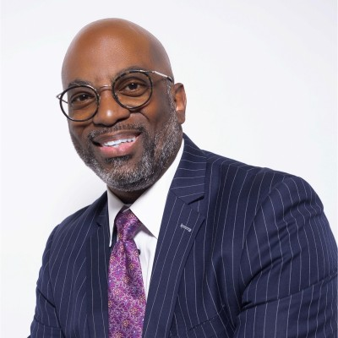

Samuel Frisby
VP, Certification &
Membership Qualifications
YMCA of the USA
Siân Sokalski
Sr. Director, Board Governance & Engagement
YMCA of the USA

Slide 3

Our Time Today
ELEVATE CONNECTION​
Use shared language and stories to strengthen purpose and connection.​
EMBED CONNECTION
Design and deliver experiences that
create connection.
INVITE CONTRIBUTION
Highlight opportunities for leaders to share their time, talents, and voices to create change.
Notes:
Through the 6 pillars of connection you’ve heard about, we’re going to focus today’s time together through elevating and embedding connection, and inviting contribution. We’ll do this through:
Grounding in National Council structure and constitution framework
Understand governance as a year‑round cycle, not a one‑time event
Identify how Y leaders elevate the association’s voice and where key opportunities exist
Explore how governance creates connected communities
Learn the foundations of Membership Qualifications
Recognize the power of governance relationships
Provide practical tools and insights

Slide 4
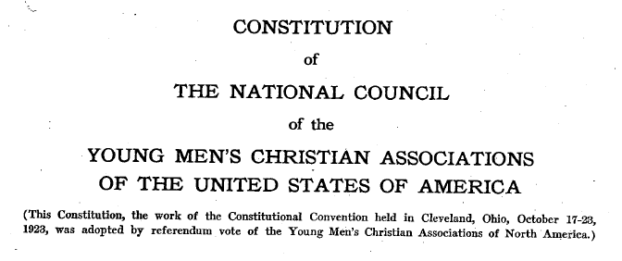
Grounding in our constitution
Notes:
The National Council Constitution was formed in 1923 and is still the foundational document guiding the work of YMCAs in the US.

Slide 5
Federated
Joined together into a single system or organization while letting each part keep some independence
Notes:
The National Council of YMCAs is structured as a federated organization. What does it mean to you to be federated? Can you think of other examples of federations?
(Ask for audience feedback/ideas)
(on click definition will appear) Simply put, federated means being joined together into a single organization while letting individual parts keep some independence.
Does this resonate with your understanding of how our current federated structure works? (Audience feedback)

Slide 6
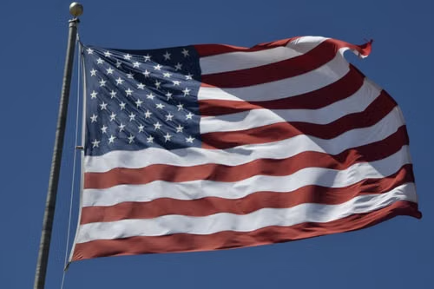
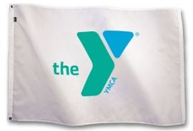
One Federated Idea ● Two expressions
A national structure creates unity while constituent bodies retain meaningful independence and local authority.
United States Government
YMCA Movement
Executive Branch
Carries out national responsibilities
YMCA of the USA
Leads, supports, and serves the Movement
Legislative Branch
Sets laws and provides oversight
National Board
Exercises governance authority and fiduciary responsibility
States
Retain authority in their jurisdictions
Local YMCAs
Independent, autonomous member associations
Notes:
KEY POINTS
• The YMCA is a federation: local associations are joined through a common national framework while retaining meaningful independence and local authority.
• In this illustrative comparison, Y-USA parallels the Executive Branch by carrying out national responsibilities, leading the Movement, and providing services and support to member associations.
• The National Board parallels the Legislative Branch by exercising the governance authority assigned through the National Council Constitution and Bylaws.
• Local YMCAs parallel states because member associations are independent and autonomous, serve distinct communities, and participate in a shared national system.
• The strength of the federated model comes from balancing national unity with local autonomy. No single part constitutes the Movement on its own.
• The National Council Constitution serves as the common covenant connecting Y-USA, the National Board, and member associations around shared purpose, authority, responsibilities, and membership expectations.
• Accountability flows in multiple directions: national leadership serves and supports the Movement, the National Board governs within its authority, and local associations uphold the qualifications and commitments of National Council membership.
• This is a governance analogy, not a one-to-one legal equivalence. The YMCA structure does not directly replicate every element of the U.S. federal government, including a separate Judicial Branch.
PRESENTATION NARRATIVE
The YMCA Movement can be understood through the familiar lens of American federalism. In both structures, a national framework creates unity around shared purposes while constituent bodies retain meaningful independence and local authority.
• Y-USA is comparable to the Executive Branch in this analogy. Y-USA carries out national responsibilities by leading the Movement, delivering resources and services, advancing national positioning, and overseeing national governance and membership qualifications.
• The National Board is comparable to the Legislative Branch in this analogy. The National Board exercises the governance authority assigned to it through the National Council Constitution and Bylaws, including national oversight and Board action.
• Local YMCAs are comparable to the states. Member associations are independent and autonomous, operate in their local communities, and retain local authority while participating in and remaining accountable to the shared National Council framework.
This comparison is intended as an illustrative governance analogy rather than a one-to-one legal equivalence. The United States also has a separate Judicial Branch, while the YMCA National Council structure described here does not map directly to all three branches of the federal government.

Slide 7
The YMCA is the movement
A federated system built to serve local Ys, shaped by local leaders, and collectively stewarded by all member associations.
For
By
Of
For the Movement
By the Movement
Of the Movement
Y-USA serves local Ys
Local leaders shape direction
Collectively stewarded
Provides leadership for the Movement
Delivers resources, services and innovation
Advances national positioning
Strengthens local community impact
Elevate issues and opportunities
Participate in governance pathways
Serve on committees and advisory bodies
Influence policy and constitutional decisions
Autonomous member associations
A shared Constitution and commitments
Distributed authority
Shared accountability and ownership
National structures exist to strengthen local Ys.
National direction is informed by local voices.
The Movement is collectively stewarded by its members.
Notes:
KEY MESSAGES
This slide captures a simple but important truth: the YMCA is not Y-USA, the National Board, or any single local association. The YMCA is the collective Movement. The federated structure joins the parts around a shared purpose while preserving meaningful local autonomy.
FOR THE MOVEMENT
Key message: The national structure exists to serve local Ys.
• Y-USA’s constitutional purpose is to help associations achieve their purposes and goals as a national Movement.
• National leadership, resources, services, innovation, positioning, and governance support are intended to strengthen local YMCA impact.
• National work should ultimately improve the ability of local YMCAs to serve their communities.
BY THE MOVEMENT
Key message: The Movement is shaped by local leaders.
• National governance is not meant to be created in isolation.
• Local leaders elevate issues, participate in Association Assemblies, serve on committees, comment on policy proposals, initiate petitions, and vote on governance matters.
• Strong national direction reflects the experience and participation of leaders throughout the Movement.
OF THE MOVEMENT
Key message: The Movement is collectively stewarded by its member associations.
• Member associations are independent and autonomous.
• Y-USA, the National Board, and local YMCAs are connected through a common Constitution, shared commitments, and mutual accountability.
• No single organization constitutes the YMCA Movement on its own. The Movement is sustained through shared stewardship.
CLOSING
“For the Movement, by the Movement, and of the Movement” describes a healthy federation. National structures serve local Ys, local leaders shape the future, and member associations collectively steward the Movement. The balance of service, participation, and shared ownership is what gives the YMCA federation its strength.

Slide 8
NATIONAL
National Board
Member Associations
Y-USA
COUNCIL
Notes:
How does it all fit together?
Member Associations and Y-USA are parts of the National Council, with the National Board serving as the governing authority to direct the implementation of the Constitution for the Movement as a whole.

Slide 9
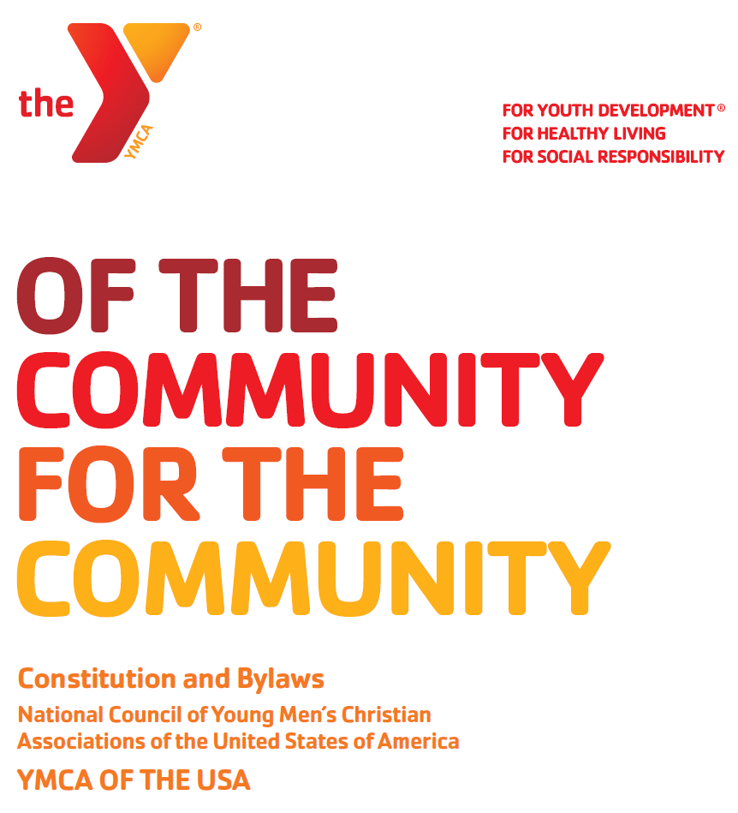
Constitution and Bylaws
Guides YMCA of the USA’s work and relationship to its member associations
Sets out the goals of the YMCA in the United States
Requires vote of member associations to be altered or changed
Bylaws may be amended by the National Board
Notes:
The National Council Constitution was formed in 1923 and is still the foundational document guiding the work of YMCAs in the US.
YMCA of the USA provides services and support to member associations (700+ in the U.S. and Puerto Rico)
Provides leadership for the Y Movement
Maintains friendly relationships with other YMCA movements outside the U.S.
Represents the U.S. Y’s in dealing with national and international organizations/governments
Contents of constitution
Article I: Purpose, Basic Objective, and Functions of YMCA of the USA
Article II: Qualifications for Membership in the National Council
Article III: Purpose and Functions of the Association Assemblies
Article IV: Role, Responsibilities and Functions of the National Board
Article V: Life Members of the Board
Article VI: Representativeness
Article VII: General Assembly
Article VIII: Intellectual Property/Names, Marks, and Symbols
Article IX: Financial Support of the National Council
Article X: Initiative, Referendum, and Amendments, and Voting by Member Associations
Article XI: Word Construction/Interpretation

Slide 10
Constitution and Bylaws
2024 and 2026 modifications to the Financial Support Formula
2025 amendment to expand YMCA CEO representation on the National Board
Notes:
Examples of recent amendments to the constitution.
Completed through a vote of member associations

Slide 11




Y-USA’s Fundamental Roles
Lead the Movement
Deliver Resources, Services and Facilitate Innovation
Advance National Positioning and Global Perspective
Oversee National Governance and Membership Qualifications
Notes:
Per Y-USA’s constitution - The basic objective of YMCA of the USA (Y-USA), as determined by Y associations and stated in the National Council constitution, is to “serve as a means through which associations can achieve their purposes and goals as a national movement, and to make available services which will enrich and strengthen associations in carrying on their work.”
Y-USA achieves this objective today by fulfilling four fundamental roles:
Lead the Movement: focus the efforts of YMCAs on key social issues and opportunities
Deliver Resources and Services and Facilitate Innovation: ensure YMCAs have access to the knowledge and resources needed to address pressing needs in their communities
Advance National Positioning and Global Perspective: communicate the Y’s value and maximize the Movement’s potential for good at home and abroad
Oversee National Governance and Membership Qualifications: knit the Movement together around shared values, goals, and requirements for YMCAs

Slide 12
Recent accomplishments
Deliver Resources, Services and Facilitate Innovation
Advance National Positioning and Global Perspective
Oversee National Governance and Membership Qualifications
Lead the Movement
10-Year Vision: Creating Connected Communities (CCC)
3-Year Strategic Plan to Support CCC
Improved Two-Way Communication w/ Y Leaders
General Assembly
Technology Roadmap
Organizational Excellence Assessment (OEA) and Practice Area Continuums
Praesidium Child Protection Accreditation (200+ Ys earned so far)
Learning & Leadership Development System
Practice Leadership
No Place Like This Place Campaign
Increased Fundraising
New High-Profile Partnerships
175th Celebration
Advocacy and Brand Positioning
Year-Round National Governance Strategy
Membership Qualification Policy Process Enhanced
Y Member Association Votes and Policy Comment Periods
Youth Advisory Council
Notes:
Lead the Movement
Established a 10-year vision for Creating Connected Communities
and a three-year strategic plan that supports done in collaboration with the Y Movement.
Established multiple communication channels to ensure Y stakeholder input and feedback:
quarterly CEO Townhalls,
CEO Advisory Council,
SMY Engagement team,
CEO annual survey,
and stronger connection to the Affiliate Networks.
Deliver Resources and Services and Facilitate Innovation
Organizational Excellence Assessment: Created and tested with 100+ Ys the
will provide a full 360 view of a Ys operations, finance and governance
full suite of tools available to support a continuous improvement process
Praesidium Child Protection Accreditation
L&LD:
Rebuilt Learning & Leadership Development infrastructure, including
A new, modern LMS system
Regional Learning Centers
Practice Leadership:
Established program experts at Y-USA to
facilitate innovation, program development, and support channel for YMCA
Advance National Positioning and Global Perspective
Launched No Place Like This Place
comprehensive ad campaign
adoption by more than 85% of Ys
Dramatically increased Y-USA fundraising
Annual average raised 2023, 2024 and 2025 was $66.6 million/yr
Almost 50% higher than previous period
Y-USA distributed an average of $30.9M out to nearly 3,000 Ys during the same period
Have set a goal of $175M
National partnerships
NBA
Comcast/NBC Universal
World Cup Spanish language ads (June-July
Today Show Campfire Across America (July)
NBC’s Primetime Centennial Special (Dec)
Oversee National Governance and Membership Standards
Established year-round national governance process that:
includes CEO Advisory Council,
reestablished regional AA meetings,
and amplifies multiple engagement points for Y CEOs and CVOs
Facilitated votes of member associations that
expanded # of CEOs on the board
approved exclusion of government grant revenue from fair share
Enhanced policy development process for membership qualifications with 30-day comment period to ensure all Ys can give input and perspective before changes approved by the Board
Supported improvements to Child Abuse Prevention and Aquatic Safety policies
Created National Youth Advisory Council to bring youth voice to organizational strategy development

Slide 13
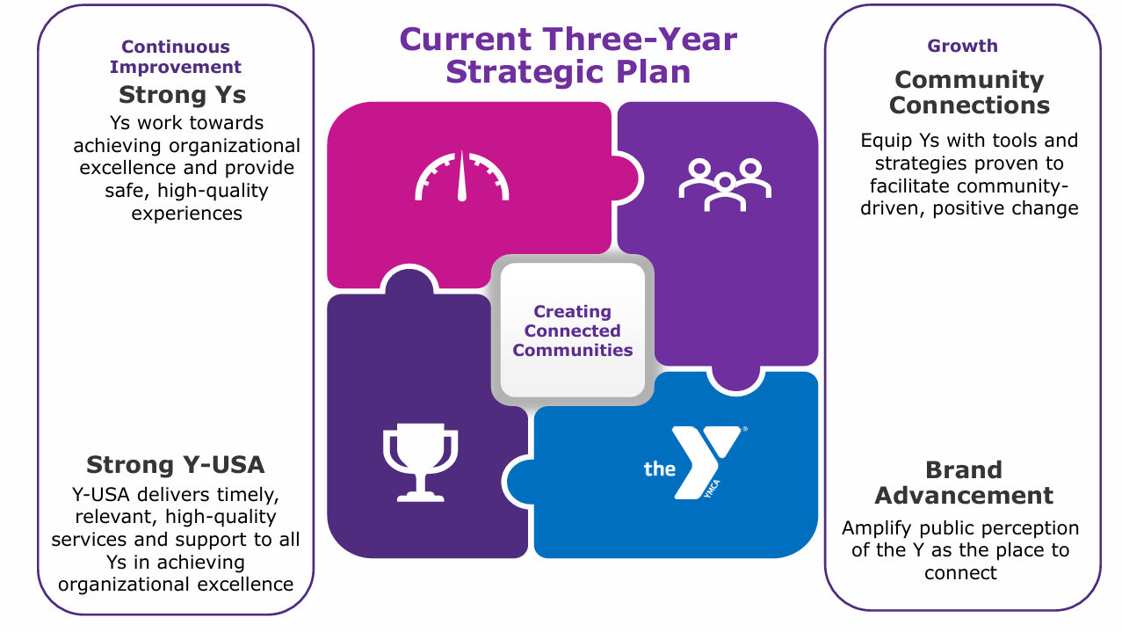
Simus volupti inctiist,
tem reritium anda dolecto bero blabo
essi optatis autendi tatur, sitat as is eos.
Notes:
And here’s what’s next Y-USA’s three-year strategic plan is first phase of 10-year journey
Four objectives:
Strong Ys
Strong Y-USA
Community Connections,
And Brand Advancement.
Start with Strong Y-USA.
To be successful in our long-term vision,
Y-USA must set goals and be accountable
We continue to build on what I shared earlier,
And we are doing it in partnership with Y leaders like you
Then, Strong Ys.
Helping all Ys pursue financial and operational excellence is not new
What is new: technology to be more data-driven in our solutions
The Organizational Excellence Assessment OEA integrates AI…
Has the potential to be a game changer for financial sustainability
Will offer a comprehensive picture of strengths and opportunities for each Y
And then identify resources to make progress where it matters most
David Martorano is an architect of the OEA and will share more in a few moments
Slide 9 (continued)
Next is Community Connections.
Ys create meaningful connections every day.
Has been true for 175 years.
But crisis of loneliness and isolation calls us to do more
Tools and resources coming to help Ys create even more intentional connections
Both in current work and in new ways
Finally is Brand Advancement.
Many people know of the Y, but knowledge is limited to their own experiences.
Inviting people to re-appraise the Y
Helping them see all that we offer
And what has always been true: there is No Place like the Y.
This includes:
175 anniversary celebrations and
No Place Like This Place advertising campaign.
National partnerships

Slide 14
National Governance Is a Catalyst for Creating Connected Communities
WHEN LEADERS PARTICIPATE, THEY EXPERIENCE:
Achievement
Belonging
Contribution
They shape the future
They share ownership
They shape the Movement
YMCA NATIONAL GOVERNANCE + CREATING CONNECTED COMMUNITIES
Notes:
Speaker notes:
National governance brings local leaders together around shared purpose, shared responsibility and shared action. It turns a federation of independent associations into a connected movement.
National governance should be understood as a community-building engine, not simply a formal structure for making decisions. It creates a recurring space where local YMCA leaders bring their experience, listen across differences, and act as stewards of the whole movement.
The connection to Creating Connected Communities is direct. Leaders experience achievement when their contributions influence movement-wide priorities and outcomes. They experience belonging when their perspectives are welcomed and they share ownership of the YMCA's future. They experience contribution when their voices, expertise and service help shape the movement's direction.

Slide 15
National Governance Is a Catalyst for Creating Connected Communities
HOW GOVERNANCE CREATES COMMUNITY
01
LOCAL VOICE
Community experience enters the national dialogue.
02
SHARED DELIBERATION
Leaders listen, collaborate and work across differences.
03
COLLECTIVE DIRECTION
Local insight shapes movement-wide priorities and decisions.
04
SHARED STEWARDSHIP
Leaders accept responsibility for the whole movement.
Local voice becomes collective direction.
Notes:
Speaker notes:
National governance should be understood as a community-building engine, not simply a formal structure for making decisions. It creates a recurring space where local YMCA leaders bring their experience, listen across differences, and act as stewards of the whole movement.
The connection to Creating Connected Communities is direct. Leaders experience achievement when their contributions influence movement-wide priorities and outcomes. They experience belonging when their perspectives are welcomed and they share ownership of the YMCA's future. They experience contribution when their voices, expertise and service help shape the movement's direction.
The process shown on the right begins with local voice, moves through shared deliberation, produces collective direction, and ultimately builds shared stewardship. The central message is that governance transforms independent local associations into a connected national movement.

Slide 16
How National Governance Activates CCC
Each lever shows a practical way governance makes connection intentional across the YMCA movement.
Governance is where the six levers become lived practice
SIX LEVERS OF CONNECTION​
ELEVATE CONNECTION​
Use shared language and stories to strengthen
purpose and connection.​
PRACTICE CONNECTION SKILLS​
Develop the skills and reinforce the culture that make meaningful connection possible.​
EMBED CONNECTION EVERYWHERE​
Design and deliver experiences that create connection.​
CREATE CONNECTED SPACES​
Build physical and digital environments that spark interaction and create access and belonging for all. ​
INVITE CONTRIBUTION ​
Provide opportunities for people to share their time, talents, and voices to create change.​
SUPPORT WELL-BEING​
Foster experiences that elevate health and well-being and help all people thrive. ​
Notes:
Speaker notes:
This slide demonstrates how all six levers of connection are activated through the National Governance Process.
Elevate Connection: Governance provides a common language, shared purpose and stories that reinforce movement identity.
Practice Connection Skills: Effective governance requires listening, empathy, trust, collaboration and the ability to work constructively across differences.
Embed Connection Everywhere: Connection is built into boards, councils, assemblies, committees, task forces and policy-development processes.
Create Connected Spaces: Governance establishes in-person and digital environments where leaders exchange perspectives and develop relationships.
Invite Contribution: Elections, committee service, public comment, task forces and other pathways allow local leaders to contribute their voices, talents and experiences to national decisions.
Support Well-Being: Governance establishes accountability, shared standards and stewardship that strengthen local Ys and their capacity to help communities thrive.
Together, the six levers produce achievement, belonging and contribution.

Slide 17
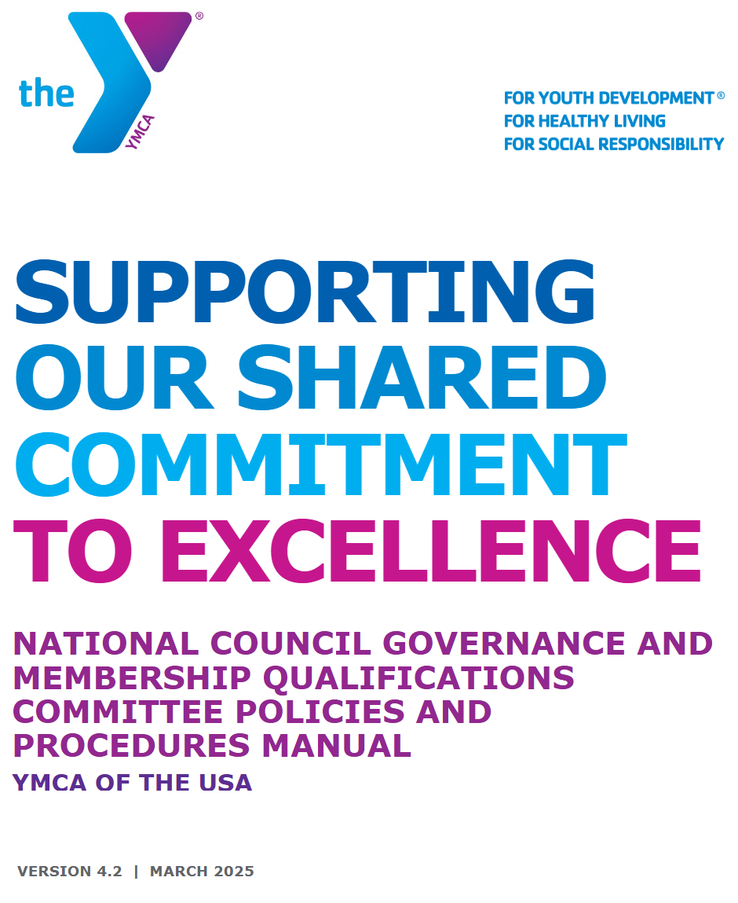
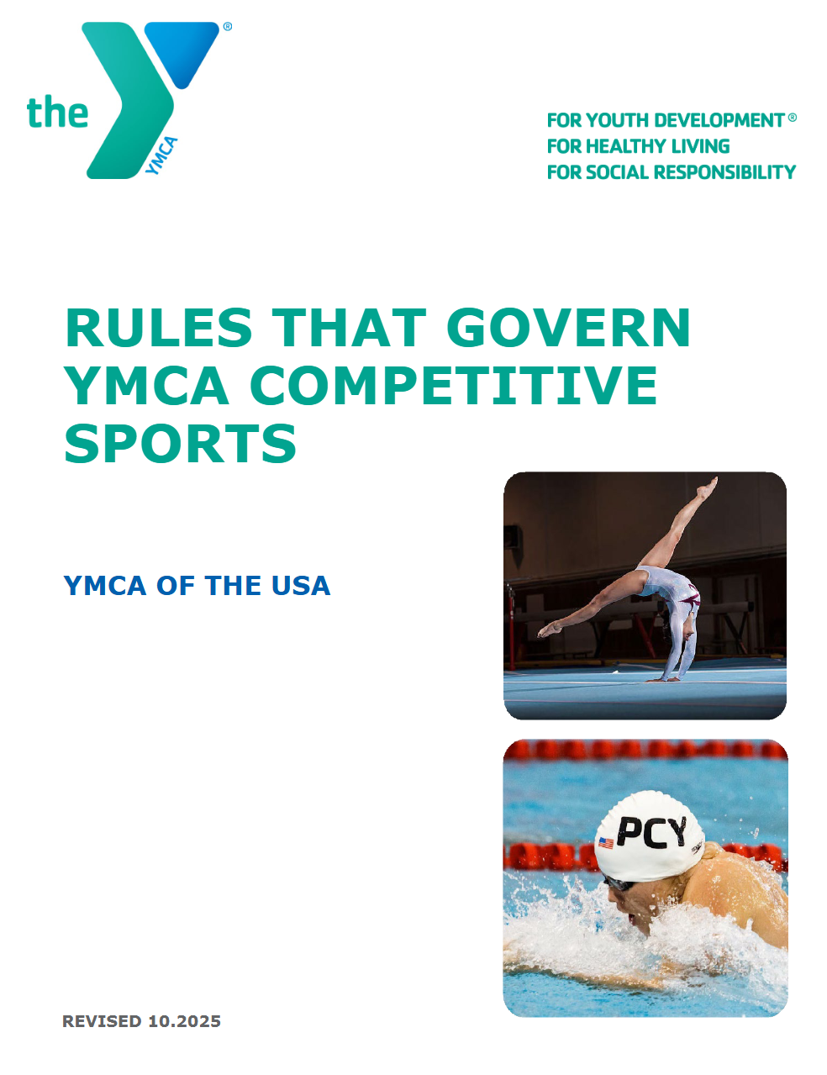
Our foundational Documents
Governance and Accountability

Slide 18






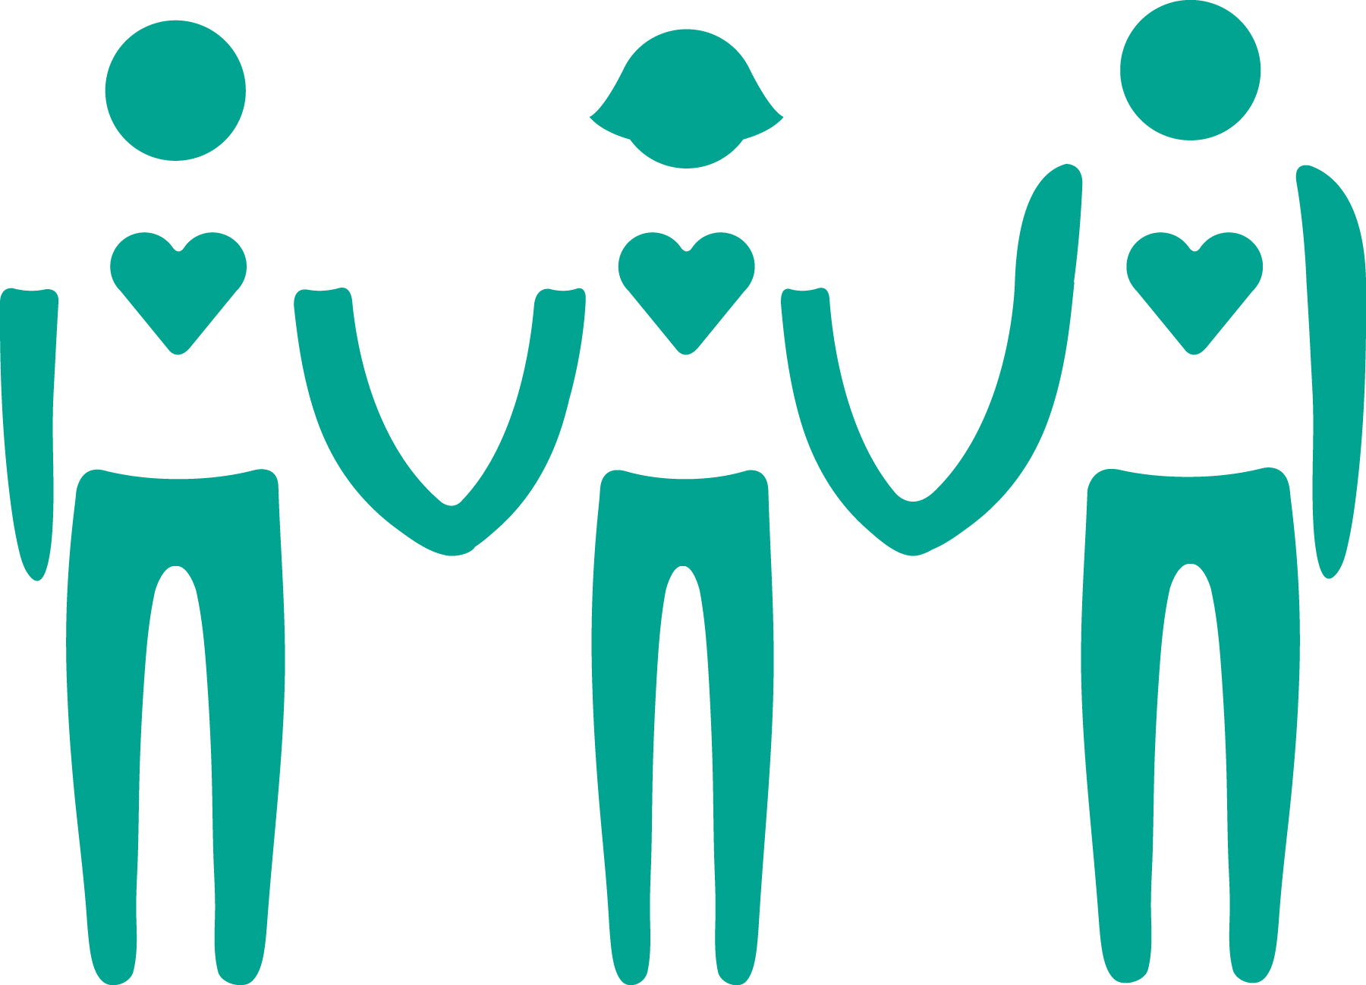

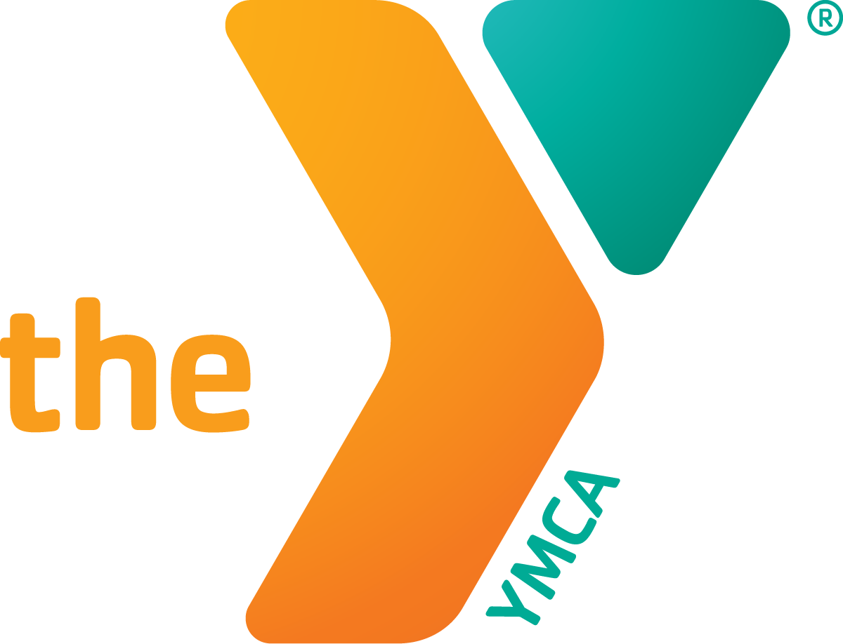

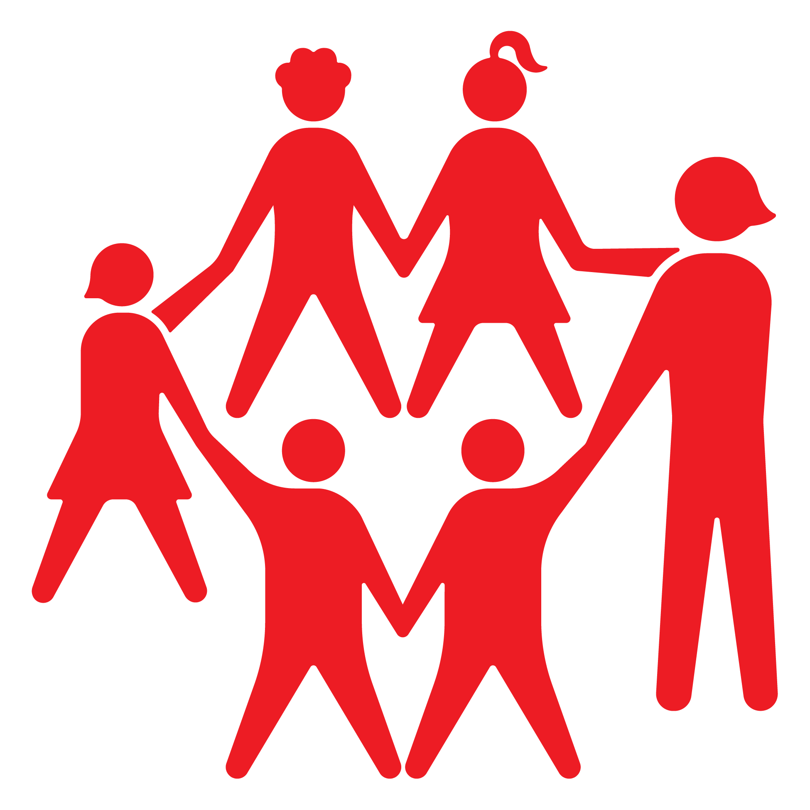
YMCA Membership Qualifications
Our shared Covenant
Article II, Section 2 • The eleven commitments member associations collectively agree to uphold
1
2
3
4
5
6
PURPOSE
IDENTITY
COVENANT
STEWARDSHIP
TRANSPARENCY
LEADERSHIP
Support the Statement of Purpose
Use our legal name
Accept the Constitution
Complete annual reporting
Maintain a qualified CEO
Pay financial support
INCLUSION
LEGAL STATUS
BRAND
RISK
SAFETY
Maintain recognized 501(c)(3) status
Properly use trademarks and logo
Protect against risk to the brand
Do not unlawfully discriminate
Uphold child protection and aquatic safety
7
8
11
Notes:
Article II of Constitution
KEY MESSAGES
• The eleven membership qualifications are the Movement’s formal covenant with one another.
• The qualifications are contained in Article II, Section 2 of the National Council Constitution and are determined by vote of member associations.
• Together, the qualifications establish a common baseline for mission alignment, governance, financial stewardship, transparency, leadership, inclusion, legal standing, brand protection, organizational risk, child protection and aquatic safety.
• Member associations renew their commitment to uphold these qualifications through the annual certification process.
• The qualifications preserve local autonomy while defining the shared commitments required for membership in the National Council.
• The National Council Governance and Membership Qualifications Committee evaluates conformance and annually certifies member association status.
[Sources]
- Internal source: 11 Membership Qualifications .pptx. Provides the eleven qualification labels and describes them as the formal covenant member associations have agreed to uphold.
- Internal source: 2026-08-06 StraCmte_Membership Qualifications Overview.pptx. Lists Article II, Section 2 qualifications 2a through 2k.
- Internal source: National Council Governance and Membership Qualifications Committee Policies and Procedures Manual, version 4.2, March 2025. States that the qualifications are determined by vote of member associations and collectively upheld, and describes annual GQ certification.
- Visual on this slide was generated with Microsoft Copilot.
[/Sources]

Slide 19
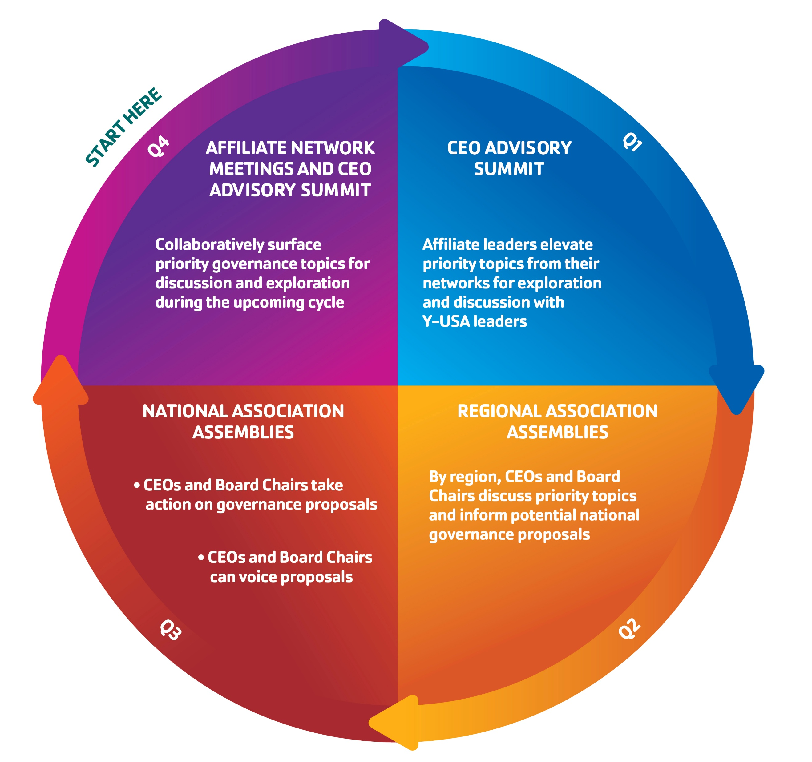
Association Assemblies
Year-Round Engagement Cycle
Notes:
Article III of Constitution
I want to share the constitutional role of Association Assemblies and explain how these regional and national meetings fit within the YMCA’s broader year-round governance process.
Our Constitution outlines the purpose of Association Assemblies. These meetings are intended to provide a formal mechanism for member associations to hear matters of importance to the movement, inform the National Board of matters of concern, and elevate proposals or issues for further consideration within the governance structure of the National Council.
The National Association Assembly remains the forum for national action items that are ready to move forward on a movement-wide basis. The regional assemblies, by contrast, are intended to create space for earlier dialogue, education, and input so that issues can be surfaced, better understood, and more thoughtfully considered before they reach that stage.

Slide 20
National council constitution
Purpose of Association Assemblies
Review reports from the National Board and state of the Y Movement since our last gathering
Inform the National Board on matters of concern and recommend proposals for consideration by the National Board
Elect members to the National Association Assembly Steering Committee
Receive a report from the National Board Development Committee, which is responsible for National Board governance and the nomination of National Board candidates
Receive findings from the National Board Financial Support Review Task Force
(last done in 2024)
Serves as a venue for informational and educational sessions and networking with our peers

Slide 21
Governance and Engagement Pathways for constitutional change
Governance Pathways
Association Assemblies
Year-Round Engagement Cycle
The National Board and its Supporting Committees
Member Association Initiative Petition
National Board
GQ
FSRTF
Notes:
The National Council Constitution outlines several ways that member associations can participate in the governance of the National Council.
The power to amend the National Council Constitution is held by the member associations of the National Council.
Y-USA supports and facilitates these pathways to ensure member association leaders have ongoing opportunities to engage in productive and iterative dialogue about governance matters.
The three pathways for constitutional change are through action of Association Assembly, the National Board, or Member Association initiative petition

Slide 22
National Board Action
Process from Topic Initiation to Resolution
Supporting Committees of the National Board
GQ
FSRTF
Initiation Point
Topic is elevated to be explored by the National Board
Review
Additional review by other governance bodies
Board Action
National Board approves action by Member Associations
Resolution
Constitutional action taken
Notes:
National Board action:
During any regular or special meeting the National Board may determine to submit to member associations any proposed amendments of the Constitution.
Topics are elevated to be explored by the National Board. If appropriate, the issue may go through additional review by other governance bodies. Examples would be the National Council Governance and Membership Qualifications Committee (commonly referred to as GQ committee), or a cyclical review of the financial support formula by the financial support review task force. If a recommendation is elevated following this review, the National Board then has the authority to move the issue to a vote of member associations.

Slide 23
Initiative Petition Action
Process from Topic Initiation to Resolution
Initiation Point
Topic is elevated by leaders of the Movement
Initiative Petition
15% of Member Associations share petitions with National Board
Board Action
National Board approves action by Member Associations
Resolution
Constitutional action taken
Notes:
Member association initiative petition:
This process is similar to the National Board action process, with the main difference being the initiation point of the topic. At the request of 15 percent of member associations who elevate an issue in the form of petitions received by the National Board, the activation of a vote of member associations is authorized by the National Board.

Slide 24
Association Assemblies Process from
Topic Initiation to Resolution
Event
Advisory Summits
Topics are elevated and explored
Regional Assemblies
Topics are discussed and prioritized
National Assembly
Action is taken on priority topics and proposals
Resolution
Constitutional action taken
OR
Topic is moved to watchlist for continued conversation in future cycle
Topics
Governance topics move to Regional Assemblies
Other topics are addressed through appropriate channels
Priority topics move forward
Approved topics move to action
Additional topics are elevated
Other topics move to watchlist
Other topics move to watchlist
Notes:
The cycle begins with advisory summits, which are held in the fall and spring with a delegation of YMCA leaders to discuss topics of importance for the movement.
Governance topics that are elevated from these advisory summits would move to regional association assemblies for discussion. Other topics would be addressed through the appropriate channels that they are related to, for example this could look like a response from our network delivery team.
Then we move to regional assemblies, where the four regions meet separately. At these governance meetings, topics are discussed and priority topics that have previously been elevated through the advisory summits move forward for discussion. At these regional assemblies additional topics can be elevated from regional representatives through discussion. And other topics would move to a watchlist for future discussion or consideration.
We then move to National Association Assembly where action is taken on priority topics and proposals. These would be topics that have been endorsed through the regional association assemblies, and included on the agenda built by the national Association assembly steering committee. Approved topics at the national assembly would then be moved to action or other topics may be moved to the watchlist for continued conversation in a future cycle.
So again coming out of national Association assembly priority issues would either move to a constitutional action such as a Movement vote or a future cycle for discussion.
A recent example of a topic that have moved through the AA cycle:
Financial Support modification to exclude government grants revenue, in the 2026 cycle, this was elevated at the advisory summit, feedback was gathered at regional assemblies, action was taken at national assemblies, and resolution was concluded through a movement-vote.

Slide 25
Save the dates
Regional Association Assemblies
Week of May 3, 2027
National Association Assemblies
September 22, 2027
Notes:
The 2026 year-round governance cycle was altered due to General Assembly being in September.
Please mark your calendars for our 2027 schedule, which will return to our typical timetable: Regional Association Assemblies in Spring and National Association Assemblies in Fall.
At the end of the day, the National Council belongs to you, our member associations. We encourage you to remain engaged in the process so your voice continues to shape the governance work of the Movement

Slide 26
HOW LOCAL YMCA LEADERS DRIVE
NATIONAL GOVERNANCE
Six pathways move local insight into Movement-wide direction, policy and constitutional action.
LOCAL VOICE
↓
COLLECTIVE ENGAGEMENT
↓
NATIONAL ACTION
ELEVATE ISSUES
ENGAGE IN ASSEMBLIES
1
2
Surface opportunities, challenges and emerging concerns from the field.
Discuss and prioritize topics through regional and national forums.
SERVE & ADVISE
SHAPE POLICY
3
4
Bring local experience to committees, advisory groups and task forces.
Review proposals and respond through the 30-Day Comment Period.
THE FEDERATED MODEL WORKS WHEN LOCAL LEADERS PARTICIPATE
INITIATE ACTION
VOTE
5
6
Use the member association initiative petition pathway.
Exercise member authority on proposed constitutional changes.
Notes:
KEY TALKING POINTS
1. Elevate Issues and Opportunities from the Field
Local YMCA leaders identify challenges, opportunities, and emerging issues through advisory summits, alliance discussions, regional gatherings, and other leadership forums. Governance issues may then enter the formal process for review.
2. Participate in Regional and National Association Assemblies
Association Assemblies allow member associations to hear matters of importance, inform the National Board of concerns, elevate proposals, and prioritize governance matters. Regional Assemblies identify priorities; the National Association Assembly provides a forum for action on proposals ready to move forward.
3. Serve on Governance Committees and Advisory Bodies
Local CEOs, board volunteers, and Movement leaders bring field experience to governance committees, advisory committees, and task forces that evaluate issues and develop recommendations for the National Board.
4. Shape National Policy Through the 30-Day Comment Period
YMCA CEOs review proposed GQ policy changes and provide feedback intended to improve transparency, identify blind spots, strengthen implementation readiness, and refine policy language before recommendations reach the National Board.
5. Initiate Governance Action Through Petition
Member associations may initiate governance action through petition. At the request of 15 percent of member associations submitting petitions, an issue may be elevated and potentially moved toward a member association vote.
6. Vote on Constitutional Changes
The authority to amend the National Council Constitution is held by member associations, which exercise that authority through the constitutional voting process.
[Sources]
- Internal source: 2026 GA Learning Session - How Local YMCA Leaders Drive National Governance.pptx.
- Internal source: 2026 Association Assemblies 30-Day Comment Period Script.docx.
- Internal source: ELT 30-Day Comment Period Presentation 2026.pptx.
- Internal source: RAA_2026_PPT_Master.pptx.
- Visual on this slide was generated with Microsoft Copilot.
[/Sources]

Slide 27
MOVEMENT LEADERS POWER NATIONAL GOVERNANCE
Volunteer leaders and local YMCA CEOs bring Movement experience into national governance, review and decision-making.
159 National Governance Participants
33
58
24
8
15
21
Standing Committees
Committee Members
National Association Assemblies
Steering Committee
National Board
Directors
Advisory Summit
Delegates
Financial Support
Review Task Force
Youth Advisory
Council Members
Sets direction, exercises oversight and acts within National Board authority.
Shapes strategy, policy, certification, and accountability.
Discuss topics of importance for the movement, elevating topics for consideration by the assemblies.
Elevates the youth voice on emerging issues and supports local YMCAs in engaging young people.
Guides Assembly agendas, nominations and regional governance engagement.
Reviews the financial support formula and develops recommendations.
Notes:
You may still be asking if there are other ways that you can be involved in governance on a national level.
• This slide depicts 159 positions across national governance and engagement bodies, using the counts supplied for this presentation.
• 33 National Board director positions provide national oversight and governance authority. Up to 9 of these seats may be held by CEOs of Y associations.
• 58 Standing Committee positions such as on the Governance and Membership Qualifications Committee, National Board Development Committee, and International Global Relations and Community Engagement Committee. These are committee seats that are not held by national board members.
• 24 Advisory Summit delegates that are not held by national board or committee members who meet to discuss topics of importance and relevance to the Y movement.
• 15 Financial Support Review Task Force positions bring Movement perspectives to the periodic review of the financial support formula.
• 8 National Association Assembly Steering Committee positions represent four regions, with two representatives from each region.
• 21 Youth Advisory Council Members, including a representative who serves as a non-voting member of the National Board.
• The central message is that national governance is informed by leaders connected to the YMCA Movement, including local YMCA CEOs and volunteer leaders.

Slide 28
Movement Leader Insights

Slide 29
What is Good governance
Board's ability to provide effective oversight, strategic leadership, and fiduciary stewardship
Accountability while advancing the YMCA mission and serving community needs
Notes:
Good governance is defined as a board's ability to provide effective oversight, strategic leadership, fiduciary stewardship, and accountability while advancing the YMCA mission and serving community needs, in partnership with executive leadership.

Slide 30

HOW WE ARE ASSESSING EXCELLENCE
Excellence Tools
Organizational Excellence Assessment (OEA)
Practice Area
Continuums
A standardized Y-USA assessment for Y CEOs to understand overall organizational performance across financial and operational metrics and identify where to focus next.
*A version of the OEA tailored to independent overnight camps is also in development.
A directional guide for local Y leadership and staff to understand progressive levels of performance within a specific practice area and identify areas for growth.
Membership & Program
Months of Liquidity
Staff
Operating Margin
RISK MANAGEMENT
EXPERIENCE
Risk Mitigation
OEA
Debt Ratio
Practice Area Continuum
Governance
Charitable Revenue
STRATEGY
ADMINISTRATION
Experience
Operating Revenue Mix
Excellence assessments will be spotlighted at GA followed by the launch of the OEA on October 1.
30
© 2026 YMCA of the USA
*Practice area continuums are in development and will be rolled out in a phased approach.
4

Slide 31
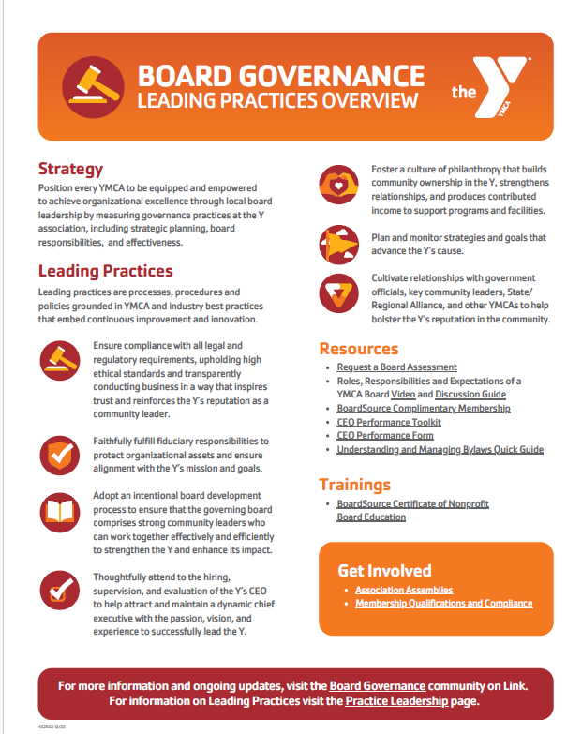
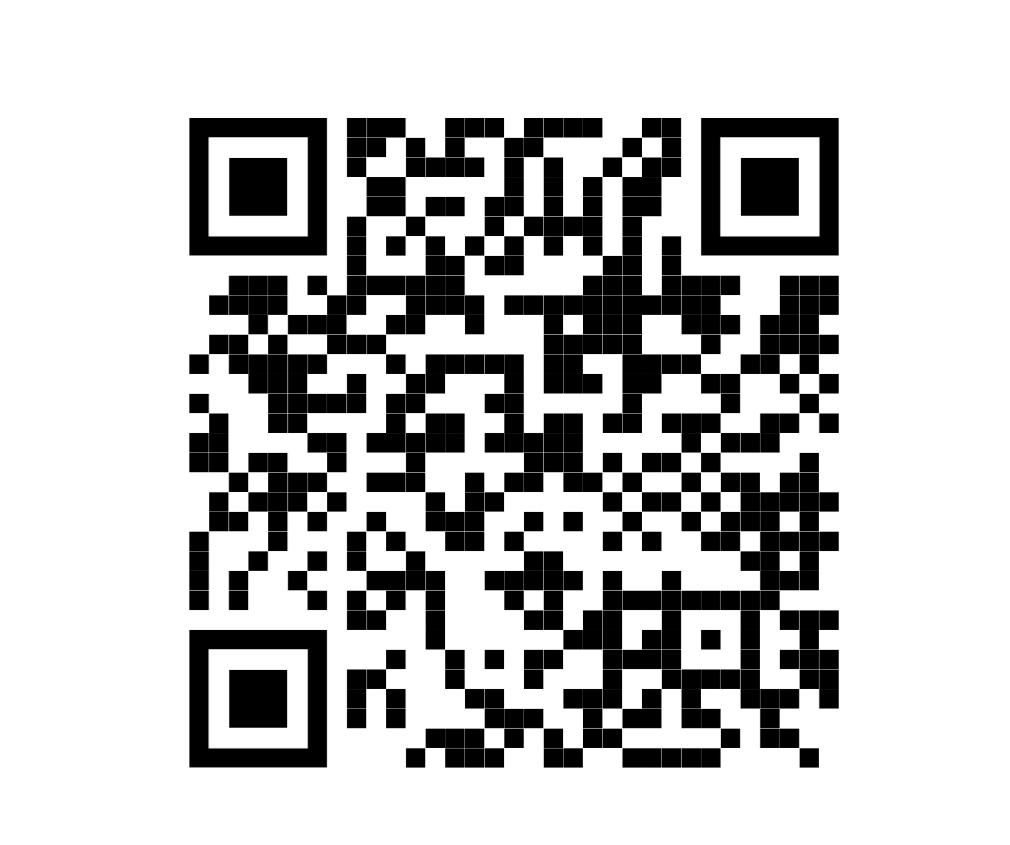
Board governance leading practices

Slide 32
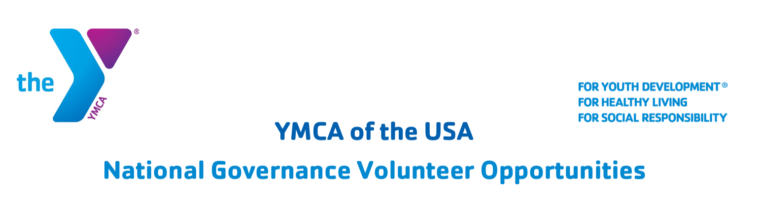
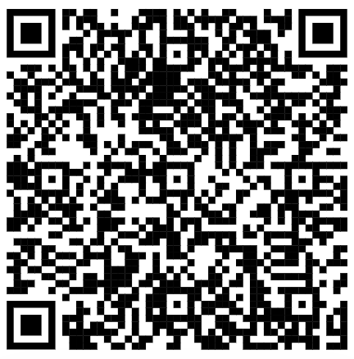
National Governance Nominations
The National Board Development Committee continuously welcomes nominations of candidates for the YMCA of the USA Board of Directors and its committees.
You can nominate yourself or a colleague with this form.

Slide 33
Q&A

Slide 34
THANK YOU
Samuel Frisby
YMCA OF THE USA
312 416 0860
Samuel.Frisby@ymca.net
Siân Sokalski
YMCA OF THE USA
312 419 8473
Sian.Sokalski@ymca.net

