Slide 1

HOW YOUNG PEOPLE ARE SHAPING THE YMCA’S NEXT 175 YEARS
E Mitchell
Emi Ren
Zion Stallings
Devon Jasiukonis
Ben Major
Notes:
Devon

Slide 2
SIX LEVERS
OF CONNECTION
CREATING CONNECTED COMMUNITIES​
Notes:
E

Slide 3
INVITE
CONTRIBUTION
Provide opportunities for
people to share their time,
talents, and voices to
create change.​
Notes:
E

Slide 4

an invitation to contribute
The story of our Movement begins with a young person seeing an opportunity to make a difference.
  Need for community
  Need for belonging
  Need for co-creation
Inviting contribution means creating opportunities for people to actively shape the future, not simply participate in it.
Notes:
E
Our origin story tells us that the Y wasn’t built for young people, but because young people were given the opportunity to contribute their ideas, energy, and leadership
With the negative effects of the Industrial revolution, much like we see in the current technological/AI revolution, young people needed to feel like they were a part of something, like their ideas matter, and that the adults in spaces of leadership would consider them when planning for the future
In my world of teen development, inviting contribution means doing what this Movement has done since 1844, creating the space for young people to lead

Slide 5

What does the YMCA feel like through the eyes of young people?
The Y will remain relevant when youth are viewed as not only recipients of a service, but when they are invited to share their experiences, perspectives and aspirations in meaningful ways.
Notes:
E (transition to Zion)
Young people help us imagine new possibilities for our Movement. Their experiences tell us what creates belonging and their perspectives challenge us to evolve. Inviting contribution isn’t only asking for feedback, it is recognizing that their lived experiences are imperative to shaping what will define our future.
The stories you’ll hear today offer more than just reflections on individual experiences, but are the ROI on creating spaces where they can belong, achieve and build relationship.

Slide 6
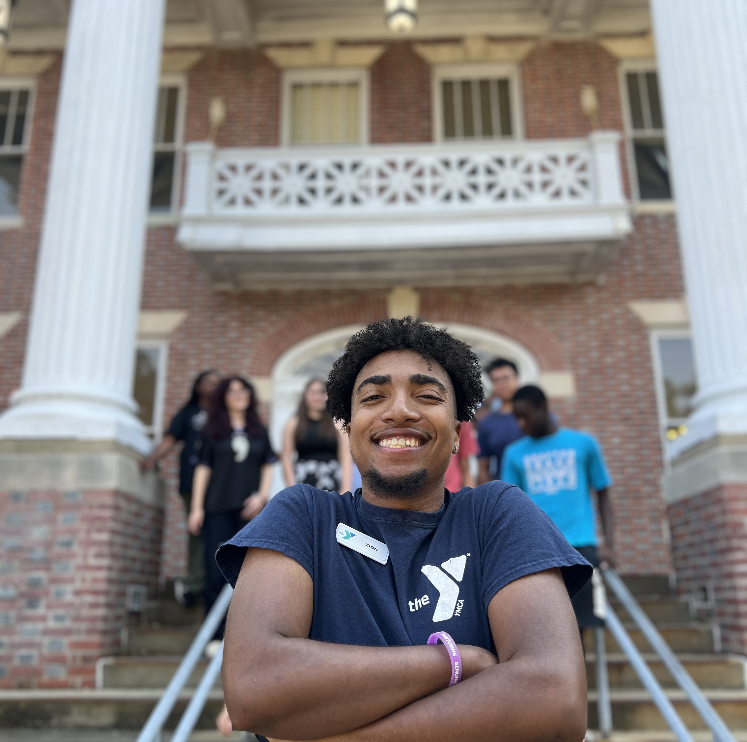

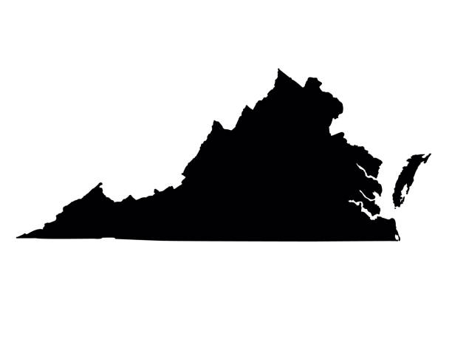
Zion's Y Story
From participant to Y Professional
Richmond, VA
YMCA of Greater Richmond
  Where it all started
YMCA of the Virginia Peninsulas
  Regional Director of Teens
Notes:
Zion

Slide 7
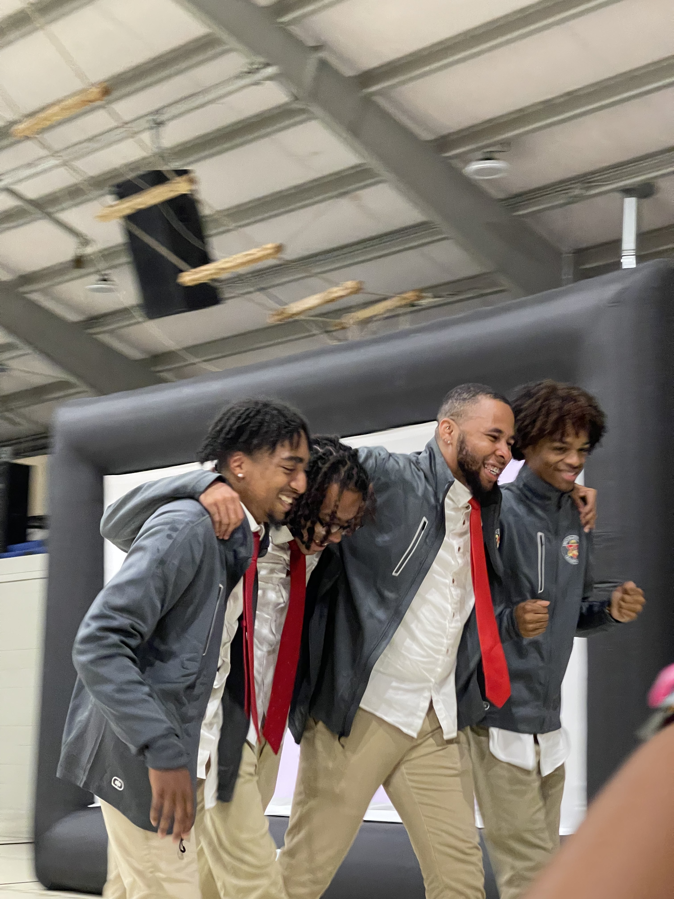
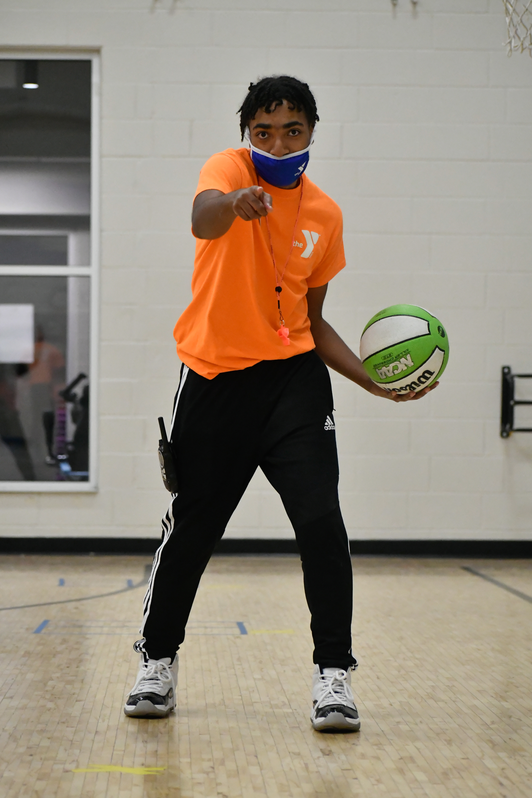
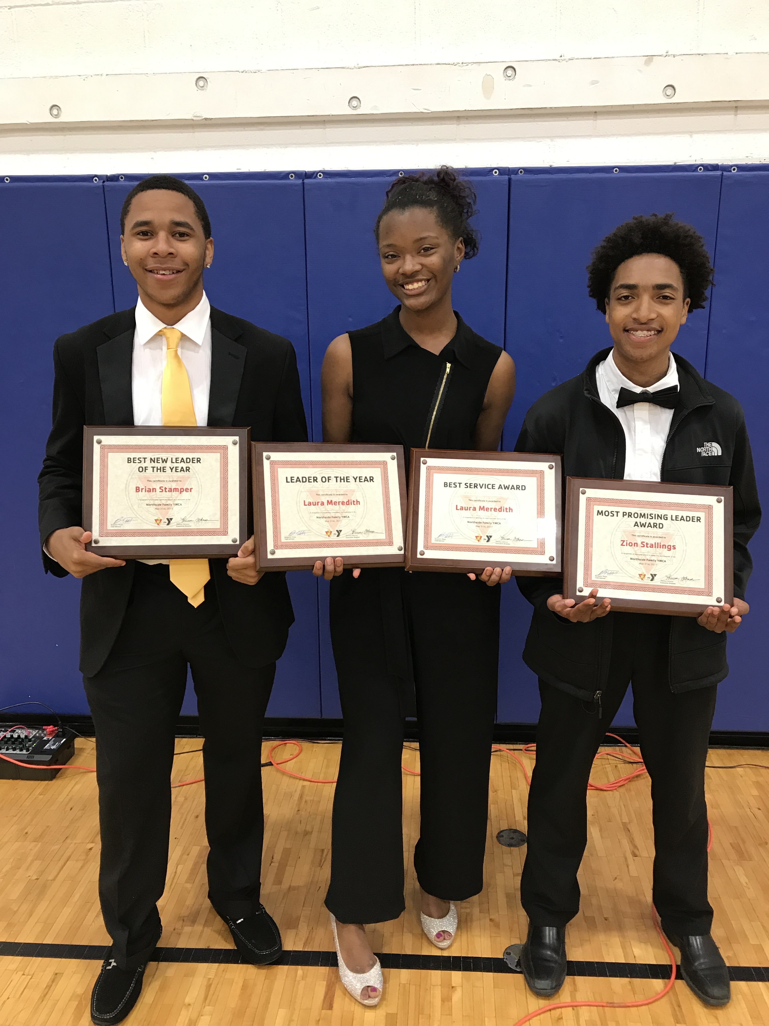
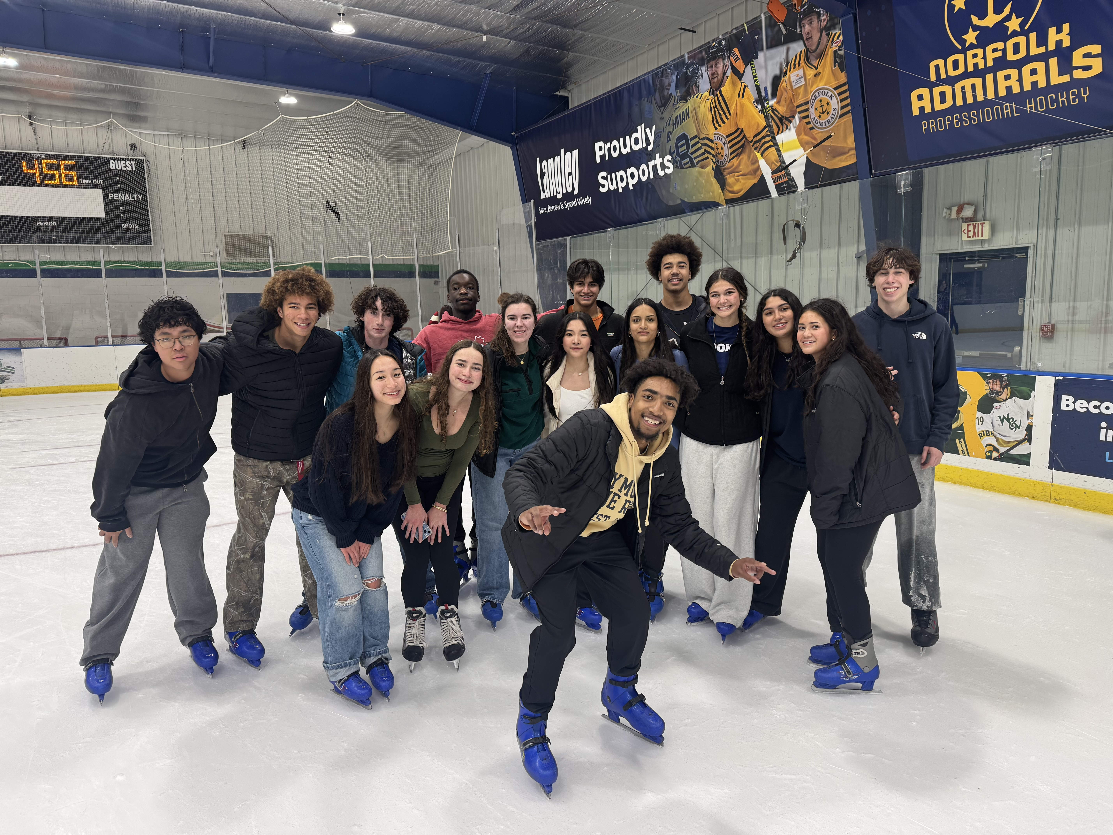
Zion's Y Story
From participant to Y Professional
Youth Sports
Leaders Club
Youth and Government
Volunteer Advisor
Teen Director
Regional Director of Teens
Student Participant
Volunteer
Staff
Notes:
Zion

Slide 8
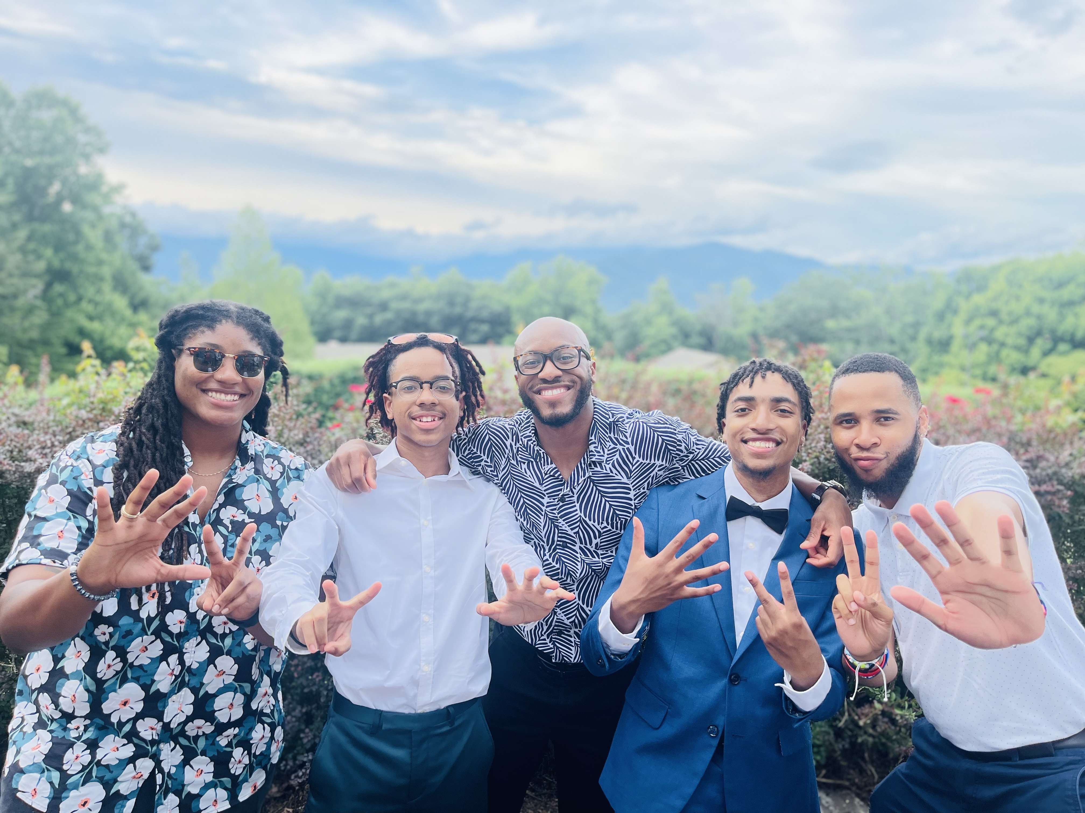
Zion's Y Story
Here's What Matters
I started...
  Someone saw a problem
Someone gave me meaningful leadership...
  I grew relationships and was invited into a community.
  It wasn't attendance, but a responsibility.
The trajectory of my life changed...
  I found a purpose
I Started
Meaningful Leadership
Life Change
How does my story relate to our YMCA?
Notes:
Zion

Slide 9
It started with a 22-year-old!
Notes:
Zion

Slide 10
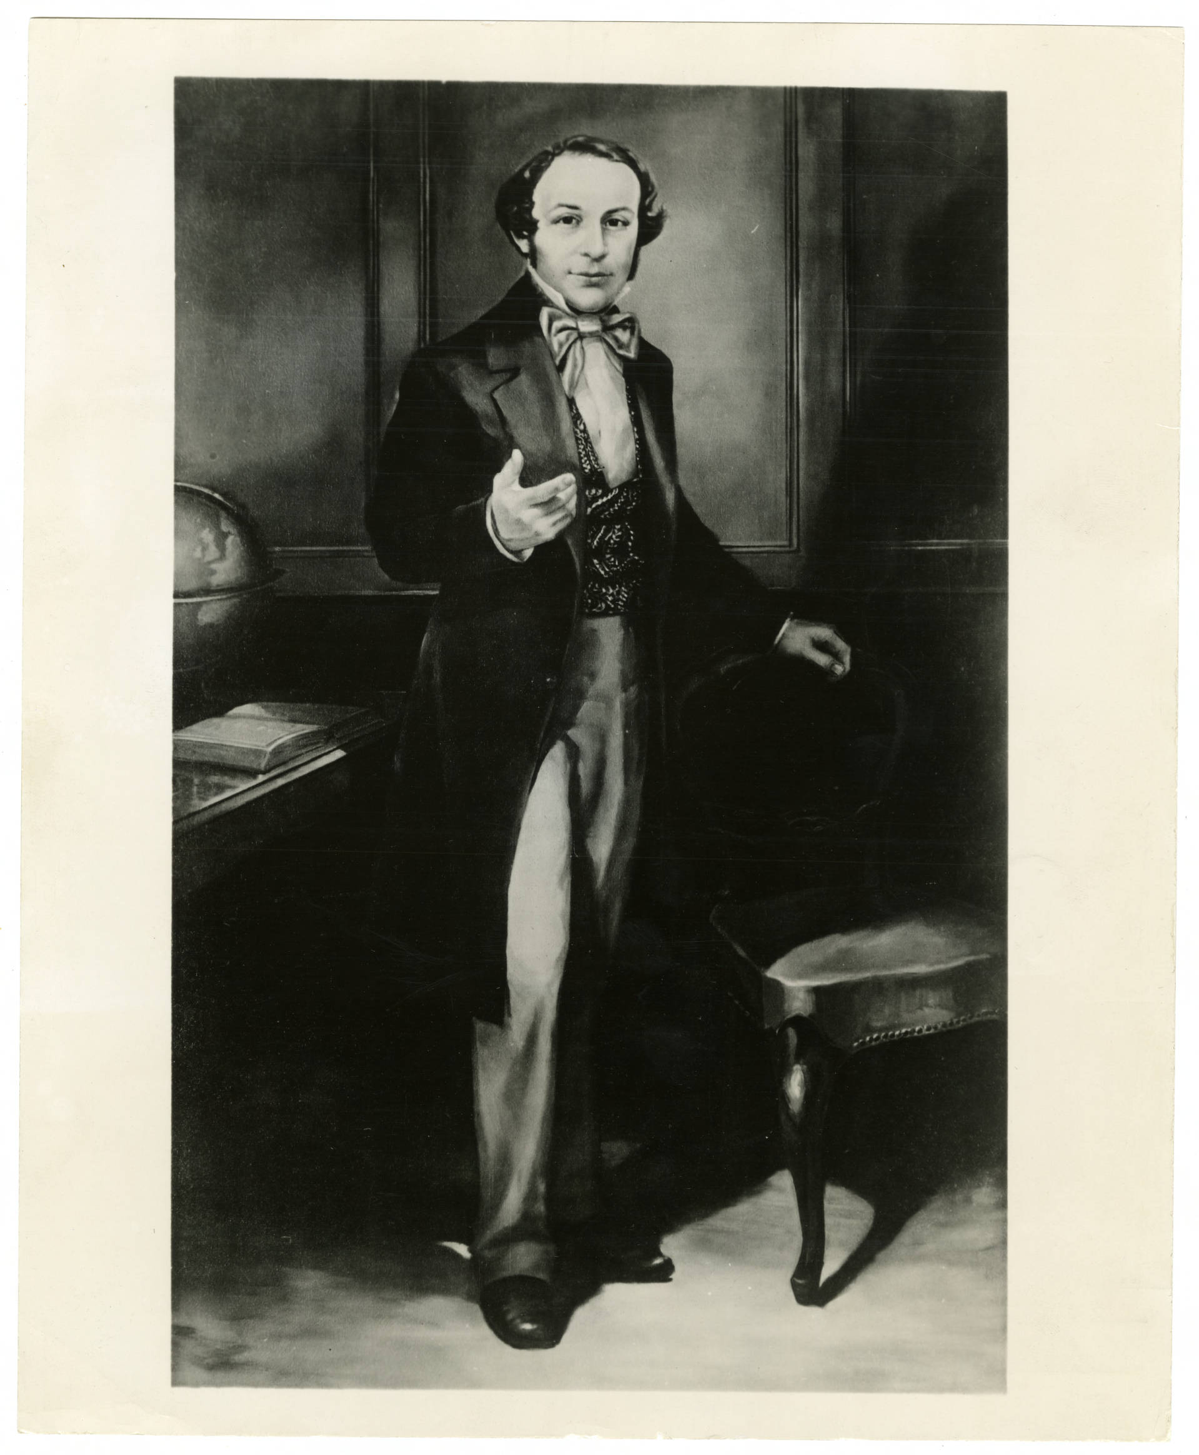
Y-History
A young person founded the YMCA
George Williams in London, England in 1844 saw a problem affecting young people around him and decided to something about it.
Created to serve as a safe-haven for young people.
Counseling, personal support, prayer meetings.
What if George Williams walked into your YMCA today?
Notes:
Zion

Slide 11
Y-History
Young people built a movement
What started in London, quickly became a GLOBAL movement.
The first ever WORLD YMCA conference took place in Paris, France in 1855
99 devoted delegates gathered from 9 different countries
All under 25 years old
Youth weren't invited to the movement later.
Notes:
Zion

Slide 12
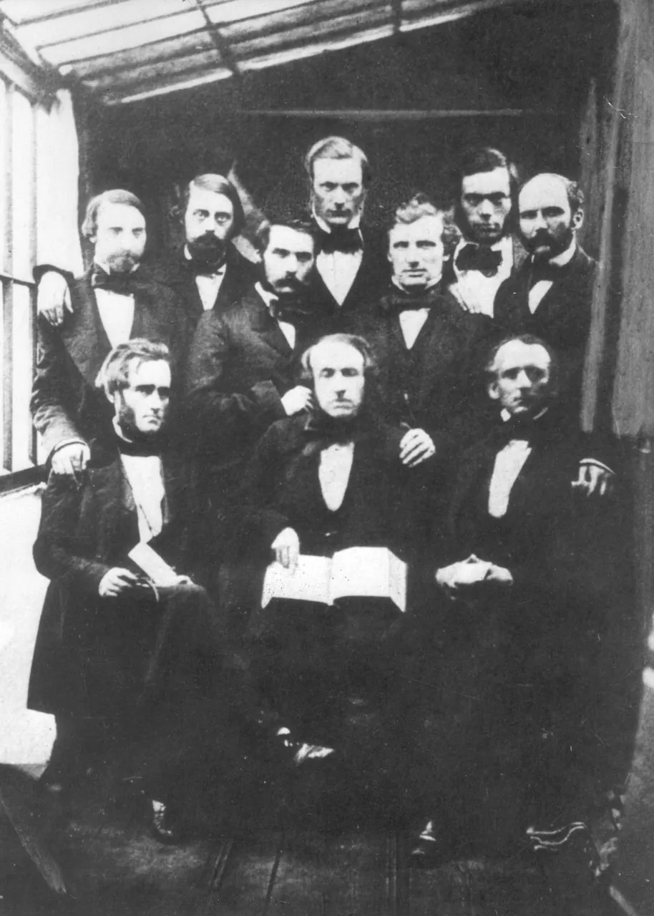
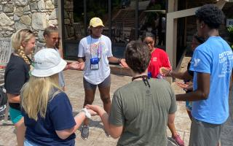
Y-History
So... What changed?
Notes:
Zion

Slide 13
Y-History
Where are we heading?
When did the YMCA shift from youth helping lead the movement, to primarily being served by it?
And what would happen if we changed that?
The question isn't how we get young people involved. The question is:
How do we give young people ownership again?
Notes:
Zion
Youth Governor
Youngest presenter at GA, a week into his 18th year

Slide 14
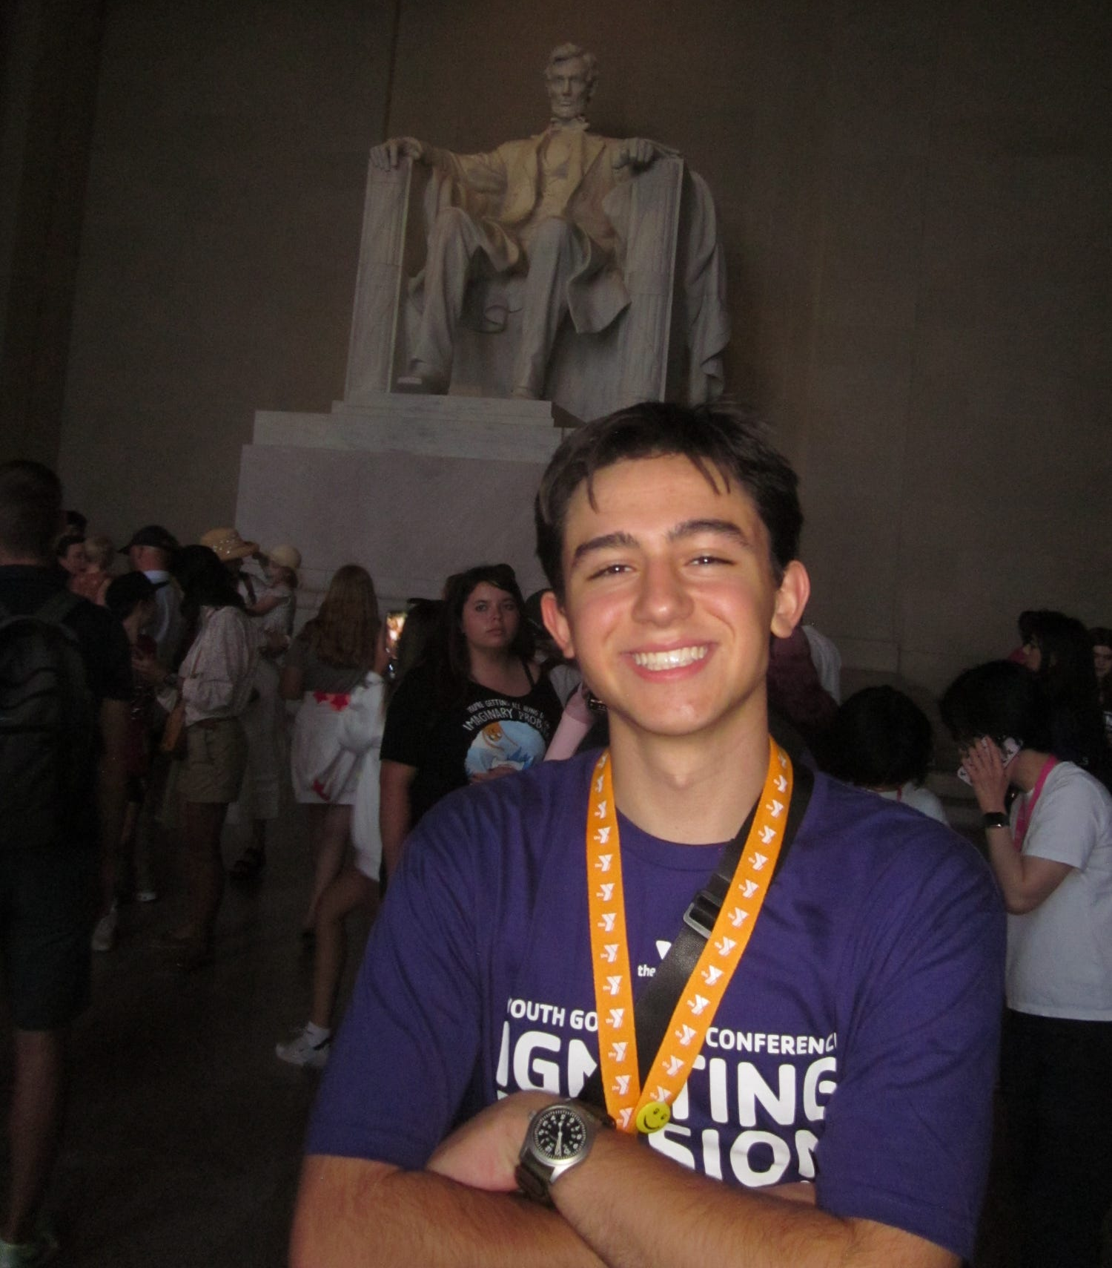

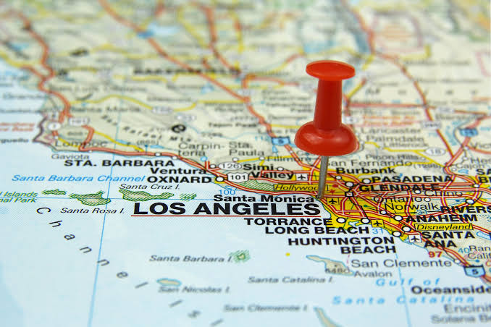
Devon's Y-Story
From participant to leader
Los Angeles, CA
YMCA of metro LA
  California Youth and Government
High School Senior
  Aspiring Los Angeles City Official
Notes:
Devon

Slide 15
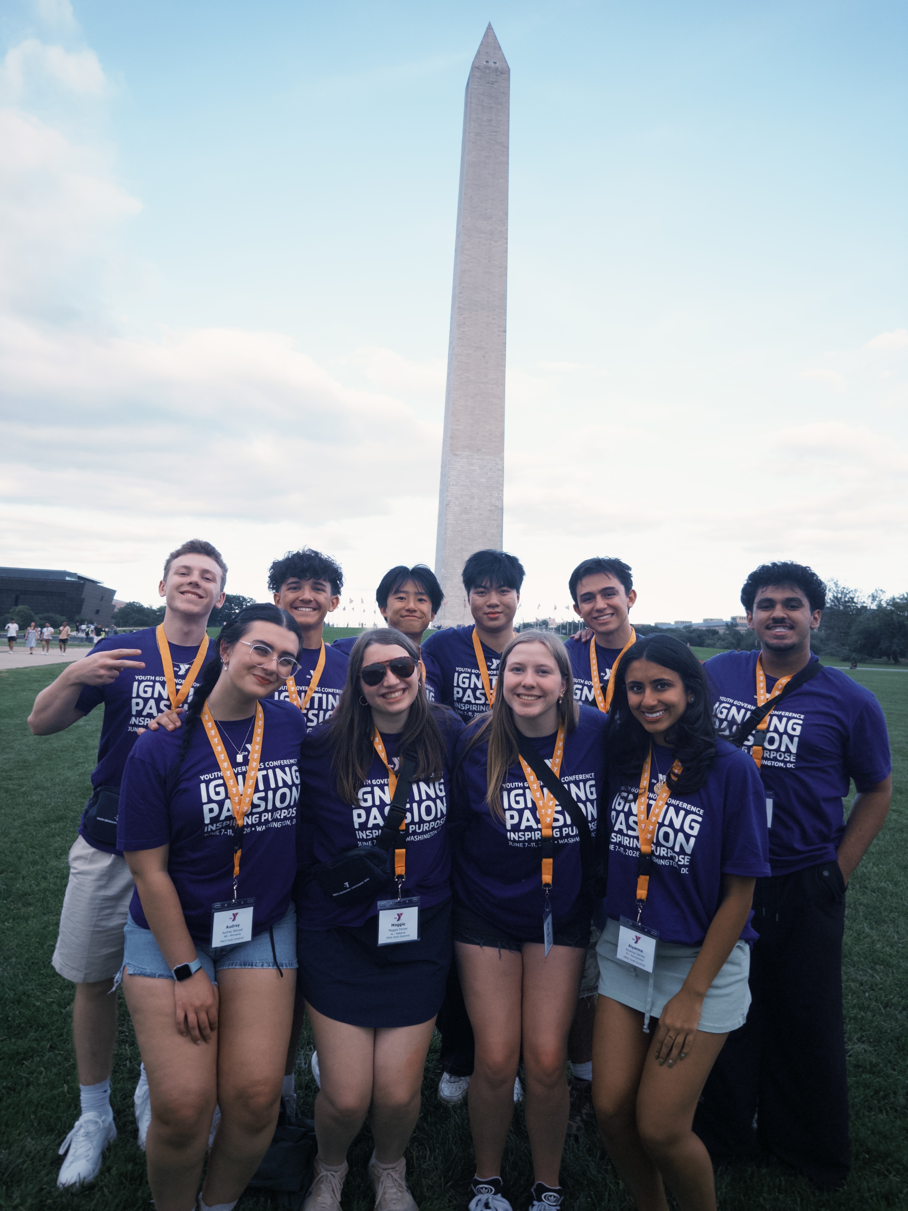
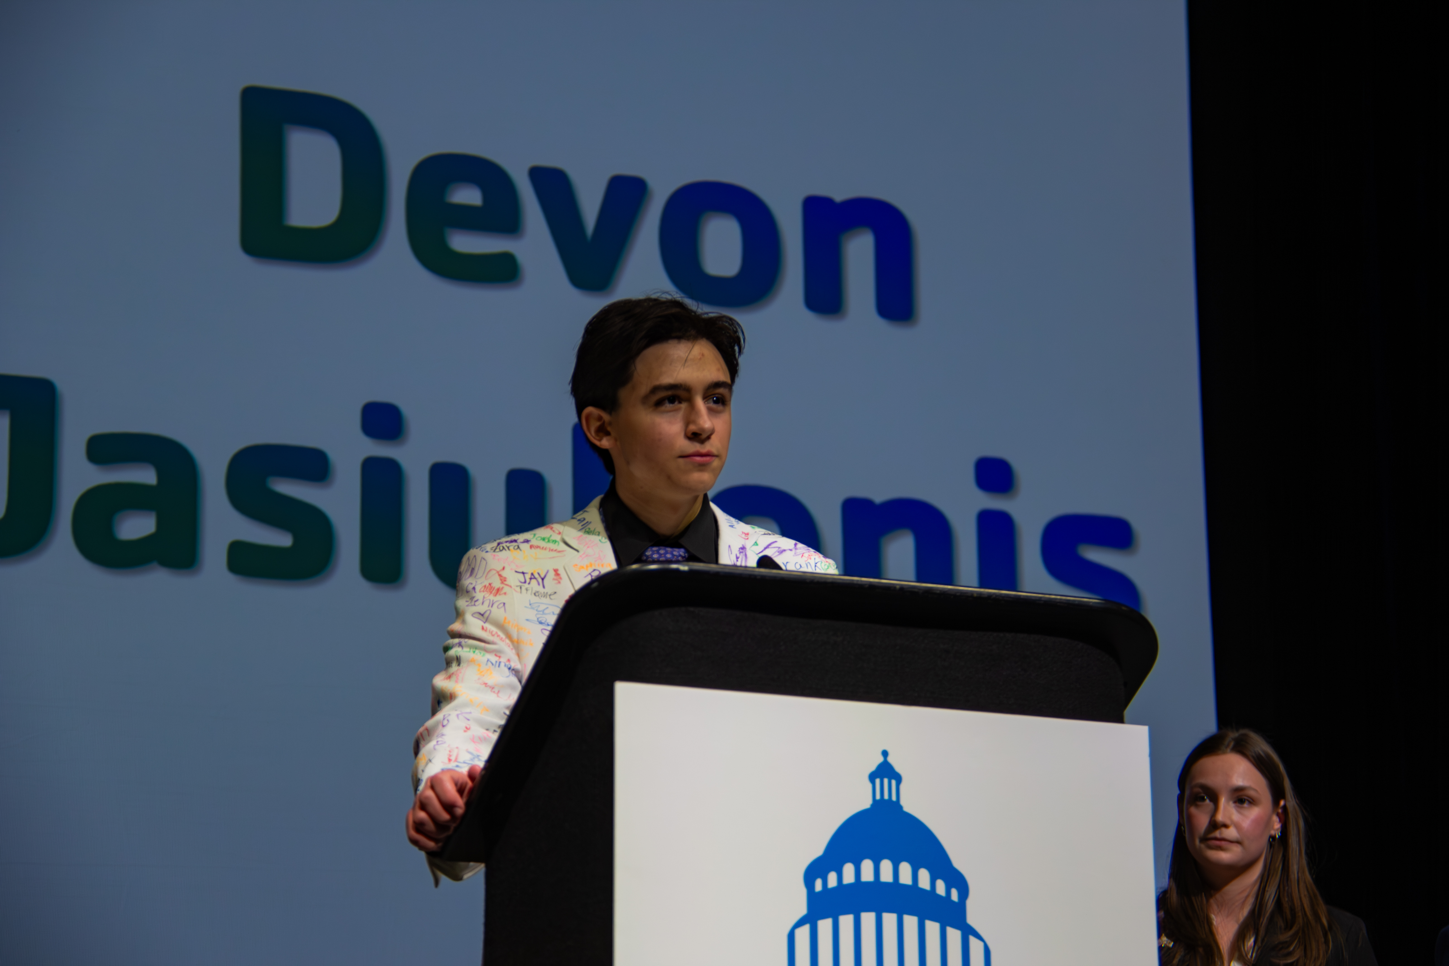
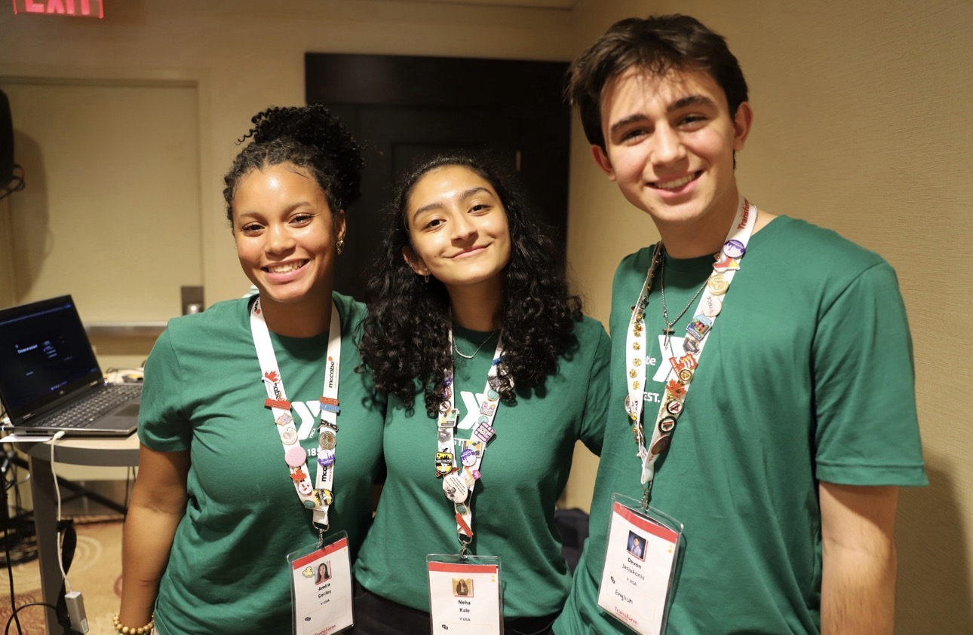
Devon's Y-Story
From Participant to Leader
Swim and Gym
Childcare
Youth and Government
California Youth Governor
Volunteering and Lobbying
Teen Mental Health Fellowship
Presenter
Student Participant
Program Leader
Advocate and Speaker
Notes:
Devon

Slide 16
What does it mean to be youth-led as opposed to youth-informed?
Notes:
Devon

Slide 17
6.5 million
Children and Teens are served in the U.S. Annually
Notes:
Devon

Slide 18
92,000 Staff
In YMCAs nationwide are Ages 24 and younger
Notes:
Devon
Should have some stats for "total staff" on hand.

Slide 19
Where we are today
In the Y, youth have...
  Youth Advisory Councils
  Youth Board Members
  Teen Fellowships/Task-Forces
But they don't have enough...
  Opportunities to be at the table
  Collaboration with adults
  Equal treatment with adults
Notes:
Devon

Slide 20
whY THIS matters
"Nothing about us without us"
  We work better together: it's proven
Youth Development
  Agency and Self-Efficacy
  Identity and Belonging
  Skill Acquisition
Notes:
Devon
Be able to reference name of study

Slide 21
where we are today?
"Stamp of Approval"
  Reaffirming decisions adults have already made
Decoration: Youth are used to promote an event or a cause but have no role in organizing the occasion.
Direction: Directing youth to carry and repeat an adult-authored message under the guise of “youth voice".
  Innovation is sidelined or excluded
Notes:
Devon

Slide 22
whY we are where we are today
Picture Perfect
  Using youth as visual symbols
  Photographed, quoted
  False image of inclusivity
Fear and Distrust
  Youth Empowerment is only possible when we share power
  Tokenism: Youth are given a platform to speak without a choice of the subject, time to formulate independent opinions, and influence over outcomes.
    "I consulted the youth."
Notes:
Emi
Take your time

Slide 23
whY we are where we are today
One and Done
  A single youth can not be representative of an entire generation
    There is a vast diversity of youth experiences
  Outnumbered, uncomfortable
    Representation of all kinds matters
  "No second chances"
    Rigid, fearful environment
Notes:
Emi

Slide 24
whY we are where we are today
Lack of Infrastructure and Training for Real Engagement
  Unintentional tokenism
    Simply not knowing how to engage youth properly
        Ex: establishing youth councils or advisory boards not built for youth to make a real impact
      Unequal infrastructure
        Ex: making youth non-voting members on committees
Comes from a lack of training on
    Sharing power
    Practical support for youth participation
    Functional feedback loops
Notes:
Zion --> could be compelling if you shared a bit about your personal experience with training on how to engage with youth!

Slide 25
Co-Creation: Become Youth-Led
Setting yourself up for success
Thorough outreach and application process
  Share goals and expectations
  The youth you need are there
Onboarding and Training
  Youth – Comfort in this group
  Adults – Understanding the role of youth
Accessible and compensated participation
  Work around school schedules
  Transportation and labor
Notes:
Devon

Slide 26
Co-Creation: Become Youth-Led
Innovation Phase
INCLUDE FROM THE BEGINNING
  Youth perspective is the foundation
    Co-Define
    Co-Design
    Co-Execute
    Co-Evaluate
  Transparent accountability and feedback loops
Clear communication
  "We are all on the same team"
Notes:
Devon

Slide 27
Co-Creation: Become Youth Led
Sharing Power
Agenda-setting power
  Youth may prioritize differently
Unlearn rigid professionalism
  Modern communication
Sitting with discomfort and dissent
  Push-back is high-quality engagement
Power of lived experience
Voting and veto powers
  Board: voting seats
  Advisory council: veto = mandatory rewrite
Notes:
Devon

Slide 28
Putting principle into practice
Task: Make a plan for how you would integrate youth onto your YMCA Board of Managers
  Outreach and Structure: Who, what, why, and how many?
  Onboarding: How can they transition onto your board?
  Board Culture: Where, when, and what can you do to construct a comfortable meeting space?
  Sharing Power: What do youth get to do on your board?
  How can you take these principles to other areas of your YMCA?
Notes:
Zion

Slide 29
Putting principle into practice
Listen & Learn
Shadow & Select
Lead & Execute
Orientation
Facility tours
Financial intro
Mentor matching
Shadow sub-committees
Find personal interests
Choose committee
Co-author goals
Co-author goals
Chair/co-chair teen program goals
Notes:
Zion

Slide 30
How can I walk with the y without working at the Y?
Notes:
Emi

Slide 31
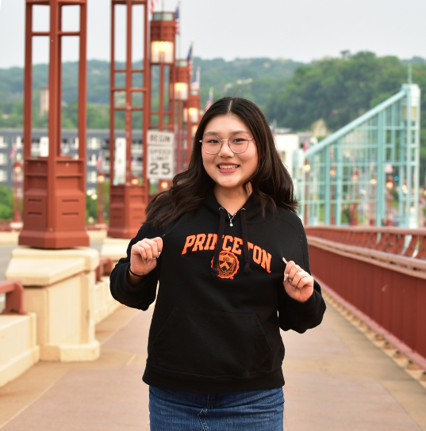
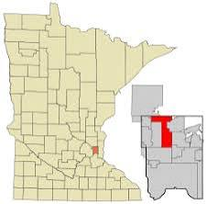

Emi's Y Story
From Participant to advocate
Shoreview, MN
YMCA of the North
  Center for Youth Voice
Sophomore at Princeton University
  Aspiring International Lawyer
Notes:
Emi

Slide 32
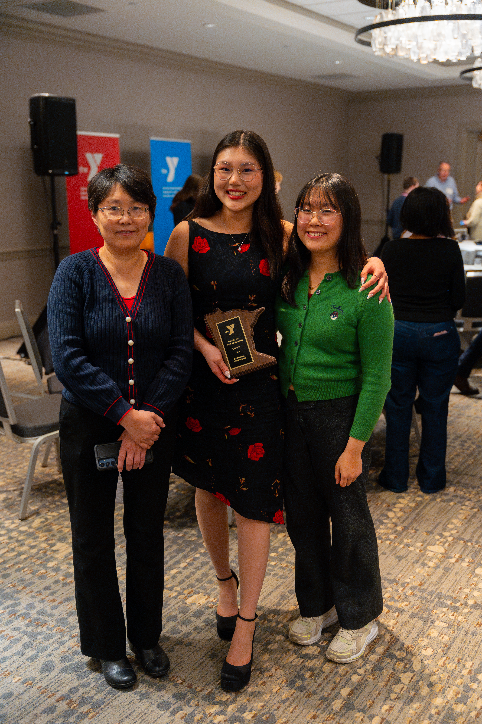
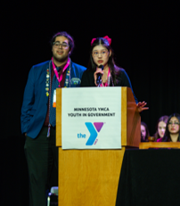
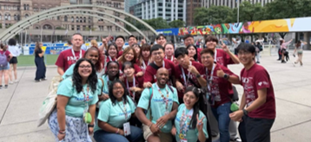
Emi's Y Story
From Participant to Advocate
Afterschool Programs
YAG Programs
Volunteering and Lobbying
Center for Youth Voice Board
Teen Mental Health Fellowship
Scholarship Student
Student Participant
Program Participant
Volunteer
Notes:
Emi

Slide 33
What does it mean for the Y to meaningfully engage youth outside of employment?
Notes:
Emi

Slide 34
Engaging Youth
How do we ensure youth want to continue finding ways to work with the Y even if they enter non-YMCA careers?
Board Members
Donors
Volunteers
Community Advocates and Leaders
Emi's Y Dream:
Providing pro bono legal counsel to the Y.
POSSIBILITIES, PRECEDENT, AND PASSION
Notes:
Emi

Slide 35
Mentorship is meaningful
Even current youth Y-employees might not stay forever.
  Leave youth with positive experiences that make them want to give back to the Y.
  Exposure to partnership possibilities
  "Leaving the Y" vs. "Growing with the Y"
Involvement at every stage
  Expanding alumni networks for programs
  Invitations to contribute (feedback, volunteering, conferences, etc.)
Notes:
Emi

Slide 36
How do we ensure other Youth have meaningful YMCA stories?
Notes:
Emi into Ben

Slide 37
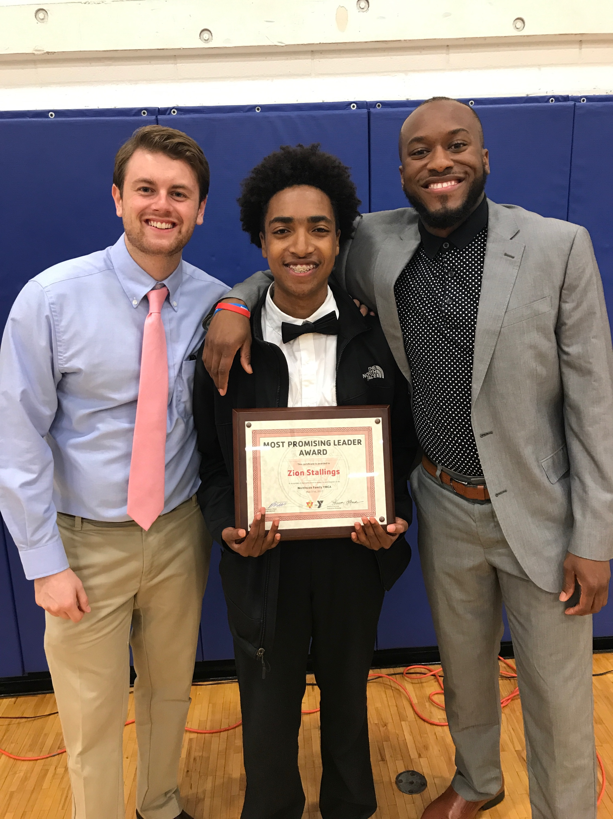
Seeing the future while in the moment
Nurturing the potential of every teen can be a valued commitment that follows you through all levels of leadership in the Y movement.
Notes:
Ben
Benefits of working in youth development (pipeline start, creating environments of youth inclusion / psych safety, advocating up to executive/senior leadership through intergenerational spaces); Establishment of role in the Y's intergenerational system (through coaching, mentoring, and sponsorship)

Slide 38
Your role in working with the next generation
Coaching: supporting skill development from your expertise
Mentoring: providing guidance from your experience
Sponsoring: creating opportunities with your resources
Learner: actively listening to understand and explore
Notes:
Ben
In a people system, there are three roles we (executives, senior leadership, C-Suite, board volunteers, any older adult in the Y) can play to sustain meaningful experiences for next generation.

Slide 39
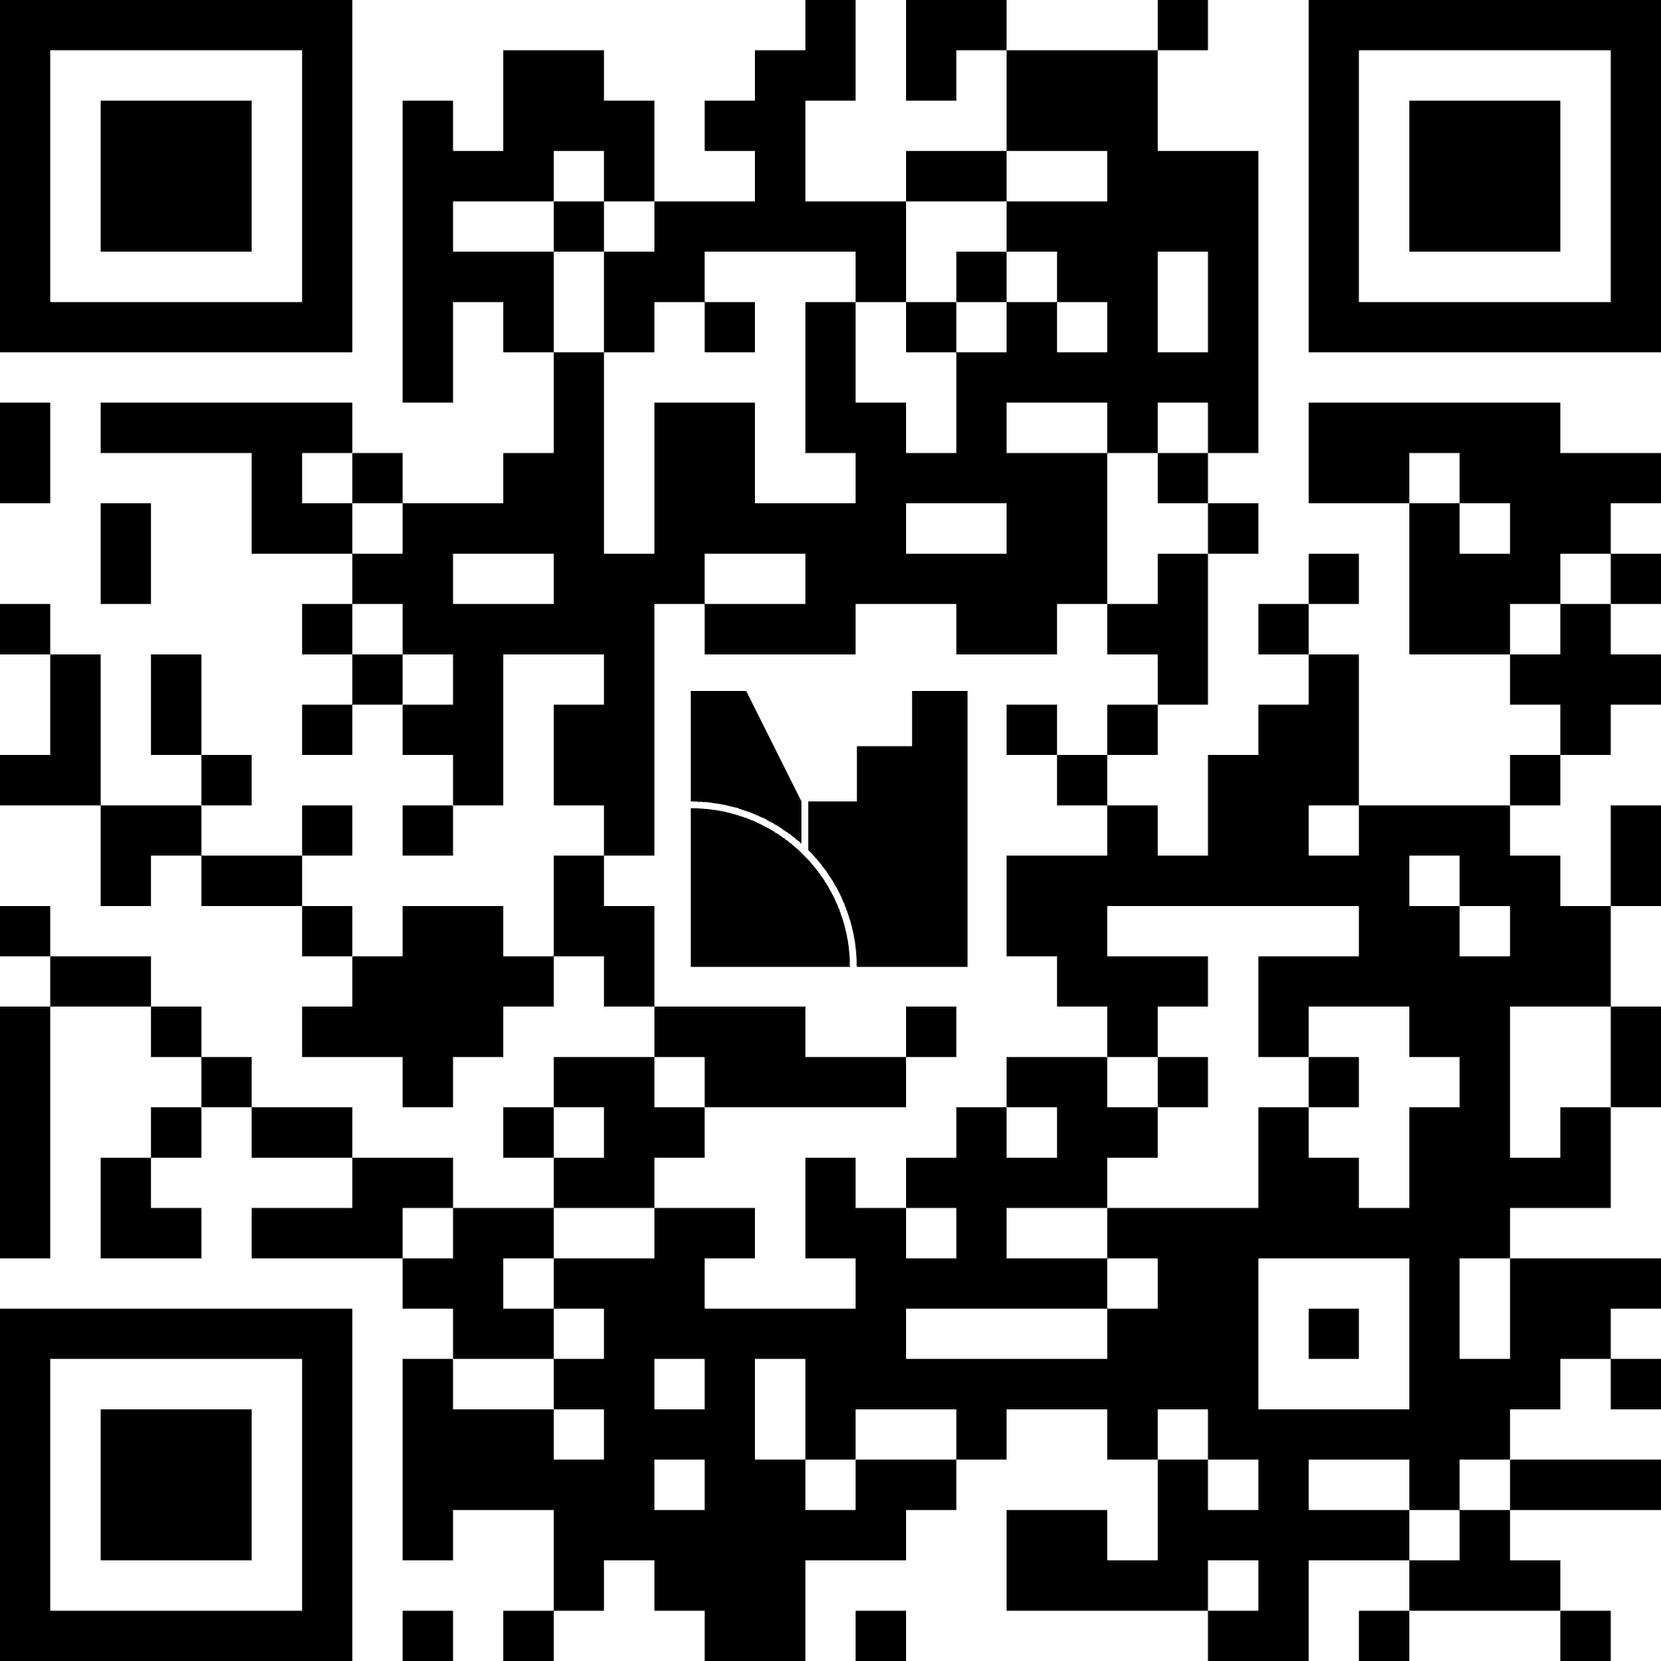
Mentimeter!
LET'S EXPLORE HOW YOU ARE CREATING SAFE, YOUTH-CENTERED SPACES IN YOUR COMMUNITY
  Scan the QR code to get access to Mentimeter!
Notes:
Each of us take a question!
Switch to Mentimeter site to have QR code and instructions.

Slide 40
What will the next 175 Years Look LIke?
Notes:
Emi

Slide 41
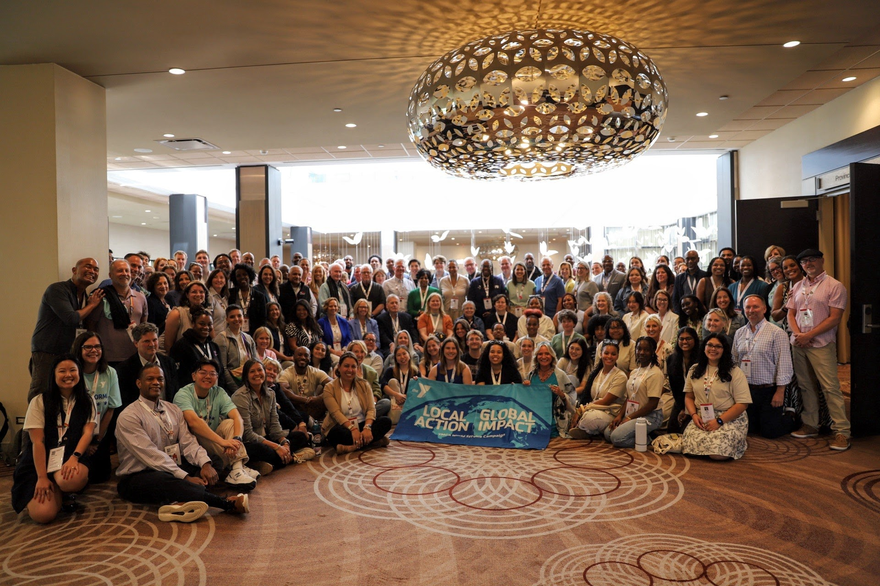
Is your Y Youth-informed or Youth-Led?
The YMCA was founded by youth.
Why should the present be different?
Extraordinary youth are everywhere
Reflection must be paired with action
Notes:
Emi

Slide 42
Youth are not just the future.
They are the NOW.
Notes:
Emi

Slide 43
Questions?
Notes:
Questions divided as appropriate

Slide 44
THANK YOU!
E Mitchell
YMCA OF THE USA
Ebone.Mitchell@ymca.net
Emi Ren
YMCA OF THE NORTH
renemily35@gmail.com
Zion Stallings
YMCA OF VIRGINA PENINSULAS zion.stallings@ymcavp.org
Devon Jasiukonis
YMCA OF METRO LOS ANGELES
devonjasiukonis@gmail.com
Ben Major
FLORIDA ALLIANCE OF YMCAs
ben@floridaymcas.org

