Slide 1
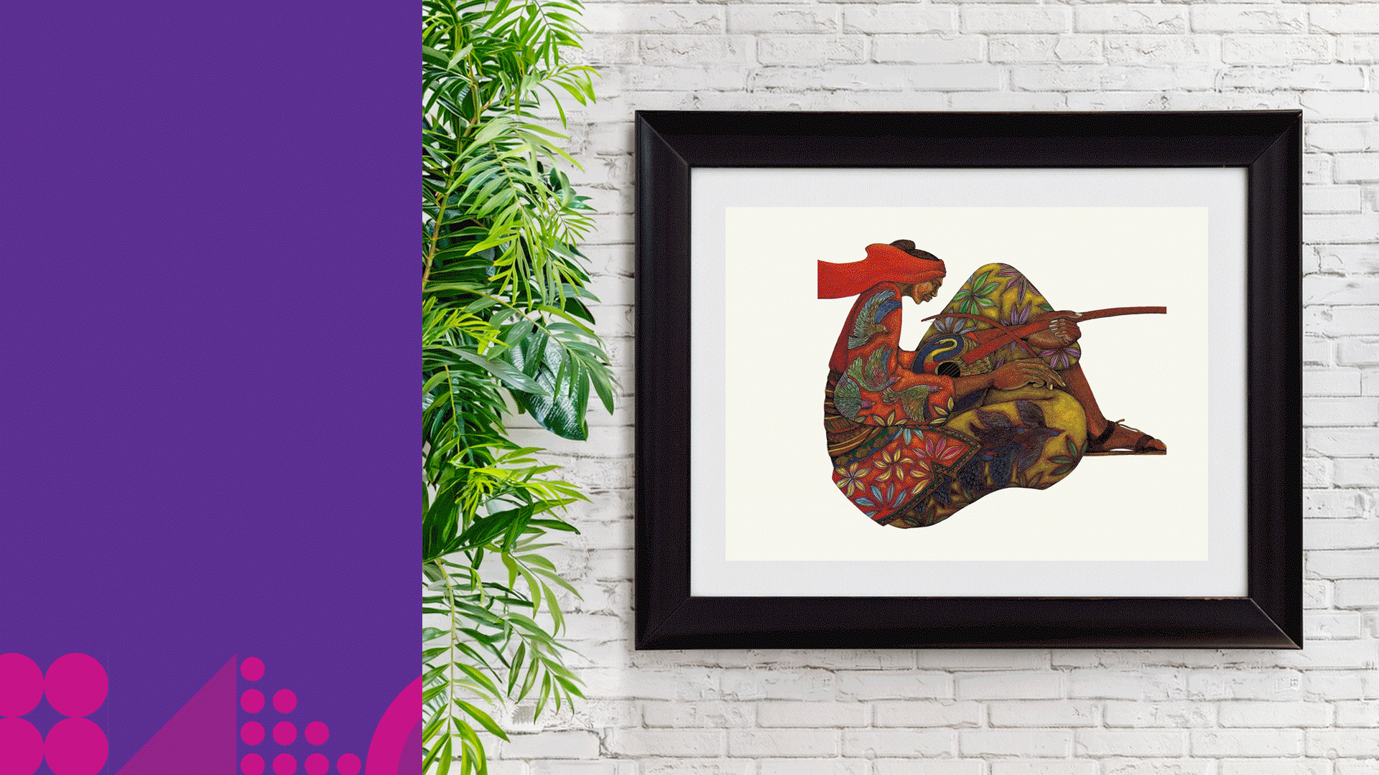

2026 General Assembly of YMCAs ·
New Orleans
HELLO
Settling in? Stay a while.
A little music while we gather.
The talk begins shortly.
Notes:
Pre-session loop: art carousel plays with Alissa's jazz loop while people settle in. No talking needed.

Slide 2

DR. LISA SCOTT
Leadership
as an Art Form.
Chief Partnership and Impact Officer · YMCA of the Triangle
September 17–19, 2026 · New Orleans, LA

Slide 3
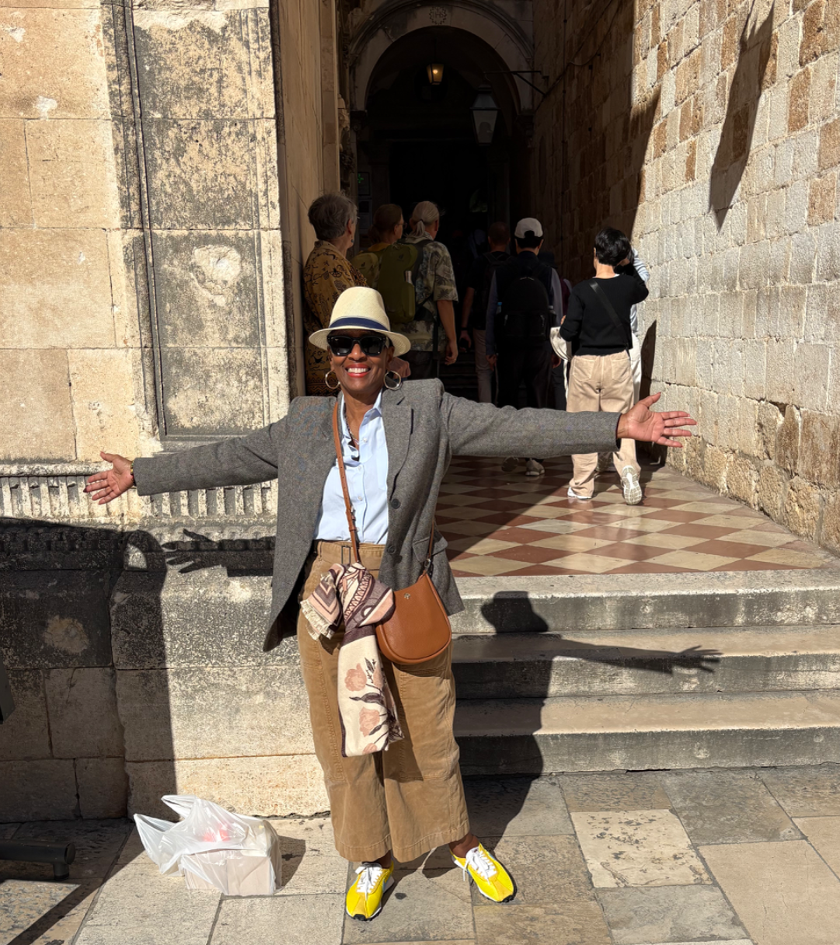
MOVEMENT COLLEAGUES
Welcome!
I’m glad you’re here. Arms open, let’s make something together. Walk with me.
2026 General Assembly of YMCAs · New Orleans

Slide 4
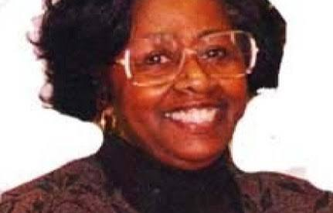
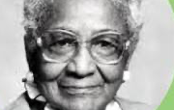
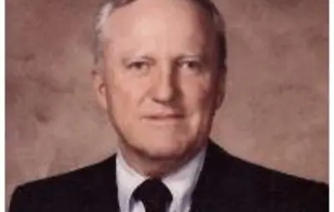
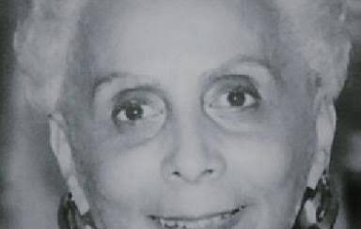
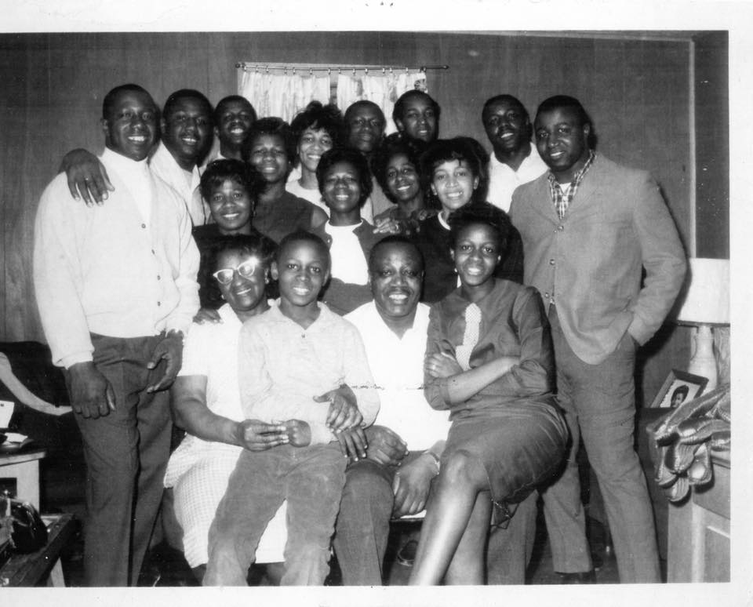
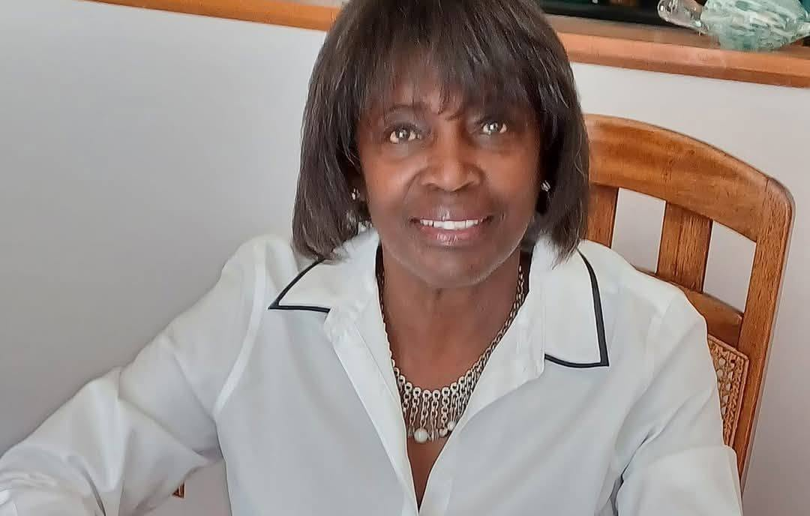
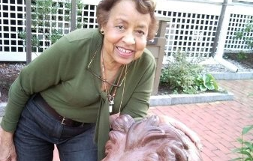
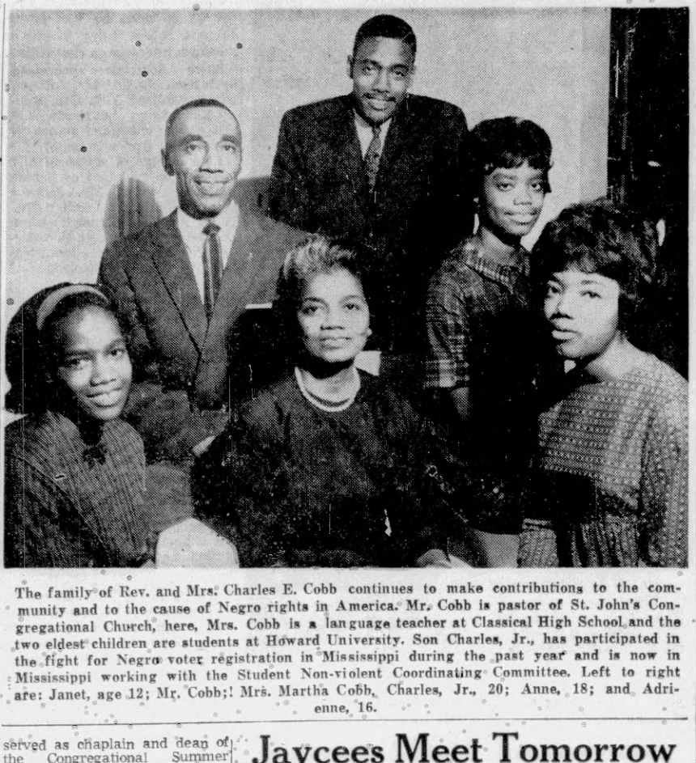
MY FIRST LEADERS
Great leaders were everywhere.
My mom, Thelma Scott
Aunt Rebecca M. Johnson
Mr. Sweeny
Mrs. Webb
My first and greatest leader
My elementary school principal
My high school principal
Director of our local library
A family of leaders
My teachers
Dr. Harris
Reverend Dr. Cobb and family
Aunts and uncles, fearless
Activists with high expectations
English and Black Literature
Renowned Activist Pastor

Slide 5

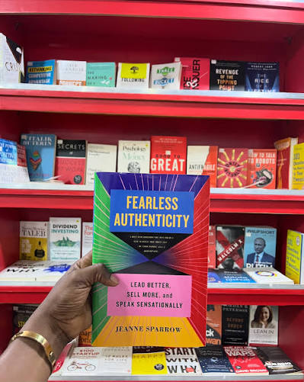
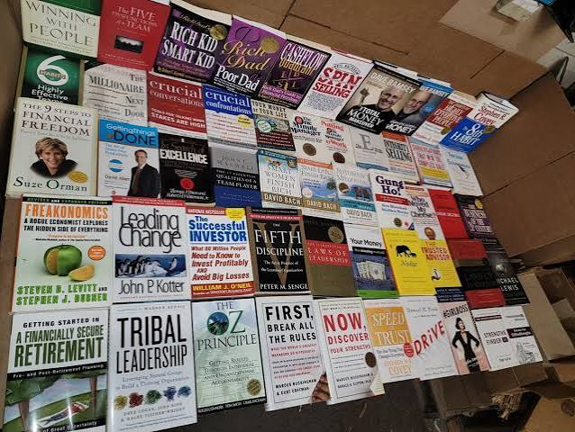
ON LEADERSHIP
10,000s of books have been published.

Slide 6
EXAMPLES OF LEADERSHIP STYLES
You know them.
Behavioral
Servant
Transformational
Authentic
Transactional
Adaptive
Contingency
Charismatic
Situational
Participative
Inclusive
Distributive
Ethical
Strategic
Systems
Relational
Complexity
Culturally Responsive

Slide 7
ON LEADERSHIP
Leadership Development
7,000
80%
35%
leadership conferences held worldwide each year — 1,500 – 2,000 in the United States alone
of U.S. and Fortune 500 organizations offer structured leadership training as part of career training
of large non-profits provide organized leadership development
Notes:
Scale of the industry: 1,500–2,000 U.S. conferences a year, 7,000 worldwide; 80% of Fortune 500 orgs offer structured leadership training; only 35% of large nonprofits do.

Slide 8
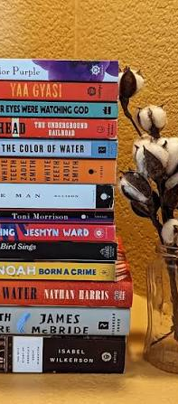
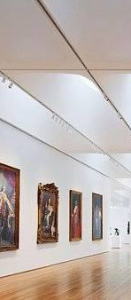
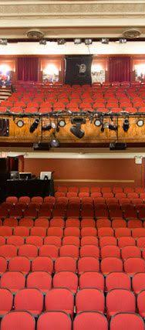
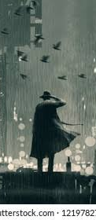
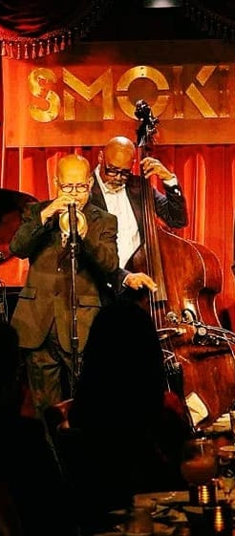
WHERE I LEARNED TO SEE
The arts that shape me.
Books
Museums
Theater
Film noir
Live jazz
Notes:
Each picture takes the spotlight as you name it: books, museums, theater, film noir, live jazz.

Slide 9
WHY I LOVE THE ARTS
Always something new — even when it’s familiar.
Sound
Discerning each instrument inside the music
Feeling
A visceral reaction — I am moved, shifted
Reflection
An opportunity for introspection
Color!
Visualization — the world made vivid
Fluidity
Form that moves and keeps moving
Words
The power of the perfect sentence
Improvisation
Creating in the moment, together
Freshness
Something new, every single time

Slide 10
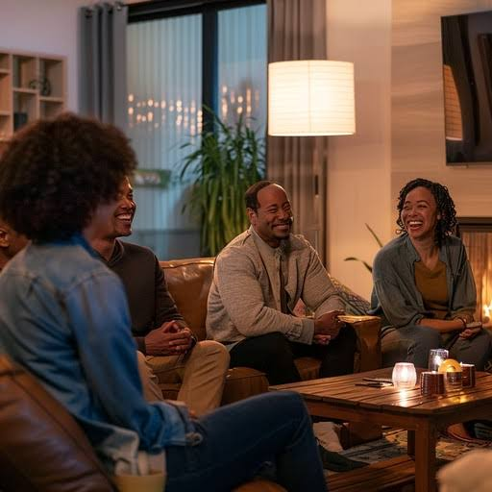
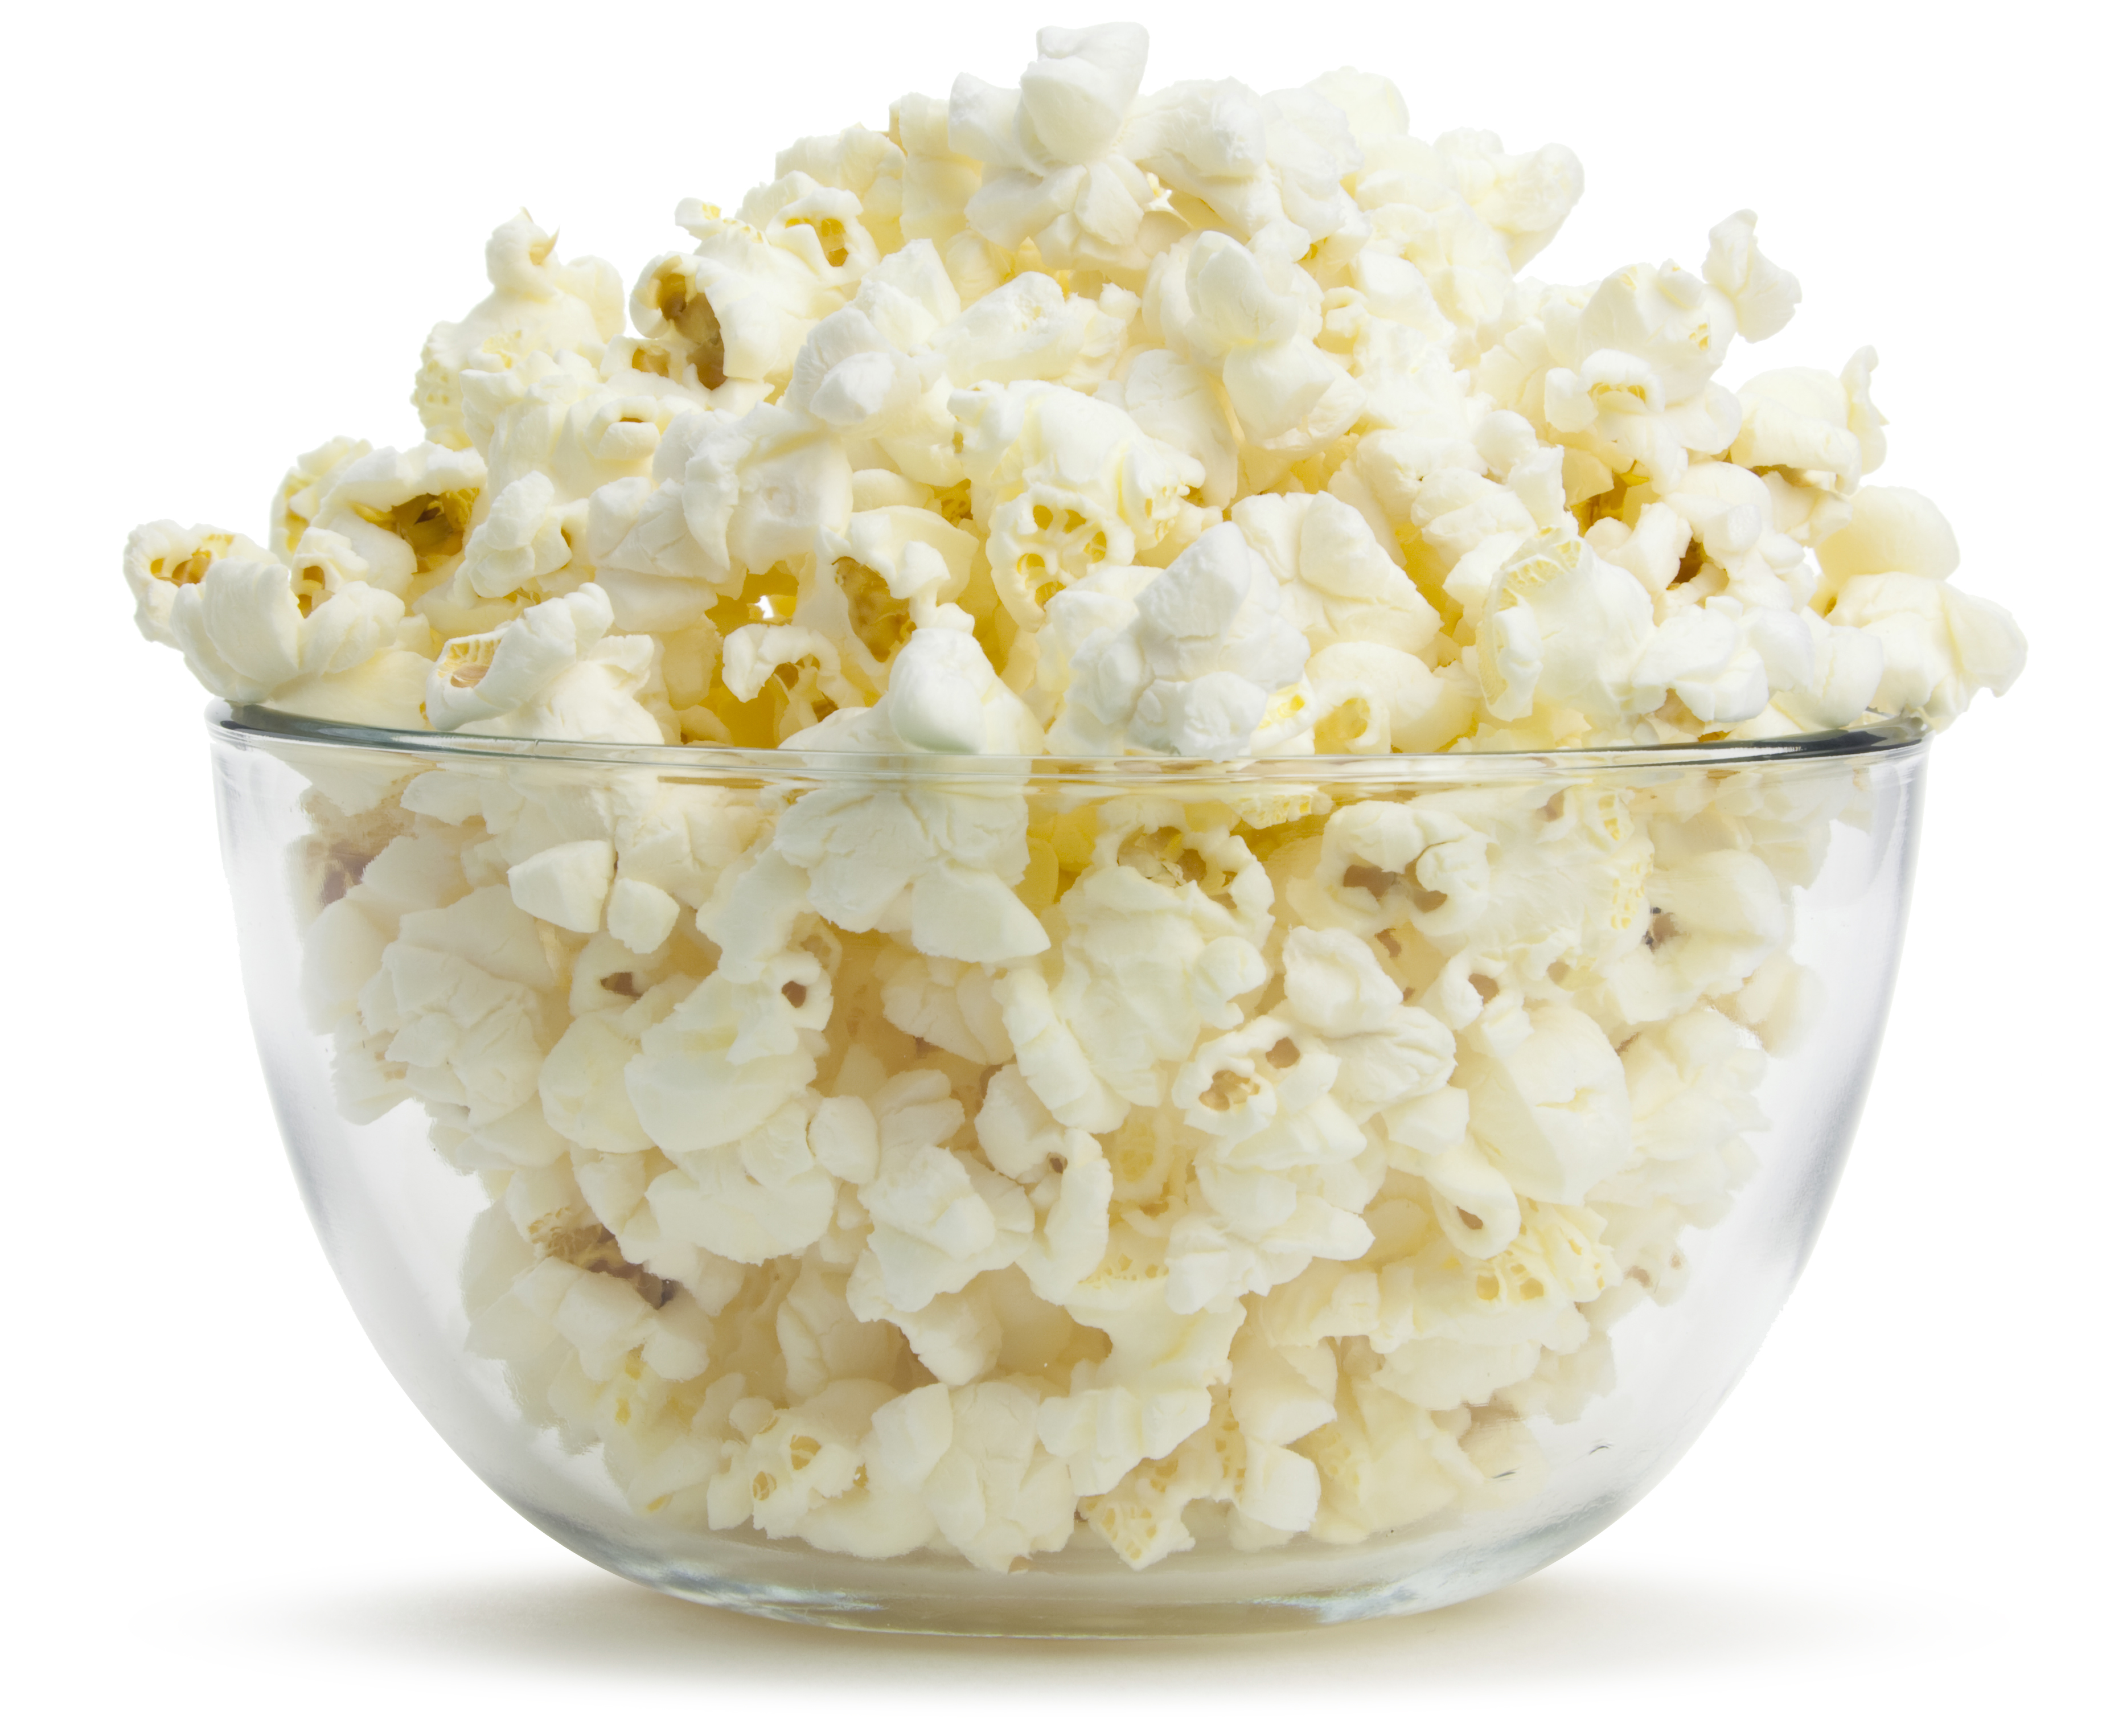
Late Night Conversation

Slide 11
ON LEADERSHIP
The Art of Leadership
Leadership experts, books and articles have expounded on the art of leadership .
The emphasis is often on creativity, vision, accountability, caring and innovation embedded in, or extrapolated from, traditional leadership frameworks.
I ask you to contemplate an altogether different question with me today.
But first, a little music.
Notes:
Set up the contrast with the existing 'art of leadership' literature, then pivot to a different question — and transition into the music.

Slide 12
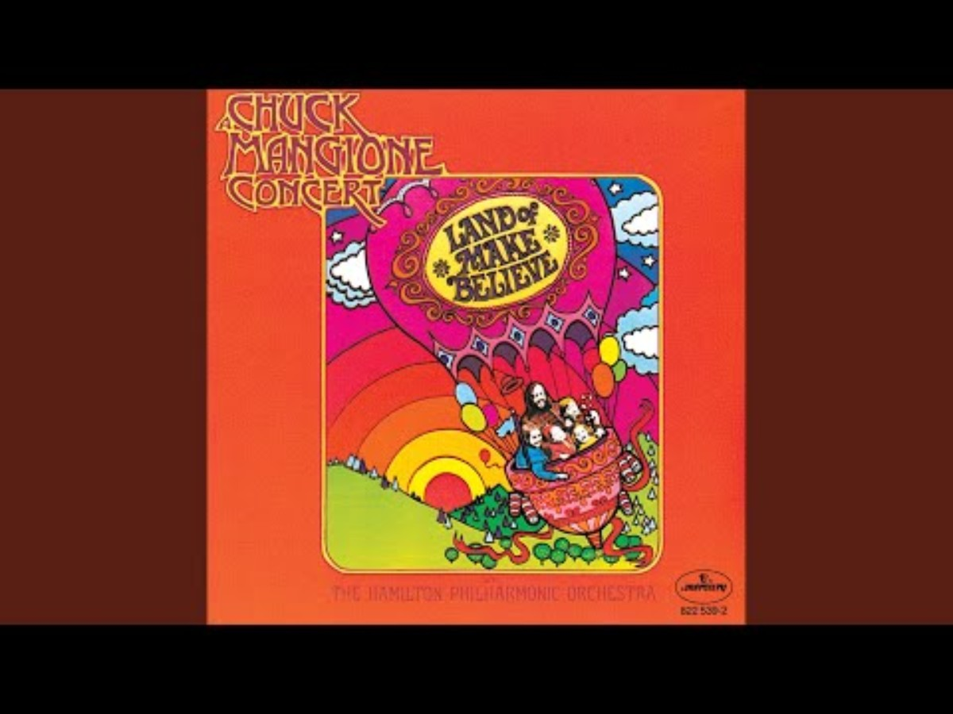
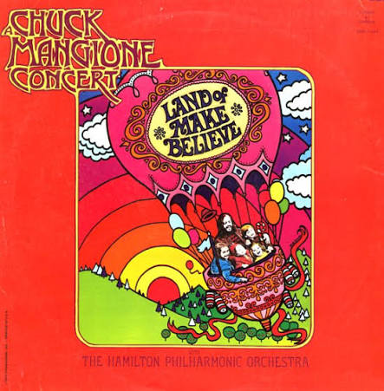
LISTENING SESSION
The Land of Make-Believe
Chuck Mangione . Esther Satterfield . Hamilton Philharmonic Orchestra
Listen — not as a music critic.
Notice what catches your attention.
Notes:
https://music.youtube.com/playlist?list=OLAK5uy_lby6PSVYpFJoIblX2QB4ocbnsIIDPCF9k&si=oPYvD7XLIi4q3xkJ

Slide 13
AS YOU LISTENED
What did you notice?
What changed?
What did you feel?
What made the music work?
Turn to the person next to you. Name one thing you noticed in the music that might also be true of leadership.

Slide 14
LEADERSHIP AS AN ART FORM
Why This Talk
I discovered leadership through frameworks.
FRAME- WORKS
THE ARTS
I make sense through the arts.
I began to wonder how one informs the other.
Where do these
two passions intersect?
Notes:
Personal origin: leadership learned through frameworks, seeing learned through the arts — this talk lives where the two intersect.

Slide 15
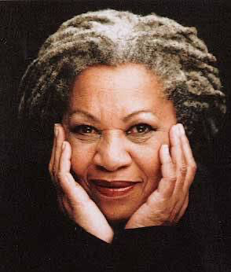
“If there’s a book that you want to read, but it hasn’t been written yet, then you must write it.”
— Toni Morrison
My favorite author — and the thinking that informs this talk.

Slide 16
ROBERT HENRI · ACTIVIST. PAINTER. THE ARTIST’S SPIRIT
The object isn’t to make art; it’s to be in that wonderful state which makes art inevitable.
Leadership is the same.
The object isn’t simply results — it’s creating the environment (the state) where trust, courage, vision, accountability, and belonging become inevitable. That environment is culture.

Slide 17
A DIFFERENT QUESTION
Can we consider leadership an art form?
An approach that considers leadership holistically and culturally — one that includes sense, and sense-making.

Slide 18
A DISTINCTION · DR. DREW
Art vs. art form.
ART
ART FORM
The overall concept — or the finished piece.
The method, medium, or practice used to make it.
Art forms are the mediums and practices through which artists express creativity, emotion, cultural narrative, and the human experience — the method by which expression becomes a work of art.

Slide 19

LEADERSHIP AS AN ART FORM
Leadership is the practice.
Human relationships and organizational culture are the medium.
Culture is the evolving work.

Slide 20
LEADERSHIP AS AN ART FORM
Same characteristics, two expressions.
ART FORM
LEADERSHIP-THE PRACTICE
Creativity
Imagines what does not exist
Creates conditions for what does not yet exist
Emotion
Moves us
Shapes how people experience the organization
Cultural narratives
Tells the story of who we are
Shapes the stories that are told
Human experience
Interprets the human condition
Leads with the human condition

Slide 21
LEADERSHIP AS AN ART FORM
Every art form has a language
Convention
Form
Tradition
Technique
Built over time. Shared patterns we learn and adopt.
Complexity
Layers
Tension
Ambiguity
Life is layered. Good art and good leadership live in the complexity.
Expression
Words · Stories ·
Symbols · Rituals · Presence
The language through which meaning is communicated and experienced.

Slide 22
LEADERSHIP AS AN ART FORM
SEE
INTERPRET
IMAGINE
EXPRESS
CREATE
Which of these five movements is asking the most of you as a leader right now—and why?
You are already creating. The question is whether what you are creating is intentional.
Notes:
Walk the five movements, then pose the reflection question. Land on: you are already creating — is it intentional?

Slide 23
ORGANIZATIONAL CULTURE
What we repeatedly create
becomes what people experience.
REPETITION COMPOUNDS
What people repeatedly experience
becomes organizational culture.
Notes:
Culture isn't declared — it compounds. What we create becomes what people experience; what they repeatedly experience becomes culture.

Slide 24
ORGANIZATIONAL CULTURE
Culture leaves evidence
Artifacts
what we see
Espoused values
what we say
Underlying assumptions
what we come to believe
Notes:
Schein's three levels: artifacts are what we see, espoused values are what we say, underlying assumptions are what we come to believe.

Slide 25
LEADERSHIP AS AN ART FORM
YOU ARE ALREADY CREATING
We work in relationships.
We make meaning.
We shape experience.
Notes:
Leadership is already a creative act: we work in relationships, we make meaning, we shape experience.

Slide 26
LEADERSHIP AS AN ART FORM
What are you creating?
Notes:
Pause here. Let the question sit with the room.

Slide 27
LEADERSHIP AS AN ART FORM
As an art form, leadership is a creative and expressive human practice —
one through which we make meaning, shape experience and create culture.
MEANING
EXPERIENCE
CULTURE
Notes:
Define the frame: leadership as a creative and expressive human practice — making meaning, shaping experience, creating culture.

Slide 28
Thank you!
Dr. Lisa Scott
YMCA of the Triangle
919 719 9622 · Lisa.Scott@ymcatriangle.org
YMCATriangle.org · @YMCATriangle

