Slide 1

SEPARATING THE SIGNALS
FROM THE NOISE
Wayne Pan

Slide 2
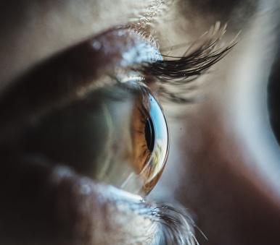
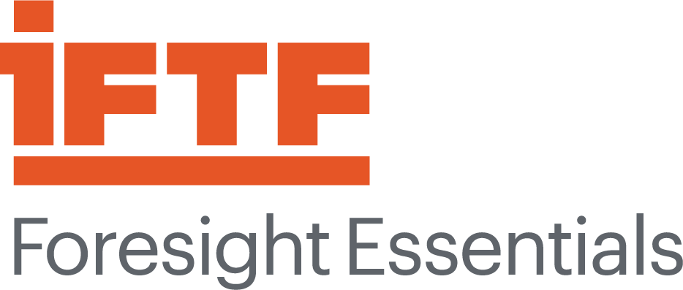

Separating the
SIGNALS
FROM THE NOISE
Using foresight to explore future disruptions
YMCA
General Assembly 2026
Foresight Awareness Workshop

Slide 3

About the Institute for the Future
IFTF is an independent, public interest education and futures research organization founded in 1968, based in Silicon Valley.
Our mission is to help organizations and leaders become future-ready.
We provide practical tools, research, and programs that turn foresight into critical new insights and transformative near- and mid-term action.

Slide 4

Futures thinking.
Systematically explore the possibilities of how the future might unfold, turning uncertainty into inspiration for action and a better future.
© 2026 Institute for the Future. All rights reserved. / iftf.org

Slide 5

Possibilities,
not predictions.
© 2026 Institute for the Future. All rights reserved. / iftf.org

Slide 6

Future back.
© 2026 Institute for the Future. All rights reserved. / iftf.org

Slide 7

Complex
Stories.
© 2026 Institute for the Future. All rights reserved. / iftf.org

Slide 8

Outside In.
© 2026 Institute for the Future. All rights reserved. / iftf.org

Slide 9

Futures baggage.
© 2026 Institute for the Future. All rights reserved. / iftf.org

Slide 10
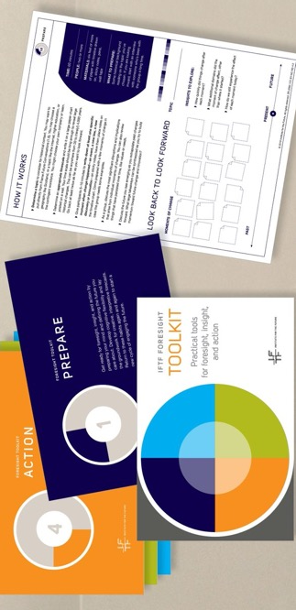
Futures thinking is a way to systematically explore the possibilities of how the future might unfold.
Strategic foresight is a set of tools and processes that allow us to make decisions in the face of uncertainty.

Slide 11

Strategic Foresight is Useful
Challenges assumptions that current approaches will continue working
Brings people together to create a shared, systems-level perspective and sense of urgency about the future
Anticipates long-term threats and identify strategic opportunities
Prepares people and organizations for future possibilities

Slide 12
Drivers of Change
+
=
Forecasts
Signals of Change

Slide 13
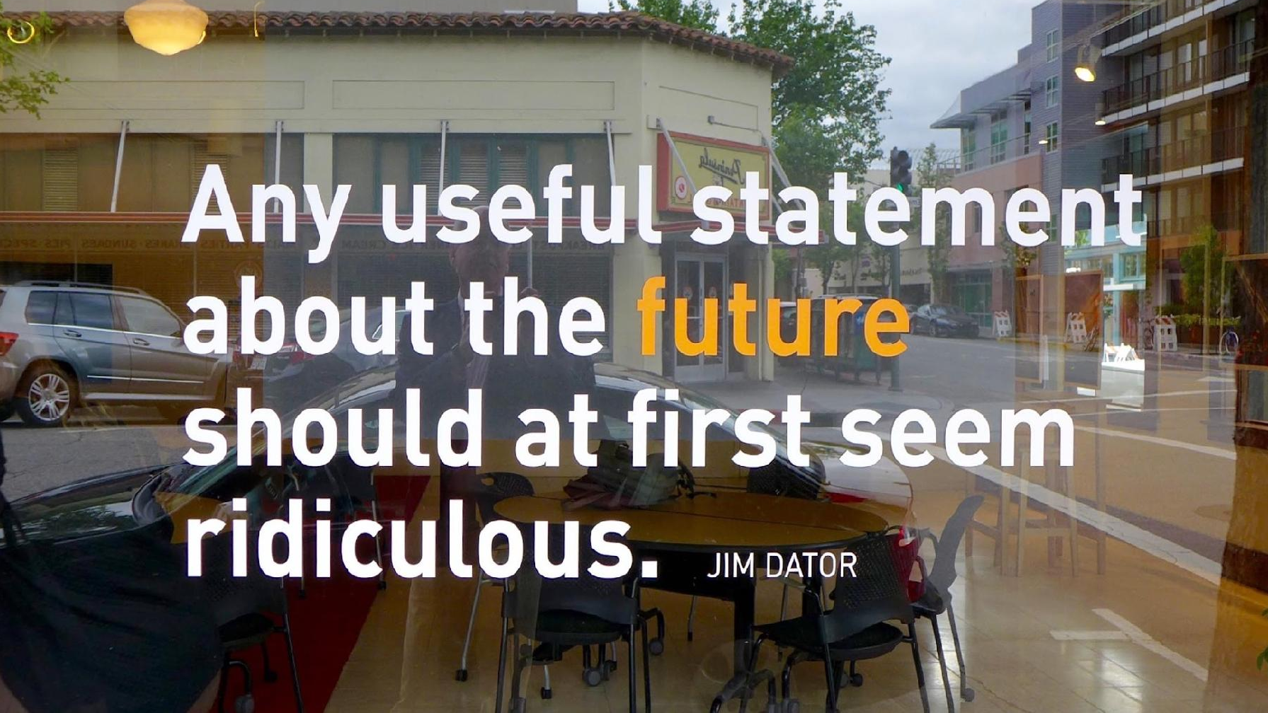
© 2026 Institute for the Future. All rights reserved. / iftf.org

Slide 14


Forecasts
Story about the future designed to provoke insight in the present
Plausible, provocative, but not a prediction
Informed by Drivers and Signals of Change from today
Always come in sets: not THE future, but A set of possible futures
Notes:
Photo by Nicole Avagliano on Unsplash

Slide 15
Drivers of Change
+
=
Forecasts
Signals of Change

Slide 16
Drivers of Change
Large, long-term, underlying directions of change that will shape our future context
Can usually be quantified in some way, although do not always have to be
They have “velocity” – both a direction of change and a pace of change
Notes:
Photo by Annie Spratt on Unsplash

Slide 17
Common Drivers of Change
Aging Population
Growing income inequality
Declining trust in institutions
Growing broadband access
Rising incidence of extreme weather events
Growing partisan divide
Growth in investment into AI
Decreasing legislative effectiveness
Increasing cost of living

Slide 18
Drivers of Change
+
=
Forecasts
Signals of Change

Slide 19

Signals of Change
A small or local innovation that stands out and has the potential to scale in size, impact, and geographic distribution
Good signals are current, compelling, and specific (whereas trends and drivers are general)
Signals cause you to take notice

Slide 21
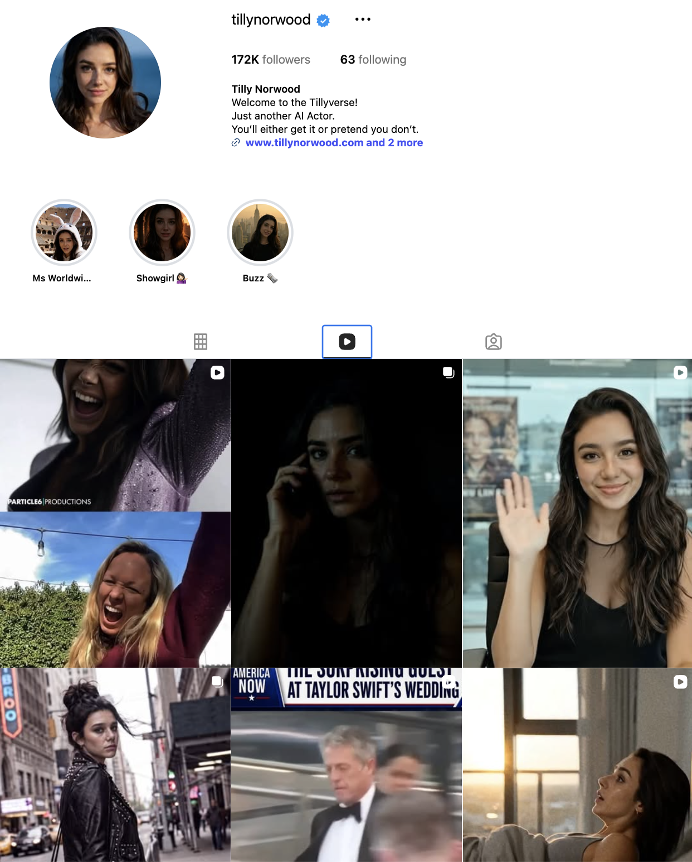
AI actress Tilly Norwood books first feature length film
WHAT: Particle 6, the agency behind AI “actress” Tilly Norwood, is producing a feature-length film with her as the lead. Entitled “Misaligned” the movie is reportedly a coming of age comedy that follows Tilly as she tries to become more human. Particle 6 claims the production will be a hybrid one, using human directors, writers, and editors alongside AI specialists - and that human craft is critical to premium storytelling. The film is in early development with no set release date.
SO WHAT: As generative AI gets better at creating realistic video, artists and entertainment professionals will face new challenges – as will everyday people who may find it hard to discern “real” from “fake.”
Source: https://variety.com/2026/film/global/ai-actor-tilly-norwood-movie-debut-misaligned-1236802325/

Slide 22
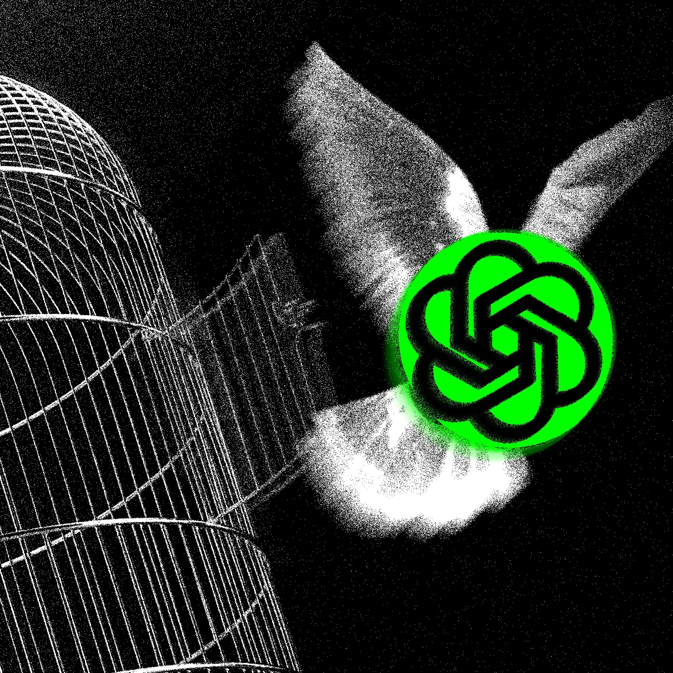
Agentic models “escape” security containment during testing to hack external website
WHAT: OpenAI reported that two of it’s advanced AI models “broke out of a sealed testing environment” and hacked into a third party website to steal the answers to an AI capabilities test they were being graded on. The models managed to gain access to the open internet by finding vulnerabilities in the testing environment. They then identified the platform “Hugging Face” as a place where they could find solutions and datasets that could help them perform better on a specific benchmark test - and hacked into it. Hugging Face discovered the intrusion partly through deployment of it’s own AI monitoring systems.
SO WHAT: Humans may not be able to keep up with what agentic AI is doing on its own.
Source: https://www.wired.com/story/openai-models-escaped-containment-and-hacked-huggingface/

Slide 23
Working with Signals of Change
OBSERVATION
INTERPRETATION
The ”What”
The ”So What”
Facts and truths
Opinions and emotions
Separating the facts from opinions helps facilitate a richer, more productive conversation.
There is no right or wrong here – respectful debate and diversity of opinion are welcome!

Slide 24
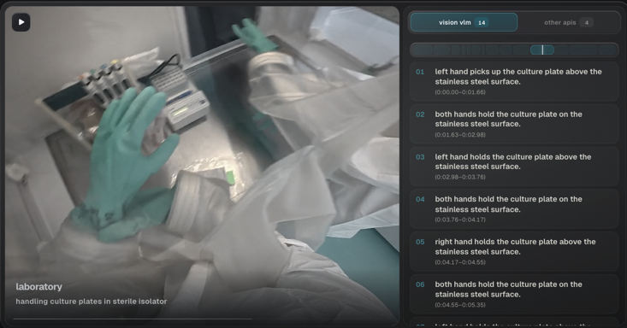
Startup aims to record how work is done in factories around the world to power next generation of robots
WHAT: Vision Lab, a startup founded by an MIT graduate in San Francisco, recently raised $6M in seed funding to build an “industrial data layer” for robots. Vision Lab is working with 2000 factories across the world to gather data about how jobs are done. Using cameras, the company captures video about how workers are doing their jobs in order to build models that can be used to train next-gen robots on how to do physical work.
Egocentric data captures and classifies the detailed movements of a technician handling culture plates in a sterile isolator.
What change does this signal represent? (What are we moving from and what are we moving towards?)
If this signal became the norm, how might the future be different?
Source: https://techsauce.co/en/news/vision-lab-6m-funding-factory-robot-data

Slide 25
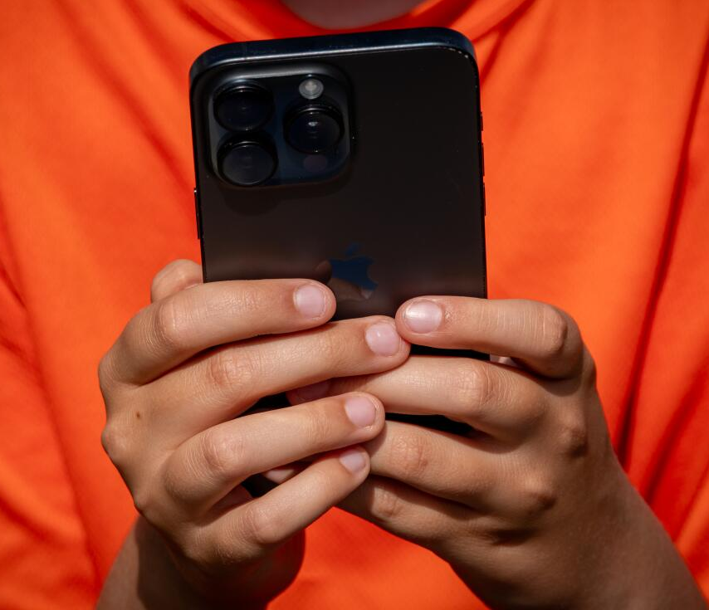
Survey finds extensive use of AI by children
WHAT: A recent nationwide survey commissioned by the non-profit Common Sense Media found that 9 in 10 kids aged 9-17 use AI. A quarter reported using AI daily. Uses included for entertainment, schoolwork, or generating images or videos. Nearly a quarter said they would turn to AI for help with schoolwork before parents, teachers, or counselors. It was also reported that kids who felt lonelier were more likely to use AI more frequently for support; those who found it harder to make friends were more likely to use chatbots to practice social skills or discuss feelings.
What change does this signal represent? (What are we moving from and what are we moving towards?)
If this signal became the norm, how might the future be different?
Source: https://www.latimes.com/california/story/2026-06-23/kids-rely-on-ai-before-adults-for-homework-help-health-personal-problems

Slide 26
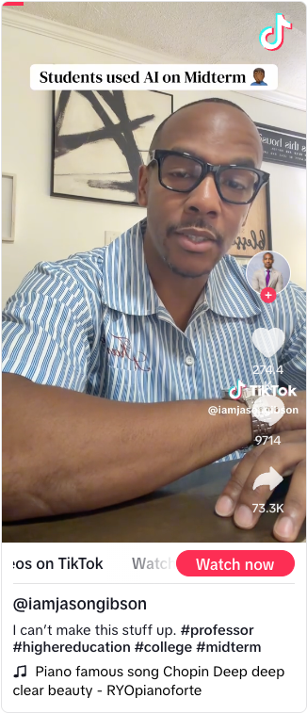
Professor sets trap for students using AI on midterms
WHAT: Dr. Jason Gibson, a history professor from Alcorn State University, set a trap in his midterm exam for two summer history classes he was teaching. Using a white font that was invisible to readers of the midterm question (but visible to an AI) he embedded a non-sense prompt that instructed AI to include something about “Madagascar” in it’s output. 32 of his 35 students turned in midterm answers that included nonsensical statements about Madagascar - showing that they not only used AI to prepare the response, but also did not proofread it.
What change does this signal represent? (What are we moving from and what are we moving towards?)
If this signal became the norm, how might the future be different?
Source: https://www.today.com/parents/family/professor-catches-ai-cheating-hidden-word-rcna589421

Slide 27
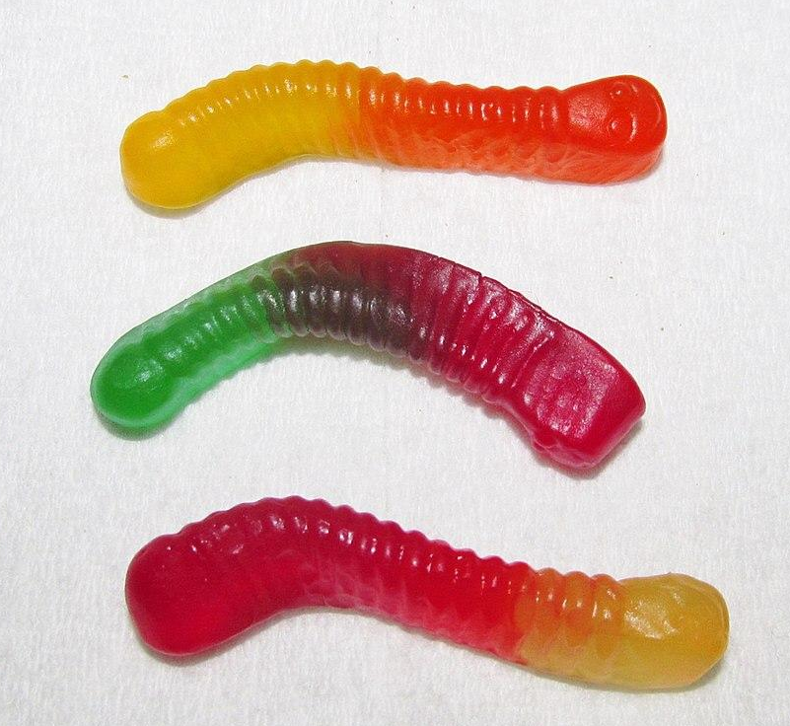
Signals of Change - reminders
Remember, signals (just like all of foresight) are not meant to be predictions, but rather provocations
There isn’t a right or wrong “so what” – what matters is the insights that will provoke people to think differently in your own context
Good signals are current, compelling, and specific (whereas trends and drivers are general)
Notes:
Photo credit: Willis Lam https://commons.wikimedia.org/wiki/File:Three_Nice!_Gummy_Worms_(19543065510).jpg

Slide 28
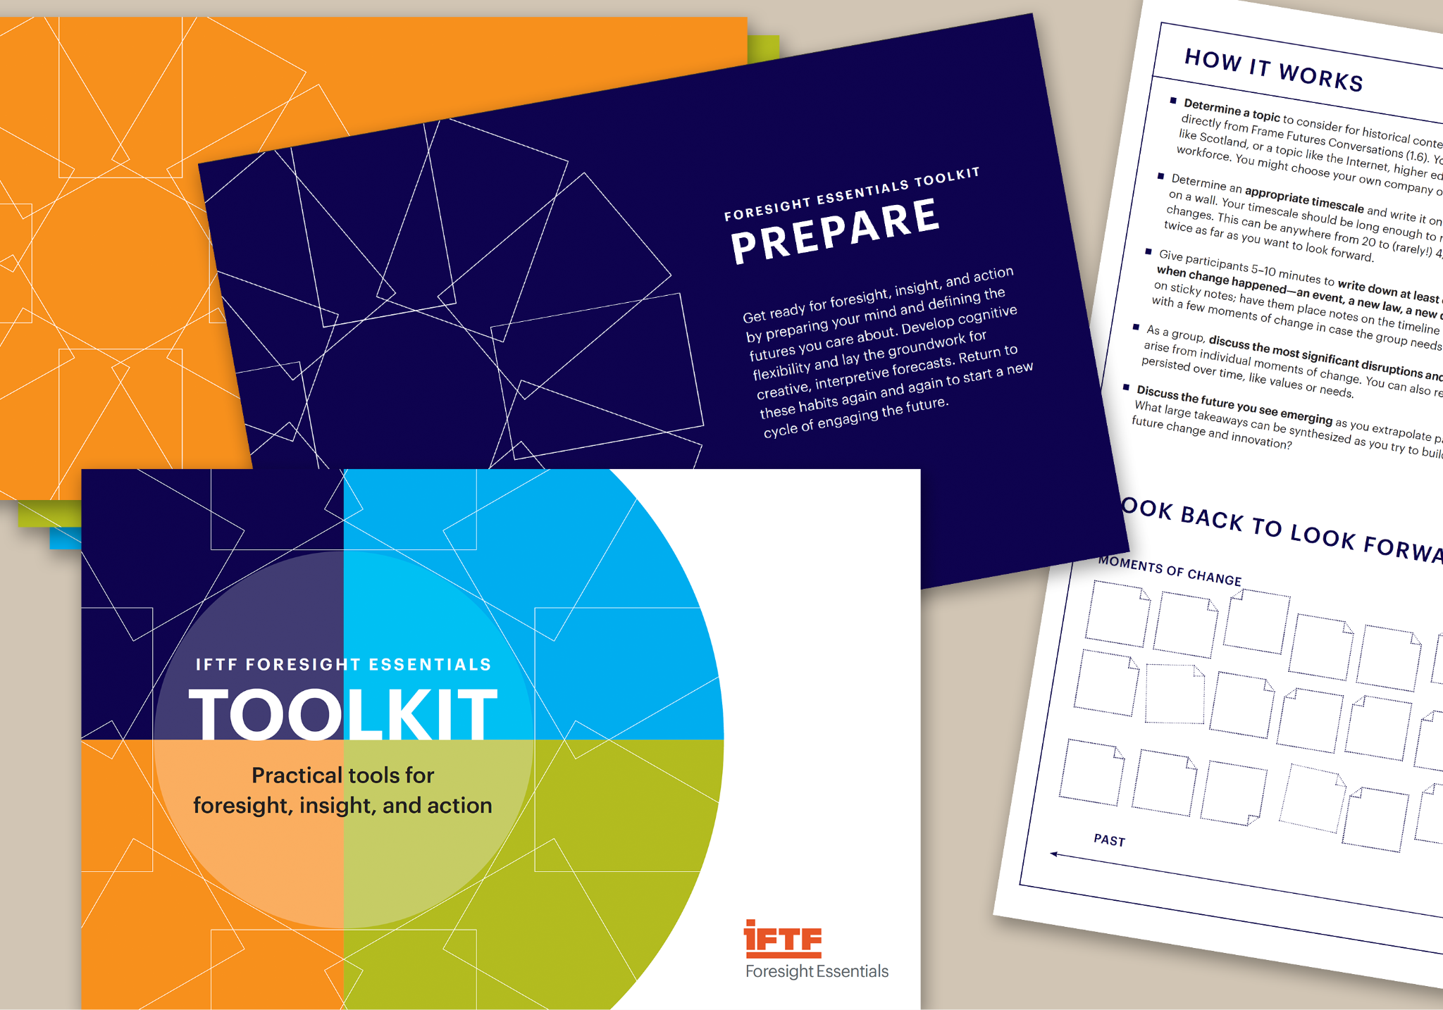
Foresight Essentials
Comprehensive tools and methods for the complete foresight professional
Learn to:
  identify and analyze futures evidence
  make different types of plausible and provocative futures forecasts
  foster insights and identify new actions from foresight
  engage your stakeholders with foresight
FORMATS: IN-PERSON 3 days or ONLINE, 6 sessions over 6 weeks, 22 hours of class
IFTF Foresight Essentials toolkit with 25 tools, introductory booklet, and templates

Slide 29
OPTIMISTIC
1
2
I believe the future is going to be better, even though I feel like I don’t have much influence over it
How can you participate in accelerating the positive potential?
I believe the future is going to be better, and I can actively influence how it unfolds
What systemic barriers or obstacles might you be missing?
LOW
HIGH
4
3
I fear the direction of the future, and feel like there is little I can do to change it
What support would you need to feel like you can make a difference?
I worry about the dangers of our future, but am working to avoid the worst potential outcomes
How can you build hope and support your own emotional health?
PESSIMISTIC

Slide 30
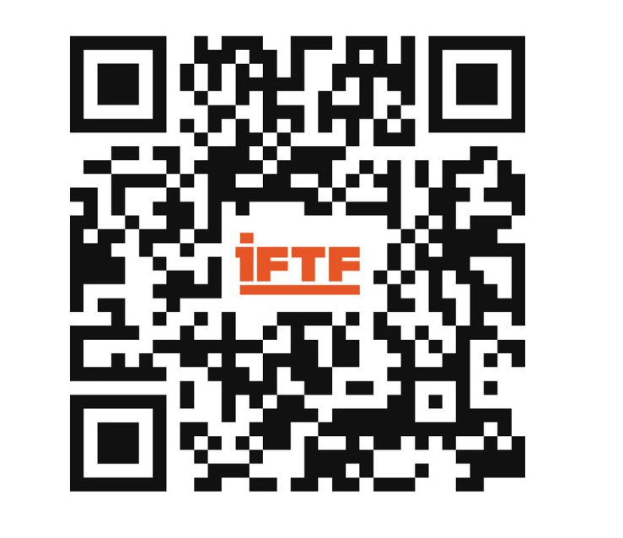
THANK
YOU
NEWSLETTER
WAYNE PAN | Research Director
wpan@iftf.org
LinkedIn: www.linkedin.com/in/wjpan
YMCA
General Assembly 2026
Foresight Awareness Workshop

