Slide 1
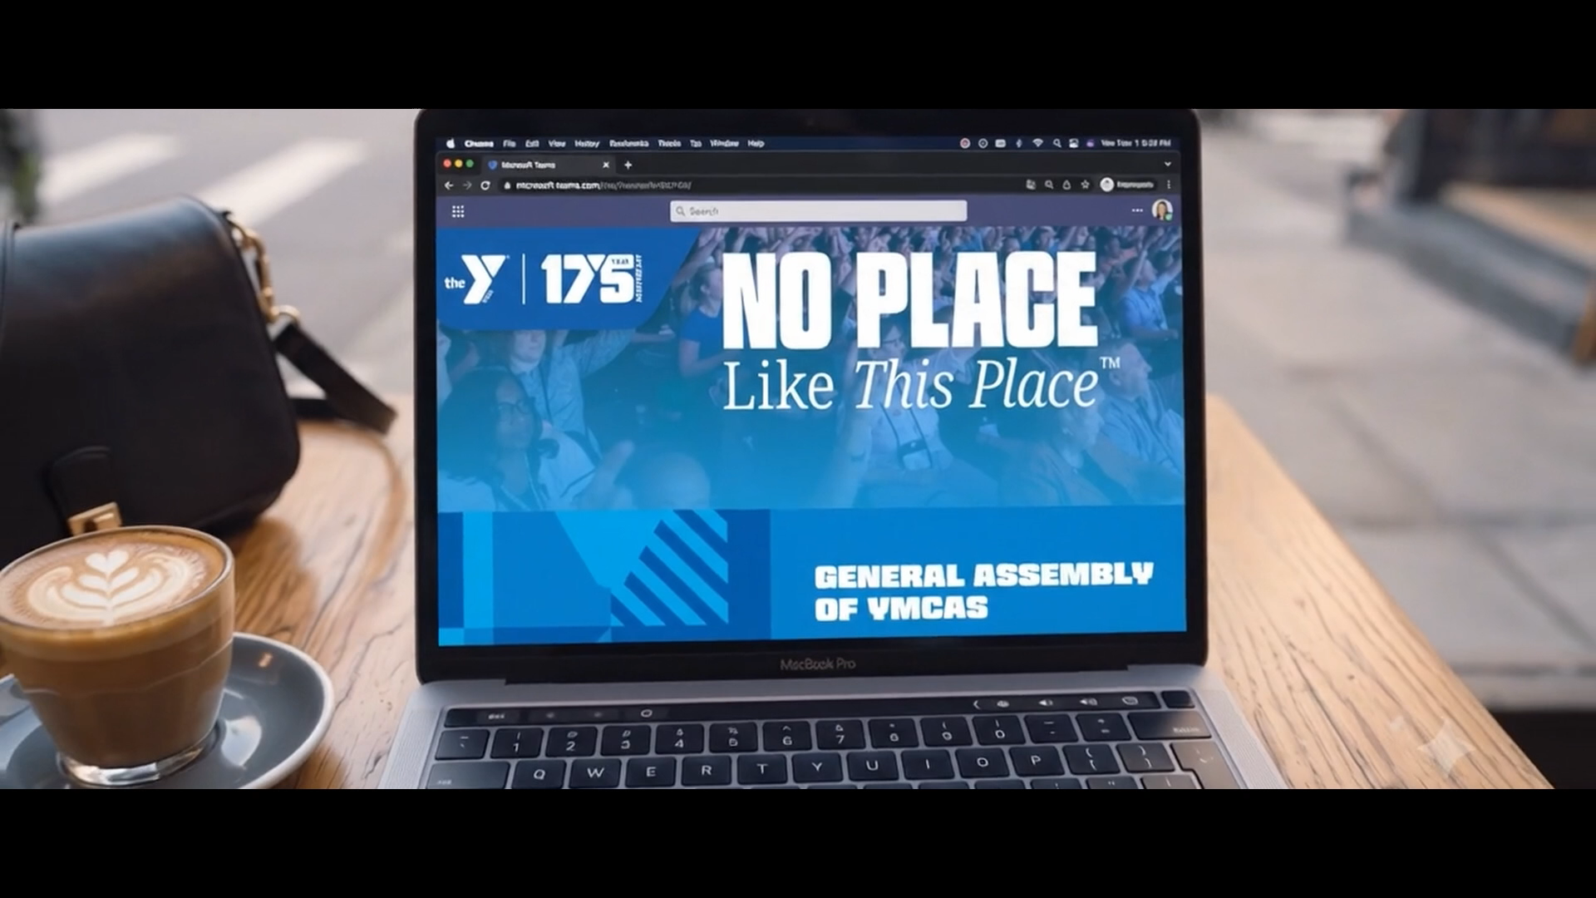

Slide 2


STAYING CONNECTED AND RELEVANT:
Leadership in a Changing World
Clara Sierra, Wall Street Senior Executive.
Notes:
1

Slide 3
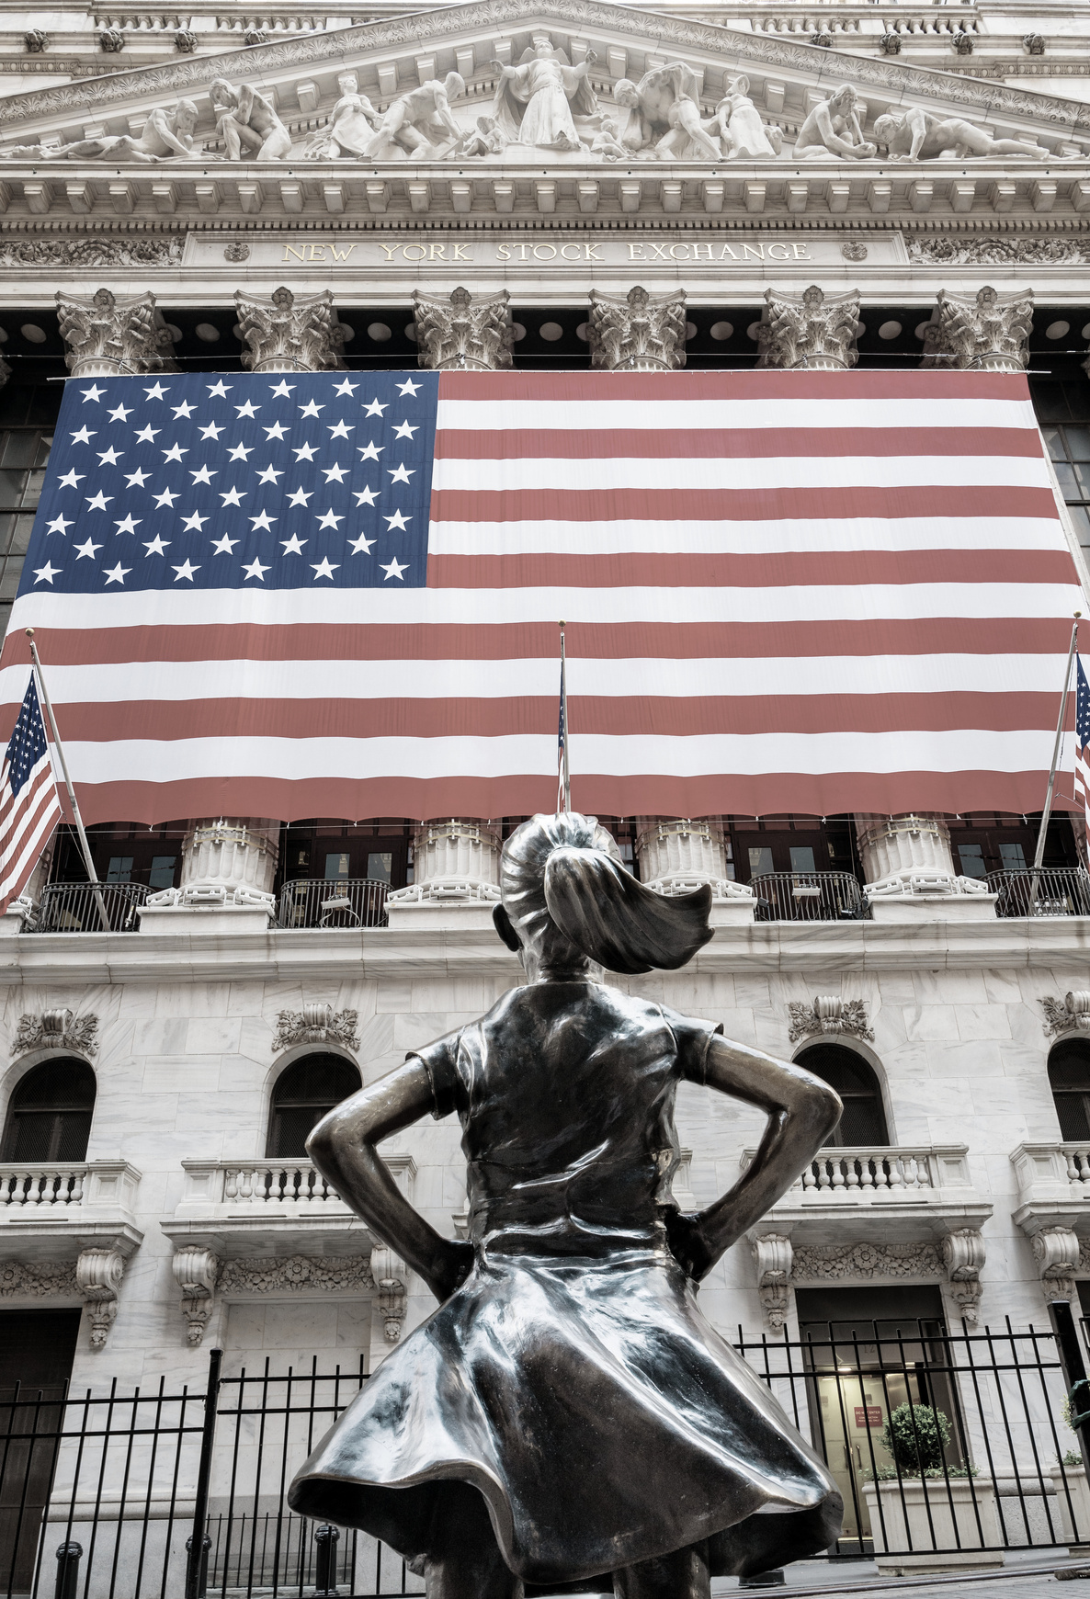
CLARA SIERRA: Award-Winning Wall Street Executive & Industry Trailblazer
  35+ Years in Finance: Executive roles at Moody’s Analytics, Amundi, AIG, and Alliance Capital.
  Managing Director at BridgePort Financial Solutions.
  $20B+ Institutional Scale: Architected growth, asset raising, and integration across global advisory divisions.
  $800M First-Year Sales: Spearheaded AIG’s shared advisory platform to record-breaking expansion.
  Board Member, Invest in Others Charitable Foundation.
  Pensions & Investments Influential Women in Institutional Investing Award Winner

Slide 4

YOU THINK YOU KNOW WHAT WALL STREET IS

Slide 5



Slide 6
THE FINANCIAL SERVICES INDUSTRY: REAL IMPACT
Building Generational Wealth:
Advised individuals... on average accumulate more than 2x the net worth of their non-advised peers, even after accounting for income and other demographics.
Securing Retirement:
Only 33% of Americans have a written financial plan, but those who do are more than twice as likely to feel 'very confident' about their finances.
[1] TIAA Institute, 2026: The Value of Financial Advice
[2] Charles Schwab, 2025 Modern Wealth Survey

Slide 7
THE FINANCIAL SERVICES INDUSTRY: REAL IMPACT
Improving Mental Well-Being:
79% of Americans who work with a financial advisor say they feel strong about their financial situation compared to just 57% of Americans overall.
Workplace & Mental Health Support:
8 in 10 employees who received financial wellness training at work say it helped them be more focused on the job, and 71% say it reduced their financial stress.
[1] Northwestern Mutual, 2023 Planning & Progress Study
[2] Talent LMS, Financial Wellness Programs in the Workplace, 2022

Slide 8
THE FINANCIAL SERVICES INDUSTRY: IN THEIR OWN WORDS
“More than ever, the power of advice to help change lives. Advisers aren't just managing money, they're changing lives.”
- Ross Liston, CEO of M&G Advice
"Peace of mind means knowing you have a trusted partner who's helping you stay on track, no matter what the markets or life throw your way."
- Garrett Harbron, Vanguard's Head of Advised Wealth Management Strategies

Slide 9

“It is a people-to-people business.”
Authenticity. The human connection.
- Clara Sierra, Wall Street Senior Executive
Our ability to stay authentically connected and relevant to our organizations, our communities, and our teams is critical for impactful leadership.

Slide 10

Remember the Video?
Some people might say Problem / Solution...
Some people might say
Technology Enhancement...

Slide 11
“Technology Enhancement” THE DIGITAL TAKEOVER
What's really happening: the decline, and what's replacing it.
THE DECLINE
THE INCREASE
56% don't attend a single
community event all year.
5 hrs, 16 min a day
on our phones. Up 14% in one year.
1] AEI Survey Center on American Life, 2025
[2] Harmony Healthcare IT Annual Screen Time Study, 2025

Slide 12
THE STATE OF ISOLATION
57% of Americans are classified as lonely today.
[1] Cigna / Evernorth Health Services: Loneliness in America Report, 2025

Slide 13
THE STATE OF ISOLATION: BY GENERATION
Genz reports the highest loneliness of any generation 67% nearly 1.5x Baby Boomers 44%.
1] Cigna / Evernorth Health Services: Loneliness in America Report, 2025

Slide 14
THE STATE OF ISOLATION: WHO'S HIT HARDEST
$154B is the estimated annual cost of workplace loneliness in stress-related absenteeism.
52% of U.S. workers report feeling lonely on the job.
[1] U.S. Surgeon General's Advisory on Our Epidemic of Loneliness and Isolation, 2023
[2] The Cigna Group, 2020 Loneliness Index / Workplace Loneliness Study

Slide 15
THE STATE OF ISOLATION : BY RACE & GENDER
22% of Black women report frequent loneliness, the highest of any group measured, vs. 17% of White, 16% of Hispanic, and 15% of Asian women.
25% of young men (15–34) felt lonely “a lot” well above the 18% national average.
[1] KFF Survey on Discrimination and Health, 2025[2] Gallup World Poll & Meta Global State of Social Connection, 2026

Slide 16
REALITY TO
RELEVANCY

Slide 17
WHAT DOES IT MEAN TO STAY RELEVANT?
Staying Relevant isn't a trend you chase.
It's a habit of staying curious without losing what makes you, you.

Slide 18

TOOLS TO STAY RELEVANT (Pt. 1)
Technology isn't the enemy of relevancy, used with balance, it's a huge part of what makes you relevant.
MODERN AI COPILOTS
Daily productivity & strategy
• ChatGPT
• Gemini
• Claude
SMART OPERATIONS
Streamlining communication
• Built-in Schedulers
• Process Automation
• Digital Workflows
BALANCED ADOPTION
Relevance without lost identity
• Active Engagement
• Forward-Facing Tech
• Human Balance / Connection

Slide 19

TOOLS TO STAY RELEVANT (Pt. 2)
Staying relevant isn't just adopting tech, it's using it without losing yourself.
PROTECTING YOUR FOCUS
Fewer interruptions, more presence
• Screen Time / Digital Wellbeing dashboards
• App-limit timers
• Focus mode & Do Not Disturb scheduling
PROTECTING YOUR PRESENCE
Automate the routine, not the relationship
• Let AI draft the email, you make the call
• CRM automation for follow-up, not for connection
•Scheduling tools that free up face-to-face time
PROTECTING YOUR REST
Boundaries that hold
• Slack & email "scheduled send" + auto-decline after hours
• Sleep Focus / Wind Down mode (auto-schedules phone-quiet hours)
  Freedom or Opal (blocks apps/sites during set windows)

Slide 20
STAY CURIOUS: WHERE TO KEEP LEARNING
The Rundown AI (daily newsletter): Beginner-friendly daily updates on modern tools and how to use them.
One Useful Thing By Ethan Mollick (Substack): Essays from a Wharton professor on what AI actually means for work.
Hard Fork by The New York Times (Podcast) : A weekly, non-technical audio deep dive on modern tech, workplace trends, and business impact.

Slide 21
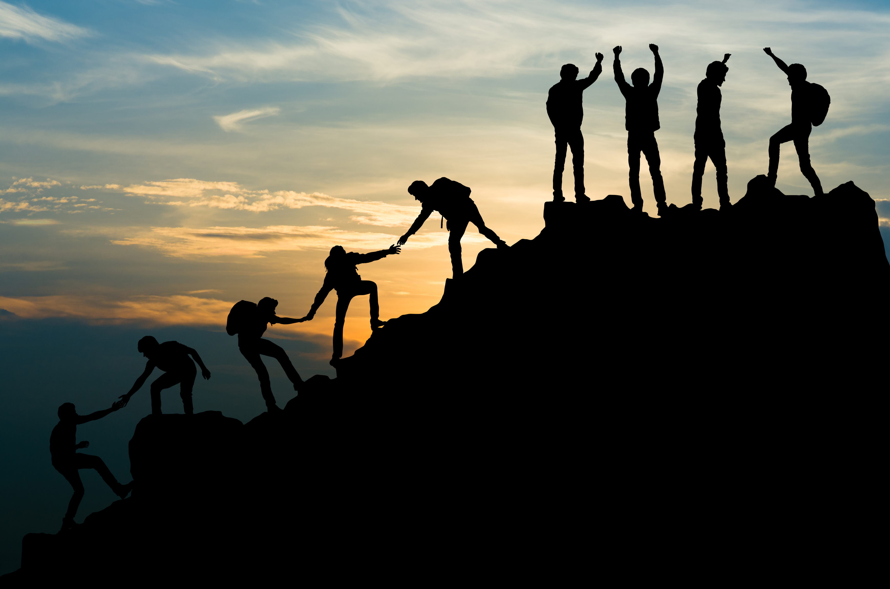
“What is impactful leadership?”

Slide 22
A STORY OF LEADERSHIP THAT FAILED
"In 2000, Blockbuster was the undisputed giant of entertainment. A small startup named Netflix offered to sell themselves to Blockbuster for $50 million. Blockbuster's leadership laughed them out of the room because they were comfortable with physical stores and late fees. They stopped sharpening their saw, ignored changing customer behaviors, and white-knuckled an outdated model. Ten years later, Blockbuster went bankrupt. That’s what happens when leadership refuses to stay relevant, avoid hard truths, and evolve."
[1] Fortune, "Blockbuster 'laughed us out of the room,' recalls Netflix cofounder," April 2023
[2] Variety, "Netflix's Origin Story," March 2025

Slide 23
Leadership & Succession Quotes
"Leadership is not about titles, positions, or flowcharts. It is about one life influencing another."
— John C. Maxwell, Leadership Author & Speaker
"The job of a leader is not to have all the ideas, but to create an environment where the best ideas can happen."
— Simon Sinek, Author & Organizational Consultant
"Before you are a leader, success is all about growing yourself. When you become a leader, success is all about growing others."
— Jack Welch, Former CEO of General Electric

Slide 24
IMPACTFUL LEADERSHIP (THE 4 PILLARS)
  1. Being comfortable with difficult conversations
Leaning into necessary, honest dialogues to drive progress.
  2. Constant education (sharpening your saw)
Evolving continuously and adopting modern technology to stay relevant.
  3. Being a present leader not an absent leader.
Showing up with authentic engagement rather than leading from a distance.
  4. Cultivating Your Succession Strategy
Actively mentoring and positioning the next generation to take your role.

Slide 25
THE NUMBERS BEHIND IMPACTFUL LEADERSHIP
52% of a company's long-term profitability traces back to the quality of its leadership team.
1.5x higher profit margins and 2.1x higher revenue growth at companies with strong leadership development.
Nearly 1 in 3 business owners has no succession plan in place.
[1] Mercer Leadership Performance Study[2] Boston Consulting Group (BCG) Global Leadership and Talent Index[3] PNC Private Bank & Ipsos Business Owner Survey, 2026

Slide 26

YOUR ROAD MAP OF WHAT TO DO NEXT

Slide 27
HOW DO YOU GET THERE?
STAYING
CONNECTED.
RELEVANT.
IMPACTFUL.

Slide 28
Three places to Start...
1
2
3
“Company” Connection
“Community” Engagement
“Team” Empowerment
Authentic relationships with the people and communities you serve.
Open communication and a culture where every voice is heard.
Visibility, trust, and engagement inside your organization.

Slide 29
COMPANY CONNECTION IN PRACTICE
Engage directly, not through layers
1
Manager engagement drives team performance more than almost anything else you control.
Answer it yourself
2
Direct executive communication builds trust and employee empowerment more than messages relayed through a chain.
Be visible, not just available
3
Transparent, direct communication from leadership is linked to stronger employee advocacy and trust.
[1] Gallup: State of the American Manager Report[2] Lee & Dong, 2023: Transparent Executive Communication and Organizational Trust

Slide 30
COMMUNITY ENGAGEMENT IN PRACTICE
1
Show up where you serve
Attend one community event in person this month not a livestream.
2
Ask before you assume
Talk to one member or stakeholder directly about what they actually need.
3
Let AI assist, not replace
Before automating outreach, ask: does this still feel human on the other end?
[1] U.S. Surgeon General’s Advisory on Social Connection & Civic Engagement, 2023

Slide 31
TEAM EMPOWERMENT IN PRACTICE
1
Pass The Mic
Have a different teammate / leader LEAD YOUR MEETING
2
The Tour of Listening
Sit in a Meeting Not Run By You / Listen, Don’t Speak
3
Cultivating Your Succession Strategy
Consistently Be Assessing Your Successor
[1] Edmondson, A. & Kerrissey, M., "What People Get Wrong About Psychological Safety," Harvard Business Review, May/June 2025
[2] Gallup & Workhuman, employee recognition and retention research (2024) — recognized employees are 45% less likely to leave

Slide 32
ADDITIONAL HOMEWORK ASSIGNMENT
Dynamic and ever-evolving, to lead in this constantly REVVED-UP, changing world.​
1
[1]
2
[1]
3
[2]
4
[3]
Have one face-to-face conversation with someone on your team, phone away
Ask your team: what impacted you this week?
Model a phone-free moment, show your team it's okay to disconnect
Show up in person for your community, not just your organization
5
[1]
6
[2]
7
[3]
Ask yourself: was I an authentic leader today?
Protect your team's focus, say no to one unnecessary interruption
Recognize one person's contribution, out loud, today
[1] Gallup: State of the Global Workplace Report, 2025[2] UC Irvine: Workplace Attention Span Study, 2023. [3] U.S. Surgeon General’s Advisory on Loneliness, 2023 (see slide 14)

Slide 33
THREE PILLARS, ONE GOAL
Company. Community. Team.
Every pillar comes back to one thing.
Authenticity. The human connection.

Slide 34

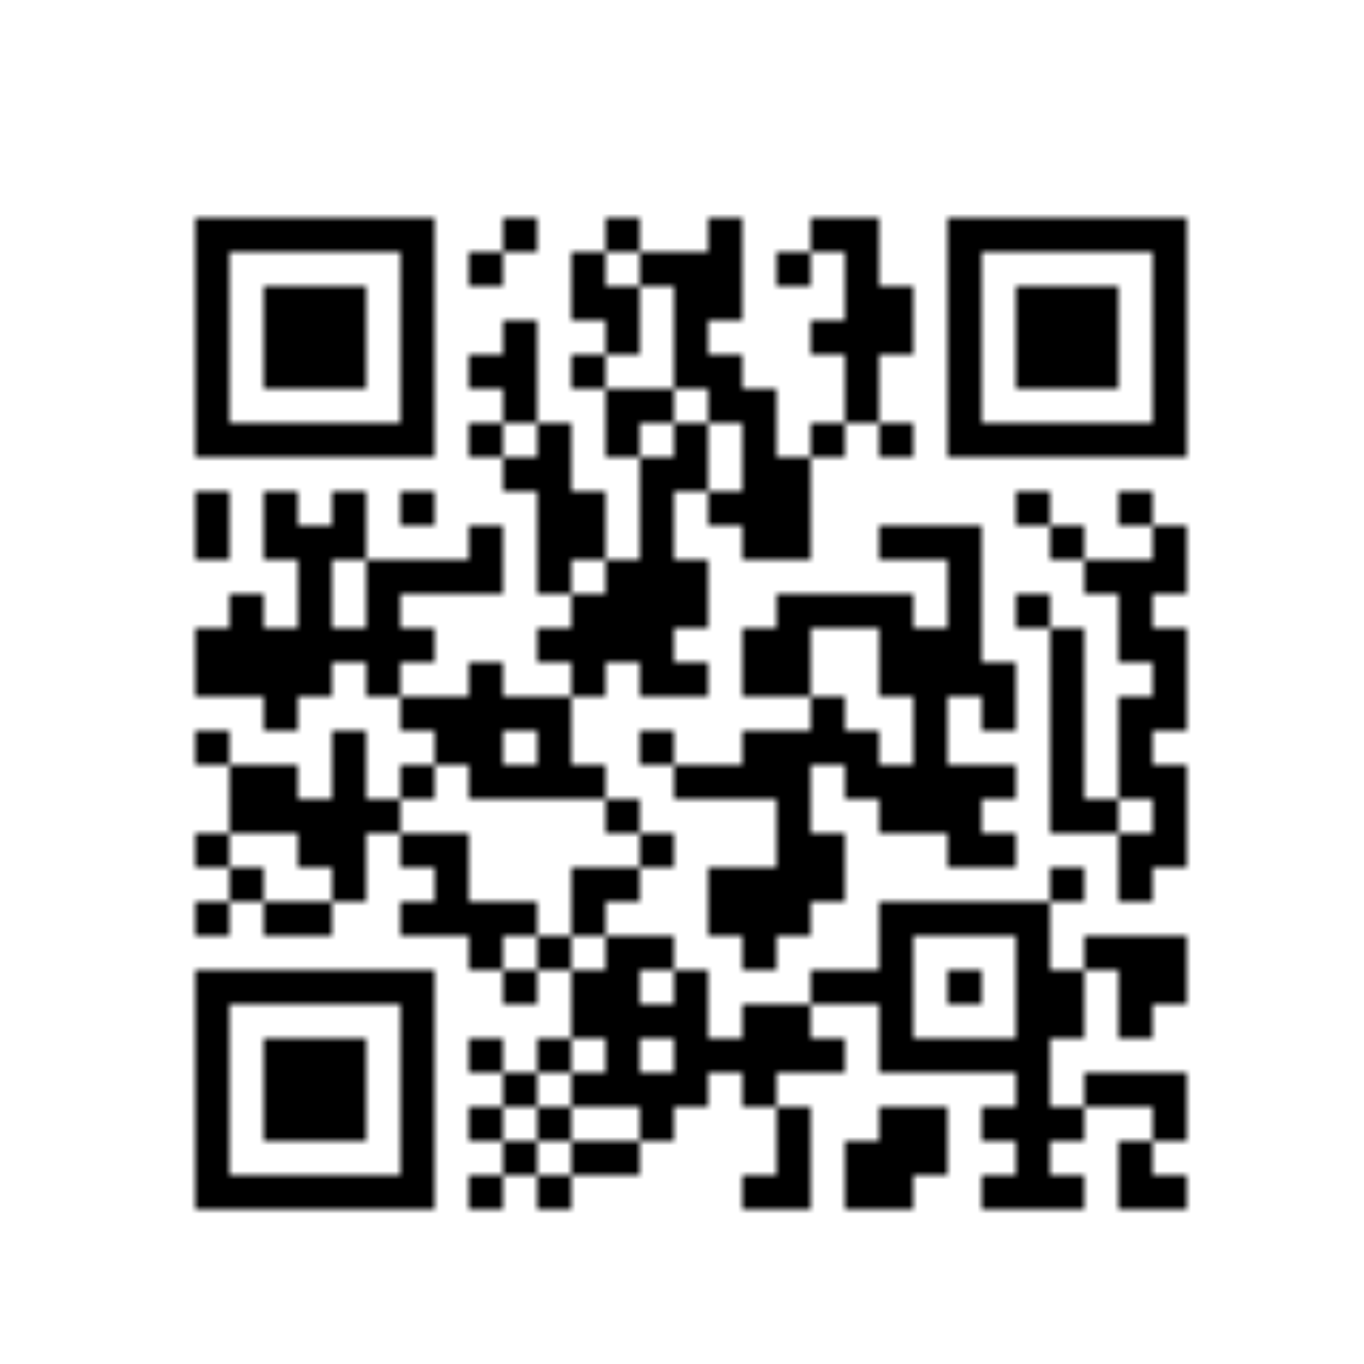
THANK YOU
Connect with Clara & Presentation Links

