Slide 1

BUILDING TOWARD FINANCIAL INDEPENDENCE
Erin Lowry

Slide 2

Buildings towards financial independence
In all seasons of life

Slide 3
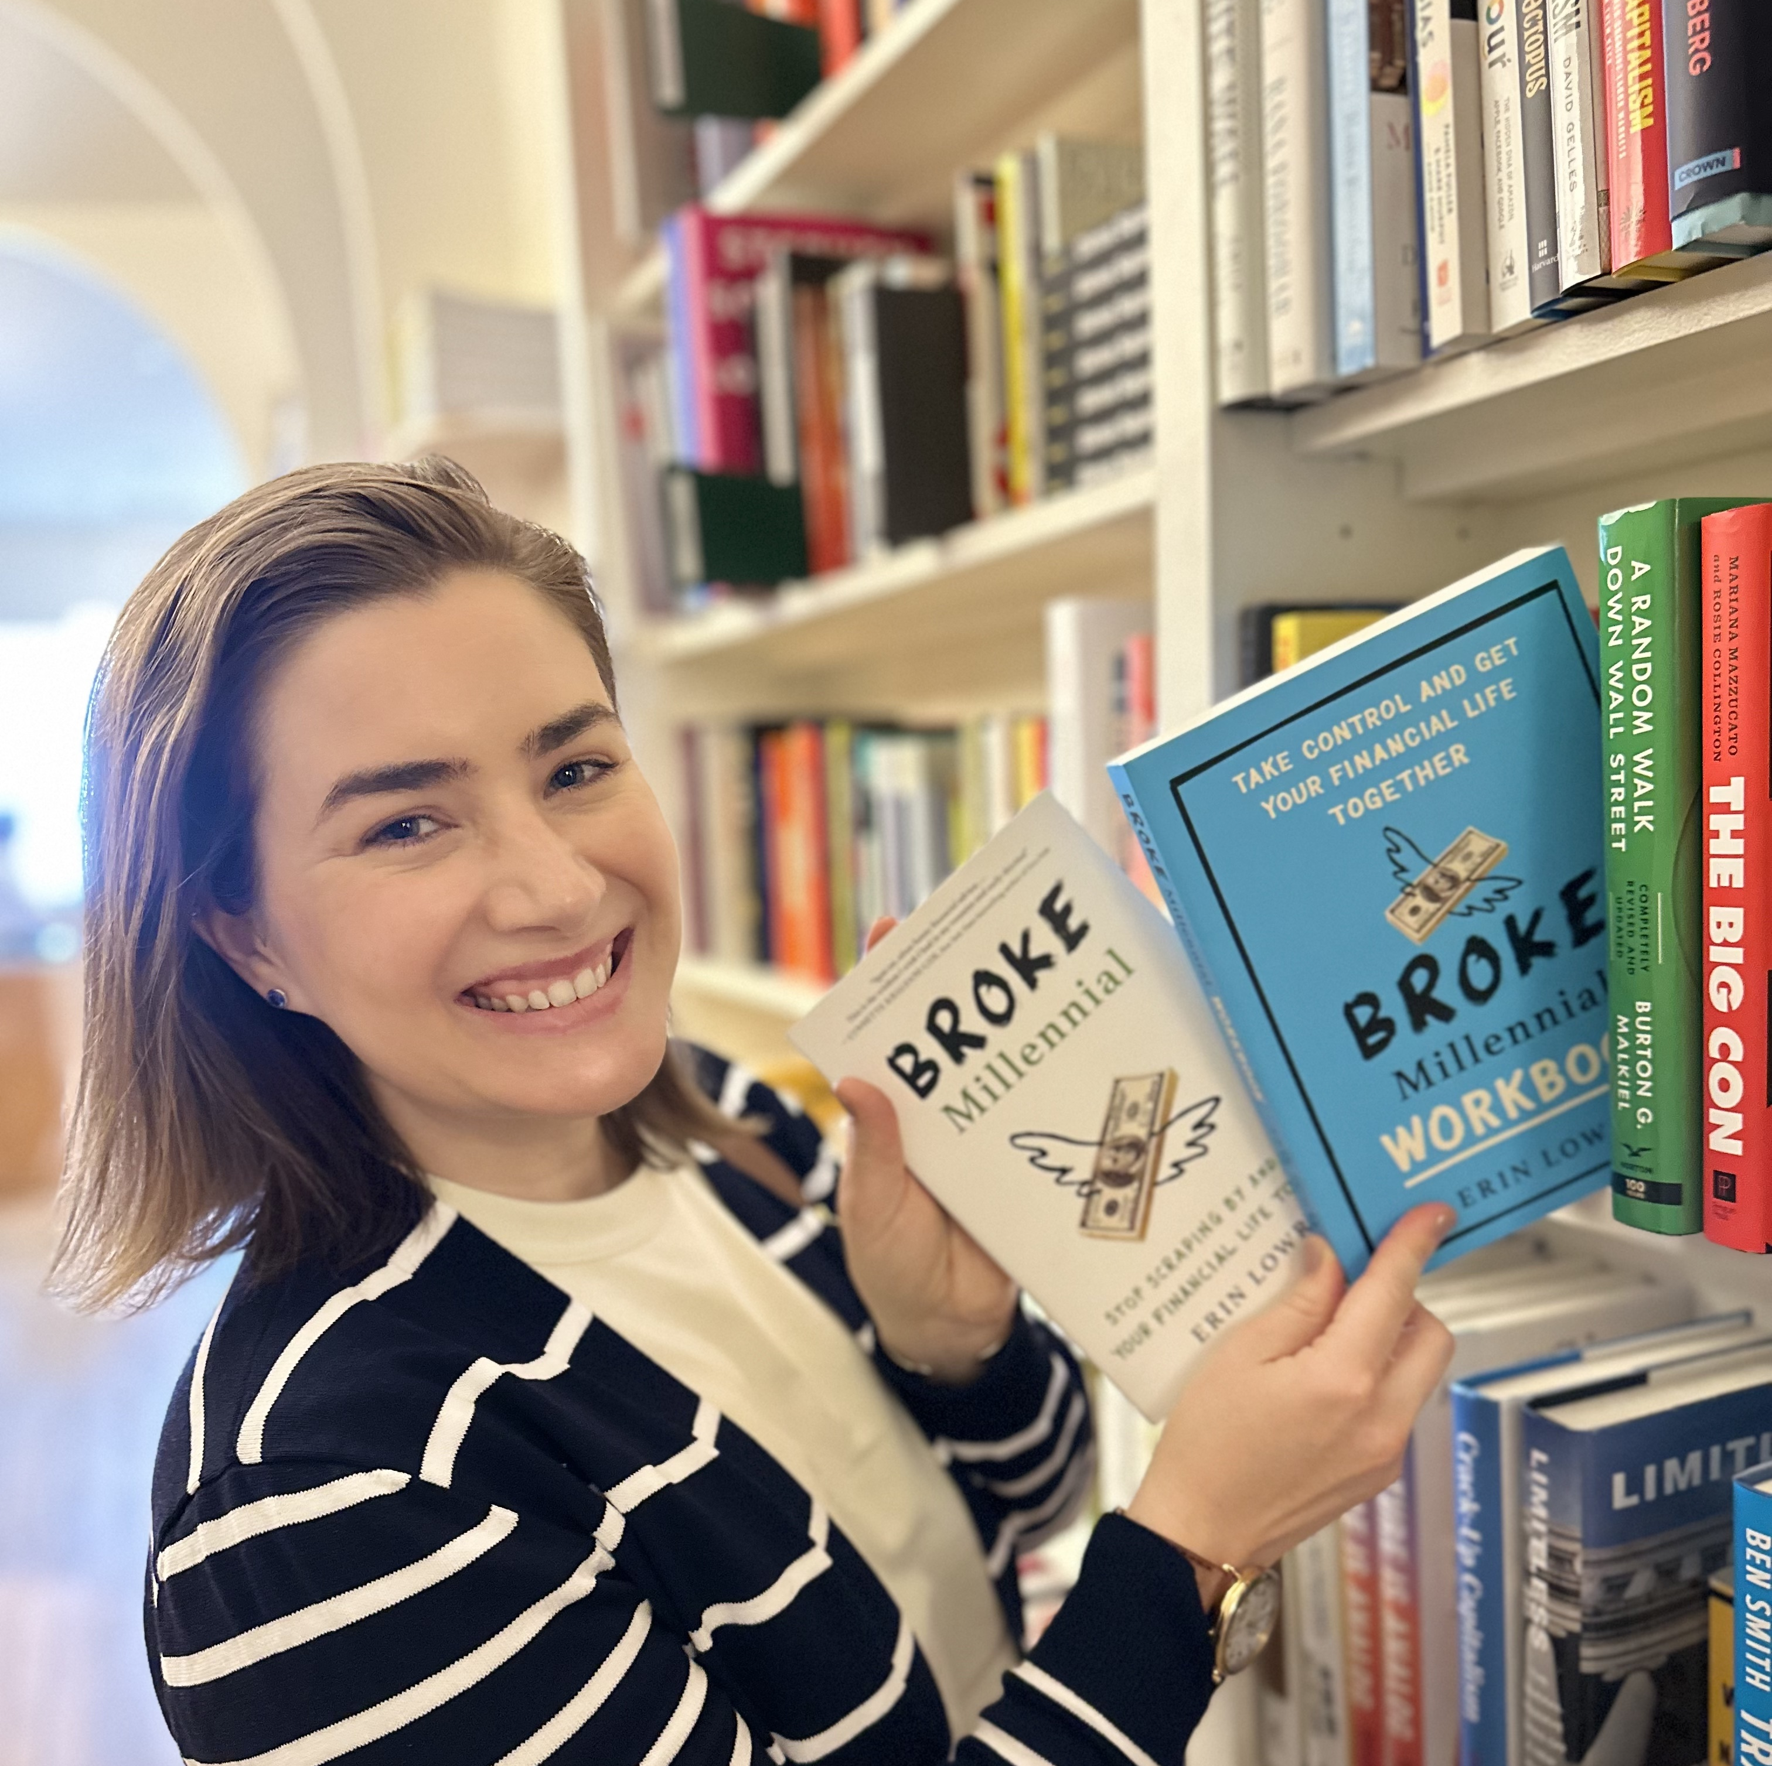
Erin Lowry
Financial Translator

Slide 4

“MONEY!”
How does that word make you feel?
Excited
Tense
A spark of joy
A little bubble of anxiety in your gut?

Slide 5

Your emotional relationship to money matters.
Sure, you need to know basics like your cash flow, planning for retirement, and how to pay off debt
But the big thing you need to understand is your psychological relationship to money.

Slide 6

What is your first memory of money?
A Krispy Kreme donut changed my life.

Slide 7
Who taught you about money?
The people who raised you.

Slide 8

Scenario #1
Mom and Dad constantly argued about money, which left you with a tendency to avoid the topic as much as possible in your own life.
Or
You may be really focused on taking back control to avoid repeating the mistakes of your parents.

Slide 9

Scenario #2
You were scolded for asking about money -- which made you believe money is taboo.

Slide 10

Scenario #3
Your parents were frugal (or even cheap) and it made you either want to spend lavishly or anxious about spending money.

Slide 11

Scenario #4
You assumed everything was okay, until it wasn’t because your family was living at or above their means.

Slide 12

Actions > Words
This isn’t to blame parents.
They (and we) do our best.
But what’s important isn’t just what you say, it’s what you model with your behaviors.

Slide 13

Exercise time
Unsure about your financial roadblocks?
Try answering these questions:
What’s my first memory of money? How does that memory make me feel?
How did my parents talk about money when I was a kid?
Was I told asking about money was rude or inappropriate?

Slide 14
Exercise time
Did my family’s financial situation make me uncomfortable around my peers?
What are my financial concerns today?
Why do I have these concerns?
Am I taking actionable steps to ensure my fears don’t happen or to minimize the fallout if they do? Or am I just using avoidance?

Slide 15

Financial psychology and your day-to-day
Financial chaos
Financial instability is your comfort zone.
It’s what you understand and even, perhaps on a subconsciously level, crave as an adult.
You might self-sabotage by going through periods of compulsive spending (or other behaviors) to return to financial instability and chaos.

Slide 16

Set up systems to protect yourself from yourself
Keep the bulk of your savings at an entirely different bank from your primary checking. That way you aren’t tempted to skim a little bit each time you look at checking.
Don’t carry around all your credit cards.
Don’t have your credit card information stored into your computer or phone in a way that autofills at check out.
Anything you can do to create a little more friction for yourself when making a purchase can help.

Slide 17

Financial psychology and your day-to-day
Frugal or Cheapskate?
Frugal is great. Spending in alignment with your values is excellent. But frugal it’s not the same as being cheap.
No debt, no obligations, fat savings account.
But what is your quality of life?
Are you able to increase, within reason, your standard of living when all facts point to financial stability?

Slide 18
The ideal relationship with money is…
Neutral to positive.
You see money as a tool.
It doesn’t cause you any angst or anxiety and it also isn’t your primary motivation nor the foundation of your happiness.

Slide 19

Time to take control of your money!

Slide 20
Challenge #1: Get informed
Track Every Penny
Write down every purchase…to the penny. You need to include what you purchased + how much it cost.
It can be helpful to also include how you were feeling emotionally when you made the purchase.
After two weeks or a month, look for patterns you didn’t realize were there
Make cuts when appropriate
DATE | ITEM | COST | FEELINGS
10.1.26 | Lunch | $23 | Stressed/busy

Slide 21

Challenge #2: Face your numbers
You can’t make an effective and actionable plan without all the information
Write down your…
  Monthly net income (what hits your bank account)
  All your bills (you think you know them, but do you?)
    Write down your annual fees/payments and divide by 12 to know how much to set aside per month.
    Ben pays $700 per year on renter’s insurance, but it’s charged annually. To prepare, he sets aside $59 per month ($700) / 12 months = $58.33 per month
  All your debts (monthly payment, your principal balance due, and interest rates)

Slide 22
Almost ready…
But first you need to reflect on one more thing!

Slide 23
Goals are the foundation of a financial plan

Slide 24
Goal setting
Common financial goals
Get debt free
Fully funded emergency savings account
Start (or work to max out) a retirement account annually
Take a dream vacation
Buy a new car
Buy a home (or move)
Start a family
Send children to college
Care for aging parents
Get ready to retire
Short-term goals 1 to 3 years
Medium-term goals 4- 9 years
Long-term goals 10+ years
The timeline of your goals determines whether you should save or invest your money.

Slide 25

Budgets need a rebrand
Budgets aren’t about restriction.
Budgets are about controlling your money so you’re prioritizing what YOU value.
But it’s often a hated word – so you can use a new one:
SPENDING PLAN

Slide 26
Traditional Budgets
Percentage budgeting (50/30/20)
50% needs, 30% wants, 20% savings
Zero-sum budget
Every dollar is accounted for and allocated as an expense, savings, or investment

Slide 27

QUESTION BREAK

Slide 28

Bracing for the unexpected
The biggest roadblock on the journey towards financial independence is the unexpected.
We can do everything right, but there are still sometimes factors outside of our control that set us back.
We can’t predict exactly which version of hardship we may get dealt with in our lives, we can do some work to prepare our finances.

Slide 29

Emergency savings fund
Emergency savings should be kept separate from other savings goal.
Yes, even if you’re paying off debt it’s important to have an emergency savings fund. It keeps you from sinking deeper into debt.
So, how much do you need? (*SPOILER* $1,000 is not enough)

Slide 30
Emergency savings:
How much do you really need?
Paying off debt
  1 month of bare essential living expenses
Debt free (except for a mortgage or manageable, low-interest student loans)
  6 to 9 months bare essential living expenses

Slide 31

Where is your money?!
Your savings account should be in a high yield savings account (HYSA) earning above 3.00% APY.
Check the annual percentage yield (APY) on your savings account.
If there’s a ZERO in front of the decimal point (0.05% APY), it’s time to switch banks.

Slide 32
The math
$10,000 saved at 0.05% = $5.00 in interest in 1 year
$10,000 saved at 3.00% APY = $300 in interest in 1 year
$295 difference just from switching banks.

Slide 33

FDIC insurance
FDIC stands for Federal Deposit Insurance Corporation.
FDIC insurance covers up to $250,000 of your deposits should your bank fail.
You need to check to see if your bank is FDIC insured. It usually says at the bottom of the bank’s website.
Investments such as stocks, bonds, and crypto are not covered.

Slide 34

Savings hacks
Automate your savings
Set actionable goals
  I want to save $10,000 in four years
  That means I need to save $2,500 per year
  Which means $208.33 per month
  (amount) ÷ (months until deadline) = monthly savings goal
Nickname your savings accounts
    Savings Account 3764910 to “Japan Trip July 2027”

Slide 35
What you need to remember about saving
It’s not just the amount you’re saving and the goal you’re working towards.
It’s about building the habit.

Slide 36
Important conversations to protect your money

Slide 37
It’s easy to let other people spend your $$$
Think….
Celebratory dinners
Bachelor and bachelorette parties
Weddings
Baby showers
Retirement parties
Group trips

Slide 38

Set financial boundaries with friends
You don’t have to disclose your salary or student loans or credit card debt to your friends.
You do, however, need to be honest that you have a financial limit on how much you can spend.

Slide 39
Compliment sandwich method
I love spending time with you, and it’s really important to me.
But I can’t [or don’t want to] spend $50 on brunch, because I’m trying to [insert your money goal here].
How about we get bagels and go for a walk in the park instead?
That way we still get to hang out!

Slide 40
Don’t say no all the time
Invest in friendship and community
Have a “fun fund”
Suggest alternate, affordable plans
Try hosting more often

Slide 41
Will you need to financially care for aging parents?

Slide 42

How to initiate the conversation
Parents LOVE to give advice.
Begin finding context clues by asking for advice in an authentic way to you.
I’m learning more about my retirement plans at work. How did you decide the best way to prepare for retirement?
[Partner’s name] and I are, starting the process of setting up wills, power of attorney forms, and advanced healthcare directives. How did you handle that whole process?

Slide 43
The foundation
Eventually, you need to be direct.
“I appreciate all that you’ve done for me as a [parent, grandparent, etc.].
I know that you’ve sacrificed and worked hard to support us.”

Slide 44
The concern
“Here’s what I’m concerned about.
As I start to plan my own financial future, it’s hard for me to think about what that future looks like if I don’t know what your future looks like, because we are connected. And I’m thinking about what that means in practical terms.”

Slide 45
The ask
“I’d really love it if we could get into a concrete conversation about how you see your future and how prepared you feel and if there’s anything you worry about. I just want you to know I’m open to that and I’d feel better if we could talk about it.
How do you feel about it?”

Slide 46
The ask, but personalize it
Or personalize it to your family history
[Concern] “Here’s what I’m concerned about. I know we have a history of dementia in our family….”
[Ask] “And I want to ensure we have all the legal documents in place so if that ever were to come up, we’d be prepared and could focus on your health and care right away.”

Slide 47
Legal documents your parents
(and you) need
  Will: More than “who gets what”. Details on final wishes.
  Power of attorney: The power of attorney gives you the ability to make decisions and actions on your loved one’s behalf if they are unable to do so independently.
  Living will/advanced healthcare directive including healthcare proxy: This document lets you name a healthcare proxy/surrogate who can make healthcare decisions for you.

Slide 48
Asking for these documents
“Mom and Dad, do you have something in writing that spells out your final wishes?”
And they’ll say, “Oh no, because your mother/father is going to get everything” or “you’re going to get everything.” And you say:
“Well, I know that’s what you might want, but unless you have an official will, the state has a will for you. And the state might divide your assets up differently than what you had planned.”
“I want to know what you want. I don’t want to have to make this decision for you. It’s not my decision to make. This way, you can put it in writing and spell out what you want, so we don’t make the wrong choice for you, and so the family doesn’t end up fighting over it.”

Slide 49
What if they’re resistant?
Gift your parents a session with a financial planner who will be an objective, third party to help you evaluate your parents’ financials and create a concrete plan for their future.
You can also start an emergency fund for your parents that you and your siblings contribute to each month, especially if your parents won’t engage in this discussion, but you’re pretty sure you’ll need to offer some support.

Slide 50

Estate planning is an act of love
No one likes ruminating on their own mortality, but it’s important to remember that estate planning is an act of love.
You are ensuring your loved ones are not experiencing unnecessary stress in their time of grief and not having to guess about the decisions you wanted made.

Slide 51
QUESTION BREAK

Slide 52

Another place you should be putting $$$ each month…
Your retirement plan!
Remember: You’re not “saving” for retirement, you’re INVESTING for your future.

Slide 53

The difference between saving and investing
Leslie started investing at 25 when she first started putting money in a 403(b) Savings Plan.
She put $200 per month into her 403(b).
She plans to retire at 65 and received an average 5.5% return.

Slide 54

Leslie’s returns
$200 per month with a 5.5% return for 40 years
= $327,853.47

Slide 55

If she just saved that money…
$200 per month x 40 years
= $96,000
(Investing = $231,853.47 more)
$200 per month x 40 years
in a high yield savings account (3% APY)
= $180,963.02
(Investing = $146,890.45 more)

Slide 56

You have a unique situation
The Y Retirement benefit is comprised of two Plans.
Participating Ys offer both Plans to their employees.
  403(b) Savings Plan: Employees can start saving voluntarily from their first day of employment – no waiting period or eligibility criteria. You can save as little as $5 per paycheck or more.
  401(a) Retirement Plan: This is the Plan that - after meeting the eligibility criteria – Ys will contribute to on behalf of employees.

Slide 57
Money in both Plans grows with daily compound interest.
  At retirement, you can convert either or both into a guaranteed monthly income for as long as you live.
  Participant account balances have never gone down in the Y Retirement’s 100+ year history – not during the Great Depression, not during the 2008 recession, and not during COVID.
  There’s a lot to know and learn about the uniqueness of the Y Retirement benefit, and I encourage you to go to their website and Y Retirement’s Learning Center to learn more! (www.yretirement.org)

Slide 58
The biggest wealth building mistake
The most common investing mistake people make is incredibly simple:
not starting early enough.

Slide 59

Time
You need time to maximize compound interest, which is why waiting too long is the biggest mistake you can make.

Slide 60

Feeling like time isn’t on your side?
Seeing the difference in starting early can be demoralizing, BUT you still have options.
First, start now. A year makes a significant difference.
Second, contribute as much as you can manage, even if that’s just $5.

Slide 61

Slow steady is a-okay
Start by contributing 1% and increasing it by 1% every three to six months is a way to ease your way towards building a strong financial future.

Slide 62

Don’t raid your future to subsidize your children’s education
It’s critical to prioritize your financial health, which can be extremely difficult for parents.
Consider balancing in some saving and investing for your child’s future with a 529 Plan.
But don’t contribute to a 529 Plan over investing for your own retirement.
There are scholarships and loans for college. There are no such loans for retirement.

Slide 63

HSA vs FSA
Both are tax-advantaged ways to save up for medical expenses.
Both must be used for qualifying medical expenses.
Health Spending Account (HSA)
You need a high-deductible health plan (HDHP)
Unused money carries over year-to-year
You can enroll on an HSA yourself if you have a HDHP
You can invest the funds
Flexible Spending Account (FSA)
You don’t have to be on a specific type of health plan for eligibility
Use it or lose it by the end of the year.
You need to enroll in a plan through your employer

Slide 64

Focus on the PERSONAL
Personal finance is personal.
You need to determine the best balance of saving, investing, and debt repayment for your life.
Don’t let where you “should” be derail you from the progress you’ve made.

Slide 65









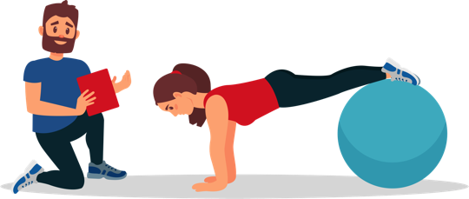


Determine What YOU Value

Slide 66



Life is about trade offs, so spend on what you value

Slide 67
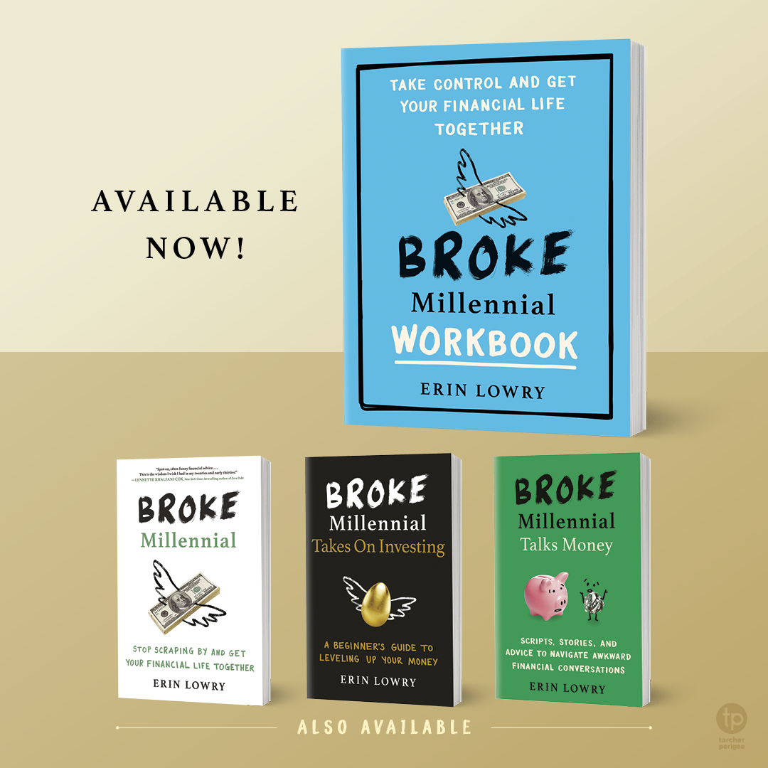
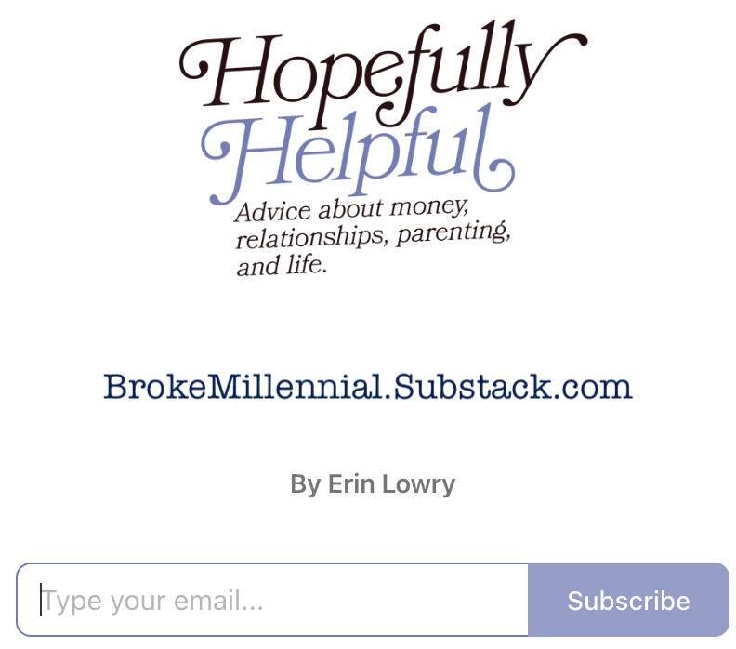
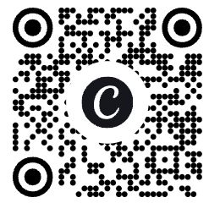
@BrokeMillennialBlog

