Slide 1

STRATEGIC FORESIGHT IN STRATEGIC PLANNING
Notes:
Convention Center
2nd floor - Room: 291 & 292 (room max 350)
Theater style set-up, no tables
Friday – 3:45-5pm (facilitators arrive at 3:15pm) – 343 registered
Saturday – 8:30-9:45am (facilitator arrive 8am) – 340 registered
Speaker lounge (snacks, prep) -

Slide 2

What is Strategic Foresight
In-Real-Life
  YMCA of the USA
  YMCA of Greater Brandywine
Notes:
Hughes and Ali
Welcome
Bios
Agenda

Slide 3

LOOK BACK
Think back ten years. What was happening in your life, at the Y, in your community, in the world?
Name one thing happening today that you would have said was unimaginable ten years ago.
Ask yourself, were there any signals that hinted today’s world was possible.
Turn to a neighbor and share.
The unimaginable future is being tested and shaped right now. Strategic foresight helps us notice signals early.
Notes:
Let's start with a simple reflection.
Think back 10 years. What was happening in your Y, your community, and the world around 2016?
Now think about something that feels perfectly normal today that would have seemed unrealistic, unlikely, or even unimaginable ten years ago. Take a minute and get something in mind. (Pause)
Now here's the important question. Looking back, were there signals? Were there small indicators, behaviors, technologies, needs, or changes already emerging that hinted this future was possible? (Pause)
Turn to a neighbor and share.
The unimaginable future is being tested and shaped right now in today’s world. Strategic foresight helps us notice those early signals

Slide 4
LOOK FORWARD
Think about today, and what you are seeing, hearing and sensing in your community that is emerging.
Imagine it’s 2036 and name one way your Y could be operating ten years from now that is hard to imagine today.
Turn to a neighbor and share.
If we only plan for the realities we see today, we risk being unprepared for the realities emerging tomorrow. Strategic foresight helps us identify and explore future possibilities before they become urgent.
Notes:
Now let's turn our attention to the future.
Think about what you're noticing today in your community. What are you hearing from members, families, volunteers, staff, community partners, or local leaders? What’s starting to feel different?
Now imagine it is 2036 and things you are sensing today have evolved. Name one way your Y could be operating 10 years from now that is hard to imagine today. (Pause)
Turn to a neighbor and share the early indicators you are seeing today that point towards your unimaginable future being possible.
If we only plan for the realities we see today, we risk being unprepared for the realities emerging tomorrow. Strategic foresight helps us identify and explore future possibilities before they become urgent.

Slide 5

Strategic foresight
Strategic foresight is…
Thinking about the future in a structured way.
Exploring multiple plausible futures
Used for…
Anticipating and preparing for future challenges
Capitalizing on emerging innovations
Expanding strategic options
Strengthens the strategic planning process by…
Asking: “What future are we planning for?”
Challenging assumptions and exploring possibilities
Allowing stakeholders to think big and dream
Notes:
Strategic foresight is simply the practice of thinking about the future in a structured way.
It's not prediction.
No one can predict the future.
Instead, it's about exploring multiple plausible futures so we can make better decisions today.
Organizations use foresight because planning based only on current realities can leave them unprepared for change. Strategic foresight helps us:
Anticipate and prepare for future challenges
Capitalize on emerging innovations
Expand strategic options
Strategic foresight helps us think about the future we are planning for. This strengthens the strategic planning process by helping us challenge assumptions, explore possibilities, and make decisions with a longer-term view. It also allows stakeholders to think big and dream.
However your Y develops your strategic plan - with a consultant, through your Alliance, maybe someone on staff – you can request strategic foresight be incorporated.

Slide 6
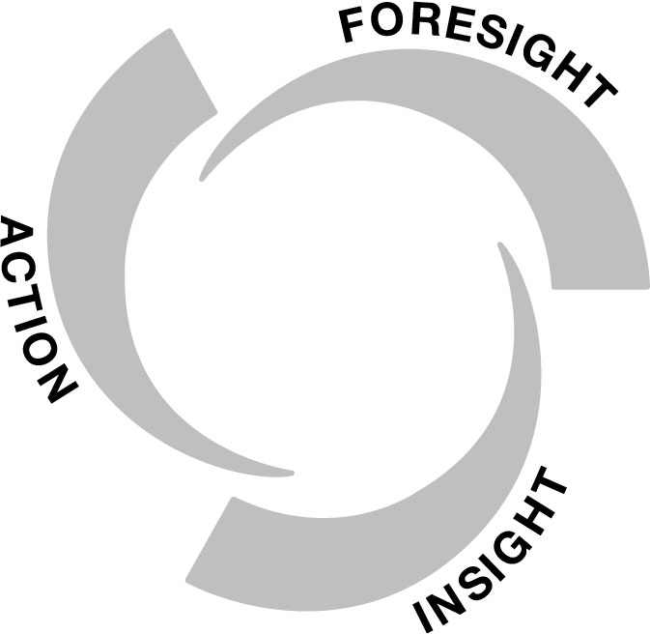
Strategic Foresight CYCLE
Foresight: turning drivers and signals of change into plausible, provocative views of the future
Use FORESIGHT to gain INSIGHT
Use INSIGHT to identify ACTION
Insight: a new way of thinking about something; new possibilities, patterns and connections that you can’t unsee
Action: identify logical actions for today to prepare for and shape the future
Adapted from IFTF Foresight Essentials, by Institute for the Future. 2021. CC BY-NC-ND 4.0.
Notes:
We use Institute for the Future’s Foresight, Insight, Action model as our framework or our thinking structure . The premise is that we use foresight to gain insights. We use our insights to identify practical and purposeful action we can take today.
We start with foresight by scanning for drivers and signals of change and ask what future they might be pointing toward. From there we generate insights. Those "aha moments.“ New ways of understanding our community, our role, or our opportunities. Then we move to action. What should we start, stop, continue, or explore today?
Foresight helps us spend time understanding what might be changing before we decide where to invest our time, energy, and resources. The goal is not simply to create a strategic plan for today. The goal is to create a plan that remains relevant as the future unfolds.
It all starts with foresight and identifying drivers and signals of change to inform plausible views of the future.

Slide 7
Drivers of change
Drivers of change are broad, long-term forces shaping the world today and will continue to drive change for decades to come.
  Artificial intelligence (AI)
  Aging population / decreasing birth rate
  Automation of work
  Deepfakes and misinformation
  Education system in flux
  Erosion of trust in institutions
  Loneliness and social isolation
  Political, social and cultural polarization
© 2024 Institute for the Future. All rights reserved. SR-2494 / iftf.org
Notes:
Drivers of change are big, long-term forces shaping the world today and will continue to drive change for decades to come. Drivers are visible – we can see and feel their impacts. We know they are changing things across all sectors of society. Drivers are also sometimes referred to as megatrends, macrotrends, and/or future forces.
Examples of drivers include:
AI
Aging population
Loneliness and social isolation
Drivers are continuous currents that must be factored when thinking about future strategy.

Slide 8


signals of change
Signals of change are localized changes happening today that make us think and feel something about the future might be very different from the present.
  Signals can be:
    Products, services, behaviors, technologies, policies, laws, social movements
  Signals can be found:
    Observations, conversations, news, social media, blogs
SPECIFIC
who, what, where, when
CURRENT
happening in the world today
COMPELLING
eye-opening & attention grabbing
Notes:
Signals of change are different than drivers. Signals are localized, tangible changes happening today that make us think and feel that something about the future might be very different from the present.
Signals are:
Specific – meaning they include concrete details like names, dates, locations and experiences;
Compelling – meaning they grab your attention and evoke interest
Current – meaning they are happening today. You know it’s a signal when you can tell a story about it – who, what, where, when, how, why
Signals are not the norm. They small experiments happening in the present that have the potential to change the stats quo.
Important to understanding, the signal itself is not the future. A signal simply suggests that a different future may be possible.

Slide 9
Signals Questions
What type of shift does the signal represent? What are we moving from and to?
What is driving or motivating the signal?
What would it look like if this signal became the norm?
What are the larger implications?
Notes:
When we find a signal, we don’t jump into action. Instead, we think about what the signal might represent in the future, what type of shift is could mean for how we live, work, and connect. Signals are not the norm, they are experiments that may turn into something or nothing, which is why we think about signals and their implications.
Questions such as
What type of shift might this signal represent? What are we moving from, and what are we moving to?
What is driving or motivating the signal? Why is it happening?
What would it look like if this signal became the norm? Who would be impacted and how?
What are the larger implications? What happens as a result of this change? What might happen if we ignore it?
The goal is not to predict the future.
The goal is to stretch our thinking.
Just as many things that seemed unimaginable in 2016 are normal today, some of the things that feel unlikely today may become common in the future.
Strategic foresight helps us think about those possibilities before they arrive.

Slide 10
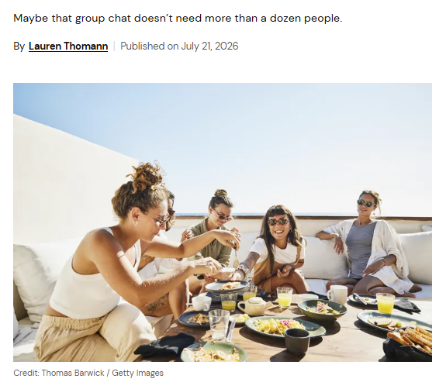
Signal of change
WHAT: Recent community-building research suggest people are increasingly seeking belonging through smaller, purpose-driven groups organized around shared interests, identities, life stages, and causes. These groups often create stronger trust, deeper relationships, and a greater sense of being known than larger organizations or networks.
SHIFT:
From belonging through large organizations and institutions, to belonging through small, relationship-centered communities.
Strategic Question: If people increasingly seek belonging through smaller communities, how might your Y need to evolve to remain a relevant and meaningful place for connection?
The Rise of Micro-Communities – and Why Your Friend Group Needs One
Notes:
This signal suggests that many people are increasingly seeking belonging through smaller, purpose-driven communities. Not necessarily large institutions or large memberships.
The shift it might represent is: From belonging through large organizations and institutions, to belonging through small, relationship-centered communities.
The strategic question we might ask ourselves when thinking about this signal is:
If people increasingly seek belonging through smaller communities, how might your Y need to evolve to remain a relevant and meaningful place for connection?
https://metricool.com/micro-communities/
https://www.realsimple.com/the-rise-of-micro-communities-12022247
https://www.influencers-time.com/micro-communities-thrive-in-2026-why-smaller-is-better/

Slide 11
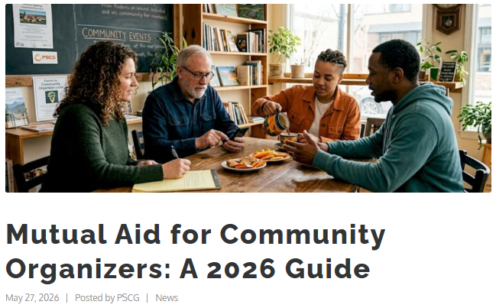
Signal of change
WHAT: Community-led efforts such as Chicago microgrant initiatives and Denver's Mutual Aid Monday demonstrate residents organizing resources, support, supplies, and services directly with one another rather than waiting for government agencies or nonprofits to respond. What began as informal grassroots efforts have evolved into ongoing community support systems.
SHIFT:
From organizations as primary problem-solvers, to communities as primary problem-solvers.
Strategic Question: If communities become more active in identifying and solving local challenges, how might the Y expand its role to support community-led action and problem solving?
Notes:
This signal highlights communities organizing solutions for themselves. Residents identifying needs, mobilizing resources, and coordinating support with one another.
One possible shift this signals represents is a shift from organizations being the problem-solvers, to community member taking on that role.
One strategic question we might consider with this signal is - If communities become more active in identifying and solving local challenges, how might the Y expand its role to support community-led action and problem solving?
https://thepscgroup.net/mutual-aid-for-community-organizers-a-2026-guide/#real-world-mutual-aid-in-action
https://nff.org/insights/the-business-case-for-community-ownership/

Slide 12
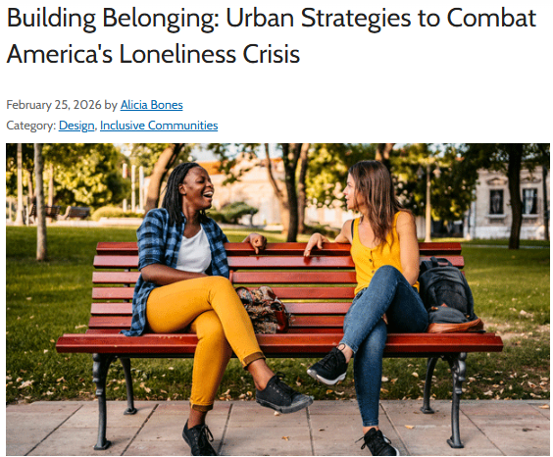
Signals of change
WHAT: Cities, public health leaders, and planners are increasingly treating social connection, belonging, and loneliness as community issues that can be intentionally shaped through public spaces, gathering places, walkability, neighborhood design, and opportunities for connection.
SHIFT:
From community design focused on movement and efficiency, to community design focused on connection and belonging.
Strategic Question: If social connection becomes a core measure of community health, how might the YMCA's priorities, partnerships, and investments evolve to strengthen connected communities?
Notes:
This signal recognizes that loneliness and connection are increasingly being viewed as community issues, not just individual issues. Cities, planners, and public health leaders are beginning to ask: How do we design environments that help people connect?
That is a different way of thinking about community health. It could represent a shift from community design focused on movement and efficiency, to community design focused on connection and belonging.
The strategic question for us becomes:
If social connection becomes a core measure of community health, how might the YMCA's priorities, partnerships, and investments evolve to strengthen connected communities?
https://mrsc.org/stay-informed/mrsc-insight/february-2026/building-belonging

Slide 13
Signals discussion
In small groups, discuss:
Imagine it is 2035 and all three signals have become the norm in your community.
  What common future do these signals point toward?
  If these signals continue over the next 5-10 years, what might people need from the YMCA that they do not need from us today?
  Which current assumptions about community engagement, volunteerism, membership, programs, or partnerships might need to change?
  What strategic opportunities or priorities should YMCA leaders begin exploring now to prepare for these possible future?
Notes:
Now let's put these signals together. Imagine that it is 2035 and some version of all three signals have become the norm. Form small groups with people near you and discuss the questions on the screen.
What we're interested in is what they might collectively suggest about the future of communities. There is no right or wrong answer. Challenge yourself to think about the unimaginable using these signals as a clues.
Most importantly, think about what these signals might point towards for the future of your Y.
(Pause for discussion)
Debrief
Transition:
Strategic foresight complements strategic planning as a tool that helps us develop strategies that are more resilient, more relevant, and better prepared for the future. To hear some in-real-examples of this, we will turn it over to Heather Hughes and Heather Worthy-Wilson.

Slide 14
YMCA OF THE USA
Heather Hughes
SVP, Strategic Alignment

Slide 15
PATHWAY TO A BOLD, SHARED VISION
Pathway to a bold, shared vision
2022
2023
2024
2025 >
Two years of discussion and research result in a timely strategic planning objective: create a bold, shared vision for the Y Movement in the U.S.
During General Assembly, staff and volunteers consider critical societal issues for the Y’s future:
Changing education models;
Mental health issues for staff and members;
Changing communities
2023 research and planning identify mental health, changing communities, and Y operational support as pillars of opportunity
CEO Suzanne McCormick announces that Creating Connected Communities will be the driver of the next strategic plan
Strengthening and socializing of CCC Theory of Change underway
CCC core workstreams established and launched
The National Board's Strategy Committee, along with the local Y Strategic Plan Advisory Committee, worked with Y-USA to develop the bold shared vision objective and contributed to the design and research for our upcoming strategic plan driver

Slide 16
How it worked
IFTF FORESIGHT RESEARCH
Long‑range drivers of change
(trust, loneliness, polarization, fragmentation)
SIGNALS OF CHANGE
Concrete early indicators of emerging shifts
(social, technological, cultural)
Y‑USA SIGNALS PRACTICE
National Signals Club
Staff scanning, sharing & sensemaking
DESIGN & SENSEMAKING SESSIONS
Enterprise convenings using the IFTF foresight cycle
(drivers → signals → implications → preferred futures)
STRATEGIC FRAMING
Clarifying the YMCA’s role as a trusted, place‑based connector
CREATING CONNECTED COMMUNITIES
Enterprise strategy grounded in foresight
and continuously informed by signals
Notes:
Can fit into any planning process.

Slide 17
IN-REAL-LIFE:
YMCA of Greater Brandywine
Heather Worthy-Wilson
Chief Strategy & Growth Officer

Slide 18
Planning Beyond Today
YGBW used Strategic Foresight to identify emerging trends, anticipate future community needs, and create a strategic plan that positioned the organization to remain relevant, resilient, and impactful in a rapidly changing world.
It ensured our strategic plan was relevant not only for current needs but also for the evolving needs of our communities.
Proactively addressed emerging social, economic, health and technological changes.
We started at the Senior Leadership Team retreat and revisited signals and drivers during small group activities, operations team meetings, branch advisory board and Association board retreats.
Those conversations and activities shaped the questions we asked community stakeholders and created buy-in as we were all working from the same foundation.

Slide 19
Looking ahead & What we Explored
Drivers and Signals of Change shaping the future of our communities:
    Growing loneliness and social isolation
    Increasing mental and behavioral health needs
    Changing family and caregiving dynamics
    Workforce shortages and shifting employment patterns
    Rising chronic disease and health inequities
    Rapid technological advancement and digital expectations
    Greater demand for belonging, connection and community trust
    The need for affordable, accessible youth development opportunities
Key Question:
What will our communities need from YGBW five to ten years from now?

Slide 20
strategic foresight changed our planning
We moved from Reactive to Proactive:
Traditional Planning focused on current challenges, relied heavily on historical performance and assumed that the future would look similar to today.
Strategic Foresight scanned for emerging trends and future opportunities, challenged our assumptions, explored multiple future scenarios, identified risks and opportunities before they became urgent and helped us build organizational resiliency and adaptability.
Mindset Shift:
From “What should we do next?” to “What future should we be preparing for?”

Slide 21
Strategic foresight shaped our four priorities
Expand Reach & Belonging for All
    Creating inclusive spaces where everyone feels connected and supported.
Develop the Next Generation
    Preparing youth with the skills, resilience, and opportunities needed to thrive.
Partner in Community Health
    Addressing physical, mental, and social well-being through partnerships and innovation.
Drive Sustainability Through Mission-Aligned Growth
    Building organizational capacity, agility, and long-term sustainability.

Slide 22
A strategic plan built for the future
The Outcome:
Anticipated future community needs.
Strengthened our ability to adapt and innovate.
Aligned mission with emerging opportunities.
Positioned YGBW for long-term impact and sustainability.
Key Takeaway:
YGBW used Strategic Foresight to move beyond planning for what is known and instead prepare for what is possible; ensuring we remain a trusted, relevant, and impactful community partner for years to come.

Slide 23
QUESTIONS

Slide 24
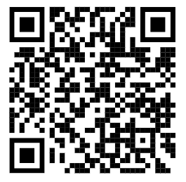
Learn More:
Strategic Foresight Learning Cohort
  National Signals Club
Service Delivery System
Connect with us
Heather Worthy-Wilson – hwilson@ymcagbw.org
Mark Demchak – mdemchak@mcymca.org
Alison Huppert – alison.huppert@ymca.net
Heather Hughes – heather.hughes@ymca.net
Notes:
Learn more about strategic foresight in upcoming cohort in November – all staff levels – SF is a
If you want help with your strategic plan you can utilize the service delivery system
We here to answer questions.

Slide 25
THANK YOU

Slide 26
SIX LEVERS OF CONNECTION​
ELEVATE CONNECTION​
Use shared language and stories to strengthen
purpose and connection.​
PRACTICE CONNECTION SKILLS​
Develop the skills and reinforce the culture that make meaningful connection possible.​
EMBED CONNECTION EVERYWHERE​
Design and deliver experiences that create connection.​
CREATE CONNECTED SPACES​
Build physical and digital environments that spark interaction and create access and belonging for all. ​
INVITE CONTRIBUTION ​
Provide opportunities for people to share their time, talents, and voices to create change.​
SUPPORT WELL-BEING​
Foster experiences that elevate health and well-being and help all people thrive. ​

Slide 27
INVITE
CONTRIBUTION
Provide opportunities for
people to share their time,
talents, and voices to
create change.​

