Slide 1

STRONG BOARDS STRONG YS
Ruben Dario Taborda
David Martorano

Slide 2

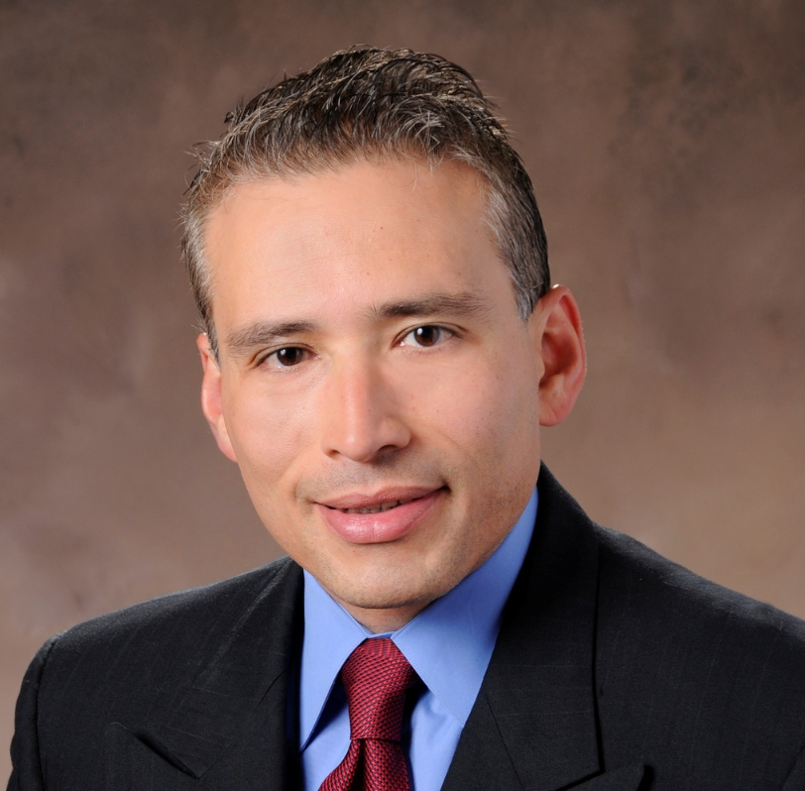
Ruben Dario Taborda
National Board Chair
YMCA of the USA

Slide 3




Y-usa’s fundamental roles
Lead the Movement
Deliver Resources, Services and Facilitate Innovation
Advance National Positioning and Global Perspective
Oversee National Governance and Membership Qualifications
3
Notes:
The basic objective of YMCA of the USA (Y-USA), as determined by Y associations and stated in the National Council Constitution, is to “serve as a means through which associations can achieve their purposes and goals as a national movement, and to make available services which will enrich and strengthen associations in carrying on their work.”
Y-USA achieves this objective today by fulfilling four fundamental roles:
Lead the Movement: focus the efforts of YMCAs on key social issues and opportunities
Deliver Resources and Services and Facilitate Innovation: ensure YMCAs have access to the knowledge and resources needed to address pressing needs in their communities
Advance National Positioning and Global Perspective: communicate the Y’s value and maximize the Movement’s potential for good at home and abroad
Oversee National Governance and Membership Qualifications: knit the Movement together around shared values, goals, and requirements for YMCAs

Slide 4
Recent accomplishments
Deliver Resources, Services and Facilitate Innovation
Advance National Positioning and Global Perspective
Oversee National Governance and Membership Qualifications
Lead the Movement
10-Year Vision: Creating Connected Communities (CCC)
3-Year Strategic Plan to Support CCC
Improved Two-Way Communication w/ Y Leaders
General Assembly
Technology Roadmap
Organizational Excellence Assessment (OEA) and Practice Area Continuums
Praesidium Child Protection Accreditation (200+ Ys earned so far)
Learning & Leadership Development System
Practice Leadership
No Place Like This Place Campaign
Increased Fundraising
New High-Profile Partnerships
175th Celebration
Advocacy and Brand Positioning
Year-Round National Governance Strategy
Membership Qualification Policy Process Enhanced
Y Member Association Votes and Policy Comment Periods
Youth Advisory Council
4

Slide 5

Current Three-Year Strategic Plan
Continuous Improvement
Growth
Community Connections
Strong Ys
Ys work towards achieving organizational excellence and provide safe, high-quality experiences
Equip Ys with tools and strategies proven to facilitate community-driven, positive change
Creating Connected Communities
Strong Y-USA
Brand Advancement
Y-USA delivers timely, relevant, high-quality services and support to all Ys in achieving organizational excellence
Amplify public perception of the Y as the place to connect
Notes:
Ruben

Slide 6

HOW WE ARE ASSESSING EXCELLENCE
Excellence Tools
Organizational Excellence Assessment (OEA)
Practice Area
Continuums
A standardized Y-USA assessment for Y CEOs to understand overall organizational performance across financial and operational metrics and identify where to focus next.
*A version of the OEA tailored to independent overnight camps is also in development.
A directional guide for local Y leadership and staff to understand progressive levels of performance within a specific practice area and identify areas for growth.
Membership & Program
Months of Liquidity
Staff
Operating Margin
RISK MANAGEMENT
EXPERIENCE
Risk Mitigation
OEA
Debt Ratio
Practice Area Continuum
Governance
Charitable Revenue
STRATEGY
ADMINISTRATION
Experience
Operating Revenue Mix
Excellence assessments will be spotlighted at GA followed by the launch of the OEA on October 1.
6
© 2026 YMCA of the USA
*Practice area continuums are in development and will be rolled out in a phased approach.
4

Slide 7
SIX LEVERS OF CONNECTION​
ELEVATE CONNECTION​
Use shared language and stories to strengthen
purpose and connection.​
PRACTICE CONNECTION SKILLS​
Develop the skills and reinforce the culture that make meaningful connection possible.​
EMBED CONNECTION EVERYWHERE​
Design and deliver experiences that create connection.​
CREATE CONNECTED SPACES​
Build physical and digital environments that spark interaction and create access and belonging for all. ​
INVITE CONTRIBUTION ​
Provide opportunities for people to share their time, talents, and voices to create change.​
SUPPORT WELL-BEING​
Foster experiences that elevate health and well-being and help all people thrive. ​

Slide 8






Organizational Excellence Continuum
The OEA includes 10 metrics to provide a clear snapshot of organizational health
Measuring Organizational Excellence
OPERATIONAL METRICS
FINANCIAL METRICS
Membership & Program
Months of Liquidity
The OEA has 10 key components including
5 operational and 5 financial metrics
Staff
Operating Margin
Risk Mitigation
OEA
Debt Ratio
Governance
Charitable Revenue
Consistent measurement provides clear pathways to excellence for every Y at every stage
Experience
Operating Revenue Mix
7
Notes:
Based on overall performance across the 13 metrics, each association scores along the Organizational Excellence Continuum, ranging from:
Foundational – basics of excellence
Attainable – establishment of core practices
Advancing – consistent performance with core practices
Aspirational – exceptional performance and leading
The continuum reinforces that excellence is a journey, not a single outcome.
It provides Ys with a clear path towards excellence, highlighting the opportunities and associated resources to support this journey for every Y.

Slide 9



YMCA LEADING PRACTICES
Leading Practice
Rigor
Operational & Program Excellence
YMCA and industry best practices that embed continuous improvement and innovation
YMCA and industry best practices that embed continuous improvement and innovation
The process of getting something done with discipline, thoroughness, and accountability
Strong communities and healthy, sustainable Ys
Strong communities and healthy, sustainable Ys

Slide 10
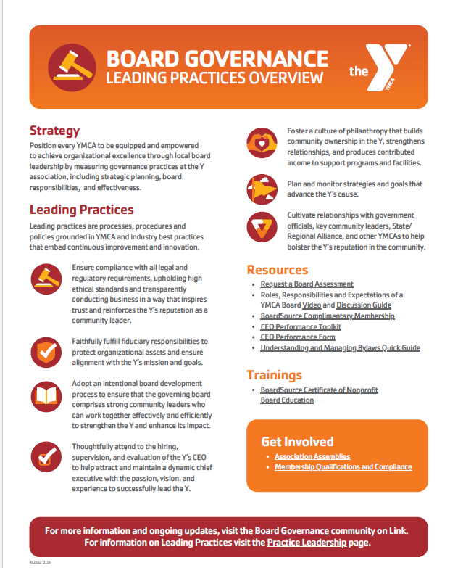
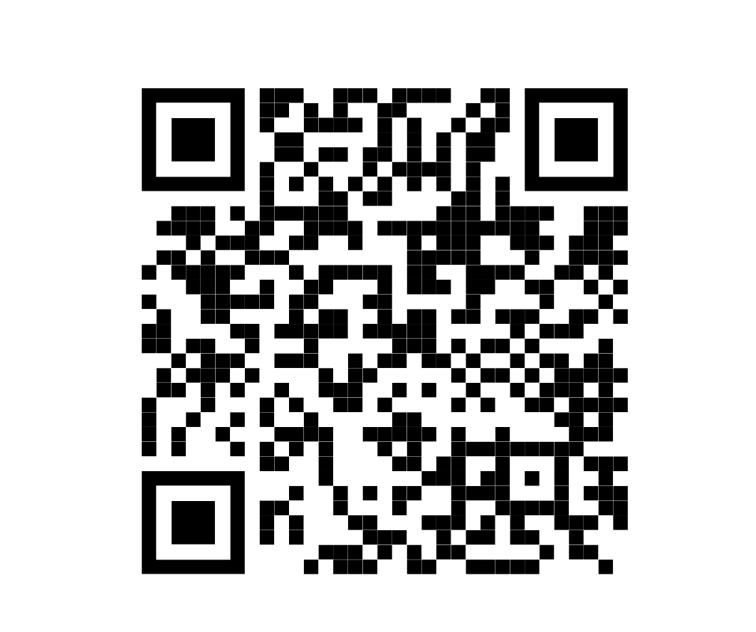
Board governance leading practices

Slide 11
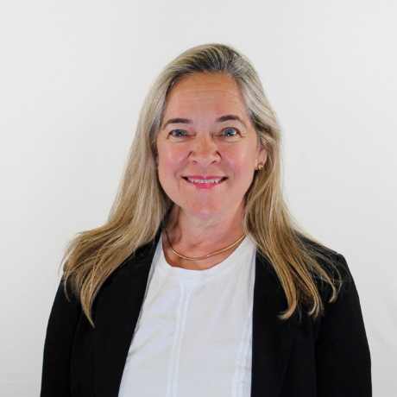
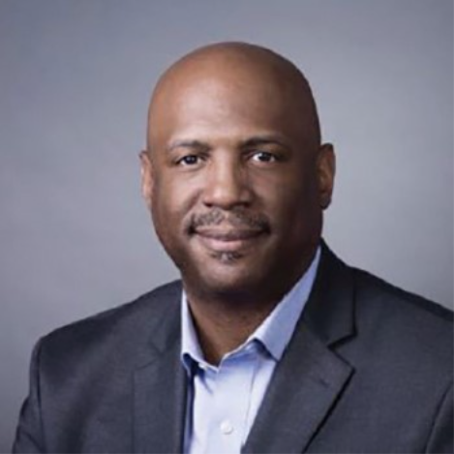
CEO and CVO Panelists
Gail von Staden
Board Chair
YMCA of Metropolitan Detroitt
Parrish Underwood
President and CEO
YMCA of Metropolitan Detroit

Slide 12
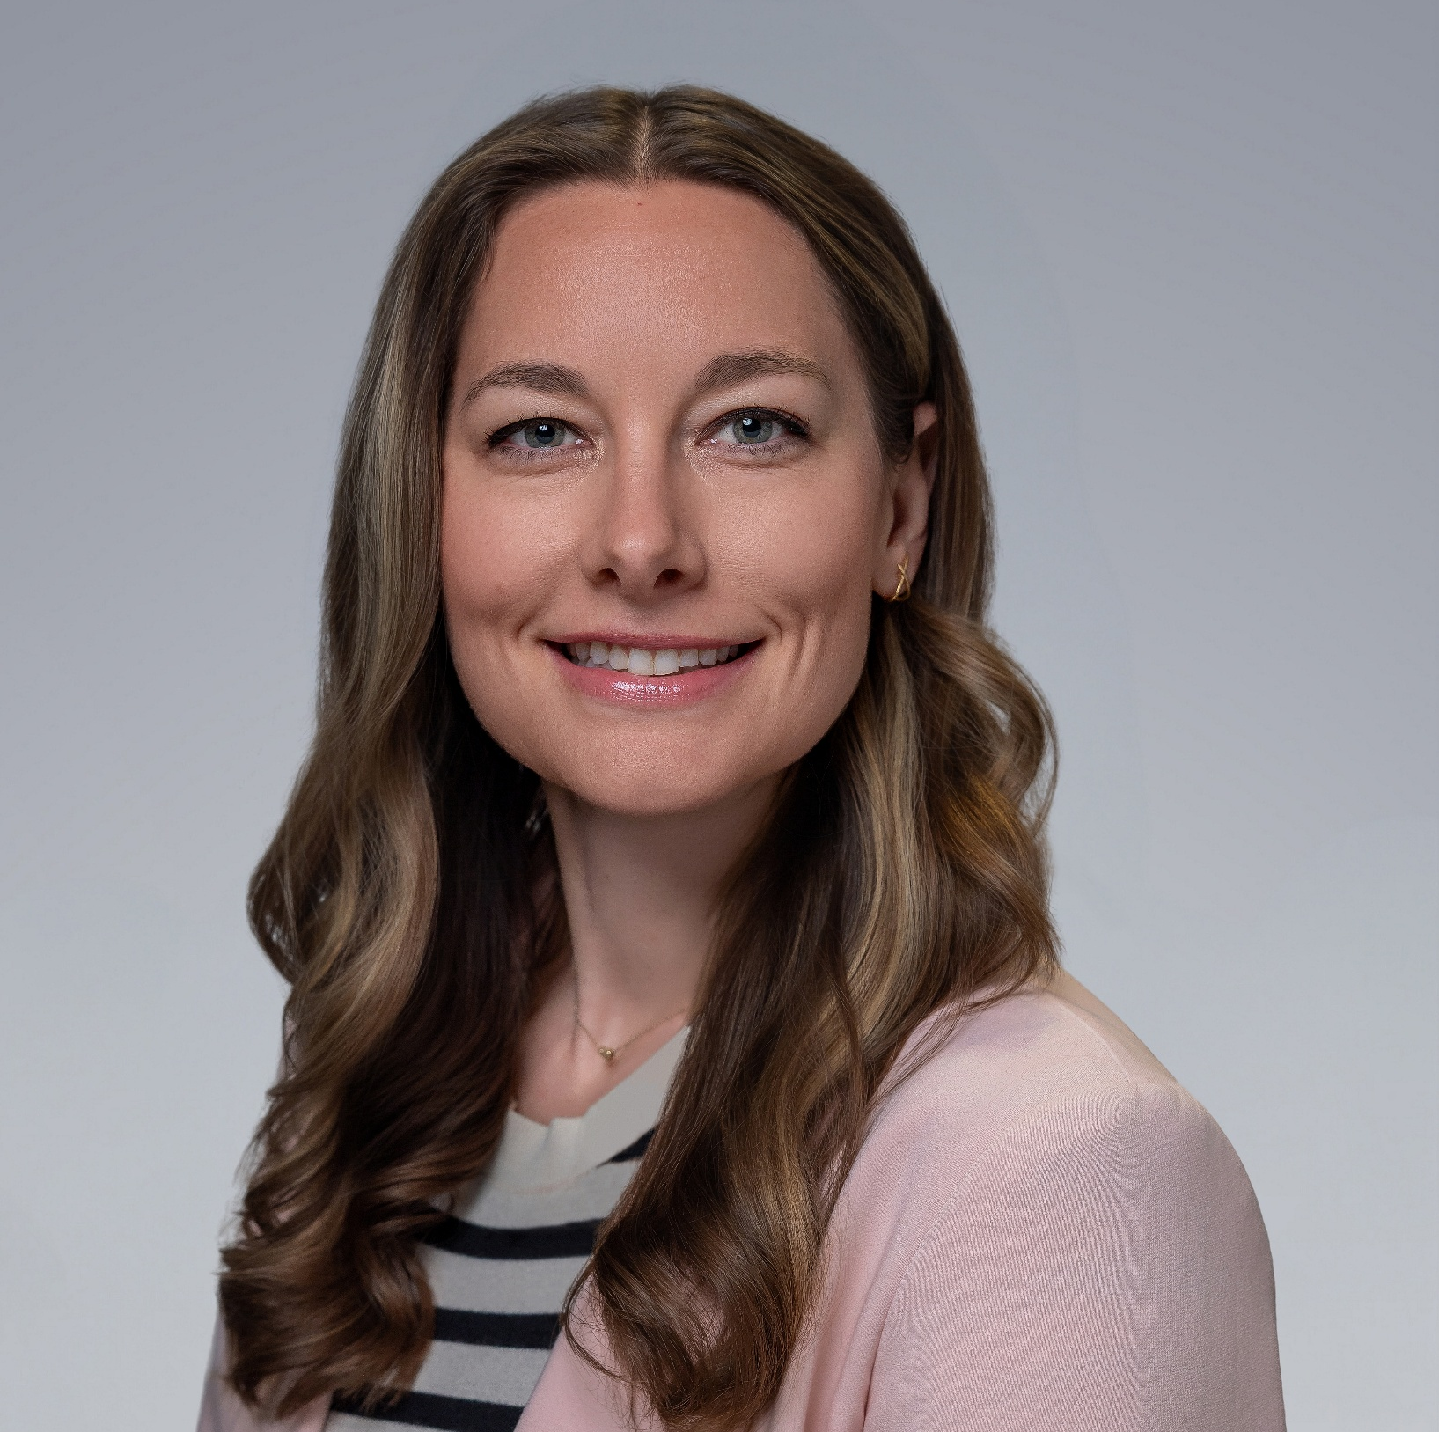
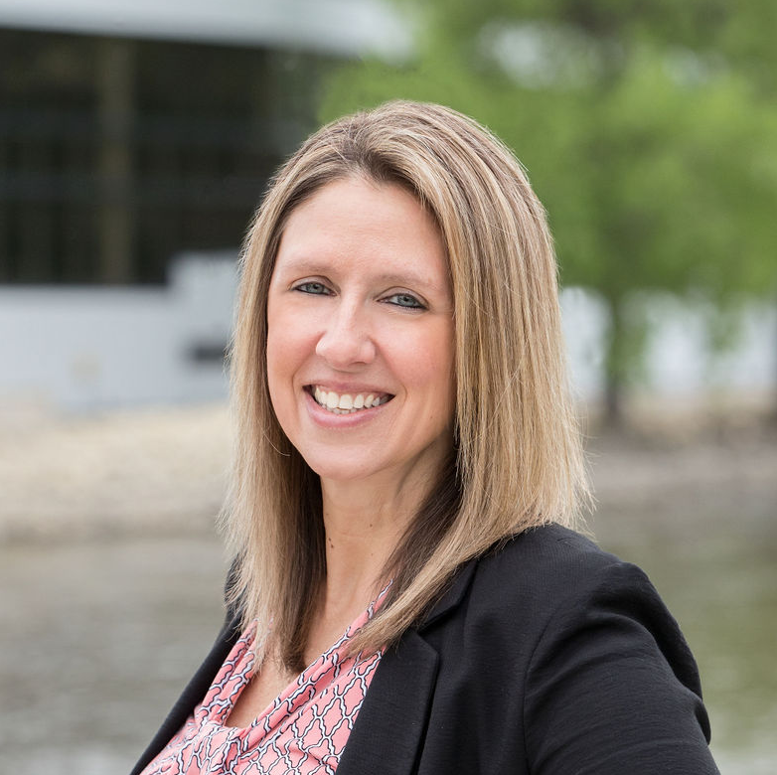
CEO and CVO Panelists
Jessica Hernandez
Board Chair
Stateline Family YMCA
Ann Hankins
Chief Executive Officer
Stateline Family YMCA

Slide 13
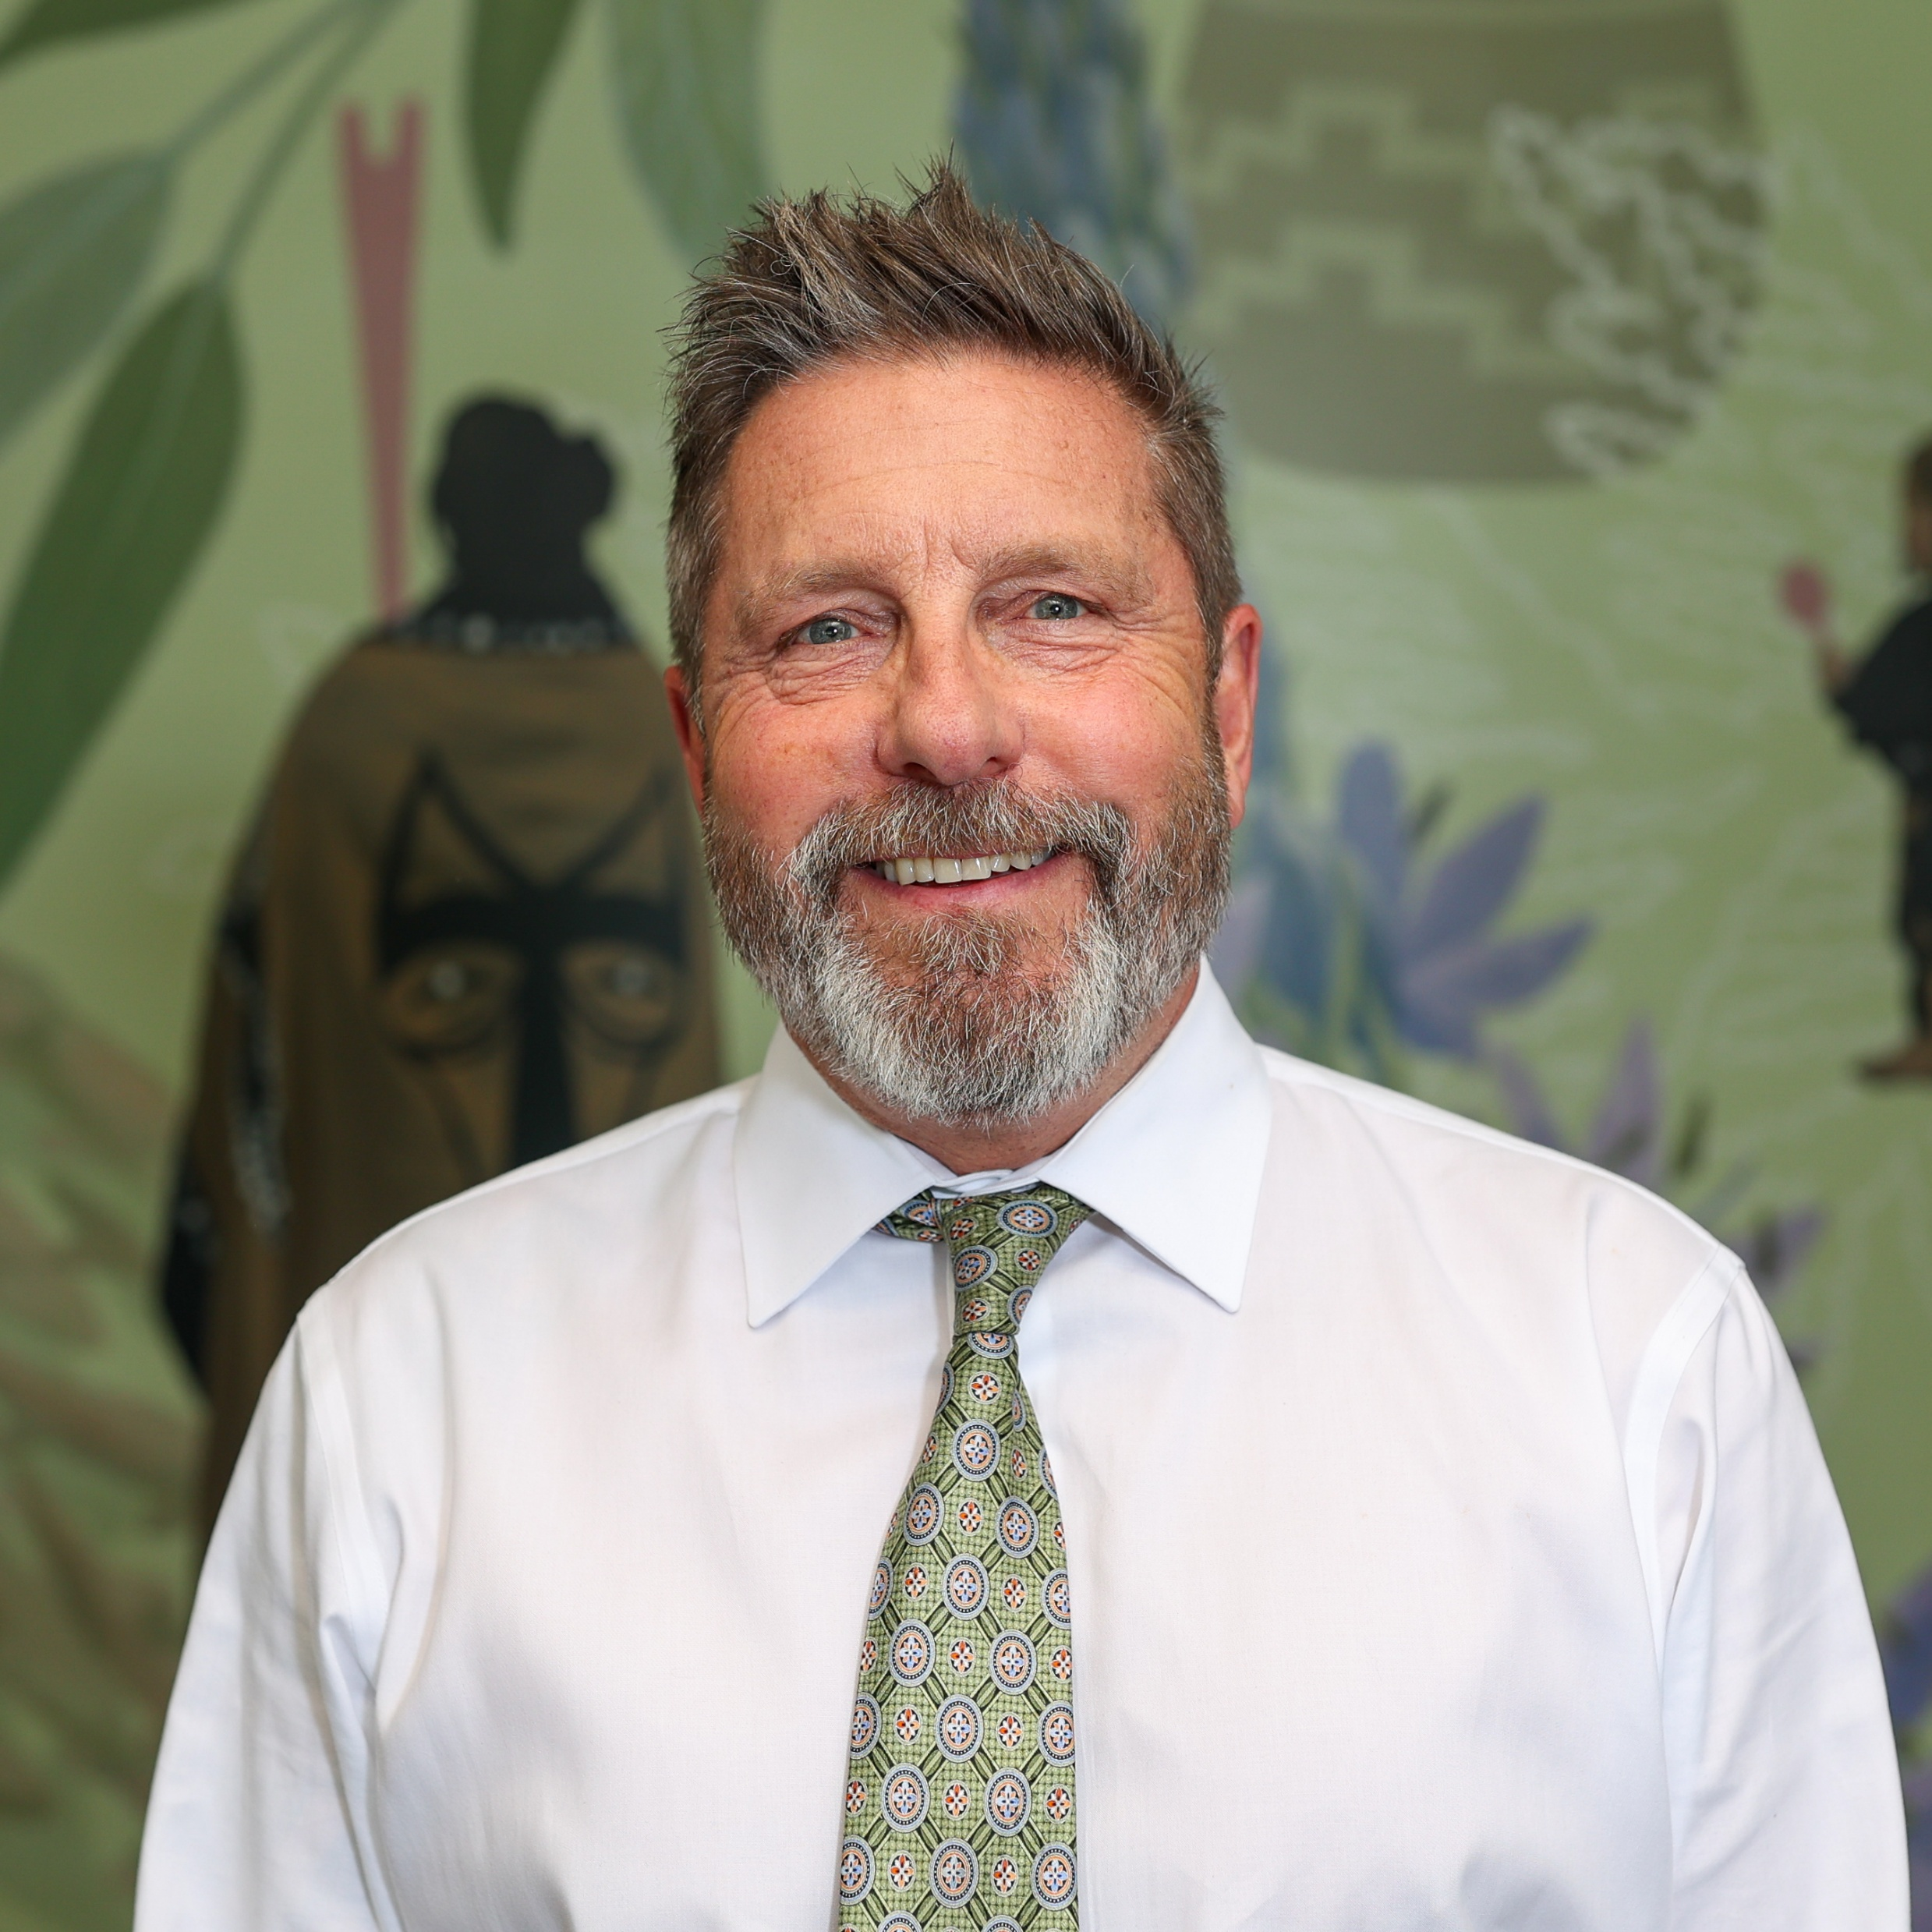
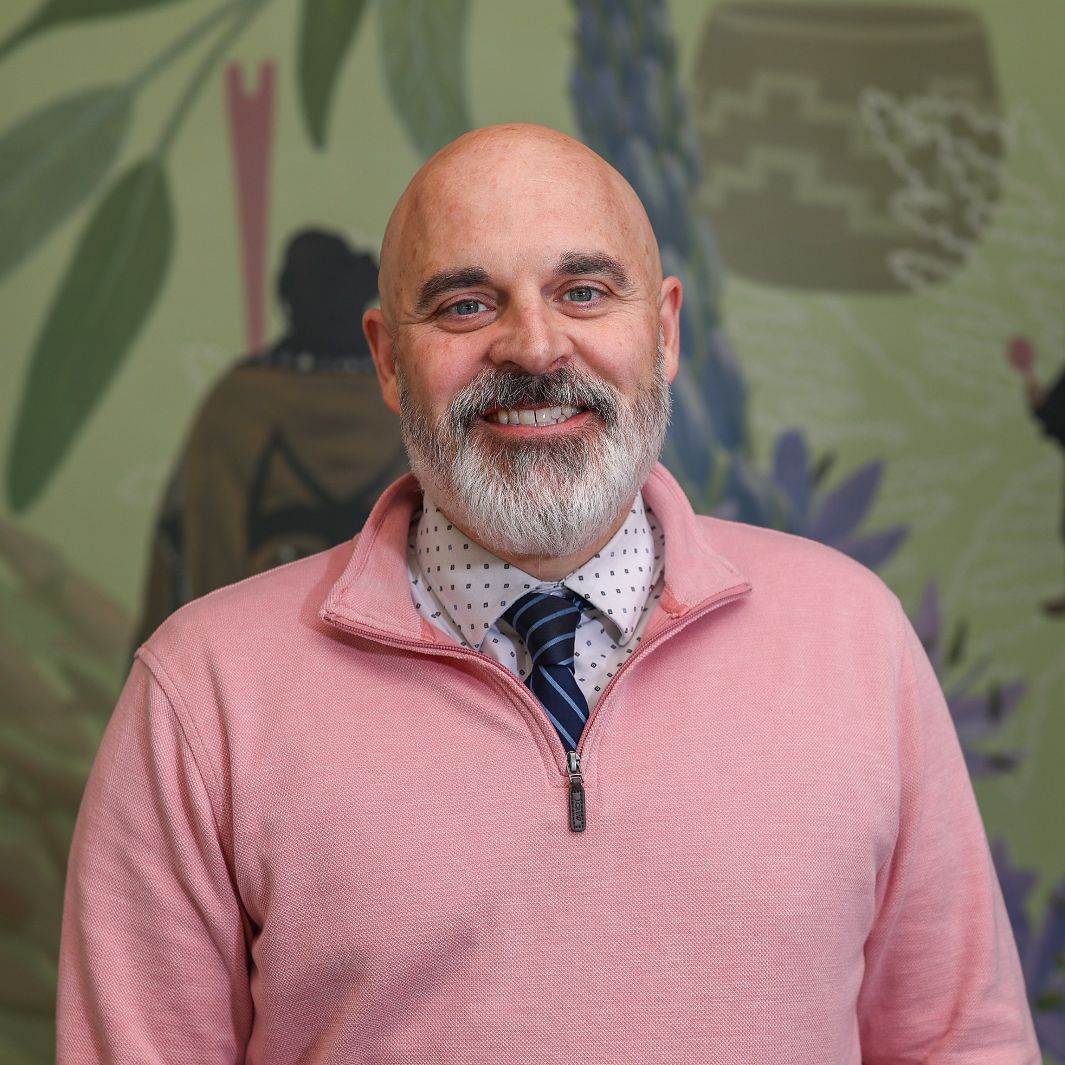
CEO and CVO Panelists
Matthew Longtin
Board Chair
Eugene Family YMCA
Brian Steffan
Chief Executive Officer
Eugene Family YMCA

Slide 14
Ceo and chief volunteer officer panel
And
Audience questions

Slide 15
THANK YOU
Ruben Dario Taborda David Martorano
National Board Chair SVP, CEO and CVO Engagement YMCA OF THE USA and Support
YMCA OF THE USA
(859) 227-9972
david.martorano@ymca.net

Slide 16
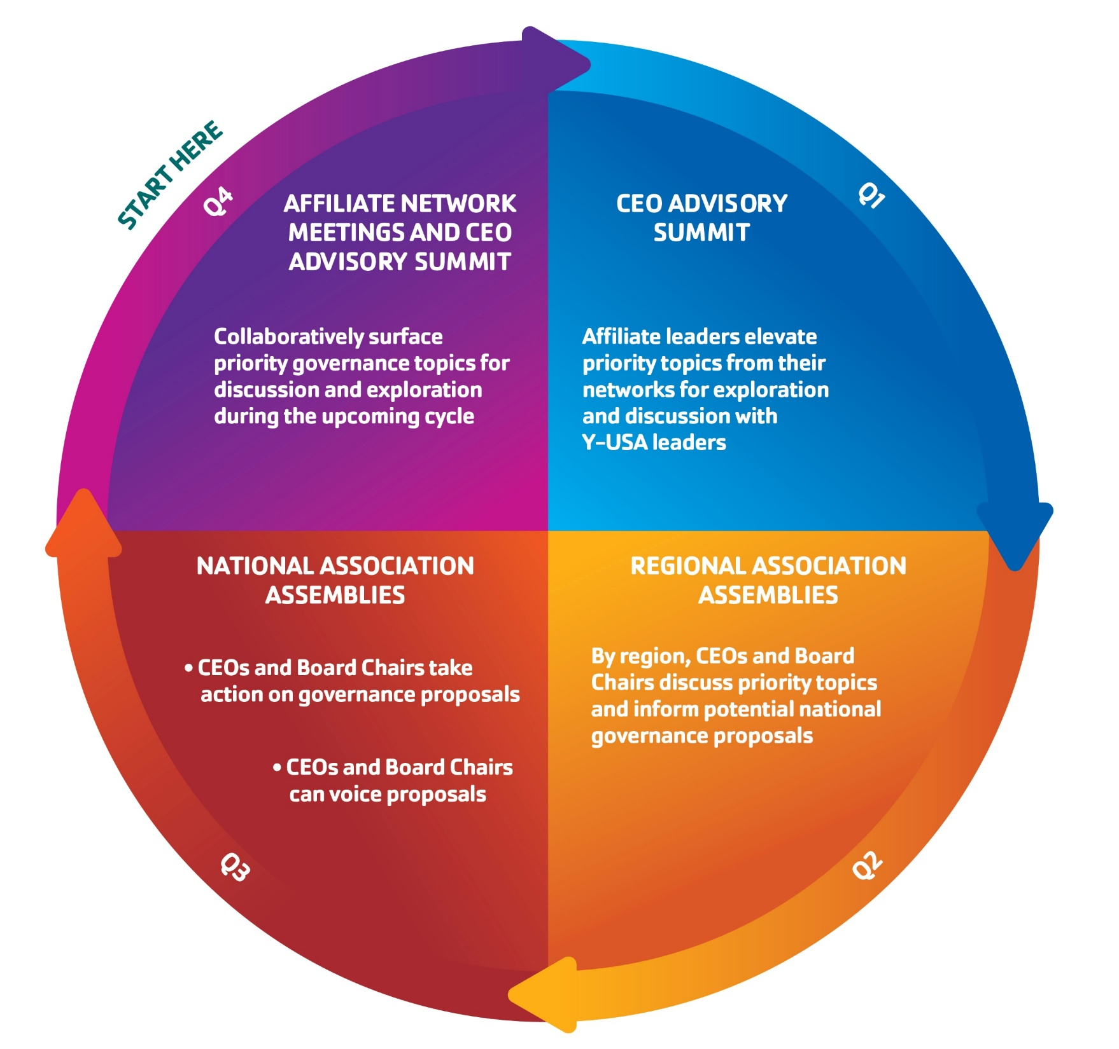
YMCA of the USA
Year-Round Governance Engagement Cycle
Notes:
Ruben – Need Talking Points

Slide 17
STRONG BOARDS STRONG YS
Ruben Dario Taborda
David Martorano

