Slide 1

SUPPORTING BRAIN HEALTH IN OUR COMMUNITIES
Jeanine Menczywor Donnelly, Alzheimer’s Association
Mamta Gakhar, Y-USA
Martha Petteys, Alliance of New York State YMCAs

Slide 2

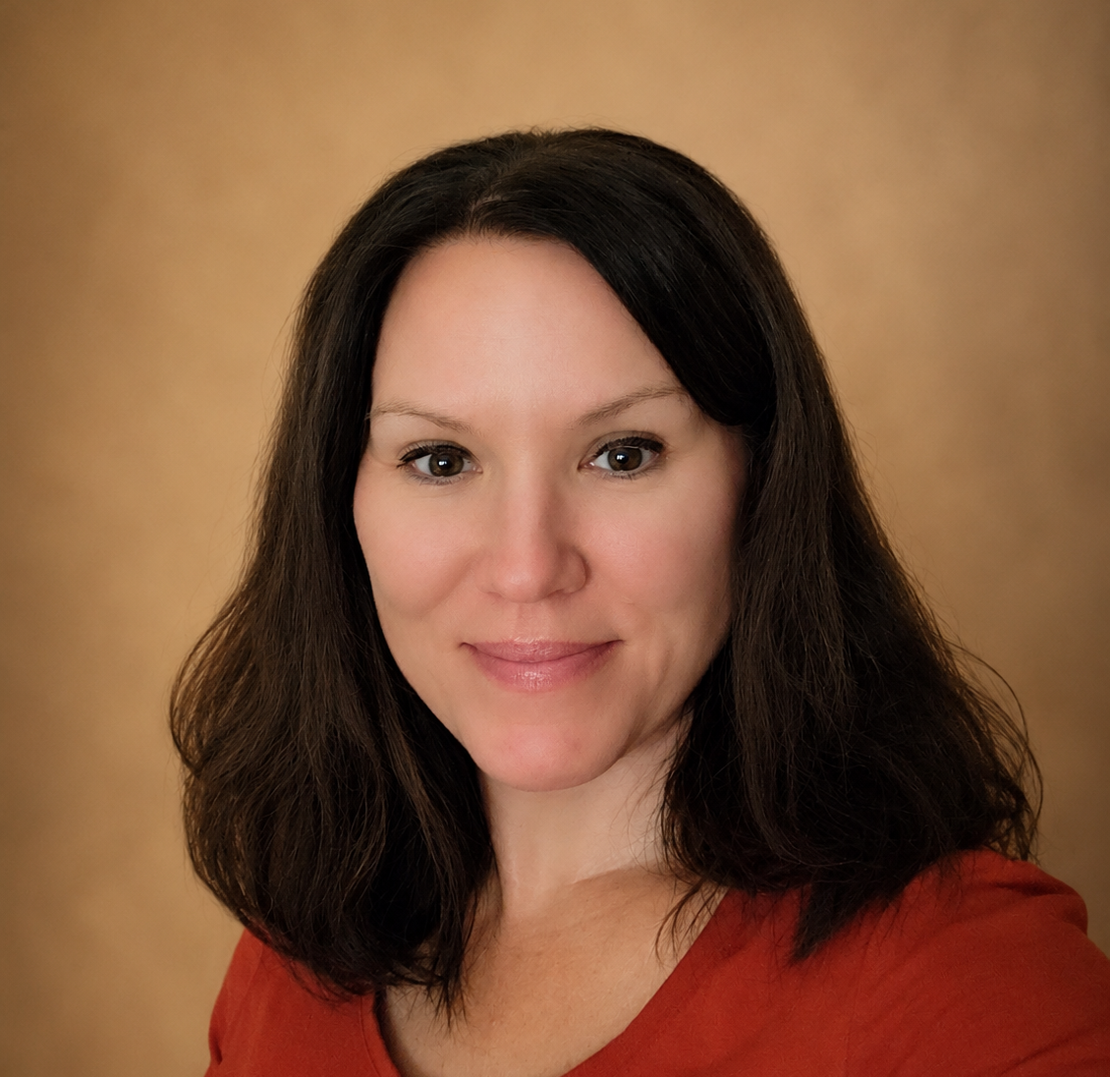
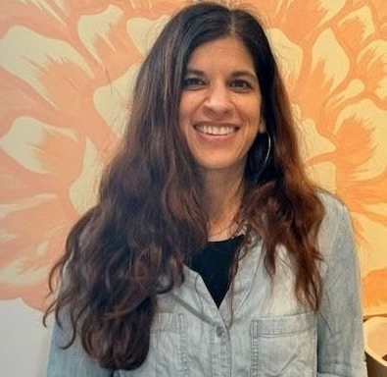
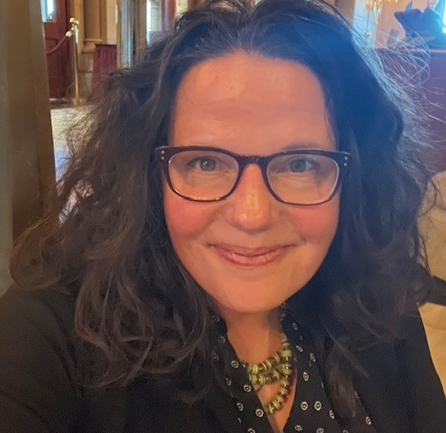
WELCOME
Jeanine Menczywor Donnelly
Director, Brain Health Programs
Alzheimer’s Association
Mamta Gakhar
Senior Director, Emerging Opportunities
Y-USA
Martha Petteys
Director of Grant Management and Health Strategies
Alliance of New York State YMCAs

Slide 3
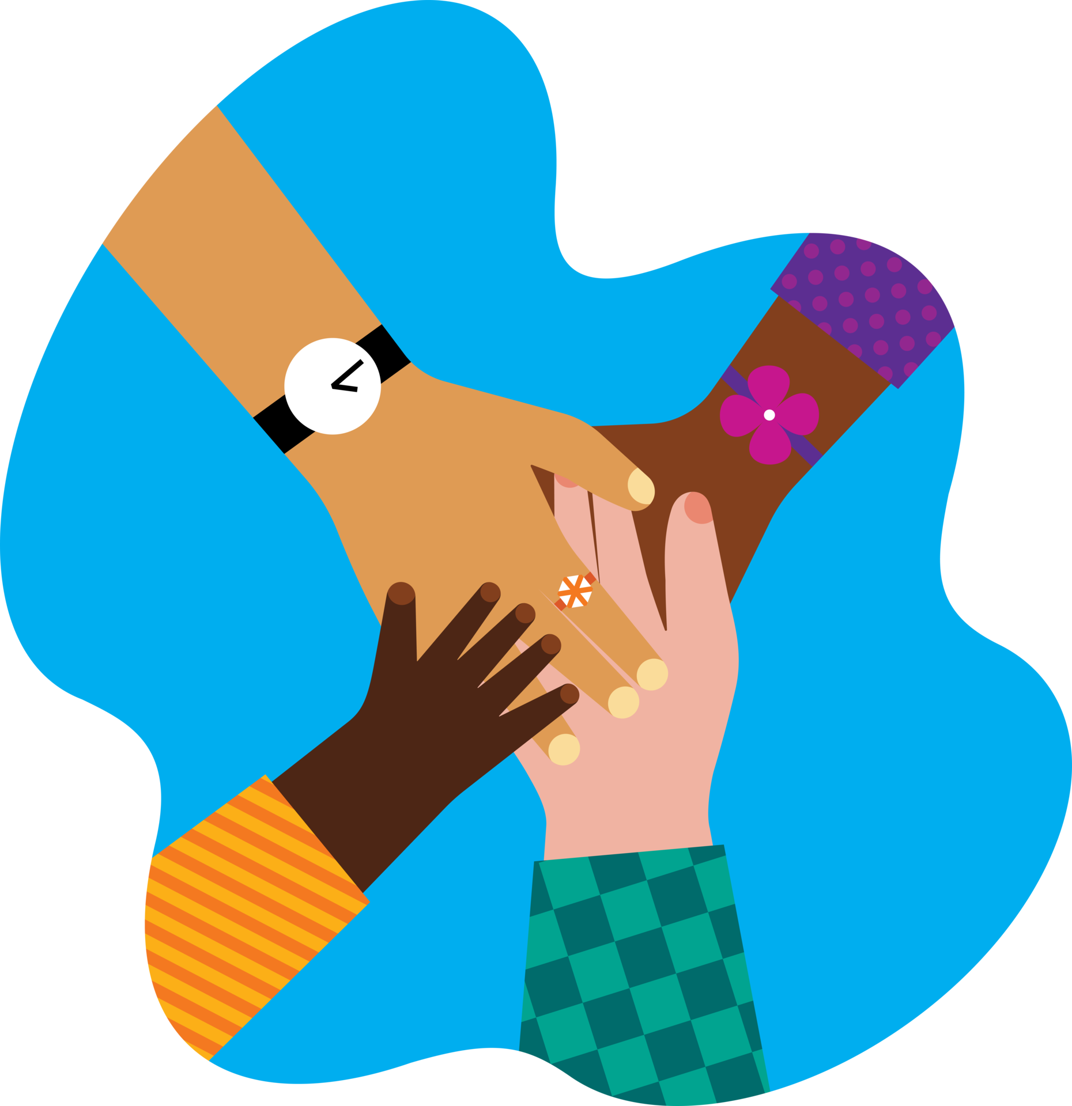
Let’s Connect
Turn to the person seated next to you and share:
  Name
  YMCA
  Why brain health matters to you and your community

Slide 4
Today’s Learning Zone
Understand the urgency for brain health promotion
Learn how New York State is taking action to educate community on brain health
Get acquainted with resources from the Alzheimer’s Association

Slide 5
SIX LEVERS OF CONNECTION​
ELEVATE CONNECTION​
Use shared language and stories to strengthen
purpose and connection.​
PRACTICE CONNECTION SKILLS​
Develop the skills and reinforce the culture that make meaningful connection possible.​
EMBED CONNECTION EVERYWHERE​
Design and deliver experiences that create connection.​
CREATE CONNECTED SPACES​
Build physical and digital environments that spark interaction and create access and belonging for all. ​
INVITE CONTRIBUTION ​
Provide opportunities for people to share their time, talents, and voices to create change.​
SUPPORT WELL-BEING​
Foster experiences that elevate health and well-being and help all people thrive. ​

Slide 6
ELEVATE
CONNECTION​
Use shared language and
stories to strengthen
purpose and connection.​

Slide 7
SUPPORT
WELL-BEING​
Foster experiences that
elevate health and
well-being and help
all people thrive. ​

Slide 8

BRAIN HEALTH: Understanding the WHY

Slide 9


About the Alzheimer's Association
The Alzheimer’s Association leads the way to end Alzheimer’s and all other dementia — by accelerating global research, driving risk reduction and early detection, and maximizing quality care and support.
Our vision is a world without Alzheimer’s and all other dementia®.
Notes:
Sheri
If you’re not already connected with your local ALZ chapter but would like to, please take a moment to scan this QR code and we will help facilitate an introduction.

Slide 10

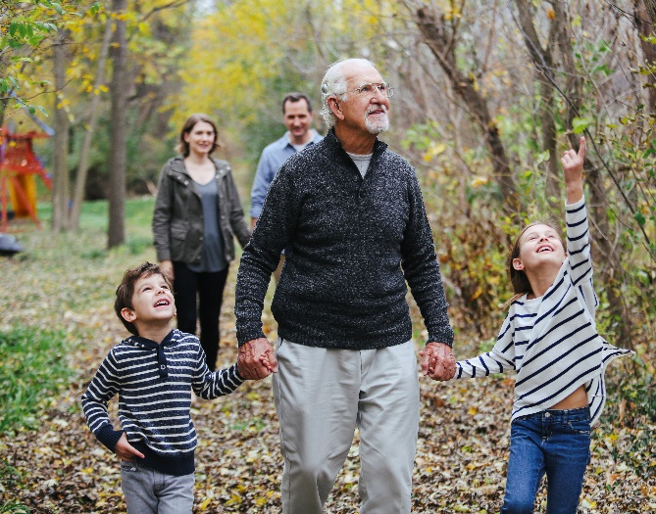
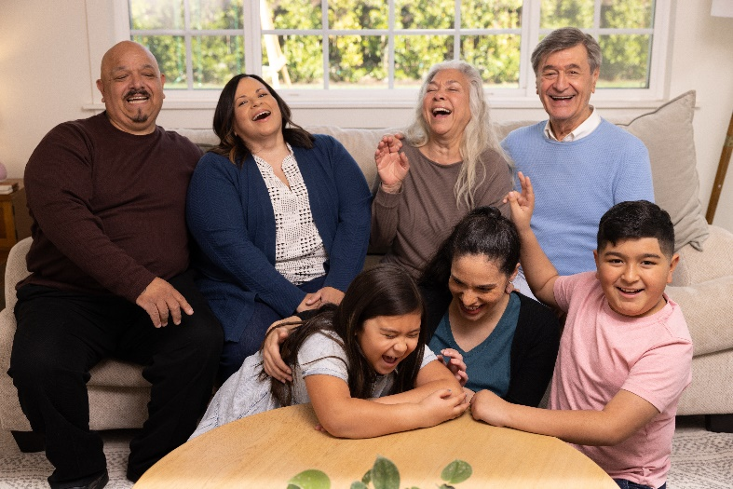
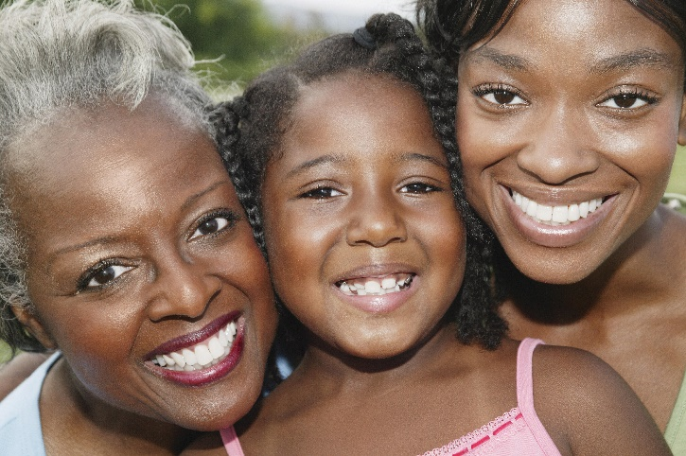
Everyone deserves to live with the
healthiest brain possible.
And we can all take action for our brain health.
Notes:
Sheri
If you’re not already connected with your local ALZ chapter but would like to, please take a moment to scan this QR code and we will help facilitate an introduction.

Slide 11
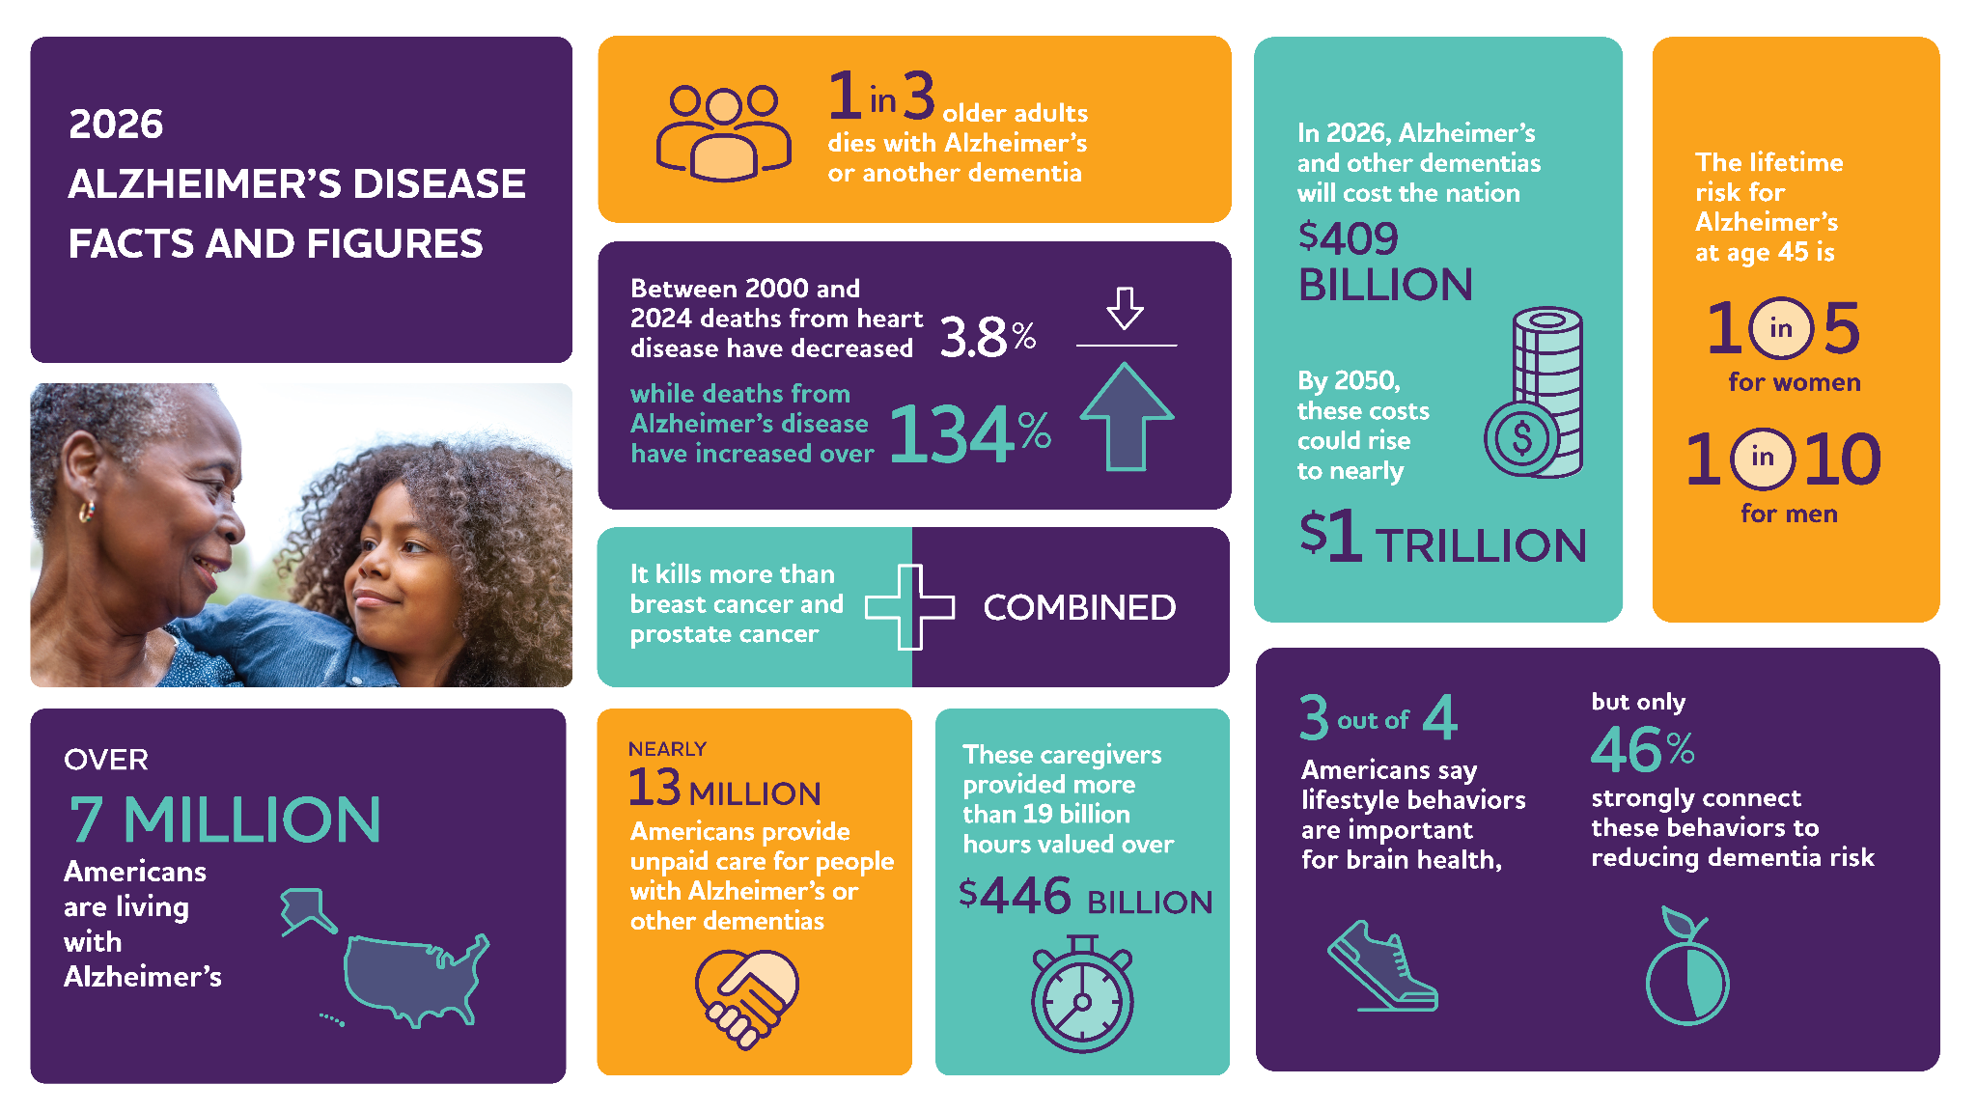
2026 Special Report
Brain Health in America: Understanding and Supporting Lifelong Cognitive Health
Americans age 40 and older show strong interest in brain health but lack clear guidance on how to support it.
  Nearly 9 in 10 said maintaining brain health as they age is very important.
  But fewer than 1 in 10 reported knowing how to take care of brain health.

Slide 12
!
Urgency for Brain Health Promotion
Millions of Americans Aged 65 and Older with Alzheimer’s
Projected prevalence is based on studies of current/recent older Americans — a group that lived through a time of lower rates of obesity and diabetes.
Notes:
By connecting efforts across individuals,communities, workplaces, and healthcare, wecan build a more equitable framework to supportbrain health and help reduce dementia risk forAmericans.

Slide 13
ONE MORE REASON: HOW WE BUILT A BRAIN HEALTH CAMPAIGN WITHOUT BUILDING ANOTHER PROGRAM

Slide 14
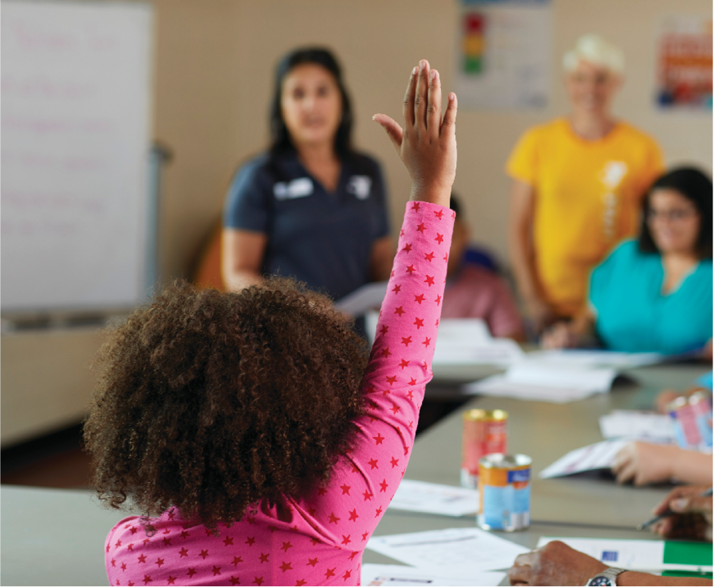
RAISE YOUR HAND…
IF YOUR YMCA NEEDS ONE MORE PROGRAM

Slide 15
WHAT IF WE DIDN’T CREATE ANOTHER PROGRAM?
WHAT IF WE SIMPLY GAVE PEOPLE ONE MORE REASON?

Slide 16
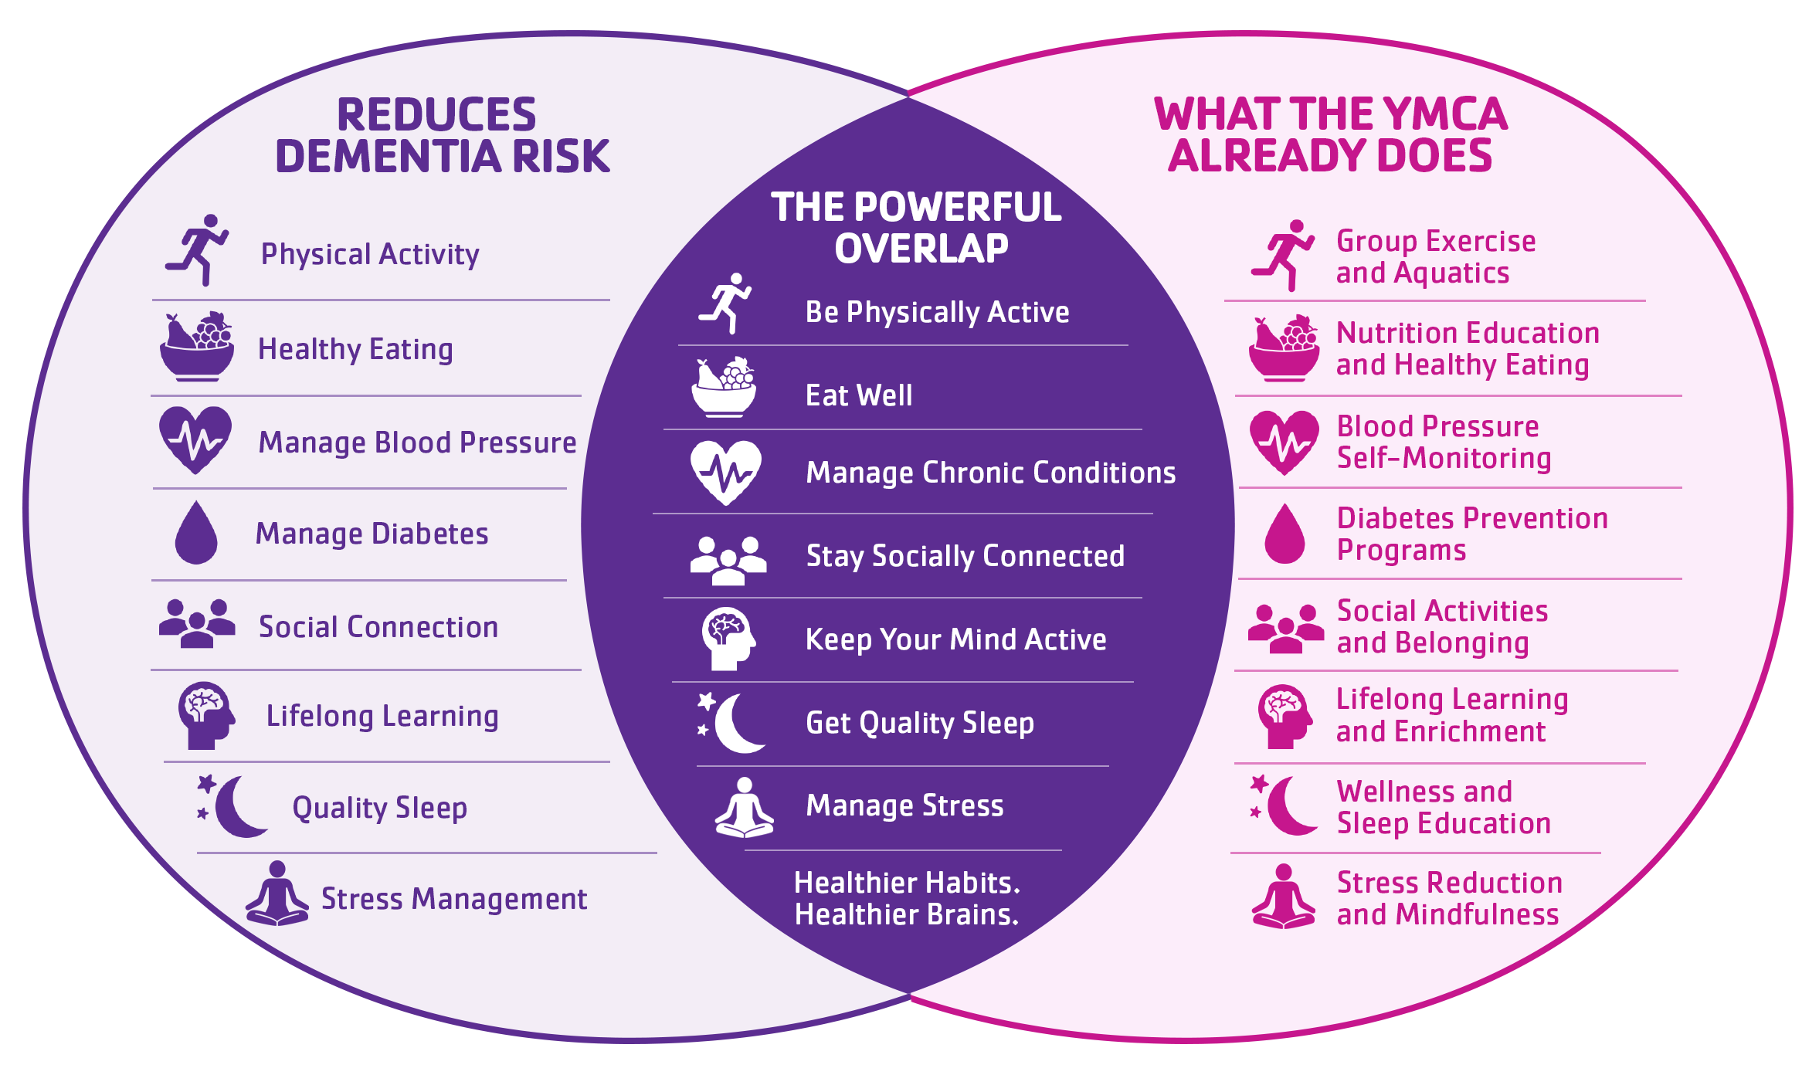
THE INSIGHT: We were already doing it.
Science shows what reduces dementia risk. The YMCA already makes it possible.

Slide 17
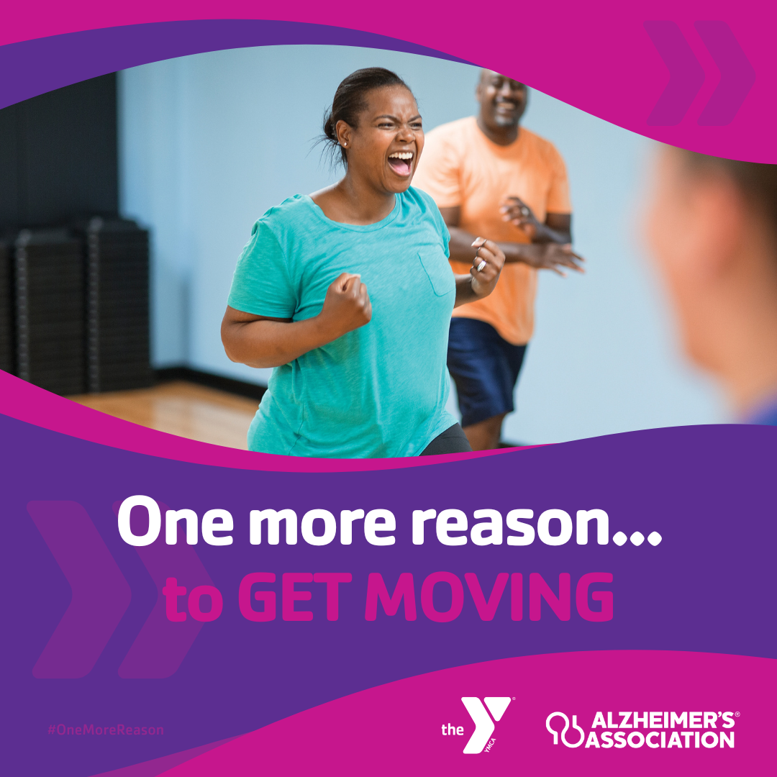
ONE MORE REASON TO…
GET MOVING

Slide 18
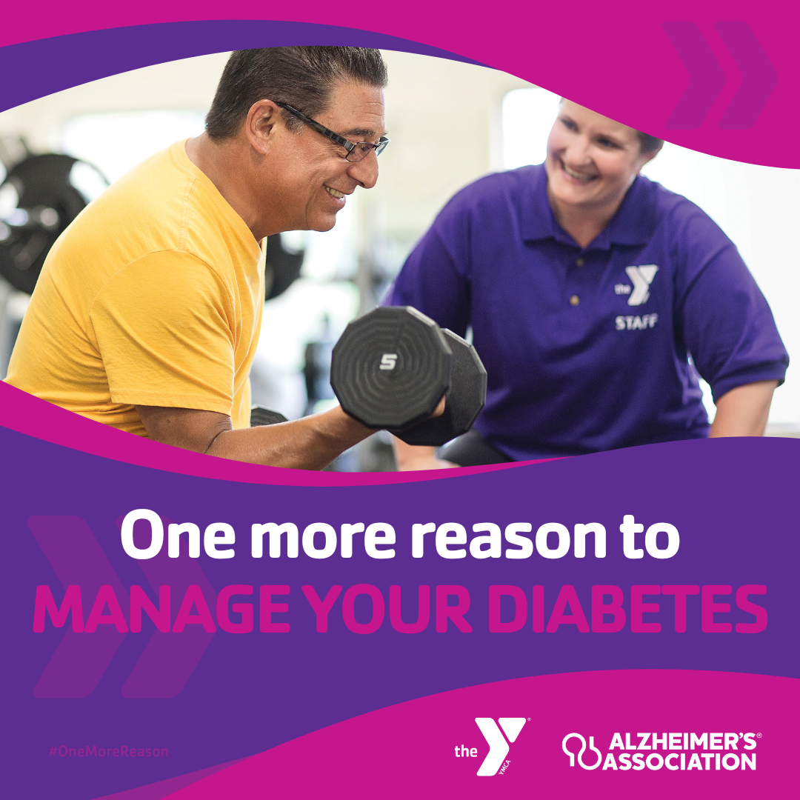
ONE MORE REASON TO…
MANAGE YOUR DIABETES

Slide 19
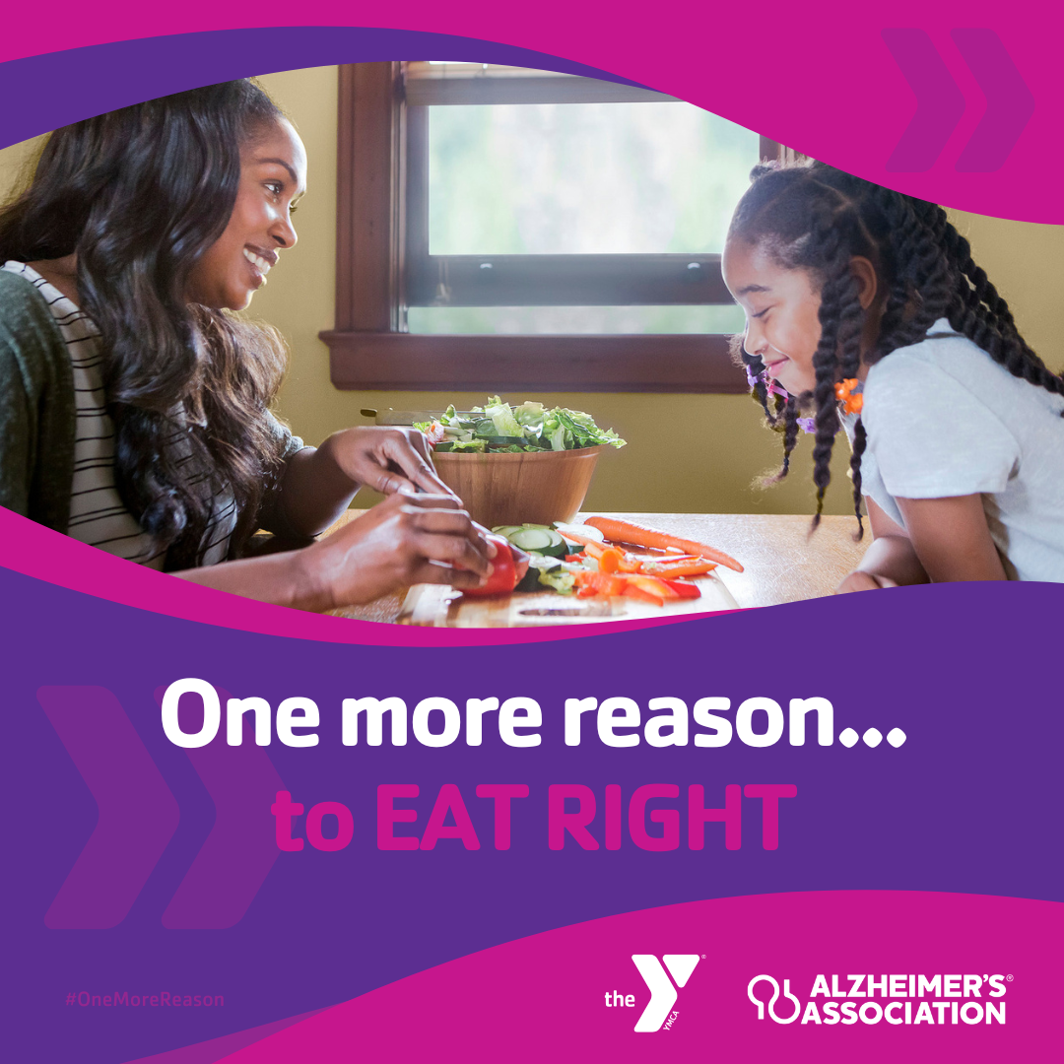
ONE MORE REASON TO…
EAT RIGHT

Slide 20
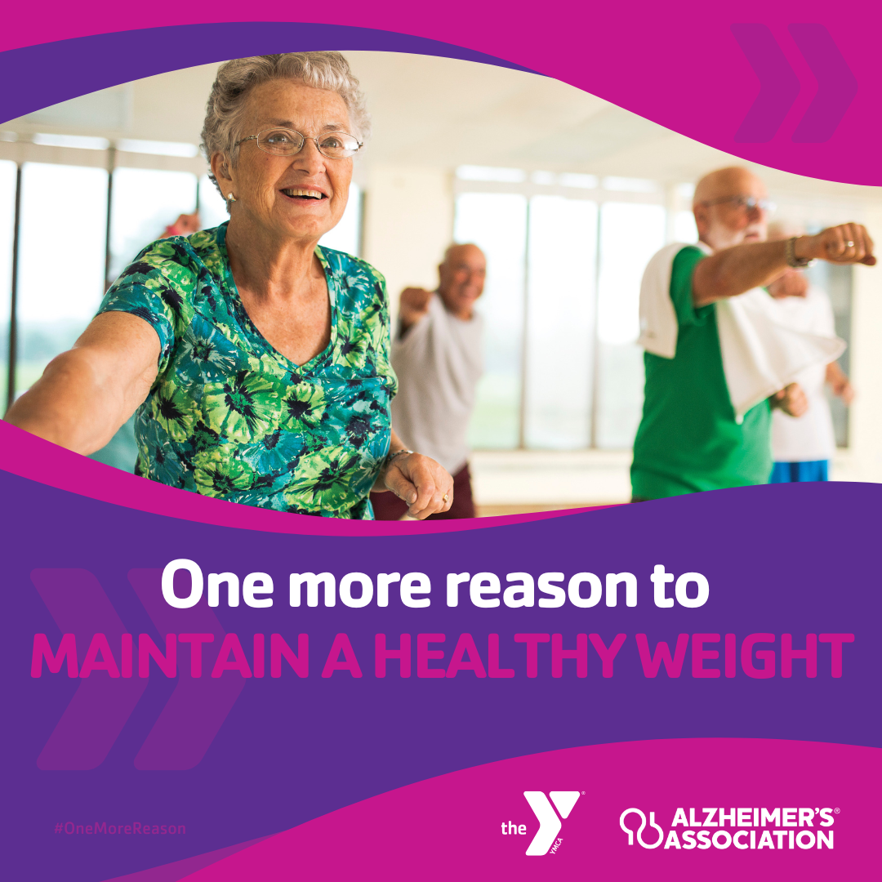
ONE MORE REASON TO…
MAINTAIN A HEALTHY WEIGHT

Slide 21
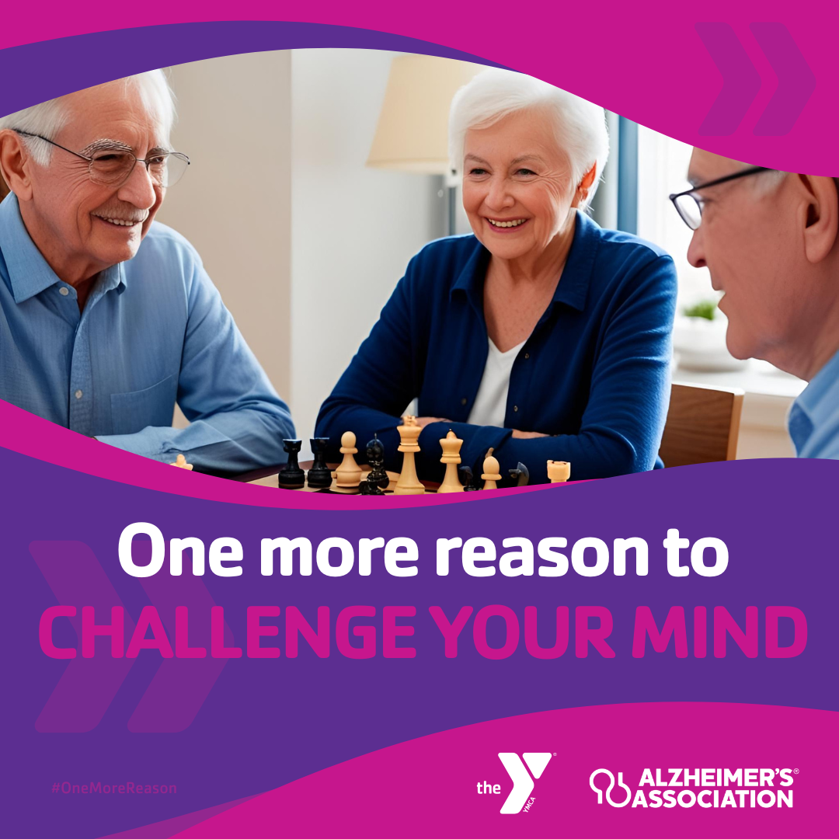
ONE MORE REASON TO… CHALLENGE YOUR MIND

Slide 22
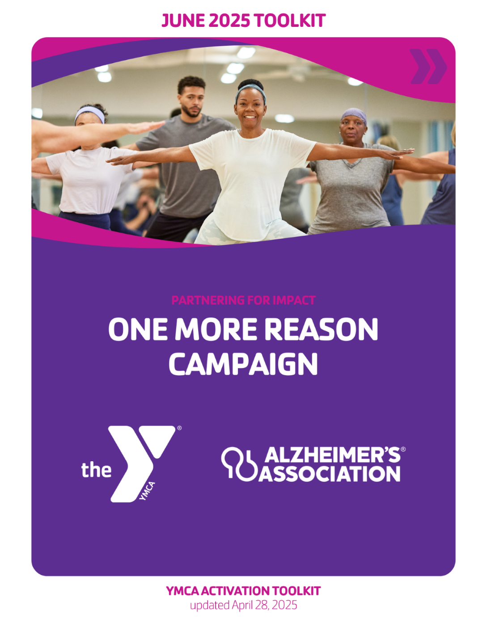
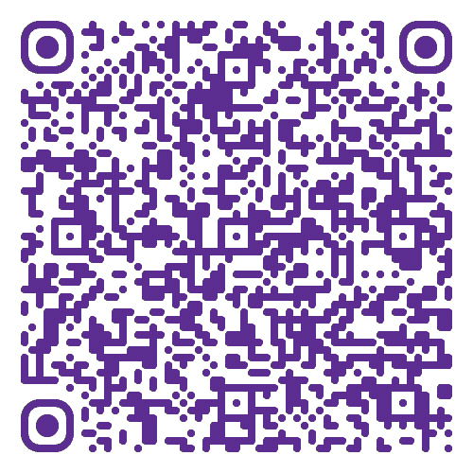
WE REMOVED THE WORK
THE ALLIANCE PROVIDED READY-TO-USE MATERIALS
NEW TOPIC EVERY MONTH
  Movement is Medicine
  Supporting Caregivers
  Building Your Brain
  Healthy Habits as a Family
  Hispanic Heritage Month
  Early Detection

Slide 23
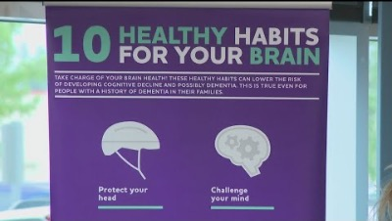
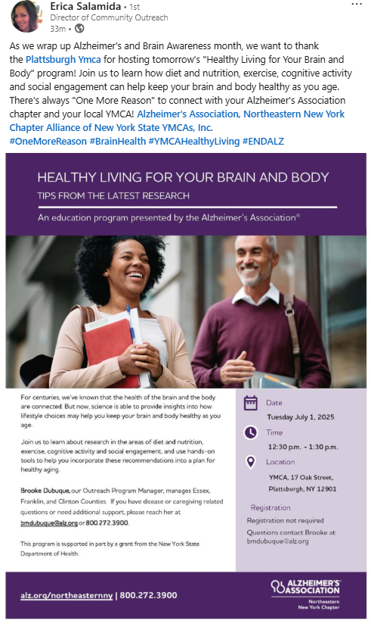
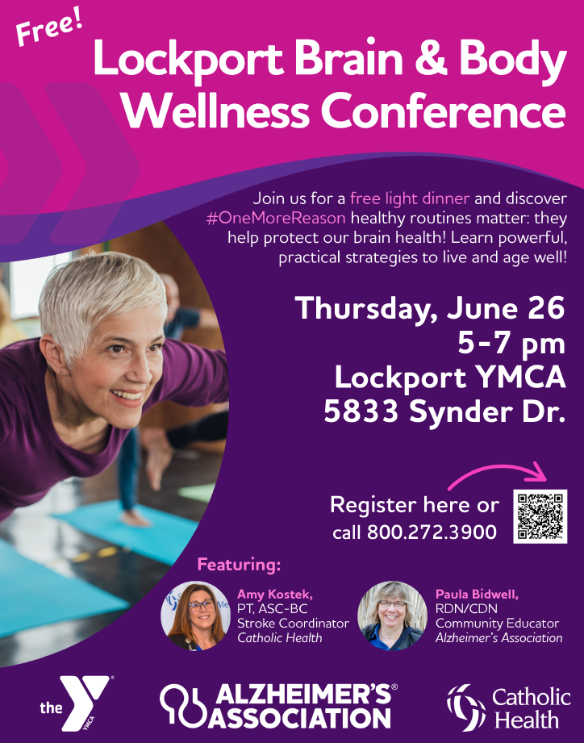
PARTNERSHIP
IN ACTION
Notes:
Buffalo News Clip - https://www.youtube.com/watch?v=mKfzkQI0kag

Slide 24
WHAT’S NEXT?
ONE MORE REASON
2027 BRAIN HEALTH CHALLENGE
Supporting Brain Health In the Workplace
Building Brain Health Knowledge in the Community
Engaging Members in Brain Health
Sharing the Brain Health Story
Notes:
Buffalo News Clip - https://www.youtube.com/watch?v=mKfzkQI0kag

Slide 25
THE YMCA HAS ALWAYS
BEEN IMPROVING LIVES
BRAIN HEALTH SIMPLY GAVE US ANOTHER WAY TO TELL THAT STORY

Slide 26
RESOURCES TO SUPPORT BRAIN HEALTH

Slide 27
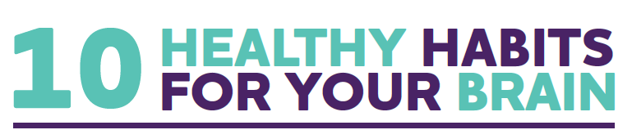


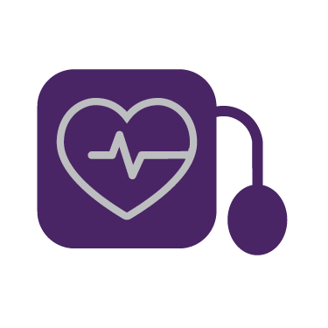

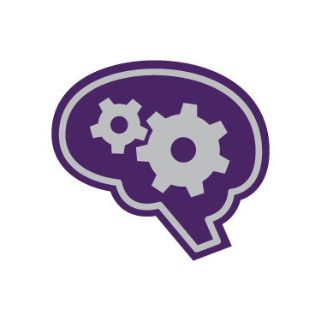
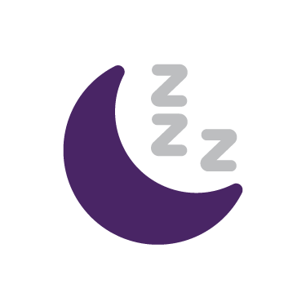

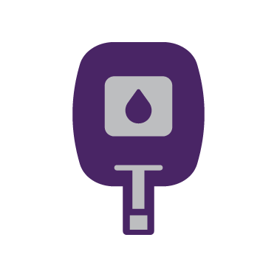


Protect your head
Be smoke-free
Get moving
Challenge your mind
Control your blood pressure
Manage diabetes
Sleep well
Stay in school
Eat right
Maintain a healthy weight

Slide 28
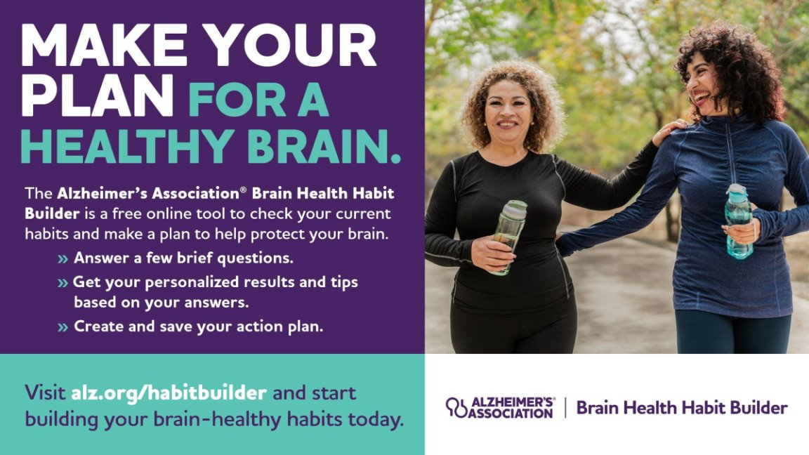
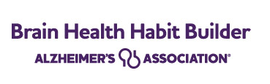
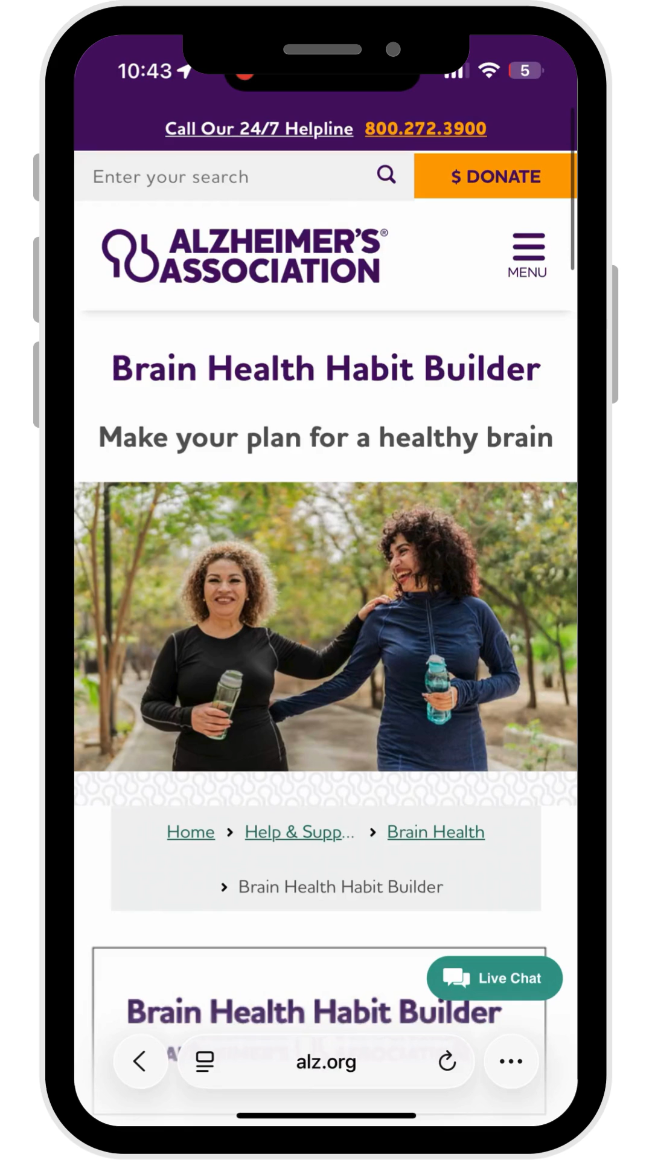
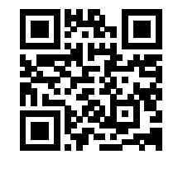

Notes:
•Overarching platform to encourage individuals to take charge of their brain health
•Begins with the 6-Step Challenge
•Includes diet and exercise logs to keep track of progress

Slide 29
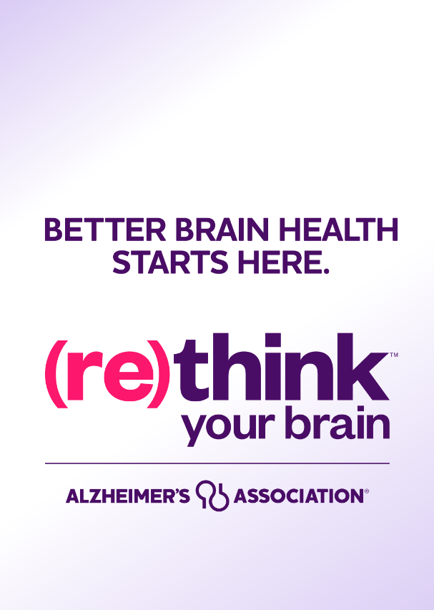
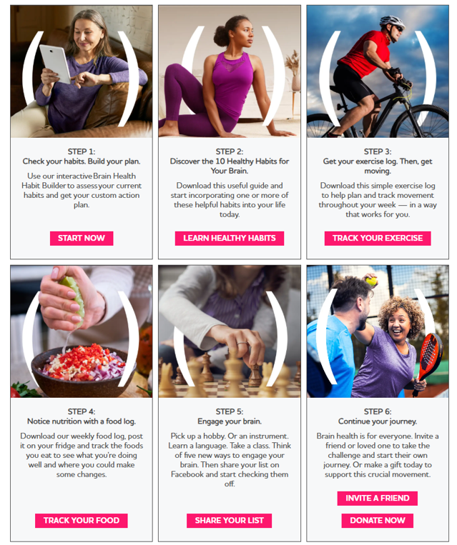
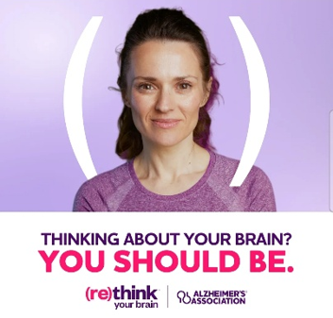
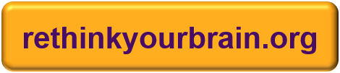
Notes:
•Overarching platform to encourage individuals to take charge of their brain health
•Begins with the 6-Step Challenge
•Includes diet and exercise logs to keep track of progress

Slide 30
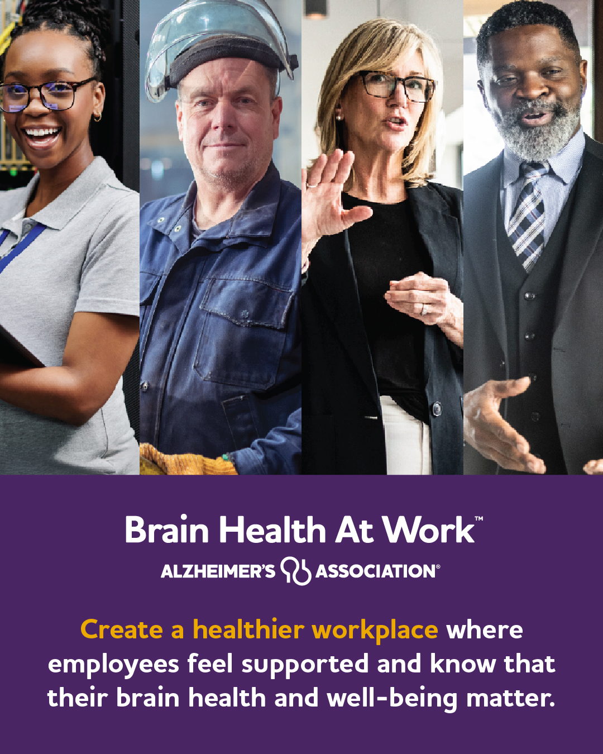
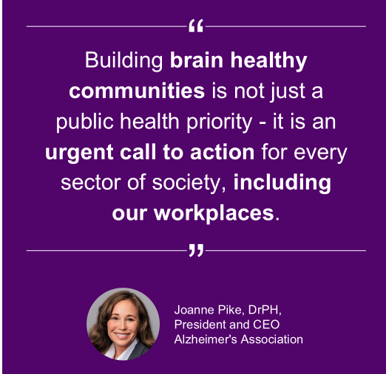
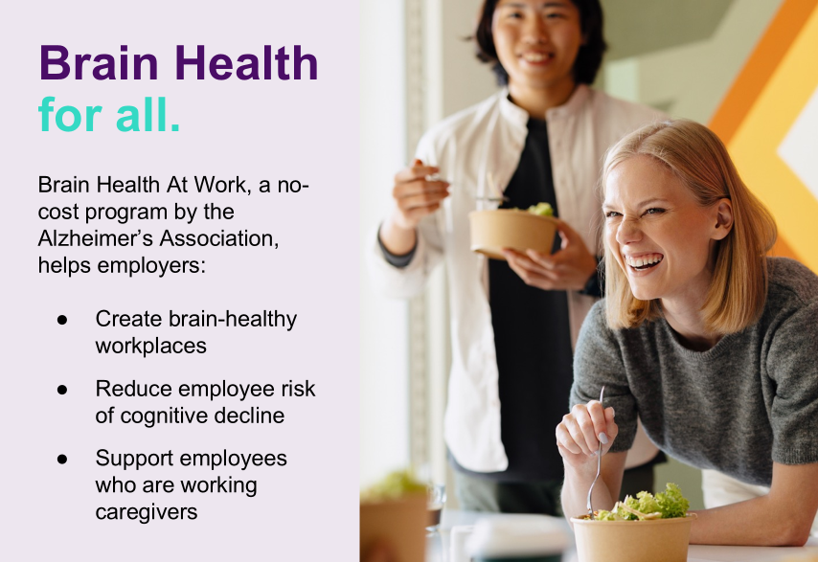
alz.org/BrainHealthAtWork

Slide 31
What can you do today?
SUPPORTING BRAIN HEALTH​

Slide 32
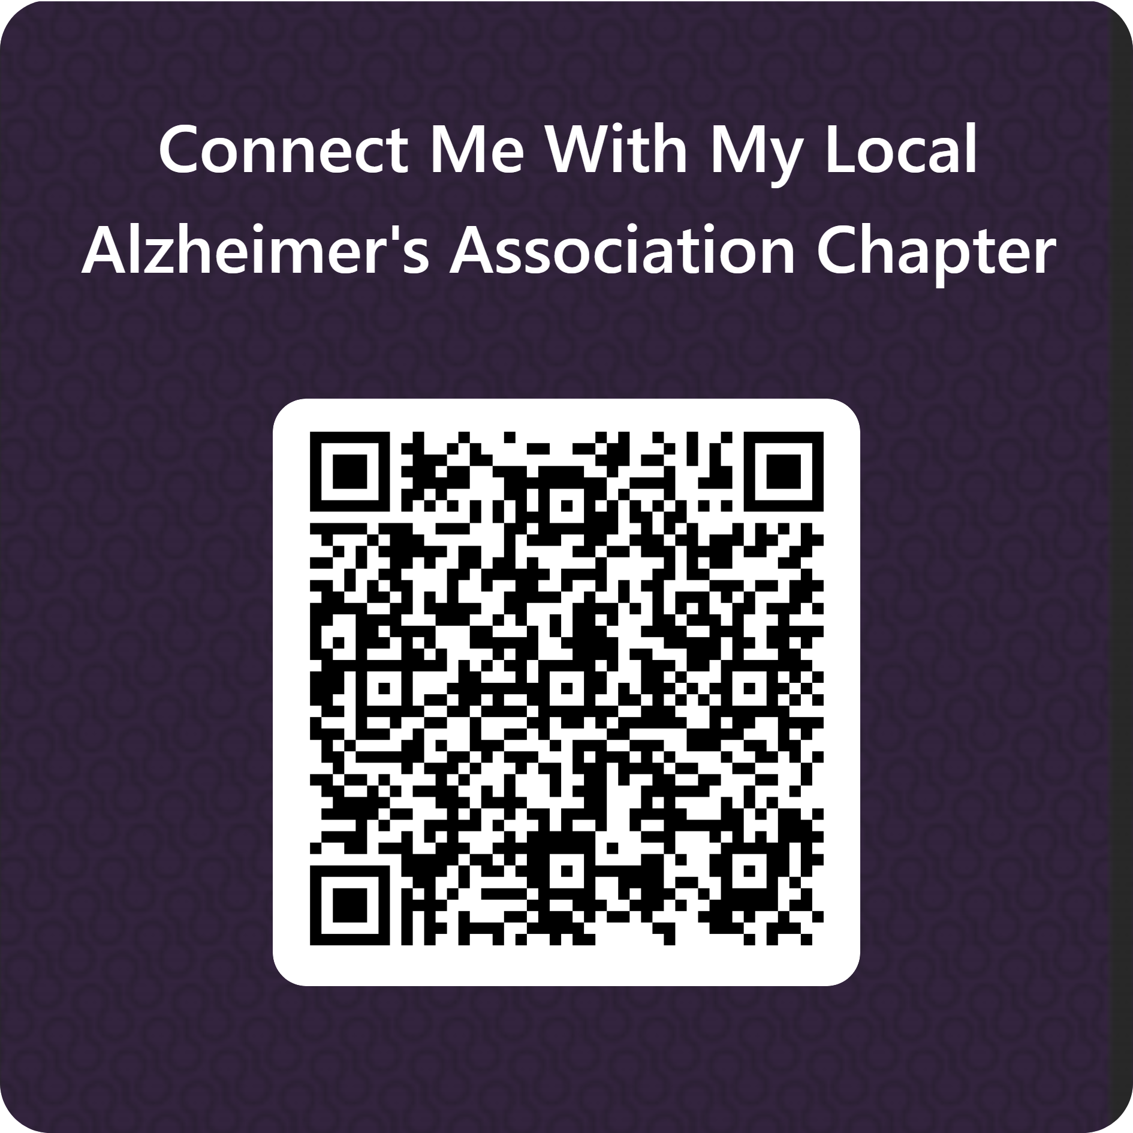

Slide 33
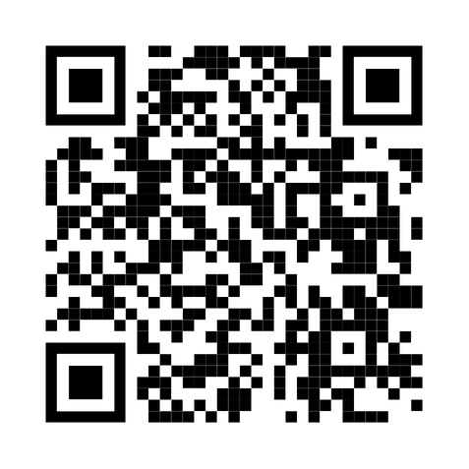
Join a Peer Community Call
Scan QR code to register for our Health and Wellness: Chronic Disease Programs & Healthy Aging peer community calls
Next call scheduled for November 5, 2026 at 2pm CT
Focus will be on brain health and opportunities to support older adults and healthy aging

Slide 34
THANK YOU
Jeanine Menczywor Donnelly
Alzheimer’s Association
jmdonnelly@alz.org
Martha Petteys
Alliance of New York State YMCAs
mpetteys@ymcanys.org
Mamta Gakhar
YMCA of the USA
mamta.Gakhar@ymca.net

