Slide 1

The Power of Connection: Creating Meaningful Change
Mamta Gakhar, Emily Greenberg,
Seana Hasson, Heather Hodge
Notes:
EO

Slide 2

Our time together
Why connection
Environmental scan
Our Opportunity and response
Measuring impact
Testing in the field
Exploring connection
Advancing your work
Notes:
EO
NOTES: this is our agenda for today’s session

Slide 3
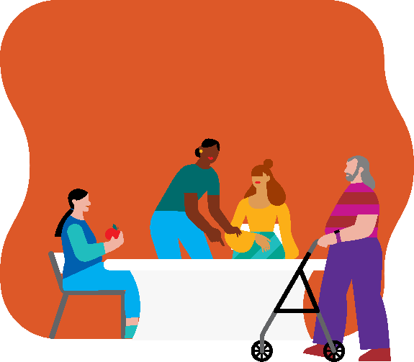
WELCOME connection reflection
When you hear the word "connection," what is the first word that comes to mind?
Notes:
EO
NOTES: the next slide is a mentimeter for Ys to scan a QR code and answer the question

Slide 4
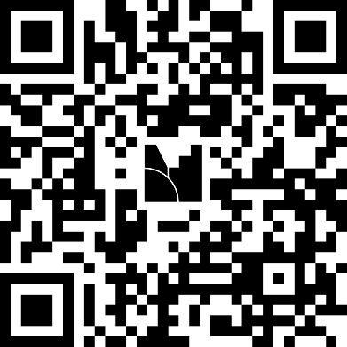
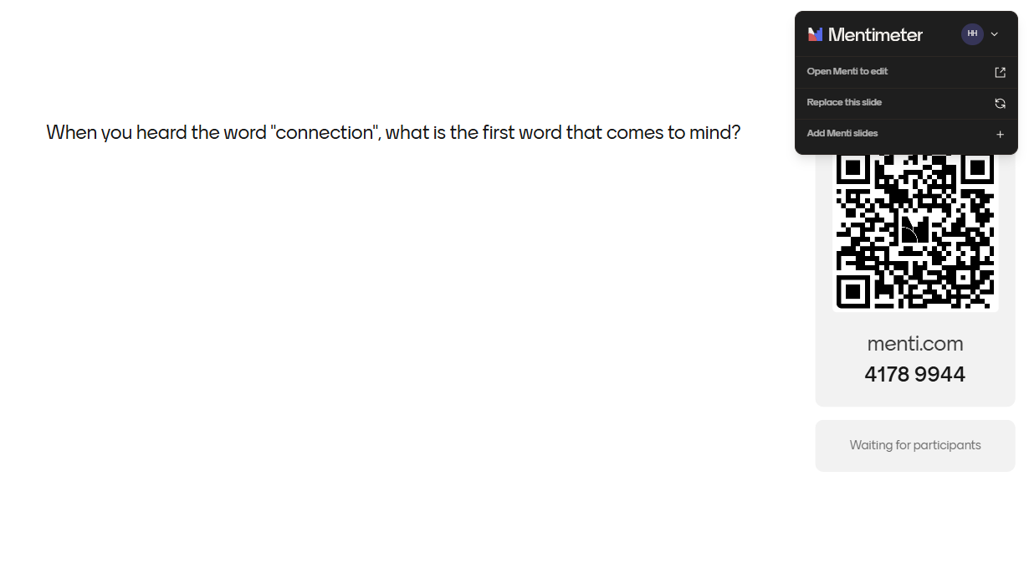
When you heard the word "connection", what is the first word that comes to mind?
When you hear the word "connection," what is the first word that comes to mind?
Notes:
EO

Slide 5
OUR LONG-TERM VISION
The epidemic of isolation, loneliness, and mistrust is diminishing the physical, mental, spiritual, and social health of individuals and communities throughout the U.S. This is a moment where we need the Y more than ever – and our calling is Creating Connected Communities.
To achieve this, we are fueled by our shared long-term vision - a compelling picture of the preferred future that the Y’s work will create.
Observable. Actionable. Measurable.
And our long-term vision is
creating connected communities.
© 2026 YMCA of the USA
Notes:
EO
NOTES: this is our long-term, shared vision for strengthening community through meaningful human connection.

Slide 6

Why Connection,
Why now
Notes:
RAI
As we move into this section, we'll look at what the research tells us about loneliness and social isolation, and why organizations like the Y are uniquely positioned to be part of the solution.

Slide 7
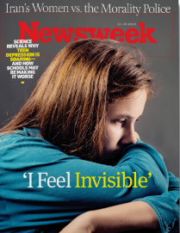
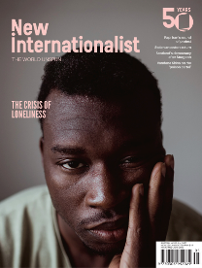
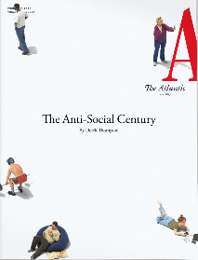
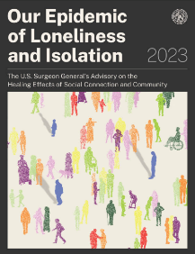
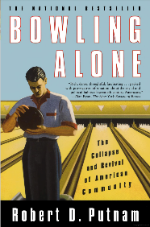
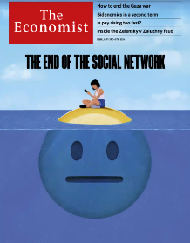
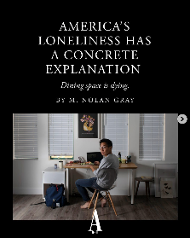
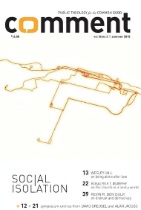

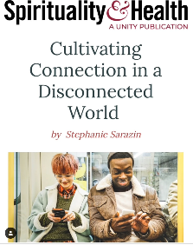
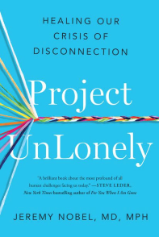
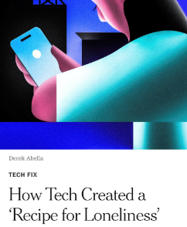
An EPIDEMIC
Notes:
RAI
Why connection, and why now? It’s an epidemic. How many have heard the stat that loneliness poses the same health risks as smoking 15 cigarettes a day?
The evidence makes it clear that across the country, and world, people are feeling more disconnected than ever.
We live in a paradox: technology connects us globally, yet many people report feeling alone or without shared purpose.
This disconnection is a longstanding challenge shaped by cultural, technological, economic, workplace, and environmental forces; importantly, it’s not simply an individual problem. It affects health, organizations, civic life, and community resilience.
We want to walk you through a few key points of evidence that can lay the groundwork for what this work might look like at your Y.

Slide 8
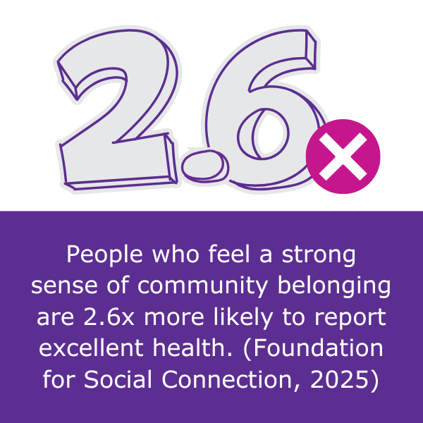
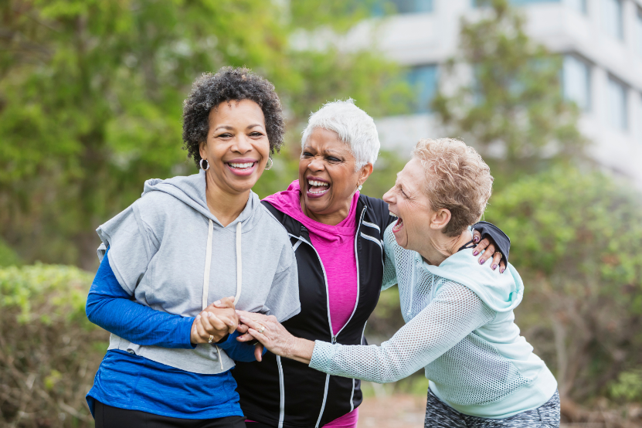
CONNECTION BOOSTS OUR HEALTH
Notes:
RAI
Why is connection important now? Connection underpins our health.
People who feel a sense of belonging are more than 2.5 times more likely to say they are in great health.
Strong relationships can help people manage stress, build healthier habits, and strengthen our ability to cope.

Slide 9
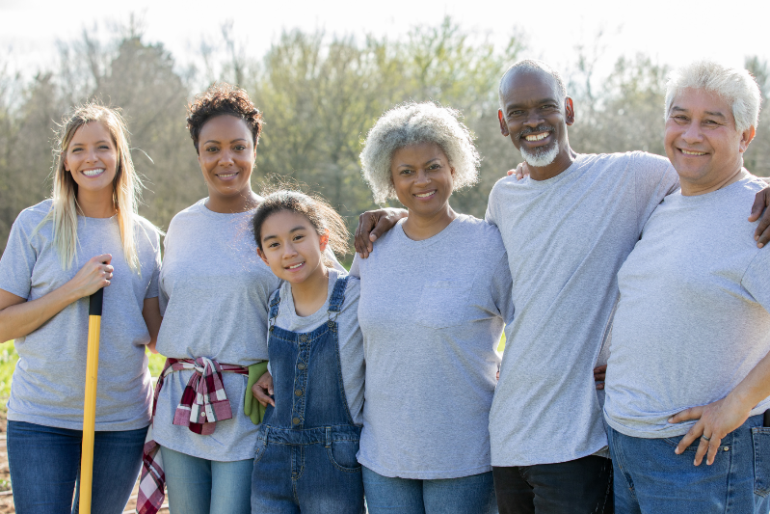
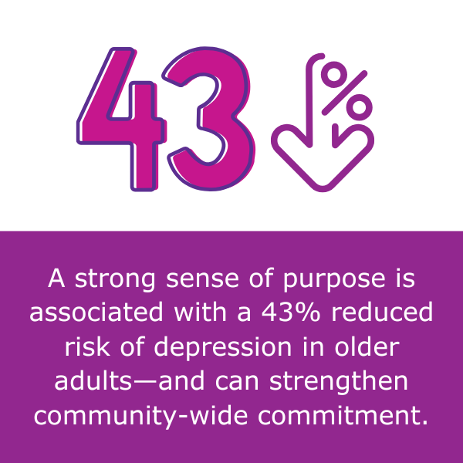
PURPOSE SHAPES OUR HEALTH
Notes:
RAI
Another reason connection matters and matters now – it’s intertwined with meaning and purpose. People need to feel individually valued and also to know that they can make a meaningful difference.
When people share their time, talents, and voice, they strengthen relationships and the collective good.

Slide 10
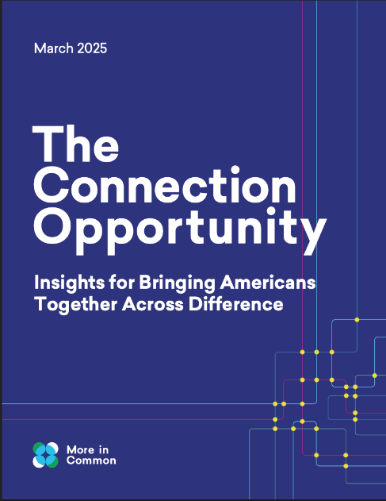
AMERICANS VALUE PURPOSEFUL CONNECTION
Most Americans value connecting across difference – and are most interested in activities where they can work on mutual goals that improve their community
The most commonly cited barrier to connection is lack of opportunity
Connection is cumulative: the more people have an opportunity to connect, the more interested they are in connecting
Notes:
RAI
And people want to connect, it’s just challenging to do so. This report tells us that the U.S. does not suffer from a lack of willingness to connect—but from a lack of structured, everyday opportunities and reinforcing social norms that make connection easy, safe, and routine.
Interestingly, not only are Americans spending less time with each other overall, but they are spending even less time with those who are different from them – leaving their opinions of each other able to be influenced by the narratives of others rather than their own lived experiences.
One of the solutions this report yields is that an effective way for people to connect across differences is by sharing a mutual goal.
Making connection easy, safe, and routine, and connecting people with mutual goals is what the Y has always done and with intentionality can really make a difference in the social connection crisis.

Slide 11
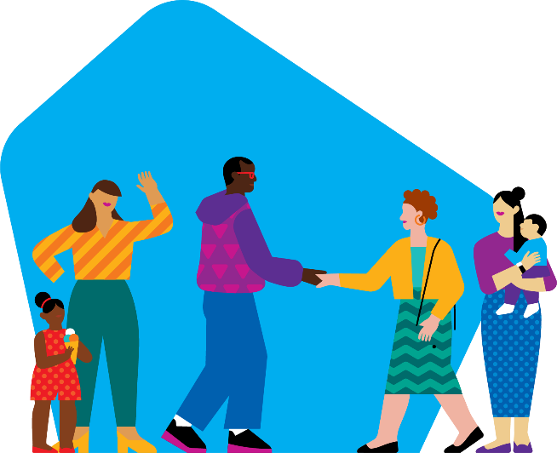
"Connectedness is a biological imperative…as humans, we are defined by our need to connect and to co-regulate."
"We did not evolve to self-regulate. We evolved to co-regulate."
Dr. Stephen Porges, neuroscientist
Notes:
RAI
The evidence is embedded in all the sciences, including the hard sciences - this quote is from a modern, well-known, influential neuroscientist who studies and writes about the very real relationship between the nervous system and a sense of connection. We are, in fact, hardwired to connect.

Slide 12
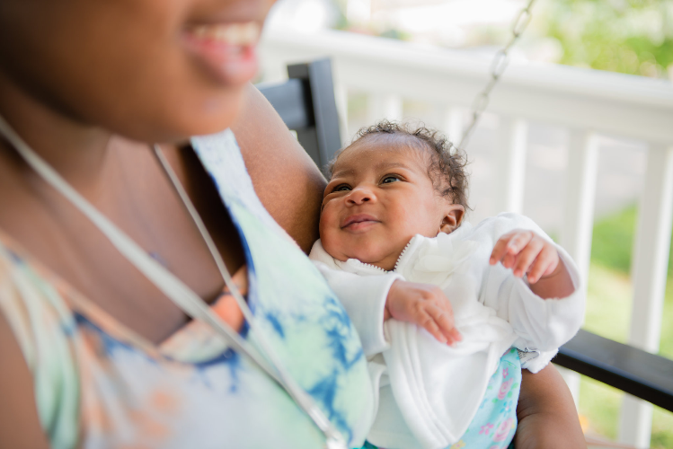
THROUGHOUT OUR LIFE COURSE
Early caregiver attunement wires the developing brain for empathy, self-regulation, and relational trust— shaping future capacity for connection.³
The adolescent brain is biologically tuned for belonging—social feedback during teen years shapes identity and moral development.⁵
Social health is as vital as physical health—supportive networks predict brain function, recovery, resilience, and self-rated well-being.⁶
Notes:
RAI
It’s also worth noting that the science supports the importance of connection throughout all life stages --- just like YMCAs reach people at all life stages. You might encounter news or studies about social connection as important to a specific age group, like teens or older adults, and yes the gaps are bigger for some than others. But in fact the need for connection spans the life cycle --- It shapes how young people form identity, how adults manage transitions, and how older adults maintain resilience.

Slide 13
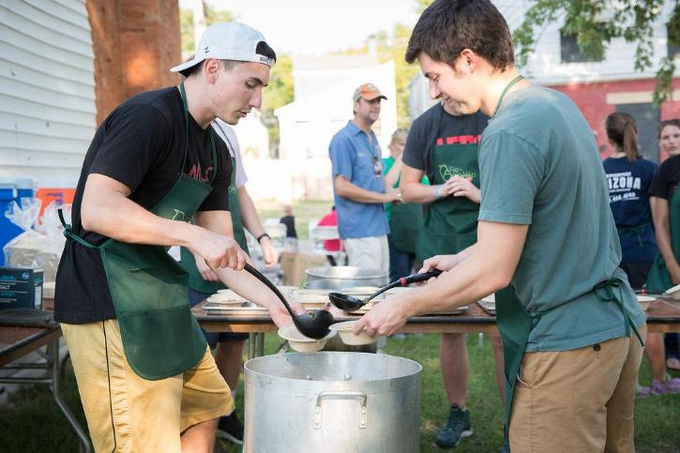
WIRED FOR CONTRIBUTION
Teens who report a strong sense of purpose show lower depressive symptoms and higher life satisfaction.⁶
People with a high sense of purpose have a 46% reduced risk of mortality over four years. ¹
Notes:
RAI
Connection matters to purpose and matters even more when purpose becomes contribution. Contribution is a real amplifier for connection --- connection is fhe foundation but contribution can both really help people connect, and connection can drive contribution.
I’ll share more later about what we mean by contribution, but for now the point is we mean it broadly --- and the evidence is clear that helping others isn’t a side benefit—it’s a primary path to well-being.
A report by the group U.S. Chamber of Connection cites a lot of evidence behind the community service flavor of contribution, including studies from our keynote speaker Dr. Holt-Lunstad, as well as long-time Y favorite Robert Putnam:
- Purpose-driven service reduces loneliness
- Volunteering connects people across difference
- Service cultures build trust and participation.
Yet another good time to point how this is in the Y’s DNA with our history of volunteerism, service learning, group exercise, child care and more --- meeting the needs of community? It’s how we show up.

Slide 14
Connection AT THE y
Reflection
Think of a time you felt a genuine sense of connection at a Y. What happened? What made it memorable?
Turn to a neighbor and share your story in 60 seconds each.
What patterns did you hear?
Notes:
RAI

Slide 15

What we have learned
Notes:
RAI
While the growing concerns around loneliness and social isolation help explain why connection matters, we also wanted to understand what organizations like the Y can do about it.

Slide 16
Evidence base: scope of 2025 environmental scan
Peer‑reviewed research across public health, psychology, economics, and civic life
National datasets and population‑level findings
Local Y examples, Y-USA Practice Lead interviews, and validated measurement tools tested within the movement
Notes:
RAI
So we did our own research, which was an environmental scan conducted by Community Initiatives, and included looking at the academic evidence, but also talking to subject matter experts and other organizations working in this space, and getting input from the Y movement and Practice Leaders.

Slide 17
From the scan:
The urgent case for connection
Loneliness and isolation are increasing across age groups and communities. Disconnection drives poor health, burnout, disengagement, and civic decline. Systems, not individual behavior, are the primary drivers.
The reality
Insights from the Y’s environmental scan
Humans thrive through connection and contribution, and these are built through intentional design of programs, spaces, and relationships. Connection is learnable, designable, and measurable.
Why this is a Y moment
This challenge aligns squarely with the Y’s mission, history, and assets. Few institutions have the reach, trust, and physical presence the Y does.
Notes:
RAI
The environmental scan validated that loneliness and disconnection are increasing, with impacts that extend beyond individual well-being to health, burnout, engagement, and civic life.
At the same time, the scan showed that connection can be intentionally designed, strengthened, and measured.
Overall, the findings position Creating Connected Communities as a strategic response that aligns directly with both the Y's mission and its unique strengths. Whether inside our facilities or throughout the broader community, the Y is uniquely positioned to create the conditions that help people connect, thrive, and contribute to something larger than themselves.

Slide 18
BASED ON the Evidence:
The Creating connected community theory of change
The epidemic of isolation, loneliness and mistrust is diminishing the physical, mental, spiritual and social health of individuals and communities throughout the U.S.
THEN
PROBLEM
we intentionally bring people together around experiences of achievement, relationship and belonging …
programs and advocacy fundamental to everyone because they build healthy spirit, mind and body for all …
we amplify the value of creating connected communities in neighborhoods across the country
activities long known to support human thriving will help restore personal, societal and national well-being.
IF
THROUGH
AND
Notes:
RAI
Based on this evidence, our theory of change follows a simple logic: if we intentionally bring people together through experiences of achievement, relationships, and belonging, we strengthen connection and contribution, improve individual well-being, and help build stronger, more connected communities.

Slide 19
Our opportunity,
Our response
Notes:
EO
NOTES: From all of this research, the Six Levers of Connection emerged: a practical framework for creating experiences that help people build relationships, foster belonging, and deepen their connection to community. We'll explore each of these levers in more detail shortly.

Slide 20
Creating Connected Communities (CCC) is the YMCA’s 10-year bold, shared vision for strengthening community by fostering meaningful human connection.
CCC builds on the Y’s long-standing purpose of strengthening community. This focus helps Ys create more intentional experiences that help people achieve goals, build relationships, feel a sense of belonging, and contribute to something larger than themselves.
The Six Levers of Connection are practical ways to make connection more intentional across programs, practices, spaces, partnerships, and community systems.
Notes:
EO
NOTES: Emphasize the Six Levers of Connection are practical ways to make connection more intentional across programs, practices, spaces, partnerships, and community systems.

Slide 21
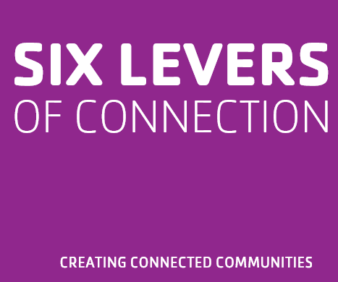
Notes:
EO
We learned through our scans, and tested with Ys, six levers of connection --- ways to be intentional within the work that is in our DNA.
NOTE: Don’t spend too much time here – we have one slide per lever to come.
Focused on how we make sure we are elevating connection, using shared language and storytelling to strengthen purpose and connection, how we practice skills and ensure our culture and staff are reinforcing what makes connection possible. Opportunities for us to embed connection in everything we do, as intentional moments of connection in the work we are already doing.
Create conditions for connection in physical and digital spaces
And support – address the conditions that impact community members and enable them to thrive.

Slide 22
ELEVATE CONNECTION
Use shared language and stories to strengthen purpose and connection.
Notes:
EO

Slide 23
PRACTICE CONNECTION SKILLS
Develop the skills and reinforce the culture that make meaningful connection possible.
Notes:
EO

Slide 24
EMBED CONNECTION EVERYWHERE
Design and deliver experiences that create connection.
Notes:
EO

Slide 25
CREATE CONNECTED SPACES
Build physical and digital environments that spark interaction and create access and belonging for all.
Notes:
EO

Slide 26
INVITE CONTRIBUTION
Provide opportunities for people to share their time, talents, and voices to create change.
Notes:
EO

Slide 27
SUPPORT WELL-BEING
Foster experiences that elevate health and well-being and help all people thrive.
Notes:
EO

Slide 28
Six Levers
REFLECTION
Which of these levers resonates most as you consider ways to strengthen connection at your Y?
Notes:
EO

Slide 29
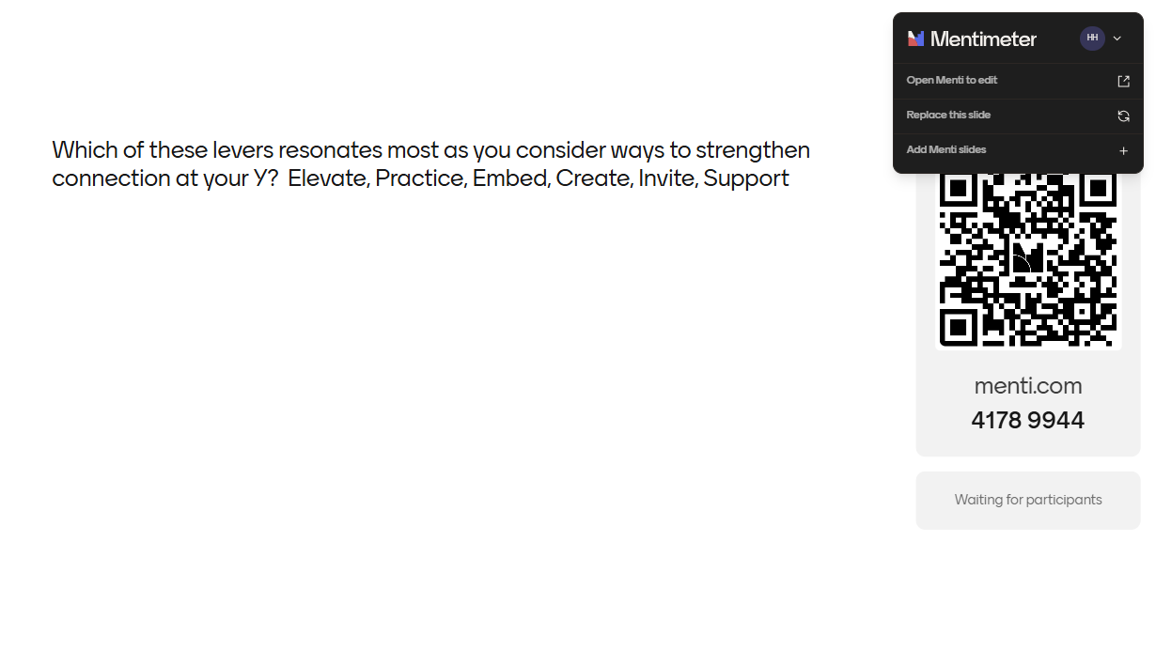
Which of these levers resonates most as you consider ways to strengthen connection at your Y? Elevate, Practice, Embed, Create, Invite, Support
Notes:
EO

Slide 30
Measuring impact
Notes:
RAI
Now we’ll share how we’ll measure the impact of this work.

Slide 31
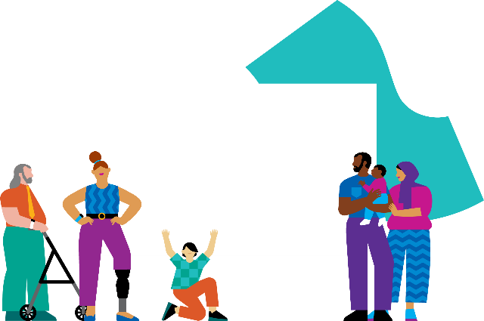
Our measurement strategy
To grow what works, we need to understand what’s working. By using measurement tools to assess impact, we can learn, adapt, and continuously improve. This helps us stay accountable to our goals, tell a clear story of change, and ensure that connection is not just a value, but a measurable outcome across the Y movement.
OUR IMPACT
Notes:
RAI
As we strengthen connection across the Y, measurement helps us understand what is working, for whom, and under what conditions.
Measurement is not just about demonstrating impact. It gives us information we can use to learn, adapt, and improve along the way, ensuring that connection is not just a value, but a measurable outcome.

Slide 32
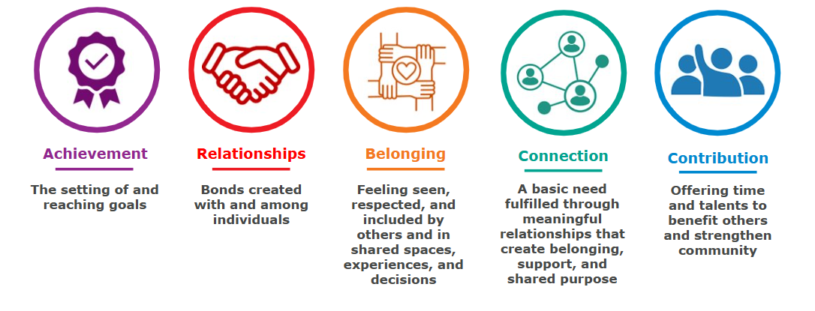
From levers to outcomes:
These five dimensions (ARBCC) provide the structure for how we measure CCC
Notes:
RAI
We are measuring the impact of Creating Connected Communities on individuals through these five dimensions: Achievement, Relationships, Belonging, Connection, and Contribution.
Together, these dimensions help us understand if Y experiences are creating conditions for building meaningful relationships, feeling included, finding purpose, and contributing to their communities. ARBCC gives us a shared language for measuring and strengthening connection across the Y.
These five are pretty common outcomes for a variety of Y experiences, and we have done evaluations that shows they are possible across a wide range of Y programs and activities --- and we also want to flag that not every experience will address all five of these equally. Your goal is to identify which outcomes are most relevant to the experiences your Y is offering, and then use measurement of them to guide learning and effectiveness.

Slide 33
Measurement of ARBCC: three levels to help the Y learn, grow, and understand impact
Individual level (People):
Are individuals experiencing more achievement, relationships, belonging, connection, and contribution through experiences with the Y?
Organizational level (Ys):
Are Ys creating the internal conditions that support quality, connection‑centered experiences?
Community level (Communities):
Are community conditions related to connection and belonging improving over time?
Looks at organizational strength, practices, and quality aligned to ARBCC
Uses community data, surveys, and local stories to understand reach and influence
Uses brief surveys with research-backed scales to measure dimensions of ARBCC relevant to the experience delivered
Notes:
RAI
In addition, CCC can be measured across three levels to help us understand impact from multiple perspectives.
At the individual level, we assess whether people are experiencing growth in achievement, relationships, belonging, connection, and contribution through their experiences with the Y.
At the organizational level, we examine whether Ys are creating the conditions and practices, through the levers, that support these outcomes. At the community level, we look at broader changes in connection and belonging, using community data and local stories to understand reach and influence.
Together, these three levels help us connect individual experiences to organizational practice and community impact.

Slide 34
By SHOW OF HANDS
REFLECTION
How many of you feel connection is already part of your Y’s strategic plan?
How many believe your Y intentionally designs for connection?
How many currently measure connection?
Notes:
RAI
Before we share some of what was learned from the inaugural cohort Ys, let’s reflect.
ASK FIRST QUESTION AND HAVE ATTENDEES KEEP THEIR HANDS UP AS YOU CLICK TO THE NEXT QUESTION (NOTE HOW MANY HANDS GO DOWN – SAME FOR NEXT QUESTION)
If hands decrease: What I see in this room is a tremendous strength. The foundation is already there. We share a belief that connection matters. Our opportunity now is to become more intentional about how we design experiences that foster connection and how we learn from the impact those experiences have on people and communities
If hands stay the same: That's encouraging to see. Not only do we view connection as central to our mission, but many of you are already intentionally designing for it and thinking about how to measure it. That tells me the Y movement is ready for this conversation.

Slide 35
Testing in the field
Notes:
EO

Slide 36
Testing the model:
inaugural cohort
What happened:
27 Ys came together to test, learn, and implement approaches that strengthen connection and contribution in the communities they serve. These Ys intentionally embedded connection into programs, spaces, and practices aligned with CCC.
How evidence of connection was generated:
Ys had the chance to test individual change in achievement, relationships, belonging, connection, contribution using assessments from the CCC Measurement Library
What we learned:
The results show that connection can be intentionally designed and activated through a variety of mechanisms such as programs, staff culture, volunteer engagement, facilities, and community partnerships. The experiments in this cohort aligned across all six levers of connection, demonstrating multiple pathways for strengthening connection.
Notes:
EO

Slide 37
Example Cohort Y experiments
CCC Experiment 1 | CCC Experiment 2 | CCC Experiment 3 | CCC Experiment 4
Y Staff | Y Staff | Inside a Y | In the Community
Community Bridging & Engagement | HEART: A Staff Culture Shift | Welcome & Atmosphere Renovation | No One Fights Alone: Social Connection Expansion
THEORY OF CHANGE If staff deepen their cultural understanding through intentional engagement events with the communities they serve, they will develop a stronger internal sense of belonging and be better equipped to bridge external divides. | THEORY OF CHANGE If behavioral expectations (HEART) are operationalized into daily HR routines, coaching, and evaluations, then staff will experience clearer communication and a more consistent culture, reducing daily transactional friction. | THEORY OF CHANGE If the physical lobby and community spaces within the Y are intentionally redesigned to be warm, clear, and inviting, it will break down transactional interactions and naturally encourage members, guests, and staff to linger, mingle, and form connections. | THEORY OF CHANGE By providing connection-centered volunteer training and structured relational touchpoints (home visits, transportation) to home-bound older adults, the program will overcome geographic and physical barriers, leading to measurable reductions in loneliness and increased feelings of belonging.
Notes:
EO

Slide 38
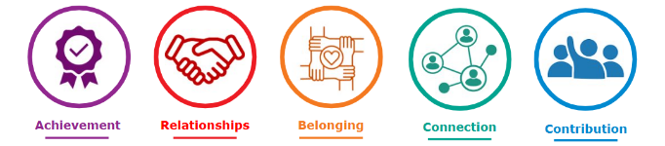
CURRENT Testing Cohorts
Use of the six levers of connection to drive decisions on how to intentionally embed connection into programs, spaces, and practices aligned with CCC.
Inaugural Testing Cohort | Older Adults in Rural Settings | Rural CCC
Launched in 2025, 27 YMCAs focused on fostering connection & contribution within organization (internal) or community (external) | Kicked off in July 2026, working with State Alliances in Alaska, Idaho, Minnesota, Montana, North Dakota, South Dakota, Washington, and Wisconsin – along with YMCAs in these states | Kicked off in August 2026 with 32 YMCAs throughout the country planning to test and apply the six levers of connection within rural settings
Notes:
EO
We recently wrapped testing with one cohort and kicked off two more
• The inaugural group of 27 YMCAs started in 2025, focusing on connection within organizations and communities.
• This new cohort for older adults in rural areas launches today, partnering with State Alliances and Ys across eight states.
• Rural CCC is kicking off next week
• All cohorts are learning about and using the levers to intentionally embed connection into programs, spaces, and practices, aligned with CCC principles, with a focus on measurement of achievement, relationships, belonging, connection, and contribution
These efforts will help us learn, adapt, and scale what works for building connected communities.

Slide 39
Taking action
Notes:
EO

Slide 40
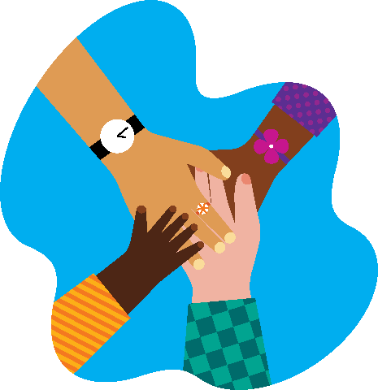
Creating connection
Taking Action
What’s one action you will take in the next 30 days to strengthen connection at your Y?
Notes:
EO

Slide 41
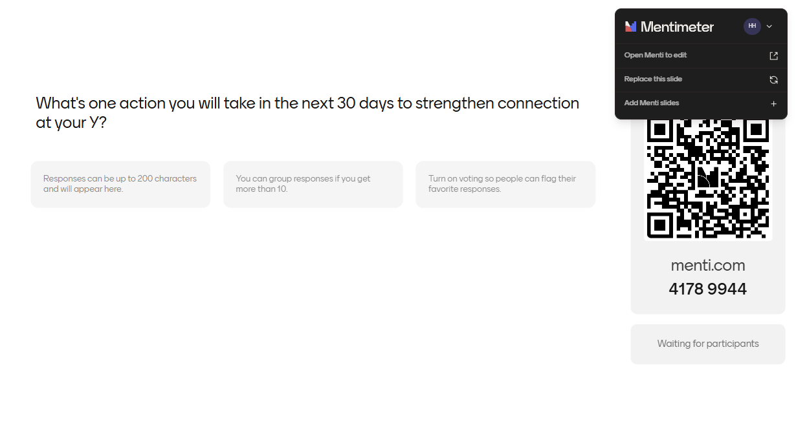
What's one action you will take in the next 30 days to strengthen connection at your Y?
Notes:
EO

Slide 42
Integrate the Six Levers of Connection into existing programs, operations, experiences, and more.
Complete the Organization Excellence Assessment and use the Practice Area Continuums.
Participate in cohorts and trainings.
Access self-service resources.
Share learning with peers.
ADDITIONAL WAYS Ys CAN TAKE ACTION
Notes:
EO

Slide 43
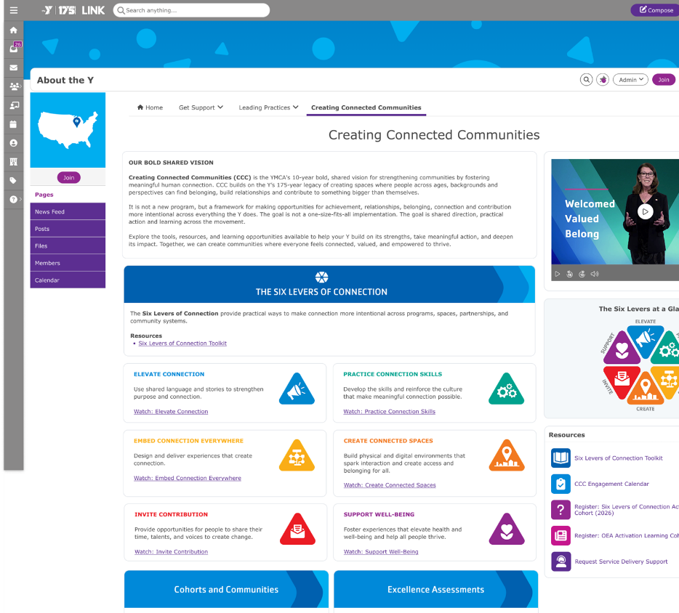
Available now
Six Levers of Connection Toolkit
Environmental Scan summary
Individual-Level Measure Overview
CCC Connection Cards
CCC Engagement Calendar
Notes:
EO

Slide 44
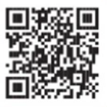

Exploring these resources
Links
GA microsite
Link
Notes:
EO

Slide 45
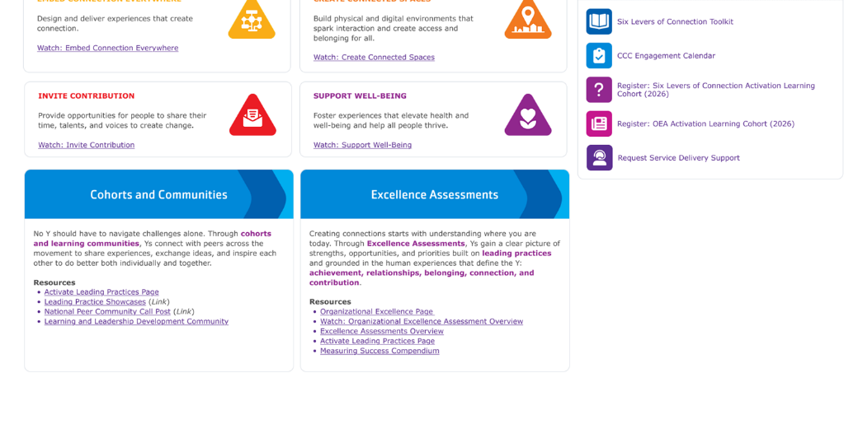
Coming soon on Link
Activation Learning Cohorts
Organizational Excellence Assessment
Ongoing learning opportunities through 2027
Even more…
Notes:
EO

Slide 46
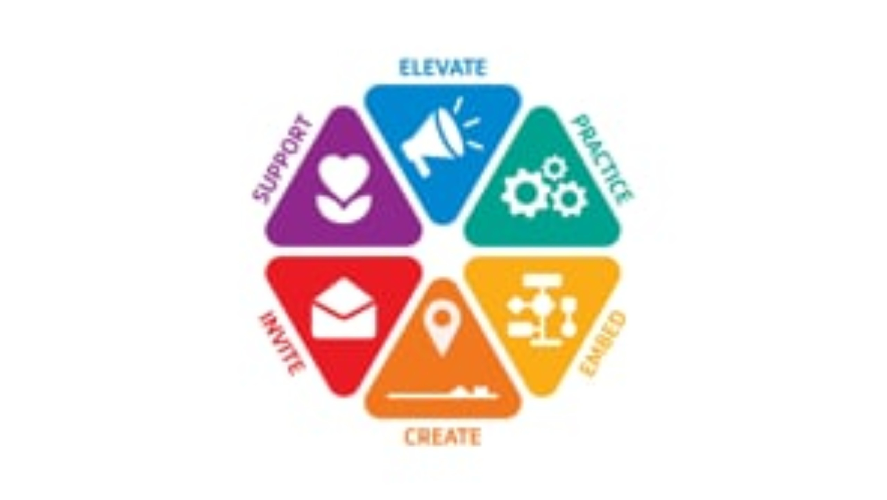
Notes:
EO

Slide 47
THANK YOU
YMCA OF THE USA
800 872 9622
Notes:
EO

Slide 48
WELCOME
SUBHEAD
Body copy Oreiciis anienis exceper isquam alibus voluptas debitatur? Eperumqui ut qui del endior si berovid molorest quae suntium harum nobit ut odignam.
Simus volupti inctiist,
tem reritium anda dolecto bero blabo
essi optatis autendi tatur, sitat as is eos.

Slide 49
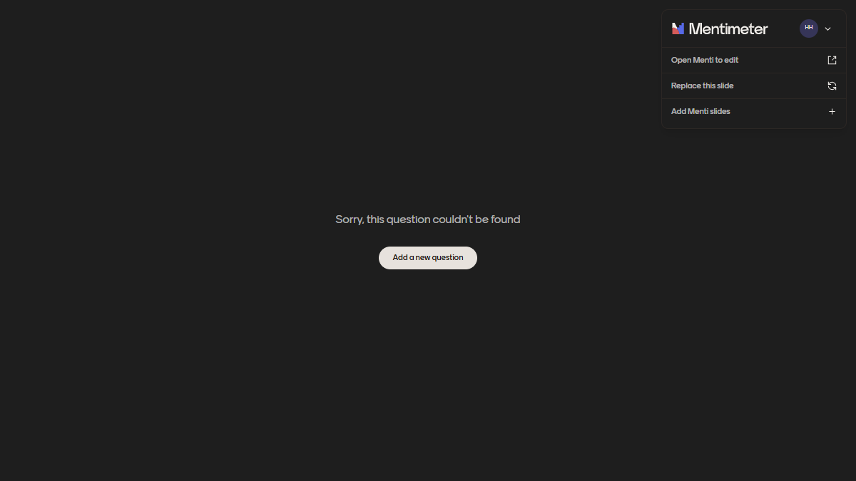
When you heard the word "connection", what is the first word that comes to mind?
When you hear the word "connection," what is the first word that comes to mind?

Slide 50
Which of these levers resonates most as you consider ways to strengthen connection at your Y?
Which of these levers resonates most with you as you think about your Y’s work to increase connection?

Slide 51
Which of these levers resonates most as you consider ways to strengthen connection at your Y?
Which of these levers resonates most with you as you think about your Y’s work to increase connection?

Slide 52

When you heard the word "connection", what is the first word that comes to mind?
When you hear the word "connection," what is the first word that comes to mind?

Slide 53
What's one action you will take in the next 30 days to strengthen connection at your Y?

