Slide 1

WHOLE PERSON HEALTH STARTS HERE: PHYSICAL AND MENTAL HEALTH ALIGNED
Karen Friedman, Y-USA
Jenn Gilburg, Y-USA
Cindy LaFond, The Granite YMCA
Katie Soule, The Granite YMCA
Notes:
Welcome to Whole Person Health Starts Here: Physical and Mental Health Aligned.
This session is grounded in a simple idea: physical health and mental health are deeply connected, and both are influenced by our relationships, environments, and access to resources.
At the Y, we have an opportunity to support these interconnected areas of well-being through the experiences, programs, services, relationships, and connections we create every day.
Today, we will explore how the YMCA’s Healthy Living Framework and Mental Health Community Care Model can work together to support whole-person health.
Our focus will be practical and operational. This is not about turning Y staff into clinicians. It is about strengthening the ways Ys promote well-being through connection, community care, supportive practices, and partnerships.

Slide 2

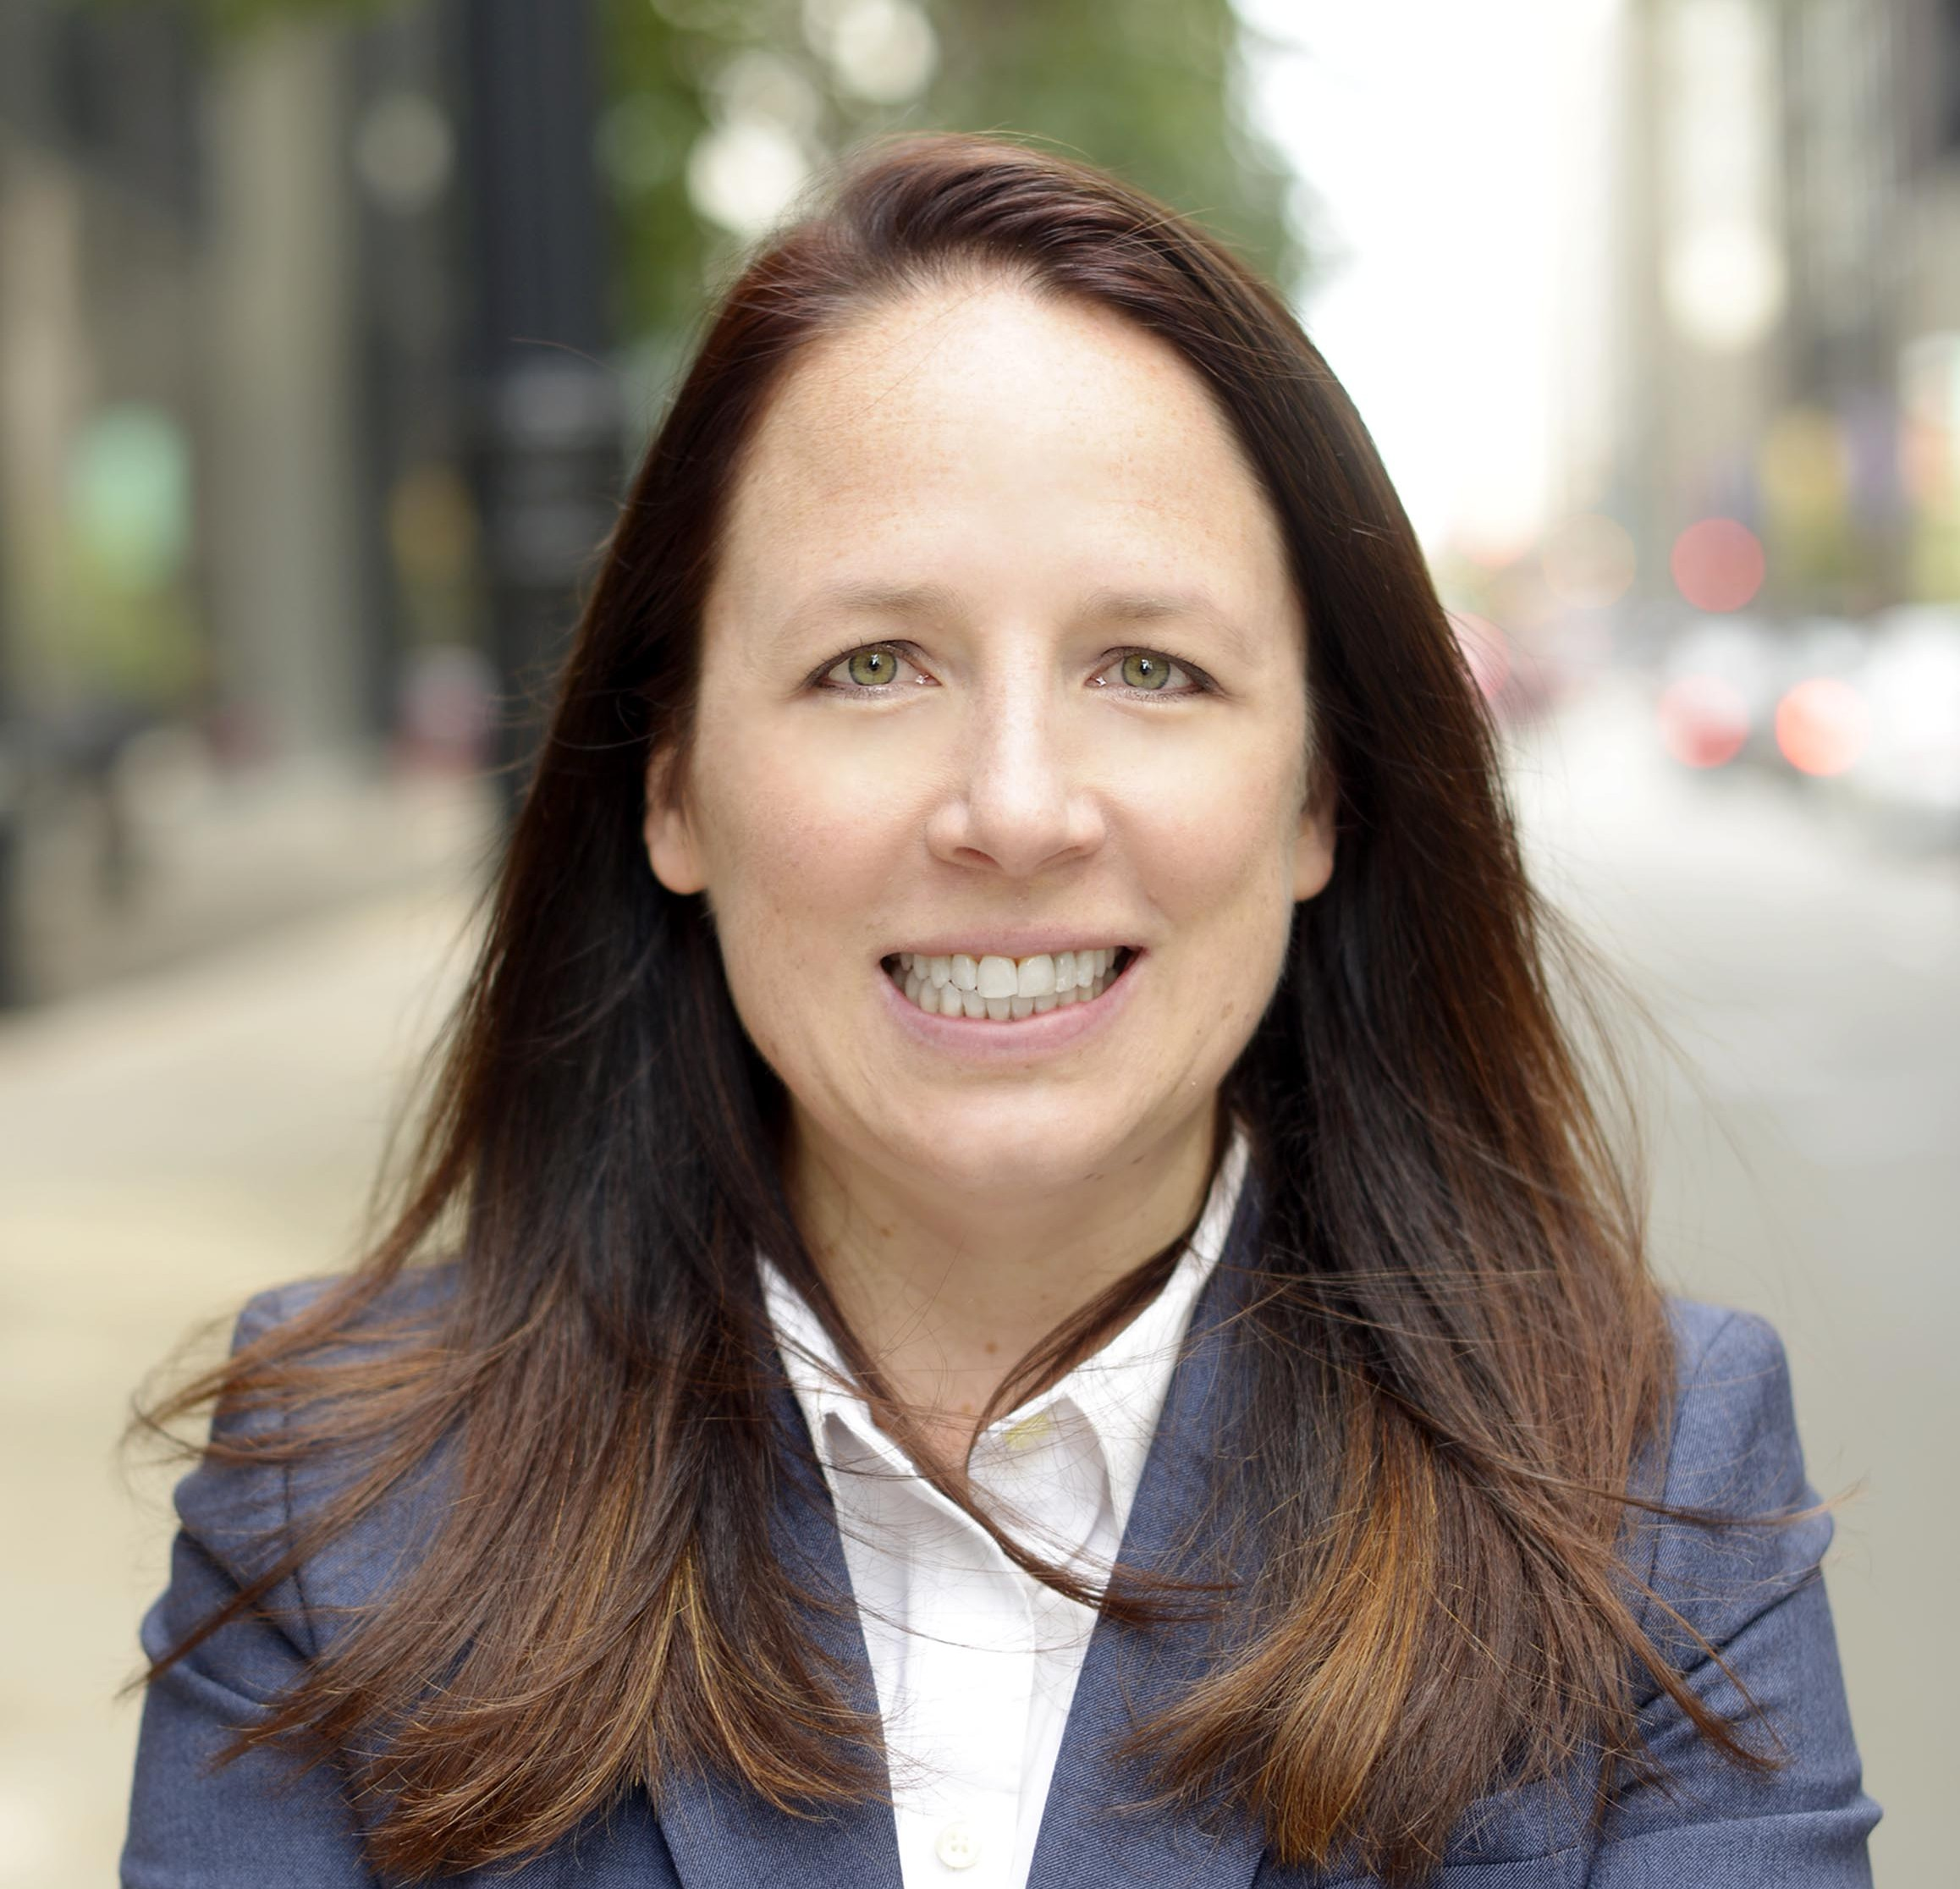

welcome
Karen Friedman
Director, Strategy & Quality Practices – Mental Health
Y-USA
Jenn Gilburg
Director, Project Implementation
Y-USA
Notes:
We are glad you chose to spend this Learning Zone with us.
Karen and Jenn introduce themselves
Our work approaches well-being from different starting points, but we quickly recognized how much these areas overlap and reinforce one another.
Later in the session, we will also hear from Cindy LaFond and Katie Soule from the Granite YMCA about how this work is taking shape in a local Y.
We know there is already a great deal of experience and insight in this room. We encourage you to consider not only what you can learn today, but also what you can contribute to the conversation.

Slide 3
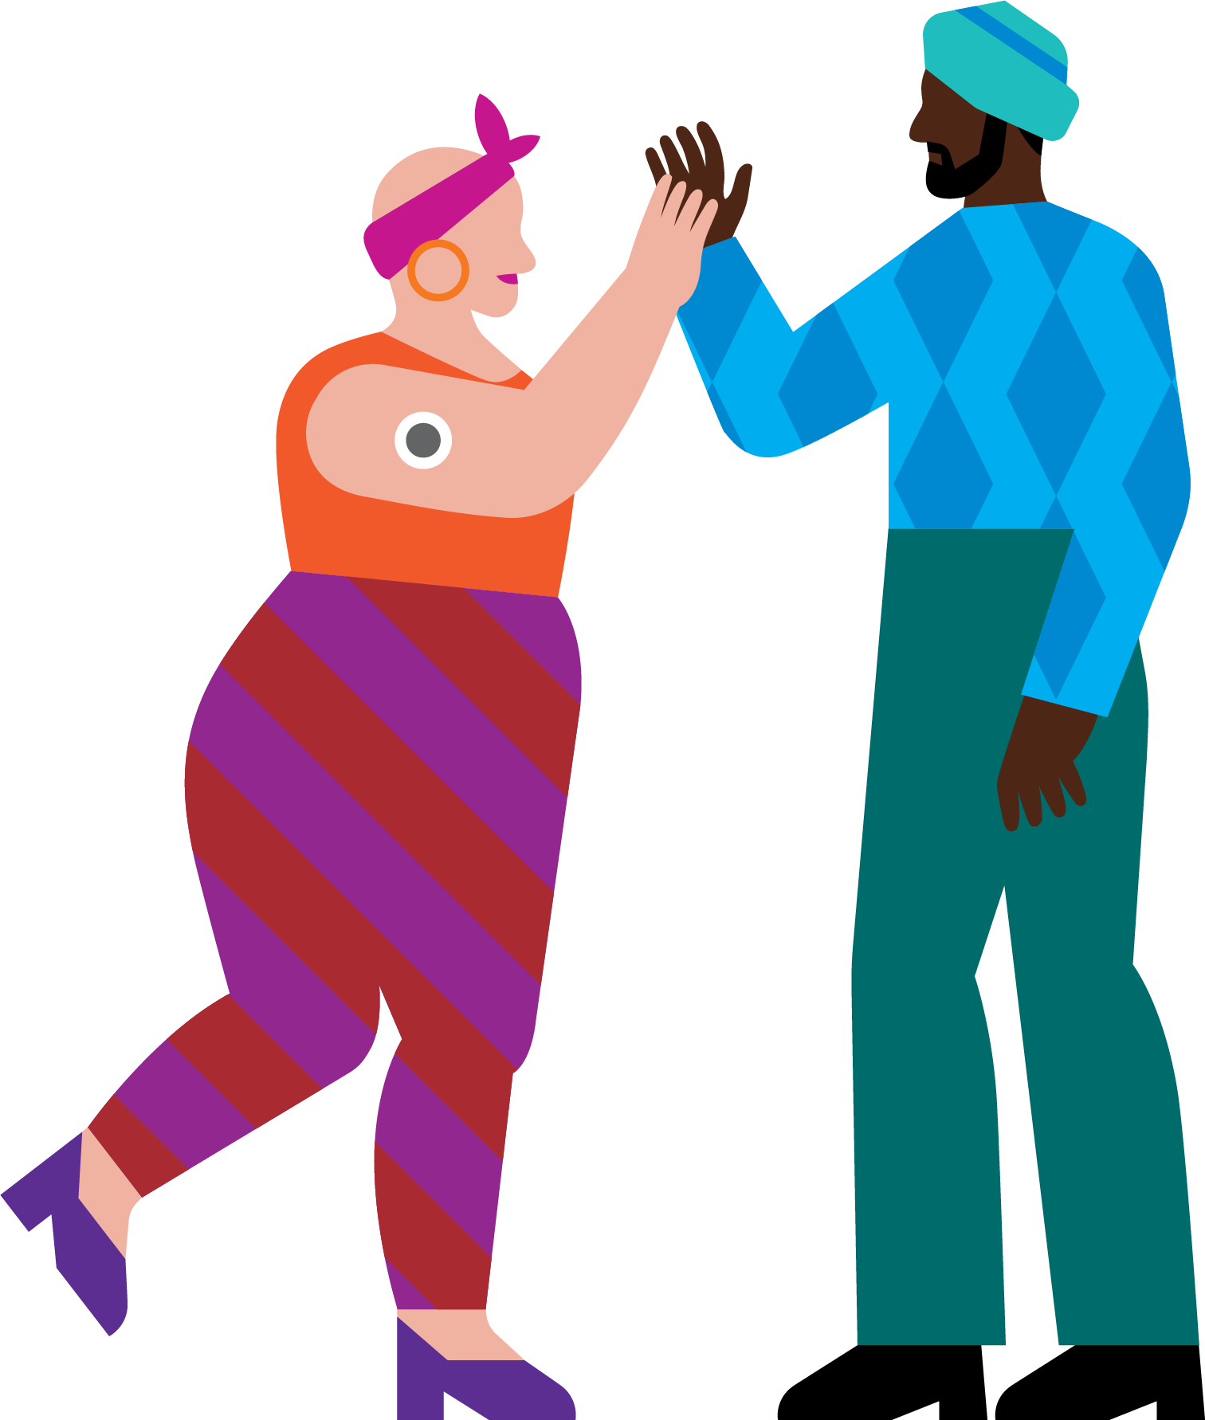
Let’s Connect
Turn to your neighbor and share:
  Name
  YMCA
  One way you are prioritizing your health and well-being during GA?
Notes:
Because connection is central to whole-person health, we want to begin by helping everyone make a connection in the room.
Please turn to someone near you and introduce yourself.
Share your name, your YMCA, and one way you are prioritizing your own health and well-being during GA.
Your answer does not need to be complicated. It might be staying hydrated, getting enough rest, taking a quiet moment between sessions, moving your body, or connecting with someone who helps you feel grounded.
We will give you a few minutes to talk, and then we will invite a couple of people to share what came up in their conversations.
Maybe have one or two people share
The examples you just shared remind us that well-being is personal and multidimensional. What supports one aspect of our health can also influence many others.

Slide 4
Whole person health starts here
Explore how we can support well-being in a more connected way
Explore the connection between mental, physical, social, spiritual, and community well-being
Explore ways to create environments where people can thrive
Notes:
Welcome to Whole Person Health Starts Here. Today we'll explore how mental, physical, social, spiritual, and community wellbeing are connected, and how Ys are creating environments where people can thrive.
When we say “whole-person health,” we are recognizing that people do not experience physical, mental, emotional, social, spiritual, and community well-being as separate parts of their lives.
These dimensions influence one another. For example, meaningful relationships can support mental and emotional well-being, while access to movement opportunities can support physical health, confidence, and social connection.
Ys already create many of the conditions that help people thrive. Our programs, staff interactions, physical spaces, partnerships, and community relationships all contribute to the experience of well-being.
During this session, we will explore how we can approach that work in a more connected and intentional way.
Learning Zones are designed to spark conversation, connection, and action. Our goal is for you to leave with fresh ideas and practical next steps that make sense for your Y.

Slide 5
SUPPORT
WELL-BEING​
Foster experiences that
elevate health and
well-being and help
all people thrive. ​
Notes:
To understand how this connects to the Y’s broader work, let’s first ground ourselves in our shared commitment to supporting well-being.
Supporting well-being is central to the YMCA’s purpose.
The statement on this slide calls us to “foster experiences that elevate health and well-being and help all people thrive.
The word experiences is important. Well-being is influenced not only by what programs we offer, but also by how people experience the Y.
Do people feel welcomed, known, connected, and supported?
Are programs and spaces designed so that people with different needs, identities, abilities, and life circumstances can participate and belong?
Do staff members have the knowledge, tools, and support needed to respond with care while also understanding the boundaries of their roles?
A whole-person approach encourages us to look beyond a single program or health outcome and consider the complete experience we are creating for individuals, families, staff, and communities.
Transition
The Y’s approach to health and wellness gives us a framework for thinking about how we create those experiences intentionally.

Slide 6

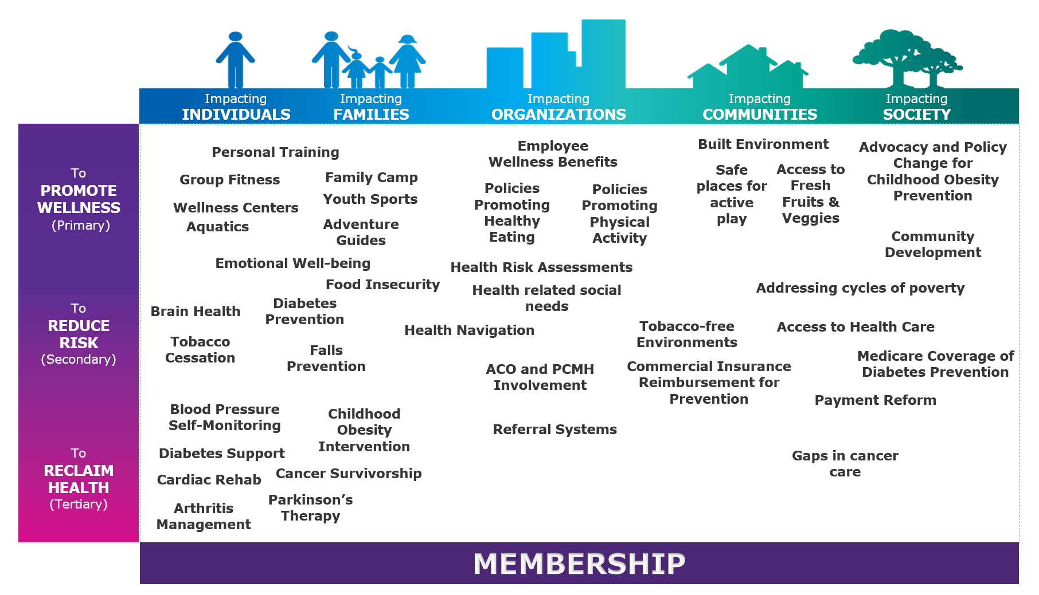
The Y’s approach to health and wellness
Notes:
This framework reflects the Y’s broad approach to health and wellness, recognizing that well-being includes multiple, interconnected dimensions.
I want to call your attention to Emotional Well-being within the framework. Emotional well-being is not separate from physical health. It influences how people experience movement, build relationships, create connections, manage challenges, engage in programs, and feel a sense of belonging.
This intentional callout to Emotional Well-being reminds us of our role and responsibility to create environments and experiences that support well-being. It invites us to consider how people feel welcomed, connected, supported, and able to thrive throughout their experience at the Y.
We can also ensure staff have the skills and resources to respond with care, recognize when someone may need additional support, and connect people to appropriate community resources.
This work does not necessarily require creating an entirely new program. Often, the opportunity is to strengthen existing programs, services, staff practices, environments, and partnerships so they more intentionally support both physical and emotional well-being.
When we view emotional well-being as an essential part of health, we begin to see a natural connection between this framework and the Y’s Mental Health Community Care Model, which Karen will introduce in just a mom
Ask as a quite reflection
As you look at this framework, where do you see your Y already supporting whole-person health, and where might there be an opportunity for stronger alignment?

Slide 7
PRACTICE
CONNECTION
SKILLS​
Develop the skills and
reinforce the culture that
make meaningful
connection possible.​
Notes:
Thank you, Jenn. I love that question about where stronger alignment might be possible, because it brings us to one of the most important ways we support whole-person health: we practice connection.
Meaningful connection does not always happen on its own. We build it through the knowledge, skills, attitudes, and everyday behaviors that help people feel welcomed, known, supported, and able to ask for help.
At the Y, that might look like checking in with someone and really listening to the answer. It might mean recognizing when someone may be struggling, responding with care, or helping connect someone to additional support. It also means creating a culture where staff care for themselves, care for one another, and understand the boundaries of their roles.
These are not clinical skills. They are human skills that staff, volunteers, members, families, and community partners can learn and practice. When these behaviors become part of how we work every day, connection becomes more than a value. It becomes part of our culture.
That belief, that everyone can develop the skills to care for themselves and others, is at the heart of the Y’s Mental Health Community Care Model.

Slide 8
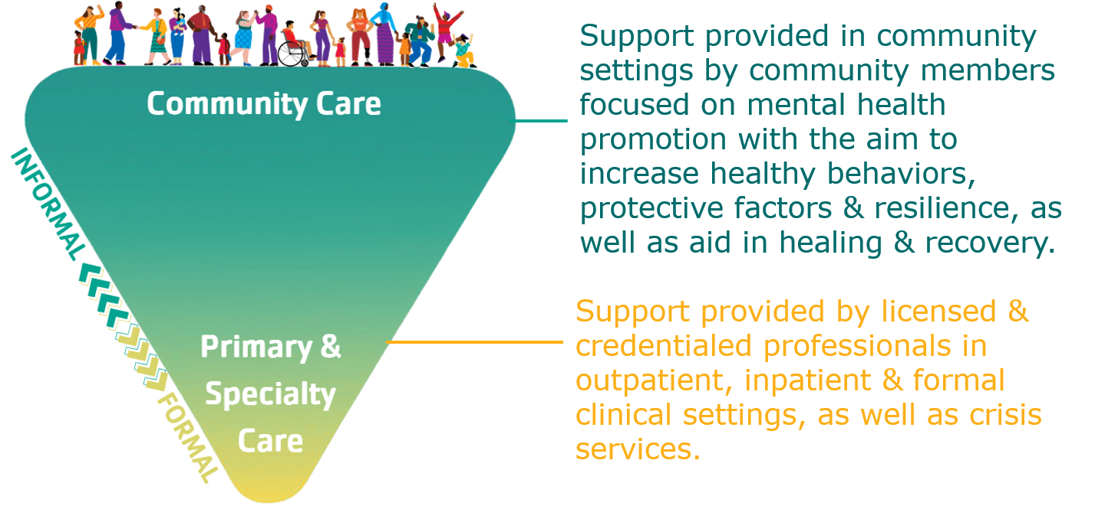
The Y’s Mental health community care model
Notes:
At its simplest, Mental Health Community Care is about building communities where everyone has what they need to be effective at caring for ourselves and each other.
I want to emphasize the word effective. Caring is something many of us already do naturally. Being effective means that we are intentional about the way we care. We understand mental health as something we all have; we know how to build connection and resilience, we can recognize when someone may be struggling, and we know when and how to connect someone to additional support.
This image shows two important and complementary parts of care. At the top is the large network of informal support that surrounds us every day: family, friends, neighbors, colleagues, schools, faith communities, local organizations, and places like the Y. At the bottom are primary and specialty providers, including clinicians and crisis services, who provide formal care.
Both are essential. Informal community care does not replace therapy, treatment, or crisis support. It works alongside those services by helping promote mental health, strengthen protective factors and resilience, respond earlier, and support healing and recovery.
This provides an important role for the Y. We are not asking Y staff to become clinicians. We are building the skills and culture that help people notice, care, connect, and know when additional support is needed. It is a preventive, community-based approach that can be integrated into our existing programs, staff practices, partnerships, and everyday interactions.

Slide 9

The granite YMCA
Notes:
So far, we have talked about the framework and the model. But the real value comes from seeing how these ideas take shape in a YMCA and in the everyday experiences of staff, members, and community partners.
To help us make that shift from concept to practice, we are pleased to welcome Cindy LaFond and Katie Soule from The Granite YMCA. They are going to share how their Y is approaching whole-person health and bringing physical, mental, and emotional well-being together through their programs, staff practices, and partnerships.
Cindy and Katie, I’ll turn it over to you.

Slide 10
Whole person health starts here:
physical and mental health aligned

Slide 11
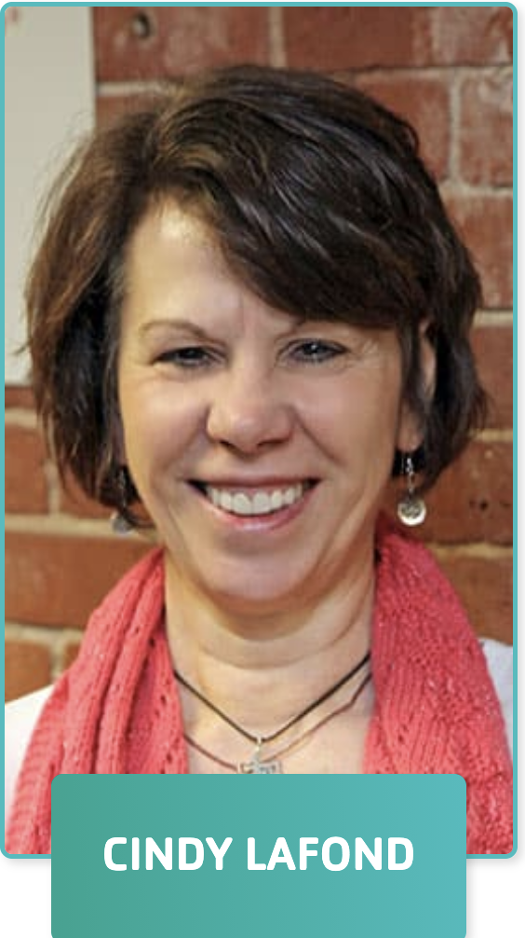
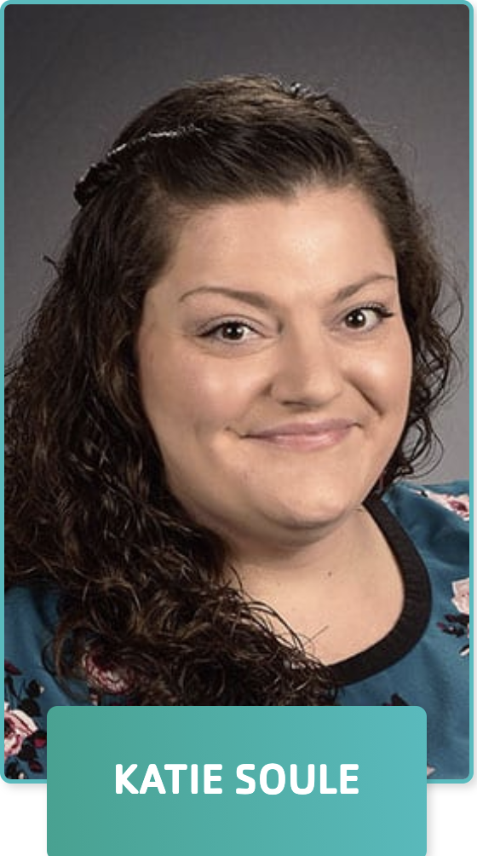
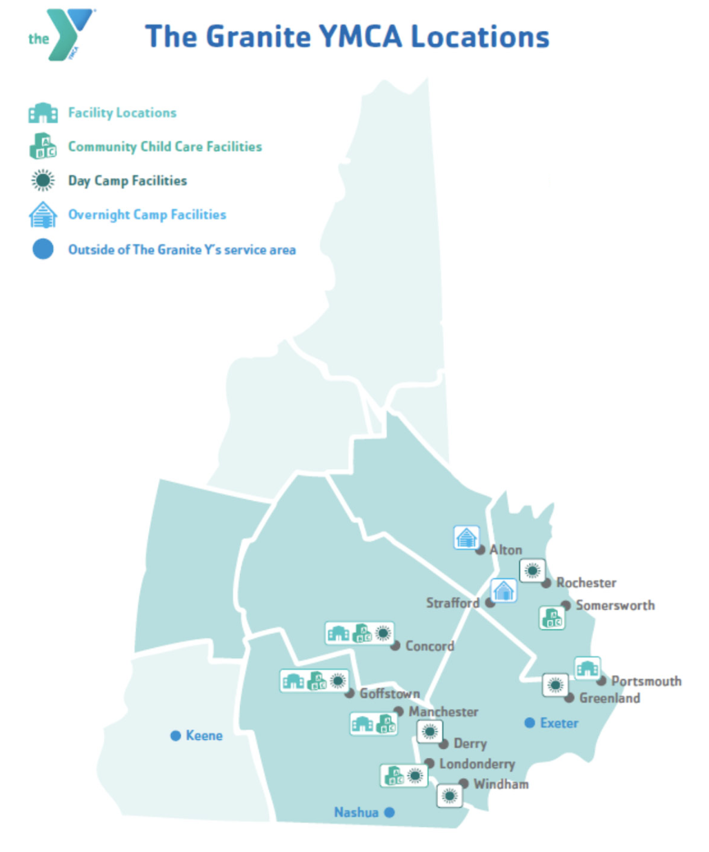
Hello from the granite y
Executive Director of
Health Interventions
Director of Social and
Emotional Wellbeing

Slide 12
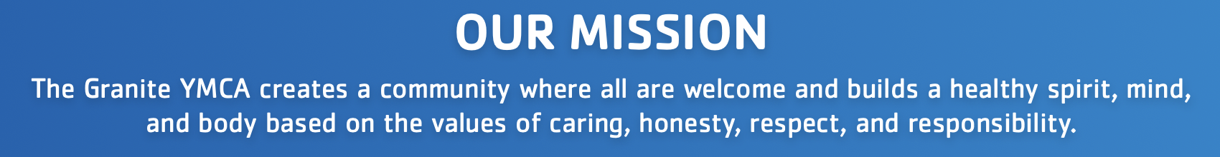
About the granite y
Our Areas of Focus
Our Footprint
Youth Development
Healthy Living
Social Responsibility
Family Strengthening
6 branches
    4 full facility Ys
    2 youth development branches
2 overnight camps
Association office
Statewide health intervention programs (in-person and virtual)

Slide 13
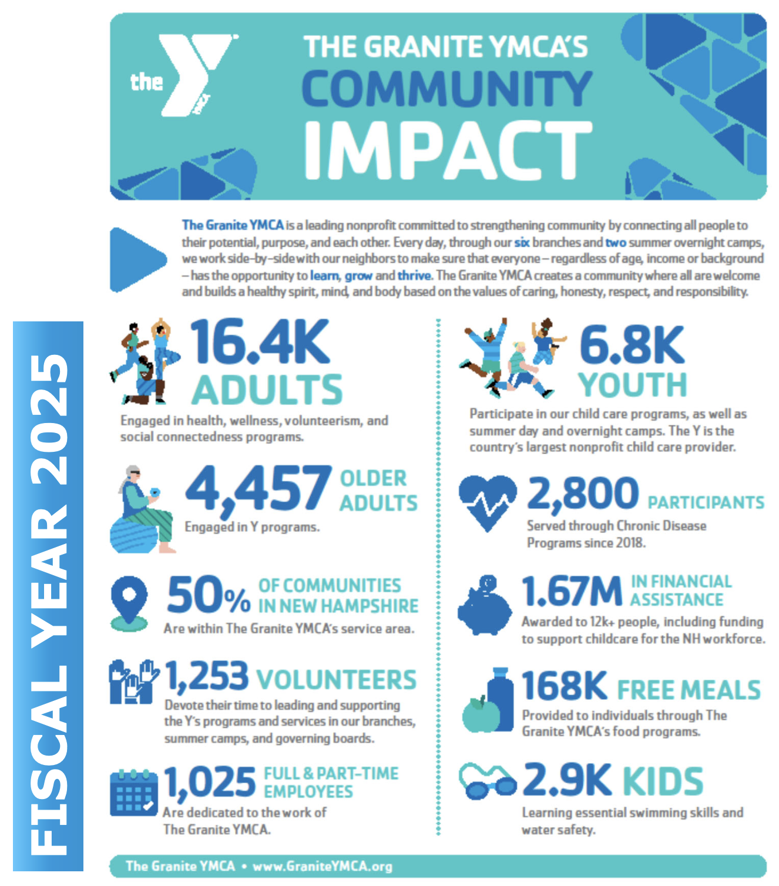
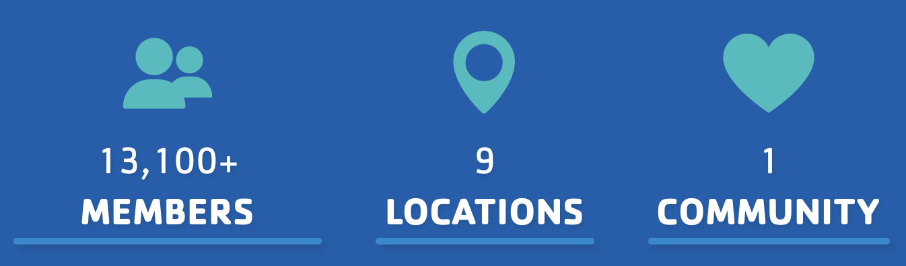
The granite y’s impact
VISION FOR IMPACT:
The communities we serve thrive because people face fewer obstacles to healthy living, have a powerful sense of connection, and work together to create access for all.

Slide 14

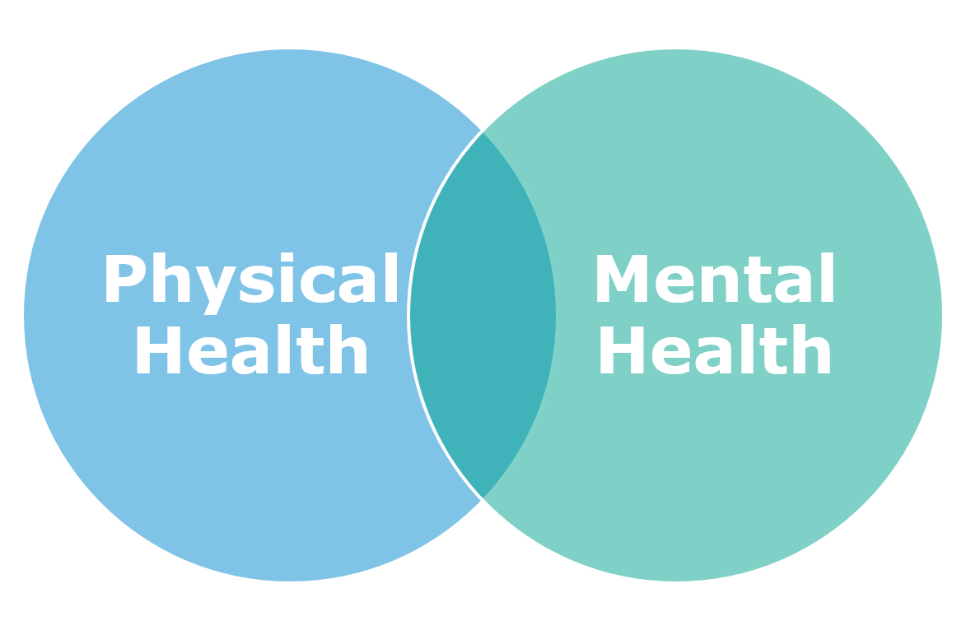

Slide 15
The tools of embodiment
Embodiment: living in and through our bodies with awareness, presence, and self-compassion
Mind-body connection
Regulation & Resilience
Energy & Vitality
Meaning & Alignment
Thriving in Daily Life
At The Granite Y, we support people in their journey to become more embodied through connection- to themselves, others, their communities, and a world larger than themselves.
Another definition of embodiment is, “living fully inside your physical body and feeling your present-moment sensory experiences.” Living fully is a full contact sport; we can’t halfway embody!

Slide 16
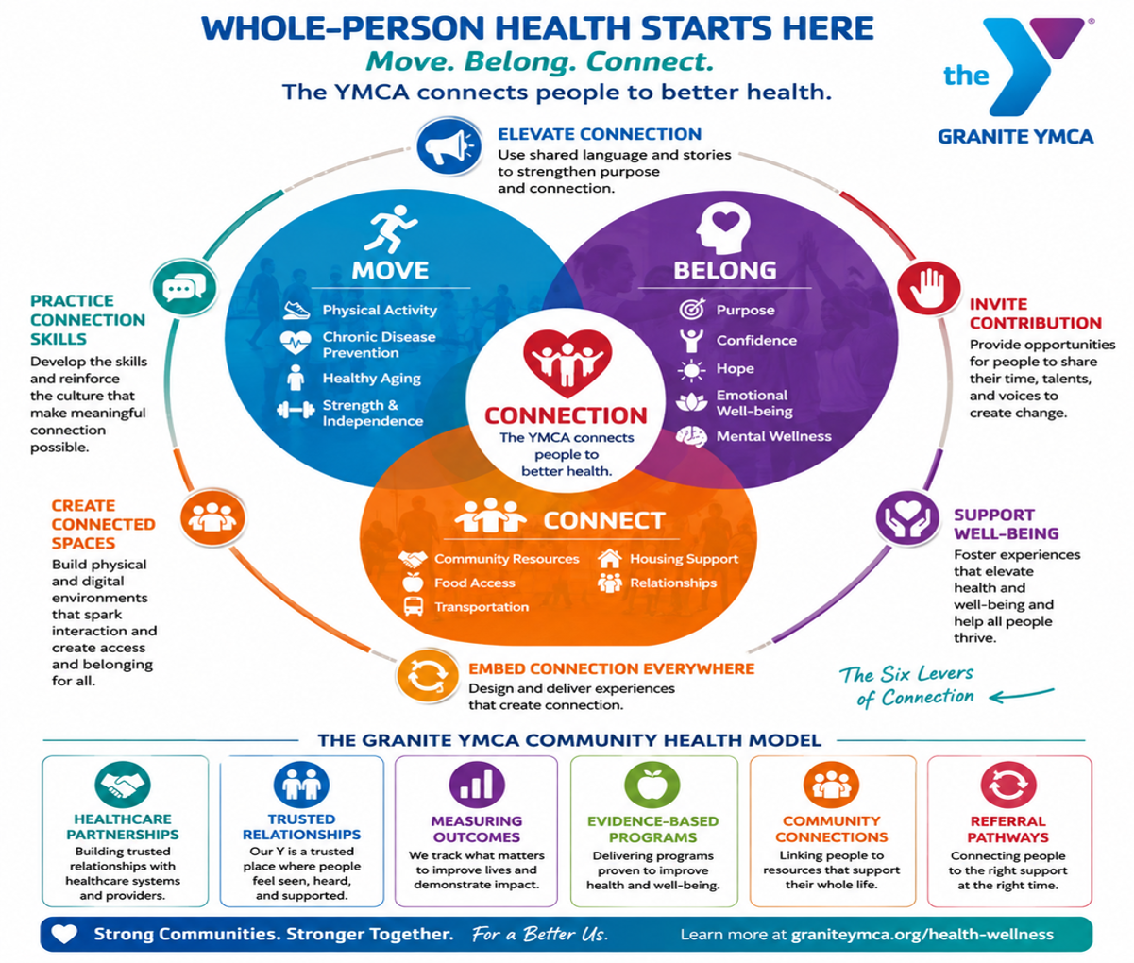

Slide 17
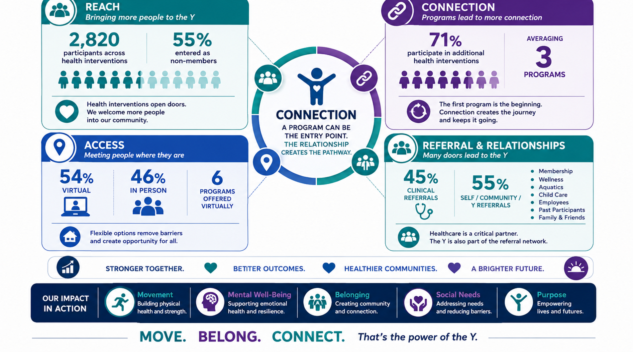

Slide 18
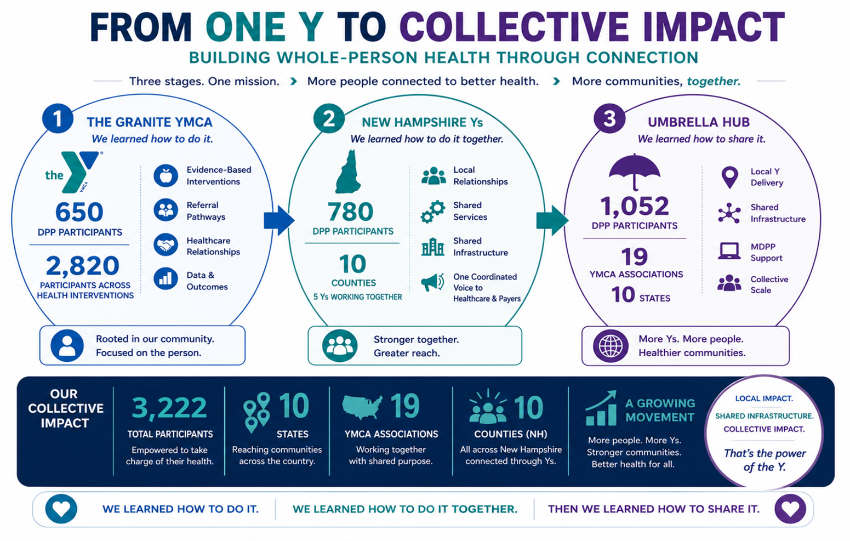

Slide 19
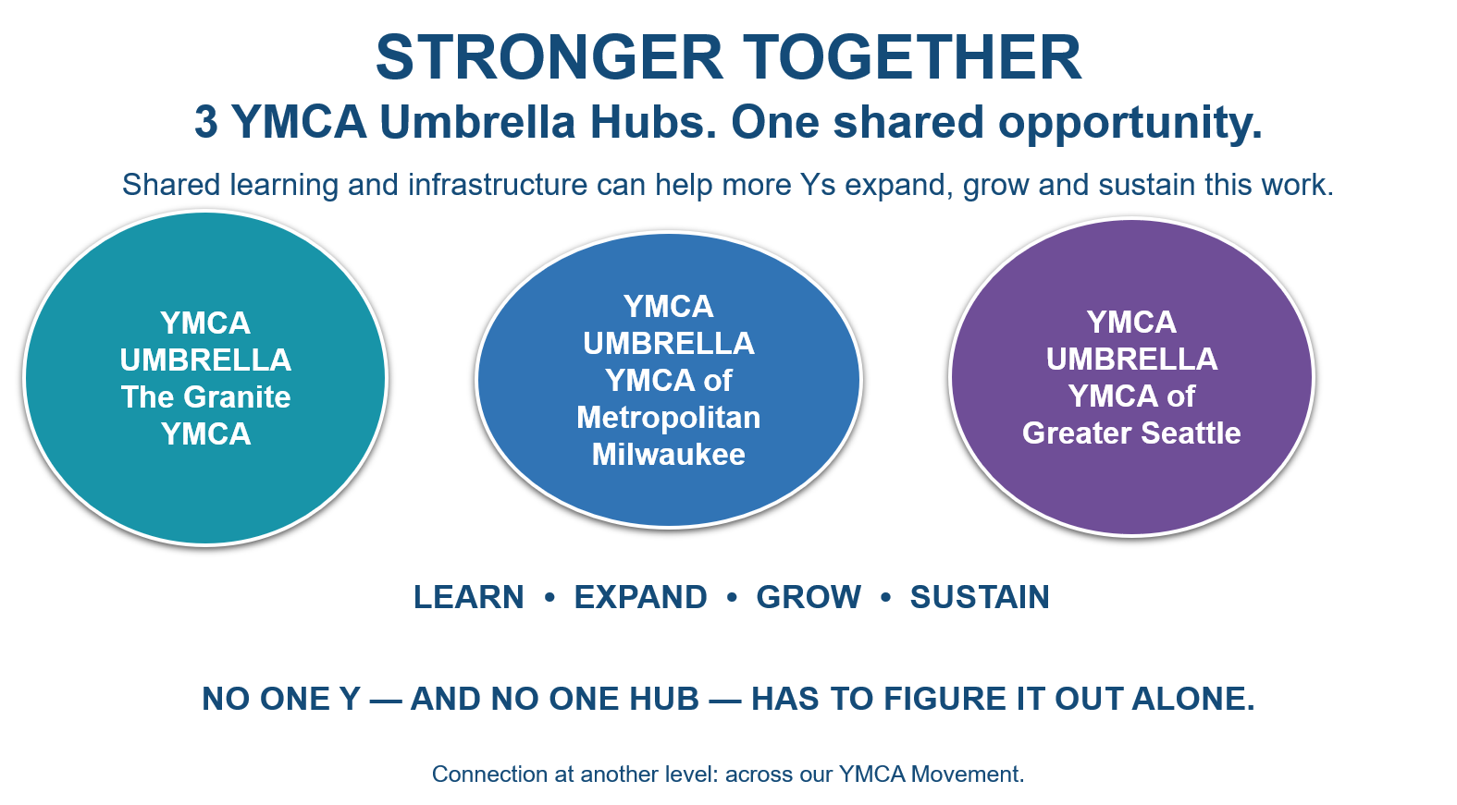

Slide 20
The power of support
Having a leader who trusts you enough to try something new is a key component to sustainable innovation.
If you are a senior leader in this room, we invite you to ponder:
Do your people know that you trust them enough to try something new that they might fail at, and what’s the evidence?
If you are an emerging leader in this room, we encourage you to consider:
What about how I show up at work communicates to my leaders that I am someone who can be trusted to try something new?

Slide 21
ELEVATE CONNECTION | How intentionally do we make meaningful human connection a priority and how would staff, members, participants, & families know that it is?
PRACTICE CONNECTION SKILLS | Do our staff and volunteers have the skills, confidence, and support to build trusting relationships, listen with empathy, and respond to the whole person?
EMBED CONNECTION EVERYWHERE | Where is connection intentionally built into the everyday YMCA experience - from the first welcome to programs, policies, communications, and leadership practices?
CREATE CONNECTED SPACES | Do our physical, social, and emotional environments help people feel safe, welcomed, included, and able to connect with others?
INVITE CONTRIBUTION | How do we create meaningful opportunities for people to share their voice, strengths, experiences, and ideas in shaping their YMCA and community?
SUPPORT WELL-BEING | How well do we recognize and respond to the interconnected physical, mental, social, and emotional well-being of the people we serve and the people who serve them?
Notes:
How intentionally do we make meaningful human connection a priority—and how would staff, members, participants, and families know that it is?
Do our staff and volunteers have the skills, confidence, and support to build trusting relationships, listen with empathy, and respond to the whole person?
Where is connection intentionally built into the everyday YMCA experience—from the first welcome to programs, policies, communications, and leadership practices?
Do our physical, social, and emotional environments help people feel safe, welcomed, included, and able to connect with others?
How do we create meaningful opportunities for people to share their voice, strengths, experiences, and ideas in shaping their YMCA and community?
How well do we recognize and respond to the interconnected physical, mental, social, and emotional well-being of the people we serve and the people who serve them?

Slide 22
Social and emotional wellbeing
Programmatic
SEL and Character Development
Dedicated staffing positions
Interpersonal
Training for all staff
Coaching, consulting, support
External Relationships
Community Partners
Convening Initiative
Mental Health Community Care
Collaborations
Policies and Procedures
Resource visibility and awareness
Wellness Days
YMHFA and ACEs Awareness
Cross-Department
Notes:
As you talk about the programs, link back to each of the 6 levers of connection as it make sense! The 6 levers are:
Elevate Connection
Practice Connection Skills
Embed Connection Everywhere
Create Connected Spaces
Invite Contribution
Support Well-Being
The Granite YMCA understands that a whole-body approach to wellness is imperative to employee wellbeing and to maintain healthy lifestyles. To support employees in their wellness journey, we have established a “Wellness Days” program to reward employees for participating in qualifying physical activities and mental well-being activities that are provided by the Granite YMCA.

Slide 23
Connection at the core connection from the start
Focus on authenticity
Meeting people where they are
Responsive to community needs
Carrying our core values with us
Walking the walk
Remembering that we cannot do it alone

Slide 24
Whole person health is best achieved through
Embodied connection in a relevant context
(a.k.a. what we have learned boiled down in one statement)

Slide 25
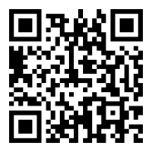
Join the Health and Wellness and Mental Health Newsletter for information on upcoming cohorts:
THANK YOU
Cindy LaFond
THE GRANITE YMCA
clafond@graniteymca.org
Katie Soule
THE GRANITE YMCA
Ksoule@graniteymca.org
Karen Friedman
YMCA OF THE USA
312 419 8290
Karen.Friedman@ymca.net
Jenn Gilburg
YMCA OF THE USA
312 917 4091
Jennifer.Gilburg@ymca.net

