Slide 1

YMCA LEARNING HUB: EXPLORING THE YMCA LEARNING ECOSYSTEM
Sara Ryan & Scott Fahrney
Notes:
SCOTT:
The YMCA Learning Hub is not the destination.
It is one of the tools helping us build the future of learning and leadership development across the YMCA movement.

Slide 2

LEARNING & Leadership development AT THE Y
YMCA staff, volunteers, and leaders are learning and engaging to grow themselves and others.
We must attract, engage, develop, inspire, and retain leaders at all levels who think, act, & communicate in ways that strengthen the community and connect people to their potential, purpose, and each other.
Notes:
SCOTT
…..we knew we couldn’t do that without the right technology foundation….

Slide 3
LEARNING & LEADERSHIP DEVELOPMENT EYCOSYSTEM
People
Content
Learning & Leadership Development Ecosystem
Technology
Strategy
Notes:
SCOTT

Slide 4

Y-USA L&LD JOURNEY 2023-2026
23
25
24
26
Evaluation
Infrastructure
Foundations
Activate
  Learning & Leadership Development Team
  Established L&LD Advisory Council
  Evaluation of L&LD Service Delivery System
  Evaluation of Learning Management System
  Leadership Forum
  LinkedIn Learning
  Leadership Programs
  LMS Vendor RFP
  National Calendar & Communication
  Learning Centers & Champions
  National Emerging Multicultural Leadership Experience
  Learning & Leadership Development Framework
  Learning Management System Configuration
  Learning & Leadership Development Programs, Certifications, Pathways, and Learning Plans
  Skills Ontology & Taxonomy
  Trainer & Faculty System
  Learning Evaluation
  YMCA Learning Hub Go Live
  Input Sessions – Trainer/Faculty, Leadership Development, Talent Management, Coaching & Mentoring
  General Assembly
  Continuous Evaluation & Improvements
Notes:
SCOTT
Presenter Intent
Provide a high-level view of the broader Learning & Leadership Development journey, helping audiences understand that the LMS is one part of a larger strategic effort to strengthen learning across the YMCA movement.
Key Talking Points
So far we’ve talked about the moment in 2023 when the YMCA identified the opportunity to revolutionize how staff access learning and leadership development. This slide zooms out slightly to show the broader journey of that work over the past several years.
The LMS is a major part of the story, but it’s not the only part. Over the last few years, Y-USA has been working to rebuild and strengthen the broader learning ecosystem across the movement.
In 2023, the focus was largely on evaluation and foundation-building.
That included evaluating our existing LMS, gathering input from the movement, and beginning to define the future direction for learning and leadership development.
In 2024, the work moved into vendor selection and system design.
The LMS RFP process lasted nearly ten months. We explored dozens of vendors and ultimately narrowed the field to three finalists before selecting the platform that would become the YMCA Learning Hub.
In 2025, the focus shifted to configuration and system design.
Hundreds of hours were spent working through platform capabilities, making configuration decisions, and aligning the system with YMCA learning structures and priorities.
And now in 2026, the focus is on implementation and launch.
When we say “Go Live,” we mean the moment when users begin entering the system and using it as their primary platform for learning.
In the next slide we’ll take a closer look at the rolling launch timeline and what that implementation process looks like.
So while the LMS is a major milestone, it is really one piece of a broader effort to strengthen learning and leadership development across the YMCA movement.
Transition:
With that broader context in mind, let’s look more closely at how the YMCA Learning Hub will actually launch across the movement.
Optional Context: Broader L&LD Work (2023–2026)
These bullets provide additional context about the broader strategic work happening alongside the LMS project. Presenters can reference these if helpful for their audience.
2023 – Evaluation & Foundations
LLD Team - The Learning & Leadership Development team began rebuilding capacity after several years of operating with a very small staff.
L&LD Advisory Council - A national advisory council was established to ensure movement voice and guidance informed L&LD strategy and priorities.
Service Delivery System - Evaluation of the previous Regional Service Hub model led to the development of a new service delivery approach relying on Learning Centers.
Leadership Forum - A national forum was convened to gather input from YMCA leaders about the future direction of learning and leadership development.
LinkedIn Learning - The YMCA launched LinkedIn Learning as a systemwide resource to provide on-demand learning in areas such as business, technology, and creative skills.
L&LD as a Strategic Priority - Our annual movement survey identified L&LD as a top 3 priority for Y-USA to place National support.
2024 – Infrastructure & Systems
Leadership Programs - Key leadership development programs were refreshed or expanded, including initiatives such as Executive Director Institute and Principles & Practices.
National Calendar & Communications - A more coordinated national communications approach was introduced to help staff across the movement more easily discover learning opportunities. Initiated a shared nationwide, proactive communications cadence and system promoting upcoming opportunities, along with a shared national calendar post that centralized those promotions.
Learning Centers & Learning Champions - Launched a new service delivery model through partnering with Ys and Alliances to create the regional Learning Centers. We also worked to identify at least one Champion, a point of contact and valued local partner to participate in the movement infrastructure and advocate for learning locally.
National EMLE - Significant attention was dedicated to planning and delivering the National Emerging Multicultural Leadership Experience.
L&LD Framework – XXXXXXXXXXXXXXXXXXXXXXX
2025 – System & Learning Architecture
L&LD Programs, Certifications, Pathways & Learning Plans - Existing learning programs and certifications were reviewed, and new opportunities were explored to better support career progression and learning pathways.
Content Development – A focused effort began to modernize and modularize YMCA learning content, ensuring courses could be delivered effectively through the new platform.
Trainer & Faculty System - Work began to rebuild trainer certification pathways and strengthen the systems that support faculty development and quality learning delivery.
Learning Evaluation - The team explored new approaches for evaluating learning impact and identifying measures that better support both learner experience and organizational outcomes.
2026 – Launch & Continuous Improvement
Talent Management Resources – Exploration of tools and resources that connect learning with broader talent development efforts such as career growth and leadership pipelines.
Skills Taxonomy – Development of a shared framework describing the skills and competencies that support YMCA roles and career development.
Coaching & Mentoring – Expansion of coaching and mentoring resources to support leadership development and peer learning across the movement.
Continuous Improvement – stablishing processes to gather user feedback and continuously refine learning systems and experiences after launch.
General Assembly – Using national gatherings such as General Assembly as opportunities to strengthen alignment, share learning innovations, and connect leaders across the movement.

Slide 5

REVOLUTIONIZE the Y staff and volunteer LEARNING AND LEADERSHIP DEVELOPMENT EXPERIENCE by RADICALLY IMPROVING ACCESS to the information, knowledge, tools, and trainings people need to be successful in their work of CREATING CONNECTED COMMUNITIES.
Notes:
SARA

Slide 6
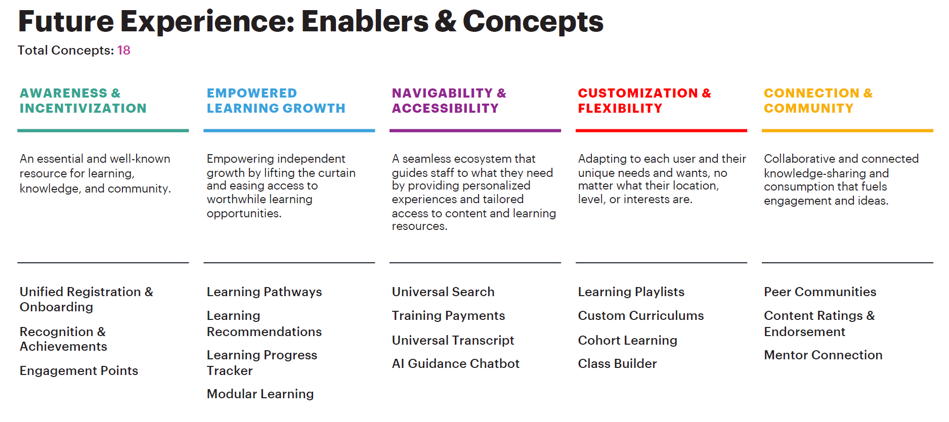
THE DESIRED EXPERIENCE
Notes:
SARA
Show that the LMS transformation was grounded in movement input, not a top-down technology decision.
Key Talking Points
After identifying the opportunity to revolutionize learning and leadership development, Y-USA partnered with Accenture to conduct research across the YMCA movement.
They spoke with people representing many different roles and perspectives, including:
• CEOs
• HR leaders
• Learning and development professionals
• Program leaders
• Other YMCA staff across the country
The goal was simple: To understand what the movement actually wanted from the future of learning technology and infrastructure.
From those interviews and focus groups, Accenture identified 18 concepts that people consistently described as important. You can think of these as the capabilities (or features and functions) people wanted to see in the future learning ecosystem. Examples included things like:
• Learning pathways that help staff grow in their roles
• A more unified registration experience
• Modular learning opportunities
• A universal transcript that follows a person through their YMCA career
When these concepts were grouped together, they reflected several broader priorities:
• Increasing awareness and engagement in learning
• Empowering staff to grow and develop
• Improving navigation and accessibility
• Providing flexibility and customization
• Strengthening connection across the movement
The important takeaway here is that these priorities came directly from the movement itself.
Optional Engagement Prompt
You might ask: “When you think about your own experience accessing learning opportunities at the Y, which of these priorities resonates most with you?”
This can help participants connect their own experience to the broader research.
Transition:
Once we understood the possibilities, the next step was determining which of those capabilities mattered most.

Slide 7

Notes:
SARA

Slide 8
Still available
New and enhanced
No longer available
Add/remove participants
Add your supervisor
Admin functionality*
Certification & recertification
Course equivalencies
Course prerequisites*
Create sessions (classes) locally
Credit (voucher) payments
Credit card payments
Download certificate PDFs
Enroll another user*
Full Y learning transcript
Roster uploads*
See learning progress*
Single sign-on with My Y Account
Trainers grade courses
Assign trainings to learners
Bookmark courses
Calendar invites
Calendar view of upcoming learning
Course catalogs
Course ratings
In-system notifications
Learning plans
Local Y training reports
Manager view of staff completions
Regional reporting
Session locations and dates visible
Universal search
Waitlist visibility for sessions
Zoom links inside sessions
Used to be able to do, but can't now:
Course-specific voucher purchases
Credit hour tracking
Decentralized eCommerce
Instructors/Trainers set up sessions
Variable course pricing
These changes support a more standardized, simplified and scalable learning experience across the Y Movement.
Couldn't do before and still can’t:
Process refunds within the system
Update personal information within the system
*Improved! Identified as “must have” during RFP
Notes:
SARA

Slide 9

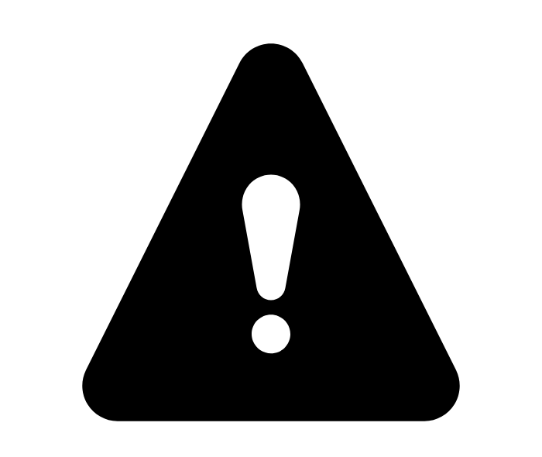
WHAT HAVE WE HEARD?
Intuitive for new users
Modernized
Easy to search
Clear steps
Manager views
Assign trainings
Training credits
Course ratings
Course catalogs
Learning Center support
Reliance on MOYP data
More challenging for tenured staff
Pricing
Local classes
Process, program and certification changes
Notes:
SARA

Slide 10
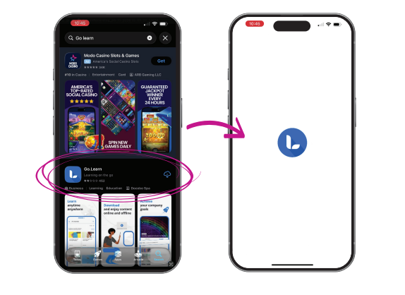
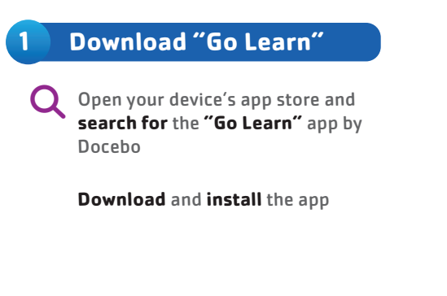
EXPERIENCE IT TODAY!

Slide 11
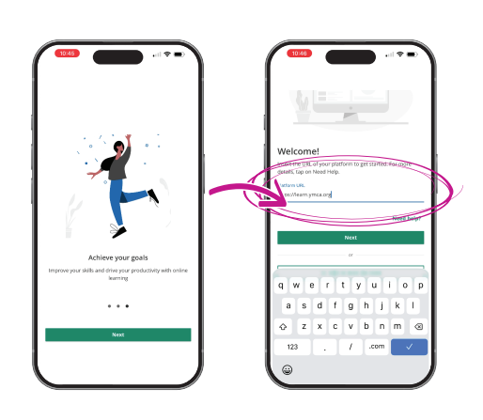
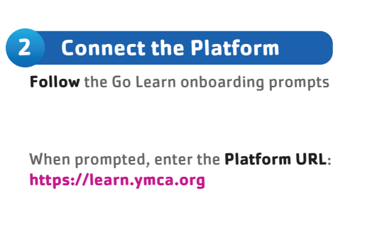
EXPERIENCE IT TODAY!

Slide 12
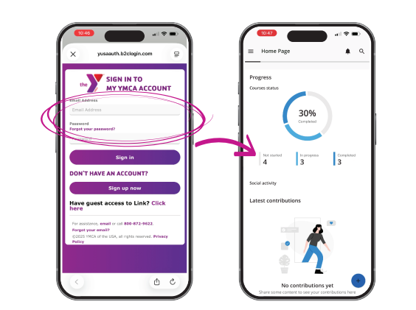
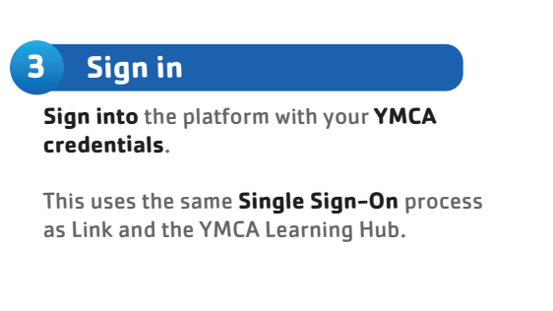
EXPERIENCE IT TODAY!

Slide 13
Y-USA L&LD 2027 & BEYOND
Active relationships with stakeholders
Active relationships with stakeholders
The individual learner is at the center of all design decisions
The individual learner is at the center of all design decisions
Trainer and faculty activation is critical to ensuring quality.
Trainer and faculty activation is critical to ensuring quality.
Continuous improvement through feedback
Critical Thinking and Collaborative Learning are foundational.
Continuous improvement through feedback
Relevant & Engaging Content
Available in the flow of work
& role-based learning.
Communications between local Ys and Y-USA is critical
National ecosystem with regional & local delivery and shared accountability
Notes:
SCOTT

Slide 14
THANK YOU
Sara Ryan & Scott Fahrney
YMCA OF THE USA
800 872 9622
sara.ryan@ymca.net
scott.Fahrney@ymca.net

